Slide 1
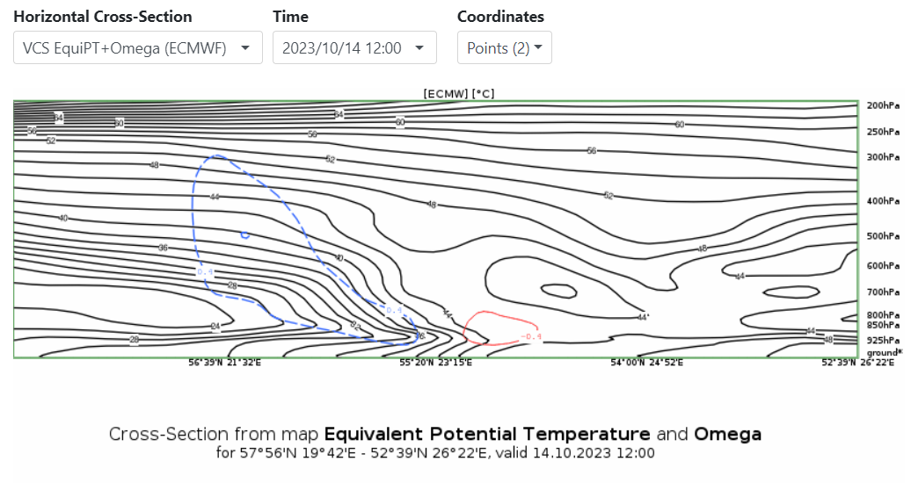
Cold front crossing Central/Eastern Europe – 14.10.2023
One of recent cases - cold front crossing Eastern/Central Europe
There was some squalls under the clouds and short-range heavy rainfall, but at least in Latvia there was not any significant damages
For omega parameter there is negative values with the frontal zone (red colour), but behind front there is positive values (blue colour)
14.10.2023.
Airmass RGB and ThetaE paramater 850hpa
JANIS KLEPERIS

