Slide 1
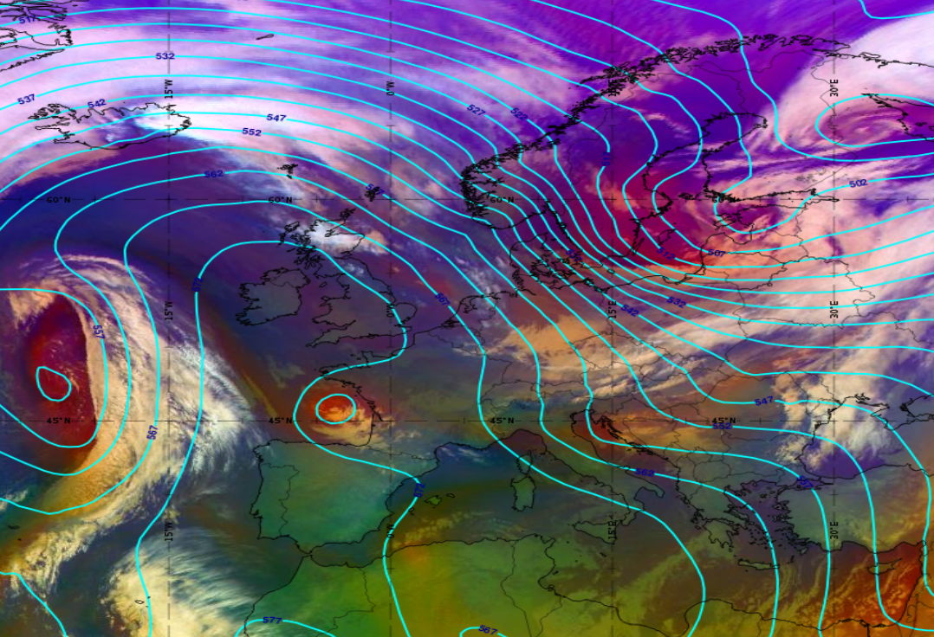
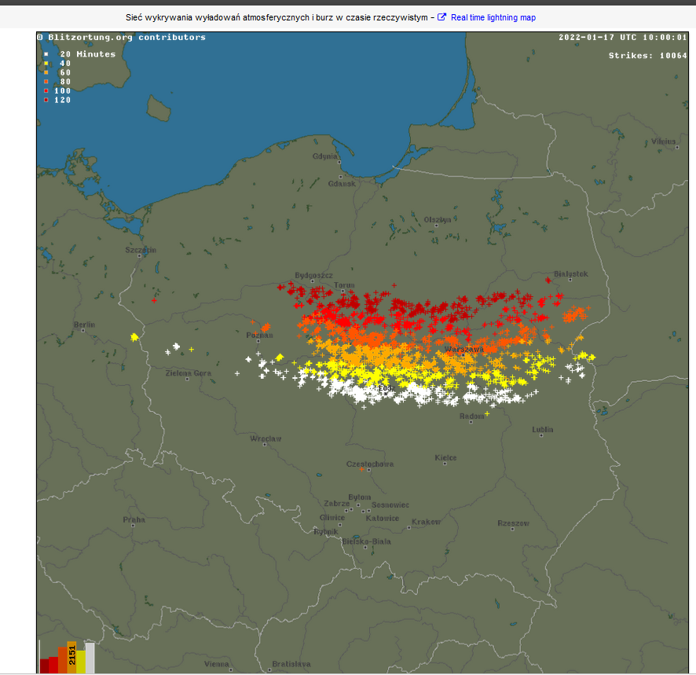
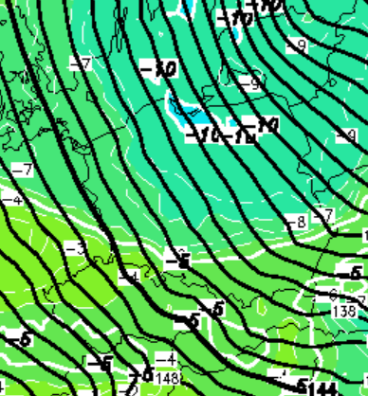
Active cold front – [17.01.2022 06:00 UTC]
The cold front in Poland drew cold and unstable air into Poland, wchich caused the strongest „winter” thunderstorms in polish history.
Strong and dynamic airflow in cyclone area was one of main storm-developing factors. Another one was thermal contrast between air masses, that is visible on 850 hPa temperature.
Airmass RGB + Geopotential 500 hPa:
- convenctive clouds in south-east Poland
- sharp pressure gradient
- dry and cool air behind front
- thunderstorms observed in Poland during the day
- snowfall, rainfall and graupel observed
Michał Kowalczuk, Institute of Meteorology and Water Management

