Slide 1
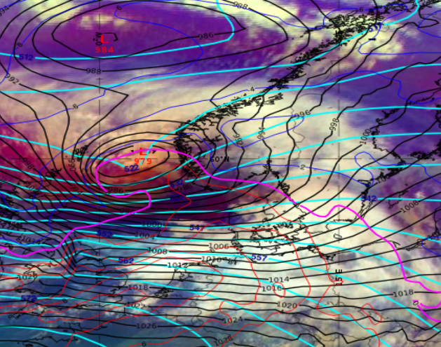
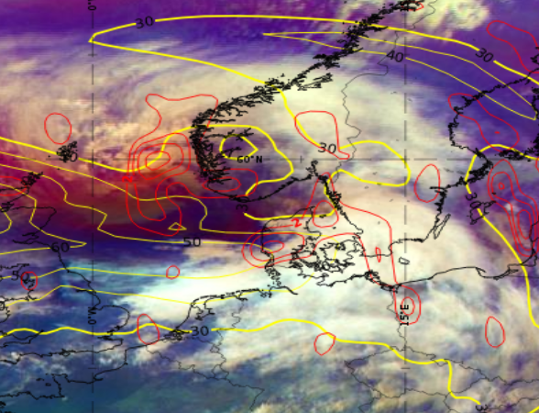
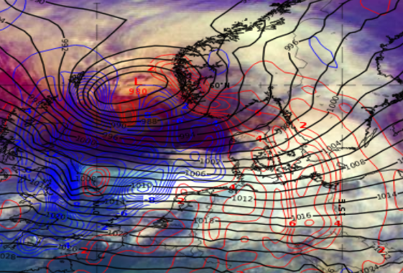
Shapiro-Keyser – 2023.02.17 09 UTC
Mature ET cyclone stage (Shapiro-Keyser Conceptual model) over Southwest of Norway
Wind gusts up to 40-45 m/s in open and Coastal areas
Above: Strong cyclonic vorticity advection (red) at jet level 300 hPA (yellow)
Right: Temperature advection at 850 hPa: cold air penetrates warm inflow that circulates around the low
Airmass RGB with 500hPa geopotential height (cyan), MSLP (black), Temperature at 850hPa
Upper-level trough in connection to deep surface low
Warm core inside cyclone centre
Saulius Šatas, LHMS, Lithuania

