Slide 1
Welcome!
Notes:
Welcome! Great that you are here and join us on this workshop!
I have to start to apologize my partner in crime for organising this workshop, Bruce Muller, who desperately wanted to be here next to me, but unfortunately he couldn’t make it because of serious heath issues of a family member.
We are not with so many as we used to be, but I am sure that despite of that we will have a very useful workshop.

Slide 2
Thank you!
Seonghoon Cheong
Nayoung Yim
Wilfried Jacobs
Patrick Parrish
Notes:
But first let me start to say thank you very much to Seonghoon and Nayoung for the exellent local organisation and all the help we have got!
Next to that I wanted to thank Wilfired and Pat for their great help in the program committee. Without the help of these 4 persons the organisation of this conference wouldn’t be as smooth as it as been for Bruce and me.

Slide 3
Destinations
Notes:
Where do we all come from? I found this map in the CALMet Moodle I thought it gave a great overview.
But I do have the feeling that the only one missing in this map is Mr Sharma from the Fuji Met Service

Slide 4
Our Motto
Notes:
Inspire, share and collaborate is the motto of our CALMet workshop and I really hope that is what we are going to do during the week to come.

Slide 5
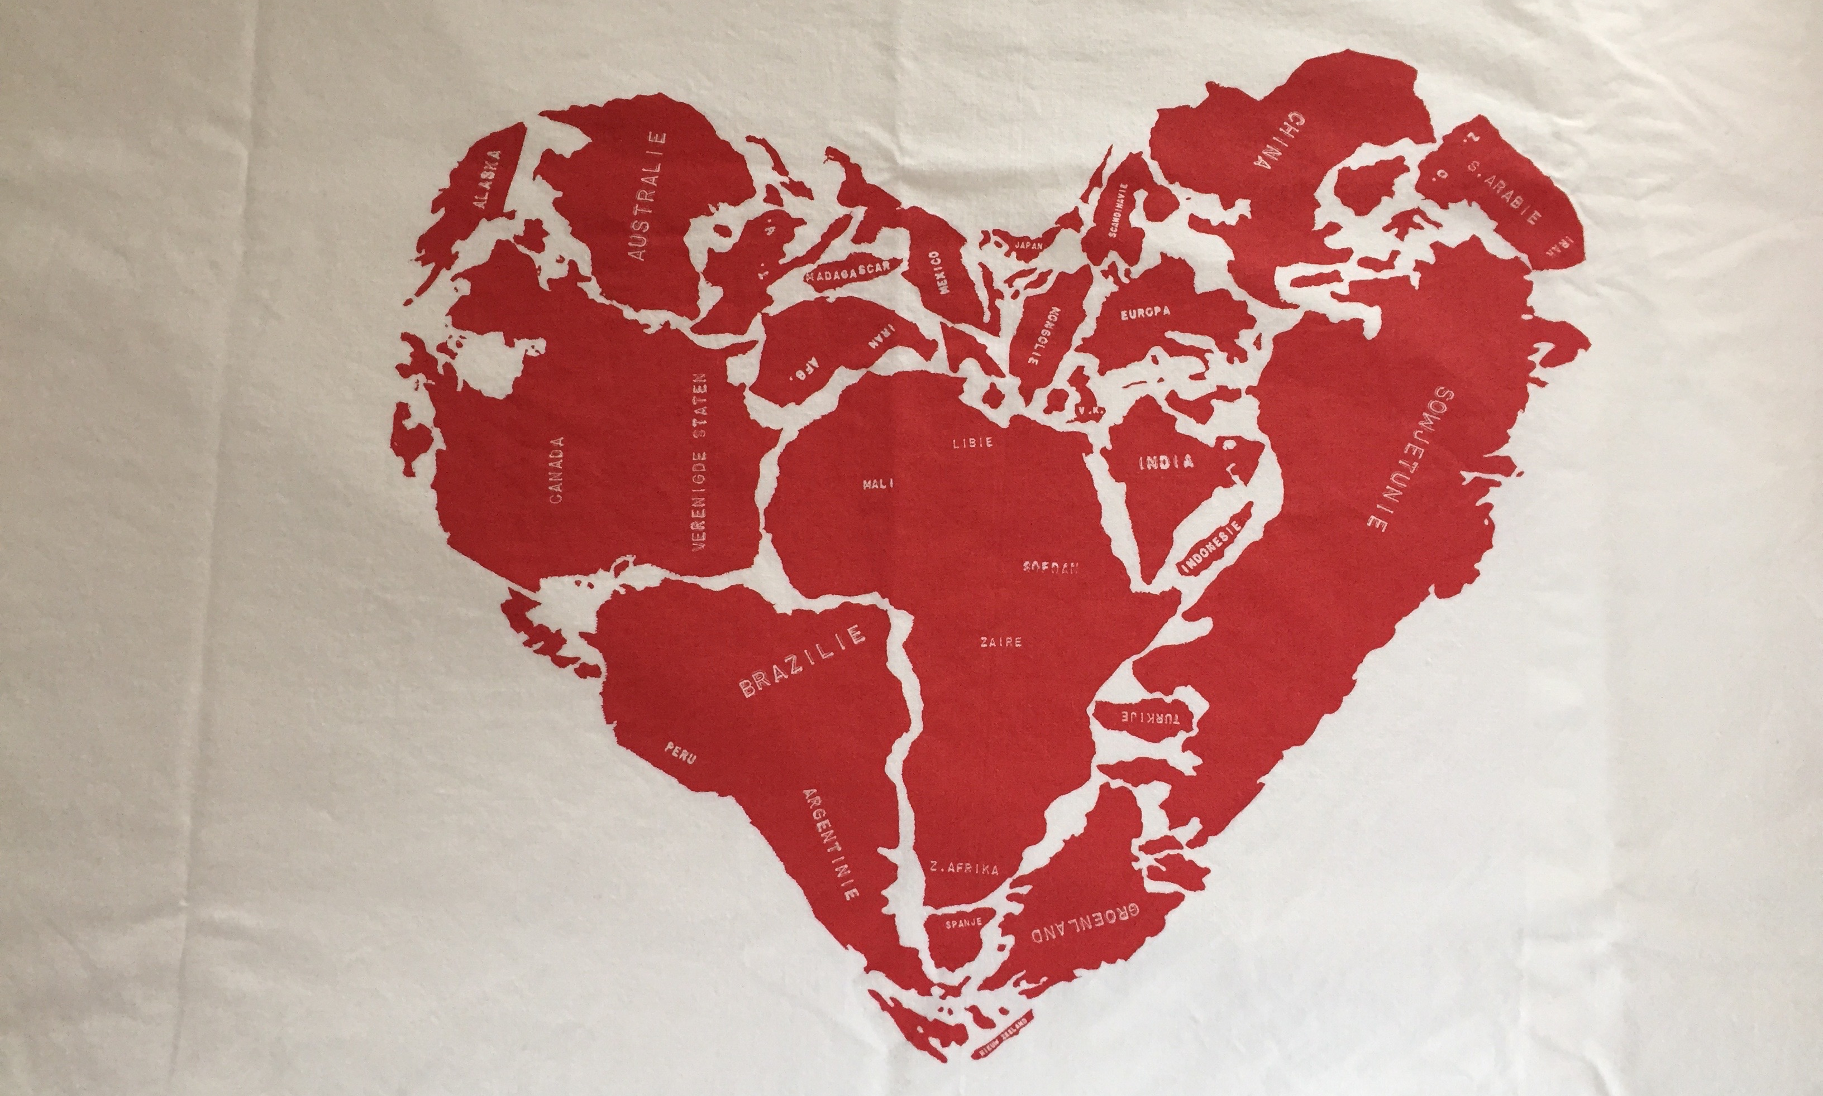
CALMet For Me
Notes:
While packing for CALMet I found a pillow case with this picture printed on it. I thought it was very applicable for this workshop because CALMet for me is also love and friendship!
I am really hoping that you will enjoy this workshop and find it useful.
Please let us know during the week how it works out for you.

Slide 6
Practical Things
WIFI
Network: kmaicd_1
Password: kma_123456
Coffee/tea in the Hallway
Lunch break outside KMA
Seonghoon and Nayoung will guide us there
Notes:
Before we finally start some practicalities….

Slide 7
Practical Things
Posters
Possible to hang the posters on the board all week
2 minute presentation in poster session
Excursion
Departure Wednesday 13.30 from here
Bring confortable shoes!
Possible to leave your stuff in the buss during the excursion
Gala Dinner
Thursday 18.00 at 15th Floor Kensington Hotel in room Grand Station

Slide 8
Practical Things
Computer & printing facilities
Available in small meeting room next door
Picture sharing etc.
We do have a closed CALMet Let’s use that!

Slide 9
Enjoy!

