Slide 2

The Flipped and Twisted Classroom
What gets flipped?
Who gets twisted?
Patrick Kuna Parrish
Notes:
An innovation that is gaining quite a bit of momentum
A potentially fundamental change to how we approach teaching
An attractive innovation with a lot of surface validity

Slide 3
1. Some Definitions Knowledge*
Information*
Content*
Teachers/Trainers*
Students*
What do we learn?
How do we learn it?
Notes:
First, lets look at what is fundamental about the change of this innovative approach
I know you all love discussions of definitions, so we will start here.
We look at definitions of ……. and how they differ in traditional and alternative viewpoints.

Slide 4
Evaluation
Synthesis
Analysis
Application
Comprehension
Knowledge
Creating
Evaluating
Analyzing
Understanding
Remembering
Applying
Bloom’s OLD Taxonomy
Bloom’s New Taxonomy
Knowledge is underated
(?)
Notes:
First, lets look at knowledge, an underated concept.
How many of you have seen knowledge at the bottom of Bloom’s OLD taxonomy, underneath application, analysis, and such.
Some still use this term to refer to reception of passive information. But even Bloom himself revised the taxonomy after thinking twice about this use of the term. What he should have said is “Recall” or “Remembering” as the bottom item on the list.

Slide 5
A Traditional View of Teaching
Knowledge
Teacher
Student
Student
Student
Student
Student
Knowledge
Notes:
In fact, in the traditional view, knowledge is the goal, an ideal
and it is the teacher who is the intermediary

Slide 6
Knowledge is Power
Data
Information
Knowledge
Sir Francis Bacon, 1597
Knowledge =
Potential energy

Slide 7
Traditional Definitions
Knowledge: The collected wisdom of experts
Smart: Having/Able to gather a lot of knowledge
Teacher: Someone who shares their knowledge
Student: Someone wanting to be smart(er)
Content: Information studied to get smart

Slide 8
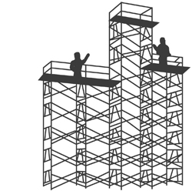
Knowledge: Potential to act wisely
Smart: Demonstrated ability to act wisely
Teacher: Facilitator of knowledge development
Student: Person focused on developing knowledge
Content: Resources/activities to develop knowledge
Alternative Definitions

Slide 9
2. What gets flipped?
Where is the action?

Slide 10
An overdue innovation?
Flipped Classroom
Lectures on line
followed by
Exercises (Homework) in the classroom
Individual
Social

Slide 11
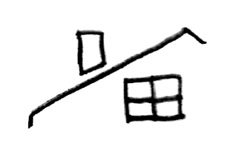

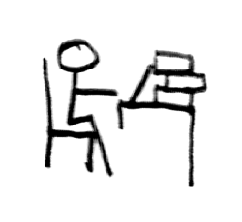
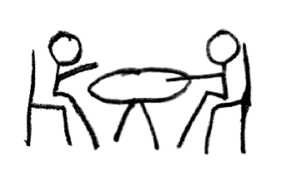
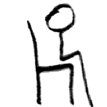
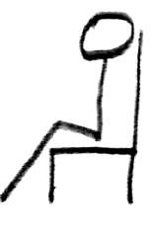
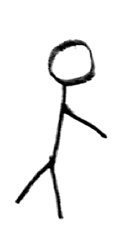
Home Work
School Work
School Work
Home Work

Slide 12
Classroom Time
Homework Time
Presenting new content
Demonstrations
Questions and answers (as time allows)
Reviewing readings
Practice alone
Reviewing content
Unanswered questions
Reading new content

Slide 13
Homework Time
Classroom Time
Viewing/using new content
Independent practice
Formulating questions
Review
Reviewing content
Guided and collaborative practice
Questions and answers

Slide 14
96% of teachers who “flip” would recommend it to a colleague
Improvements on tests increase around 10-15% or more (but does not reflect all improvements)
Increased homework completion
Drops in disciplinary cases (student behavior)
80% of students appreciate more frequent and positive interactions with teachers and students
80% view learning as more active
Flipped Learning Network had grown to over 20,000 in 2014 (from 2500 in 2012)
10% of professional training organizations already provide or plan to provide flipped learning in next year
But does it work?

Slide 15
3. Who gets twisted?
Who owns the action?

Slide 16
Innovation
Flipped Classroom
Lectures on line
followed by
Exercises in the classroom
Flipped Classroom
Lectures on line
followed by
Exercises (Homework) in the classroom
or nothing so new?

Slide 17

lecture = a reading
What is a lecture?

Slide 18
A Traditional View of Teaching
Knowledge
Teacher
Student
Student
Student
Student
Student
Knowledge

Slide 19
An Alternative View of Teaching
Student
Student
Student
Student
Knowledge
Student
Teacher
Knowledge

Slide 20
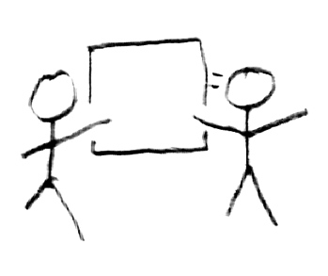
Home Work
School Work

Slide 21
To throw-away assignments
Just say no

Slide 22
Thank you
Definitions, Discussions, Cases, Research:
flippedlearning.org
Photo Credits:
Flipping man: Tbreedphoto.com

Slide 25
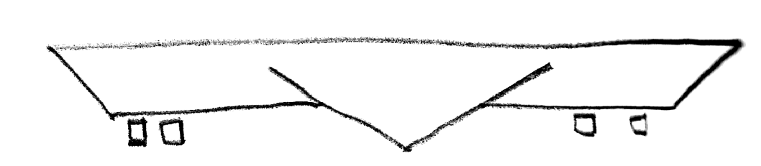
Home Work
School Work

