Slide 1
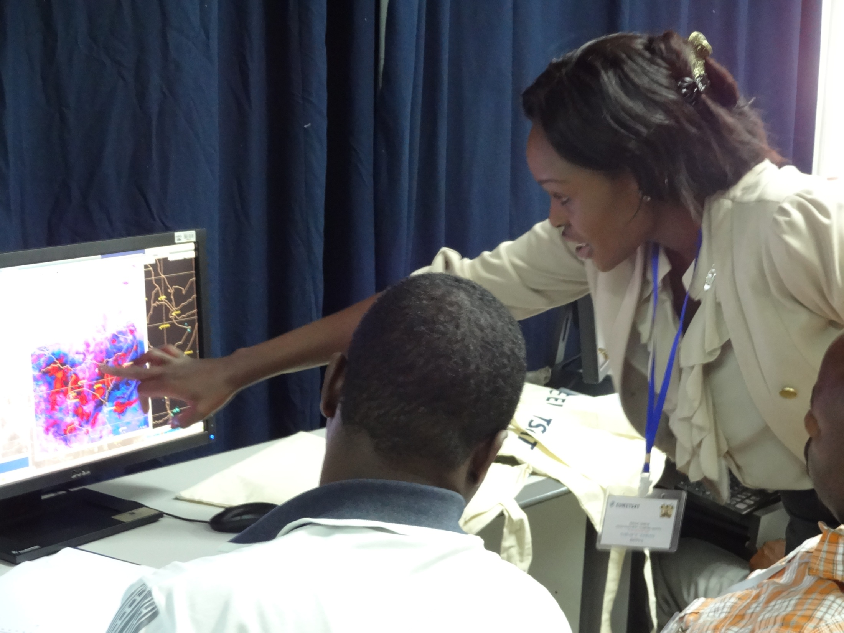
BOOST MY Course
Workshop
CALMet XI
Seoul

Slide 2
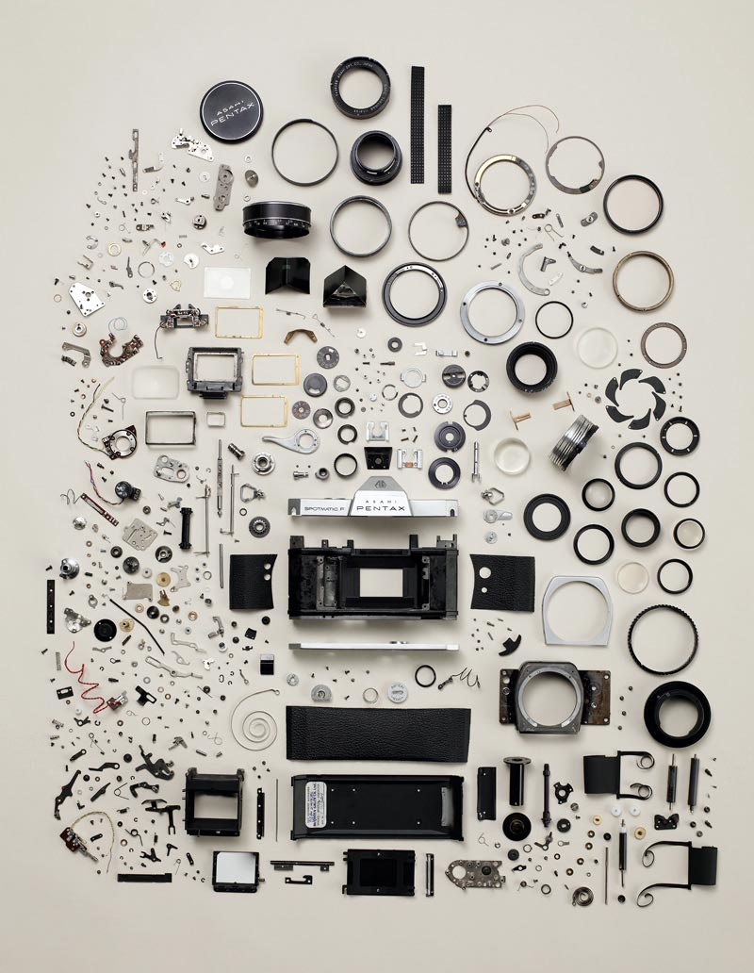
Key questions
What do you expect the
course to achieve?
What is its purpose?
Implementation
What are the course components?
How do they fit together?
Design
Do course evaluations give
you additional guidance for future revisions?
Requirements
What other instructional approach can be used?
Concept
Complete disassembly of a Pentax K1000 camera.
Image borrowed from bitrebel.com.
Notes:
Each of the stages have its key questions to be asked.

