Slide 1
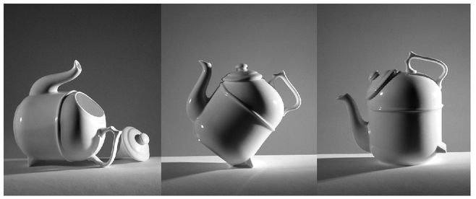
Notes:
The Ronnefeldt “tilting” teapot

Slide 2
Image by William Murphy
Notes:
Image borrowed from William Murphy: https://www.flickr.com/photos/infomatique/

Slide 3
How does it Work?
The mirror allows the viewer to see through the lens.
Light is bounced from a mirror through a pentaprism to the viewer's eye while choosing the object for photography.
The shutter button lifts the viewing mirror while opening the shutter to allow the light to fall on the film...
Old Pentax K1000
Image borrowed from Juan Andrés Del Puerto González
https://www.flickr.com/photos/juandy90/
Notes:
Every time packing for holidays, I have a camera on my to-take list. Every time taking a picture, I think a little bit about the shuttle speed and aperture settings. Every time taking picture with my phone, I think only about the image in front of me, as all the other settings are automated. Once or twice when starting being curious about photography, I asked myself and Internet, how does an old-fashion reflex camera work?
Description of a single-lens reflex 35 mm camera. The eye sees approximately what the film will record.
The mirror allows the viewer to see through the lens. Light is bounced from a mirror through a pentaprism to the viewer's eye while choosing the object for photography. The shutter button lifts the viewing mirror while opening the shutter to allow the light to fall on the film. (http://hyperphysics.phy-astr.gsu.edu/hbase/geoopt/slr.html).

Slide 4
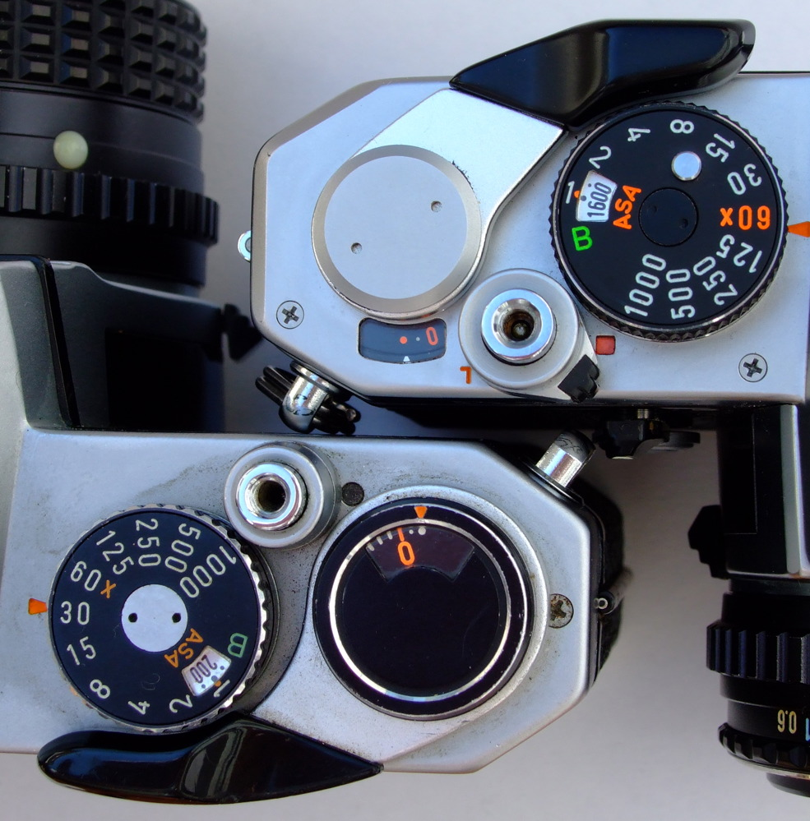
Why Do you Want to Know?
Pure Understanding
Attempts to obtain an in-depth understanding of a product for intellectual purposes.
Quality Improvement
Searches for ways to improve
an existing product.
Cost Reduction
Evaluates the product and/or manufacturing methods in search of cost savings.
Benchmarking
Is often useful for comparing a group of products in a detailed manner.
Evaluating Competitors
Examine patent violation , analyze the product for cloning , design modification.
Comparison of new Pentax MX (top) and old K1000 (bottom)
Image borrowed from slimmer_jimmer
https://www.flickr.com/photos/slimjim/
Notes:
Often we don’t have a luxury of time available to stop and reflect on the question how does something work. Some procedures become automated and habitual if we perform them multiple times. Or there is simply no reason to question procedures. We are happy that they work.
I wanted to know how the single-reflex works out of curiosity and to gain understanding of the product. There might be, or might have been other reasons to ask this question. Taking for example an older model of the camera, the model is outdated in comparison to the newer version. There was a time that that engineers looked into the product and decided how to improve its quality to release the new upgraded version. What can be other rationale for wanting to know how a product works? For instance, cost reduction of the existing production, benchmarking to compare a group of similar products, evaluating a competing product.

Slide 5
Reverse engineering
“Process of information getting and analysis from existent systems, in order to optimize systems being developed.”
Observe and assess the mechanisms that make the device work
Dissect and study the inner workings of a mechanical device
Compare the actual device to your observations
Suggest improvements
Notes:
When a product is designed and develop from scratch, so if the single-reflex camera did not exist yet, one of the appropriate approaches would be forward engineering. ON the contrary, when the product or system already exists, reverse engineering or combination of both applies. Even if in this workshop we are not asked to improve new imagery instruments to be placed on the next generation satellites, or copy what Japanese already have in place ☺, knowing general principles of reverse engineering may be useful for quality improvement of existing training systems. What are the principles? First of all it is worth to remember simple definition of reversed engineering, which is a “process of information getting and analysis from existent systems, in order to optimize systems being developed.” Secondly, there are different models that reverse engineering applies, however for the scope of the task that will be presented in a minute, highlighting the main four steps may be enough. These are:
Observe and assess the mechanisms that make the device work
Dissect and study the inner workings of a mechanical device
Compare the actual device to your observations
Suggest improvements
[Need a reference]

Slide 6
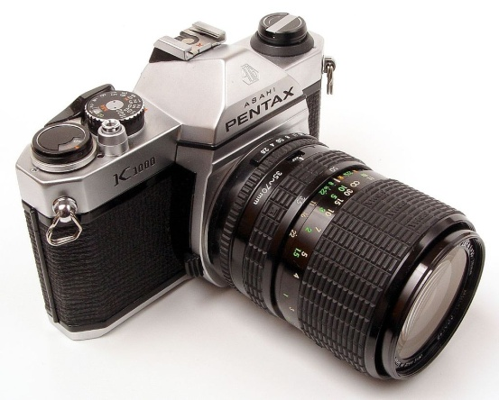
How does it Work?
Reverse engineering could be applied in many different fields, software, mechanics, cognitive science, espionage…
Notes:
Let’s think where else, except mechanical engineering, these overall rules of reverse engineering, which is analyzing existing system for better understanding and optimization, can bring benefit. Reverse engineering is and could be applied in many different fields, like software, cognitive science, espionage and training. Everyone is impatiently looking for an exciting spy story, or ways of optimizing our cognitive capacities, or together improve some apps, but following the scope of the workshop we will explore benefits of reverse engineering approach in training.
More one how reverse engineering is used in cognitive science at http://www.engineeringchallenges.org/9109.aspx-
Also consider evolutionary biology as reverse engineering

Slide 7
Why you may want to know how the learning environment works?
Quality Improvement
We have been teaching one course for some time. We are able to tell the impact of the course and find ways of improvement.
Pure Understanding
Somebody else taught this course in the past. We would like to gain understanding. Or you know this course works well and you would like to apply it to other courses. Or your are planning to change learning solution.
Cost Reduction
Can we improve the efficiency of the course? Time required? Delivery methods?
Evaluating Competitors
Somebody else is teaching a similar course. How do they do it? Is it better?
And more…
Notes:
When we talk about training, a training course is one of the most frequent solution. Nevertheless, there are other solutions available for training, like COMET lessons, other interactive resources presented in this workshop (simulators, interactive exercises, websites like eport), weather briefings etc. To bring our thinking beyond a course for a moment, let’s use a term learning environment(s), which allows to captures variety of solutions.
Looking at an existing mechanical system, like a camera, a few reasons for its analysis have been established. What about learning environment? Why would we bother to pose a question about how does it work? Surprisingly, the reasons can be similar, like quality improvement, pure understanding, cost reduction, or evaluating competitors (or possible partners). And there is even more…

Slide 8
Why you may want to know how the learning environment works?
Benchmarking
Assessing recourses/curricula provided by the others. Global campus.
Updates, changes and progress
Changes in legal guidelines and relevant policies affecting the course.
Progress or change in the domain field.
Updates in teaching and learning methodologies.
Updates in relevant technologies.
Notes:
Benchmarking was present also on the list for a mechanical system review. More specifically for the learning environment there can be internal and external motivators for the revision. These are:
Changes in legal guidelines and relevant policies affecting the course.
Progress or change in the domain field.
Updates in teaching and learning methodologies.
Updates in relevant technologies.
I am confident that most of us can relate to at least one of the motivators listed.

Slide 9
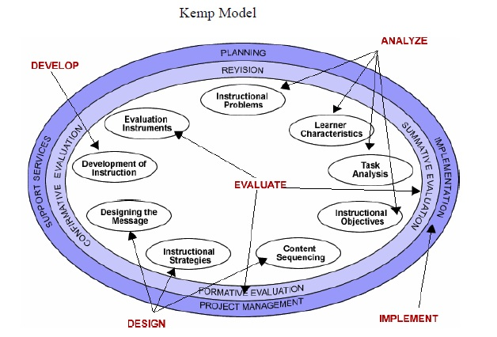
ISD models
Analyze
Design
Develop
Implement
Evaluate
ADDIE
Kemp
Notes:
But why to use an engineering model and not something mores specific defined for instruction and learning environments? Some of you may have came across instructional systems design (ISD) models, which introduce more systematic approach to design of courses, lessons, or generally learning environments. ISD provides systematic guidelines instructional designers follow in order to create a workshop, a course, a curriculum, an instructional program, or a training session” (McGriff, 2001). “The application of a systems approach to training insures that training programs and the required support materials are continually developed in an effective and efficient manner to match the variety of needs in an ever rapidly changing environment.” (Clark, 2000).
One of the most known ISD model called ADDIE, includes five phases of analysis, design, development, implementation and evaluation. As shown on the chart, ADDIE is a continuous process and once we are in the loop, we will be repeating it with every updated release of the learning product. Some variations of ADDIE appear more iterating, but still with a fixed structure.
Another ISD model developed by Kemp presents more appealing systemic approach. It is appealing for everyone who agrees with more recent systems learning theories, which see educational and learning environments as complex systems, where various elements reciprocally influence each other rather than follow a liner cause-effect chain. Not getting to deep into details, the second ISD model consists of similar stages but leaves the elements more flexibility. In principle all the ISD model address the same questions: Where are we going? How are we going to get there? And how will we know that we got there? And how will it all fit together?
ISD models are easier to follow when we need to design a new system (learning environment). Nevertheless they do not present evident instructions for a review of an existing system, especially in case ISD was not used in the first place. Significant part of the ID literature provides vague instruction for revision such as “Revise Instruction. What changes need to be made based on the formative evaluation? (This step includes making the revisions.)” (The Herridge Group, 2004, p. 20).
Clark, D. (2000), Introduction to Instructional System Design. Retrieved from: http://www.nwlink.com/~donclark/hrd/sat.html
McGriff, S. (2001), Instructional Systems Design Models, Pennsylvania State University.
The Herridge Group. (2004). The Use of Traditional Instructional Systems Design Models for eLearning. Retrieved from: http://www.herridgegroup.com/pdfs/the%20use%20of%20traditional%20isd%20for%20elearning.pdf

Slide 10
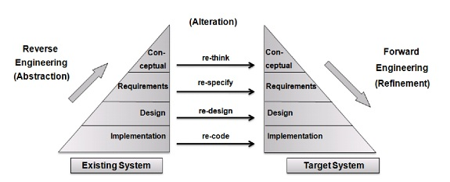
RE model
Byrne, E., “A Conceptual Foundation for Software Re-engineering,” Conference on Software Maintenance, 1992.
Notes:
Let’s look now at an example of the reverse engineering (RE) model remembering that RE addresses an analysis and optimization of and existing system. Even if the model seems more linear, it was created with a system in mind. Four stages of abstraction help to gather data and analyze the existing product. Respectively the four stages of refinement lead to the product alteration and re-implementation. There is a significant similarity with the ISD model which can be explicitly noticed in the overlapping implementation and design stage.

Slide 11
RE & ISD models for Course Re-design
Observe and assess how the course works
Analyze and study course’s elements and structure
Compare the actual course to your initial observations
Verify initial ideas for meeting learning needs
Design
Concept
Implementation
Requirements
Notes:
The proposed re-design process, inspired by reverse engineering, does not have to be followed in a linear manner but definitely proposes systematic and systemic. approach It consists of four stages. 1) Implementation stage focuses on gathering data, observation and assumptions about what to expect after looking closer at the learning environment. 2) Design stage consists of “disassembling” and examining of the learning environment structure. 3) Requirements stage concentrates on the actual learning outcomes and compares them with the initial observations. 4) Concept stage assesses if the original idea solve the instructional problem, and secondly looks at the state of art, in terms of teaching and learning methods, technologies.

Slide 12
Key questions
What do you expect the
course to achieve?
What is its purpose?
Implementation
What are the course components?
How do they fit together?
Design
What are the
actual learning outcomes?
Requirements
What learning need is met?
What other instructional approach can be used?
Concept
Complete disassembly of a Pentax K1000 camera.
Image borrowed from bitrebel.com.
Notes:
Let’s talk about a course as an instructional approach. Each of the stages have its key questions to be asked.

Slide 13
Reasons for SAC Re-design
Common good practice
New guidelines related to the Meteorological Satellite Enabling Skills and Knowledge released by WMO in the draft version
Benchmarking with a course on similar topic being developed by EUMeTrain
Examination of the possible changes in the domain
Updates in teaching and learning methodologies
Updates in relevant technologies that could improve the course
Notes:
After three years of the blended delivery there are several reasons for course revision.

Slide 14
Implementation Stage
What do you expect the course to achieve?
What is its purpose?
Topic
Objectives
Lessons (structure)
Delivery mode (learning solution)
Intended audience
Learning environment
Course description
Objectives
Agenda
Format
Notes:
The example given is simplified for the purpose of this short presentation. The specific tasks to be done in this phase are:
Analyzing the course website if possible from a new distant perspective trying to forget about decision process when creating the course.
Identifying explicit course objectives. For this course the identified objectives are: “explain what meteorological information is available in the thermal and solar channels; explain brightness temperature, reflectivity and counts; distinguish between different RGB combinations and choose the best RGB for different forecasting applications; and you will be ready to learn how to interpret satellite data for your operations context.”
Predicting what elements (resources, activities) we expect to be included in the website without yet looking in details. For example, generally if the course is about advancing learners skills in using satellite products to improve elements to be expected are a check of the entry level of participants, as this is a course leading to advancement, or very explicit pre-requisites. Moreover, If the course is about usage of satellite products, elements (resources, activities) related to application of various satellite products in forecasting. If it is about practical application there should be some authentic exercises that help to apply it. If the prerequisite is not to know already all the products, than example products should be explained. If the product is tailored for African audience, it can be foreseen that products available in specific region and the most useful ones will be addressed.
Analyse briefly the course structures:There are four lessons: Sun-Earth-Atmosphere energy system, Selective absorption, Channel selection, Dust & Natural RGBs
Identify the number of learners (25-30) and instructors (6).
-----------
From the worksheet
Question
What do you expect the system to do?
Task
Collect data. Observe.
Supporting Qs
What is the main task that the course/learning intervention is meant to accomplish? PREPARE THEM TO EXPLAIN☺ AND TO BE READY, BUT NOT DO IT
What are the planned measures that will help understand if the course accomplished its tasks?
How do you think the course works? Be specific. What do you expect to find after disassembling it?
Detailed tasks
Look at the course website
Check the agenda
Check how many teachers and participants in previous editions
Gather data that can help answer the questions
Check if there is course evaluation
Objective
Get an overview on the delivery method and course subject. Predict product behavior.

Slide 15
Design stage
What are the course components?
How do they fit together?
practice
Content sequencing
Resource and activities match objectives
Content and skill level required
Sufficient examples
Selective Absorption
resource
demonstration
Provides practice
activity
practice
Colors of water vapour images
quiz
assessment
Notes:
After obtaining an overall picture of the course, we can move on to the design stage. The design stage is one of the broadest tasks. The scope is to analyze the existing course, tag and map all the elements. In the end see a big picture and how all the elements are sequenced and how they fit together.
-----------
From the worksheet
Question
What are the course components? How do they fit together?
Task
Begin disassembling the course learn and document the structure components. Build a model/map. (Concept map and tagging one of the ways to proceed with the rich picture.)
Supporting Qs
What is the function of each component?
How do the various components function together?
Detailed tasks
Examine component/content function (resource or activity) and sequencing (simple to complex, general to detailed etc).
Classify behaviors/nature of resource: motivation/activation, example, demonstration, guidelines, nice-to-know/optional resource
Classify behaviors/nature of activities: assessment, practice, reflection, evaluation
Examine the role and involvement of peers, teachers, technology
Examine what are the relationships between components (support, provide, practice, exemplify, demonstrate) and how they function together.
Map learning objectives with different sets of components identified in the course structure.
Objective
Analyze structure, behavior of each component, and function of the whole system

Slide 16
Requirements stage
What are the actual learning outcomes?
Intended learning outcomes
Actual learning outcomes
Evaluation results
New requirements, data, products, processes
Comparisons to other training programms
New learning
outcomes
Analysis of course evaluations
Notes:
Compare the big picture with your predictions. Do they match? Is there something missing? Are there unnecessary elements? The newly released satellite enabling skills for meteorological forecasters may influence the prerequisites. Adjust the learning outcomes according to new policies and guidelines, consider input form evaluation of previous editions.
The actual learning outcome for Lesson 2 is: “interpret colors in WV images”, which is not explicitly mention in the intended outcome.
Moreover the resource helping with the activity related to this outcome is missing.
From the evaluation we can tell this subject was new to quite a few participants
Linked to the element 2 in the “enabling skills”.
Thought by EUMeTrain in a similar course.
Question
What are the learning outcomes?
Task
Compare the actual course to your initial observations
Supporting Qs
How might another solution serve the same function as one or more of the existing components? (eg. online vs. classroom)
Is there a more effective and efficient way to achieve the same outcome? (eg. development of self-paced material, shortening the classroom phase, blending with online component, designing peer-reviewed activities vs. tutored etc.)
What is the way to remove inconsistencies and discrepancies?
Have guidelines and relevant policies that might affect the course revision changed? (eg new standards)
Assess the current learning outcomes against new guidelines and policies.
What progress or change in the domain field might inform the course revision? (eg. new methods)
Detailed tasks
Look at the assessment results.
Look at the course evaluation.
Objective
Find discrepancies between intended outcome (implementation), design and the needs.
Find more sound solutions.

Slide 17
Concept stage
activity
Unnecessary activity
What learning need is being met?
What other instructional approach could be more effective?
Learning activities (simulations, discussions, exercises, case studies)
Teacher-student interaction
Learning solution (formal, informal, semi-formal)
resource
objective
Missing resource
Another solution
Notes:
In case of the example course self-paced resource is proposed to cover the topic of Water Vapour images. In case the resource is needed immediately a recorded webinar can be a solution. Later on a self-paced lesson can be produced
Question
What instructional problem is solved?
Task
Re-think initial concept and adjust
Supporting Qs
Is the solution proposed (course, on-job training, job aid, community of practice etc) fully solving the initial instructional problem?
What updates in teaching and learning methodologies might be relevant?(eg. new instructional strategies like flipped classroom, MOOCs)
What updates in relevant technologies could improve the course? (eg. new tools for course delivery)
Detailed tasks
Assess if the instructional problem is solved, and if not propose other solutions (on-the-job-training, community of practice, self-paced lessons, series of webinars etc)
Objective
Verify if the indented learning outcomes are aligned with the current instructional problems.

Slide 18
Refinement
Re-develop
Re-design
Re-specify
Re-think
Design
Concept
Implementation
Requirements
Notes:
Now is the time to start the refining process which has four scopes of rethinking the original concept, re-specifying the requirements, redesigning the learning environment structure and redevelop the new elements.
Taking our previous example the following refinements are proposed:
re-think - more self-directed resources for practice that will also take away workload from facilitators, start collecting examples from specific regions with help of participants to build a library of cases
re-specify – map with the satellite enabling skills for meteorological forecasters, specify prerequisites, adjust objectives to reflect enabling skills and remove unnecessary items
re-design – search for new resources for example on application of satellite images for high impact weather, change the sequence of the lessons, add an activity on VIS channel, adjust a resource on RGB so it supports better the objective of “selecting the distinguish between different RGB combinations and choose the best RGB for different forecasting applications”, find a more in-dept resource on WV images, introduce more inquiry learning? Balance physics continent at the beginning with practical examples. Develop simplified graphics to introduce physical concept. Move the theory to optional material in order to make this more practical. How this approach can be applied to other activates?)
re-develop – update the course website according to the new design
In addition and in the future it would be beneficial to consider more usage of techniques for learning analytics, which were briefly mentioned at the beginning of this week in Patrick’s presentation. This would especially apply to the improvement of online learning environment. Moreover, embedding some universal quality management principles in the re-specification phase could be of benefit. Lastly, I would suggest to explore further relevance of well-established change management techniques for the re-development phase in case we talk about a large scale project. This would apply for both online and on-site learning environment.

