Slide 1

National Meteorological Center
Beginning of your Tomorrows !
Welcome to National Meteorological Center
Welcome to National Meteorological Center

Slide 2
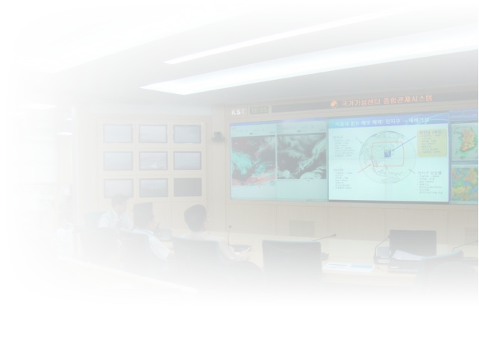










Early Warning on Natural Disaster
Anticipative dealing with National prevention of disasters
Statistics of natural disaster during
the past ten years
Constructing a close responding system
for relieving natural disasters
Damage :
1.7 billion $ /year
restoration :
2.7 billion $ /year
The press
Cause of damage
Local
government
Weather information for natural disaster
Others
(1%)
Heavy rain
(27%)
Heavy snow
(12%)
Natural
Emergency
Management
Agency
Natural
Emergency
Management
Agency
typhoon
(60%)
Relevant
DRR

Slide 3


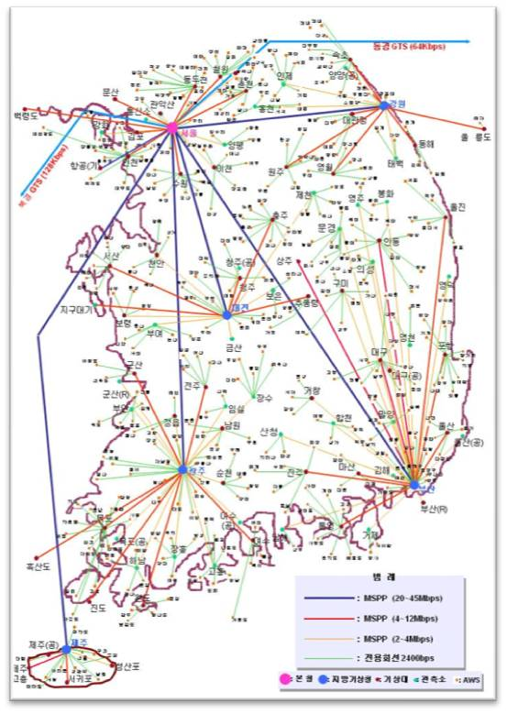



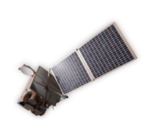



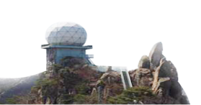
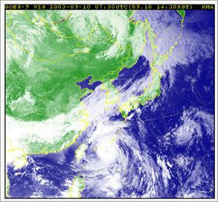


Ⅰ
. Composition of National Meteorological Center
Ⅰ
Duties
Prompt supply of correct and valuable weather information
Contributing to the people’s safety, wellbeing, and national economic development
National Meteorological Center
Work system
Day : 08-20h
Night : 20~08h
National Meteorological Center
Gangwon
R.M.O
Head
quarter
Gangwon
R.M.O
Head
quarter
Headquarter forecaster
+
Regional office forecaster
Total 300
Emergency
support
150/day
Aviation
R.M.O
+
Aviation
R.M.O
8 days work schedule of 4 team
: D-D-N-N-O-O-O-O
Gangwon
R.M.O
Seoul Metro.
M.O
Cheongju
W.S.
Forecast policy division
Daejeon
R.M.O
Forecast technology
Daejeon
R.M.O
Daegu
W.S.
Chief forecaster(4 teams)-High Impact Weather Team
forecast(5), radar(1), earthquake(2) / dust(3),
Jeongju
W.S.
Gwangju
R.M.O
10 Regional offices (Seoul Met., Busan, Gwangju,
Daejeon, Gangwon, Jeju, Daegu, Jeongju, Cheongju /Aviation)
Gwangju
R.M.O
Pusan
R.M.O
Pusan
R.M.O
National Meteorological
Supercomputer center
National Meteorological
Satellite center
Weather Radar Center
National Typhoon Center
Jeju
R.M.O
Jeju
R.M.O

Slide 4



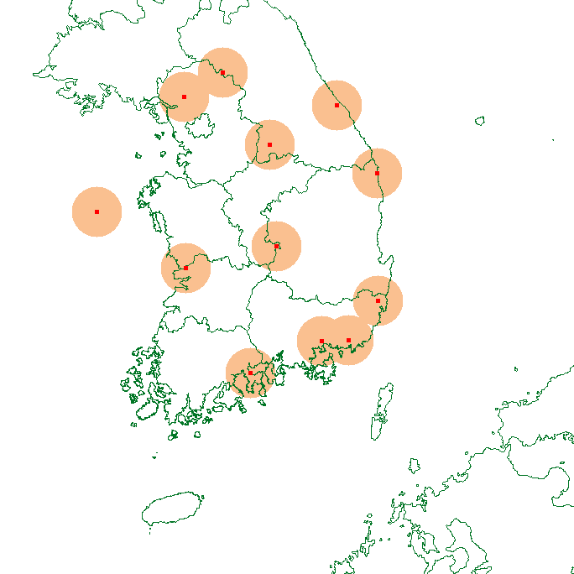
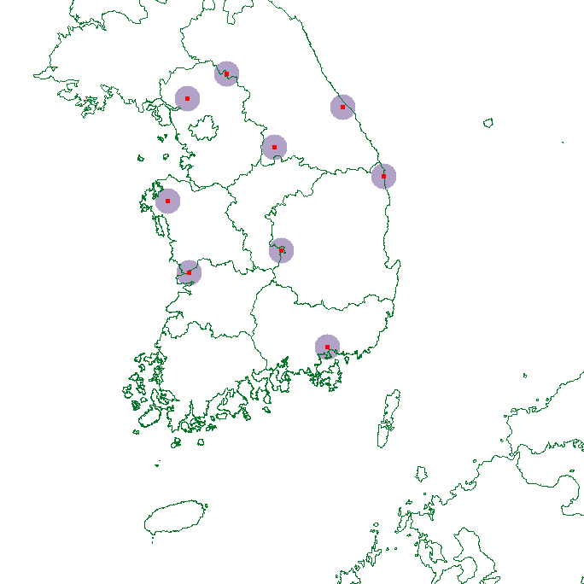
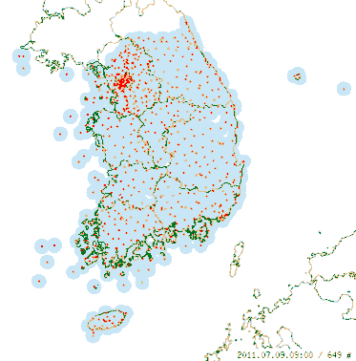
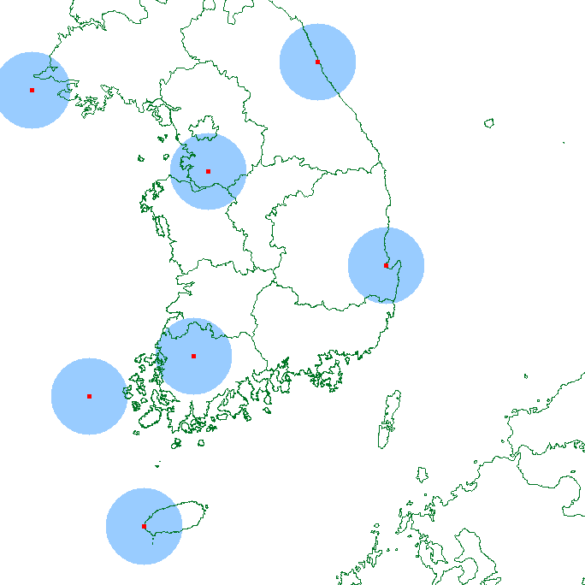


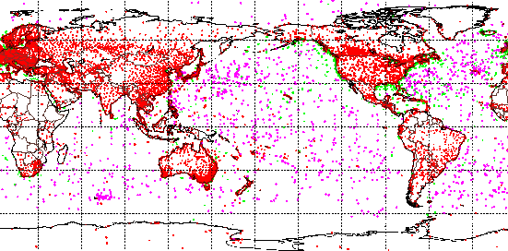

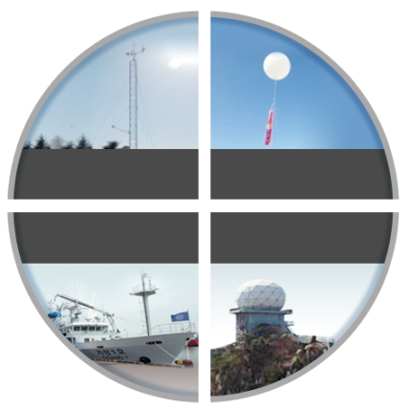
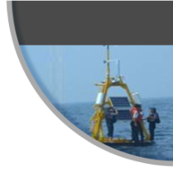
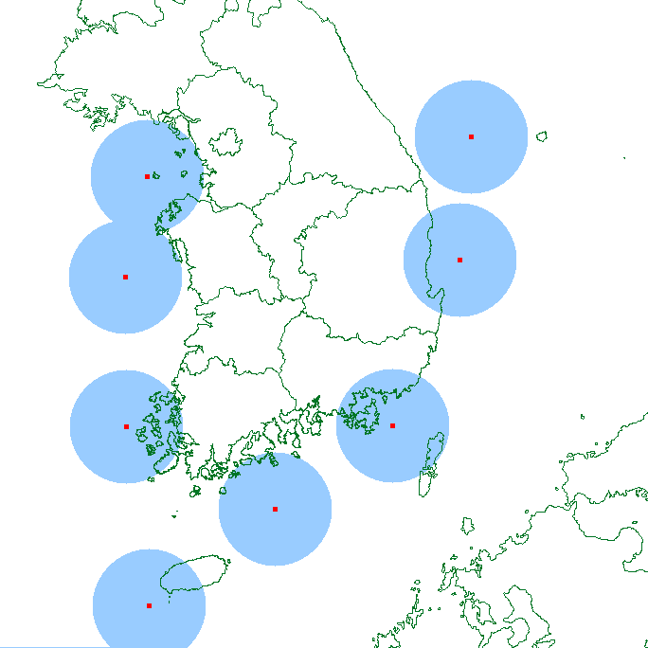
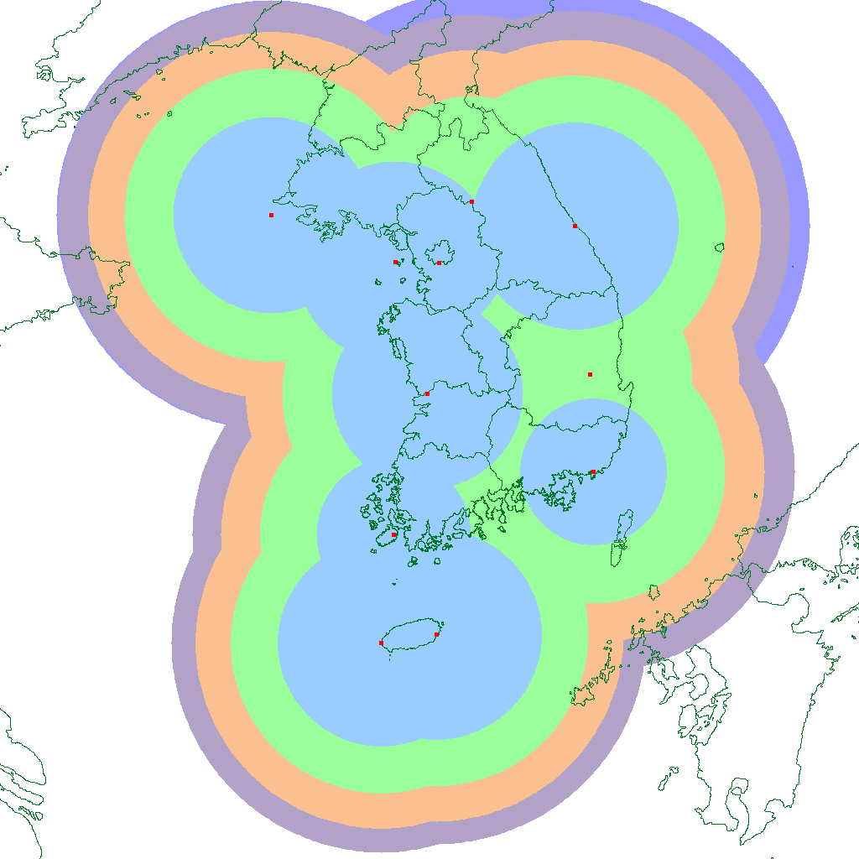
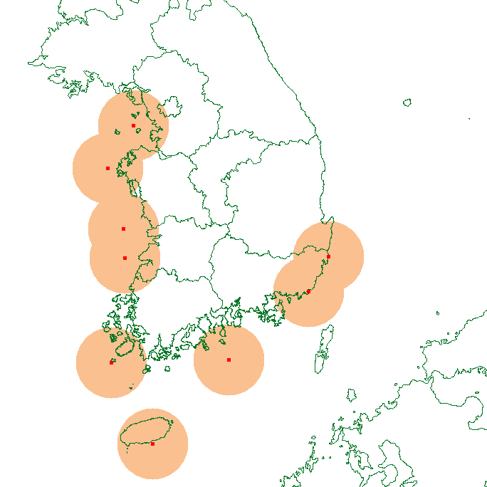
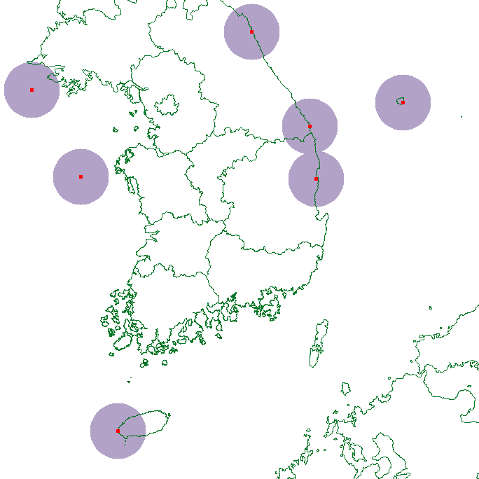
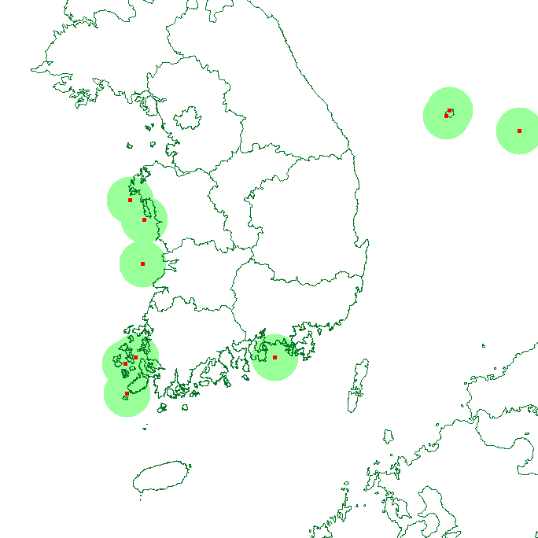
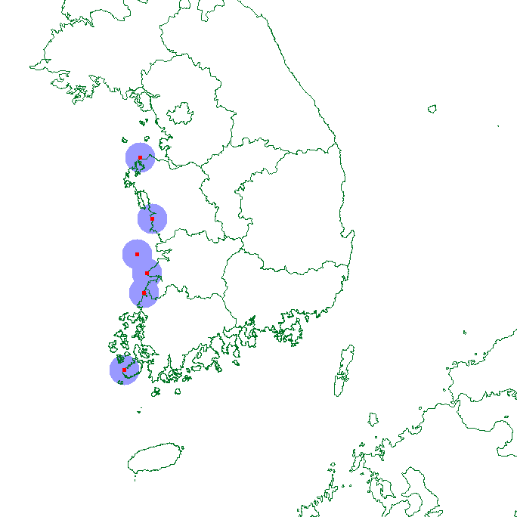
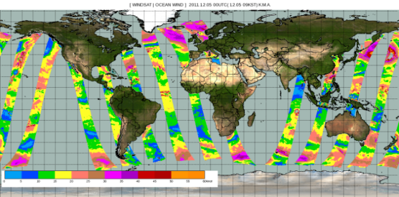
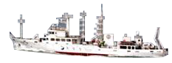
Ⅱ
. Weather Forecast Process - Observation
Ⅱ
Three dimensional meteorological observation and
worldwide meteorological information gathering and analysis
Observation
The three dimensional observation of the Korean Peninsula
through Surface , Upper air, Sea, Radar observation
Worldwide meteorological information
gathering
Observation
Monitoring
Exchanging real time meteorological data with 180 countries over the world
Model
Model
Analysis
572# / 1 min
18# /10 min
Surface
Upper
100# / 1hour
10# / 10 min
~5000 stations / 3hours
Forecast
Sea
Radar
Forecast
Production
Delivery
Delivery
Application
Satellite observation

Slide 5



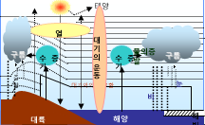
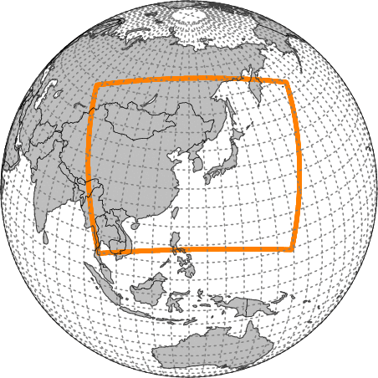
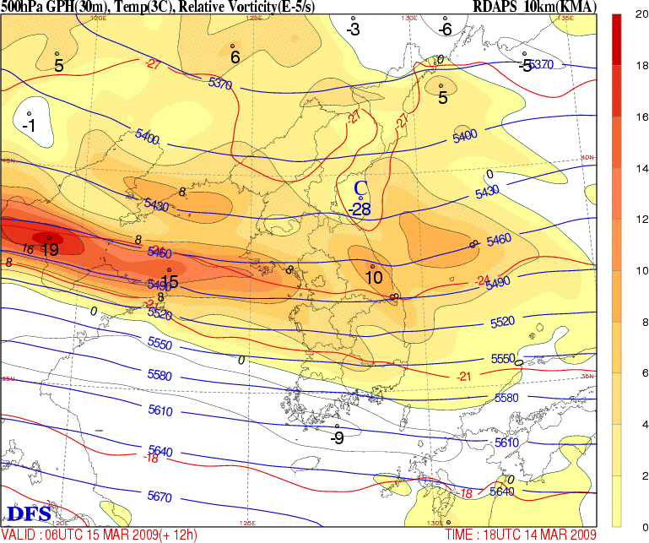
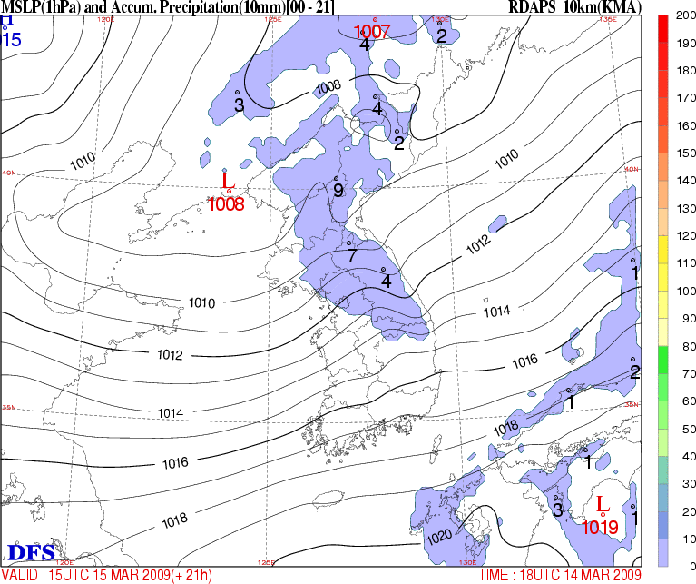
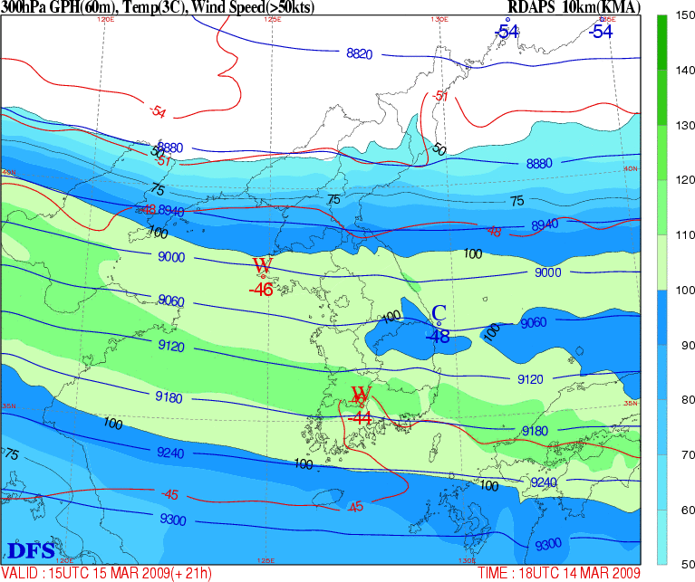

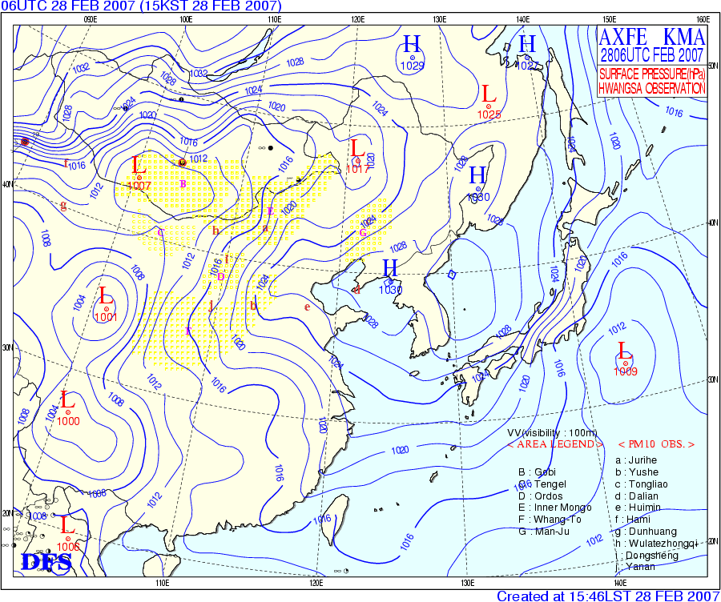
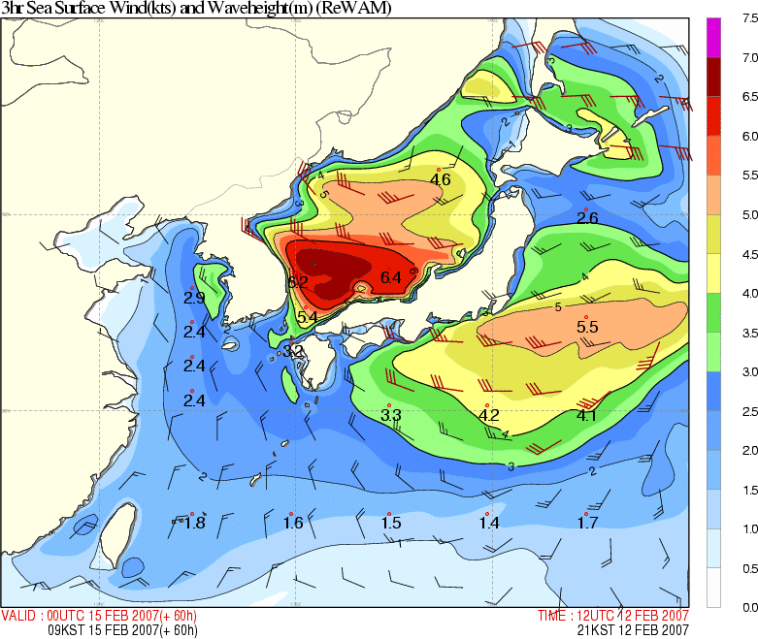
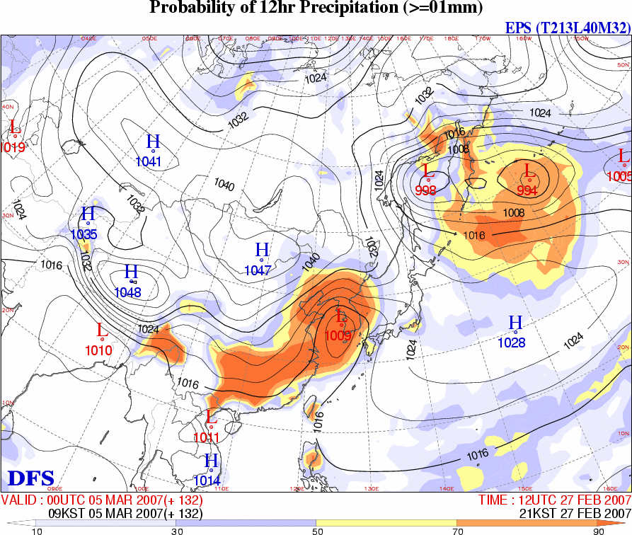
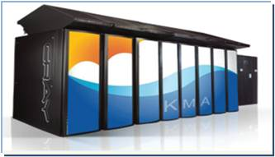
Ⅱ
. Weather Forecast Process - NWP
Ⅱ
Producing Forecast guidance
Observation
The Unified Model(UM) which is introduced from Met Office, UK has been operated, but we have been developing our own model since 2011.
Observation
Present
Monitoring
The law of nature
(Prediction equation)
Numerical model
(Supercomputer)
Numerical
prediction
Model
Model
Analysis
Analysis
Forecast
Forecast
Production
Delivery
Delivery
Application
Supercomputer version 3
130,000 charts / 1 day

Slide 6
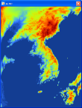
Operational NWP system(based on the UKMO UM)
E-ASIA
Resolution
12kmL70
(0.11°x0.11° / top=80km)
Target Length
72hrs (6 hourly)
Initialization : 4DVAR
GLOBAL
Resolution
N512L70
(~25km / top = 80km)
Target Length
252hrs (00/12UTC)
72hrs (06/18UTC)
Initialization : 4DVAR
LOCAL
Resolution
1.5kmL70
(744×928 / top =39km)
Target Length
24hrs
Initialization : 3DVAR
Global EPS
Resolution
N320L70
(~40km/ top =80km)
Target Length
252hrs
IC : GDAPS
# of Members : 24
VSRF
Resolution 5kmL40
(235×283 / top =20km)
Target Length
12hrs
Initialization : KLAPS

Slide 7

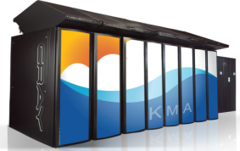
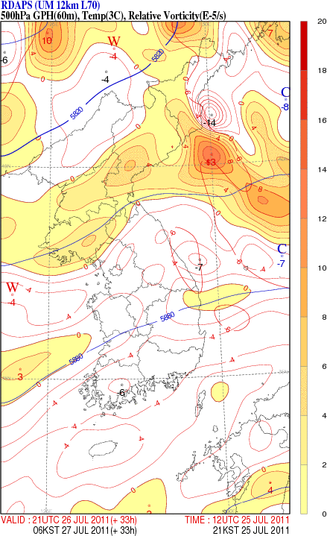

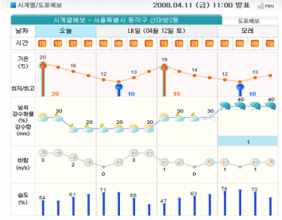
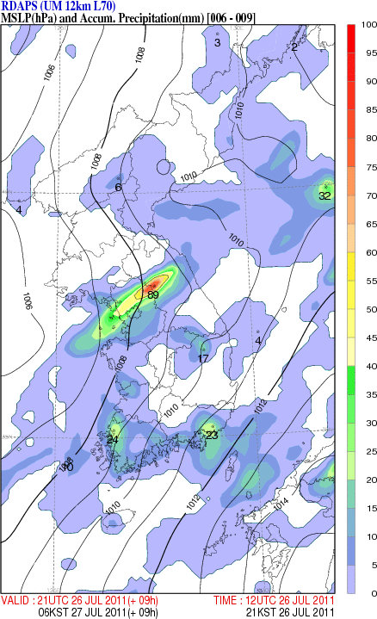



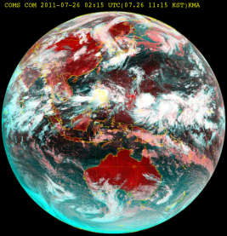
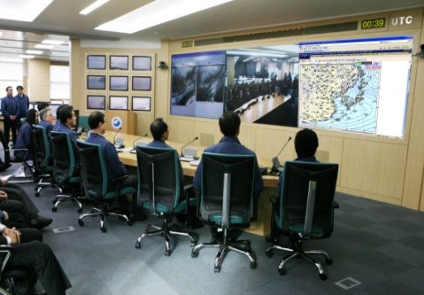
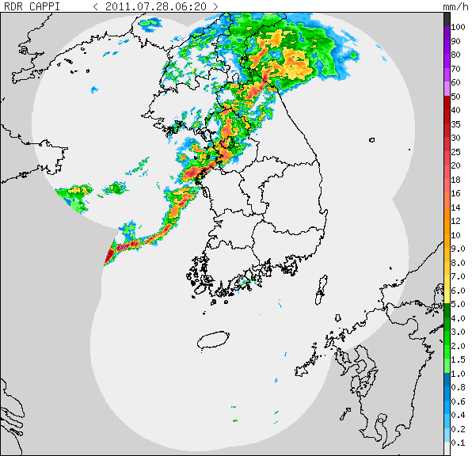
Ⅱ
. Weather Forecast Process - Forecast
Ⅱ
Producing forecast through Knowledge, experience, and know-how
Observation
Observation
Monitoring
Numerical prediction of Supercomputer
Subjective judgment of forecaster
Forecast
Model
Model
Knowledge, Experience,
Know-how
Analysis
Forecast
Forecast
Production
warning, information
Observation
short time forecast
(4 hour)
Digital forecast(3 days)
Medium-range forecast(10days)
Delivery
Delivery
1 month forecast
Application
3 month forecast

Slide 8
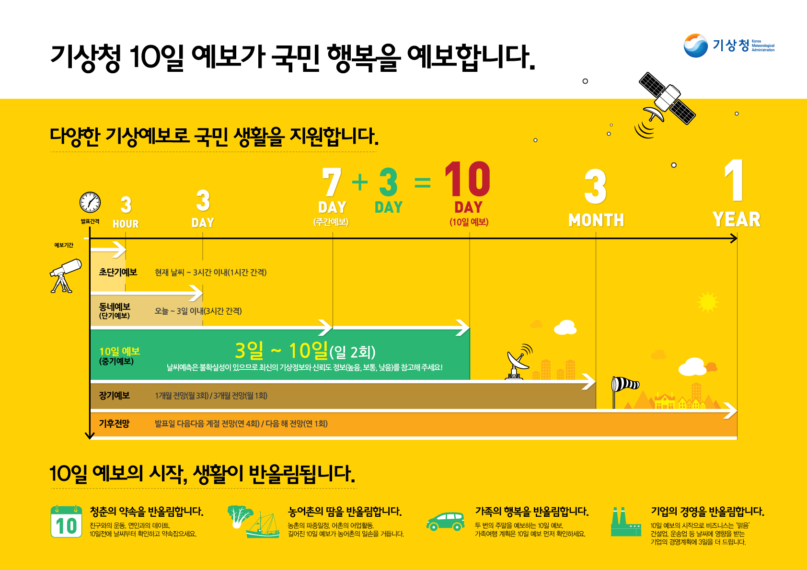
Forecast for 4 hours to 1 year
4
4

Slide 9


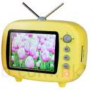
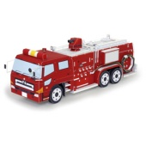
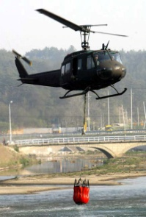


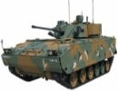

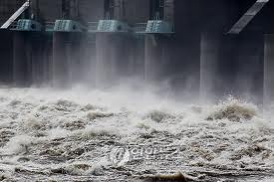
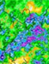


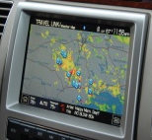

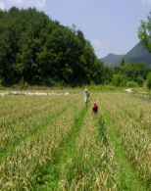


Ⅱ
. Weather Forecast Process - Delivery
Ⅱ
Ubiquitous delivery and application
Observation
Observation
Monitoring
Delivery
Area
Application
TV, Radio, Paper
severe weather
Model
Model
disaster
Analysis
Homepage
kma.go.kr
defense
military operation
Forecast
Energy
Forecast
• Smart phone
• 131 Telephone
electric power
Water resources
Production
Resources
Meteorological information system for preventing disaster
Transportation
Wevigation
Delivery
Transportation
Delivery
Internet weather broadcast
Agriculture, Fisheries, Forestry
Application
Application

Slide 10



Beginning of your Tomorrows !
National Meteorological Center
We take a responsibility for
the well-being
and
enriching life
of our people through
providing accurate forecast
!
Thank you

