Slide 1

THE IMPACT OF HARMONIZING COMPETENCY -BASED TRAINING AND ASSESSMENT AT NMTS, UGANDA
By: Asalu Amos asaluamos@yahoo.co.uk

Slide 2
Content
Introduction
Purpose
Objectives
Methodology
Action Activities at & out of NMTS
Assessment
Results
Limitation
Conclusion/recommendation

Slide 3
Introduction
Competency based training developed at NMTS has the following attributes:
Student centered i.e.
engages trainees throughout the learning
process.
Puts the learner at the forefront .
Defines the role of the trainer and the learner.
Exposes a learner to a variety of learning
Options .
Uses the exhaustive tripartite assessment
methodology to ensure competences learnt
by the learner have been achieved fully.

Slide 4
Purpose
To equip trainees with competencies for
effective service delivery at
meteorological/ hydrological and other
related institutions.
To minimize performance gaps noted at
Met stations in Uganda which were
attributed to the nature of training
undertook by the personnel. This study is
providing a solution to these gaps.

Slide 5
Objectives
To produce;
Competent
Self motivated
All round meteorological technicians

Slide 6
Methodology
By teachers
Brainstorming
Action mapping
Theory & Practical teaching
Tasking
Students listening to give a learner
freedom to express themselves
Supervision, Assessment & Rewarding
Institution to institution dialoguing
Follow up

Slide 7
Methodology cont’d………..
By students
Group studies
Student presentations
Hands on practices
ICT/GIS learning
Online learning
Role modeling
Research projects
Field training

Slide 8
Action Activities
At NMTS
Out of NMTS

Slide 9
At NMTS
1
Students
Do practical exercises
Analyze weather charts
Draw weather instruments
Make manual weather instrument models
Design conceptual models
Make weather charts & world reports
Produce simple weather publications
Some are shown below:

Slide 10
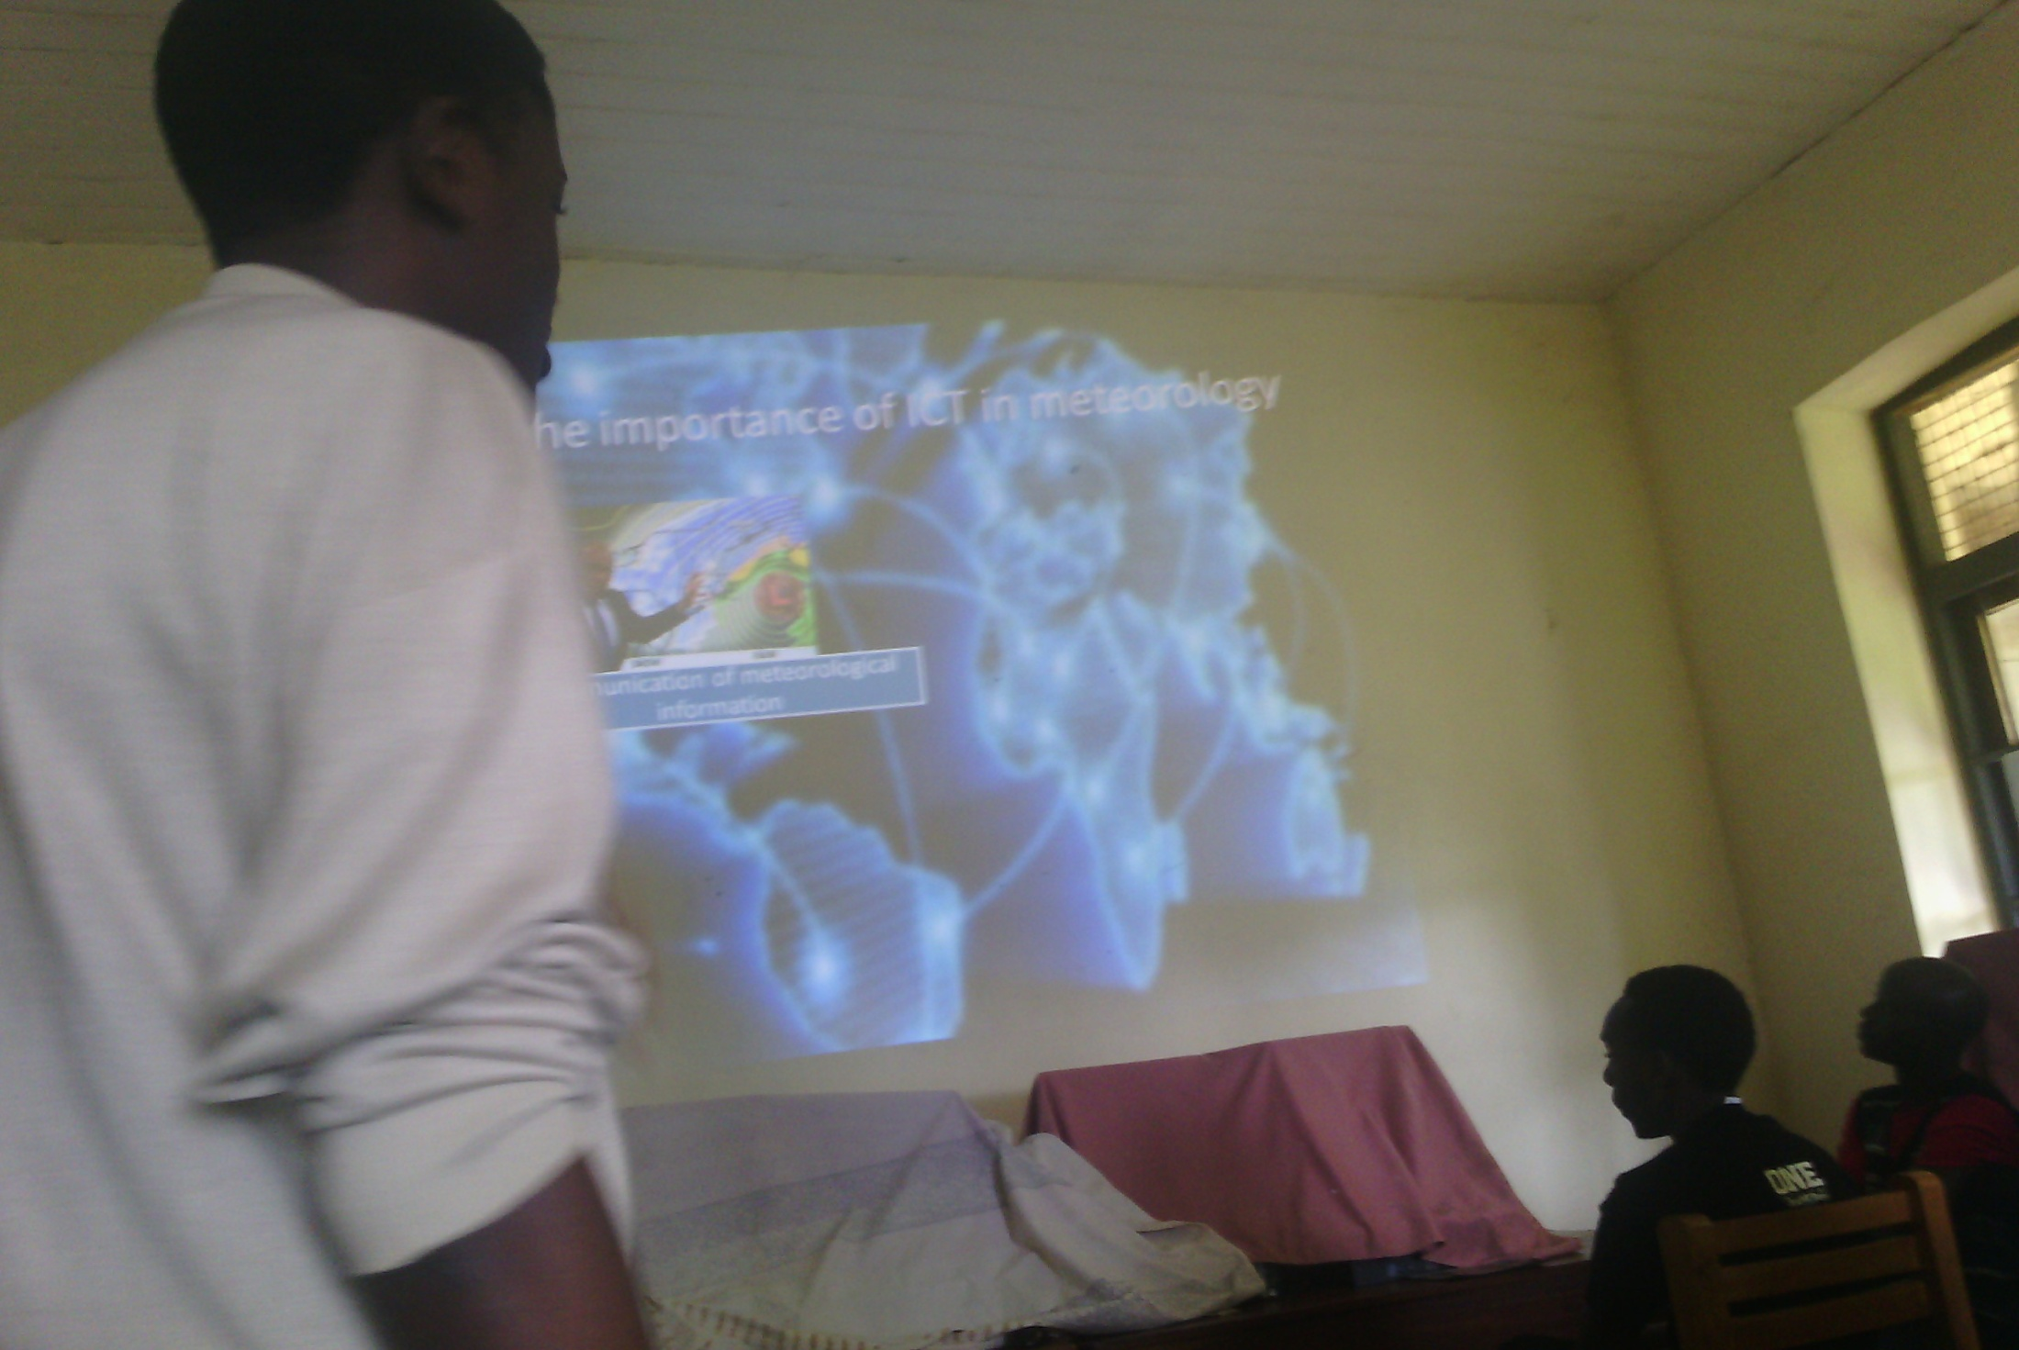
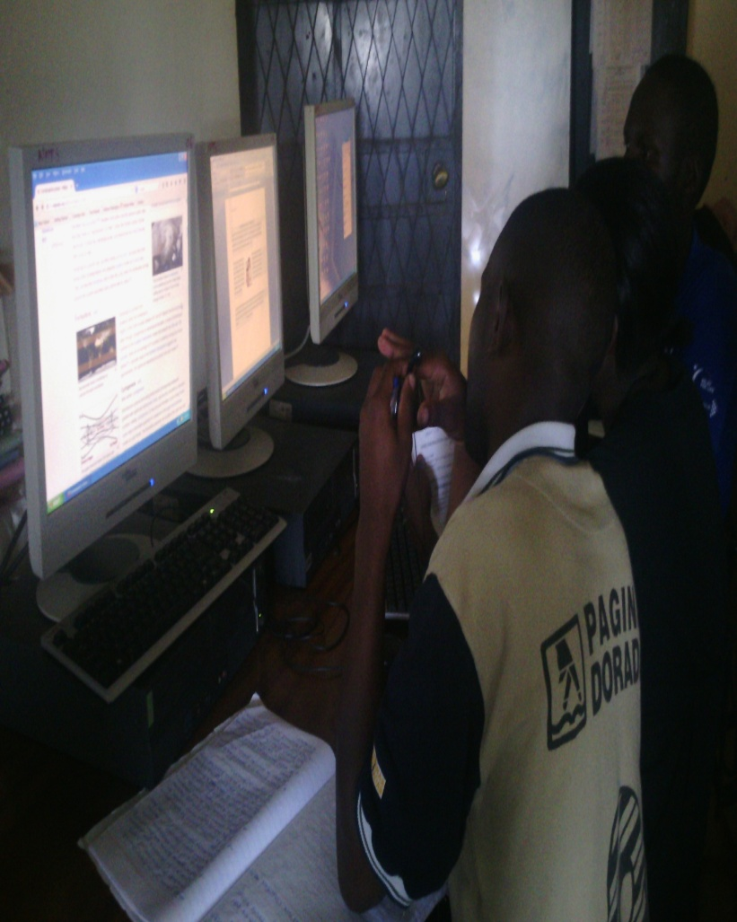
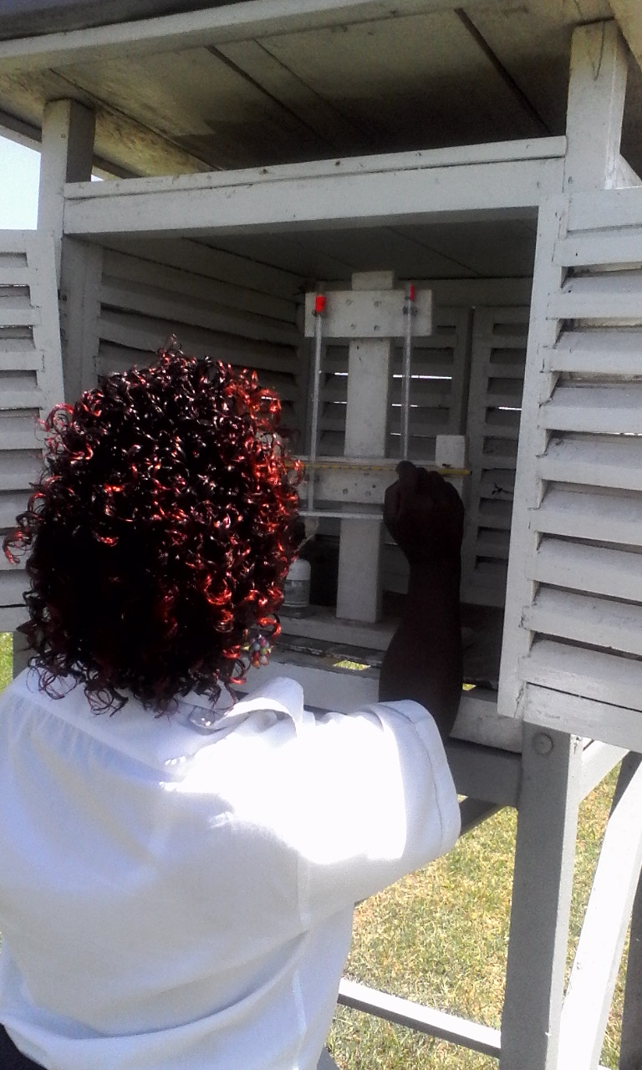
PRESENTATIONS
DATA ANALYSIS
RESEARCH& ONLINE LEARNING
WEATHER OBSERVATIONS

Slide 11
Observe &Make Weather reports
Communicate weather
Analyze charts
Forecast weather
Broadcast weather
Facilitate public on study tours
Data entry, processing & storage
Use weather data management software
Make weather outlook bulletins
Apply GIS techniques
Analyze flight charts
Brief pilots
Make aerodrome forecasts
Get flight experiences
NATIONAL METEOROLOGICAL CENTRE
UNMA HEADQUARTERS
CLIMATE CHANGE UNIT
NARO & NGETAZARDI
E. A CIVIL AVIATION ACADEMY IN SOROTI
2
OUT OF NMTS ( Field Training)
Determine planting dates
Apply weather data to agricultural practices
Apply mapping techniques
Analyze climate change causes, impacts, adaptation and mitigation techniques
Sensitize public

Slide 12
Tripartite Assessment
ENTRY
Interviews
Questionnaire
SESSION
Listening to students
Assignments
EXIT
National examination
Field/Industrial training
Think-do-feel table
Practical tasks
Situational tests
Project
By teachers:
World of work

Slide 13
Assessment tools
PRACTICAL LESSON IDENTIFICATION TOOL (BRAIN STORMING)
Lecturer | Course unit | Title of practical lesson
1
INDUSTRIAL TRAINING AREA IDENTIFICATION TOOL (BRAIN STORMING)
Lecturer | organization | Job tasks/competencies | Remarks
2
STUDENT’S SKILL CONFIDENCE TOOL ( BY STUDENT)
No. | Name of skills acquired | Possible area of application
1.
2.
3

Slide 14
FIELD TRAINING STUDENT’S SKILL CONFIDENCE TOOL ( FOR ACADEMIC AND FIELD ASSESSOR)
No. | competence | Score (out of 10) | comment
1 | Work attitude
2 | Team work
3 | Working under minimum supervision
4 | Application of met. Knowledge to tasks given
5. | Oral & written communication
6. | Handling uncertainties/ emergencies
7. | Professional potential
8. | Managing met. Tools and matched technologies
9. | Willingness to acquire new knowledge & skill
4

Slide 15
Results
Teachers are able to
Train within the syllabi (Focused)
Train with interest (Motivated)
Train confidently/basing on
competences (Competent)

Slide 16
Results Cont’d………….
Students are able to:
Do many tasks (Multifunctional)
Create jobs for themselves (creative)
Initiate projects (Innovative)
Make devices (Inventive)
Make wonderful presentations (Confident)
Get award in Dip Meteorology (Competitive)

Slide 17
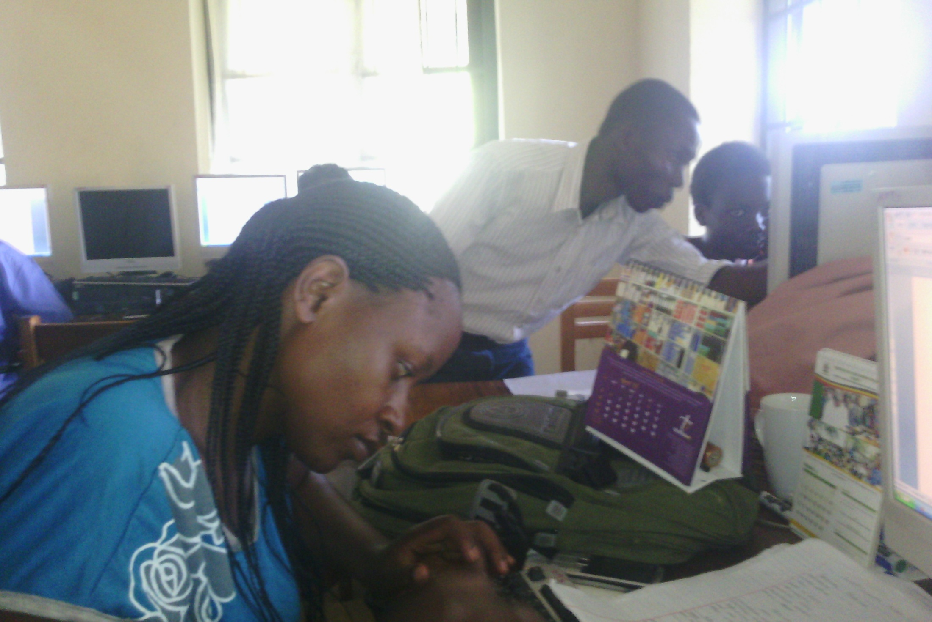
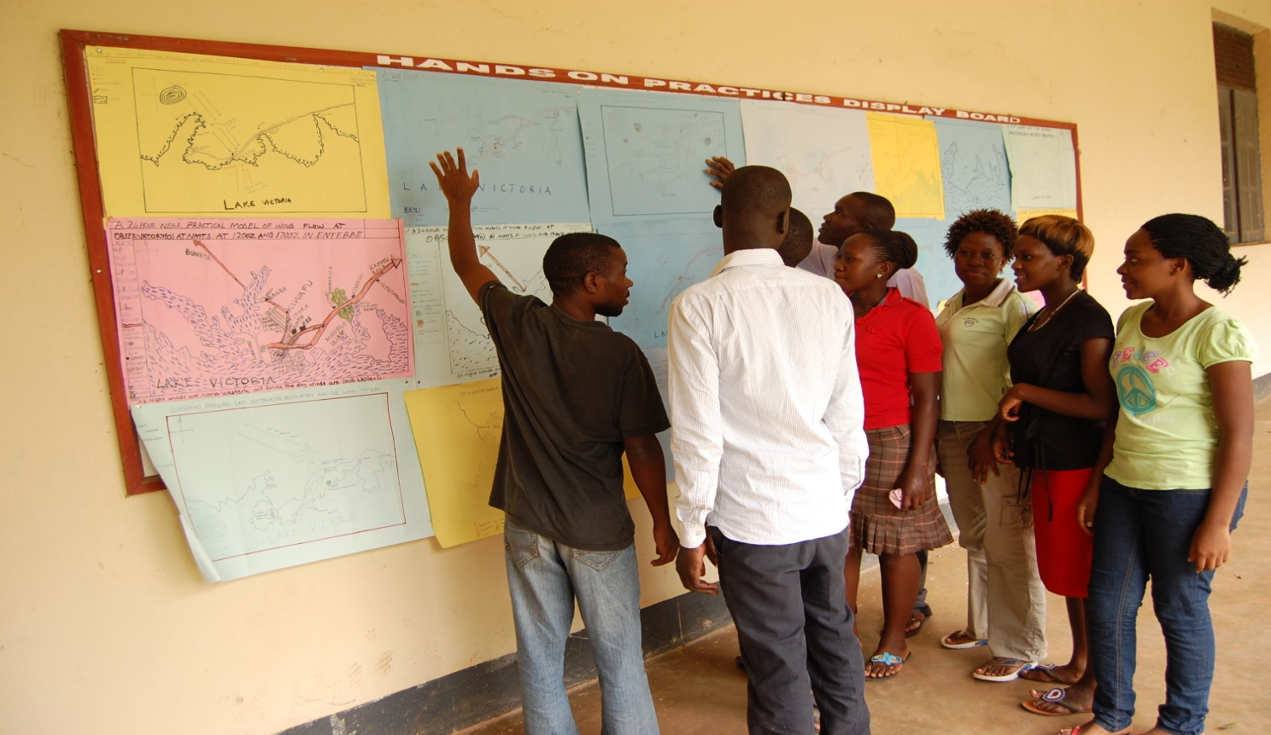
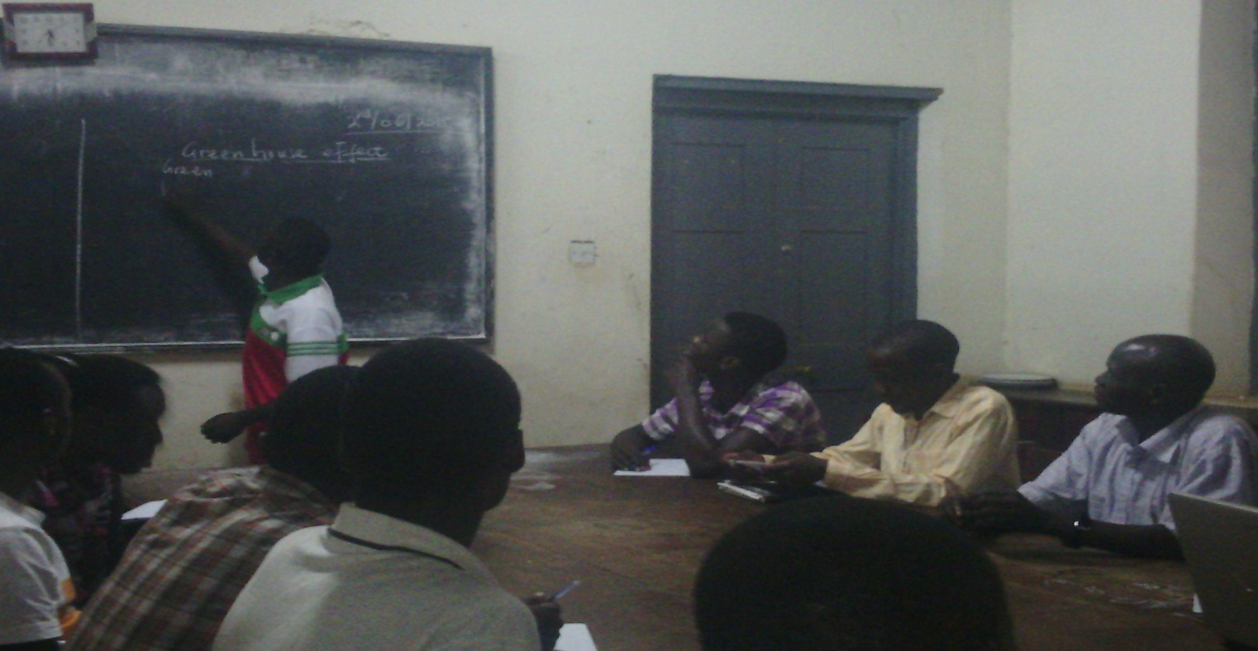
SELF – DRIVEN LEARNING
Listening to students

Slide 18
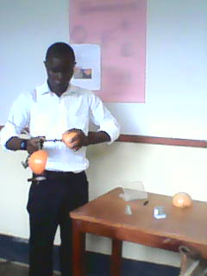
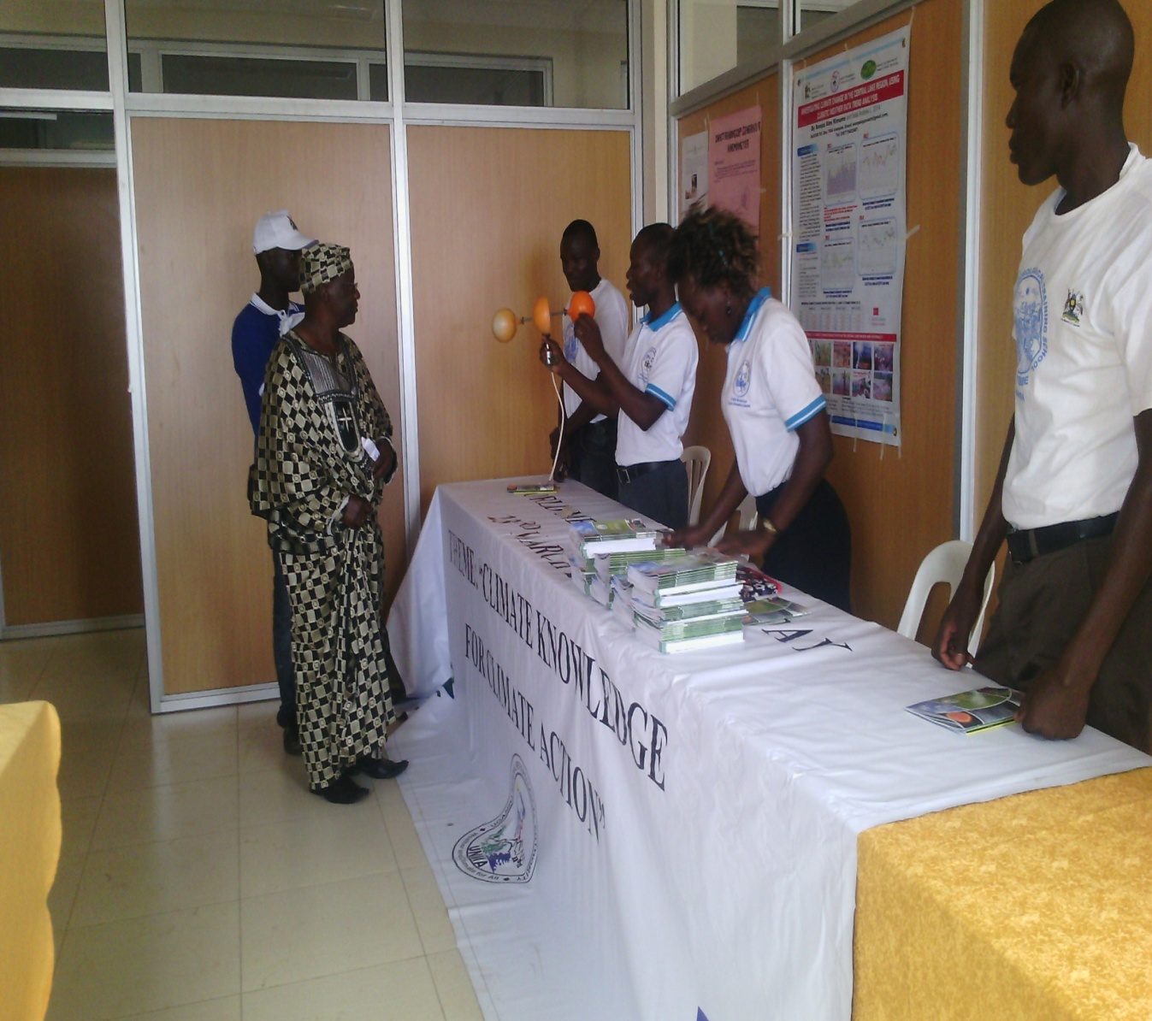
INVENTIVE & SELF - MOTIVATED

Slide 19
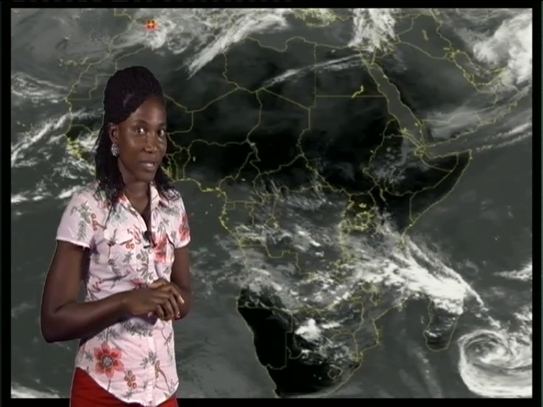
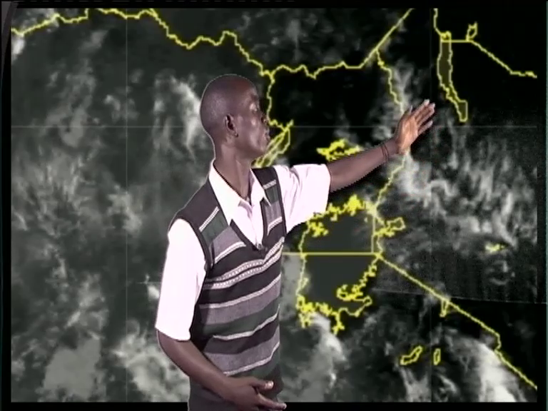
CONFIDENT & COMPETITIVE

Slide 20
Limitations
Expensive (field assessment).
Student Mobility.
Shortage of training equipment at the
industrial Training Centers.
Shortage of well trained trainers.

Slide 21
Conclusion/recommendation
Personnel to offer/deliver services at meteorological/hydrological institutions in Uganda should be subjected to a harmonized competency- based training and assessment.
Competence Based Training and Tripartite assessment is recommended for all Meteorological Training Institution.

Slide 22
THANK YOU
MERCI
CALMET XI-WORKSHOP
7TH-11TH , SEPTEMBER, 2015
KMA, SEOUL
REPUBLIC OF KOREA

