Slide 1
Using “Specific Web Page” to guide post and self-study _“counselor” training case as an example
Gao Jie & Li Hui-xin
China Meteorological Administration Training Center(CMATC)
2015-09
Notes:
题目：利用“专题”指导上岗和自学——学习点“辅导员”培训为例

Slide 2
Content Points
1. Background
Counselors need to interact at any time
2. Solving ideas
Create a “Specific Web Page” for counselor
3. Present situation
Intend to create a “Specific Web Page” for counselor
4. Future plans
Existing Web Page into the use of the needs of counselors
Notes:
问小冀：
第一条中，用“interact”好还是“communicate”好？这里想表达“交流互动”的意思。
第三条中，改为“Current Specific Web Page serving both grassroot station e-learning demonstrate sites and counselors ”好吧？
以下备查：
要点：
1.背景：问题的提出，辅导员队伍需要随时交互
2.解决问题的思路：策划面向辅导员的培训专题
3.目前现状：示范点专栏兼顾辅导员专题的作用
4.打算：促进辅导员培训专题的建立和使用

Slide 3
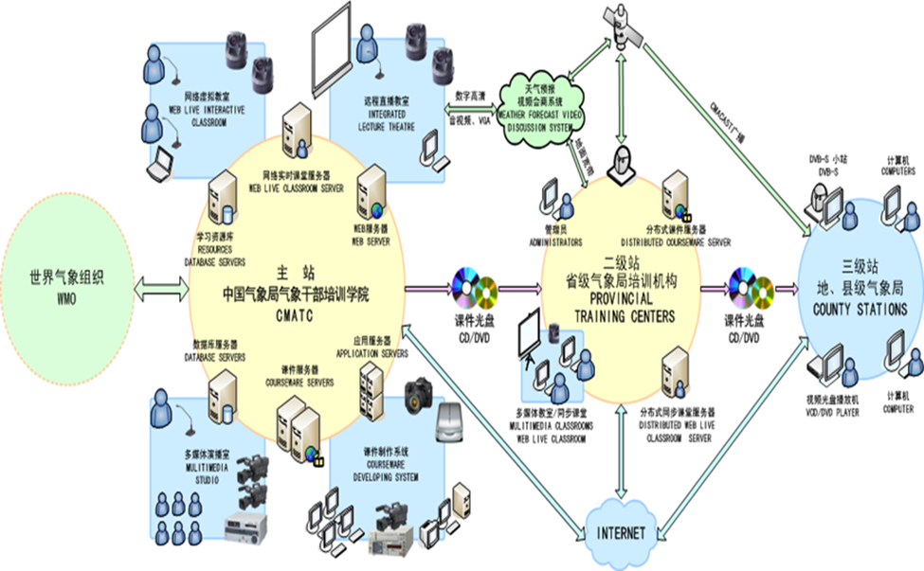
1.Background
108 grass-root station e-learning demonstrate site.
Each learning point has a counselor.
CMA Three-tier Distance Learning Network
China Meteorological Administration Training Centre
（CMATC）
Provincial training centers
County stations
(more than 2000)
Counselor
Notes:
1、背景：三级体系；基层台站中108个点有辅导员

Slide 4
Counselor role
communication and supervision
CMATC
His colleagues
Provincial training centers
His leaders
Group learning
Using CMATC website
Notes:
辅导员作用：交流和督促。上级和同事之间的沟通；组织本学习点的同事一起学习
主站，二级站，基层学习点
本学习点的同事
要求各学习点的辅导员组织和辅导本单位职工利用气象远程教育网自主学习。

Slide 5
Counselor training
Face-to-face training is held in CMATC,
once a year
Problems: Counselors still need guidance in time,
due to:
Solving ideas: To build a “online home” for them at the CMATC website (“Specific Web Page” for counselor)
1.personnel replacement.
2.Miss the latest notice.
3.Some specific problems usually occur in practical work ,they need to be solved in time
Notes:
辅导员培训情况：面授在CMATC，一年一次
存在问题：他们需要及时的指导。……原因：人员更换，没有关注(最后改为’错失了’)最新通知，实际工作中的具体问题需要及时得到解答
解决思路：在网站给他们建立一个家园——培训专题的策划

Slide 6
2.Planning “Specific Web Page” for counselors
“Specific Web Page” is a web column of learning resources which are from the “China Meteorological Distance Education Network and Resource-sharing Platform(CMA-MDERP)”.
It is presented in the form of web pages, including some online-study resources on related topics.
It is a utilization attempt to accomplish the online services of counselors’ training in four aspects.
It plays a guiding role of CMATC, and creates a learning and communicating platform for the counselor training , learning activity management and learning feedback collection.
Notes:
问小冀：
第一条中的“a kind”改为“a column”更好？
第二条中的“training to counselors”改为“counselors’ training”更好？
以下备查：
2、策划辅导员培训专题（即2.解决思路）
上述3点来自摘要中。
摘要中原文：
“专题”是中国气象局气象远程教育网学习资源建设的一个栏目，以网页形式呈现，汇总了与该专题主题相关的在线学习资源。
"Specific Web Page" is a kind of learning resources which are constructed by the China Meteorological Distance Education Network. It is presented in the form of web pages, and includes some online-study resources on related topics.
本文尝试用“专题”实现针对辅导员培训的四方面在线服务，发挥干部学院的指导职能，搭建辅导员培训的学习和交流平台。This paper attempts to utilize “Specific Web Page” to accomplish the online services of training to counselors in four aspects, plays a guiding role of CMATC, and creates a learning and communicating platform for the training of counselors.

Slide 7
The four aspects of online services:
1.Providing counselors’ requisite post responsibilities knowledge 2.Providing the resources of required skills which are need to complete job responsibilities 3.Offering a pre-training platform to counselors who will attend face-to-face trainings 4.Providing a communication platform for counselors and e-learning administrators from CMATC
Notes:
续上页：
四方面的在线服务包括：1.呈现辅导员必备知识；2.提供完成岗位职责所需技能的学习资源；3.辅导员参加面授培训的预培训平台；4.辅导员之间、辅导员与干部学院远程培训管理员之间的交流分享平台。
The four aspects of online services include: 1-Presenting counselor’s requisite knowledge; 2-Providing the resources of required skills which need to complete job responsibilities; 3-Offering a pre-training platform to counselors who will attend face-to-face trainings; 4-Providing a communication platform for counselors and e-learning administrators from CMATC.

Slide 8
About the “Specific Web Page” for counselor(Plan)
3+1 major columns：
document
skills
Share
Pre-training platform
1. Counselor work related documents
2. Counselor work related skills
3. Counselor work communications
+1. Offering a pre-training platform to counselors who will attend face-to-face trainings(When necessary)
Notes:
辅导员专题策划：exchange share’ Instructor post responsibilities
辅导员工作相关文件：示范点建设评估指标，针对辅导员发布的有关通知，
辅导员工作相关技能：辅导员岗位职责涉及工作的操作方面的培训课件或者问题解答。
辅导员工作交流分享：工作体会，案例，成绩展示
辅导员参加面授培训的预培训平台
“专题”是开放的，辅导员可以上传相关内容
Establish training topics for Counselors
(”Specific Web Page” for counselor)
Planning
3+1个主要栏目：
3 major columns：
Counselor work related documents
Counselor work related skills
Counselor work exchange share
辅导员参加面授培训的预培训平台(Offering a pre-training platform to counselors who will attend face-to-face trainings)(When necessary)

Slide 9
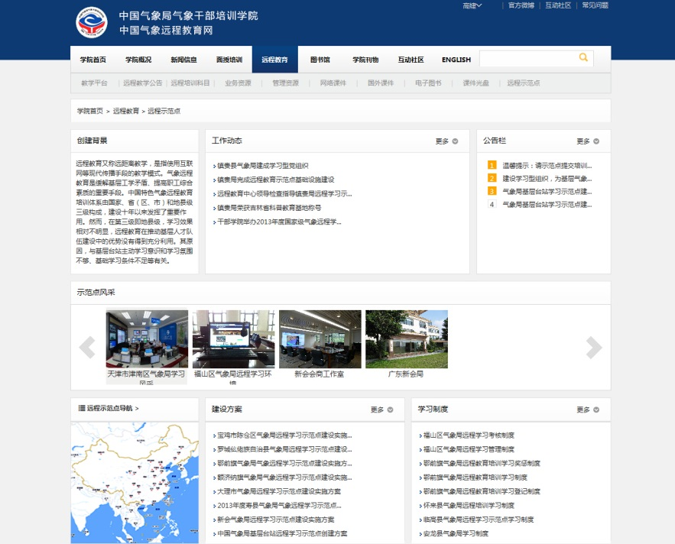
3.Present situation
Specific web page for “the Chinese grass-root station e-learning demonstration sites” （In use）
accomplished 3 major columns obviously：
Work related documents
Work related skills
Work communications
IM(QQ) and phone calls are the main tools for communication now.
Limited by energy and conditions,
Only this now
Notes:
3、目前情况：示范点专题网页
目前现状……在“示范点”专栏里面部分实现了辅导员的需求，

Slide 10
4.Future plans
Intend to create a “Specific Web Page” for counselor
Planning “Specific Web Page” for counselor
VS
Focus on practical, timely communication
Specific web page for “the Chinese grass-root station e-learning demonstration sites”
Focus on publicity, informed the full situation
Notes:
4、未来打算:促进建立（Future plans: to promote the establishment of）
Intend to create a “Specific Web Page” for counselor
两个专题的VS
目前“远程示范点”栏目……侧重宣传，通报示范点建设全貌（Focus on publicity, informed the full situation）（In use）
新拟的——“辅导员专题”……侧重在辅导员实用，及时交流（Focus on practical, timely communication）

Slide 11
Look forward to:
Thank you for your attention
To exchange the application of the “Specific Web Page” for counselor next time
Gao Jie : gaogao@cma.gov.cn
Li Hui-xin: huixinli2011@sina.com
Notes:
期待：下次交流辅导员专题的实际使用情况

