Slide 1
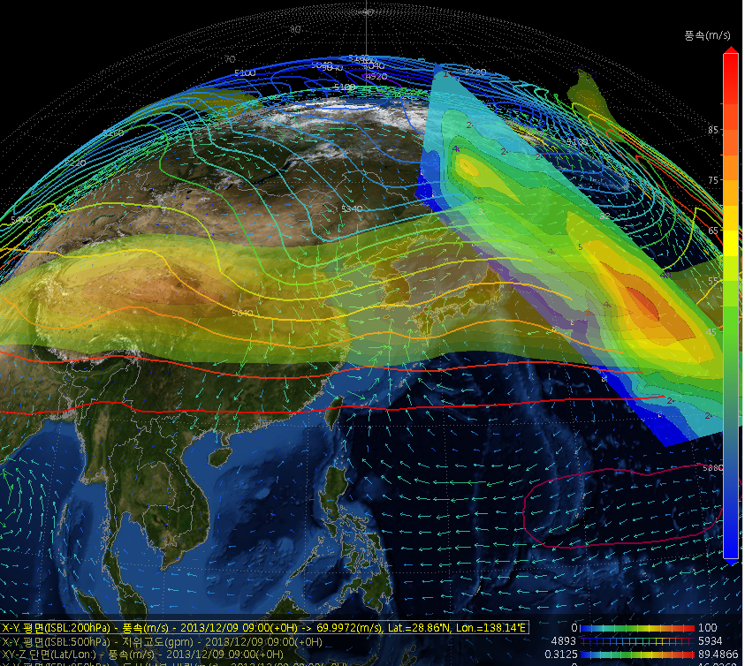
Introduction of 3D(Gloview) analysis program
Han, Sang-Un. High Impact Weather division, Forecast bureau, KMA

Slide 2
3D visualization tools
2D
GrADS, NCL, GMT, FAS, AWIPS, …
3D
VAPOR, IDV, Vis5D, VisAD, openDX, …
IDL, Matlab, vGEO, …
d3d

Slide 3
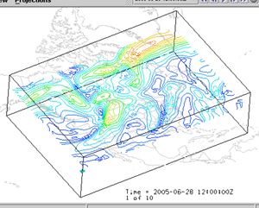
Ex) 3D visualization
Heavy rain of south coastal(7. ’09)
IDV
VAPOR
Limited use from specific model
Hard to control, resource problems
It is useful to model experts rather than forecaster
Not easy

Slide 4
Background
3-D display than 2-D is advantage to do intuitive weather analysis
Use numerical model and observation data
Easy and useful functions
Detail analysis all over the world
We have developed 3D visualization application “Gloview” for 2 years(2011~2012)

Slide 5
Introduce of Gloview
Can change the display angle and direction like ‘google earth’
Gloview is the PC-based running system
if you save model and observation data through FTP, you can perform analysis you need

Slide 6
contents
Numerical model : unified model(global, region, local) , ECMWF
formation : isobaric field(3D), isentropic field(3D)
Observation data : GTS ground, upper level
satellite : infrared, water vapor, visible, etc. total 15
Typhoon information : past, now, prediction
Skew T log P : GTS, model points
Trajectory : isobaric field, isentropic field
2D plain, vector, vertical section
Derived variable : vorticity, div&convergence, etc.

Slide 7
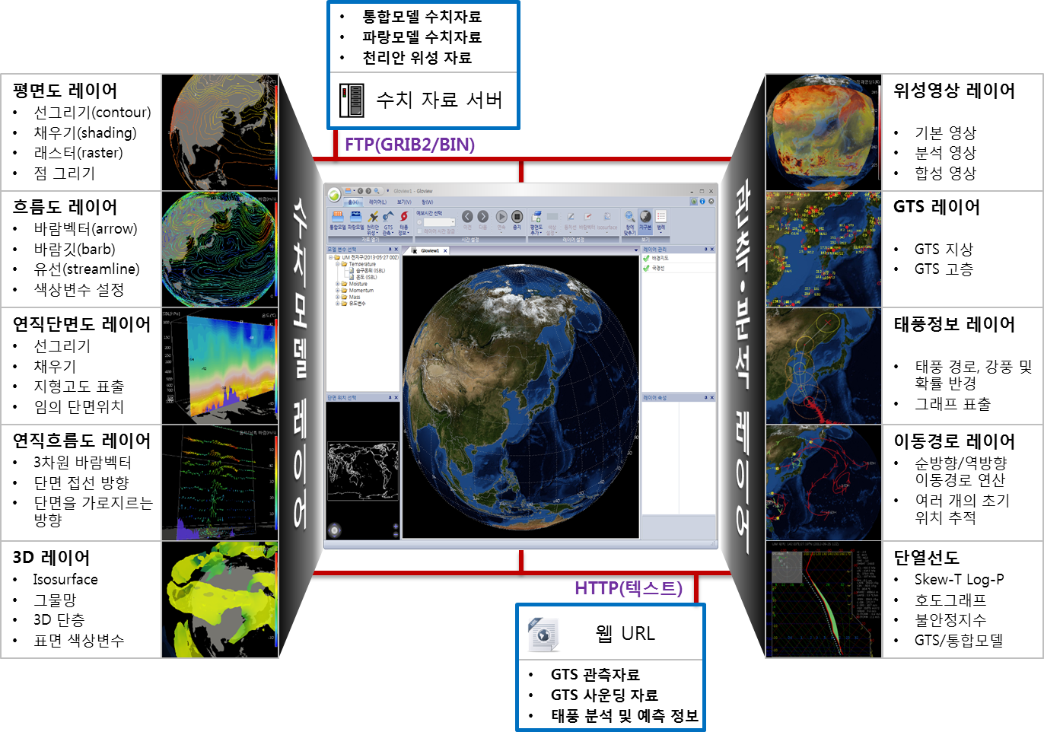
Layer “Gloview”
UM model
Ecmwf model
Model data layer
observation data layer
Plain layer
COMIS
streamline layer
Cross section layer
URL

Slide 8
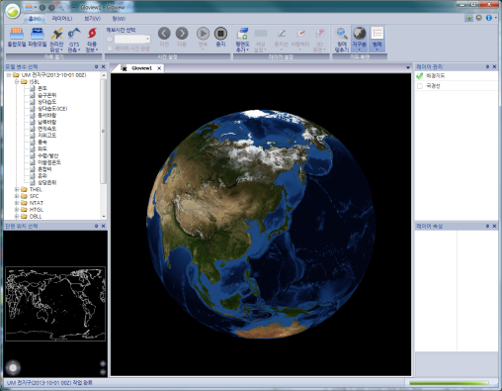
Gloview display
satellite
typhoon
Background map
route
model
(global,
Region,
local)
Vertical section
GTS
(ground
Upper level)
Plane field
Wind vector
Wave(global, res지역)
Iso surface
Stream line

Slide 9
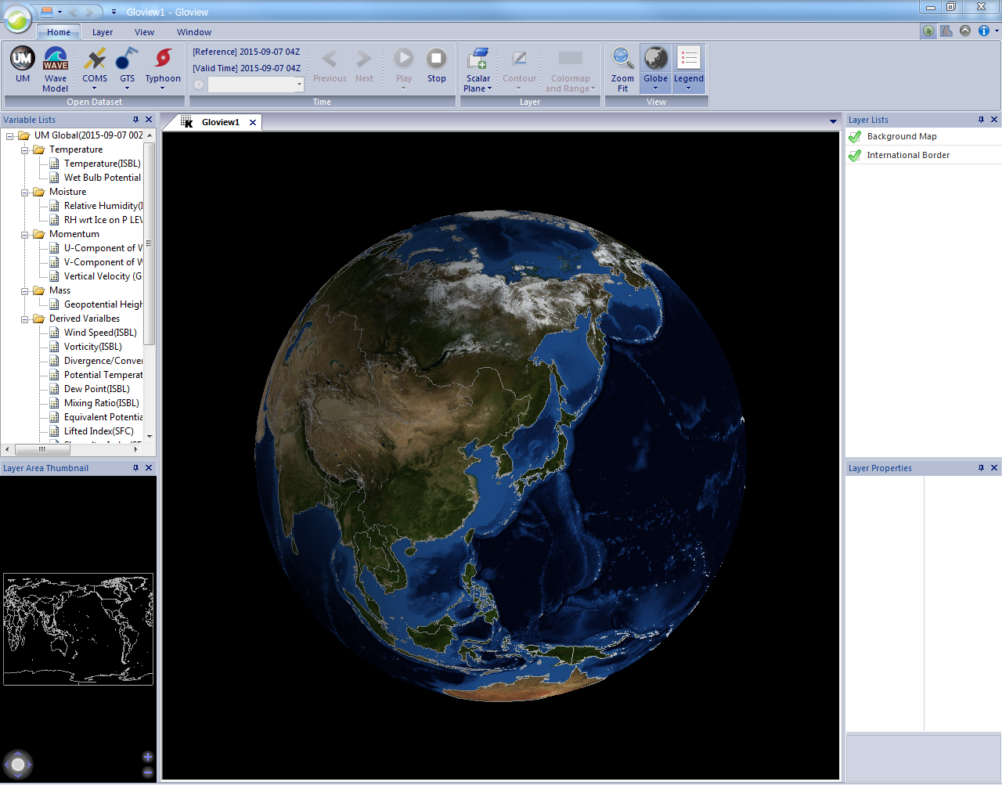
Use all elements of UM model

Slide 10
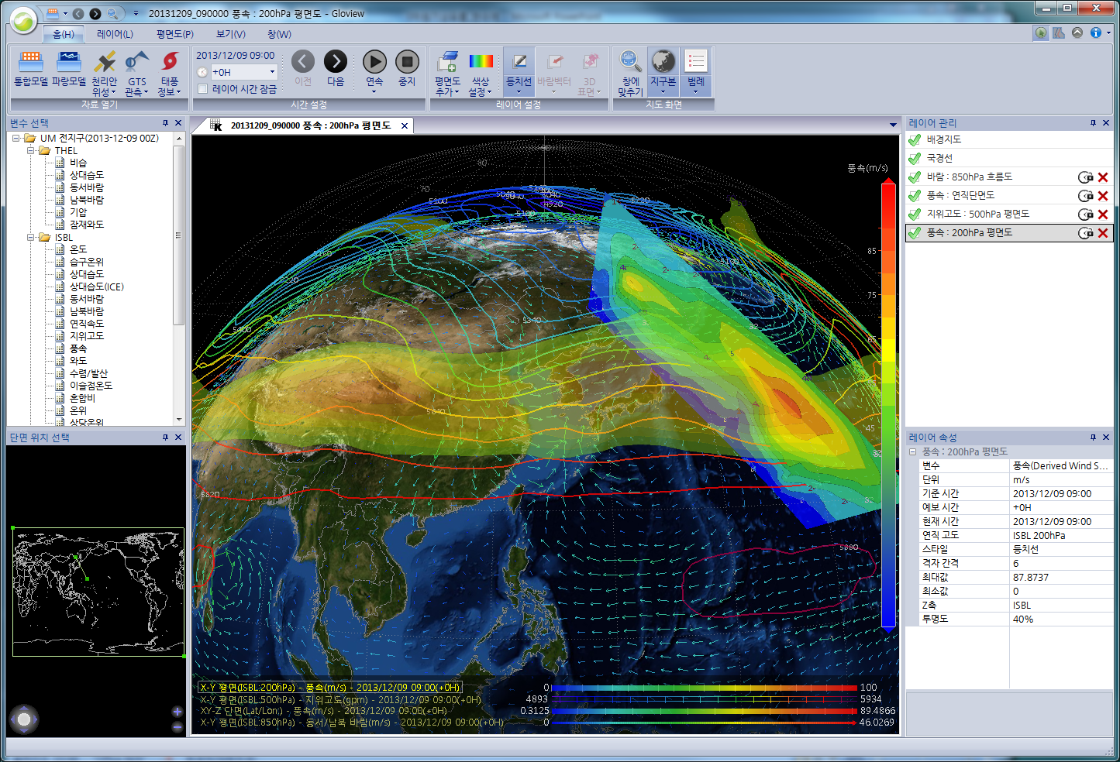
Composition of menu
① Main menu
④main display
⑤ layer management
② variable
⑥ layer correction
③ position of cross section

Slide 11
Background maps
- Total 38 global maps
color designation between
sea and continent

Slide 12
Major functions

Slide 13
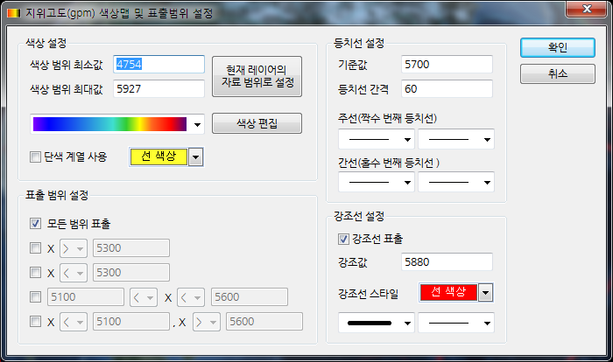
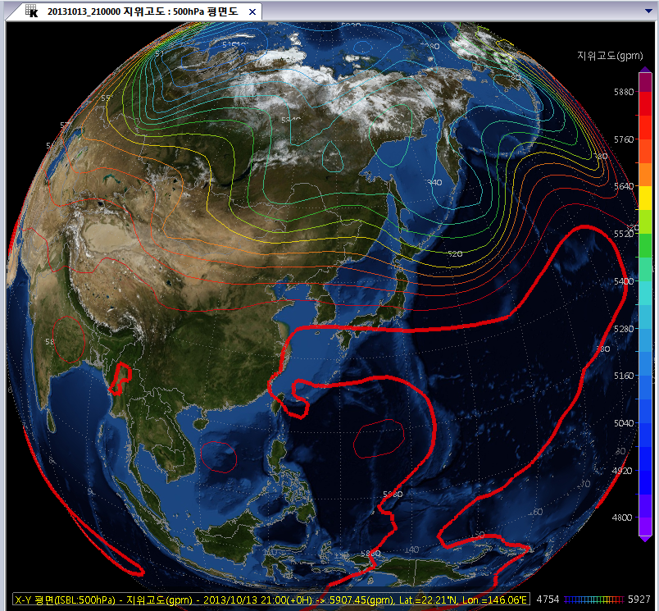
Plain field(emphasis of geopotential height line)
500 hPa field
60gpm interval
5880gpm emphasis

Slide 14
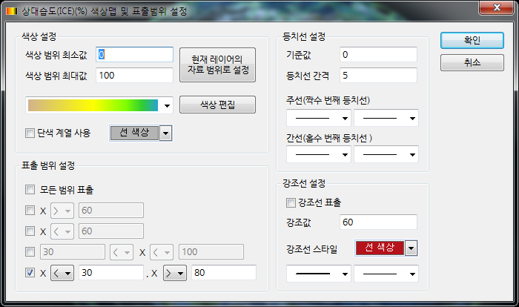
Plain display (range control)
850 hPa RH field
0~100, 5% interval
RH<30 and RH>80
Setting as 5 ranges

Slide 15
Z axis setting
Z : SFC
Z : significant wave height
To see stereo effect
SFC → m(WVHGT)

Slide 16
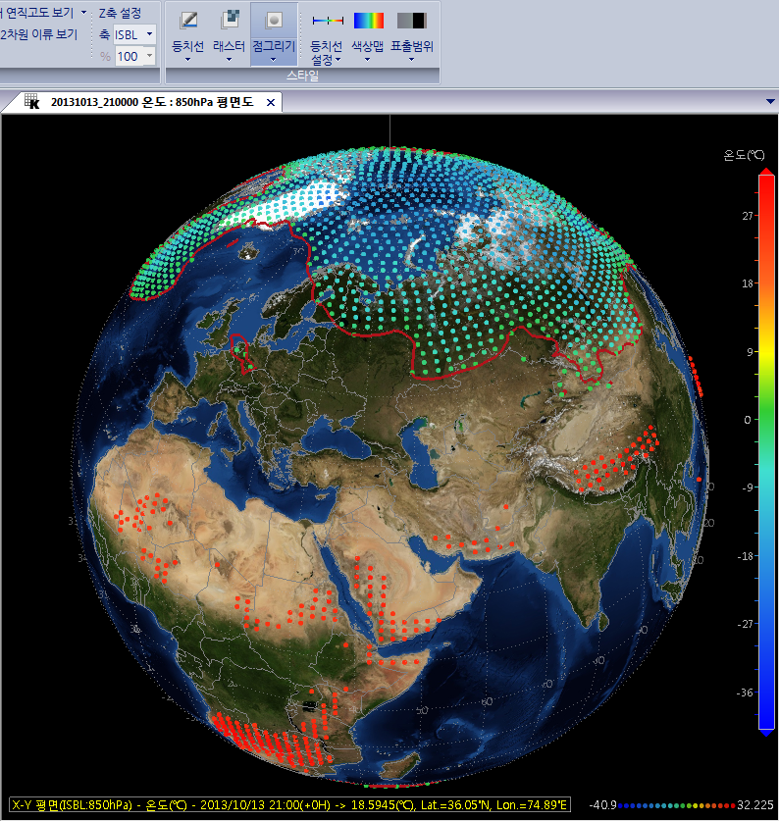
Draw point
850hPa temperature
Below 0℃
More than 25 ℃
Emphasis of 0 ℃

Slide 17
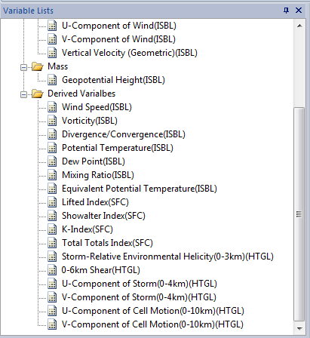
second derived variables & unit transformation
Vorticity, divergence, etc.
K-index, etc. instability index
Unit transformation (℃ ↔ K, Pa ↔ hPa)

Slide 18
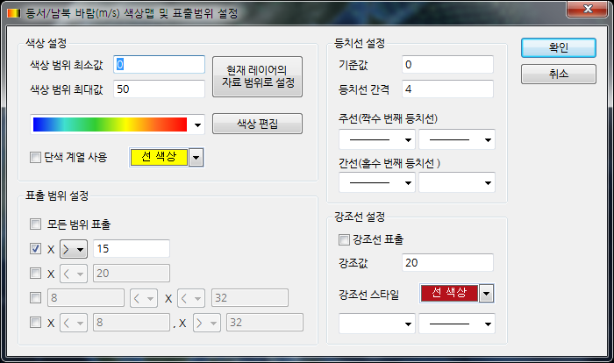
Wind vector
More than 15m/s
vector, arrow, streamline
Add horizontal and zonal wind
Setting of display range

Slide 19
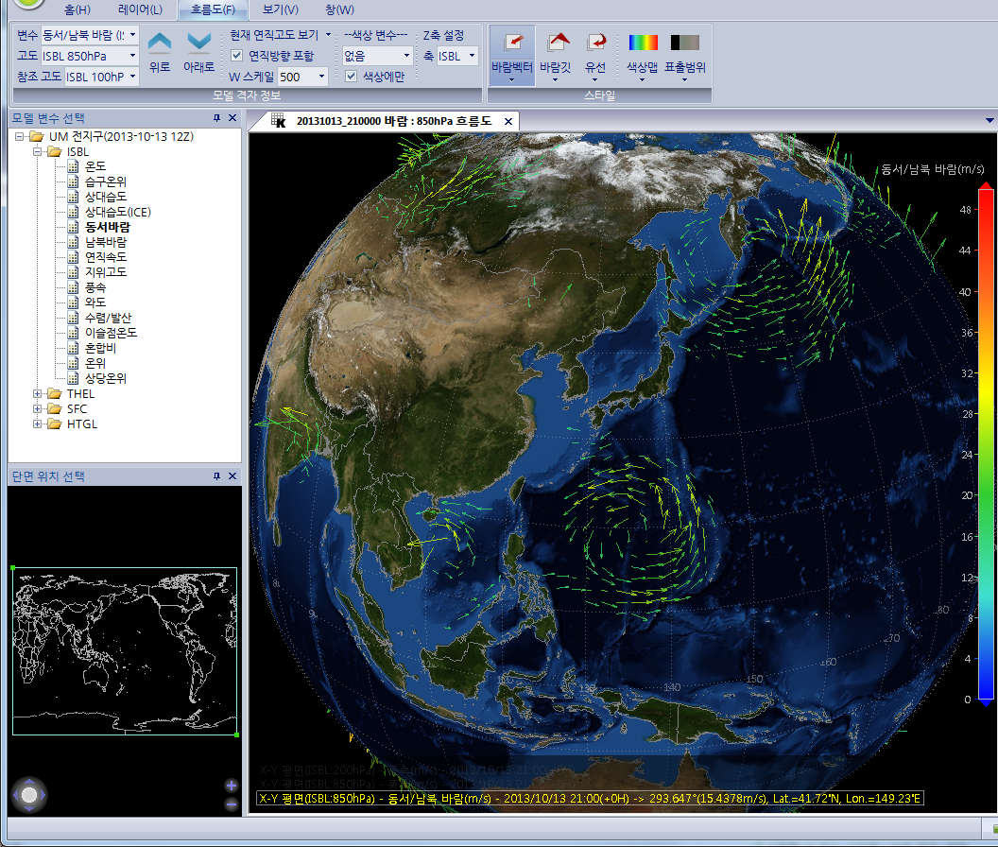
Wind vector : vertical direction
Control W scale

Slide 20
Cross section
Solid line
Shading
Draw dot

Slide 21
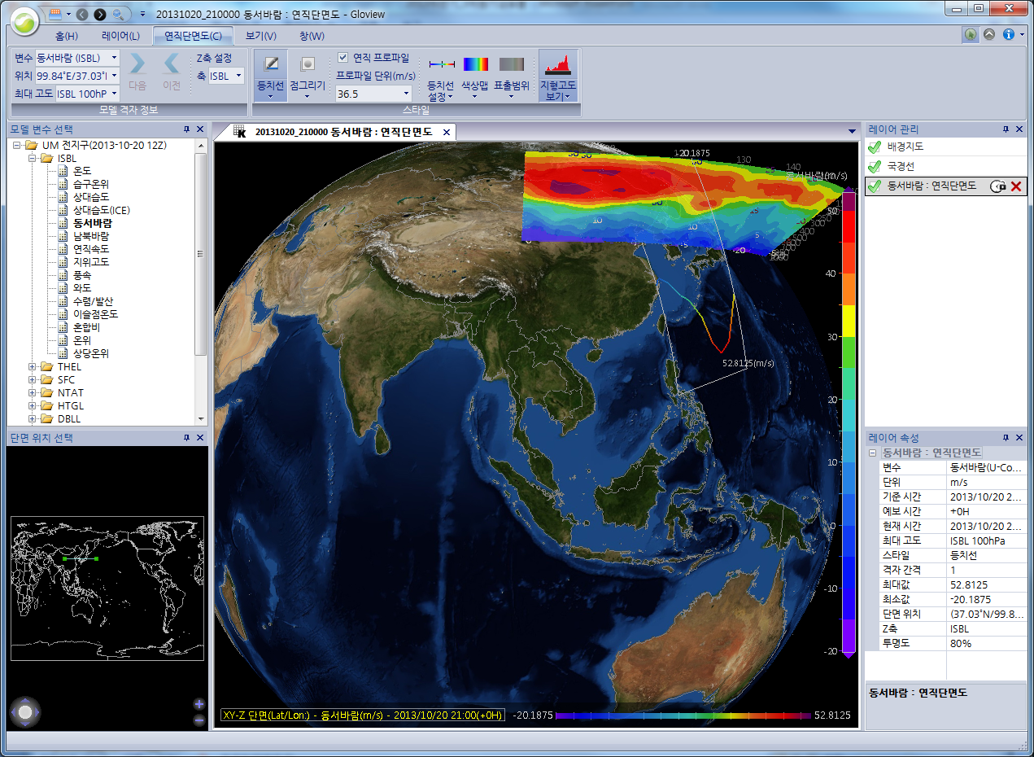
Cross section : vertical profile
Vertical profile

Slide 22
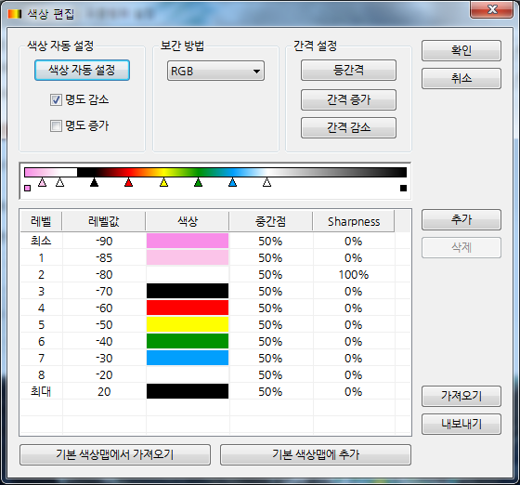
Edit color
Various color bar
Possible user’s setting

Slide 23
ex 1> typhoon
Rising area
Sinking area

Slide 24
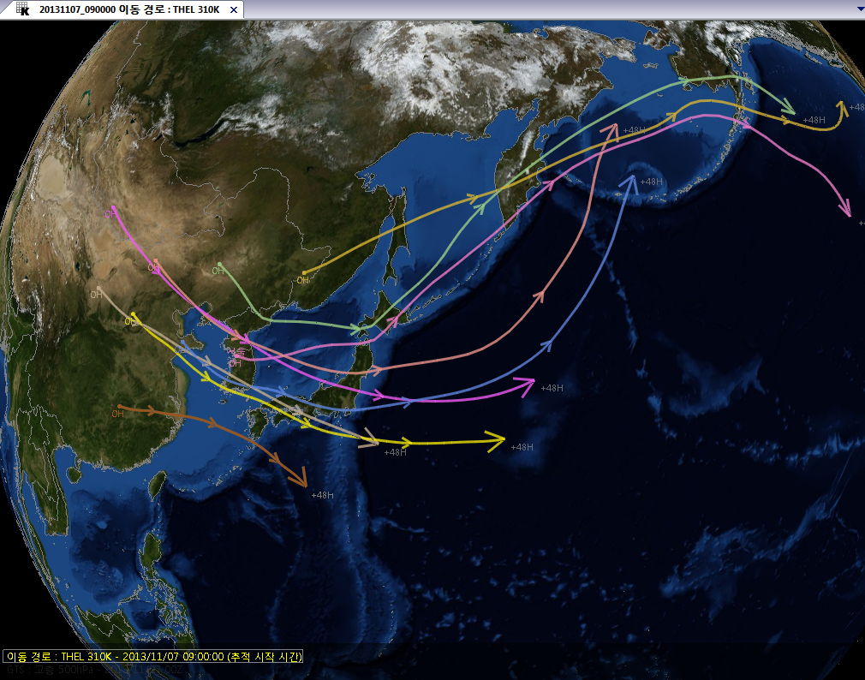
ex 2> trajectory (315K)
Foreward/Backward Trajectory

Slide 25
ex 3> Isentropic field(310K pressure+wind+specific humidity)

Slide 26
ex 4> Iso-Surface (1.5PVU+200hPa wind)
More than 1.5PVU
1.5PVU + 200hPa wind

Slide 27
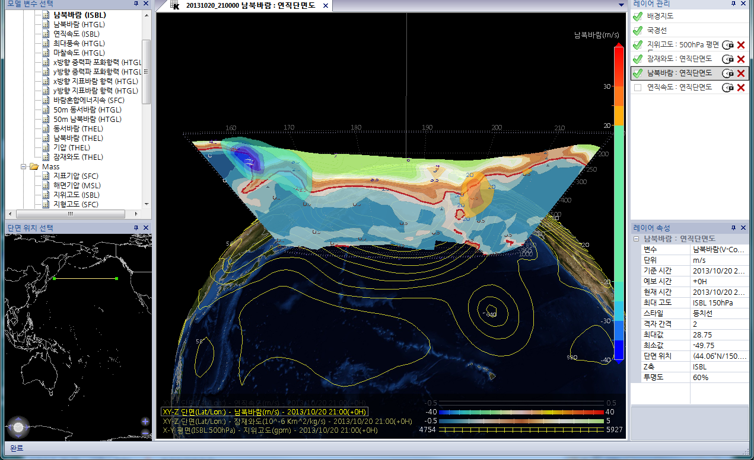
Potential vorticity + Jet core position
v<-20m/s
v>20m/s
1.5PVU

Slide 28
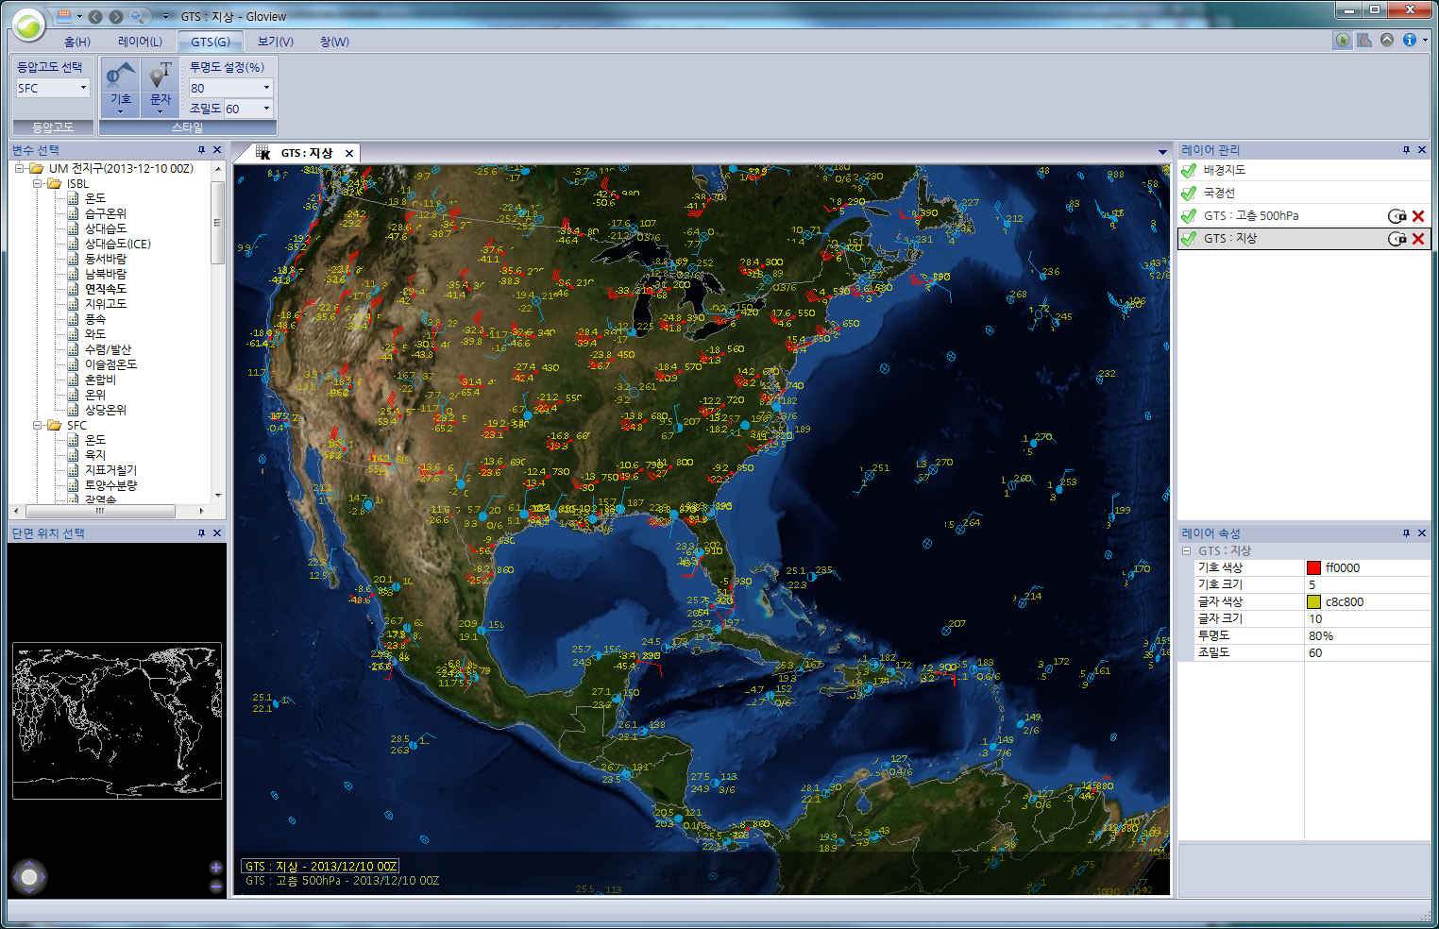
GTS display

Slide 29
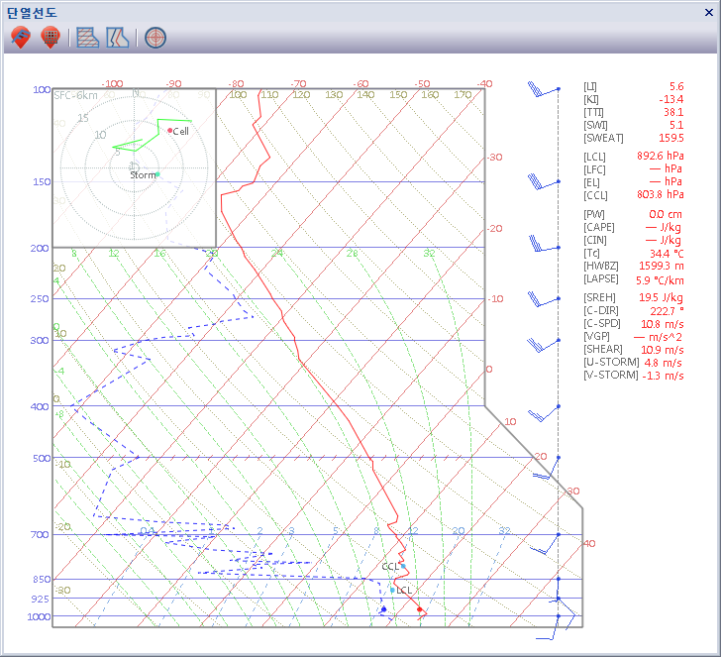
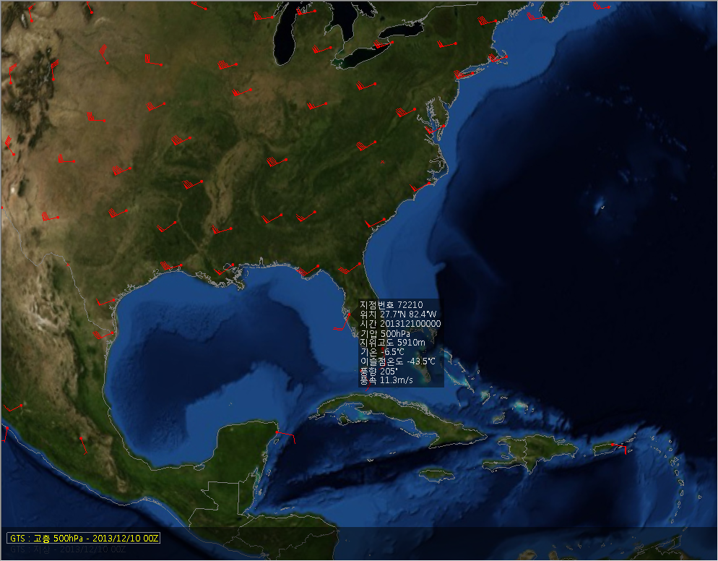
Skew T log P display

Slide 30
Distance learning

Slide 31
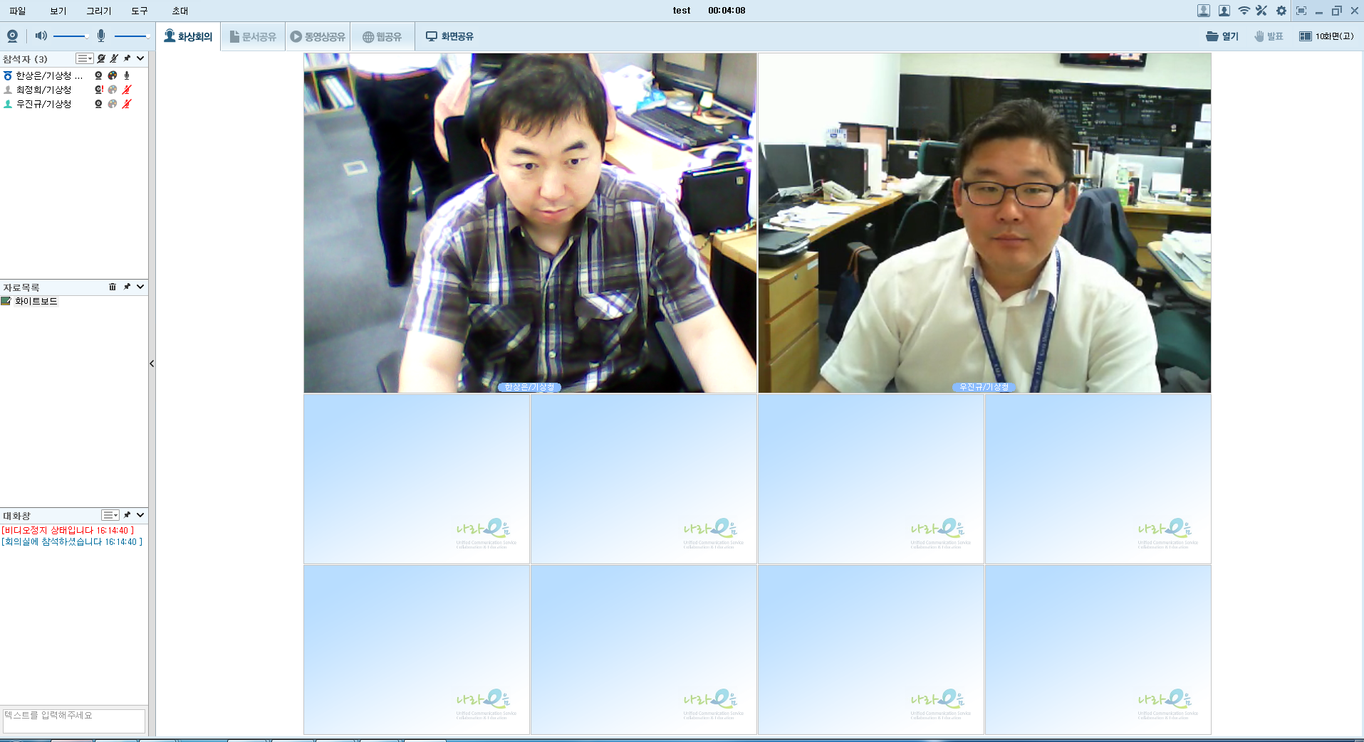
Distance learning
Korean government make it to reduce time of gathering education
Our division are doing distance learning more than 2 times per month
Use local network host
All officials can use this without the consideration of government department

Slide 32
Distance learning - functions
Concurrent connection is more than 100 persons
Document sharing function
Movie file sharing function
Screen sharing function
Various drawing tools
Recording function,
after uploading movie file

Slide 33
Distance learning - topic
Learning topic
- analysis of HIW case study
- introduce on the application method of new systems
utilization method of programs
meteorological information like theoretical principle

Slide 34
Thank you

