Slide 1
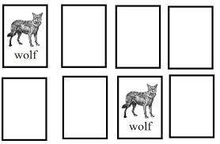
Tailoring of a competency-based satellite course
Ivan Smiljanic
CALMet, Seoul, 20150909

Slide 2
/ first, one question …/

Slide 3
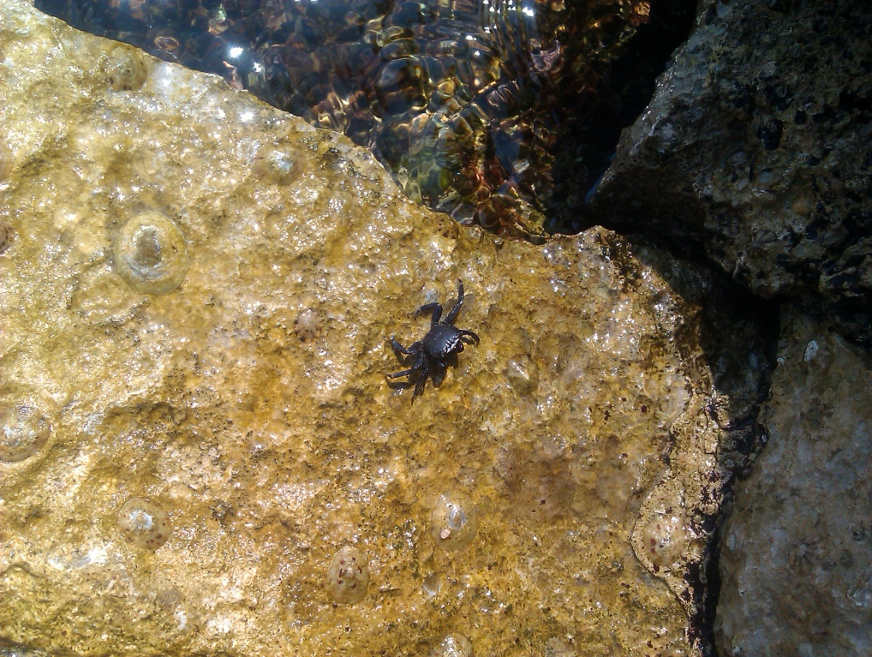
/ first, one question …/
> connection to competency-based course?

Slide 4
/ first, one question …/
> not much!

Slide 5
/ from the scratch /
> start from the basics and then develop…
EUMeTrain Basic Satellite Meteorology Course(s)
Session 1: Satellites and Orbits – from Past to Current Satellites
Session 2: Instruments onboard Polar and Geostat. Satellites
Session 3: Principles of Radiation and Remote Sensing
Session 4: IR Channels
Session 5: WV Channels
...
> university-like approach (not bad in the right time frame)

Slide 6
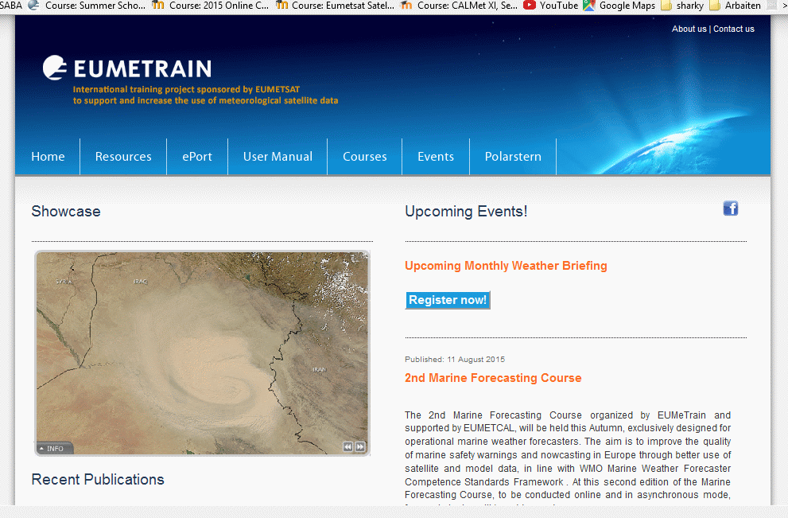
/ from the scratch /
> start from the basics and then develop…
EUMeTrain Basic Satellite Meteorology Course(s)
Session 1: Satellites and Orbits – from Past to Current Satellites
Session 2: Instruments onboard Polar and Geostat. Satellites
Session 3: Principles of Radiation and Remote Sensing
Session 4: IR Channels
Session 5: WV Channels
...

Slide 7
/ from the scratch /
> start from the basics and then develop…
EUMeTrain Basic Satellite Meteorology Course(s)
Session 1: Satellites and Orbits – from Past to Current Satellites
Session 2: Instruments onboard Polar and Geostat. Satellites
Session 3: Principles of Radiation and Remote Sensing
Session 4: IR Channels
Session 5: WV Channels
...
> university-like approach (not bad in the right time frame)

Slide 8
/ blame the structure /
> new TDP was written for the course in within the WMO ‘Train the Trainer’ online course (Carla B. and Ivan S.)
> during classroom phase we have heard about the document ‘Satellite Skills and Knowledge for Meteorologist Forecasters’ that is still in beta phase
> new TDP was old...

Slide 9
/ ‘competency document’/
Satellite interpretation skills:
Interpret satellite imagery data and derived fields to support analysis, diagnosis, prognosis, and forecasting.
Elements:
1. Identify surface features
2. Identify cloud types and their characteristics
3. Identify and interpret broadscale, synoptic and mesoscale systems
4. Identify and interpret atmospheric phenomena
5. Interpret derived fields
6. Identify and interpret oceanic features and systems

Slide 10
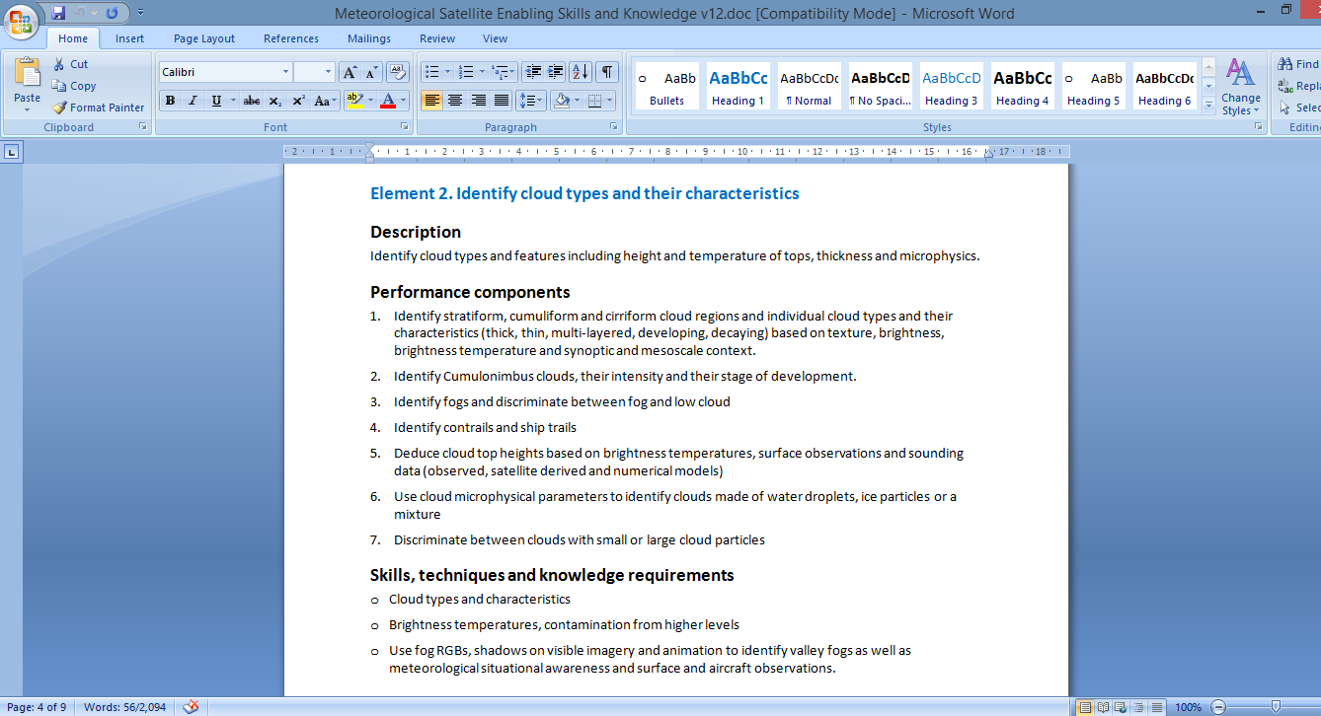
/ ‘competency document’/
Satellite interpretation skills:
Interpret satellite imagery data and derived fields to support analysis, diagnosis, prognosis, and forecasting.
Elements:
1. Identify surface features
2. Identify cloud types and their characteristics
3. Identify and interpret broadscale, synoptic and mesoscale systems
4. Identify and interpret atmospheric phenomena
5. Interpret derived fields
6. Identify and interpret oceanic features and systems

Slide 11
/ outcome /
= new structure + new approach

Slide 12
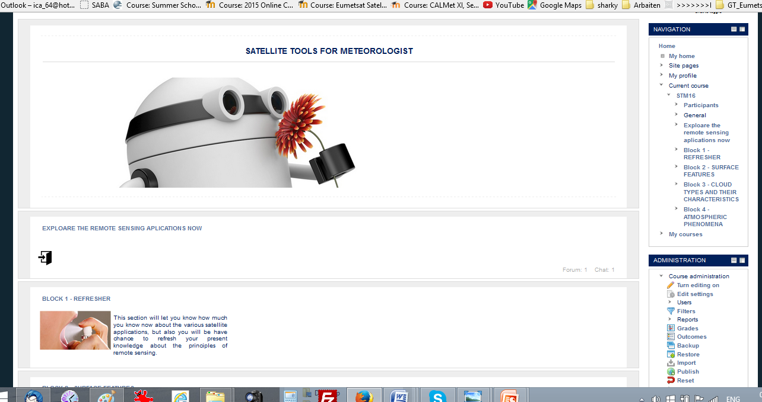
/ satellite tools for meteorologist /
> new TDP was written for the course in within the WMO ‘Train the Trainer’ online course (Carla B. and Ivan S.)
> during classroom phase we have heard about the document ‘Satellite Skills and Knowledge for Meteorologist Forecasters’ that is still in beta phase
> new TDP was old...

Slide 13
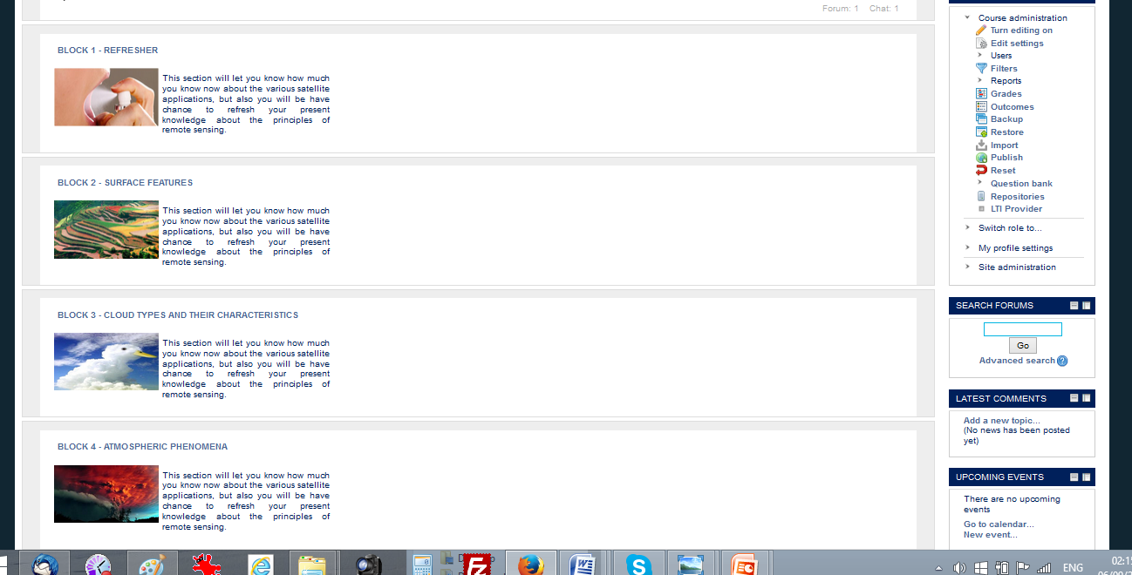
/ satellite tools for meteorologist /
> new TDP was written for the course in within the WMO ‘Train the Trainer’ online course (Carla B. and Ivan S.)
> during classroom phase we have heard about the document ‘Satellite Skills and Knowledge for Meteorologist Forecasters’ that is still in beta phase
> new TDP was old...

Slide 14
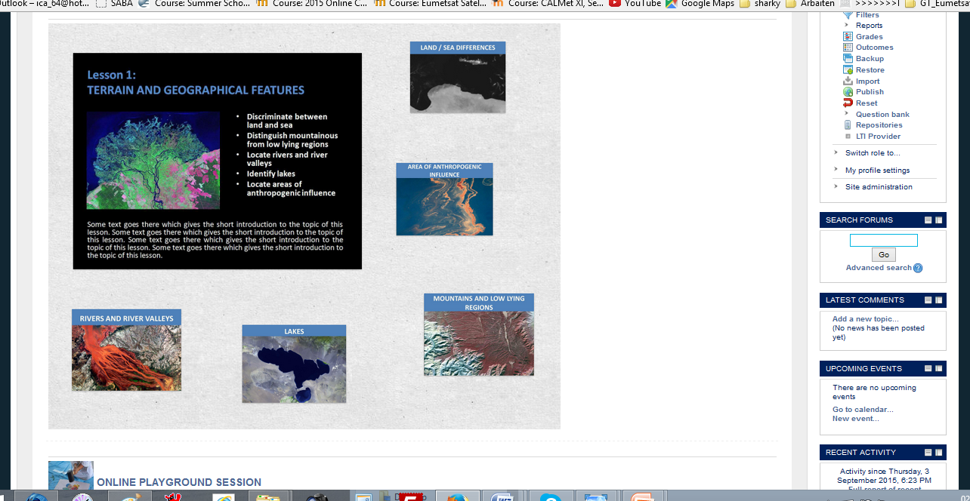
/ satellite tools for meteorologist /
> new TDP was written for the course in within the WMO ‘Train the Trainer’ online course (Carla B. and Ivan S.)
> during classroom phase we have heard about the document ‘Satellite Skills and Knowledge for Meteorologist Forecasters’ that is still in beta phase
> new TDP was old...

Slide 15
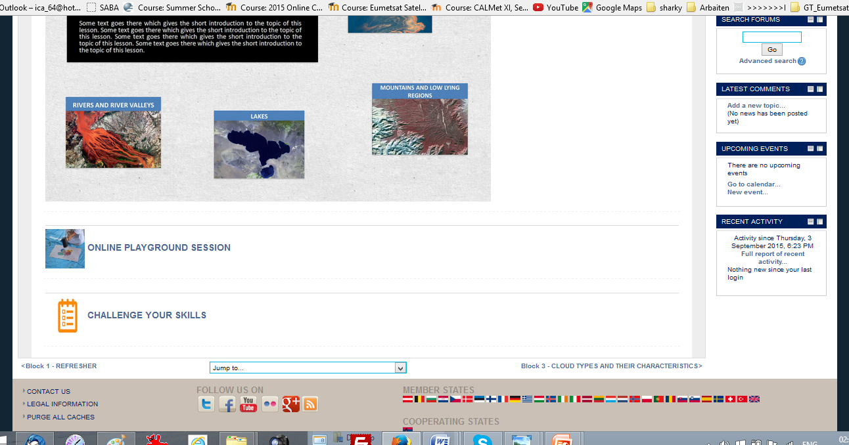
/ satellite tools for meteorologist /
> new TDP was written for the course in within the WMO ‘Train the Trainer’ online course (Carla B. and Ivan S.)
> during classroom phase we have heard about the document ‘Satellite Skills and Knowledge for Meteorologist Forecasters’ that is still in beta phase
> new TDP was old...

Slide 16
/ satellite tools for meteorologist /
> new TDP was written for the course in within the WMO ‘Train the Trainer’ online course (Carla B. and Ivan S.)
> during classroom phase we have heard about the document ‘Satellite Skills and Knowledge for Meteorologist Forecasters’ that is still in beta phase
> new TDP was old...

Slide 17
/ satellite tools for meteorologist /
“Just invoking them in a course description does not magically create competency-based instruction. Implementing competency-based instruction impacts every aspect of the training process, from how we identify needs, to how we determine the intended learning outcomes, how we choose the learning activities, and particularly how we assess and document training completion.”
- P. P.

Slide 18
/ gomawo /

