Slide 1

of "Small-world effect" in Met. education and training
The characteristics and enlightenments
JI Wenbin, HOU Jinfang
China Meteorological Administration Training Centre (CMATC)
Sep. 2015
Notes:
005468066583
999-9684776407

Slide 2
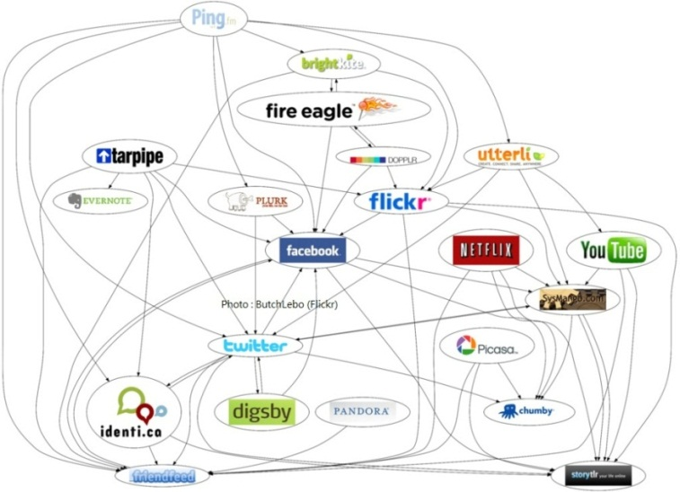
Background
Online education & training scale is expanding, the number of participants in Global Campus will be huge.
Knowledge & experience, learning interest and needs of participants are complex.
Communication and exchange medias are diversified.
What are the network structure features of large-scale
education & training?
How to deliver the appropriate teaching resources to learners?

Slide 3
content
Small-world effect and its features
Regularity in complex education & training
Network analysis of education & training
Making the full benefit of Global Campus
Challenges and Discussions
mainly focus on:
Informal & semi-formal, Learner-centered, e-learning

Slide 4
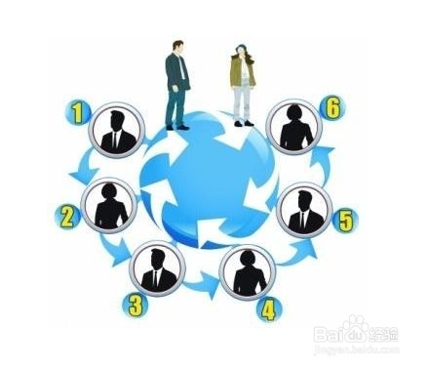
Small-world effect and its features
The experimental studies on Small-world effect (the Six Degrees of Separation) shows
Describes the real network – Complex Network
a Universal Phenomenon, covers all areas of society & nature
Complex networks can be described with a common model – Network Graph
Two people all over the world randomly, can establish their contacts through only several (about 5) intermediates.

Slide 5
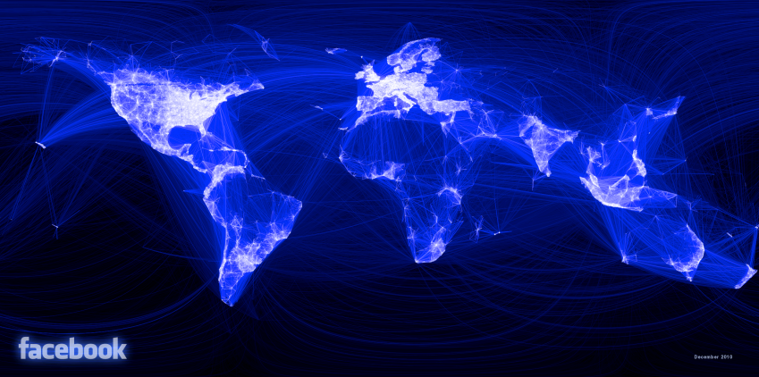
Some Typical Examples
Mapping Facebook Friendships
Author(s): Paul Butler
Institution: Facebook
Year: 2010
URL: http://on.fb.me/hy6dmb
Notes:
Mapping Facebook Friendships Author(s):
Paul Butler Institution:
Facebook Year:
2010 URL:
http://on.fb.me/hy6dmb
Project Description:
Developed by Facebook intern Paul Butler this visualization maps the connections of 10 million Facebook users spread across the globe. Butler took a sample of 10 million pairs of friends from Facebook's Apache Hive database, Facebook's warehouse containing the social graph of 500 million people, and matched them with the corresponding coordinates of each city, connecting them with blue lines. As Butler explains: "Visualizing data is like photography. Instead of starting with a blank canvas, you manipulate the lens used to present the data from a certain angle. (...) What really struck me, though, was knowing that the lines didn't represent coasts or rivers or political borders, but real human relationships. Each line might represent a friendship made while travelling, a family member abroad, or an old college friend pulled away by the various forces of life."

Slide 6
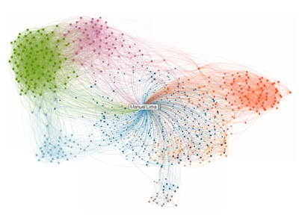
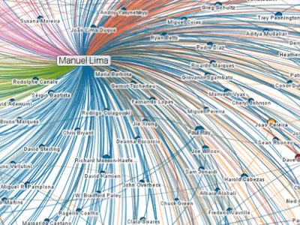
Some Typical Examples
Linkedin In Maps
Author(s): Linkedin Labs
Institution: Linkedin
Year: 2011
URL: http://inmaps.linkedinlabs.com/
Notes:
Linkedin InMaps
Author(s):
Linkedin Labs Institution:
Linkedin Year:
2011 URL:
http://inmaps.linkedinlabs.com/ Project Description:
Developed by Linkedin Labs, InMaps provides a visual representation of your professional Linkedin universe. This appealing visualization tool allows anyone with a Linkedin account to map their professional ties and is a great way to understand the relationship patterns between you and your entire set of LinkedIn connections. The map is color-coded to represent different affiliations or groups from your professional career, such as your previous employer, college classmates, or industries you've worked in. Bigger names represent people who are the most connected within that specific cluster or group. When you click on a contact within a circle you'll see their profile pop up on the right, as well as lines highlighting how they're connected to your connections.

Slide 7
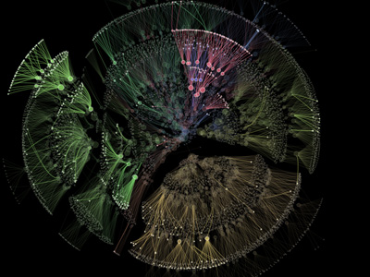
Some Typical Examples
Organic Organization Chart
Author(s): Justin Matejka
Institution: Autodesk
Year: 2013
URL: http://www.autodeskresearch.com/projects/orgorgchart
Notes:
Organic Organization ChartAuthor(s):
Justin MatejkaInstitution:
AutodeskYear:
2013URL:
http://www.autodeskresearch.com/projects/orgorgchartProject Description:
The OrgOrg chart visualizes the evolution of a company's structure over time. The organizational hierarchy was recorded every day between May 2007 and June 2011, constructed as a tree. The circles represent employees, and edges represent connections between employees and their managers. The size of the circle corresponds to the number of employees he or she supervises. The organization can change day-to-day depending on employees leaving, joining, and changing managers. The transitions are depicted an animated in a dynamic video.

Slide 8
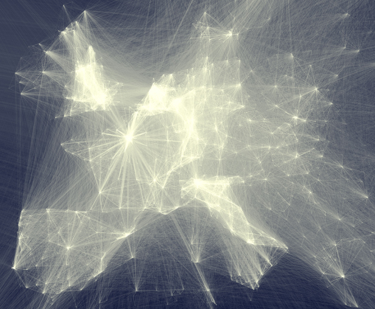
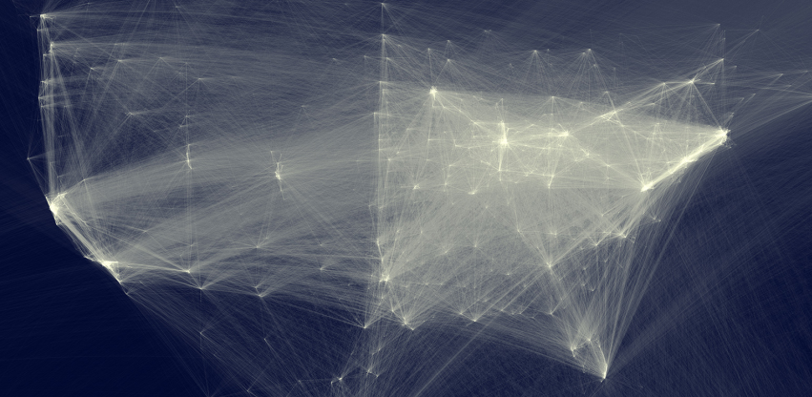
Map of Scientific Collaborations
Author(s): Olivier H. Beauchesne
Institution: Science-Metrix
Year: 2011
URL: http://bit.ly/e9ekP2
Some Typical Examples
See more pics at http://www.visualcomplexity.com/vc/
Notes:
Map of Scientific Collaborations Author(s):
Olivier H. Beauchesne Institution:
Science-Metrix Year:
2011 URL:
http://bit.ly/e9ekP2 Project Description:
Using data from Science-Metrix, a bibliometric consulting firm that licenses data from journal aggregators like Elsevier?s Scopus and Thomson Reuter?s Web of Science, Olivier Beauchesne build an intricate map of scientific collaborations between cities all over the world, between 2005 and 2009. As Olivier explains: "...if a UCLA researcher published a paper with a colleague at the University of Tokyo, this would create an instance of collaboration between Los Angeles and Tokyo. The result of this process is a very long list of city pairs, like Los Angeles-Tokyo, and the number of instances of scientific collaboration between them."
The brightness of the lines is a function of the logarithm of the number of collaborations betweena pair of cities and the logarithm of the distance between those same two cities.
You can also see a high-resolution version of the map.

Slide 9
Small-world effect and its features
features of most large complex networks
Small-world features:
Scale-free Degree Distribution feature:
Small Average Distance (the number of links along the shortest path of network connection)
Large Clustering Coefficient (Explained as the ratio of your friends are still friends themselves)
The distribution of node degrees (the number of node’s links can be characterized by a power law distribution function)

Slide 10
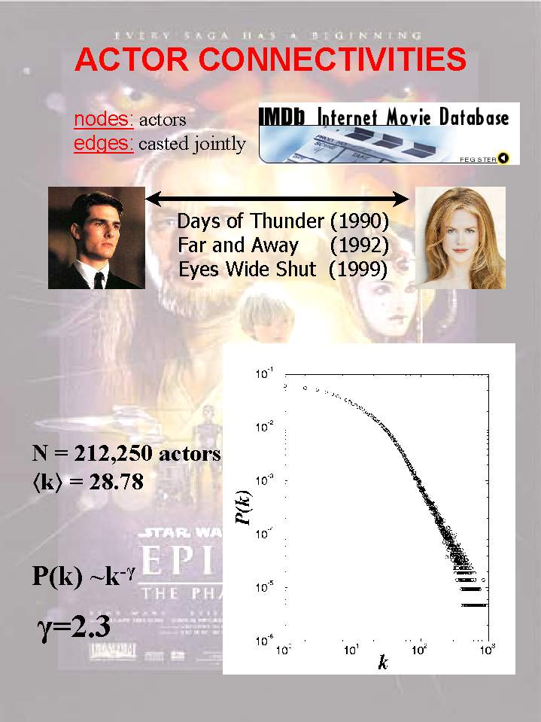
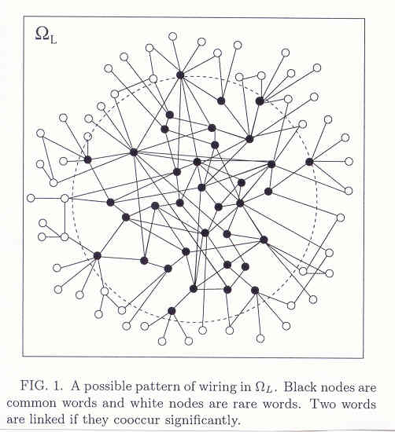
Small-world effect and its features
power law: a few nodes may have many links but most nodes have very few links
Example
Words in Human Language Interact
Human brain can memorize about
10^{4} ~10^{5} words. Average distance between two words is 2~3(Romaine, 1992)

Slide 11
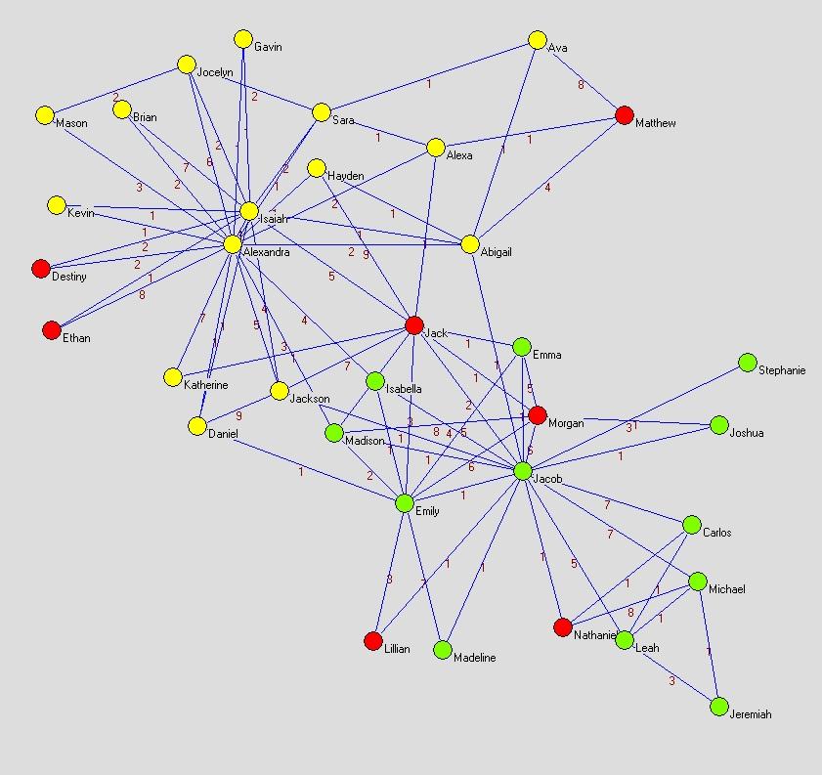
Regularity in complex education & training
Abstract modeling of education & training
Nodes (learners, managers, trainers, etc.) establish positive relations as edges.
Example
A fictional school ‘Springfield’
Nodes 34, edges 78, cluster 3
The network of education & training is mainly based on nodes and edges, most of edges are short-ranged.
Simulation
Notes:
but also has a small part of the long history of the establishment of the association.

Slide 12
Regularity in complex education & training
Nodes have their different attributions
Education & training community formed by a group of nodes sharing some common attributions as a virtual autonomous domain.
LMS (with interaction, SNS supported), e-learning (synchronous & asynchronous) are important tools for edge building.
When education & training occurs, information will be delivered through network edges.
interest
profession
position
node

Slide 13
Regularity in complex education & training
Structural features of education & training network
Differences of node abilities
Robust but vulnerable
Although the total number of nodes in the complex network is large, its ‘core’ nodes number is quite small relatively.
If 80% of nodes are removed randomly, the entire network running will not be affected.
If a small amount of core nodes leave (5%) , the whole network will be paralyzed.

Slide 14
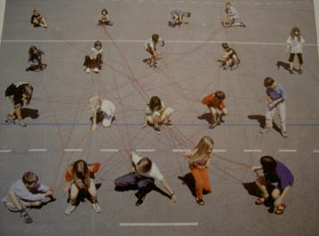
Regularity in complex education & training
Information passes quickly
Resource delivery is effective
When newly released courseware be studied and shared by a certain number of participants (reaching the network’s threshold), it will soon be popular among nearly all staff of the network.
Resources are closer to learners through sharing in communities. Useful resources will sooner be popularized.

Slide 15
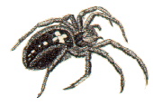
Network analysis of education & training
When manually calculate, plot, and do research on Complex Network (education & training) with naked eyes:
Visualize massive data into images, inspire our image thinking, and find out the hidden rules
Pajek (Open & Non-commercial Tool)
not easy
who are the most important participants?
Which are the shortest paths to build relations?
What does the distribution of communities like?...
By Vladimir Batagelj & Andrej Mrvar
more at http://vlado.fmf.uni-lj.si/pub/networks/pajek/
What can we do with the tool?

Slide 16
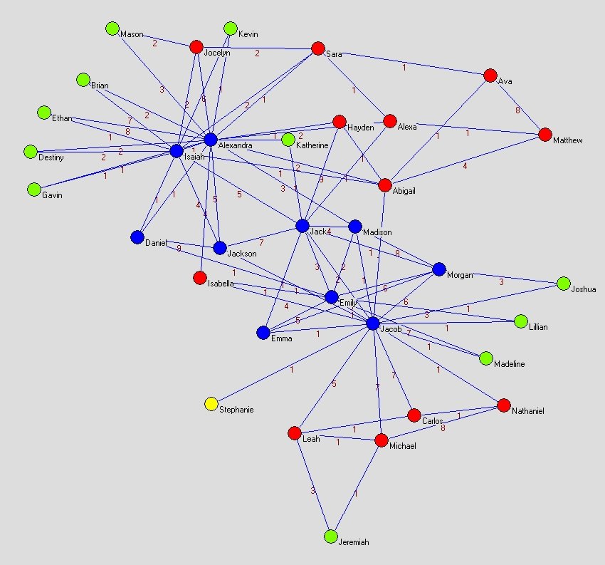
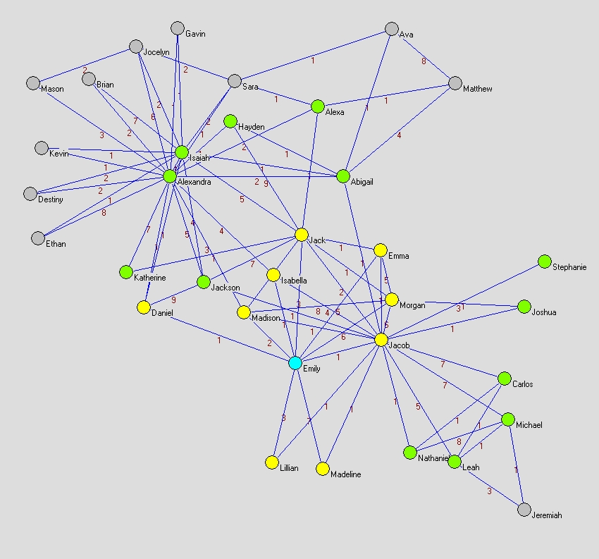
Network analysis of education & training
Example
Experiment with ‘Springfield’ Network
>2-steps neighbors
3-cores (>=3 edges)
4-cores (>=4 edges)
2-steps neighbors
by edge counts
1-step neighbors
2-cores (>=2 edges)
Emily her self
1-cores (>=1 edge)
X-cores in network
Emily’s neighbors

Slide 17
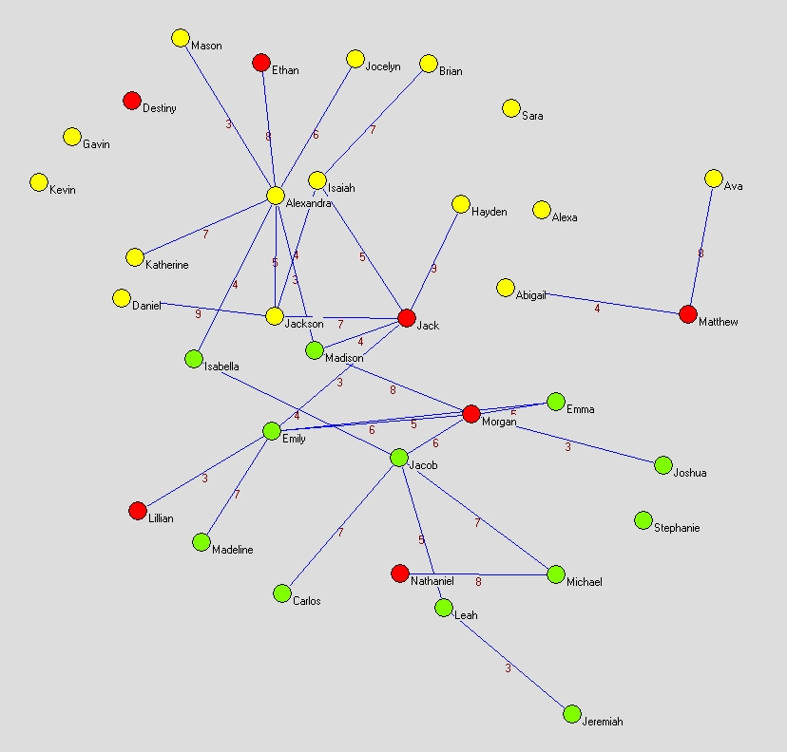
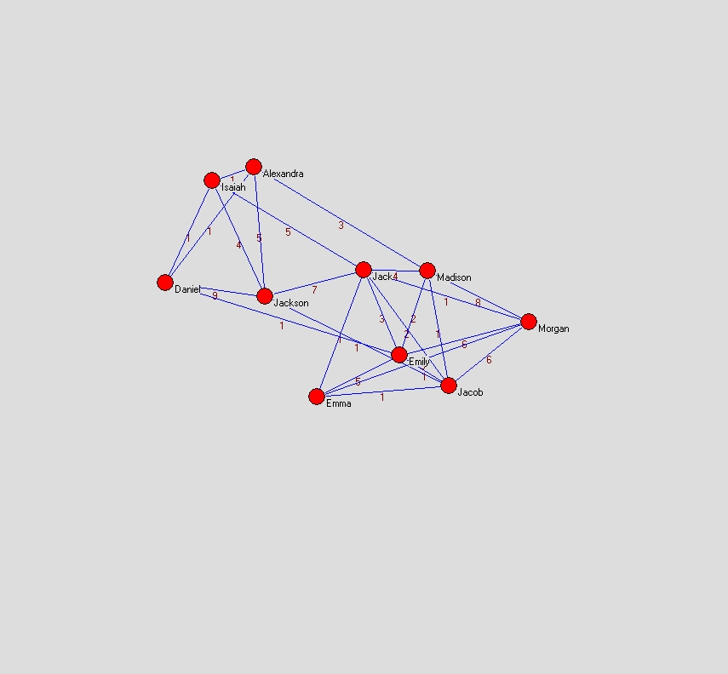
Network analysis of education & training
Network Reduction and backbone show
Degree Reduction: to 4 at least
4-cores shows
Line Reduction:
value lower than 3

Slide 18
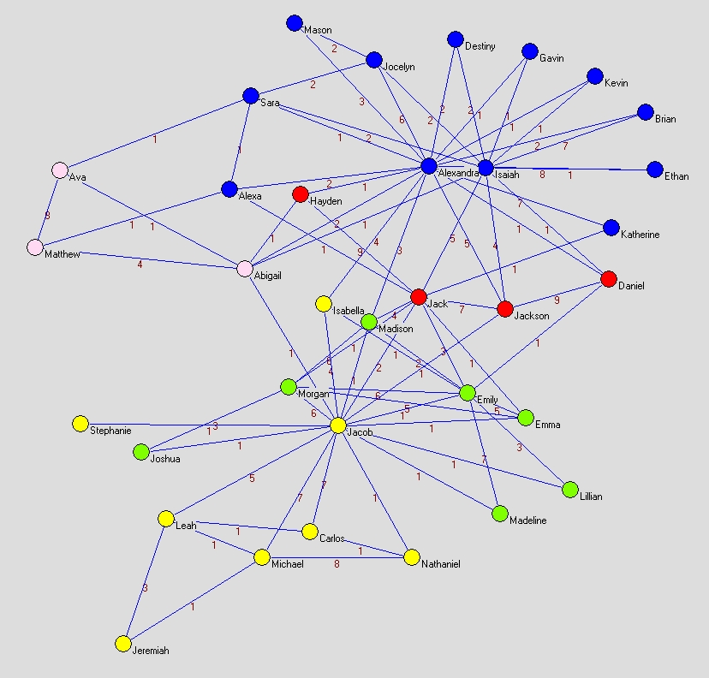
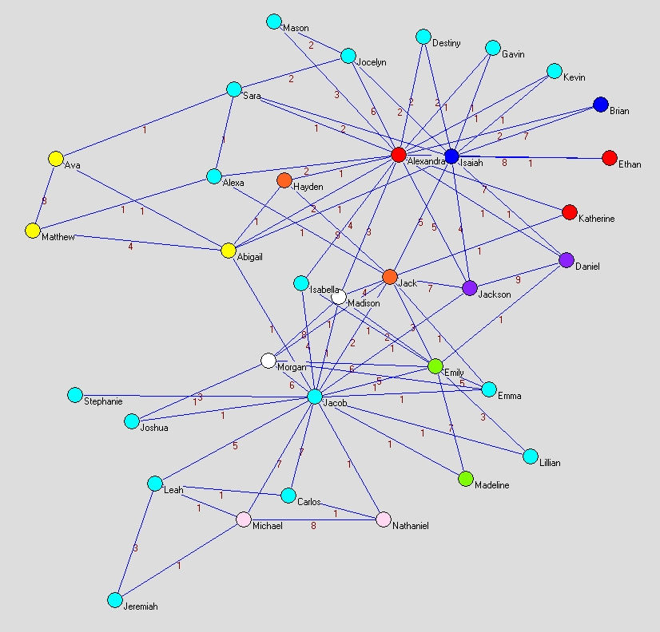
Network analysis of education & training
organizations & communities relations show
5 communities Identified showed by colors
8 islands Identified by edge weight

Slide 19
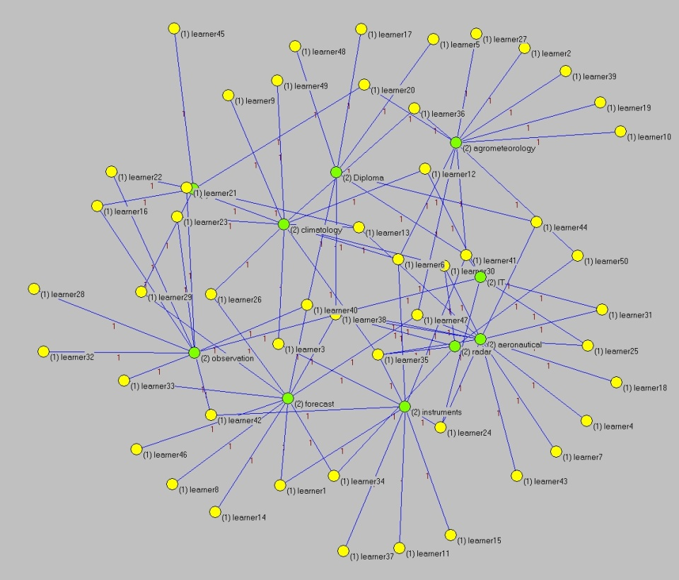
Network analysis of education & training
Discover potential Network Structure or Training Needs from Education & Training Tables
2-mode (actors <-> events)
2-mode
courses
learners
questionnaire
Courses
Learners
Can it easy to figure out the potential friendships? Courseware Deliver recommendation?
mode transformation

Slide 20
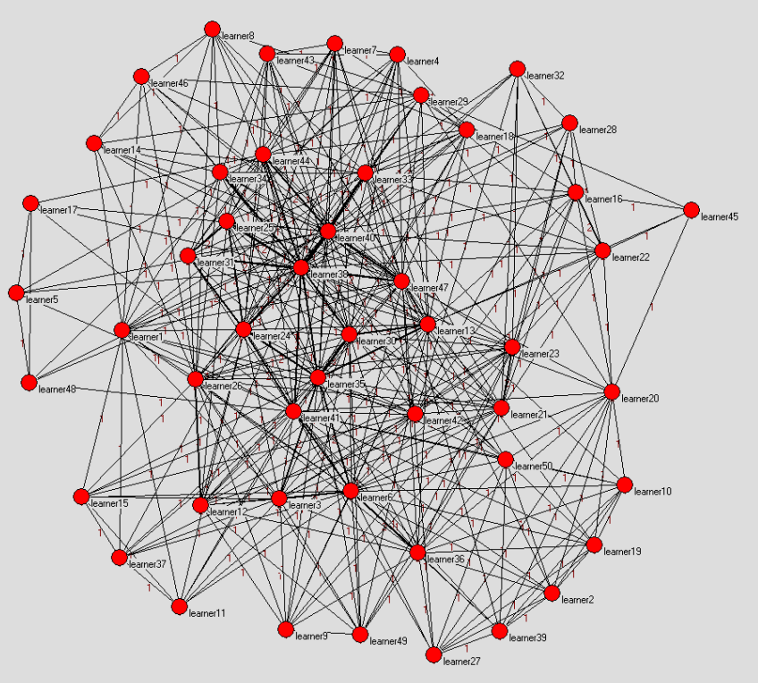
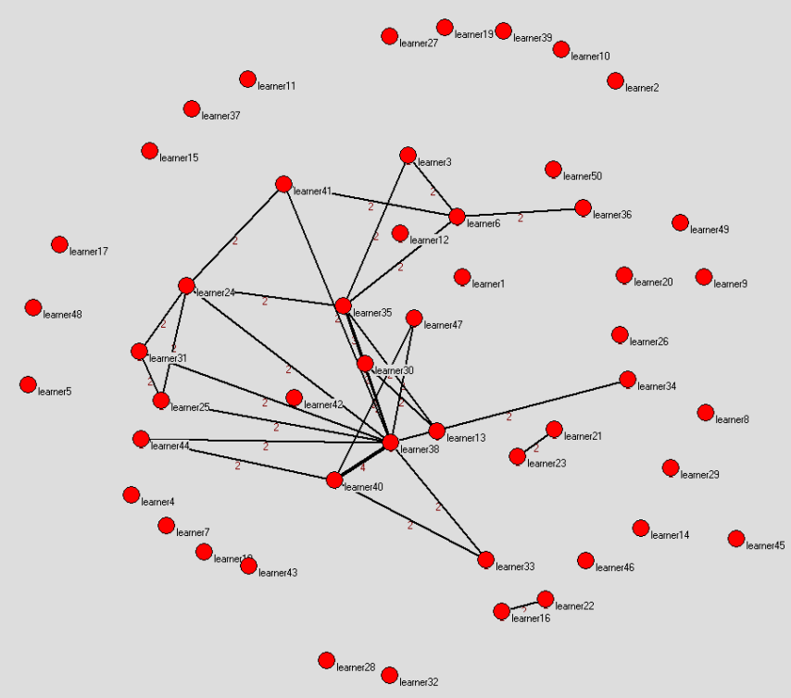
Network analysis of education & training
Easer to find which learners are close logically.
relations of 50 Learners
Link reduction hierarchy
1-mode
2-mode VS 1-mode
Core learners
Links: Counts of joint courses
Notes:
Core learners

Slide 21
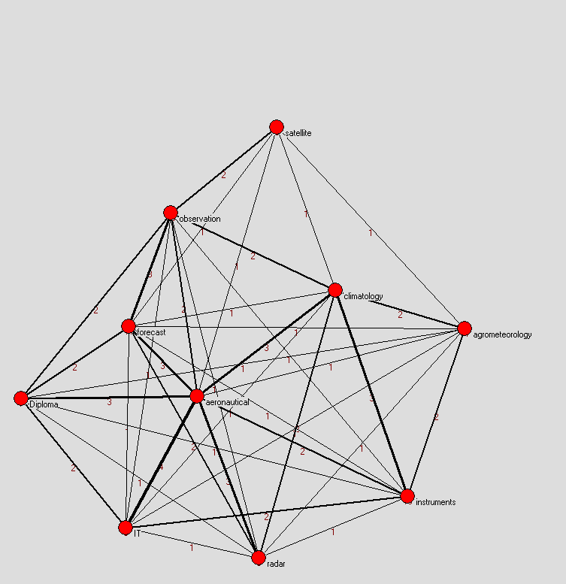
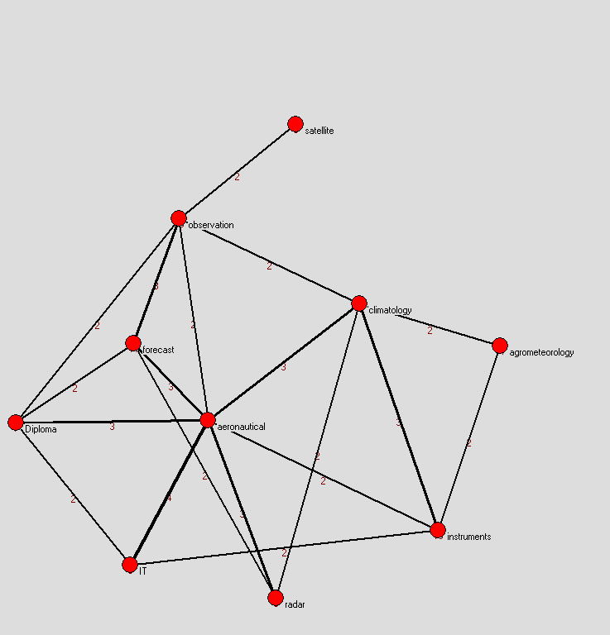
Network analysis of education & training
Easer to find which courses are close logically.
relations of 10 courses
Link reduction to weight more than 2
1-mode
2-mode VS 1-mode
Links: counts of learners taking same course
Core courses
Notes:
Core learners

Slide 22
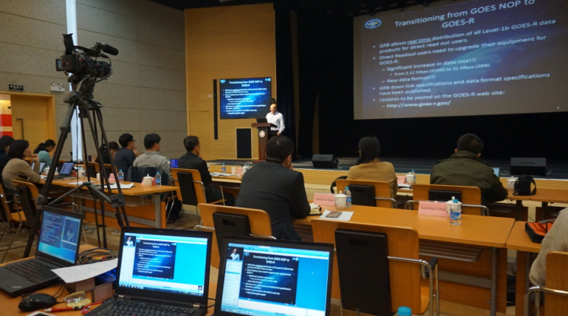
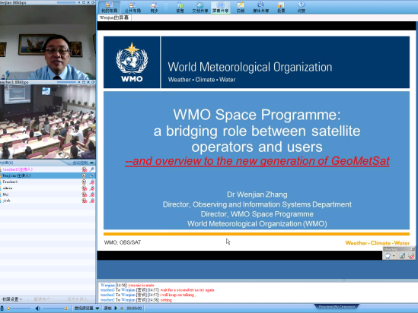
Making the full benefit of Global Campus
Small-world effect of Met. distance education & training in China
The building of long range links
CMA Three-tier Distance Learning Network built
LMS, synchronous classroom, online communities
The effect of creating of Distance Learning Sites
The fifth Asia/Oceania Meteorological Satellite Users’ Conference (AOMSUC-5) Training Workshop. 2014
Training Course on Application of Met. Satellite Products. 2015

Slide 23
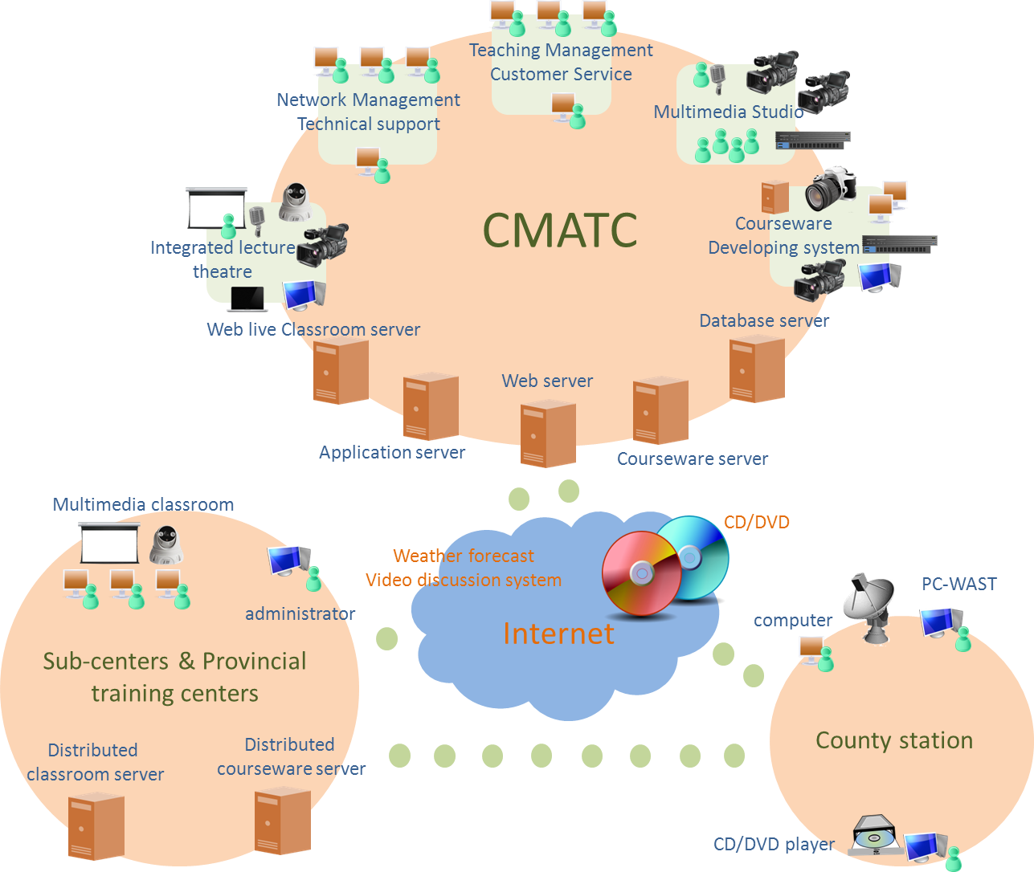
Making the full benefit of Global Campus
CMA Three-tier Distance Learning Network
First-tier Station (CMATC)
Second-tier Stations (Provincial Training Centers)
Third-tier Stations (Prefectural and County Learning Sites)
Second-tier:
7 sub-centers, 25 provincial training centers

Slide 24
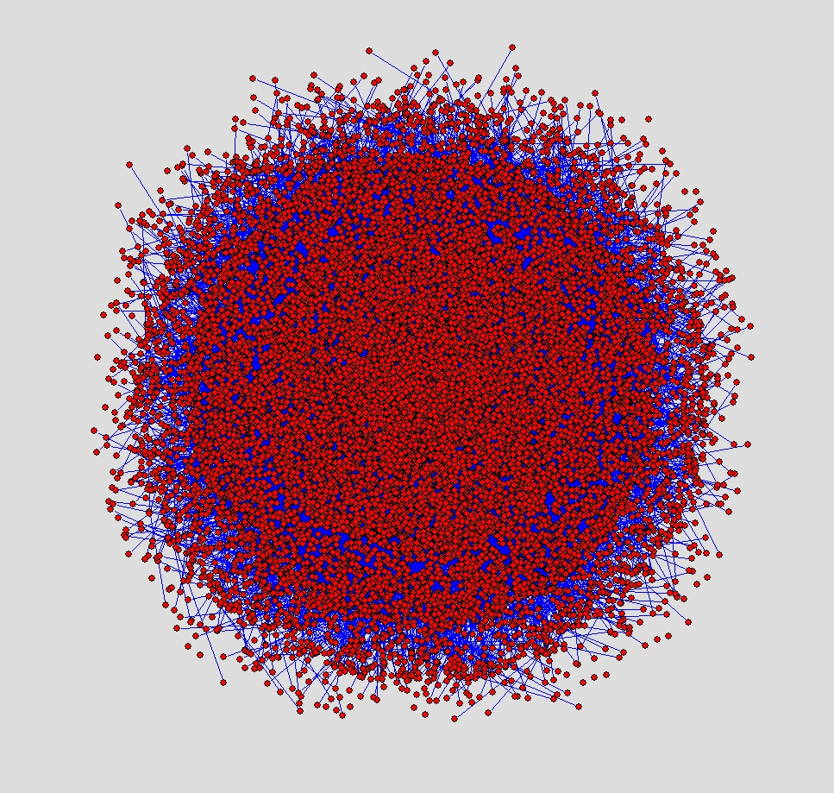
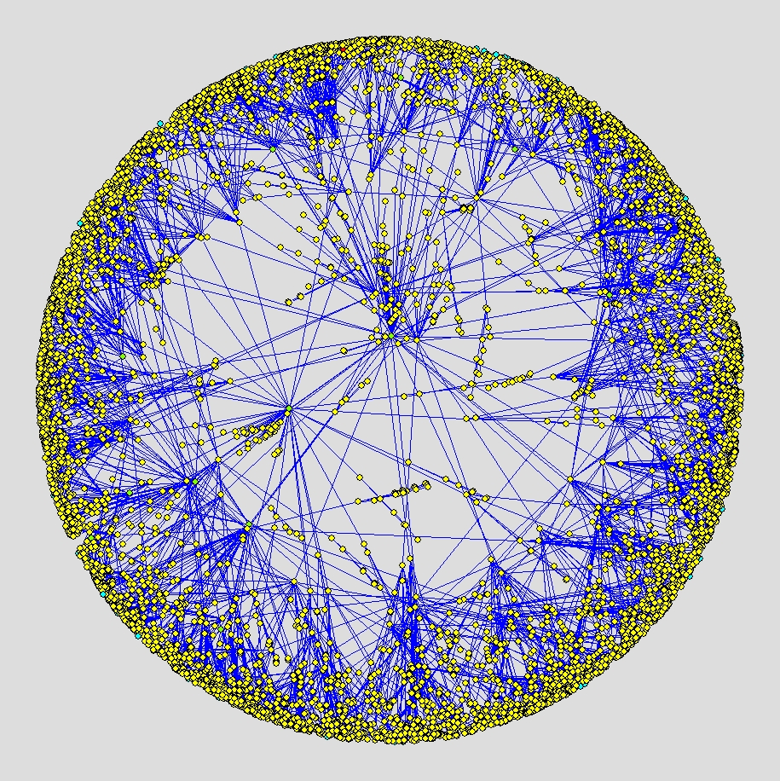
Making the full benefit of Global Campus
The Network of CMA Training in Energy Layout
clustering
nodes Number > 17000
edges number > 17000
Diameter 12(v955 to v2613)
CMATC
Kamada-Kawai show
Fruchterman Reingold show(2D)
Country
Provinces
Prefectures and Counties

Slide 25
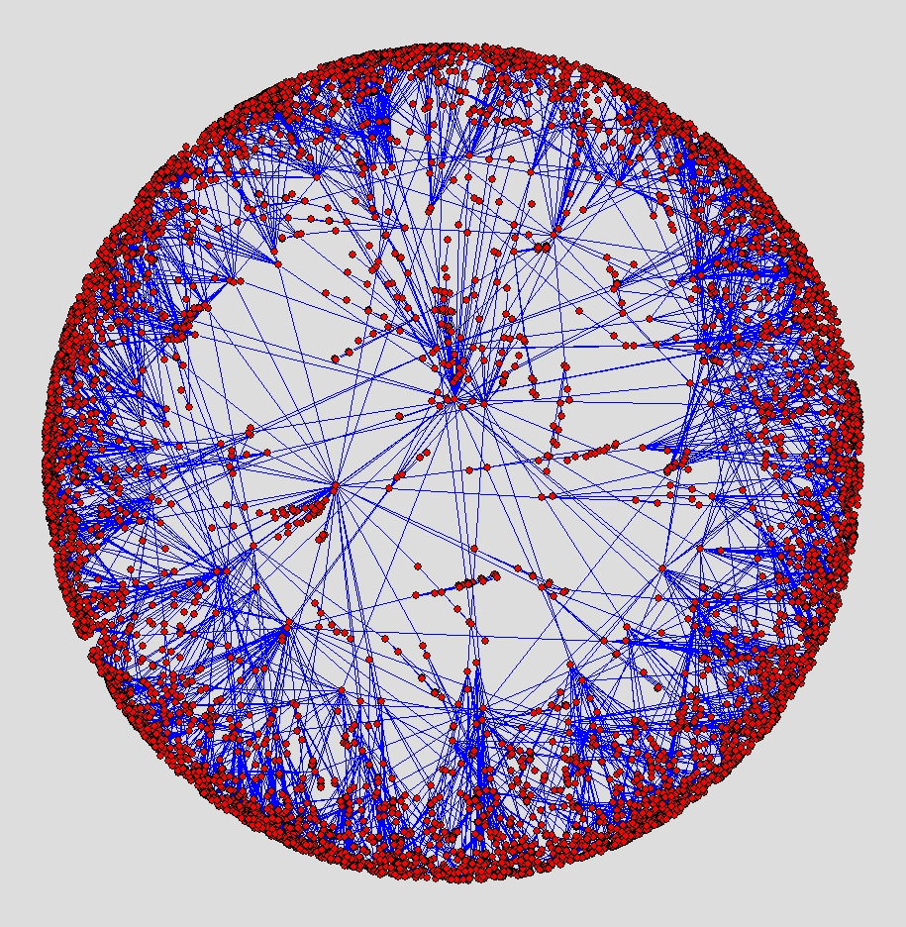
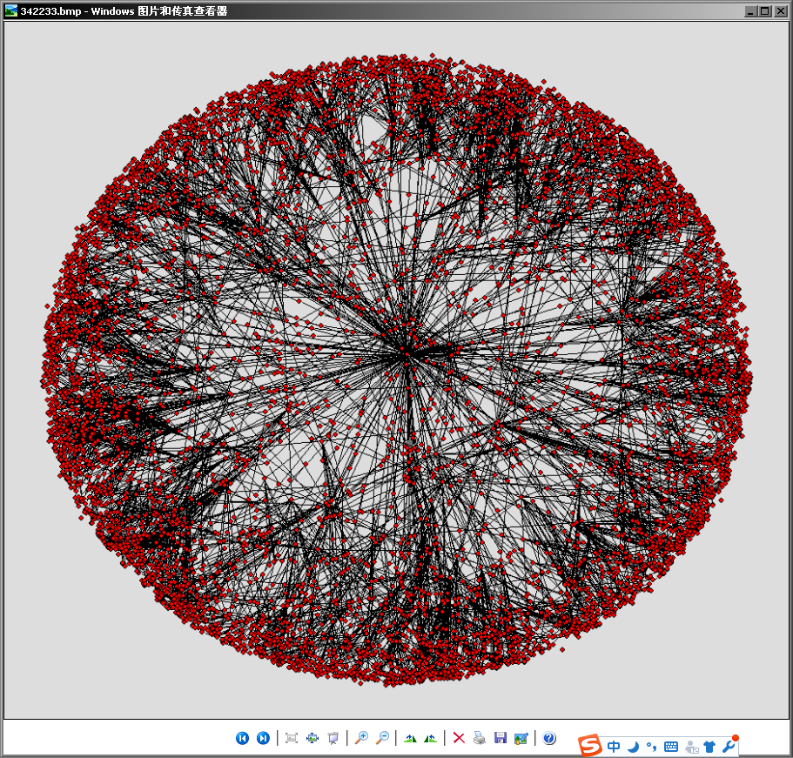
Making the full benefit of Global Campus
The function of creating Distance Learning Demonstration Sites (108 Sites)
108 long distance links
shape changed
Average Degree 1.998->2.012, grows

Slide 26
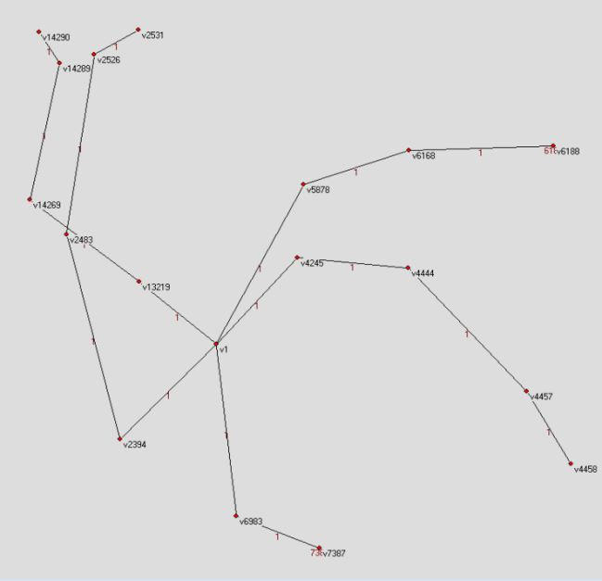
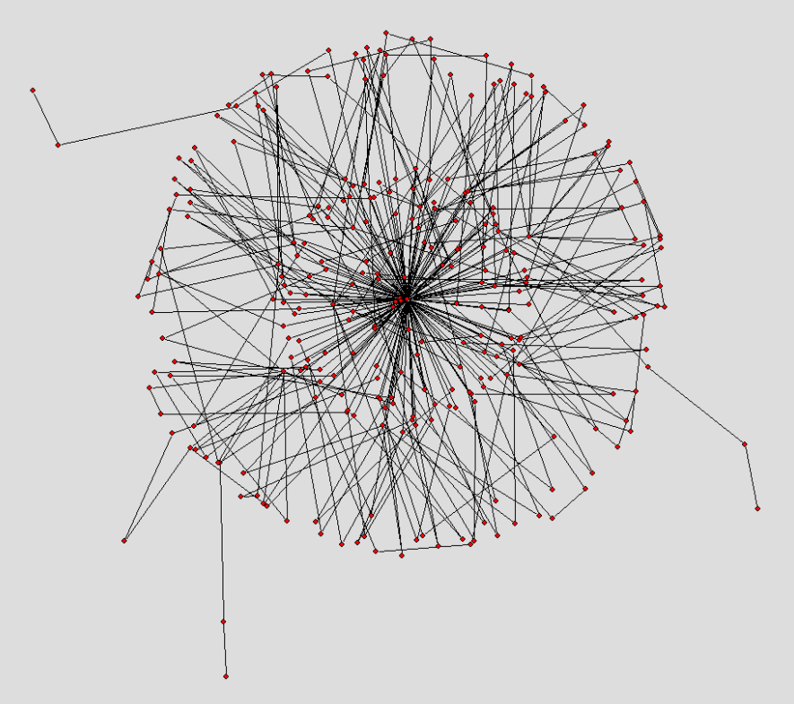
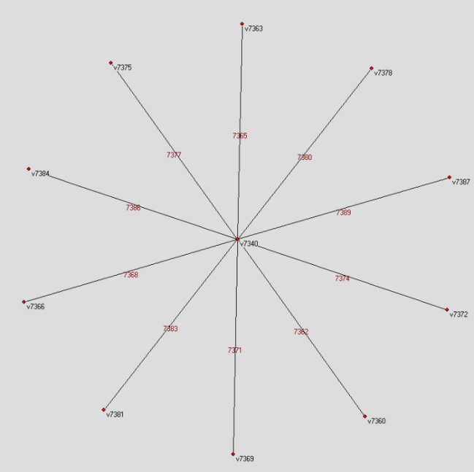
Making the full benefit of Global Campus
The Network backbone and all core partitions
Hierarchy reduction
Hierarchy reduction
Demonstration Sites
Star shape
before
after
CMATC
degree > 3
reduction
stable and Robust

Slide 27
Making the full benefit of Global Campus
Small-world effect in the modernization of CMA Met. education & training
Help the promotion of collaborations within the ‘CMA Three-tier Distance Learning Network’
Help the Design Scheme optimization of the ‘CMA LMS (CMA-MDERP)’
Help the training needs analysis of CMA staff
Help courseware delivery to the right learners
Notes:
The role

Slide 28
Making the full benefit of Global Campus
Global Campus could be regarded as a complex network consist of:
The method and tool study of complex network structure might promote the structural optimization effectively and change the size, shape, nature and culture of education & training gradually.
Social Network
Information Network
Resource Network
Organizational Layout
Study the features of nodes and edges from a local view.
Study the structure and resource allocation from a global view.

Slide 29
Making the full benefit of Global Campus
Help optimize the layout of Global Campus
Show what kind of importance that nodes are playing.
Identify and promote the formation of various communities.
Monitor and extend bottlenecks, joint the isolated region in the network structure.
Check and reduce the building cost of distant connections.
Core Nodes such as: National training institutions, Regional institutions, Universities

Slide 30
Making the full benefit of Global Campus
Help delivery through structural synchronization
A locally coupled network will not synchronize if its size is sufficiently large, which result in:
Small-world network is easy to synchronize.
Help know potential training needs
Clustering analysis with mode transformation.
Potential collaboration relations mining.
Uneven resource distribution
Info transfer speed slowdown
Good News

Slide 31
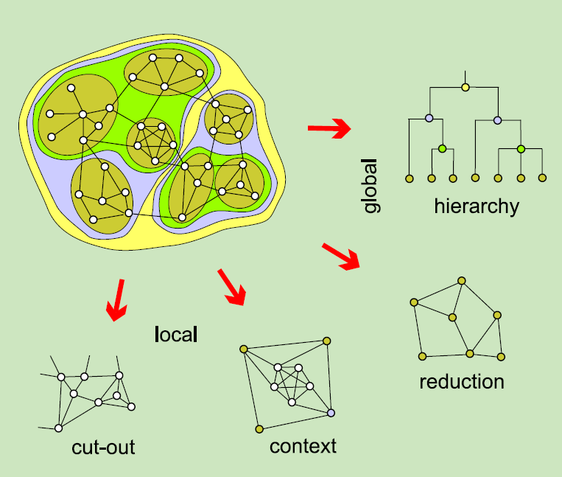
Making the full benefit of Global Campus
Help diagnose and maintain network stability before restructuring
Discover extreme cases (backbone, isolated nodes)
Node protecting schemes against network attacks
Simulate before
Network Mergence
or Separation

Slide 32
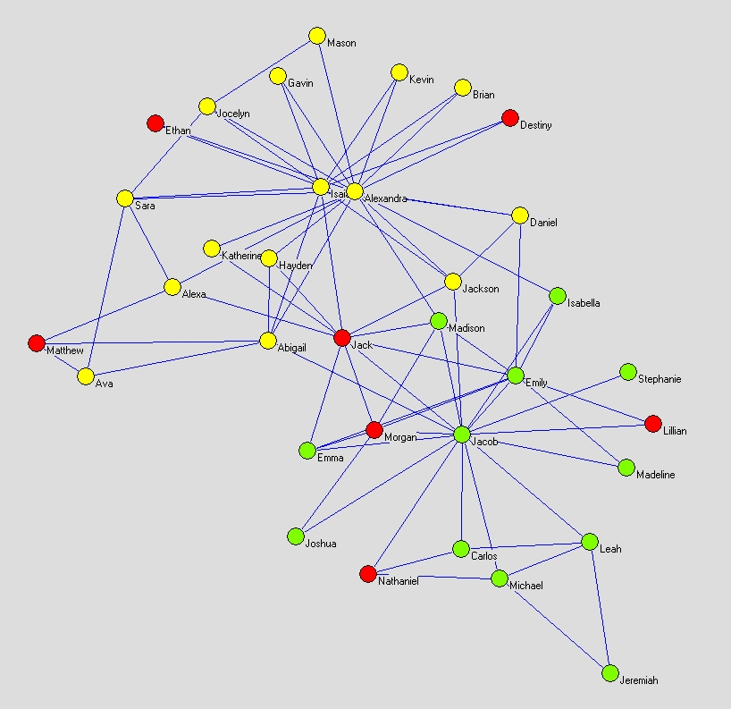
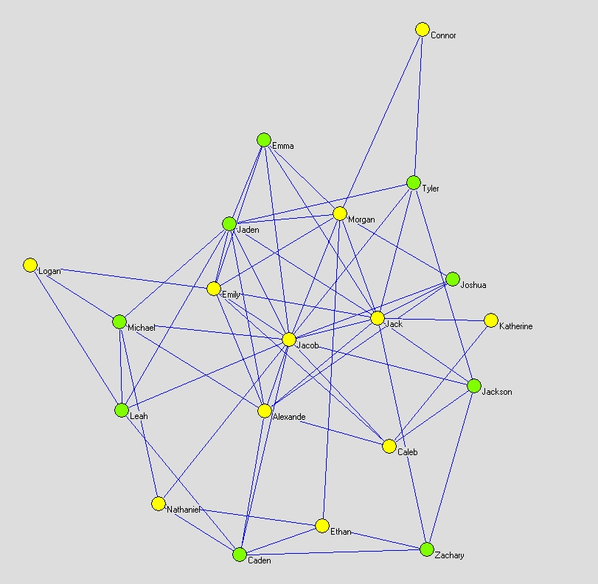
Making the full benefit of Global Campus
Springfield has 10 students exchanged to Quahog, what will happen after the union?
Example
Jacob
Emily
Jack
Morgan
Nathaniel
Leah
Michael
Emma
Jackson
Katherine
New relations built
Networks Mergence
‘Springfield’
‘Quahog’

Slide 33
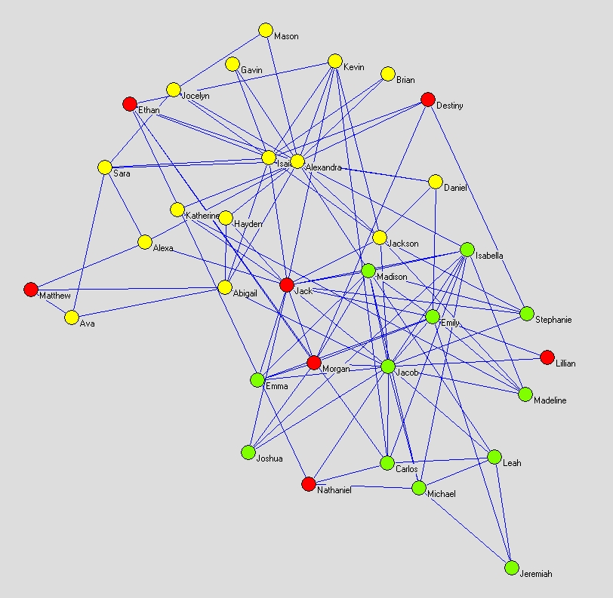
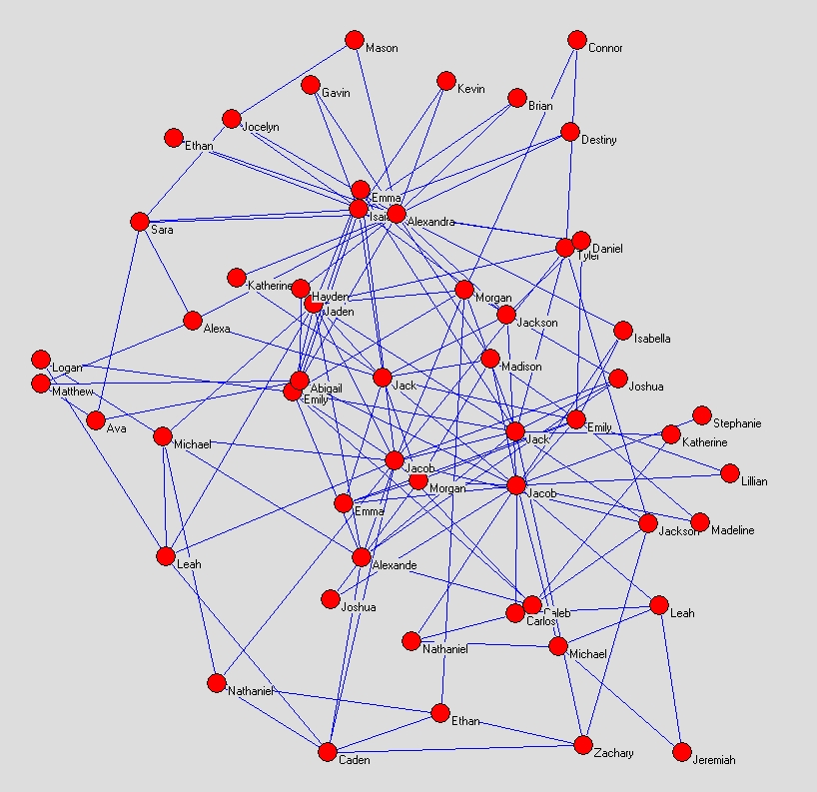
Making the full benefit of Global Campus
Union of edges
Union of nodes
 | Quahog | Springfield | Union of edges | Union of nodes
nodes count | 20 | 34 | 34 | 54
edges count | 63 | 78 | 141 | 141
average degree | 6.30 | 4.59 | 8.29 | 5.22

Slide 34
Challenges and Discussions
Data collection defects affect the structural presents?
Data is large, not complete, error, inaccurate, etc.
Any resistance to the establishment of long range connections?
Geographical range, time zone, technical barriers, intellectual property, etc.
How to reduce vulnerable risks of structure?
sudden disappearance of some key nodes and paths, would resulting in wide range disasters

Slide 35
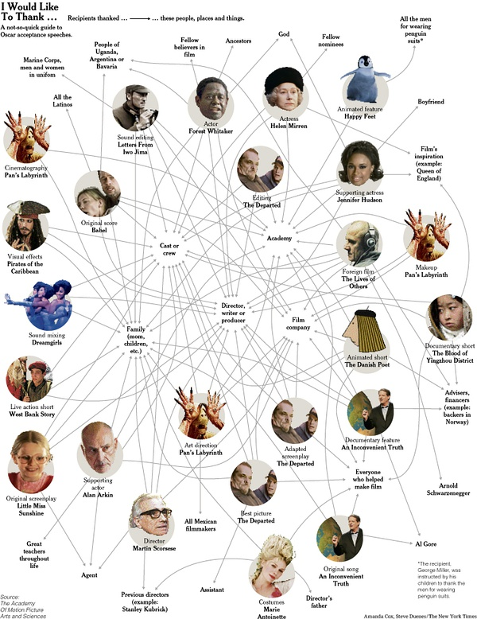
Thank you!
Notes:
小冀，

