Slide 1
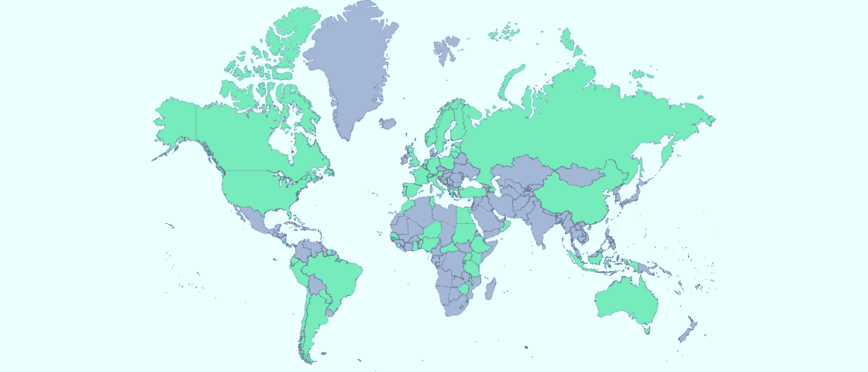
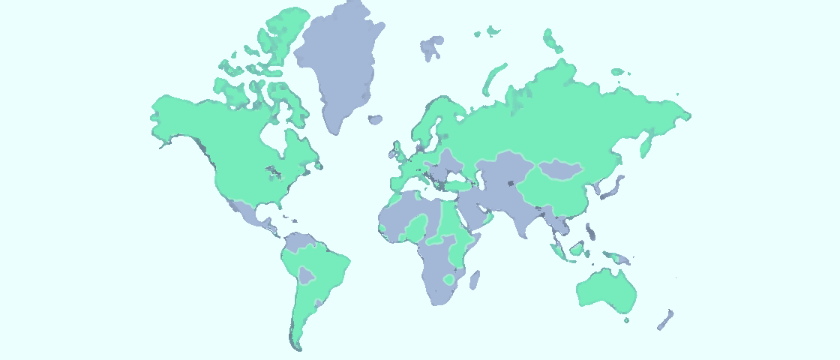
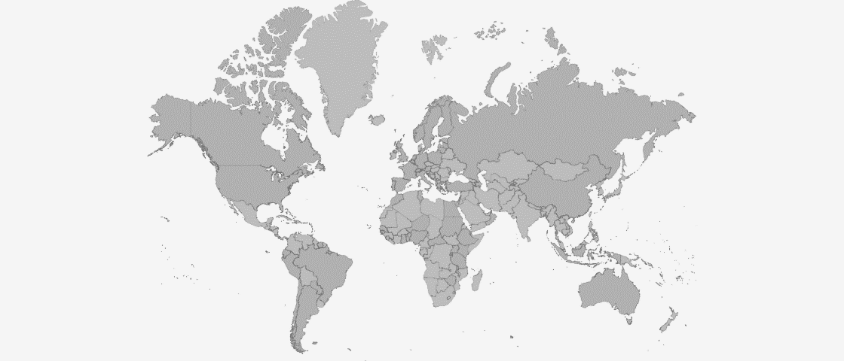
CALMet Online
2010 – 2016
@ CALMet Conference, Seoul, 7 – 11 September 2015
Notes:
Hello, I am Roro from BMKG Indonesia and Vesa from Eumetsat. Thank you for being with us. Hope the pleasant dinner last evening, bring your energy back and you ready to begin the activity…
Before we are going, as all my mentors here makes me keep in mind, how important to check the understanding before we start the activity, “how many of you that had attended CALmet Online?”
Thank you…

Slide 2
CALMet Online is…….
A global online conference
between two CALMet conference
For old and new colleagues to meet
Share new ideas and best practices, inspire through new tools and methods, initiate the collaboration
Notes:
But, for you who had not had opportunity yet to attend, I have a pleasure to inform you that CALMet online is……

Slide 3
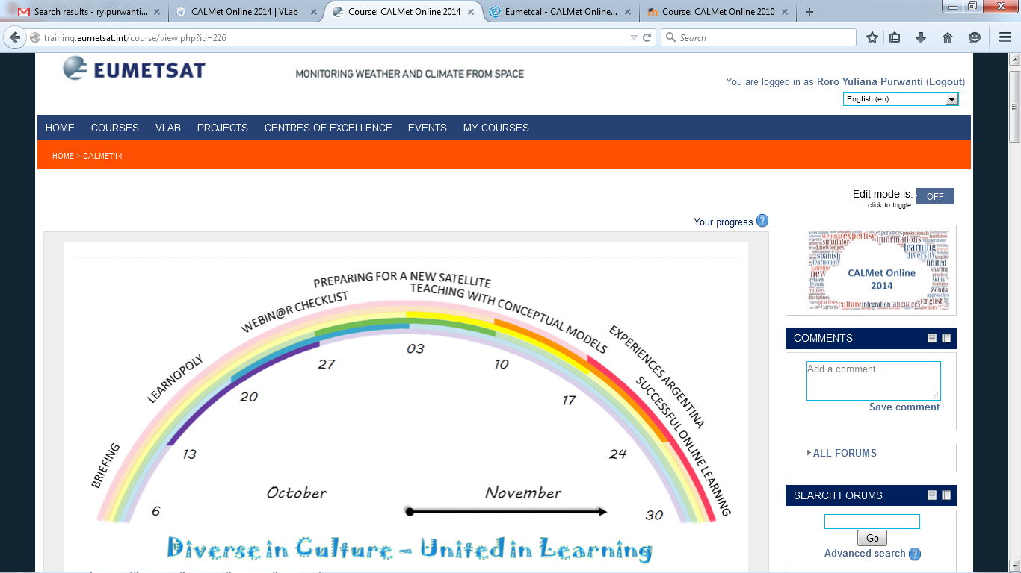
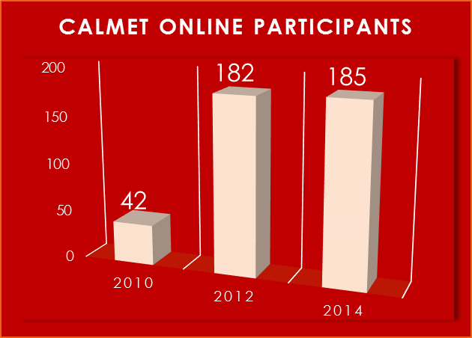
In these moodle, we met …
Notes:
We met in these moodle, and the events reached some number of participation so far…

Slide 4
Booster question
Determine Quality of Training
Communication and collaboration via Global Campus
Collaboration using Moodle platform
Reassembling existing event for improvement
Notes:
From some activities we did in this very active week, we heard about the importance of determine quality of training from Pat, the benefit of using booster question to check the learning and retention after some period of time, we heard Aileen said about world-wide community communication and collaboration via Global Campus, and Mustafa showed us the Moodle platform and how we using it to collaborate.
The last CALMet was conducted almost a year ago. We would like to say, that this is the time to assess CALMet Online. How we ensure that CALMet online really useful and help us to do our task as a professional.
I would like to give a big thanks to Maja and Vesa for the inspiration of reassembling existing event for improvement..
You do, you learn, without, you forget..
Now it is the time to practice what we learned this week…

Slide 5
Welcome to the CALMet Online world café
Notes:
We welcome you to the CALMet Online world café…
This café, has the special etiquette.
Choose your favorite table of CAPUCCINO, ESPRESSO, AMERICANO, CAFFE LATTE. Please go randomly. Find your group minimum 5 people and maximum 7 people. For this FIRST ROUND, do not be in a group with the people whom you sit side-by-side in this week.
====================
You are asked to do the brainstorming in your group. You need a minute taker, so choose someone to write down the summary of the discussion You have 10 minutes to discuss within the group. When you heard bells ringing, time is up, discussion end and you have to be ready for the next activity.
Now, please work together in your group on the given topic.

Slide 6
Do we need CALMet Online? For what purpose? Why?
Topic1
Notes:
First topic. DO we need calmet online? For what purpose? Why?

Slide 7
What components in CALMet Online need improvement?
Topic 2
Notes:
OK…now, you finished topic number 1. Thank you. And we move to the next topic. As you have to try all coffee, now, move to another table, and find your group. Please leave the worksheet in the table.
======
Looks like you are ready, then comes the topic no 2: What components in CALMet online need improvement?
You have 15 minutes to brainstorming your ideas within the group. You may use the worksheet in the table, to gain the idea.

Slide 8
How the future CALMet online could look like?
Topic 3
What other approach can be used?
Notes:
Now, as the bell rings, we moveto the topic no 3. How the future CALMet online could look like? What other approach can be used?
Again, brainstorming within your group in 15 minutes.

Slide 9
What can you do to make the next CALMet Online a success?
Topic 4
Fill the card individually but you can discuss within your group….
Notes:
The bell rings again.. You know what to do… move again…

Slide 10
See you in CALMet Online 2016 …..

