Slide 1
DUST STORM OVER SUDAN 11TH MAY 2022 0900 UTC TO 12TH MAY 2022 0000 UTC
Case Study Simulator

Slide 2
Step 1: Evidence of weather phenomena contributing to the current weather situation on 11th May 2022 at 1200 UTC
Question: Look at the MSLP chart and explain the pressure systems over the Mediterranean region.
Answer: High pressure center sits over the area and a strong ridging to the South eastern direction all the way to Northern Sudan can be observed.

Slide 3
Step 2: Analyze the past weather Task: Analyze the evolution of the weather systems in step one above for the past 12 hours
Feedback:
MSLP: The Mean Sea Level pressure in the Mediterranean region was at 1023 hPa at 0000 UTC, at 0600 UTC the pressure increased to 1025 hPa. There is a ridge with a southeastern orientation coming all the way to the central part of Sudan. The increase in the pressure led to the strengthening of the ridge and the winds around the ridge also became stronger.
Winds:
Surface: Strong easterly winds blowing between 0000 UTC and 0600 UTC. The maximum wind speed reached at 0600 UTC was 25 knots.
850 Hpa Winds: Strong easterly winds were noted. The maximum wind speed at 0000 UTC was at 35 knots and increased to 40 knots at 0600 UTC.
700 hPa winds: An area of convergence is seen over this period of time.
200 hPa Winds: At 0000 UTC areas of confluence begin to form on the east and western parts indicating a low pressure center at this level.
Dust RGB: At 0000 UTC, there are no dust storms seen on the satellite imagery, however at 0600 UTC a small dust cloud is seen on the eastern part of the country.

Slide 4
Task: Compare charts for 1200 UTC with 1800 UTC
Feedback:
Pressure: The high-pressure center in the Mediterranean region has reduced slightly to 1023 Hpa.
Winds: The Maximum surface wind speed is expected to reduce slightly from 25 Knots observed at 1200 UTC to 20 Knots at 1800 UTC.
200 hPa Winds: The large-scale low pressure region seen at the 1200 UTC is filling up, and the large-scale subsidence of air is still expected. Since the winds at the surface are still strong the dust storm is still expected to persist though the conditions are improving slightly.

Slide 5
Step 4: Develop/Generate the Nowcast Task: After reviewing all the provided data, Generate a nowcast forecast.
Feedback:
“The intense dust/sandstorm with strong winds is expected to continue to sweep over many parts of central Sudan from 1200 UTC over the next 3 hours. Very low visibility is expected in these regions. Lots of dust expected in the air. From 1500 UTC the conditions are expected to improve slightly though there will still be a lot of dust lifted which will take time to settle. The public is advised to take caution.’

Slide 6
Step 5: Disseminate the Nowcast
Task: Discuss the various sector specific forecasts to be disseminated after generation of the forecast in step 4. Discuss the different common alerting protocols (CAP) available.
Feedback: Give forecasts tailored to the following users;
Transport industry
Aviation
TAF HSSK 111100Z 1112/1218 03015G25KT 8000 NSC TEMPO 1112/1118 1000 BLSA
TEMPO 1204/1209 6000 SKC=
General Public
Health

Slide 7
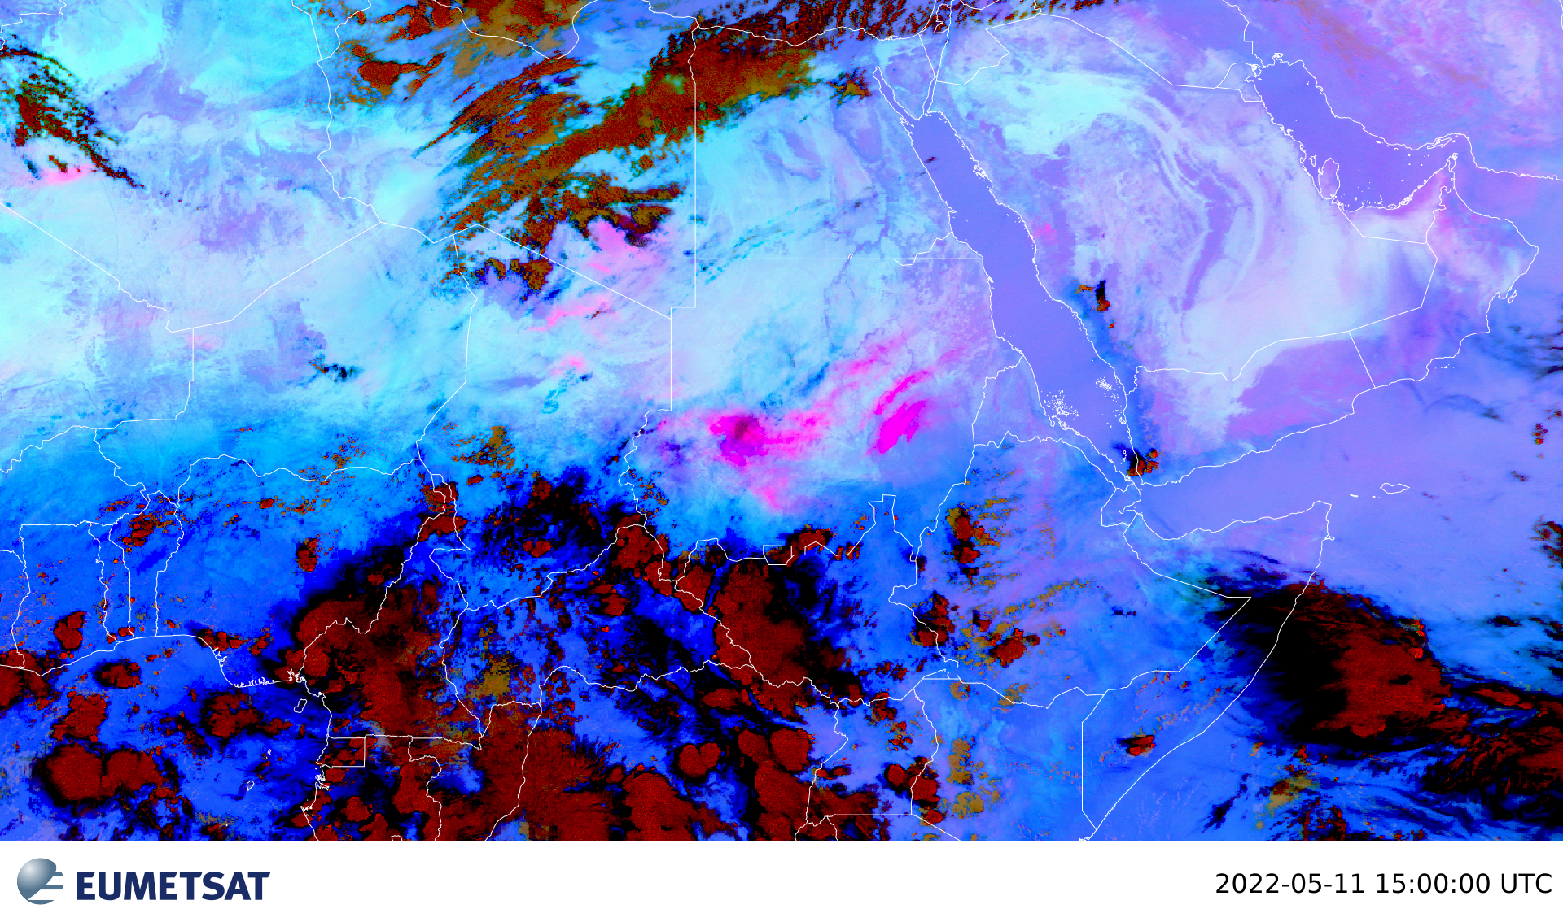
FORECAST VERIFICATION

Slide 8
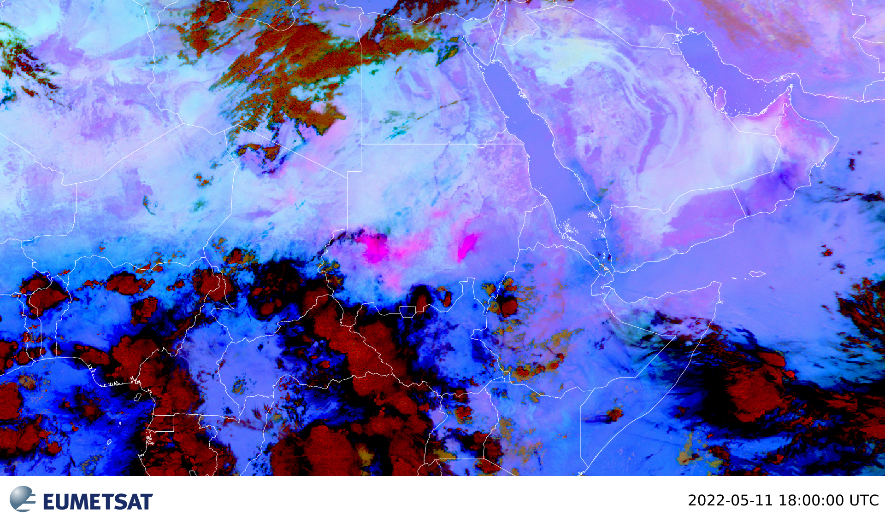
FORECAST VERIFICATION

Slide 9
Step 6: Verification of the Nowcast

