Slide 1
SAC2024 Nairobi
Group 1
Sudan
South Sudan
Gabon

Slide 2
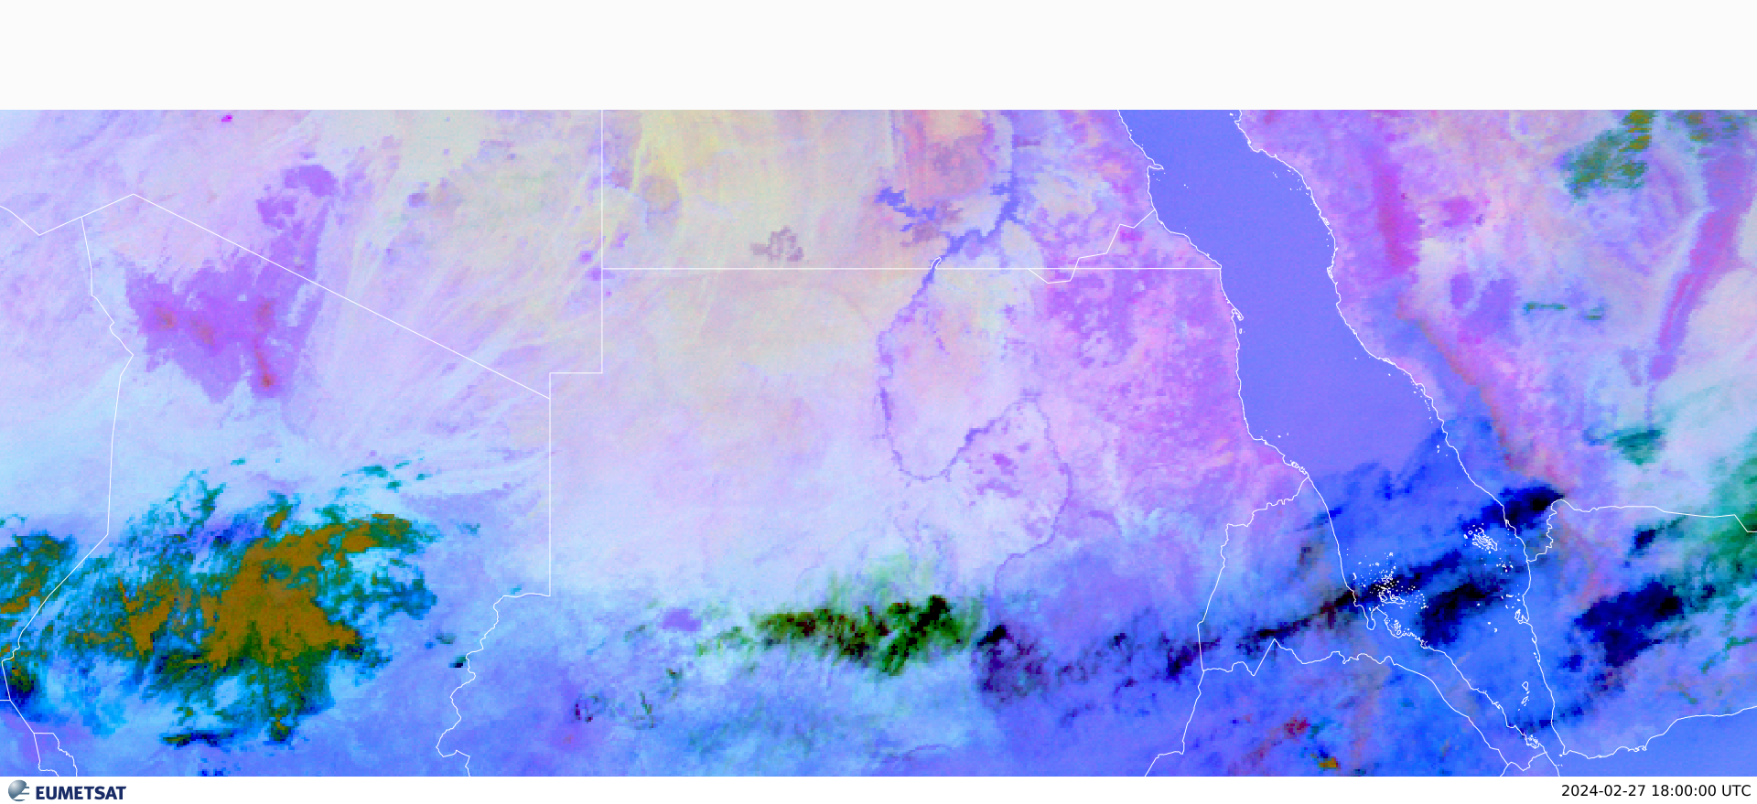
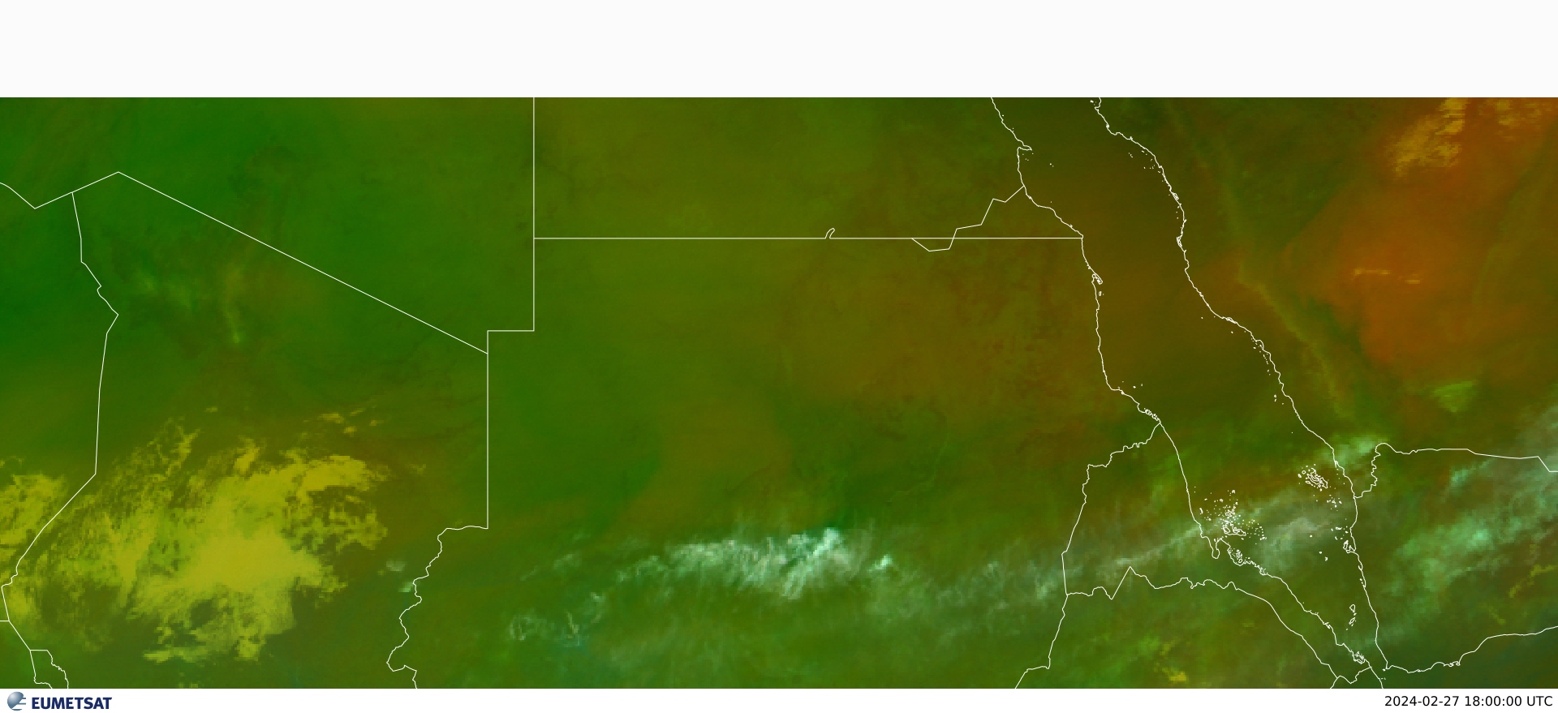
RGB Dust image_at1800utc
RGB Air masses image_at1800utc

Slide 3
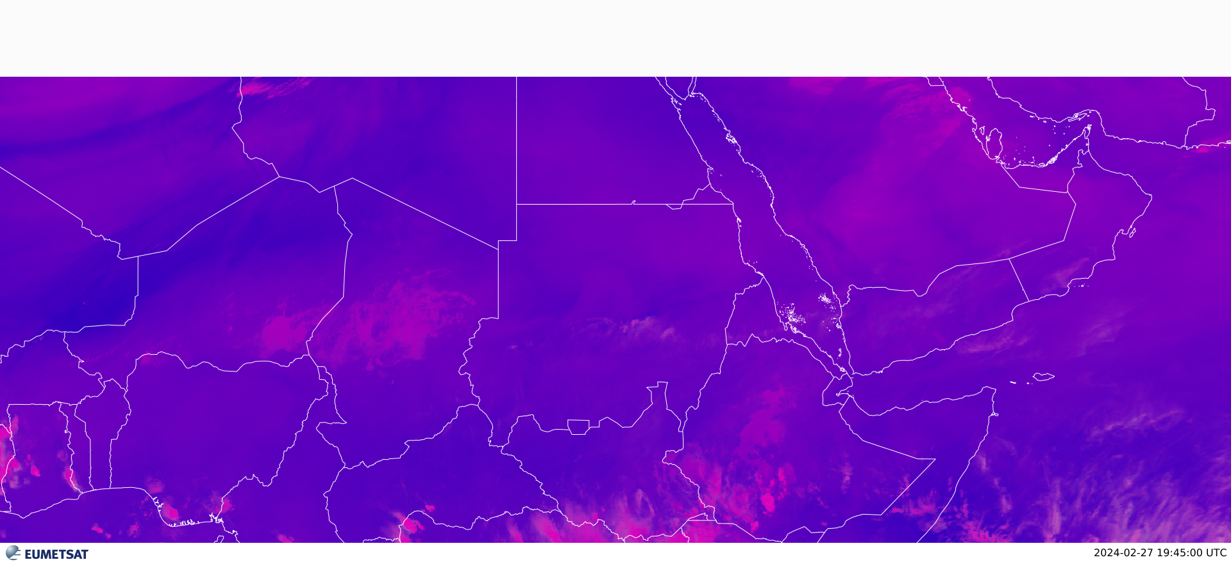
RGB convection images_at1800utc

Slide 4
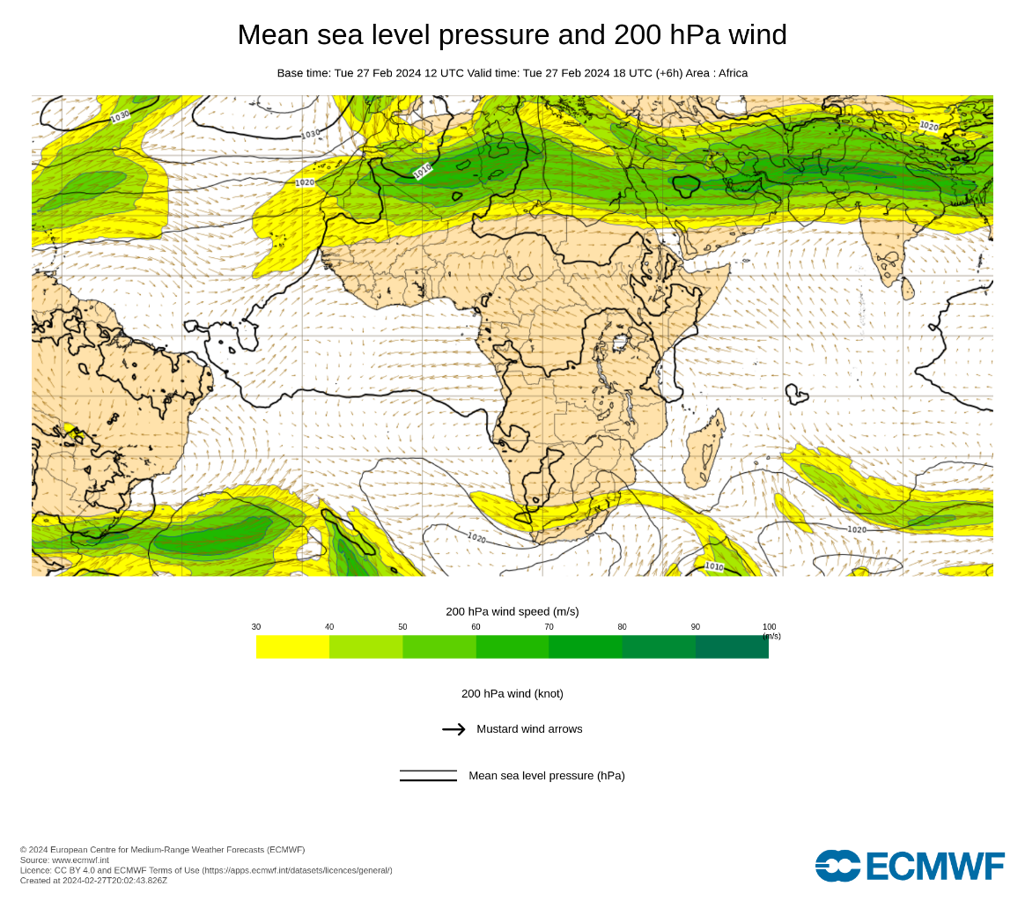

Slide 5
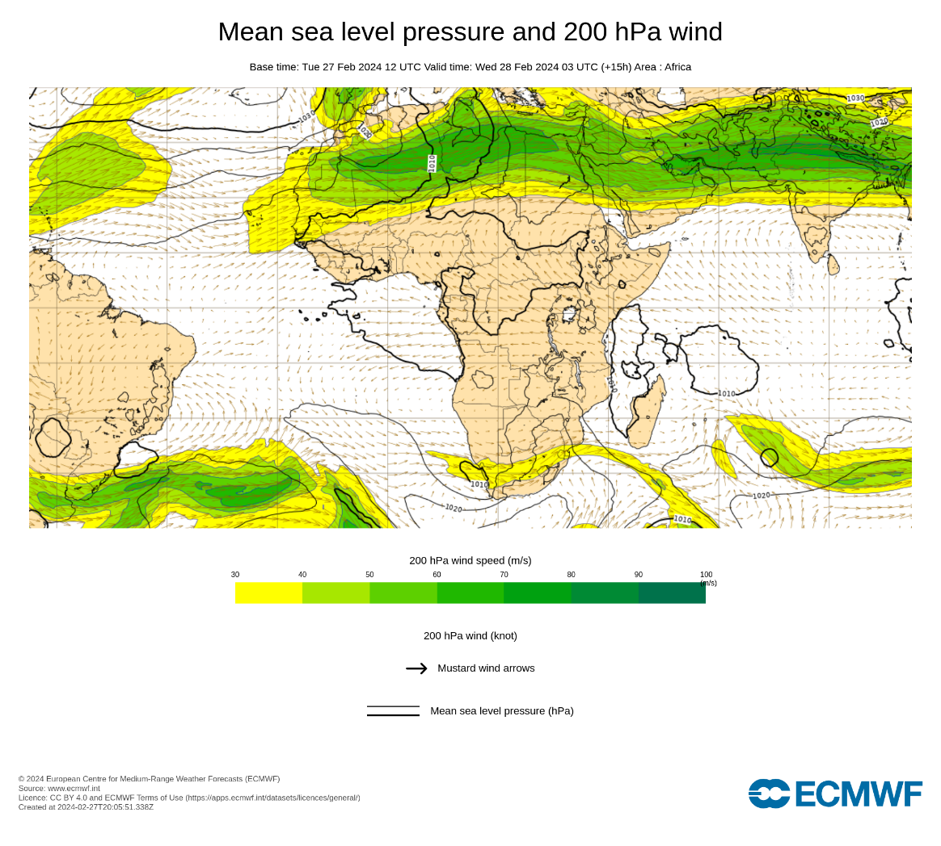
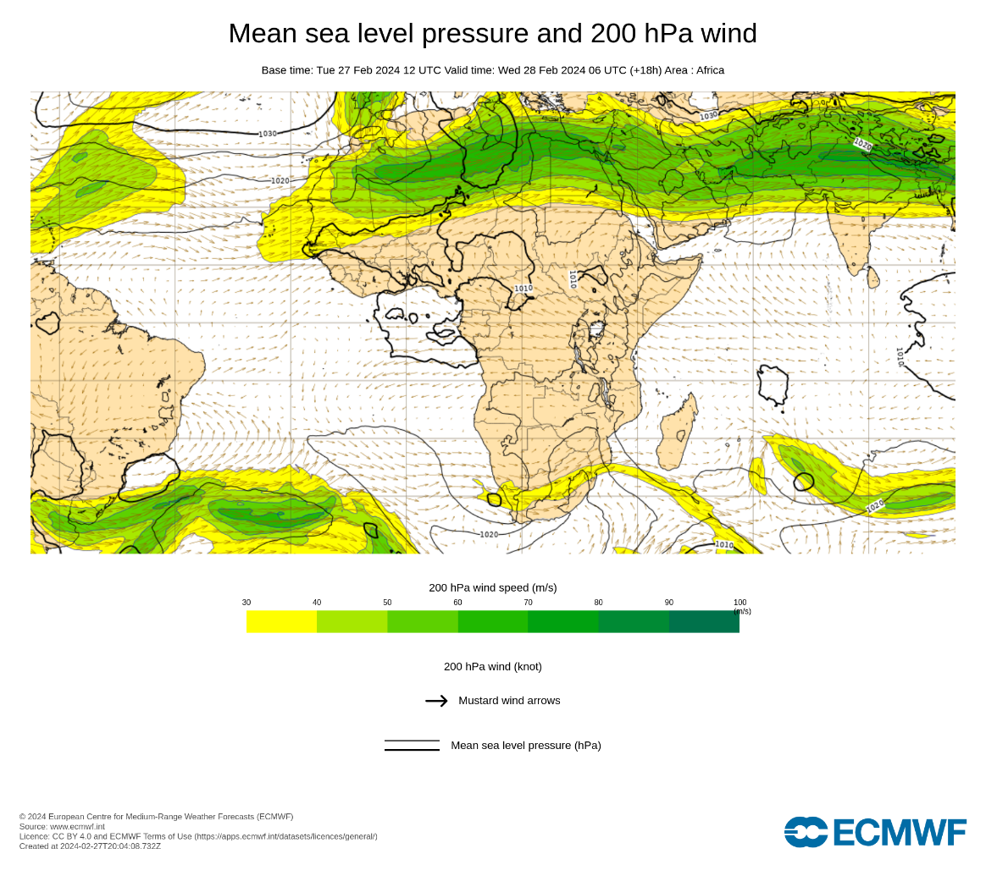

Slide 6
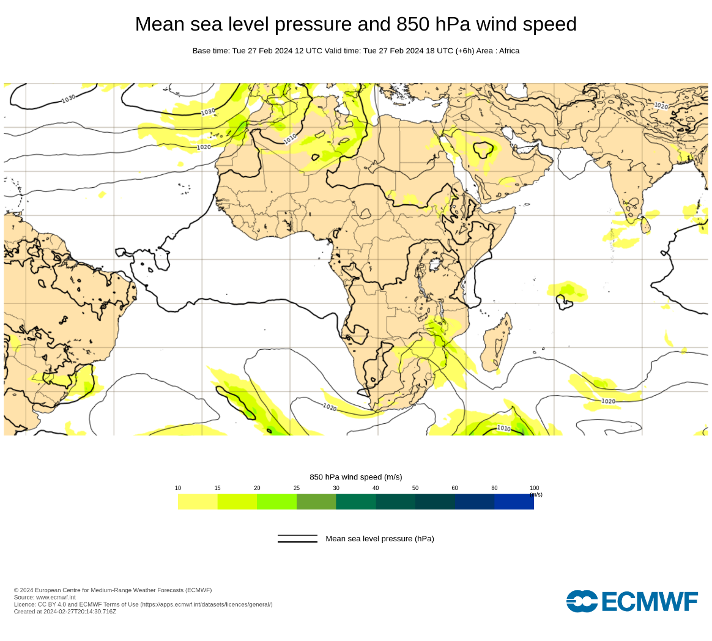

Slide 7
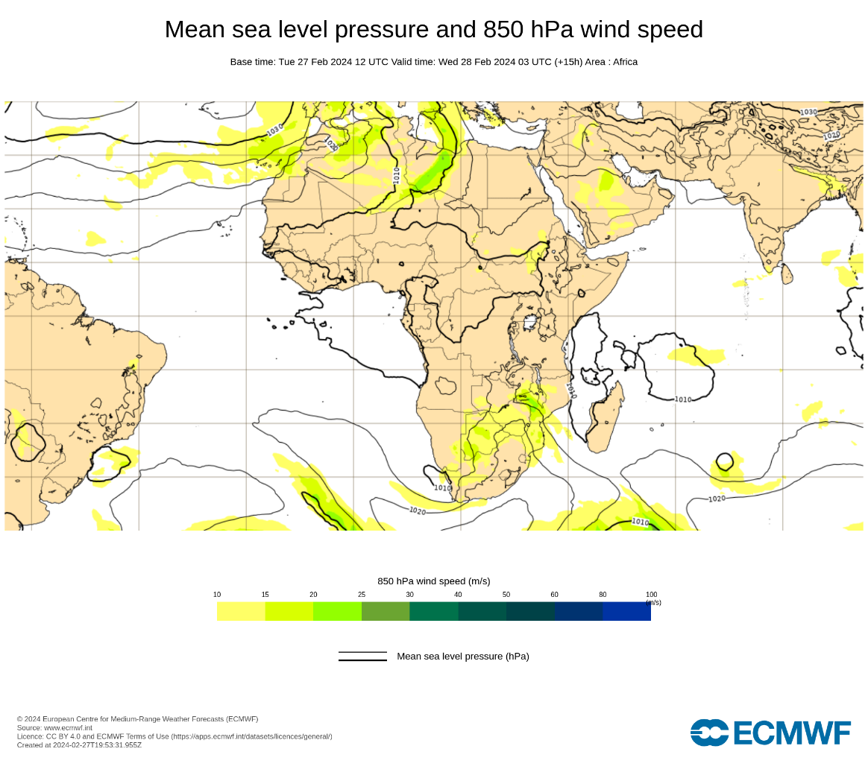
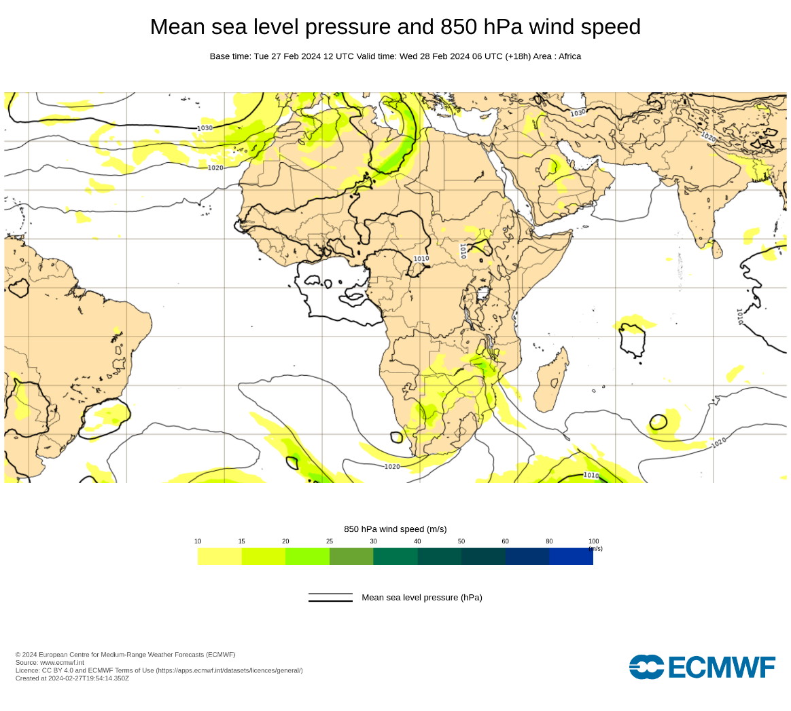

Slide 8
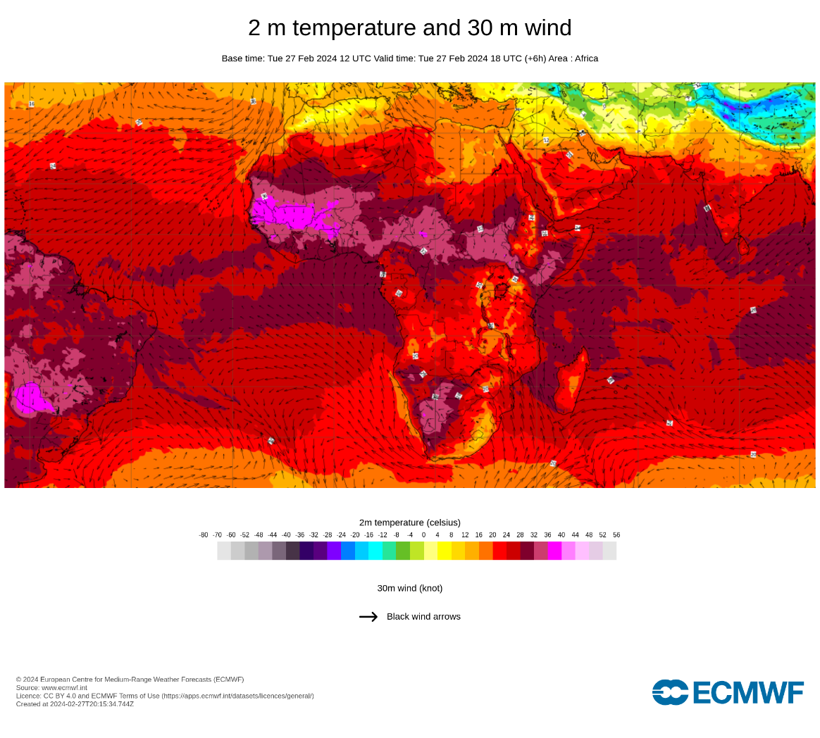

Slide 9
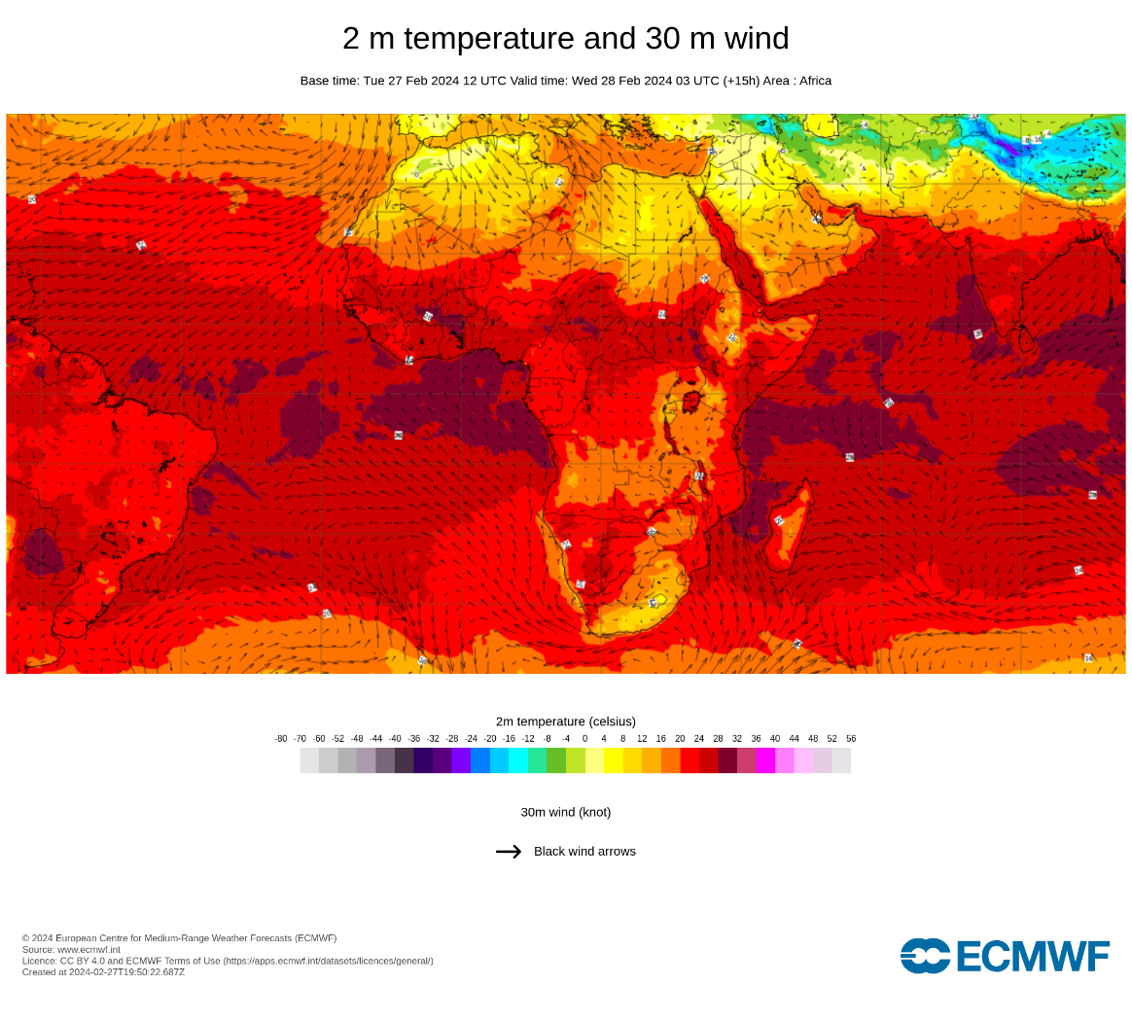
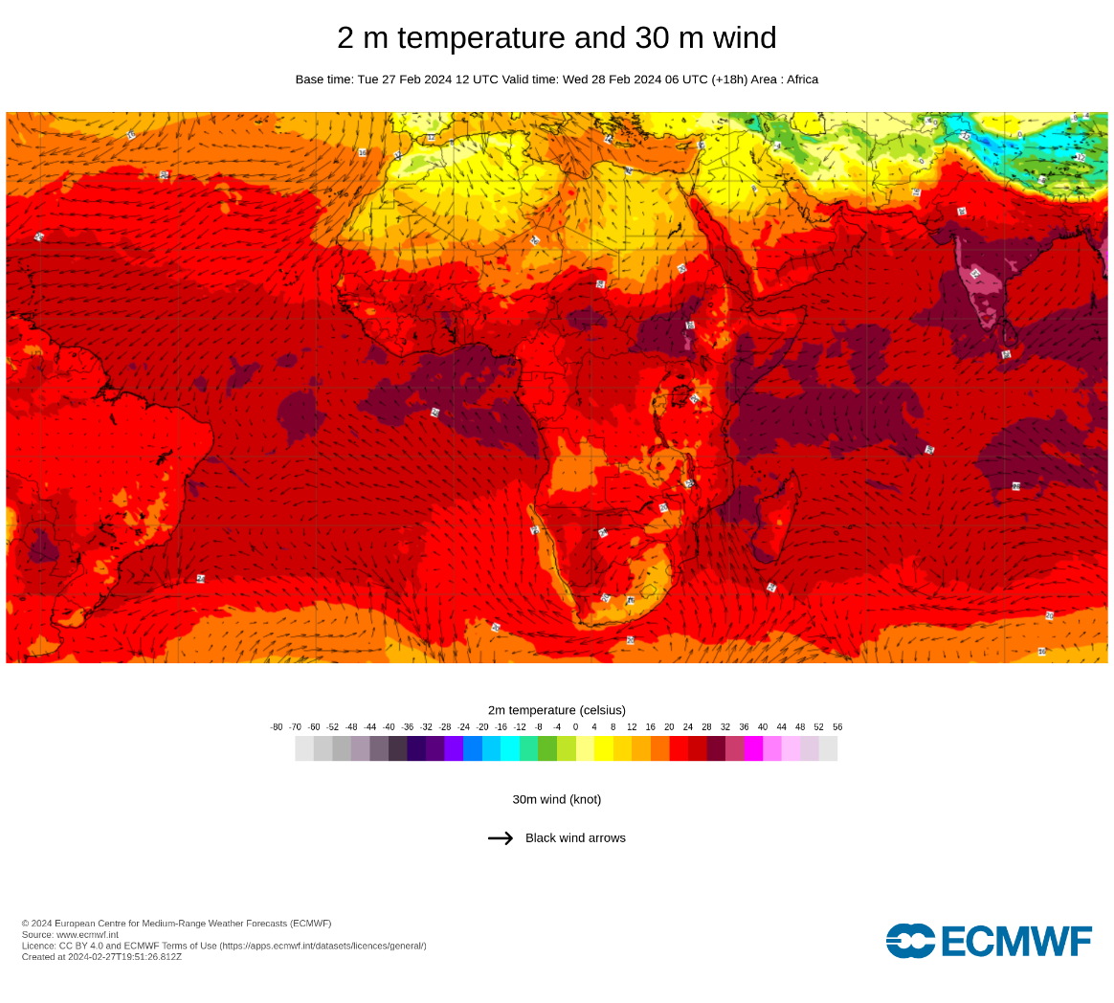

Slide 10
Analysis Summery
High pressure centered in north west Africa extending to north central, Southern and western Sudan.
high pressure centered in northwest Africa, extending to north-centred, southern and western Sudan.
Sudan thermal low, covering the far east and southeast of the country.
some medium and high clouds are expected over eastern extending to central parts of the country.
The divergent in the pressure and the air masses, leading to no downstream movement of winds southward.

Slide 11
Forecast
Sky clear is expected over most parts of the country.
Medium clouds are expected over eastern and central parts of the country.
Maximum temperatures may fluctuate between (30 degree to 24 degree).

Slide 12
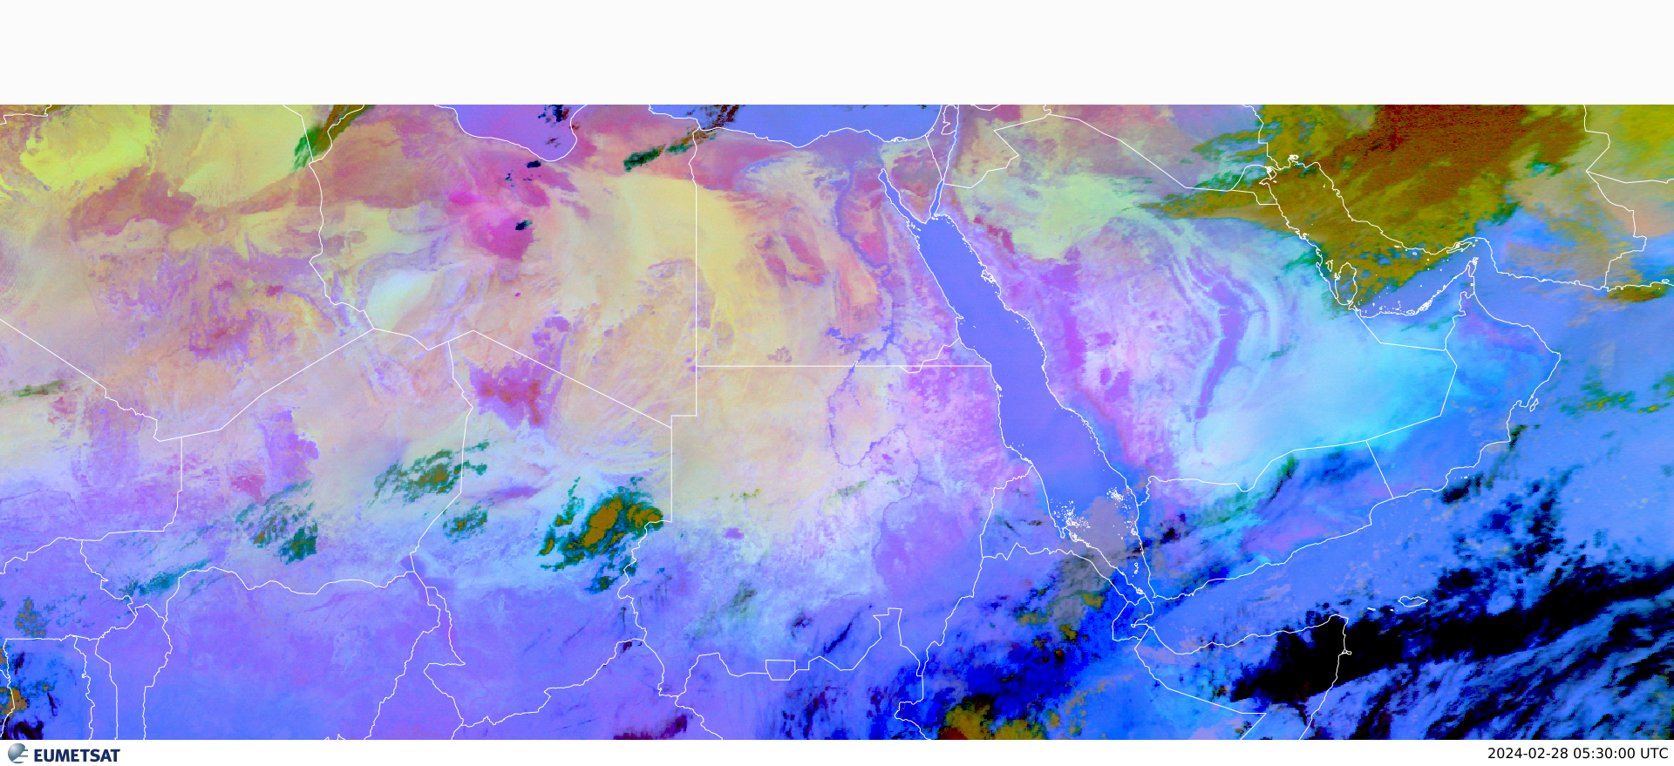
verification
RGB_DUST_AT 280530UTC

Slide 13
METARS
METAR HSOB 280600Z 36010KT CAVOK 25/M05 Q1010=NOSIG
METAR HSPN 280600Z 09008KT CAVOK 20/10 Q1011=NOSIG

