Slide 1
GROUP 6
MORONI, COMOROS

Slide 3
NATURAL RGB

Slide 4
NATURAL COLOUR ENHANCED RGB

Slide 5
CONVECTION RGB

Slide 6
AIRMASS RGB WITH RDT

Slide 7
MSLP AT 1800 UTC

Slide 8
WIND AT 850 AT 0000 UTC AND MSLP AT 0000 UTC

Slide 9
EXPECTED PRECIPITATION
FORECAST AT 12:00 UTC
FORECAST AT 3:00 UTC

Slide 10
ANALYSIS
From the satellite products we noticed a fully developed convective clouds with possible thunderstorms as the temperature were high.
The area is within the ITCZ with some low pressure systems nearby.
From the MSLP we noticed convergence of SE and NE (ITCZ) and the SE were strong, meaning there’s chance of pushing the system northwards.

Slide 11
FORECAST FOR MORONI
During the period of 18:00 to 06:00 UTC Expect cloudy conditions with thunderstorms and rains mainly during early morning hours due to the convergence of SE and NE (ITCZ).

Slide 12
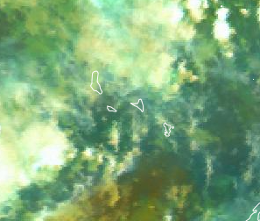
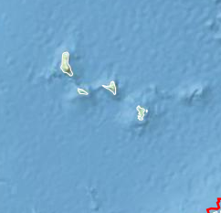
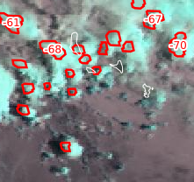
VERIFICATION
AIRMASS RGB AT 1900
AIRMASS RGB AT 04:15
RDT AT 2215
RDT AT 0515

