Slide 1
Daily weather forecast/NWC for 18UTC 27 Feb to 06UTC 28 Feb 2024
Team 4
Houssein & Nilton

Slide 2
Satellite Image
IR
Severe Convection RGB

Slide 3
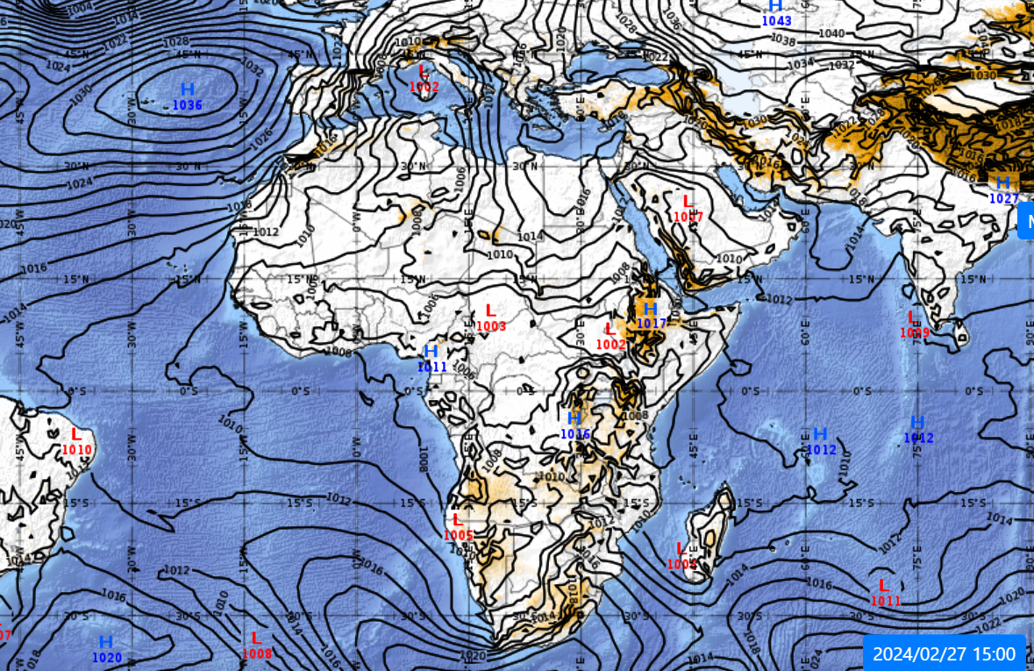
MSLP
forecast
Current

Slide 4
HR
700 hPa
850 hPa

Slide 5
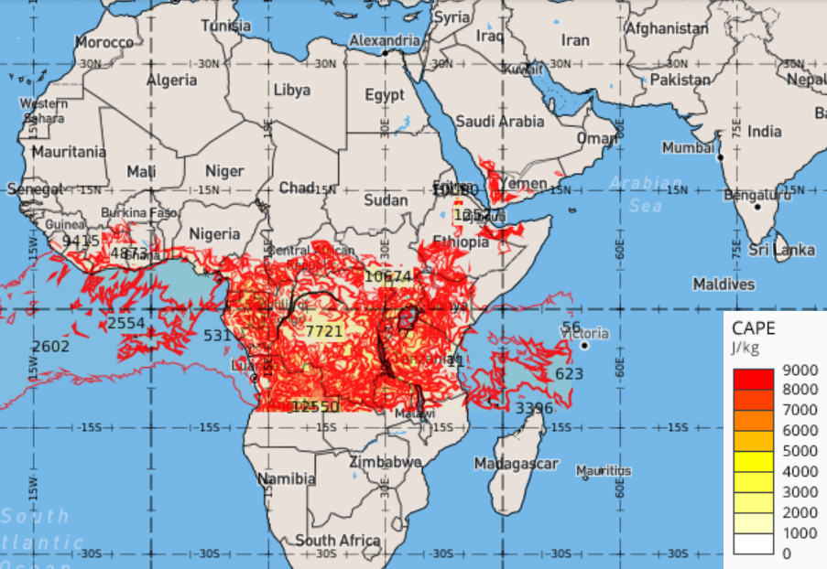
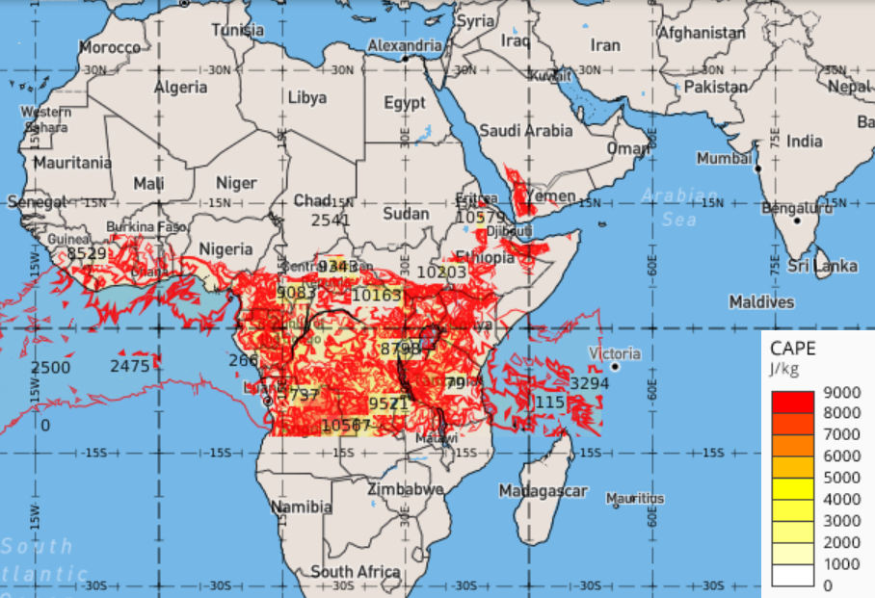
CAPE
18 UTC
21UTC

Slide 6
Wind
850 hPa
700 hPa

Slide 7
Rainfall
18-00UTC
00-06UTC

Slide 8
Conclusion
there is convective clouds over Southern parts of EA and Nothern parts of SA.
Forecast indicate high RH over South-eastern part of the continent and easterly moderate winds.
In the same above mentioned area the CAPE value is very high which shows the presence of the convective instability around this area.
Taking into account all these conditions there is a high chance of Rainfall, thunderstorm and moderate winds over Kenya, Uganda, Mozambique, Madagascar, Malawi, Zambia, Angola.

Slide 9
Verification

