Slide 1
Case study
Forecast - 27/02 18 UTC and 28/02 06 UTC
Group 2
Gaella-Bentricia Bitsoumani-Ngouaya
Nabil HASSAINE
Stephanie Vanessa Ashu Ngono
Wafa Khalfaoui

Slide 2
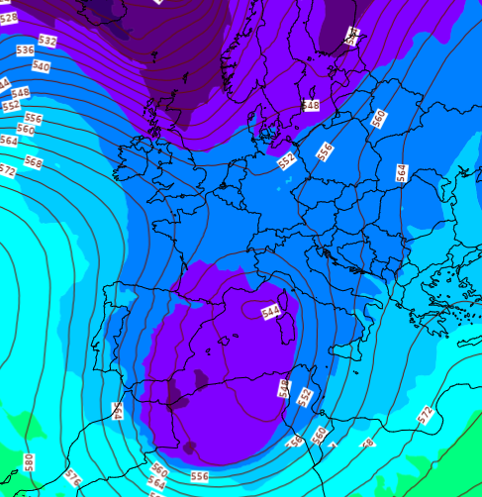
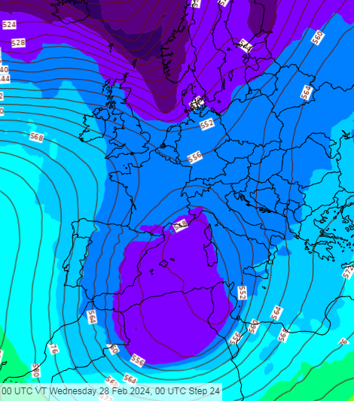
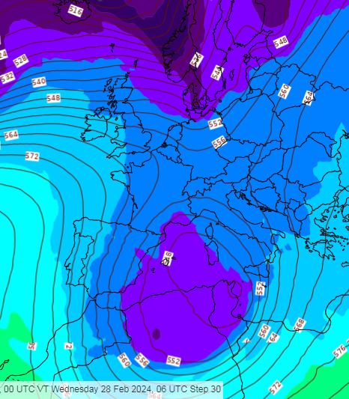
GP 500 hPa
18H UTC
00H UTC
06H UTC
A small shift of the GP Low (5430 gpm/-27°C) from Corsica at 18 UTC to NE coast of Tunisia at 06 UTC.
Cold polar air infiltration with Thalweg reaching south Algeria.

Slide 3
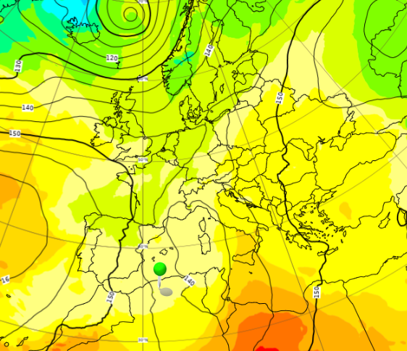
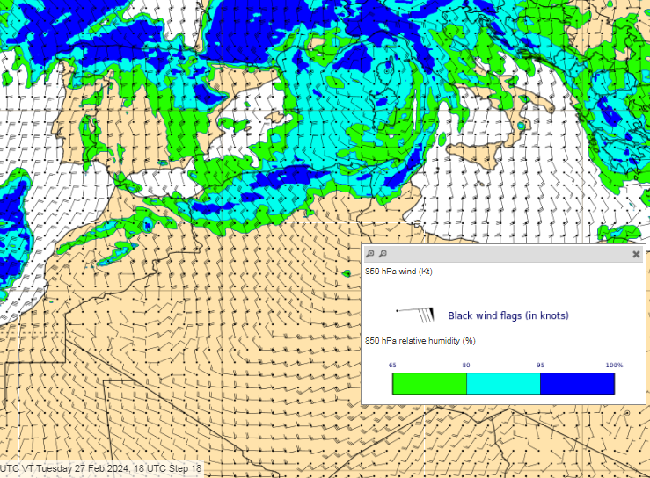
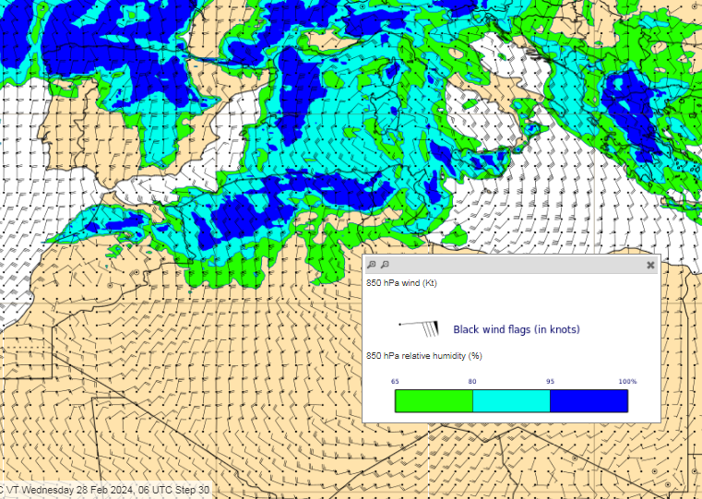
GP & T at 850 hPa
A GP Low (1380-1400 gpm/ 2°C) over Corsica at 18 UTC and isotherm 0°C over the North of Algeria
Increase of the humidity from 18UTC to 06UTC
RH & Wind at 850 hPa
18H UTC
00H UTC

Slide 4
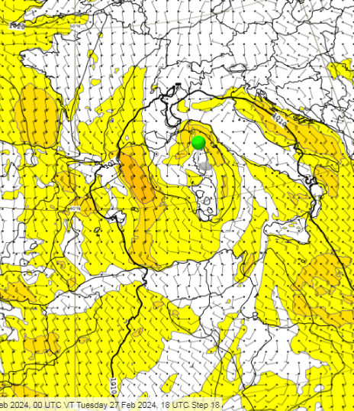
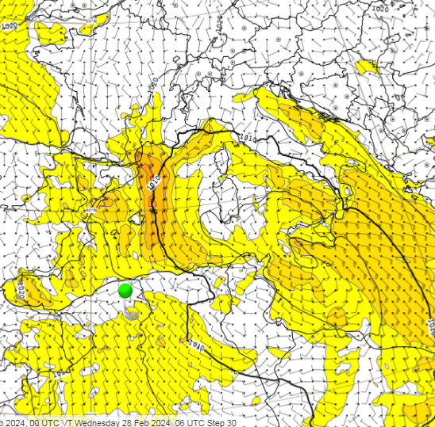
MSLP
18H UTC
06H UTC
A Low (1003 hPa ) over Genoa Gulf at 18 UTC moving gradually to the South-East and deepening. Expected 999 hPa over Sicily at 06 UTC.
Wind Speed: 30-35KT at 18UTC in the Mediterranean Sea and 15-20 KT over the Algerian – Tunisian coast.

Slide 5
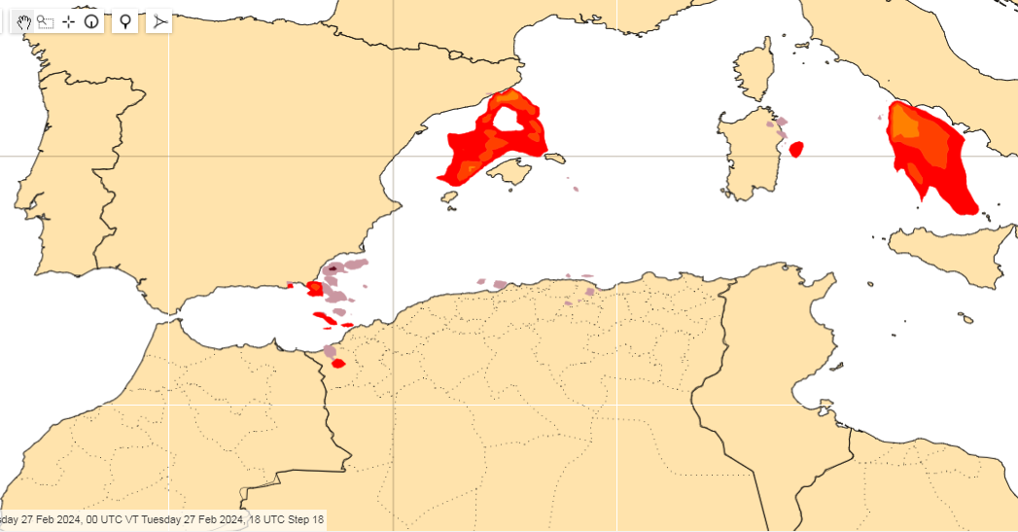
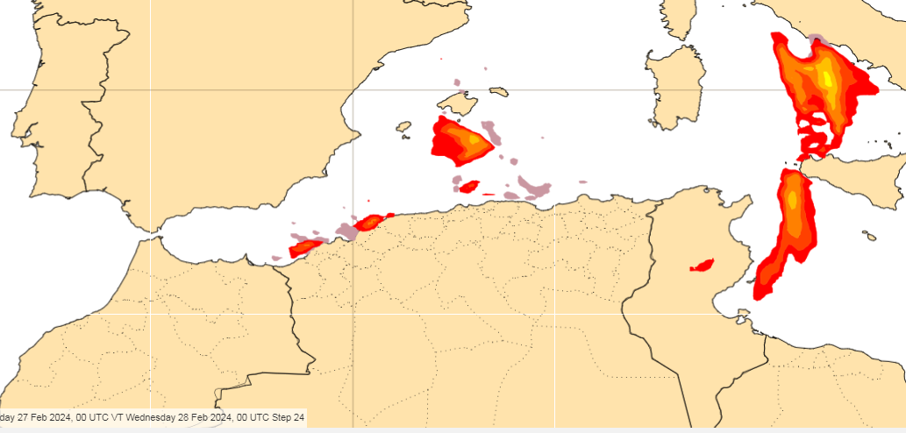
CAPE / Lightning
18H UTC
Instability between Tunisia and Italy (Warm Front).
00H UTC

Slide 6
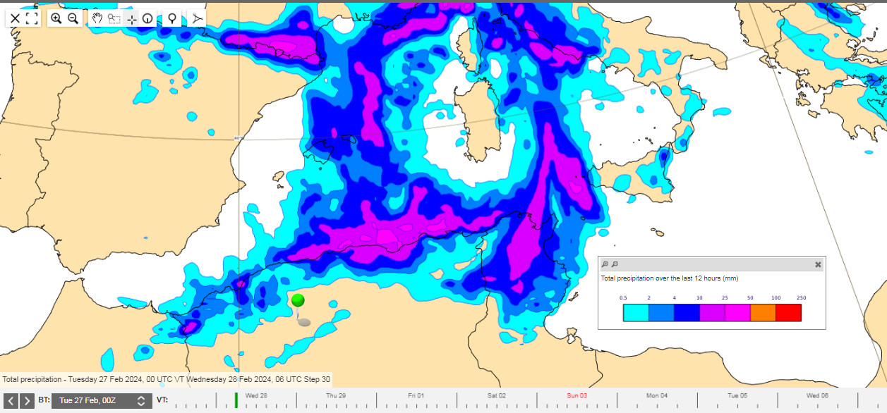
12 H Total Accumulated Precipitation between 18-06 UTC
Precipitation between 20-30mm reaching a maximum of 40mm on the coast of Algeria

Slide 7
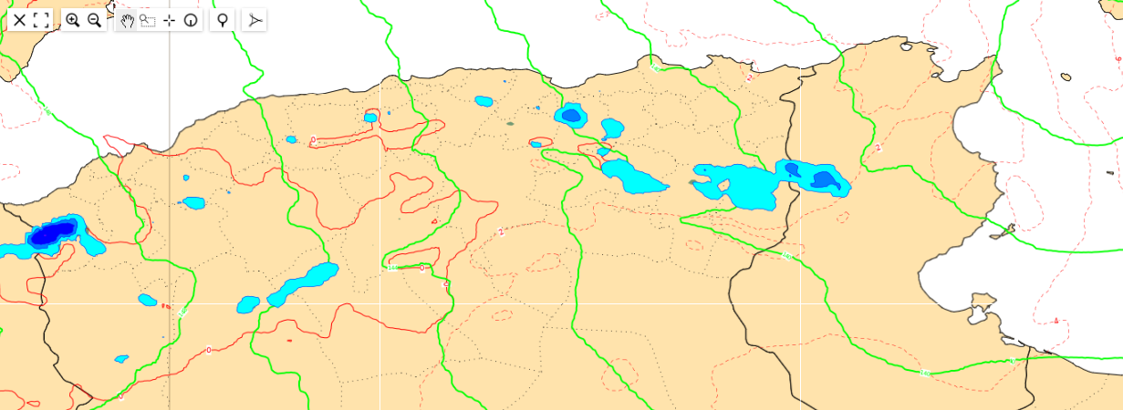
Snow 18-06 UTC
Snow over the Atlas mountains (above 1000 meter): ~ 5-10 cm Algeria and 2-5 cm Tunisia

Slide 8
Forecast - 27/02 18 UTC and 28/02 06 UTC
- Rain + Hail with thunderstorms expected over Algeria and Tunisia between 20-40 mm.
- Snow fall over the Atlas mountains (above 1000 meter)
- Moderate to Strong Winds and thunderstorm gust over Algeria and Tunisia coast

Slide 9
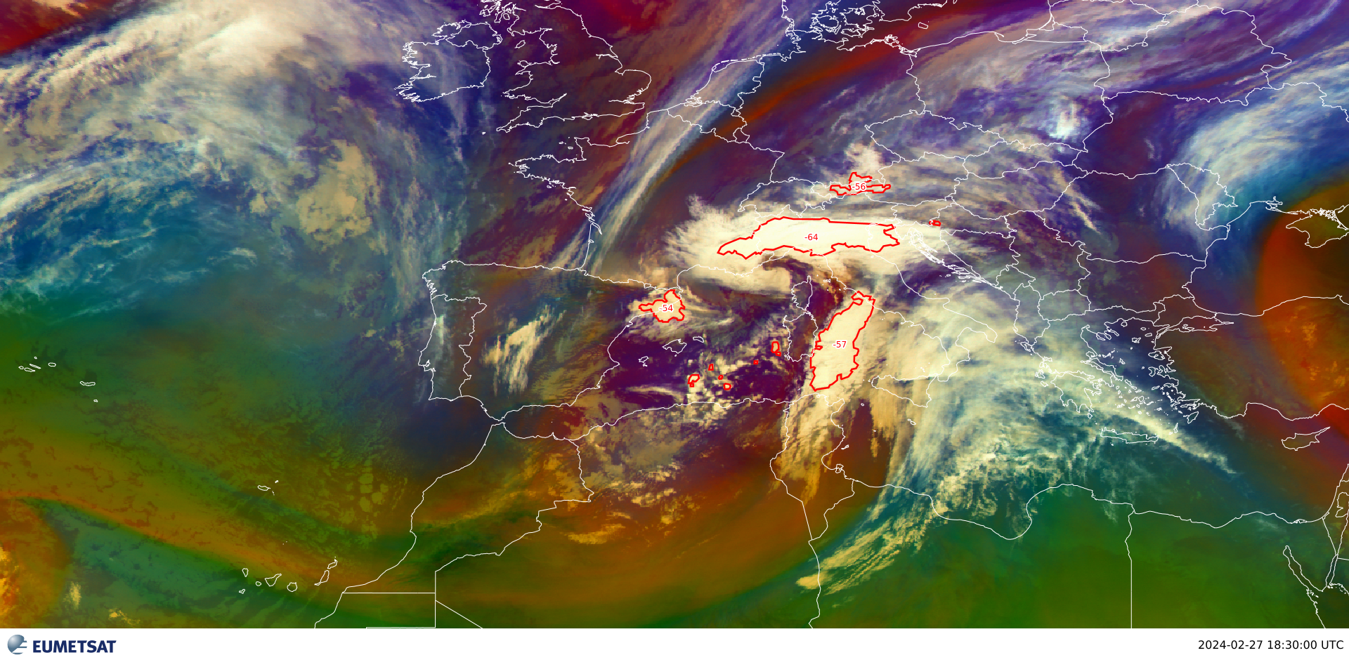
Satellite Image – 18H30 UTC
Air mass RGB + RDT

Slide 10
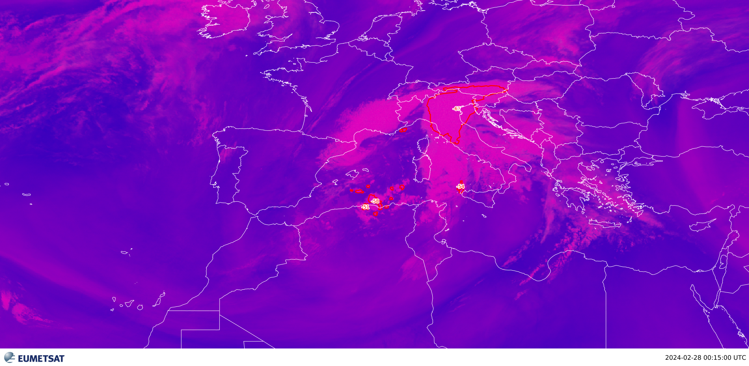
Satellite Image – 00H15 UTC
convective RGB + RDT

Slide 11
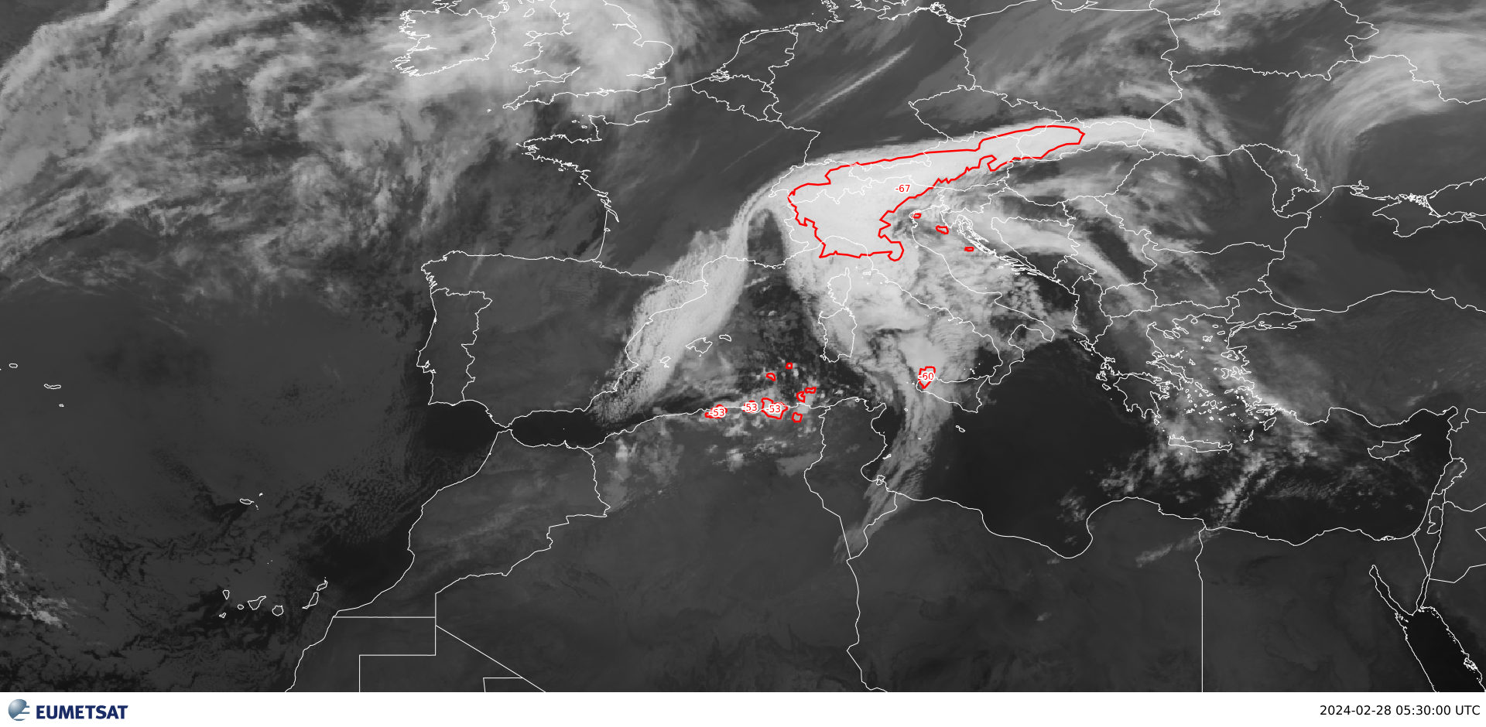
Satellite Image – 05H30 UTC
IR 10.8 + RDT

Slide 12
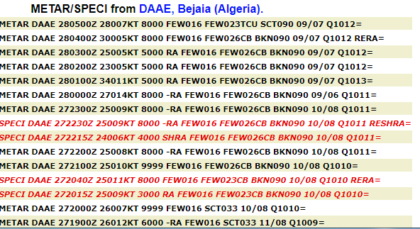
Observations

