Slide 1
Current Weather over Northern Egypt; 27 & 28-02-2024

Slide 2
Efffect of Syberian High Surface Profile; 1500z, 27-2-2024

Slide 3
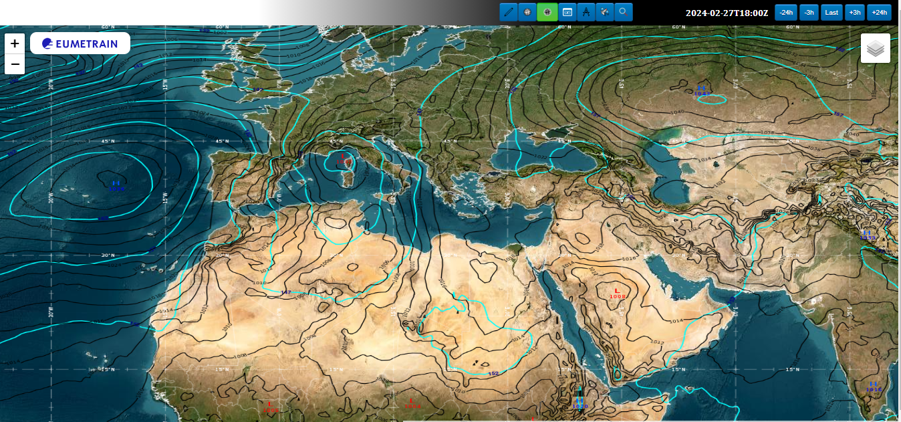
Surface & 850 mB Profile 1800z, 27-2-2024

Slide 4
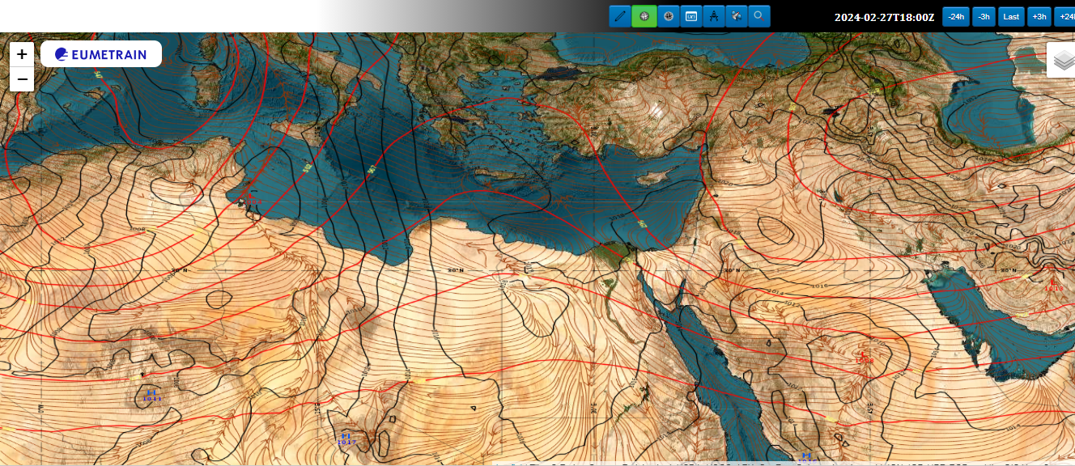
Surface & 500 mB Profile 1800z, 27-2-2024

Slide 5
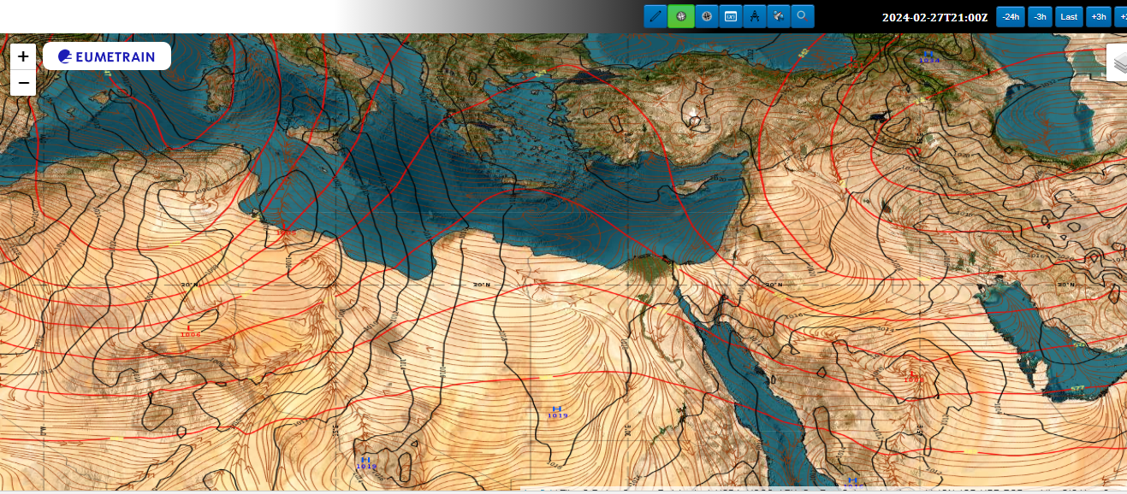
0000Z, 28-2-2024

Slide 6
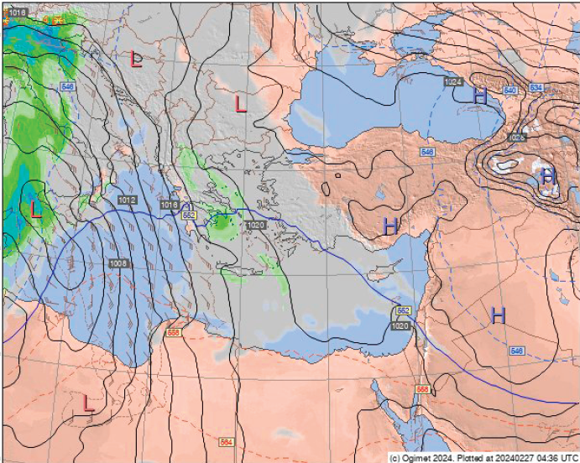
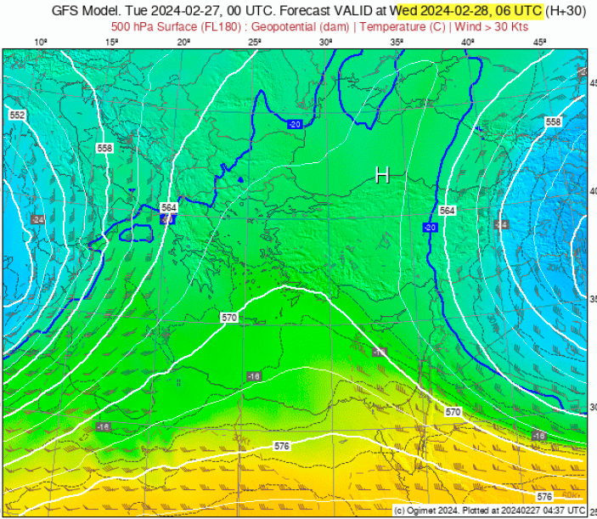
At 0600Z

Slide 7
At 1800Z

Slide 8
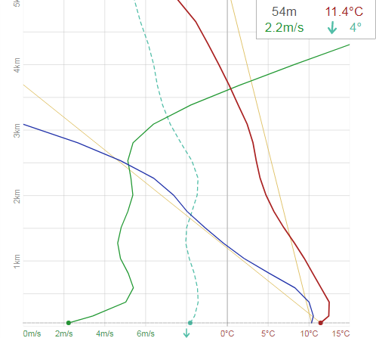
Ver. Prf. 0000Z, 28-2-2024

Slide 9
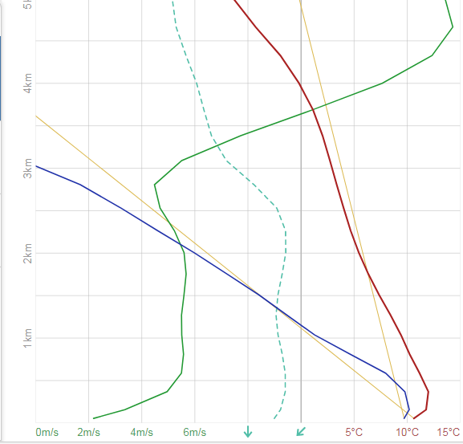
Ver. Prf. 0300Z, 28-2-2024

Slide 10
Discussion:
The surface high pressure over northern Egypt is extended aloft, with no significant upper air cooling.
We expect the sky will be clear for most of the time from 1800Z (27-2-23024) to 0000z of Thursday 29-2-2024 with little amount of low clouds (not more than 3 octans), since the air column is nearly homogenous over northern Egypt.
Surface visibility will be more than 10 KM, except in presence of BR or FG, during nighttime or early morning hours, with values equal to or less than 3000 meters.

Slide 11
Discussion (Continued)
At night , from 2200Z; 27-2-2024 to 0500Z of 28-2-2024, wind speed will be small (VRB) and Calm, with high RH values approaching 100% due to the north-eastern direction/bearing of the surface wind, wet and hazy winds.
So, there is a big chance for the formation of mist (BR) or even fog, especially over northern coasts and Nile delta, where vertical profile shows a little thermal inversion near ground, as a feature of the prevailing surface high pressure

