Slide 1
Weather forecast for Nairobi
27th Feb 2024 @ 18z
till 28th Feb 2024 @ 06z

Slide 2
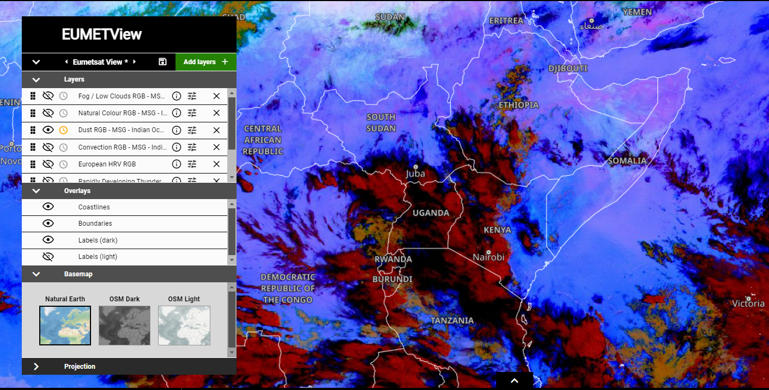
Satellite pics from eumetview @1330 utc
Convection RGB and Dust RGB channels showing CB clouds over Nairobi. Dust RGB channel also indicating presence of high humidity within the region (dark blue) which is favourable for more cloud developments.
Convection RGB Dust RGB

Slide 3
metars from Nairobi wilson airport(Observed weather)

Slide 4
Video of ECMWF mslp & surface wind charts

Slide 5
Video for 850 wind charts on ecmwf

Slide 6
Video for 700 wind charts on ecmwf

Slide 7
Video for 500 wind charts

Slide 8
Video for 200 wind charts

Slide 9
ECMWF metgram for nairobi

Slide 10
Video for Rain and mslp charts on ecmwf

Slide 11
Weather forecast
Warm and humid south easterly airstream blowing over the region.
On 850 hpa at night and today morning, trough associated with perturbed flow crossing
A cyclonic flow NE of the region on 700 hpa & 500 hpa, the region will still be under influence of this cyclonic flow till tomorrow 06z
Based on MSLP & Rainfall charts and metgram above
Moderate to heavy Showers with risk of isolated TS is expected tonight,
However the showers are expected to become less frequent during the morning.(According to metgram there is high possibility for afternoon showers also)
Visibility will be greatly reduced and fog patches will be present on highgrounds at night and during early morning.
Winds from Northern sector around 15km/h(Due to presence of low to the NE)
Mean max temp slightly lower due to the cloud development & showers
Mean min temp will be slightly higher due to cloudiness

Slide 12
Forecast Verification using metars

Slide 13
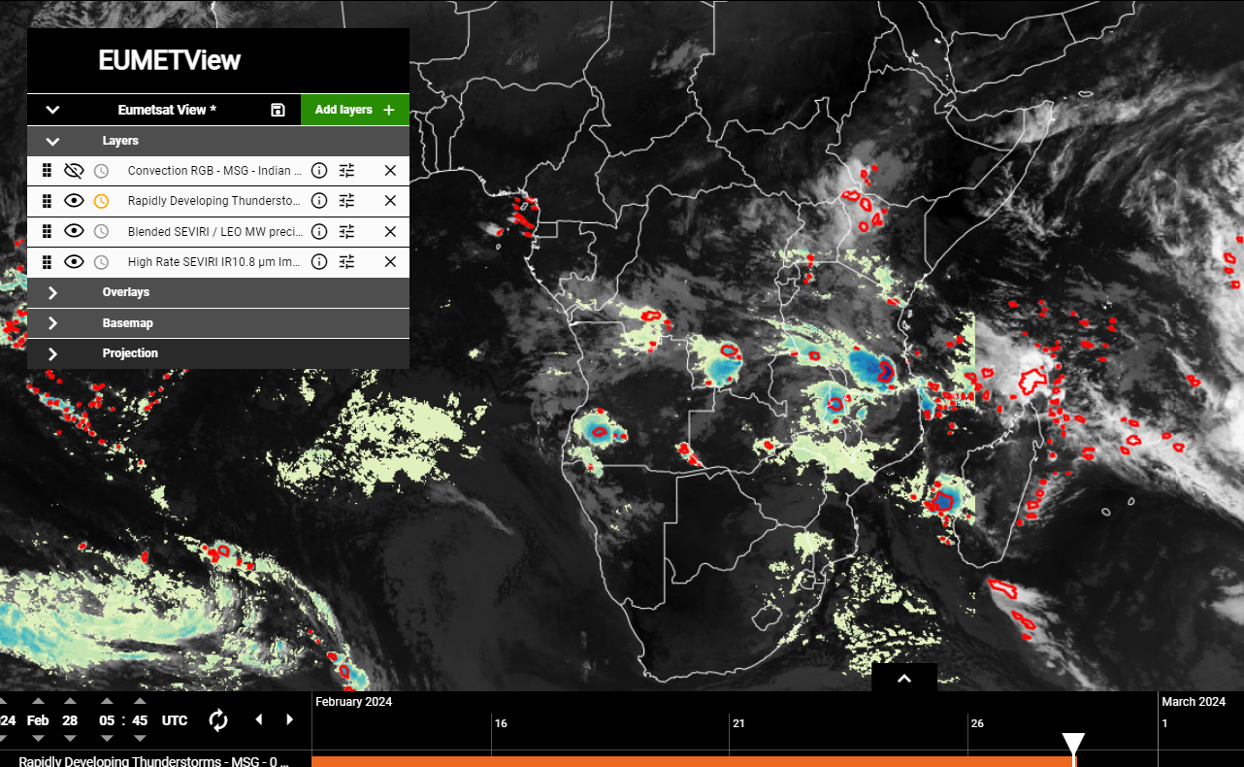
Forecast verification using satellite pictures

