Slide 1
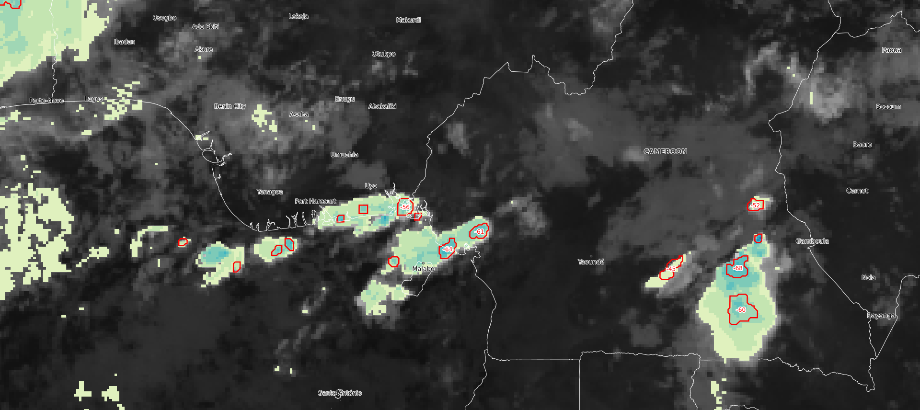
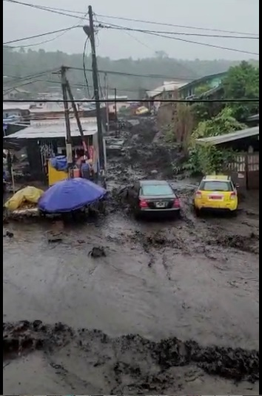

Heavy rains caused floods in the streets of Cameroon, Limbe- 19 July 2023
-Limbe, is a coastal town located in southwestern Cameroon. It lies along Ambas Bay in the Gulf of Guinea, at the southern foot of Mount Cameroon.
-Convective clouds with minimum brightness temperature of -63.83 °C developed over the area.
-The heavy rain in this area that resulted from these convective clouds led to the flooding of streets, hospitals, mudslides and drowned vehicules due to a poor drainage system and loose muddy soils.
-Forecasting floods accurately could reduce the loss of lifes and properties that result from this.
LIMBE
LIMBE 19 JULY 2024
Figure. MSG-0 Degree : Blended SEVIRI/ LEO MW Precipitation and Morphologic Information, 19 July 2023, 05:15 UTC.
Heavy rain was registered along the coast.
ASHU NGONO Stephanie Vanessa, DMN CAMEROON and BITSOUMANI-NGOUAYA Gaella-Bentricia, ANAC/DM CONGO

