Slide 1
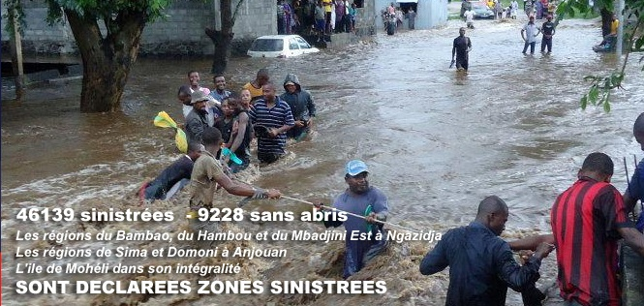
Title : TROPICAL CYCLONE CAUSED FLOODS IN SEVERAL REGIONS IN THE COMOROS, April 24-25, 2019.
On the night of April 24 to 25, 2019, tropical cyclone Kenneth passed close to the Comoros archipelago causing significant flooding. Cyclone Kenneth mainly affected the island of Grande Comore and to a lesser extent those of Anjouan and Mohéli.Kenneth's passage caused the death of six people and left 200 injured. 4,854 houses were severely affected or destroyed. Livestock and agricultural production have been heavily impacted, putting food security and local livelihoods at risk. In total, 185,000 people were impacted.
Figure: Degree MSG-0: Precipitation rate on the ground by High Rate SEVIRI IR10.8, from April 24 to 25, 2019, 3:00 p.m. UTC.
ARCENE MOHAMED and MONIQUE KOUMBA

