Slide 1
Title : Phenomenon - Date
Explain briefly which weather feature we can see in the satellite image. Describe also what happened and what impacts this weather event caused.
Add here 1-2 additional explanatory images (NWP, Sounding, observation or a photo of the event, etc)
Add the satellite image in the space above.
Write the product name, the date and hour. Write a few lines about what we can see in the ímage. You are encouraged to choose the most useful image for your case to describe the event.
Add your name and your institute here

Slide 2
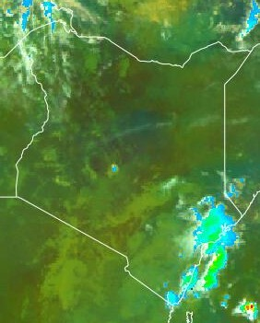
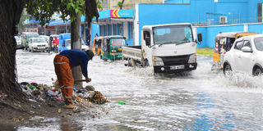
HEAVY RAINS CAUSED FLOODS IN THE STREETS, 04 MAY 2022
Mombasa is a city in Kenya located along the coastline near the Indian Ocean. It experienced floods in its streets causing disruption of transportation as roads were already submerged.
Deep convective clouds formed over the region. They resulted to heavy downpour.
The heavy precipitation caused flooding in the streets due to the drainage systems being poor.
EXAMPLE
The accuracy of floods forecasting has to be very high. Damages due to floods has been increasing and thus need to rely floods warning and advisories early enough.
Mombasa
Mombasa , 04 May 2022
Figure. MSG-0 Degree : Precipitation rate at ground by GEO/IR supported by LEO/MW, 04 MAY 2022, 09:00 UTC.
Heavy precipitation was experienced along the coastline resulting to flooding of the areas.
Phinous Othoo , IMTR

