Slide 1
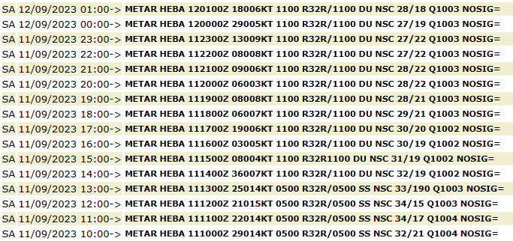
Sand Storm over Egypt, 10 Sep 2023
A low depression formed over Libya and was then directed to Egypt.
A Sand storm formed due to strong wind, high temperature and the topology of the west part of Egypt.
Observations on Borg Elarab and Cairo international airports.
Add here 1-2 additional explanatory images (NWP, Sounding, observation or a photo of the event, etc)
Dust RGB – MSG - 0 Degree , 10 Sep 2023, 17:00 UTC to 12 Sep 2023, 03:00 UTC.
A heavy sand storm moved from the west of Egypt to the east.
Abdelaziz Elhelbawy – Egyption Meteorological Authority

