Slide 1
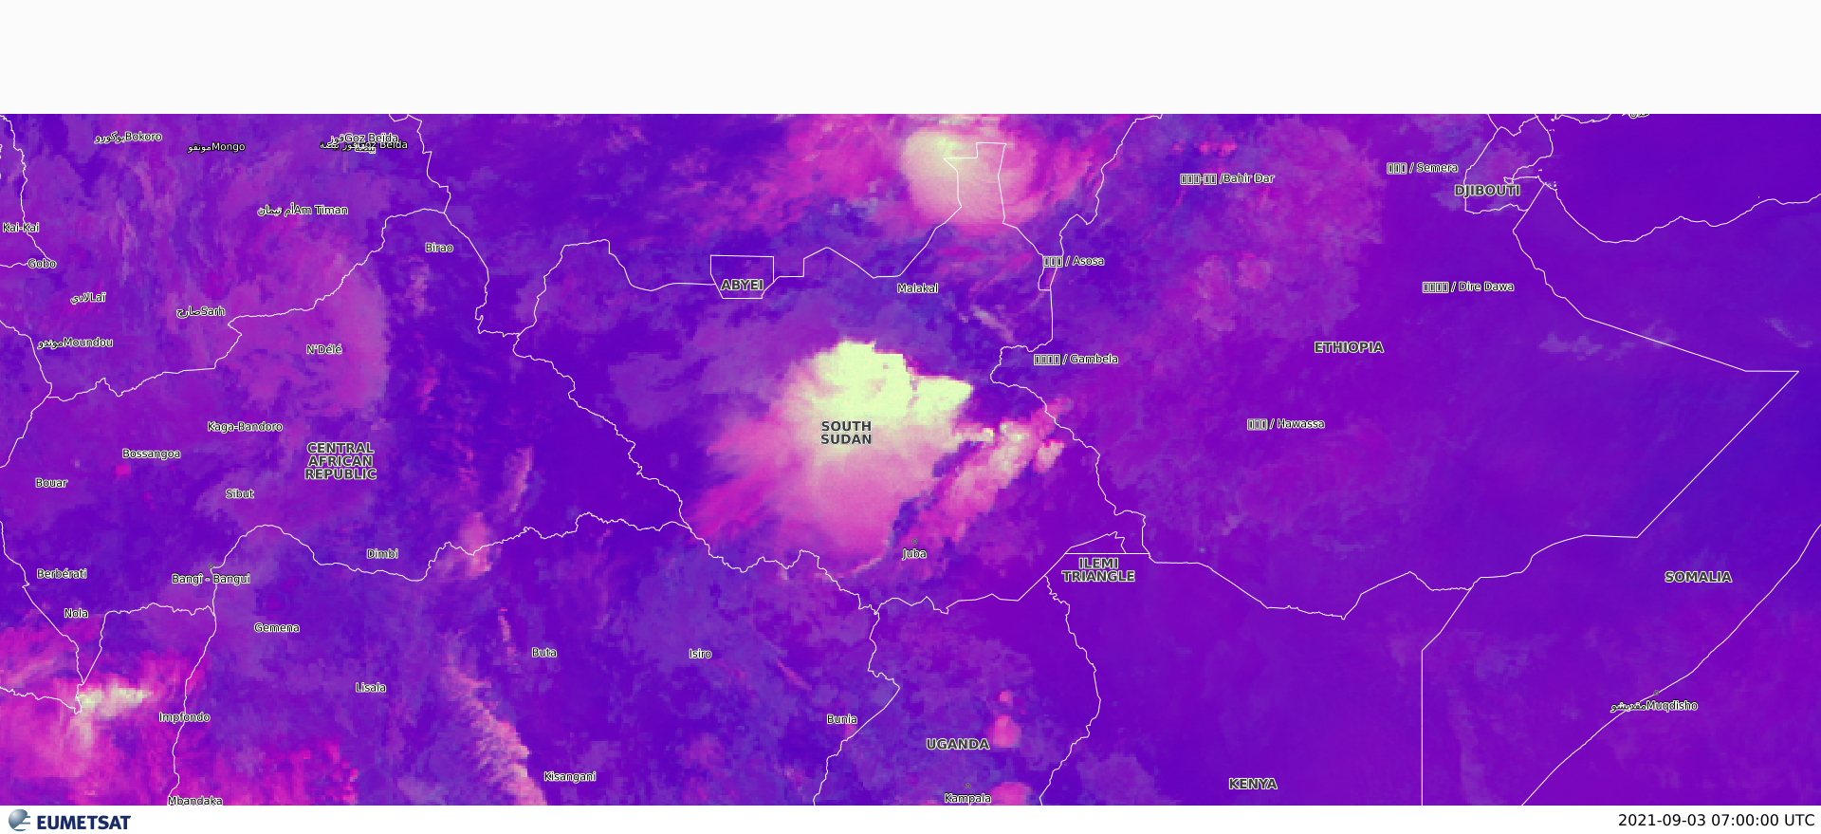
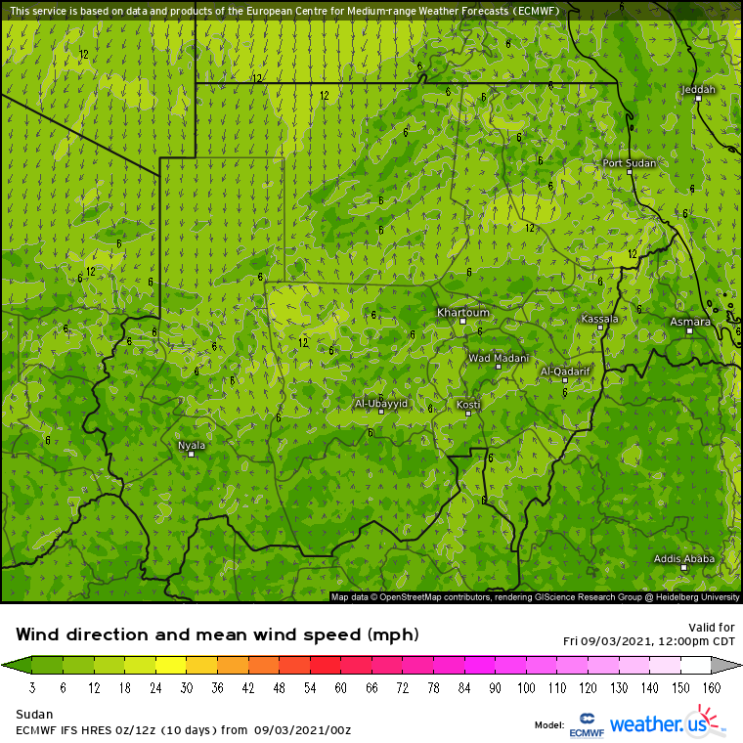
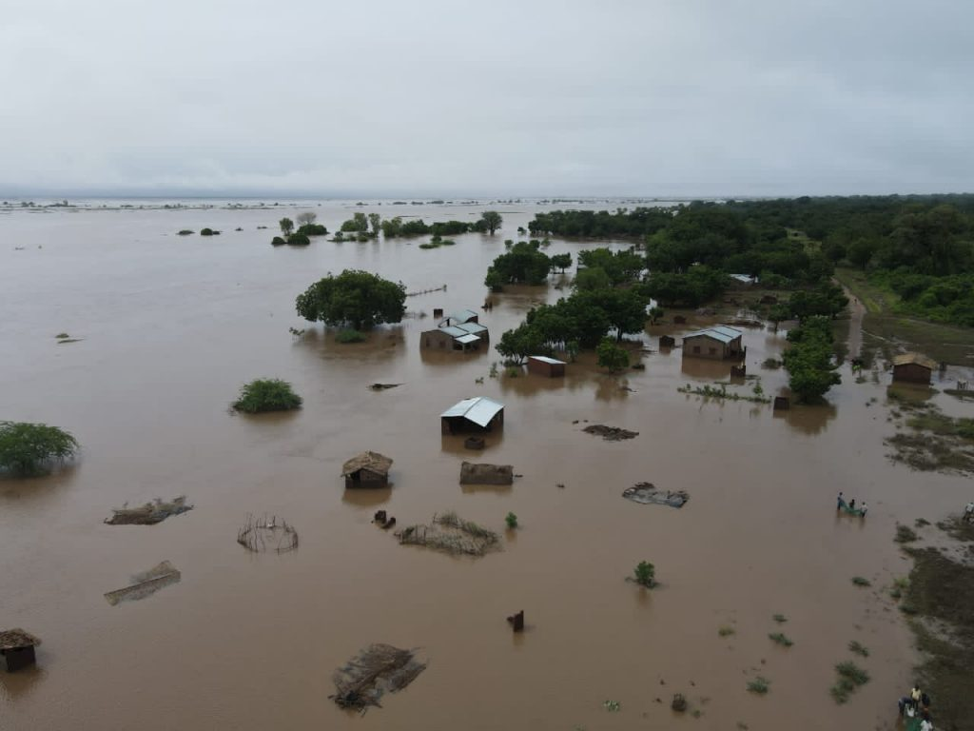
ITCZ Influences over South Sudan (Bentiu)– 03 September 2021
Bentiu is a town located in North Central part of the country.
Deep convective clouds formed over the area, resulted to heavy thunderstorm with rain.
The heavy precipitation caused flooding in the due to the area topography (flat).
Its an upstream town, rainfall elevates lake Victoria and lake albert’s water levels, and increase the flow of other sources that feed the white Nile.
The floods has affected 220,000 people, of whom 110,000 were internally displaced.
Convective clouds over bentiu
The map left from (ECMWF MODEL) showing the convergence zone caused by two different air masses, showing the location of the ITCZ, which has reached most northerly position up to 20° N, following the area of most intense solar heating or warmer surface temperature.
RGB convection image, showing convective clouds cells (cbs) over bentiu on Sep 03 2021 at 07:30 UTC.
Aciek, Madeleine/ SSMD &

