Slide 1
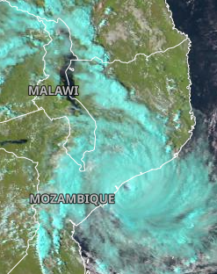
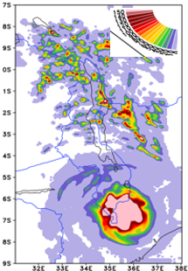
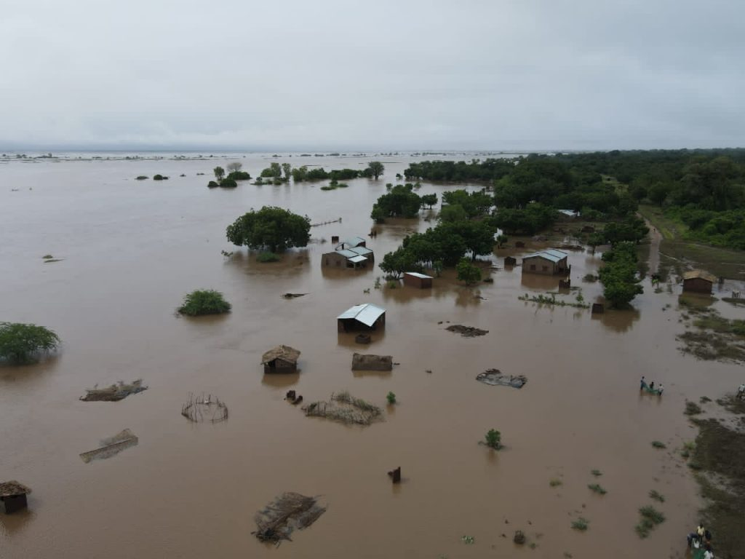
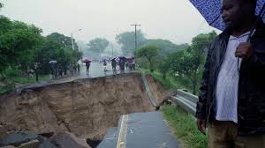
TROPICAL CYCLONE FREDDY OVER MALAWI – 10-12 MARCH 2024
Malawi was affected during the period of 11-15th March. Freddy developed over Australia region and was named by the Australian Bureau of Meteorology on 6th February 2023. The system then crossed the entire southern Indian Ocean and made four landfalls in Africa; 2 over Madagascar and 2 over Mozambique. It was during the second landfall over Mozambique when Cyclone Freddy posed a threat over Malawi. The expected hazards were; strong winds, heavy rains and floods. With the assistance from satellite images, the department managed to warn the nation on heavy rains and possible threat of floods mainly over the south.
TROPICAL CYCLONE FREDDY
Natural color RGB, showing Intense Tropical Cyclone Freddy making a landfall over Mozambique on March 11 2023 at 11:30 UTC. Freddy caused strong winds and heavy rains which resulted into Flooding and mudslide mainly over the south.
A local NWP, COSMO showing 24 hourly rainfall expected on 11th March 2023 and the impact of Freddy over the southern Malawi as some areas received. Some areas 3 days cumulation exceeded 1000mm.
BRENDA MDZAGADA-SOKO, DCCMS - MALAWI

