Slide 1
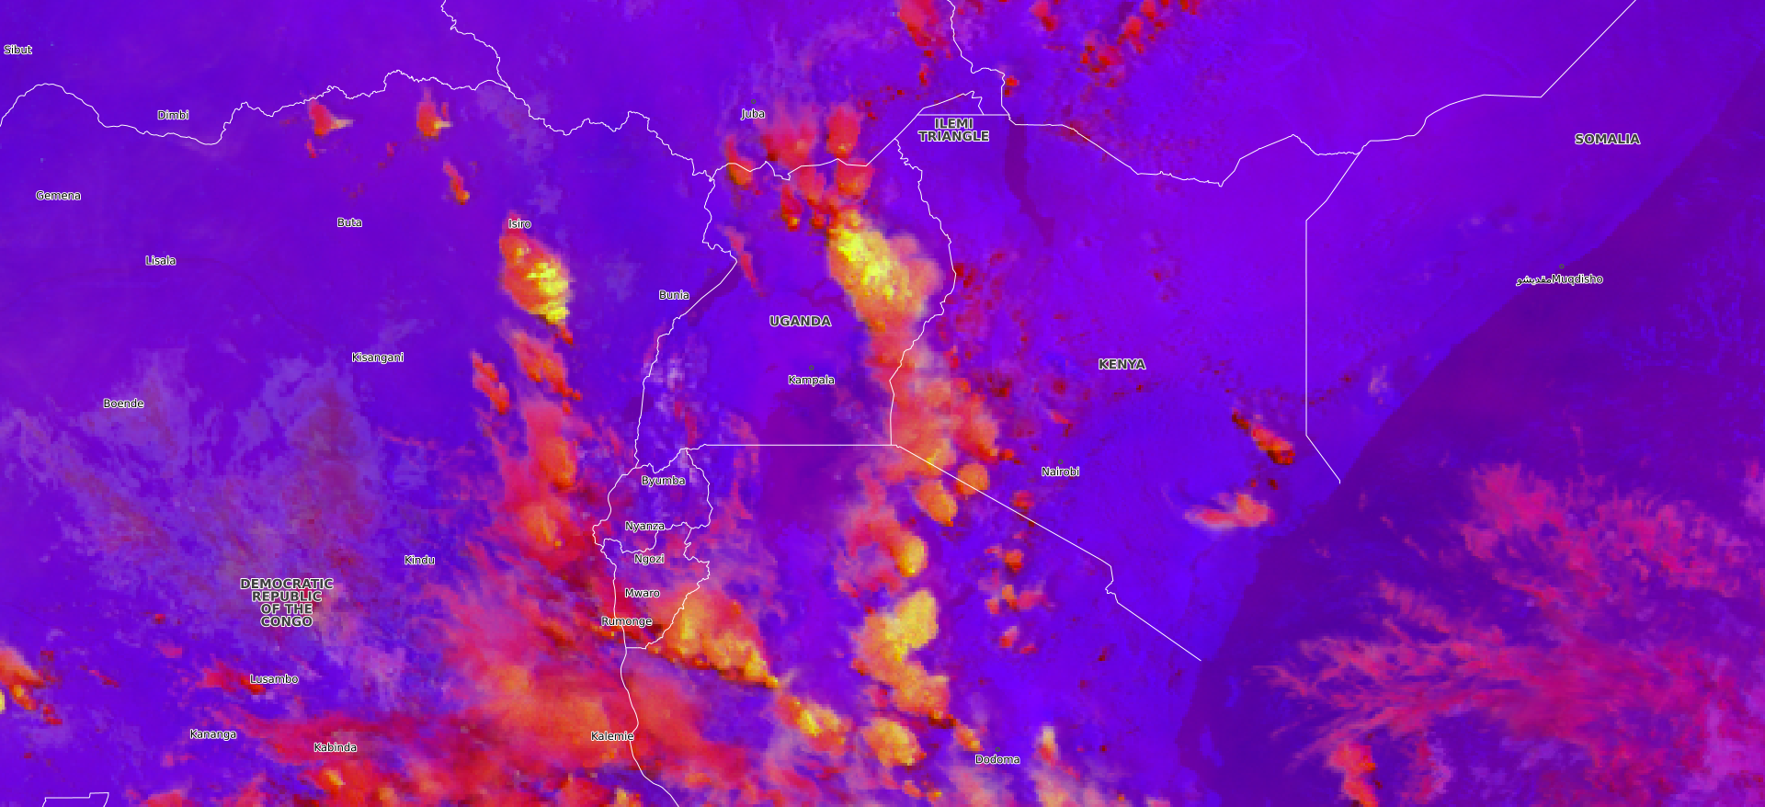
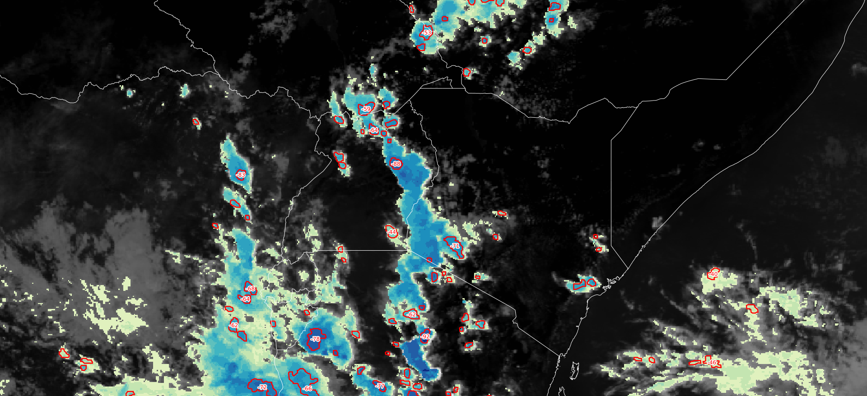
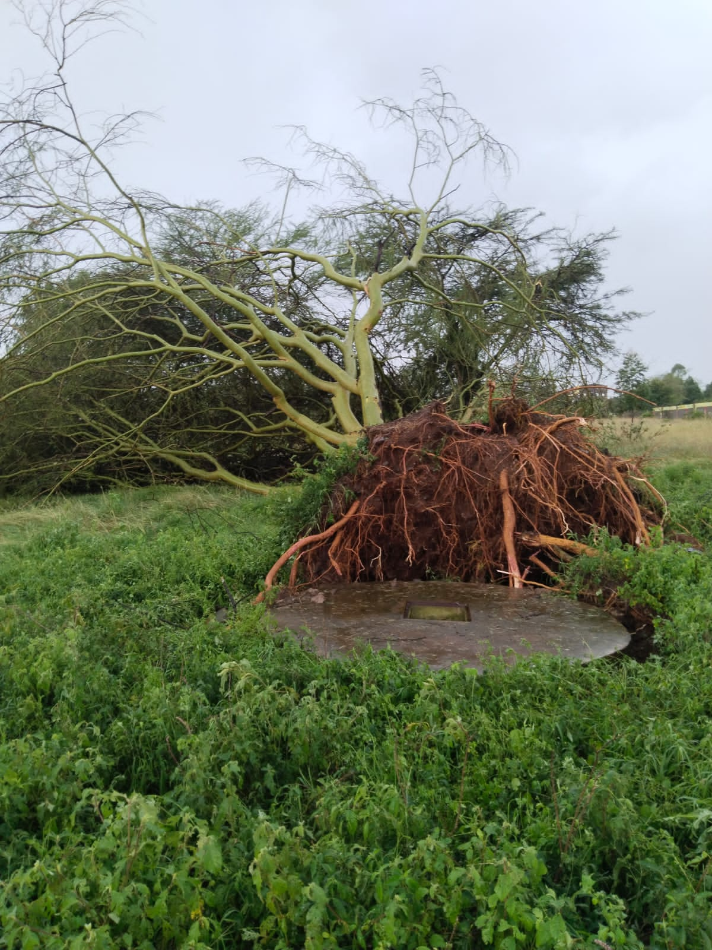
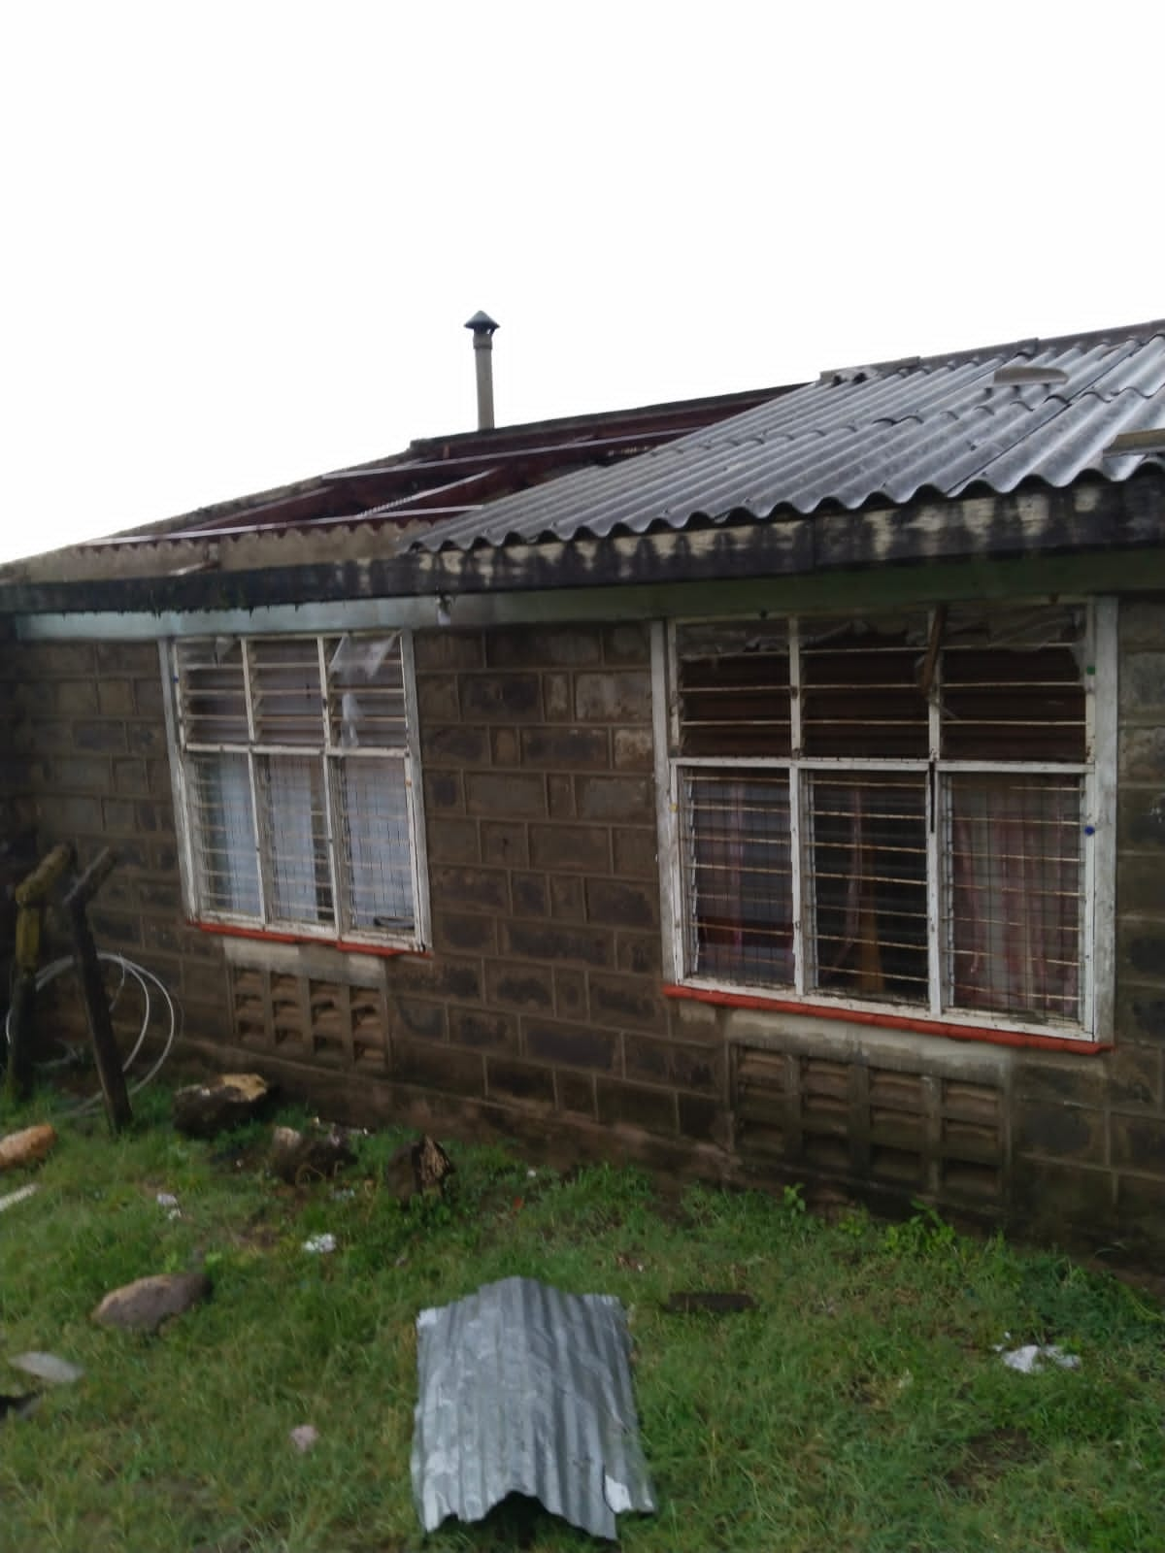
Cloud burst at Narok-Kenya on 10th February 2024
There was a very active cumulonimbus around Narok leading to heavy precipitation and a cloud burst around the KMD Narok station. (+TSRA)
The downdrafts had very strong Wind gust, this resulted in the uprooting of trees and also some houses had their roofs blown off besides uprooting power lines.
Convection RGB(top) Rapidly developing thurnderstorms both at 1345Z on 10th February 2024
Narok is to the West of Nairobi. Top image shows an active precipitating CB. The area had a lot of convective activities
Humphrey Geoffrey Angulu, WMO-RTC, Nairobi 29th February 2024

