Slide 1
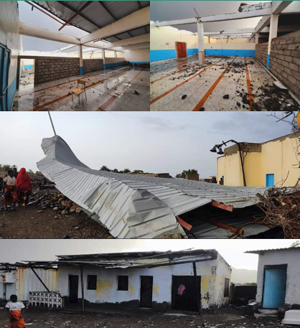
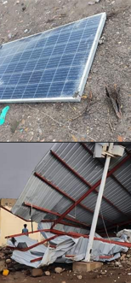
Convective Storm across the Sagallou Area, Djibouti – 05 August 2023
Sagallou : is a small city situated on the Gulf of Tadjoura, in Djibouti. It experienced Convective storm which caused many houses of collapsed and unroofed.
Convective storm is a result of the convective instability which normally Mountainous regions of Djibouti experience in the summer time when the sun heats the surface (T => 35°C ) and strong north-westerly winds bring warm air.
NWP models usually find challenges to predict local phenomena and it is difficult to forecast this without knowing climatology of the area.
Sagallou
The animation is Convection RGB - MSG - 0 degree, 05 August 2023 (11:00 – 16:00 UTC)
The above satellite image animation shows the formation and development of convective clouds over the inland of Djibouti specially high grounds of Tadjoura region.
.
.
Houssein Darar Dirieh, Djibouti National Meteorological Agency

