Slide 1
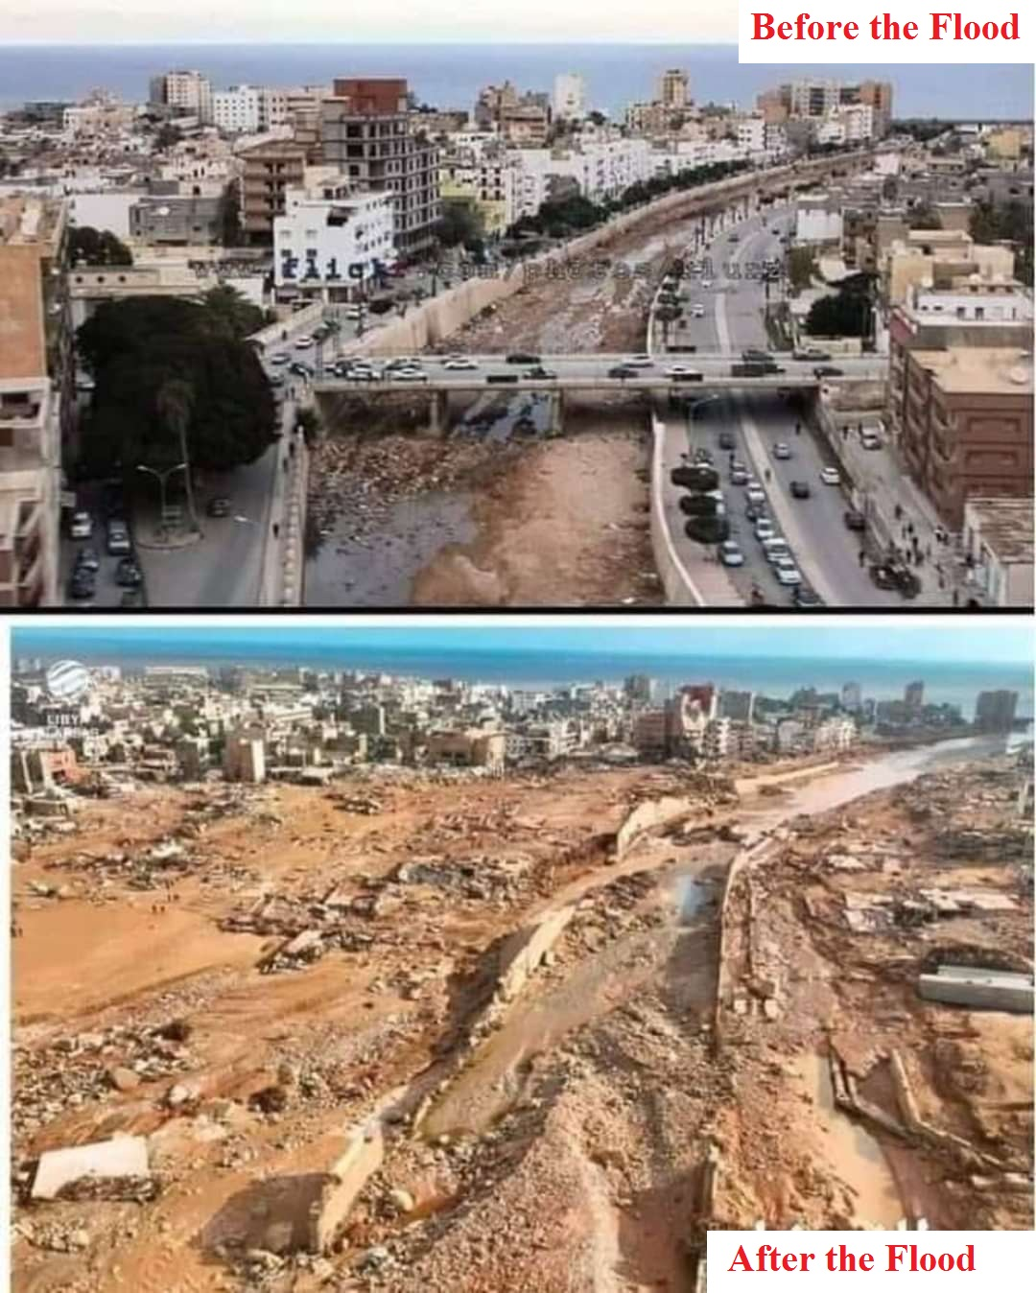
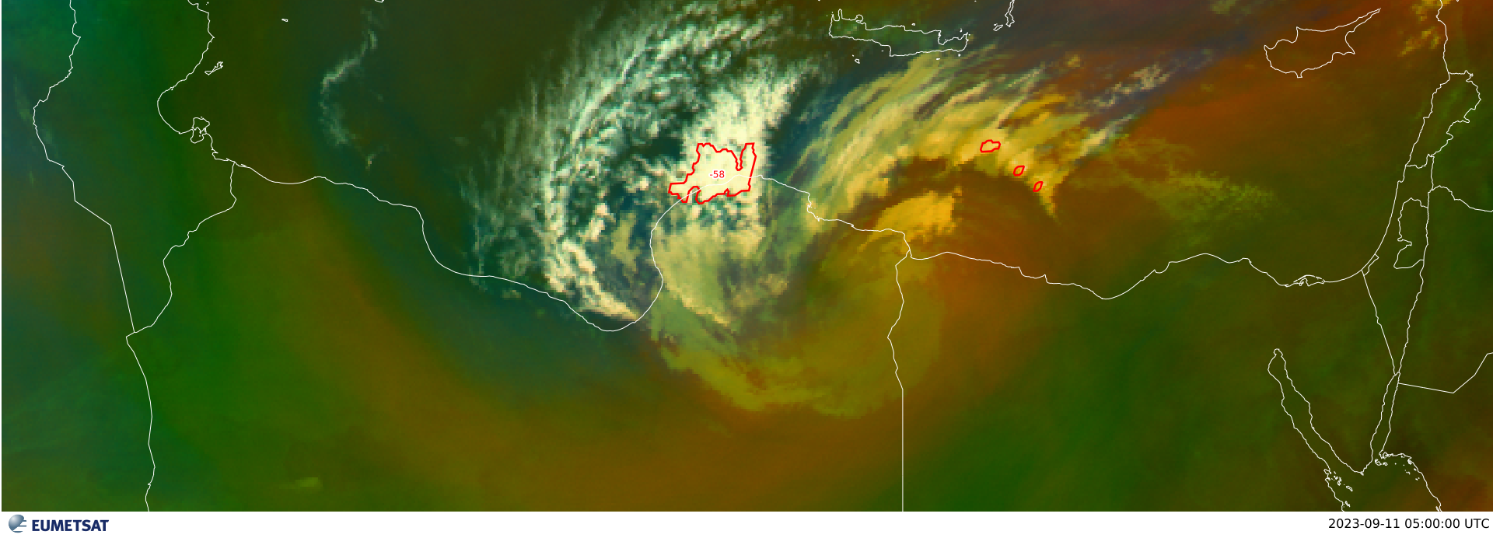
Derna Disaster Medicane – 10 & 11 Sep 2023; Haven’t we learnt the Lesson Yet ? !!!
A mediterranean sea hurrican, a Medicane, has been formed over the coastal city Derna in northern east of Libya located on the mouth of the deep Derna vally which is surrounded by Al-Akhdar Mountain heights.
There was a deepened surface low pressure cell accompined with strong convergence in upper air levels [850, 700 and 500 mB] with a strong jet stream winds exceedig 80 KT in the 300 mB level. It was a perfect storm that caused a powerful vertical Positive Vorticity Aea (PVA), causing a very heavy shower rain all the night of 10th and 11th of last Septemper and , as described by a local official, the usual yearly precipitation has just fallen in these few hours of that omenous night till morning.
All this rain water gathered beyond the Derna Vally Dam that had not been mintained or developed for the last 12 years, due to the ongoing civil war and the corrupion of local authorities. The result was the sudden collapse of that dam under the tremendous rain water pressure, and a huge flood wave, with a 30m height, sacked everything in its way to the sea coast, devastating and removing third of Derna city from the Earth’s surface into the sea. The death toll was finally more than 25,000 souls, with more than 10,000 lost, in just 2 hours of flood !!! Poor souls ☹ ☹. A catastrophy that could be avoided in good peace times.
This horrible disaster could be avoided, even with the presence of a simple meteorological forecasting services. So, not only wars destroy human civilizations, also carelessness and corruption will do the job. Only peace and justice keep civilizations. War and corruption destroy humanity and anything good. Haven’t we learnt the lesson yet ?
The upper photo shows the physics of the situation [surface isobars in black and 500 hP isobars in red] from surface level to 500 hP level, at 11th Sep. 2023; 0300Z, overlapped with the Eumetsat photo [IR10.8 & enhanced IR10.8 µm] showing the structure of this medicane, with colored temperatures of the tops.
2nd photo is an air-mass RGB sat of the same region, showing the evolution of that cyclone, the power support – red arrow- from the sea and the upper-air streak. Also added is the fast developing contour of thunder storms making the medicane occluded front.
Usama Saleh Ahmed AbdELKAREEM , EMA, Cairo, Egypt.

