Slide 1
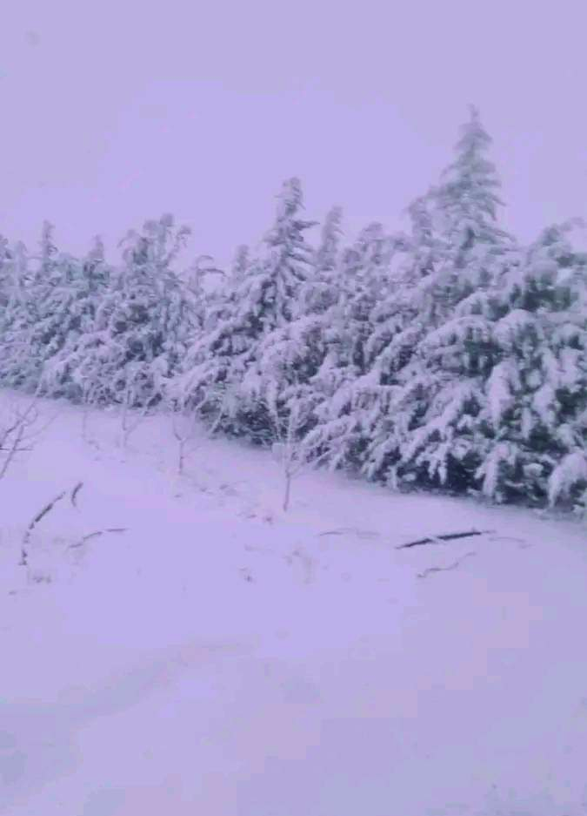
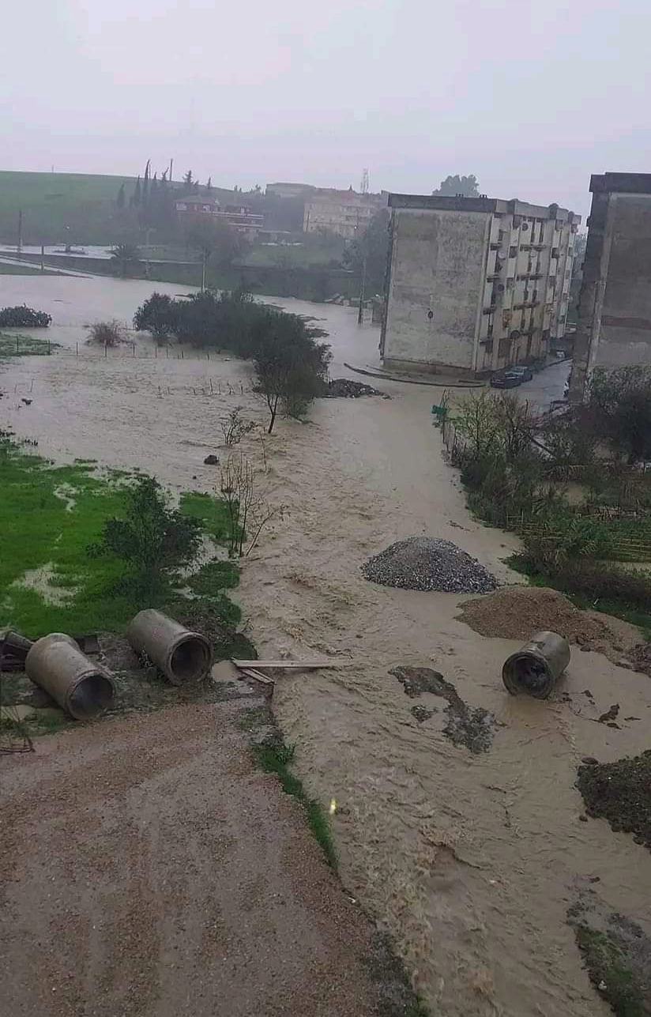
Snow and Heavy Rain over Algeria and Tunisia 28-29 February 2024
Low pressure system (EMIL Storm) over the Mediterranean sea with occluded front causing snow fall over Atlas range mountain in Algeria and Tunisia above 1000 meters and heavy rain leading to flooding in the eastern coast of Algeria.
Thunderstorms with hail were observed in different regions in Tunisia and Algeria mainly over the coast.
Strong winds and gusts hit several area.
MSG 0-Degree - Airmass and RDT RGB Animation, 28/02 21UTC - 29/02 06 UTC:
Low pressure system over the Mediterranean sea with intrusion of warm air from the south Into a cold air mass.
Severe convection with thunderstorms was observed.
Thala mountain, Tunisia
Jijel, Algeria
(94 mm in 30hours)
Nabil HASSAINE ( ONM, Algeria) & Wafa KHALFAOUI (INM,Tunisia)
Notes:
1

