Slide 1
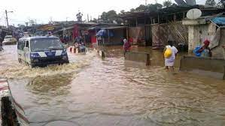
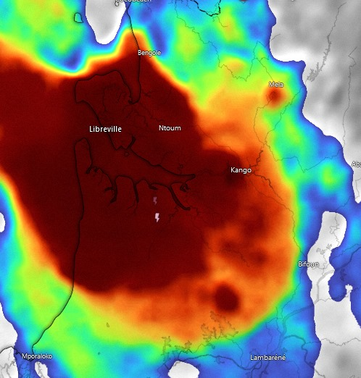
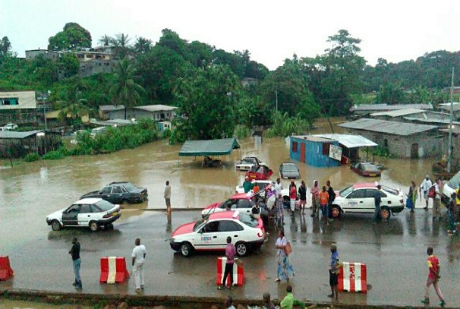
Heavy rains caused floods in the city of, Libreville ,Gabon 24 Februarys 2024
On the 24 february 2024, Libreville, in Gabon has experienced heavy rains situation winch caused flooding in many areas of the city,
The floods affected 33300 people , which lead to the loss of people’s properties, houses.
Figure: Convection RGB(top) Rapidly developing thunderstorms on the , 24 Fev 2024, 22:33 UTC
Heavy stormy rains were recorded on the west coast of Gabon
KOUMBA BELLA MONIQUE _DIRECTION GENERAL DE LA METEOROLOGIE GABON

Slide 2
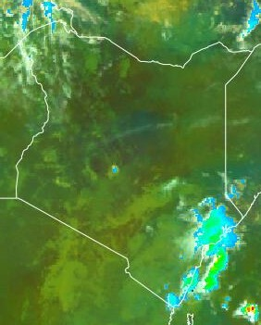
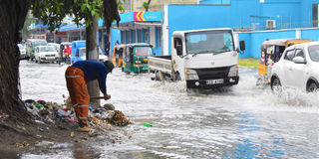
HEAVY RAINS CAUSED FLOODS IN THE STREETS, 04 MAY 2022
Mombasa is a city in Kenya located along the coastline near the Indian Ocean. It experienced floods in its streets causing disruption of transportation as roads were already submerged.
Deep convective clouds formed over the region. They resulted to heavy downpour.
The heavy precipitation caused flooding in the streets due to the drainage systems being poor.
EXAMPLE
The accuracy of floods forecasting has to be very high. Damages due to floods has been increasing and thus need to rely floods warning and advisories early enough.
Mombasa
Mombasa , 04 May 2022
Figure. MSG-0 Degree : Precipitation rate at ground by GEO/IR supported by LEO/MW, 04 MAY 2022, 09:00 UTC.
Heavy precipitation was experienced along the coastline resulting to flooding of the areas.
Phinous Othoo , IMTR

