Slide 1
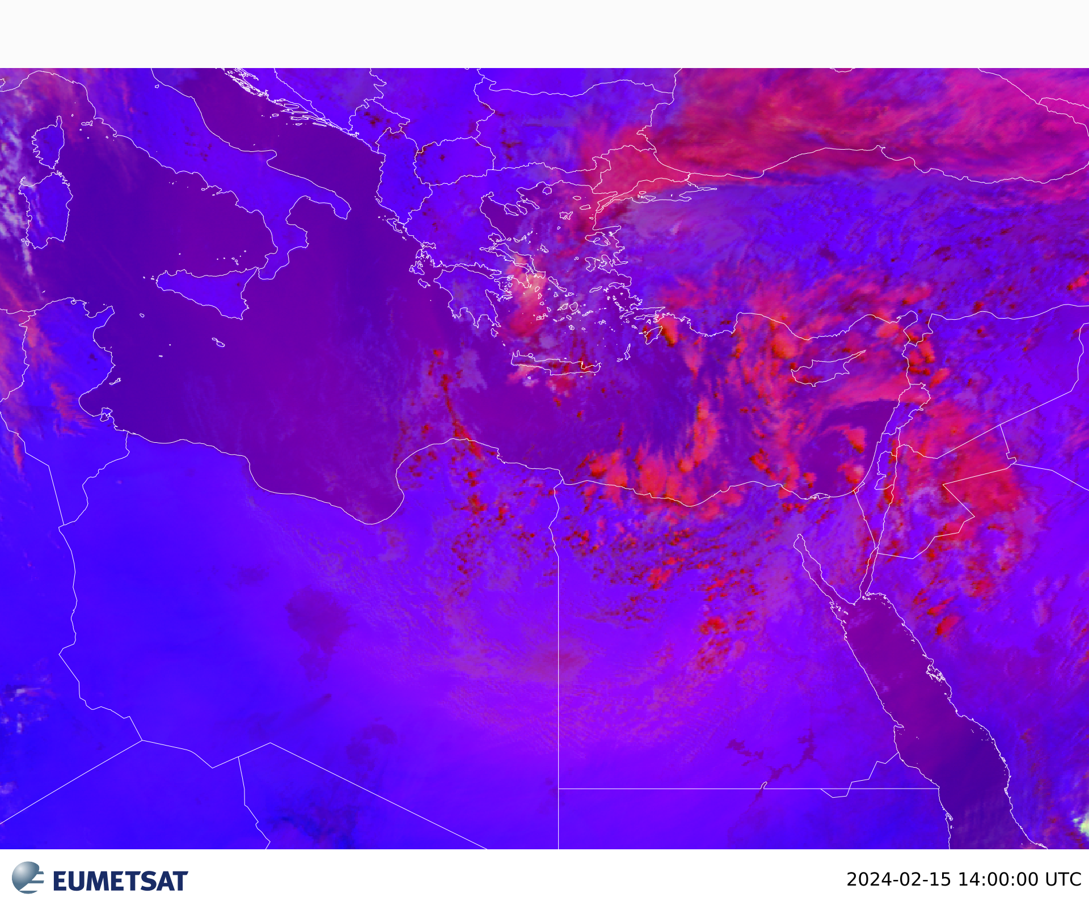
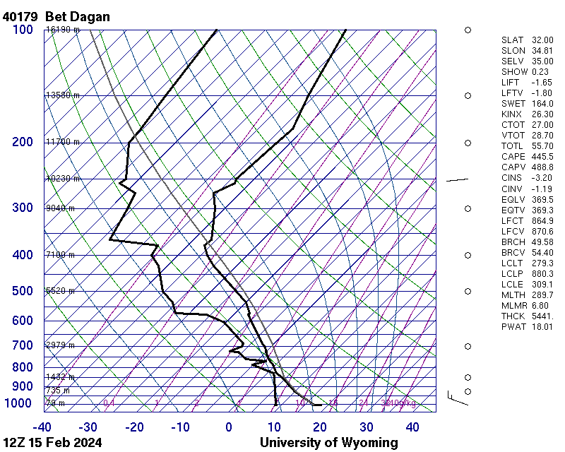
Thunderstorm with shower rain in 15 Feb 2024
We see convective clouds formed due to the presence of low pressure at the surface on the medetrainian and also there is upper air trough on 500 hpa that means that there is unstable weather that cause heavy shower rain on the north coast of Egypt and reached Cairo.
Temperature vertical profile shows CAPE is more than CINS ,K-index is more than 20 ,LIFT is negative, TOTL more than 50 these conditions indicate instability.
The image is for Convective RGB for 15 feb 2024 at 1400UTC
Indicate red clouds are convective clouds contains some yellow cells means thick cold clouds with ice crystals that’s thunder clouds on the north coast of Egypt and reached Cairo.
Hanan Mohamed/Egyptian Meteorological Authority

