Slide 1
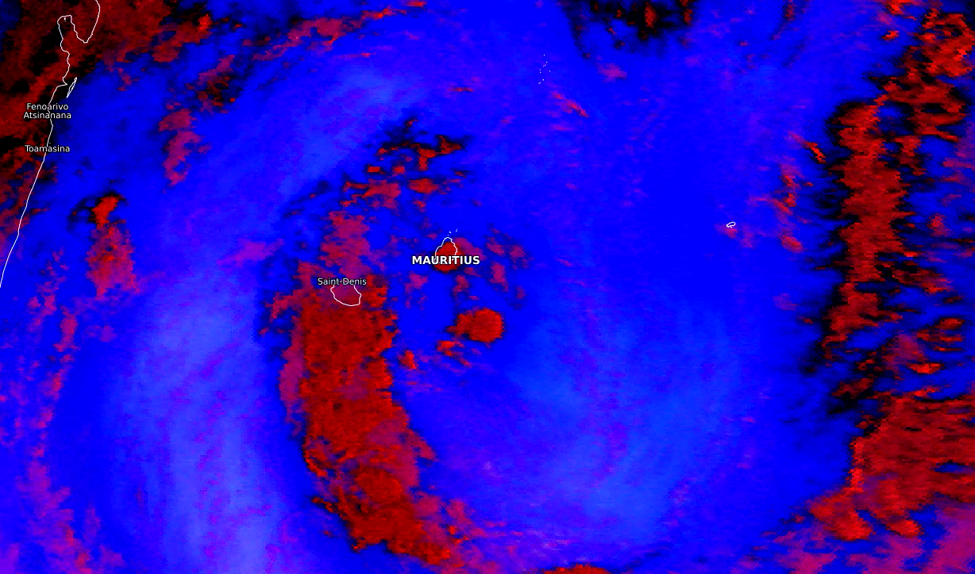
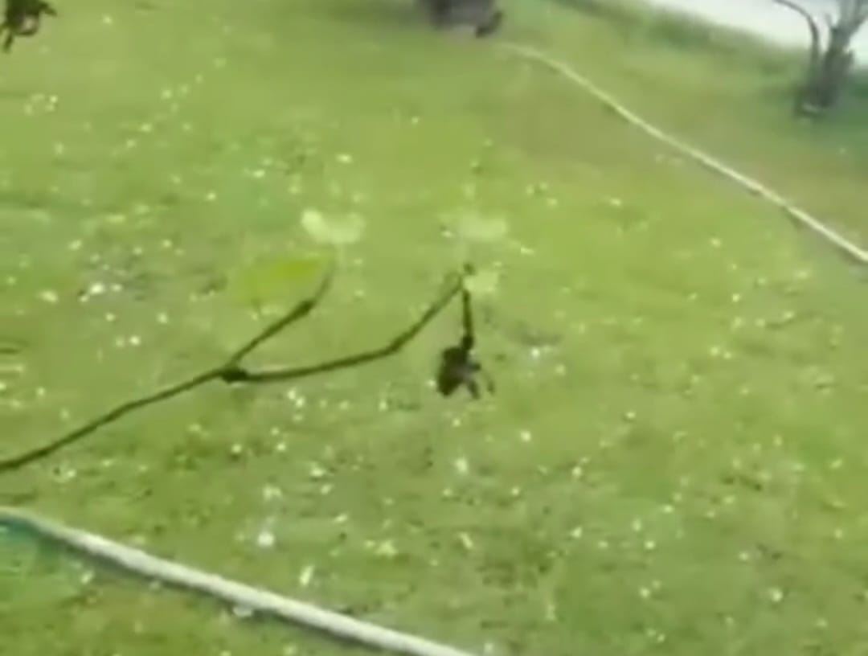
Hail over the highgrounds of Mauritius island- 27.02.2022
Mauritius is an island off Africa's southeast coast located in the Indian Ocean, east of Madagascar. Mauritius enjoys a mild tropical maritime climate throughout the year.
Severe convective activity resulted into heavy thundery showers which was also accompanied with hail over the highgrounds.
At 0900 utc the low level circulation as shown in the satellite imagery crossed Mauritius.
Also, the signature of the low on 850 hpa and 700 hpa levels along with presence of upper level cold core low made this event one of a rare severity.
Add here 1-2 additional explanatory images (NWP, Sounding, observation or a photo of the event, etc)
Eumetview Fog/Low cloud RGB channel at
27th February 2022 at 0900 utc
Convective thunderstorms over the West, South and Central Plateau regions
Yeshna Devi Parboteeah, Mauritius Meteorological Services

