Slide 1
EUMETView
Vesa Nietosvaara
EUMETSAT
7th May 2024

Slide 2
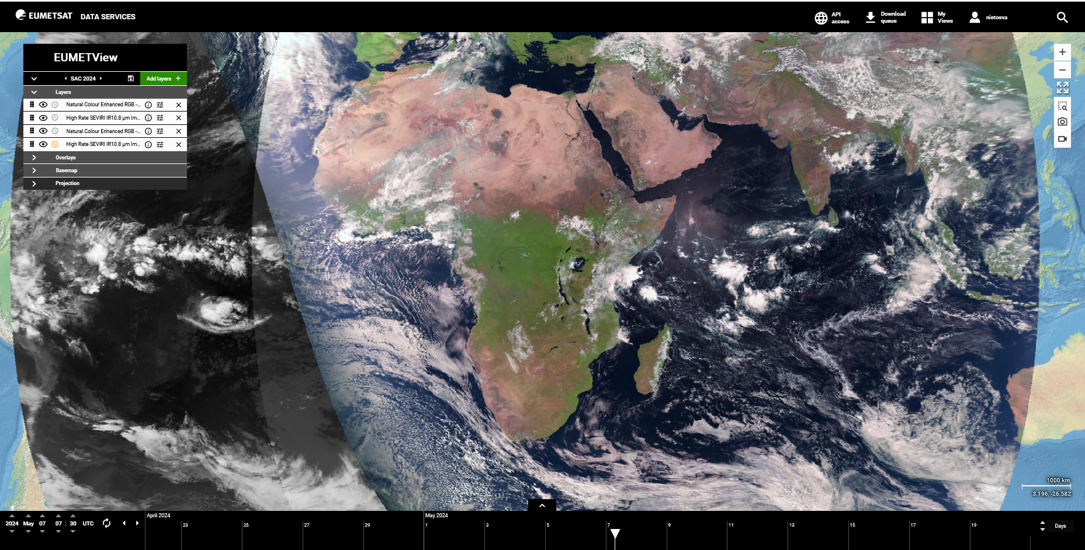
EUMETView – your view to satellite images

Slide 3
How to ?
Go to https://view.eumetsat.int
You are free to browse, search, and visualise all of the imagery in EUMETView without any registration.
For more functions, you can create a login.
User guide: https://user.eumetsat.int/resources/user-guides/eumet-view-user-guide

