Slide 1
Introduction to Satellite Products
Scholastic Maloba
IMTR
7th May 2024

Slide 2
Agenda
Satellite Products - Forecasting
Single Channels
RGB Composites
Derived Products

Slide 3
Why Satellite Products?
Satellite imagery is a powerful tool for quickly assessing the current weather situation over large areas at any time of day.
You can diagnose:
synoptic-scale weather patterns,
track the growth of individual convective storms,
differentiate high clouds from low ones or ice clouds from liquid ones, and
distinguish between low clouds, snow, dust, land and water surfaces.

Slide 4
Satellite Products - Forecasting
What Satellite Products do you use in your NMHS for Forecasting?

Slide 5
Single Channels (Visible O.6)
The satellite receives sun radiation which is reflected by the earth surface or by cloudiness.
Window channel: radiation is not significantly absorbed by the gases in the troposphere;
it is possible to look as though through a window downward to the radiating surface which can be the earth’s surface or cloud tops.
Objects that look dark to our eyes appear dark in visible imagery and vice versa.

Slide 6
Single Channels (Visible O.6)
Used during daylight hours to observe:
land surfaces, including deserts, water bodies, vegetation, bare ground, cloud types & structure within clouds.
The brightness of the clouds can change over the course of the day.
Different grey shades indicate differences in cloud thickness, land cover or ocean surface.
At night, no light is reflected and thus the image is black.

Slide 7
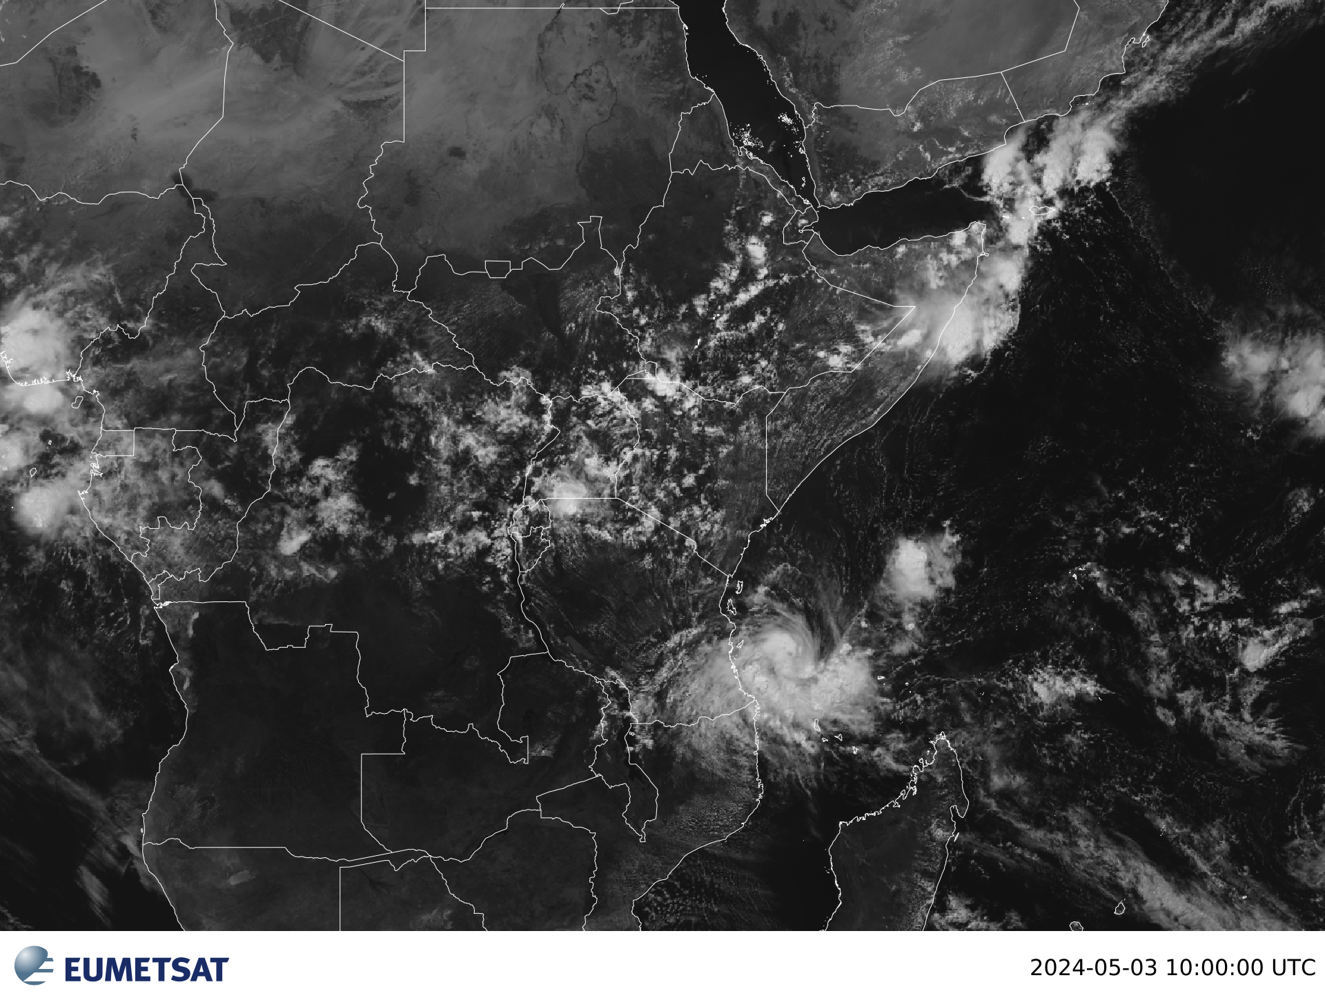
Single Channels (Visible O.6)
Different grey shades in VIS channel represent different values of albedo
Bright values | High albedo | Thick clouds Land surfaces
Grey values | Low albedo | Thin translucent clouds
Dark values | Almost no reflection | Water and vegetation

Slide 8
Single Channels (IR 10.8)
The satellite receives radiation emitted by the earth and the clouds because of their temperature.
Can be used both day and night time.
IR is a window channel, as is VIS, and with the same consequences.
Different grey shades in the IR channel represent different temperatures of the radiating surface which can be the earth surface or the cloud tops.

Slide 9
Single Channels (IR 10.8)
The grey shades presented in the IR images are reversed (white becomes black) to get a similar appearance to the VIS image.
Warmer objects appear dark grey while colder objects appear light gray through white.
Brightness Temperature allows us to differentiate between land, ocean and clouds.
Cloud top temperatures allows us know their height: colder – lighter coloured = higher clouds, warmer – darker coloured = lower cloud tops.

Slide 10
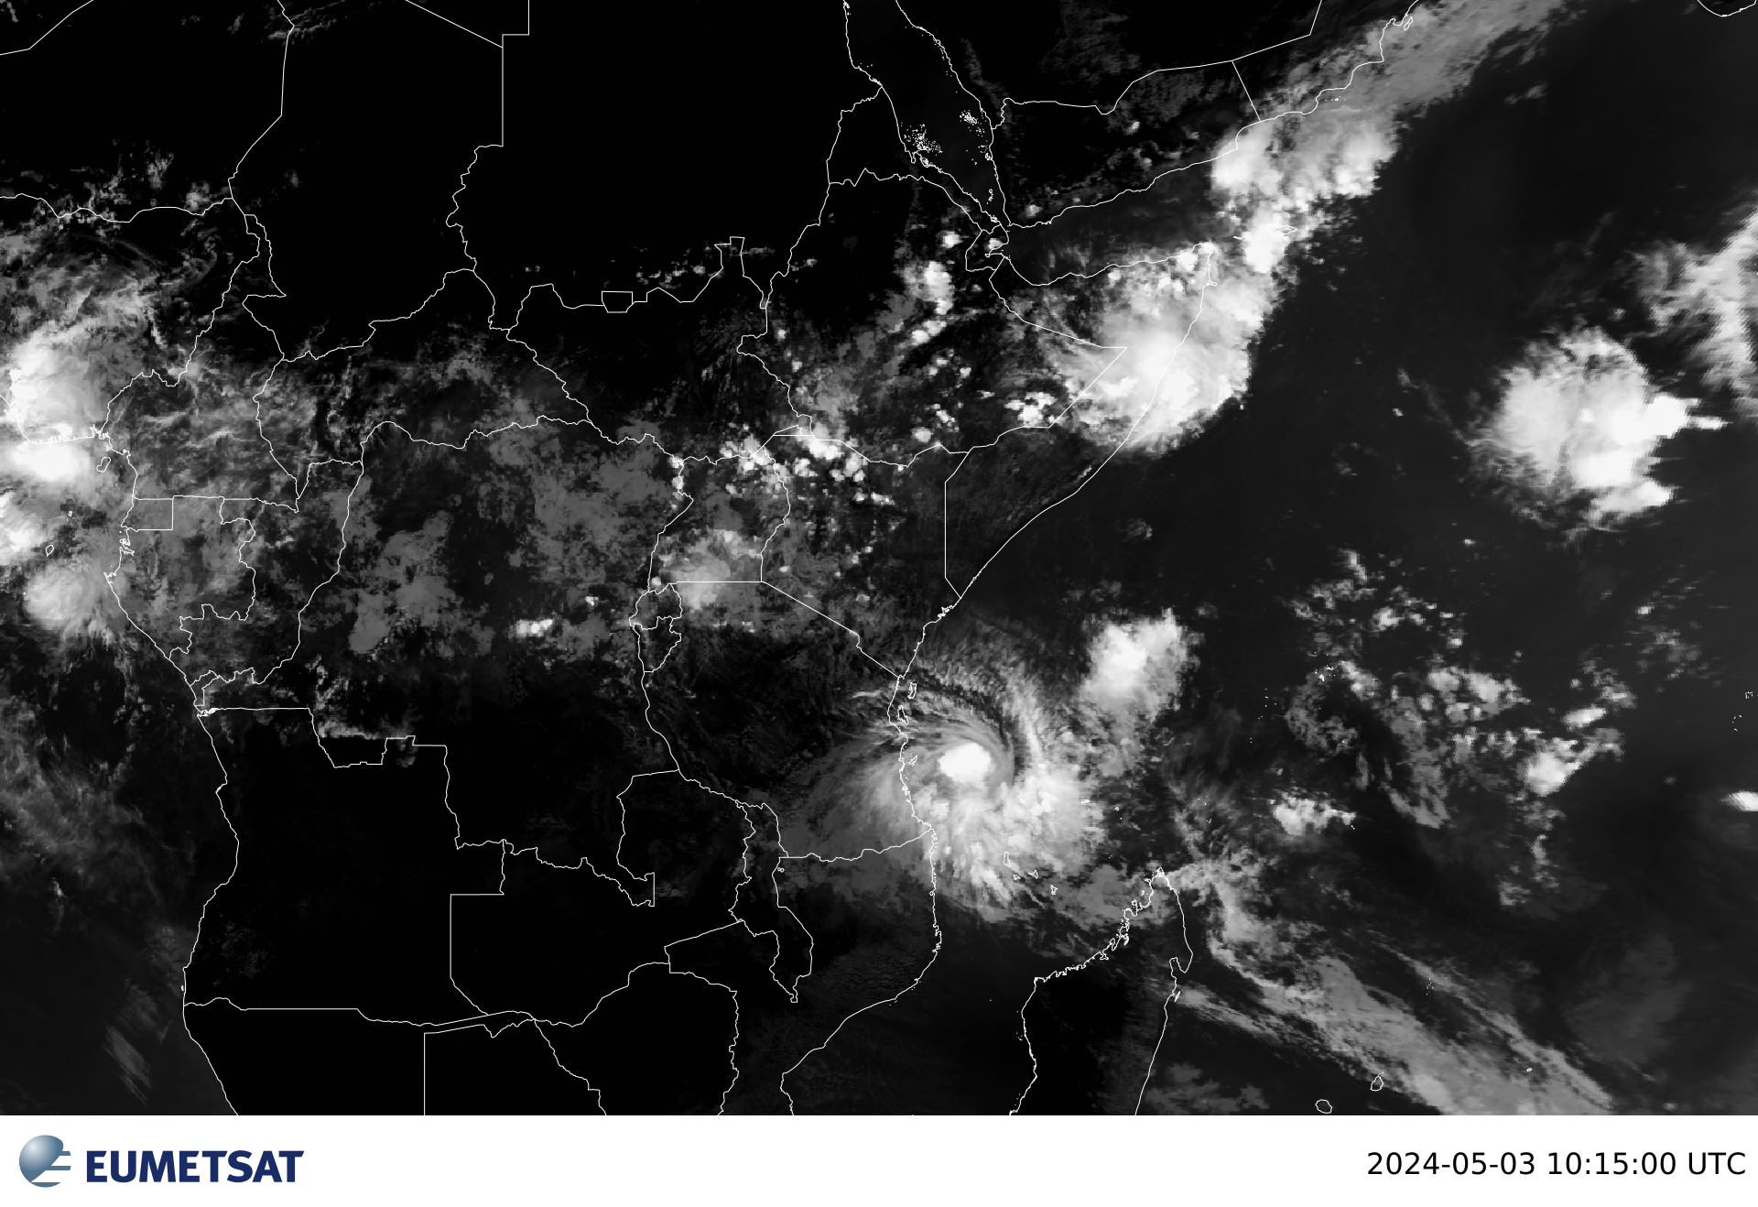
Single Channels (IR 10.8)
Different grey shades in IR channel represent different values of temperature
Bright values | Low temperatures | Cold (high) cloud tops
Grey values | Middle temperatures | Middle cloud tops
Dark values | Warm temperatures | Hot land or sea surface

Slide 11
Single Channels (WV 6.2)
Satellite receives radiation emitted by the water vapour in the upper troposphere (approximately above 600 hPa up to 300 hPa).
Radiation from below 600 hPa is absorbed by the WV in the layer above which according to the radiation laws (Kirchhoff) becomes a radiating surface itself.
Well suited for illustrating the three dimensionality of the atmosphere and the continuous water vapor layer in the mid and high latitudes.
WV useful in monitoring developing thunderstorms, mesoscale downdrafts and upper level dynamics in the tropics

Slide 12
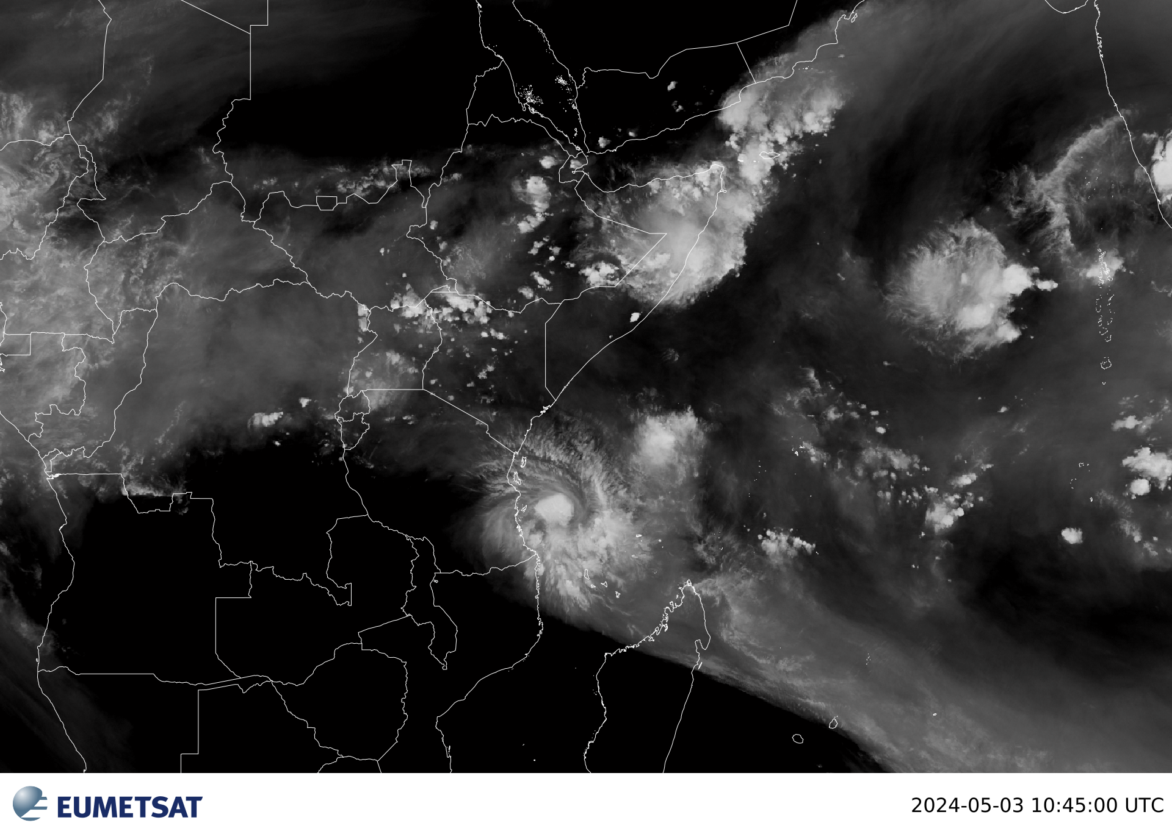
Single Channels (WV 6.2)
Different grey shades in the WV channel represent different WV content above 600 hPa
Bright values | Liquid water | Clouds
Grey values | Water vapour | Water vapour with varying intensity
Dark values | Very low water vapour | Dry upper troposphere
Highest humidity will be the whitest areas while dry regions will be dark.
Water vapor imagery is useful for indicating where heavy rain is possible

Slide 13
RGB Composites

Slide 14
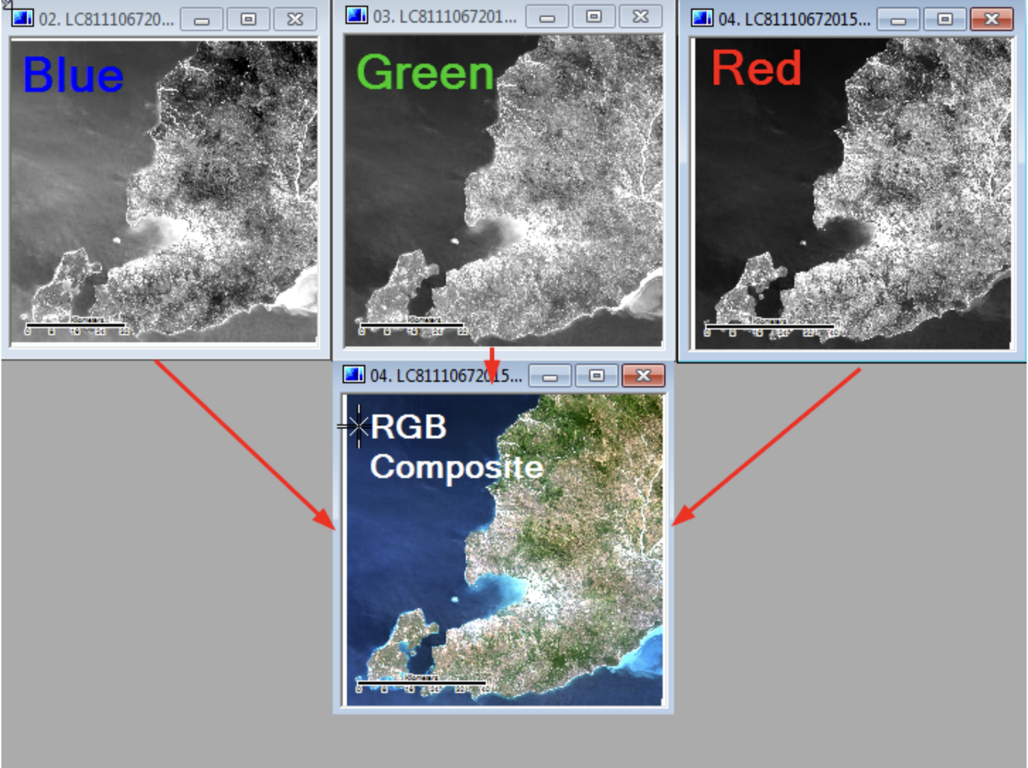
RGBs
RGB stands for Red, Green, and Blue
RGB colors are the basic colors used for displaying images, objects, etc.
Satellite imagery is captured in multiple wavelengths of reflected light otherwise known as image ‘Bands’
Three image bands can be combined into one picture by displaying each band as either Red, Green or Blue.

Slide 15
Natural Color RGB
Combines three channels (two visible and one near-infrared) to make a colorized version of the visible imagery.
Surface ice/snow and ice clouds all show as differing shades of cyan (light blue).
It is not useful at night

Slide 16
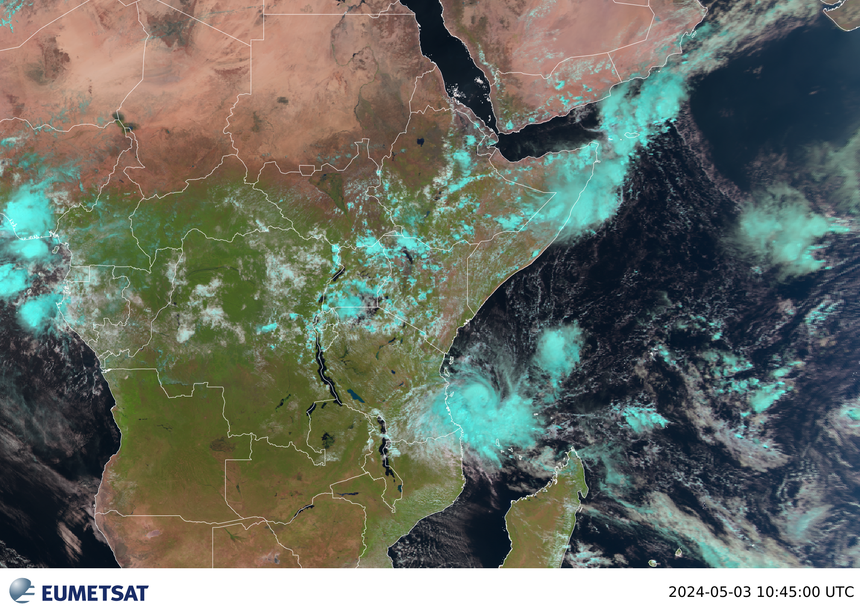
Natural Color RGB
Most surface features look realistic in this product:
grasslands and forests are typically green
water appears black
desert is tan to reddish brown
clouds are white-pink

Slide 17
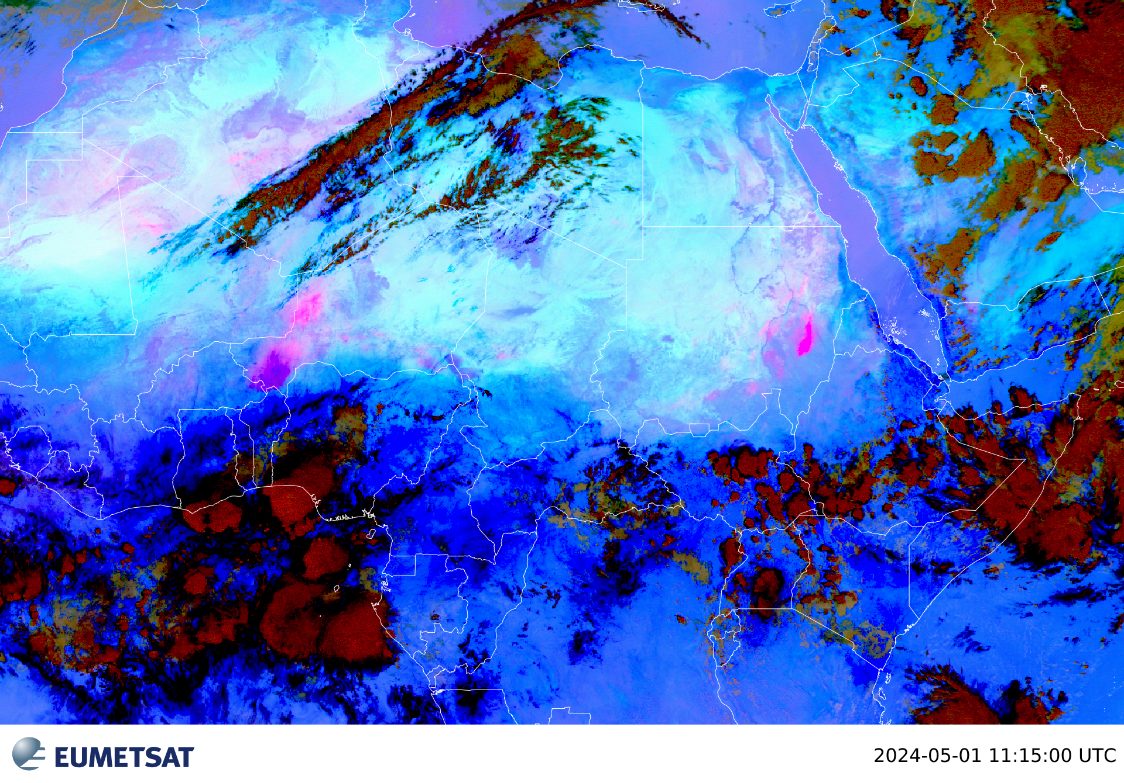
Dust RGB
Combines information from several IR channels and channel differences in order to highlight dust; shades of bright pink in this RGB
Daytime, bright pink areas are always dust and very thick dust can appear dark magenta.

Slide 18
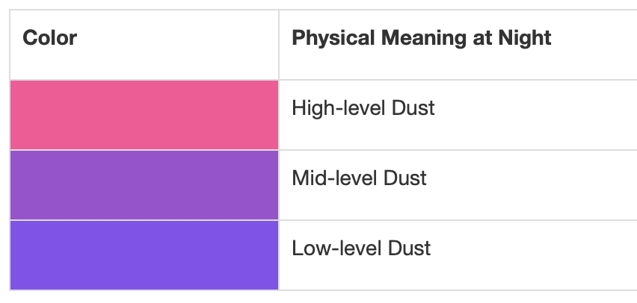
Dust RGB
At night, dust ranges in colour from pink to purple or purple-blue.
The pinker the dust area, the higher its cloud-top is.
Likewise, the bluer the area, the lower the dust cloud top

Slide 19
Severe Convection = Convection RGB
Shows areas of active thunderstorms with strong updrafts in colours ranging from red (less intense convection) to yellow (most intense convection)
The rest of the product is blue or purple to make the strongest storms stand out.
This product is made with a combination of visible, infrared and water vapour channels and channel differences.
Can be used only during the day.

Slide 20
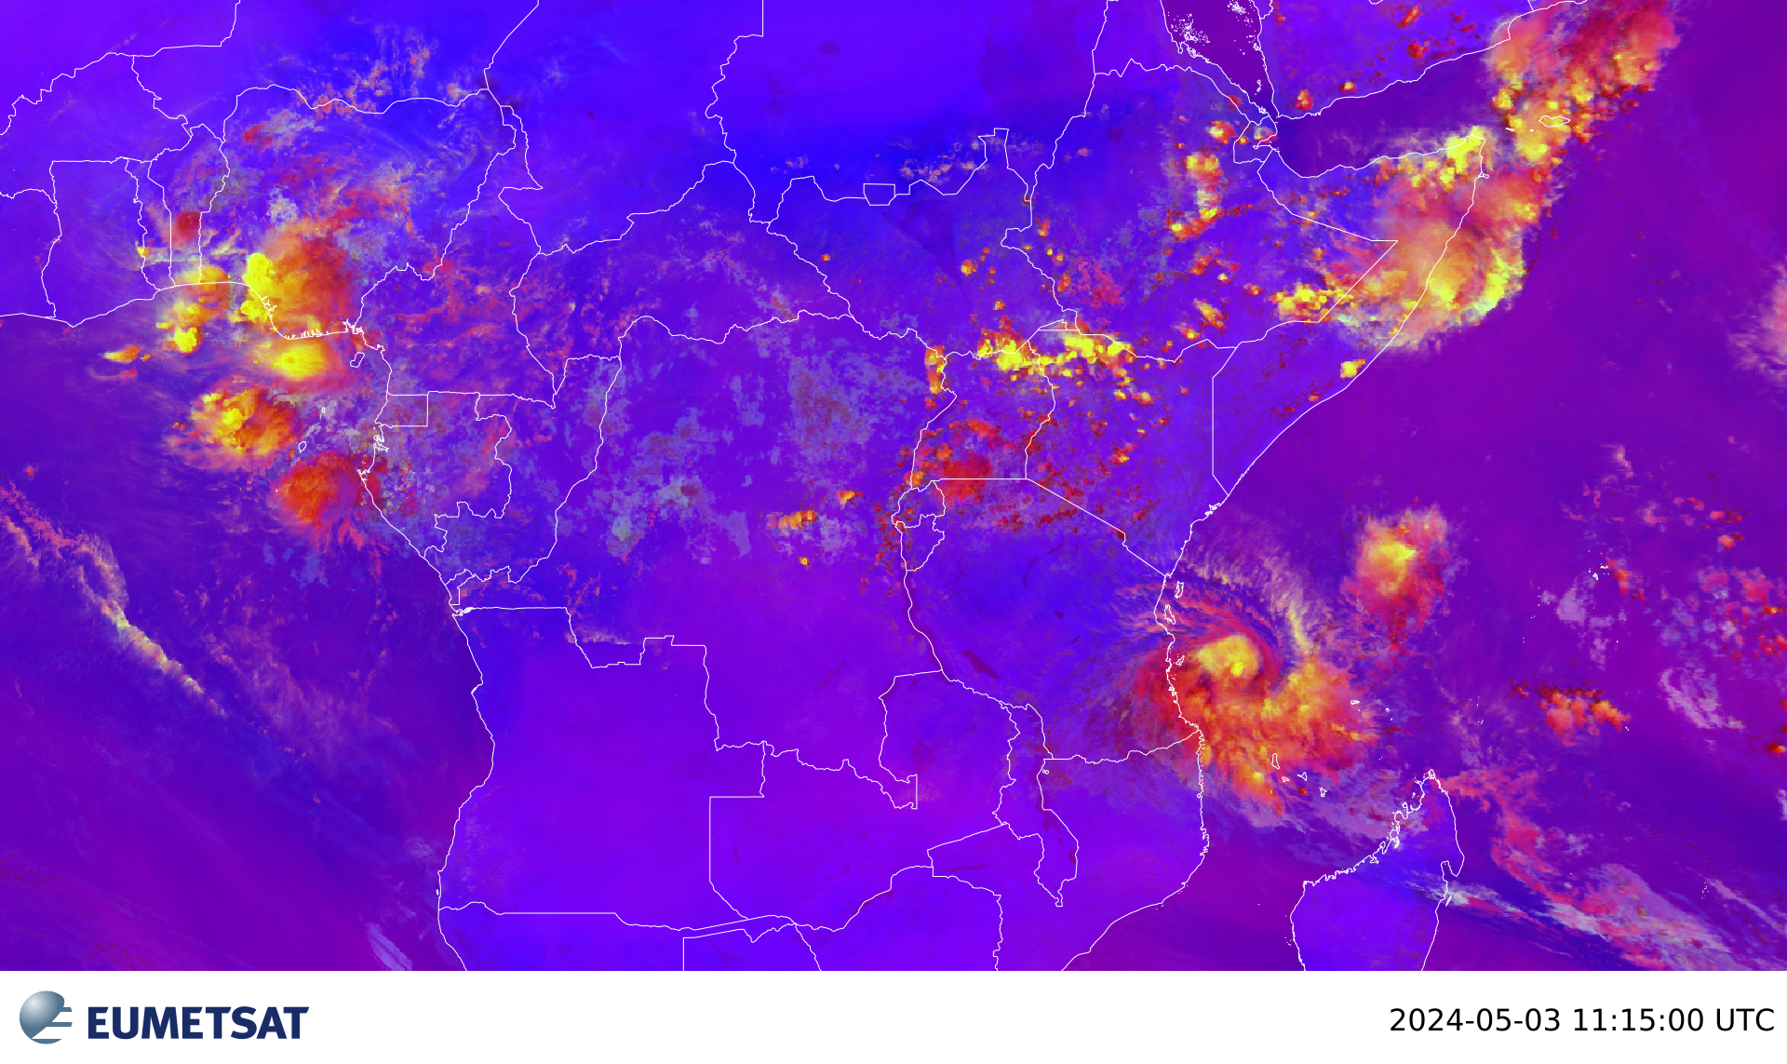
Severe Convection = Convection RGB
Tall, thick clouds initially appear red.
Over time, as the updraft generates and pushes more ice crystals upward, the tops will appear more yellow.
Later on, the yellow areas may grow horizontally as small ice crystals fill out the anvil of the storm.

Slide 21
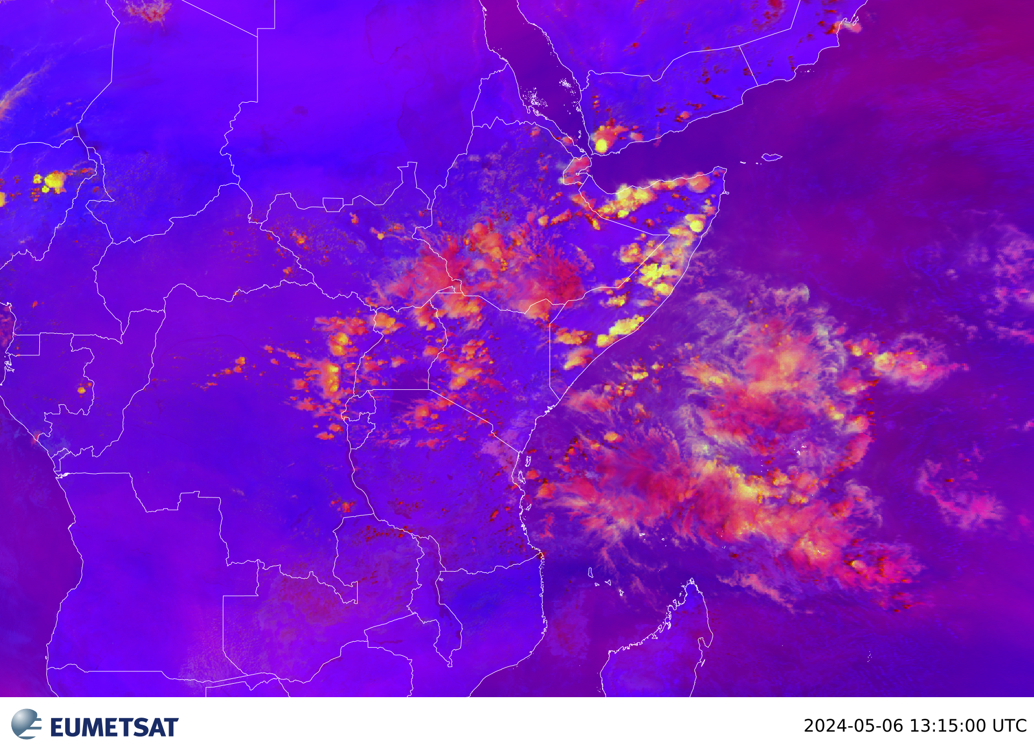
Severe Convection = Convection RGB
Dissipating yellow colours indicate that the updraft is weakening

Slide 22
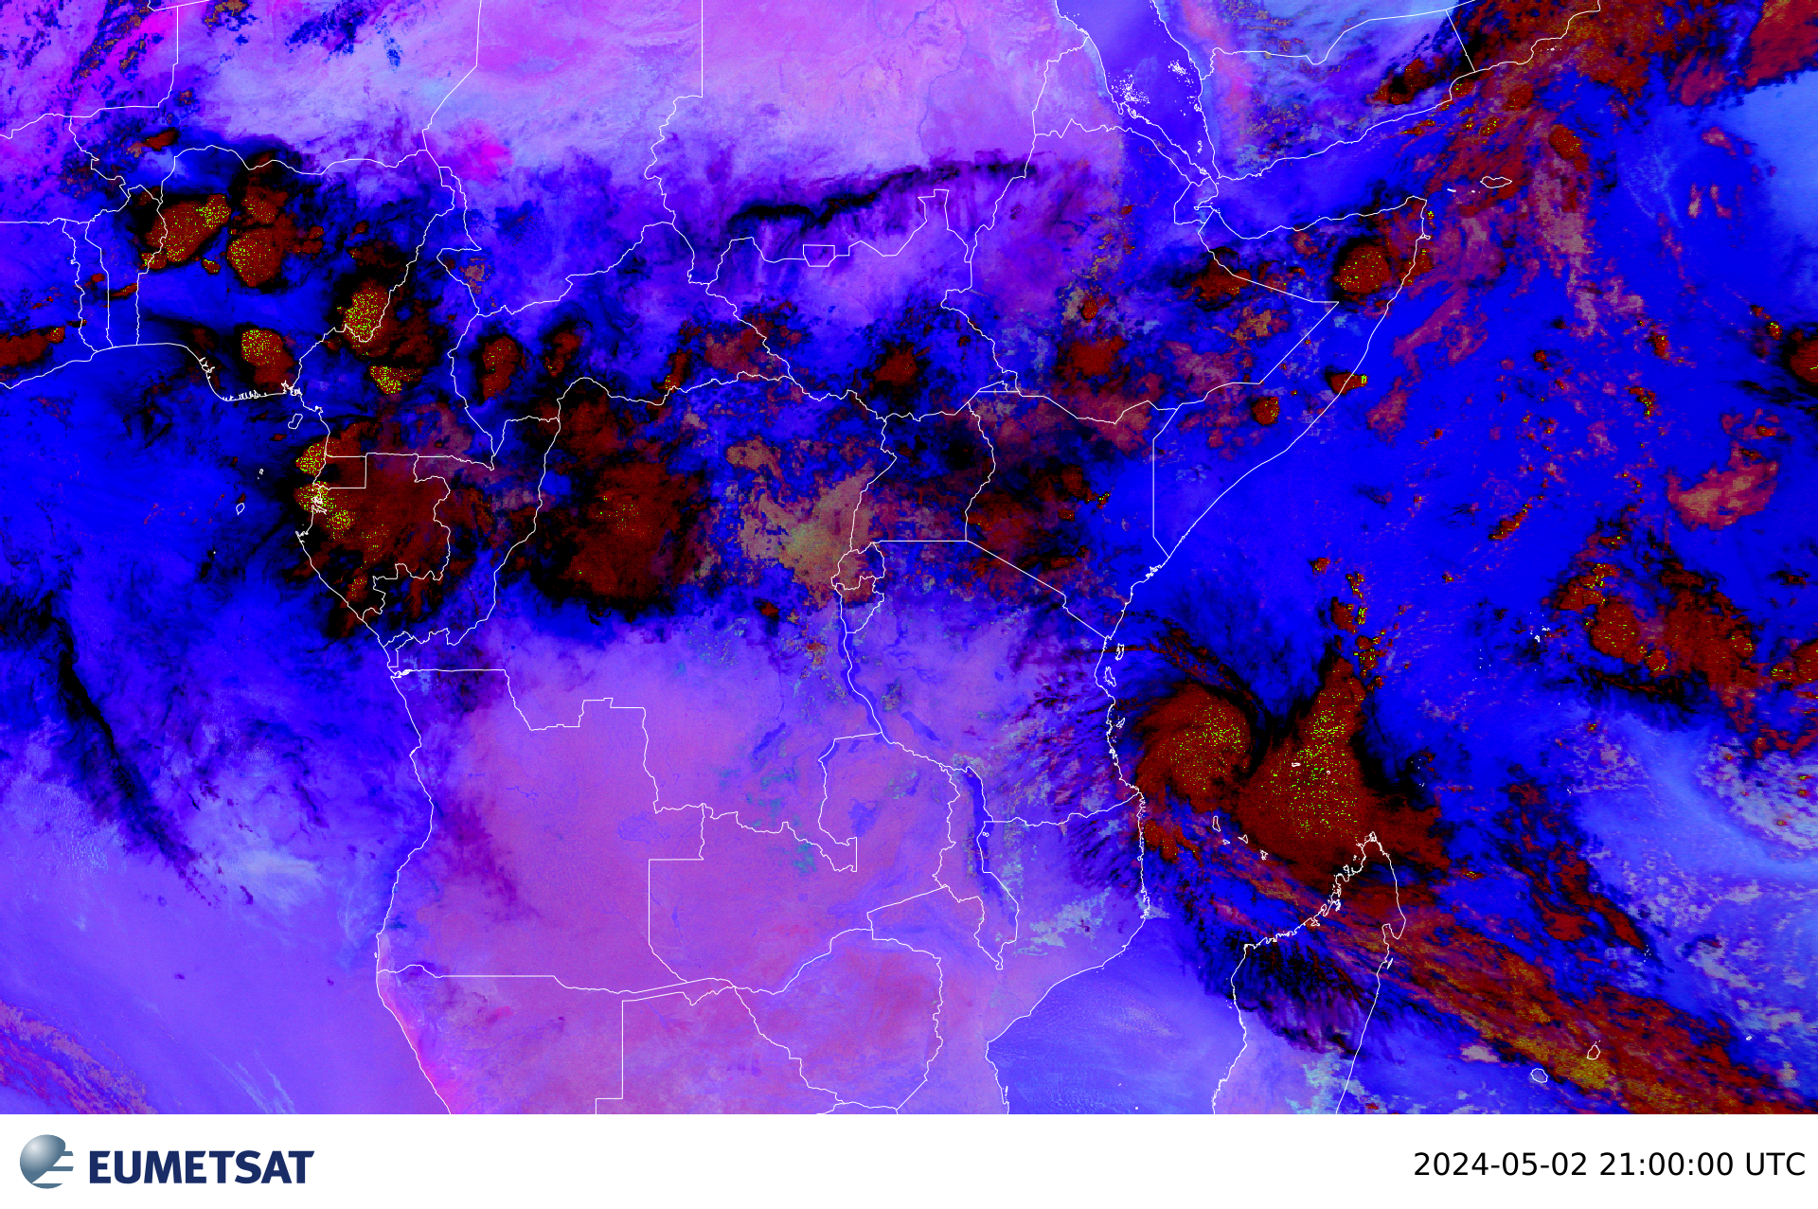
Night Microphysics RGB = Fog/Low Clouds RGB
Combination of three different IR channels and channel differences
Can be used any time of day, but night microphysics RGB is tuned for night-time

Slide 23
Night Microphysics RGB = Fog/Low Clouds RGB
Colours are controlled heavily by the cloud-top temperature and cloud-top temperature difference between channels.
This also depends on season, viewing angle or overall temperature profile. Generally, low clouds/fog appear:
green in the mid- and high-latitude cold seasons and during cold weather regimes
light blue in the mid- and low-latitude warm season and during warm weather regimes
Helps identify night-time low-level clouds and fog, determine cloud heights.

Slide 24
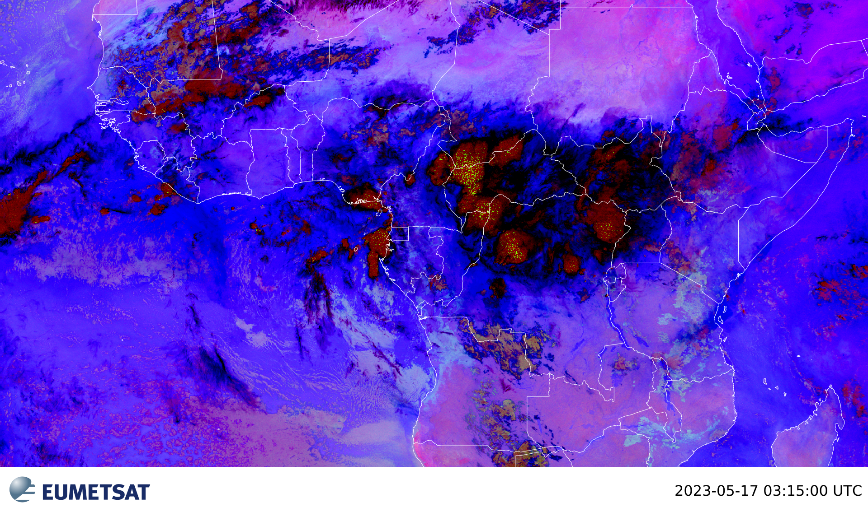
Night Microphysics RGB = Fog/Low Clouds RGB
In the tropics, low-level stratiform clouds are light blue.
Mid-level clouds are pinkish to brownish
high-level cirrus are black to dark blue

Slide 25
Day Microphysics RGB
Combines information about:
cloud brightness,
cloud particle phase and size, and
cloud top temperature
Used to analyze convective clouds as well as other cloud and surface features.
The cloud particle phase and size can be qualitatively determined to estimate if strong updrafts are associated with the convection or if warm rain processes are active.
Identification of cloud types, including fog and low stratus as well as fires, snow, and contrails

Slide 26
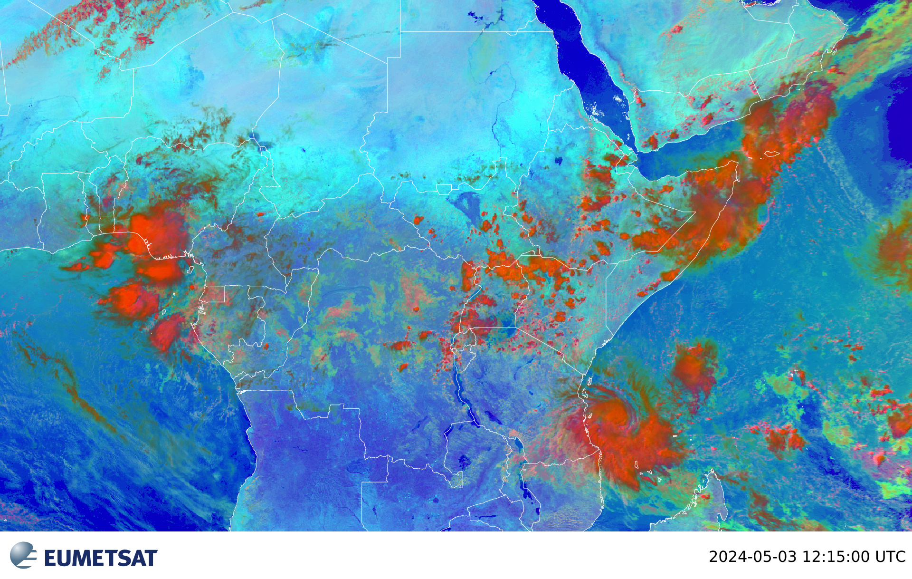
Day Microphysics RGB
The surface appears in shades of blue
Low clouds appear yellow to greenish (small droplets) to magenta (large droplets)
High ice clouds appear deep red (large ice particles) to bright orange (small ice particles)

Slide 27
Airmass RGB
Based upon data from IR and WV channels
Designed and tuned to monitor:
Distribution of different air masses
Evolution of cyclones, in particular rapid cyclogenesis
Jet streaks and
PV (potential vorticity) anomalies
Used day and nighttime

Slide 28
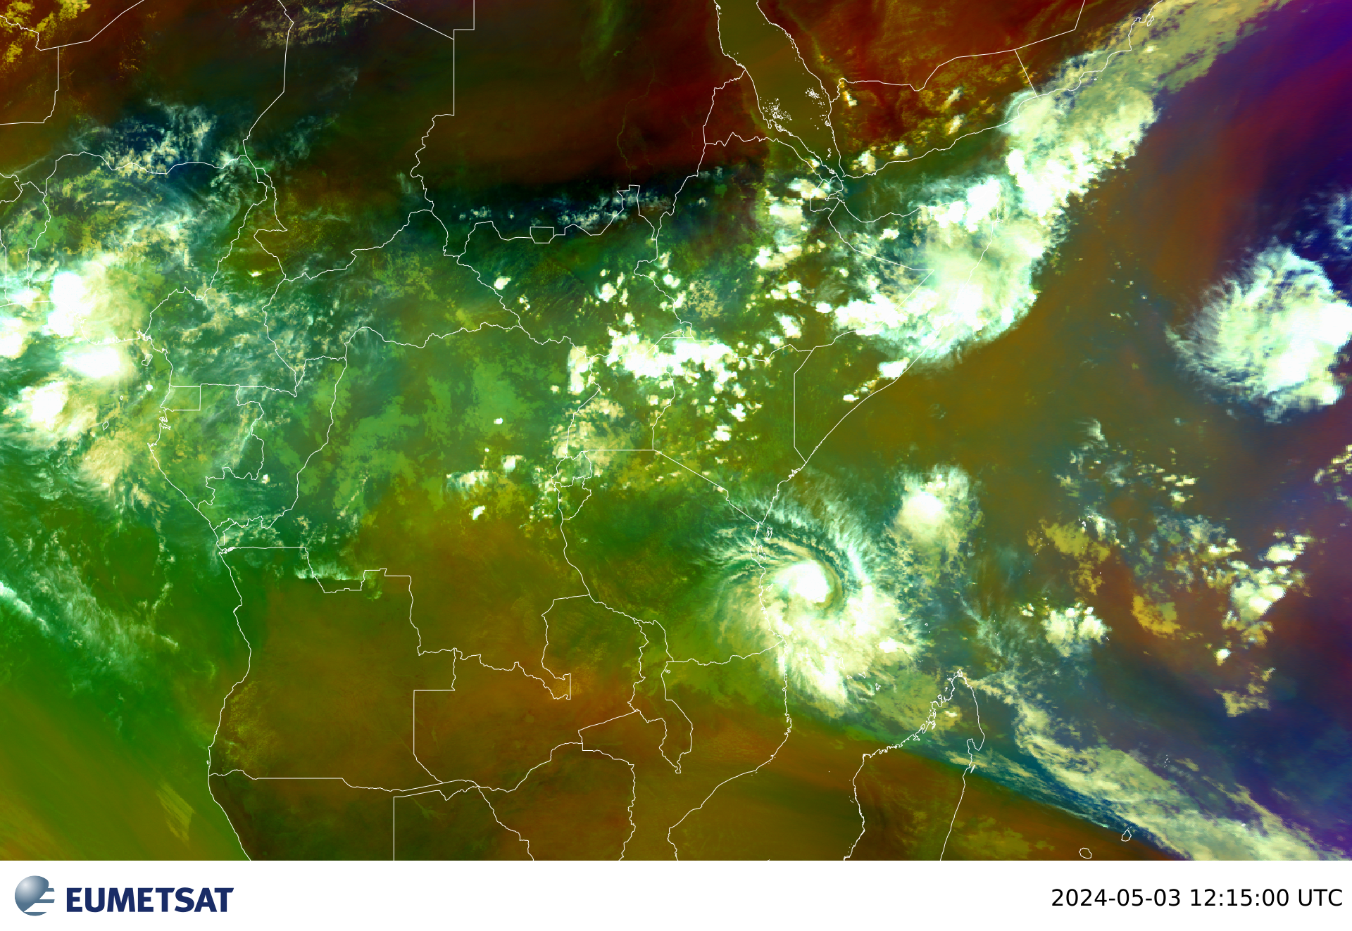
Airmass RGB
Dry air masses in the upper troposphere (such as those related to sub-tropical high pressure systems, PV anomalies, jet streaks, and deformation zones) are red to orange
High-level clouds are white
Mid-level clouds are brown

Slide 29
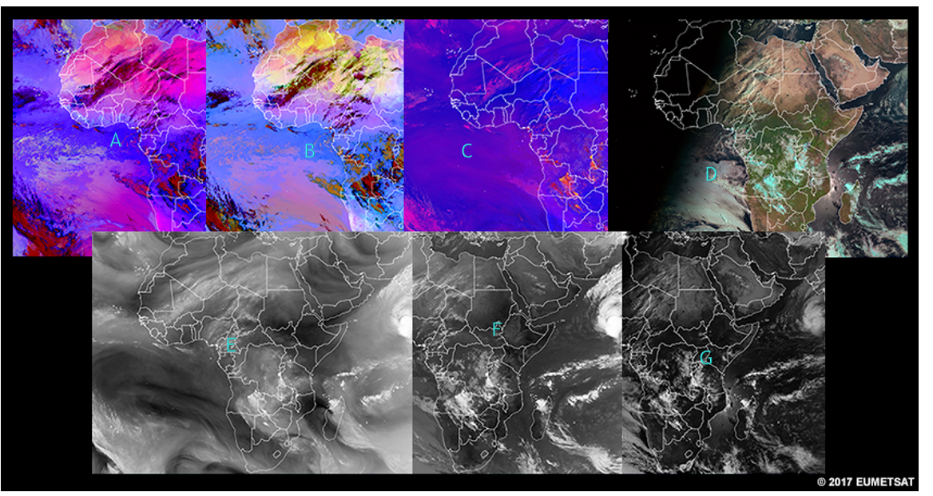
Can you identify the satellite images?

Slide 30
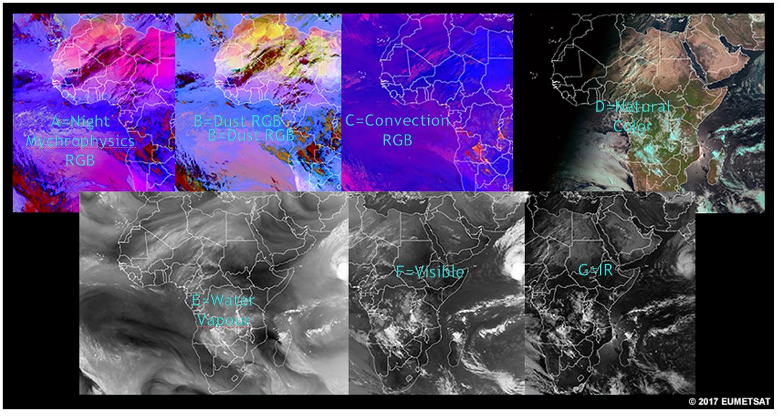
Can you identify the images?

Slide 31
DERIVED PRODUCTS

Slide 32
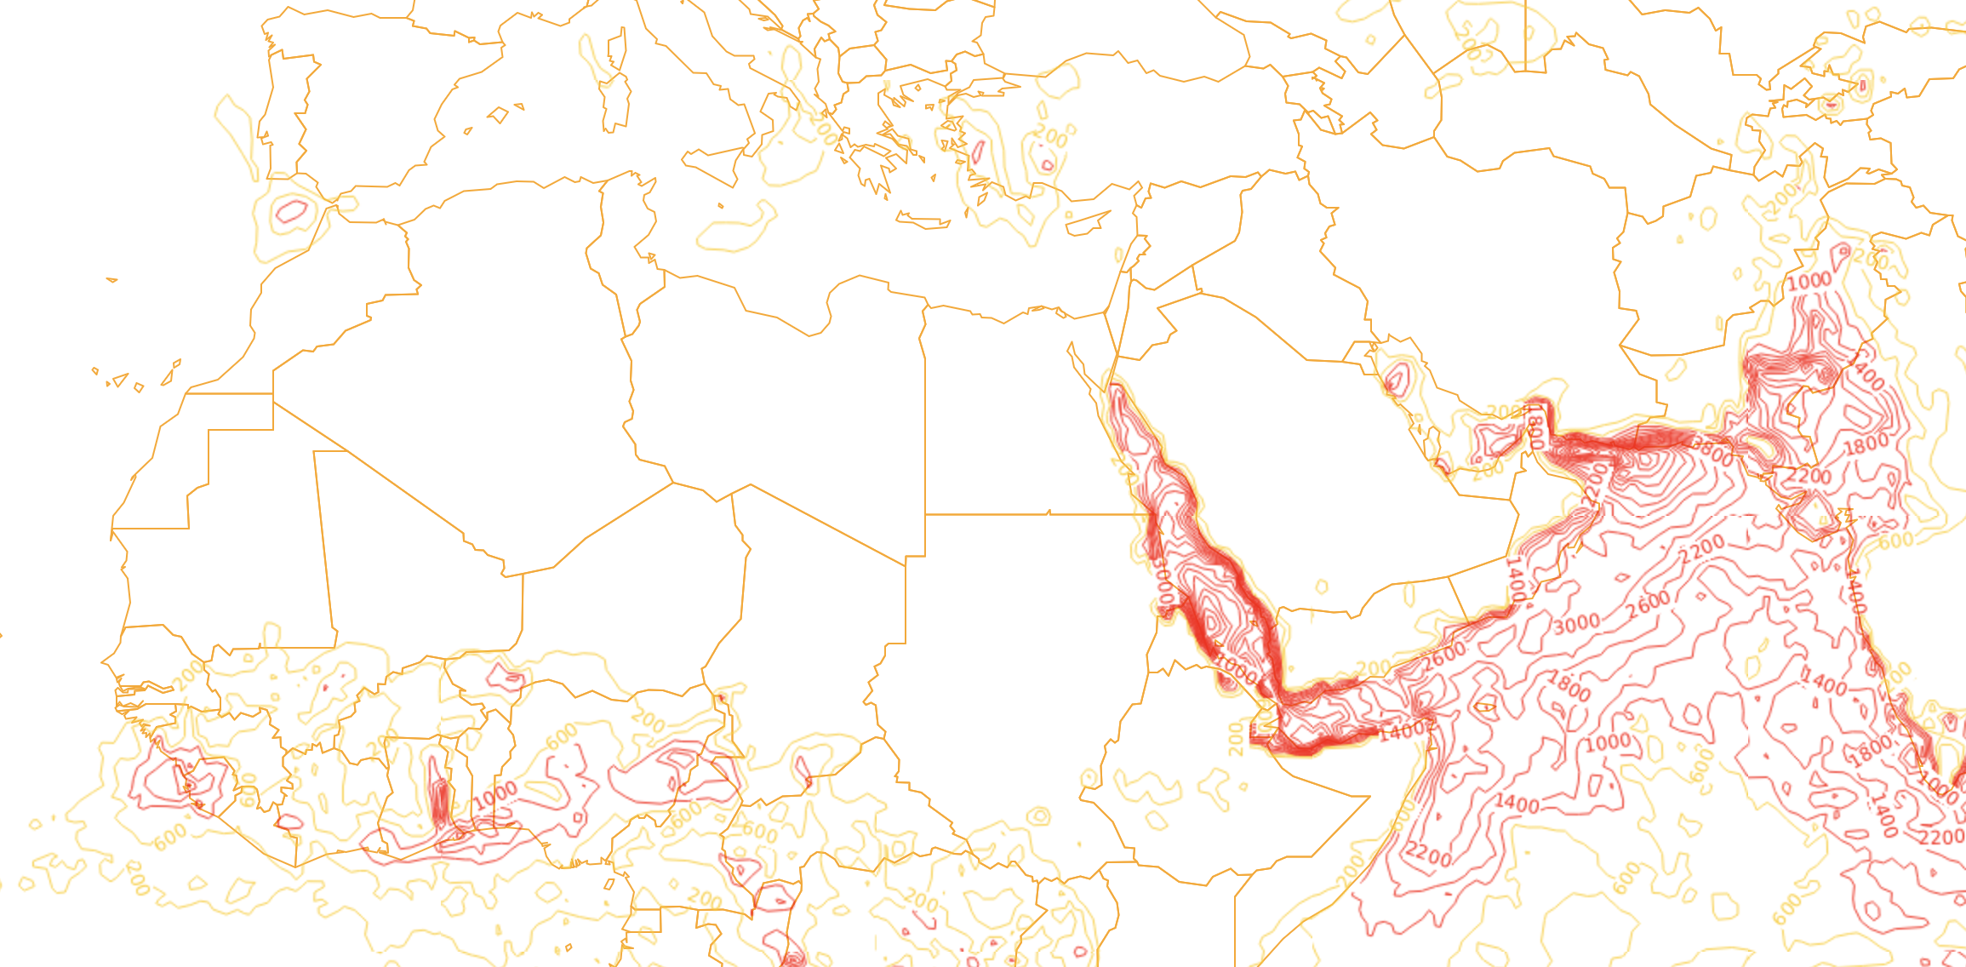
Derived Products - CAPE

Slide 33
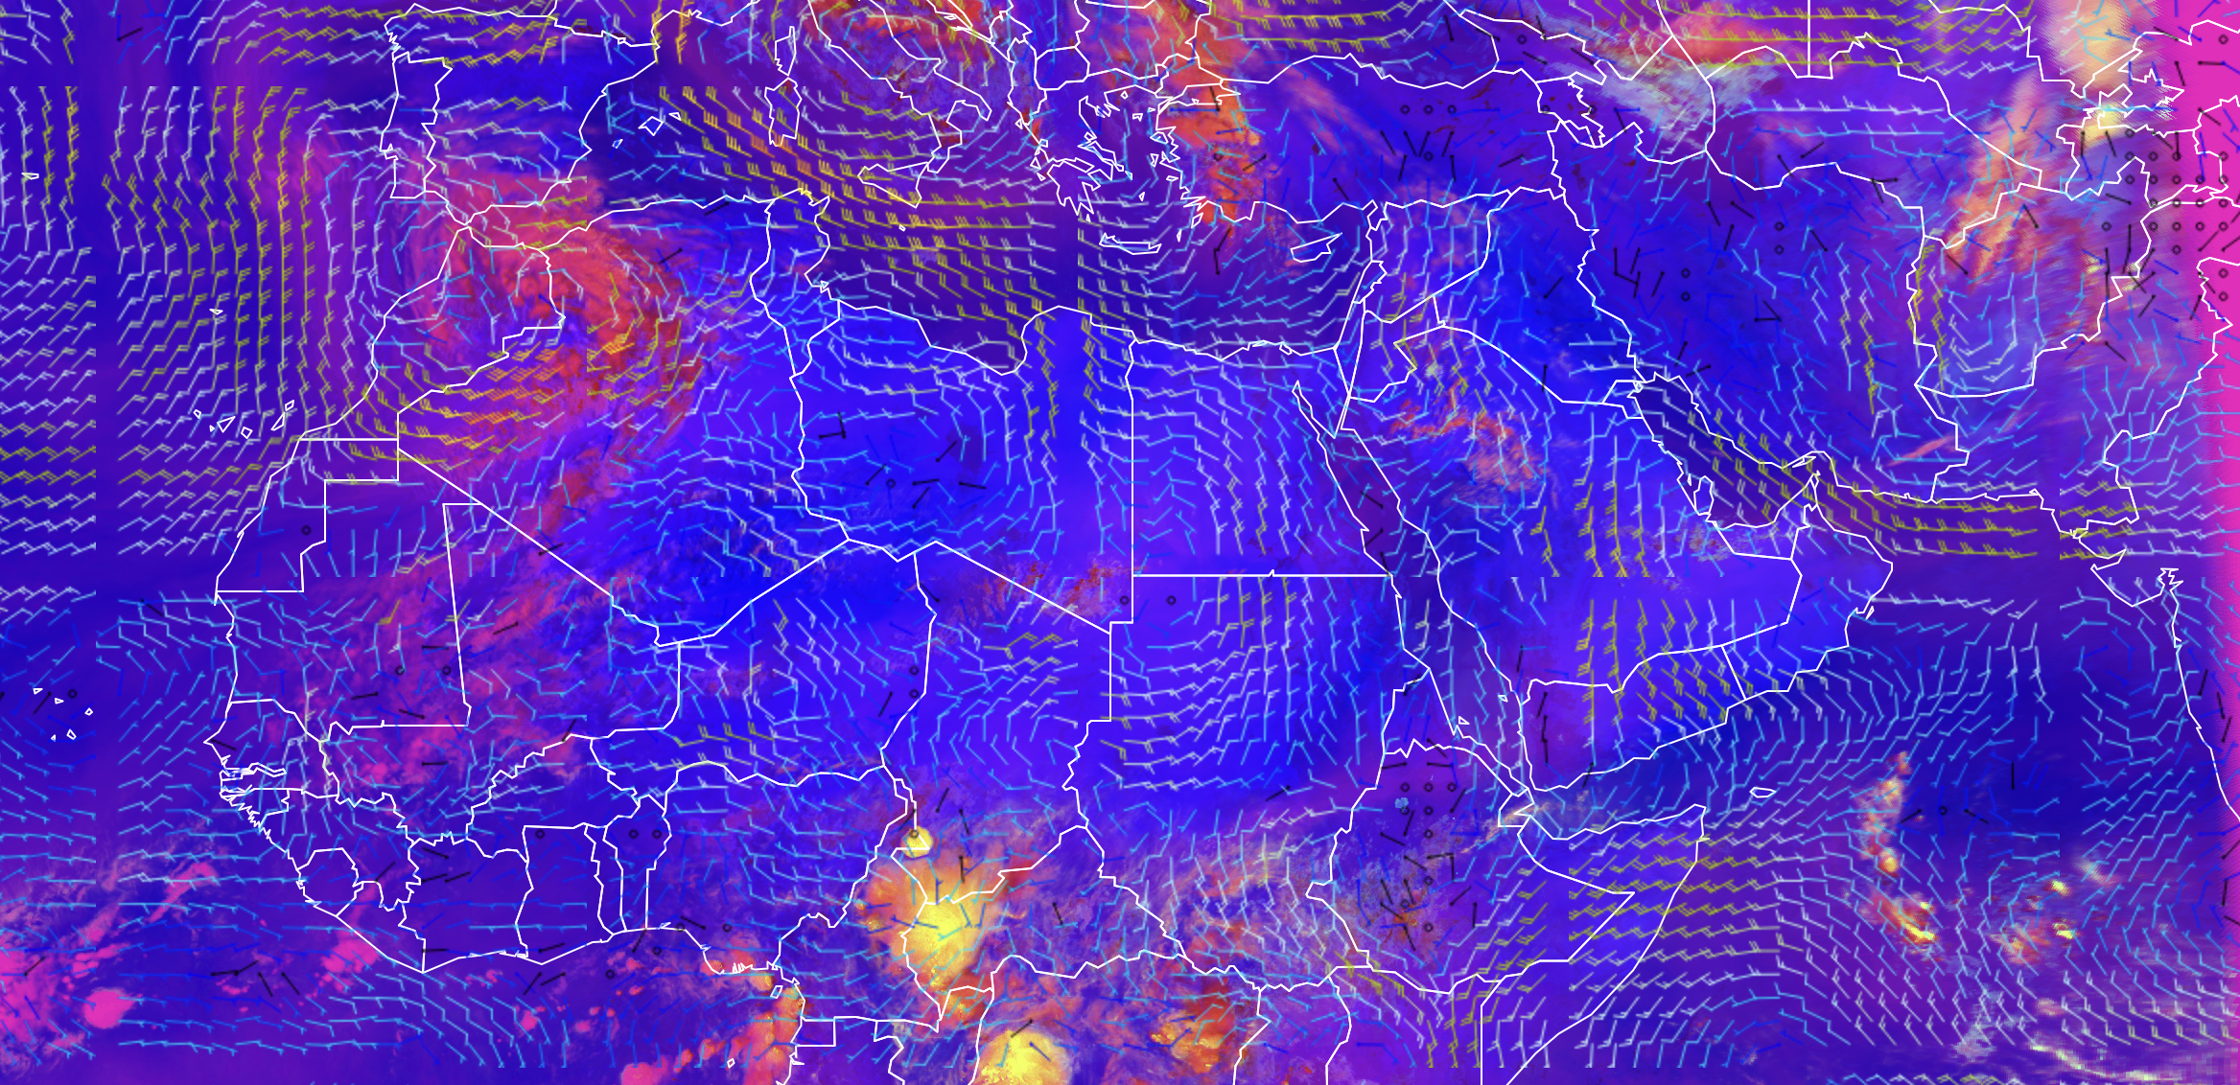
Derived Products– Severe Convection and 850HPA Wind

Slide 34
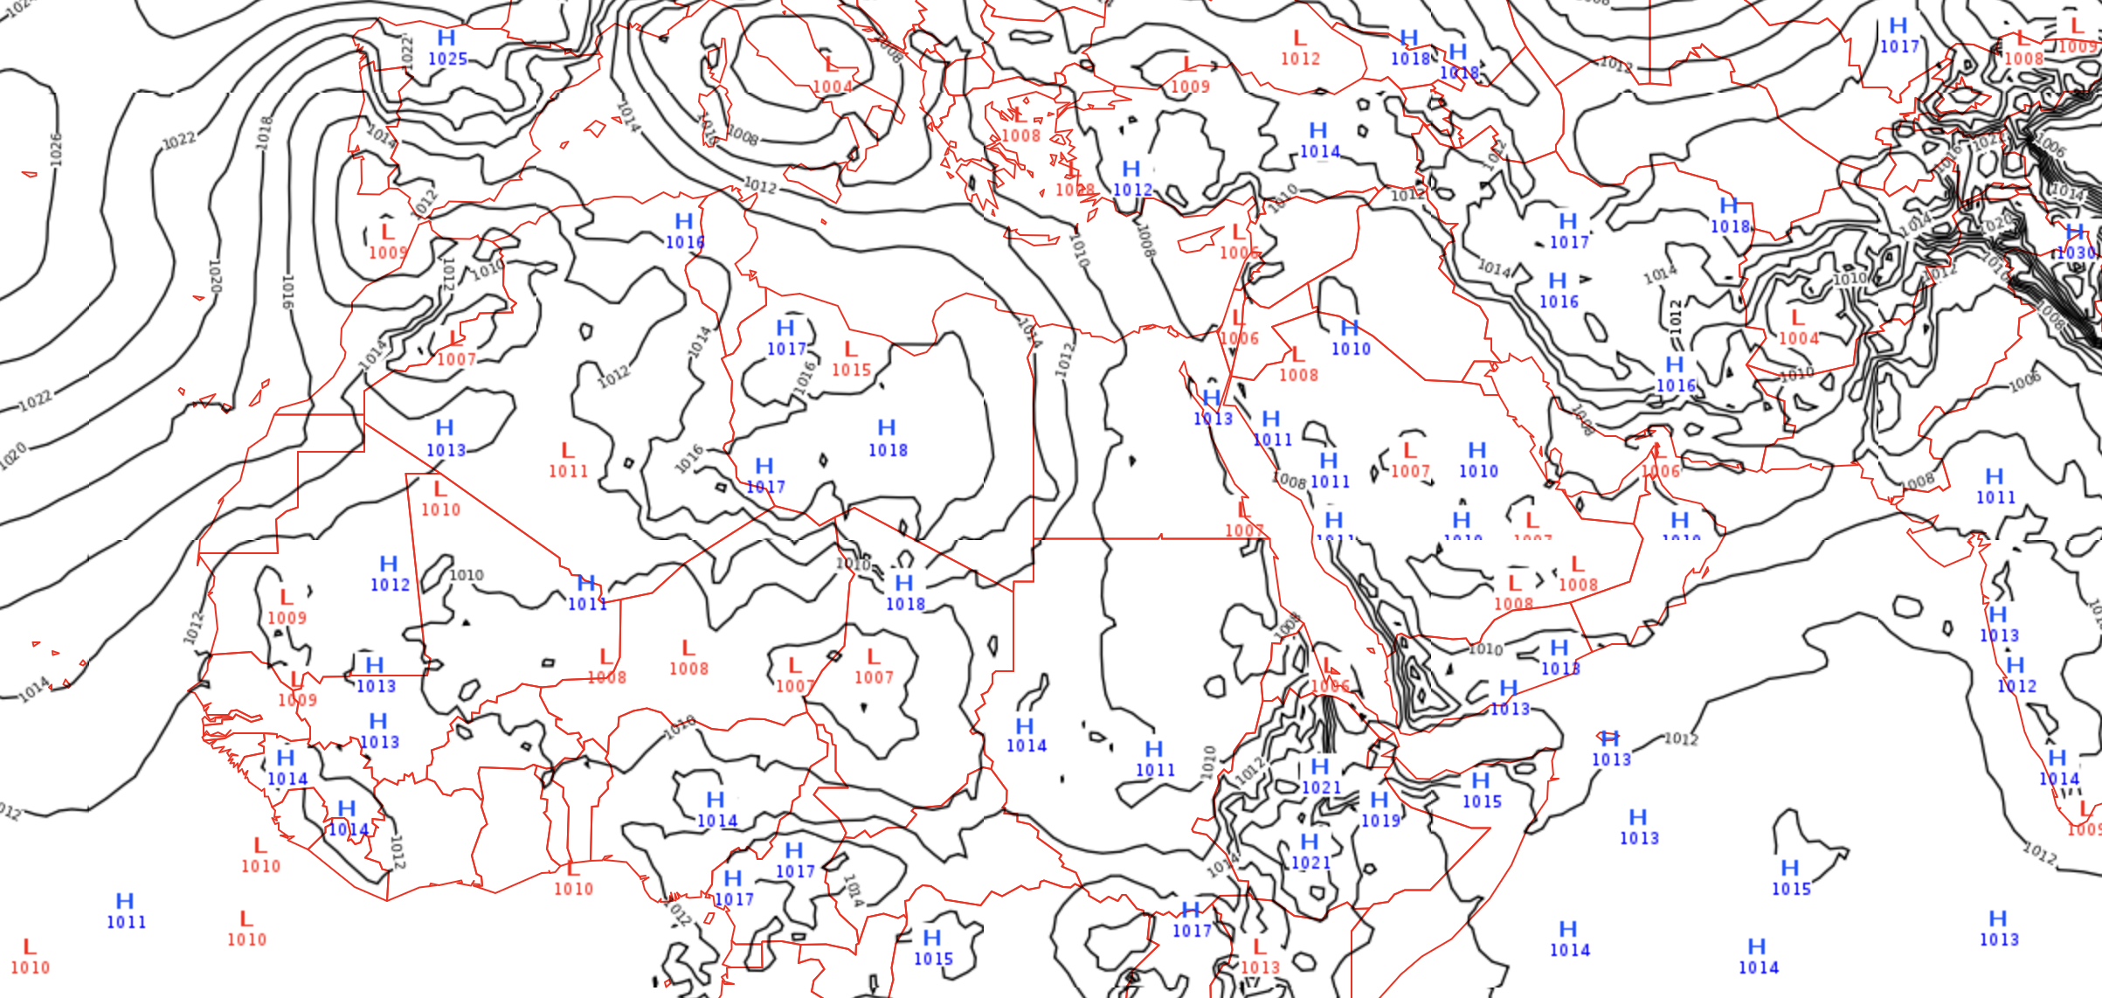
Derived Products– MSLP

Slide 35
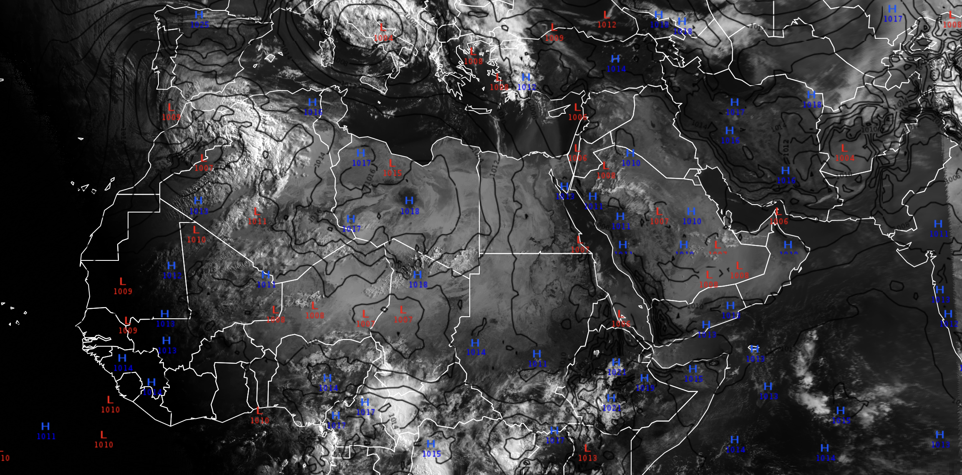
Derived Products– IR 10.8 and MSLP

Slide 36
Case Study

Slide 37
READ MORE HERE
Multispectral Satellite Applications: RGB Products Explained
Basic Satellite Imagery Interpretation
MSG CHANNELS Interpretation Guide

Slide 38
... NEXT... Where do you find all these incredible satellite products?

