Slide 1
Introduction to Satellite Products
Sarah Kimani - IMTR
17th May 2023

Slide 2
Agenda
Satellite Products - Forecasting
Single Channels
RGB Composites
Derived Products

Slide 3
Satellite Products - Forecasting
What Satellite Products do you use in your NMHS for Forecasting?

Slide 4
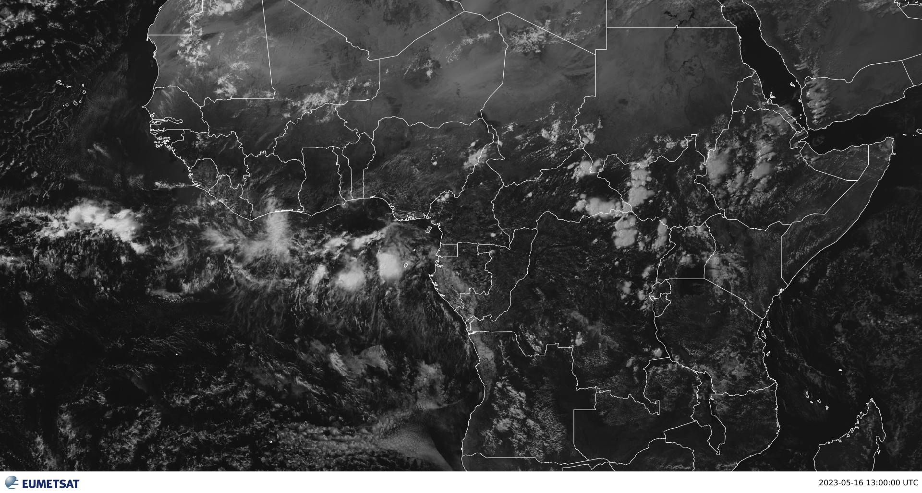
SINGLE CHANNELS (Visible O.6)
Objects that appear dark in our eyes seem dark in the VIS and vice versa

Slide 5
SINGLE CHANNELS (Visible O.6)
Used during daylight hours, useful for identifying cloud types, structure within clouds
Different grey shades indicate differences in cloud thickness, land cover or ocean surface

Slide 6
IR 10.8
Uses the temperatures of objects ie, warmer objects appear dark grey while colder objects appear light gray through white
Brightness Temperature allows us to differentiate between land, ocean and clouds
Cloud top temperatures allows us know their height: colder – lighter coloured = higher clouds, warmer – darker coloured = lower cloud tops

Slide 7
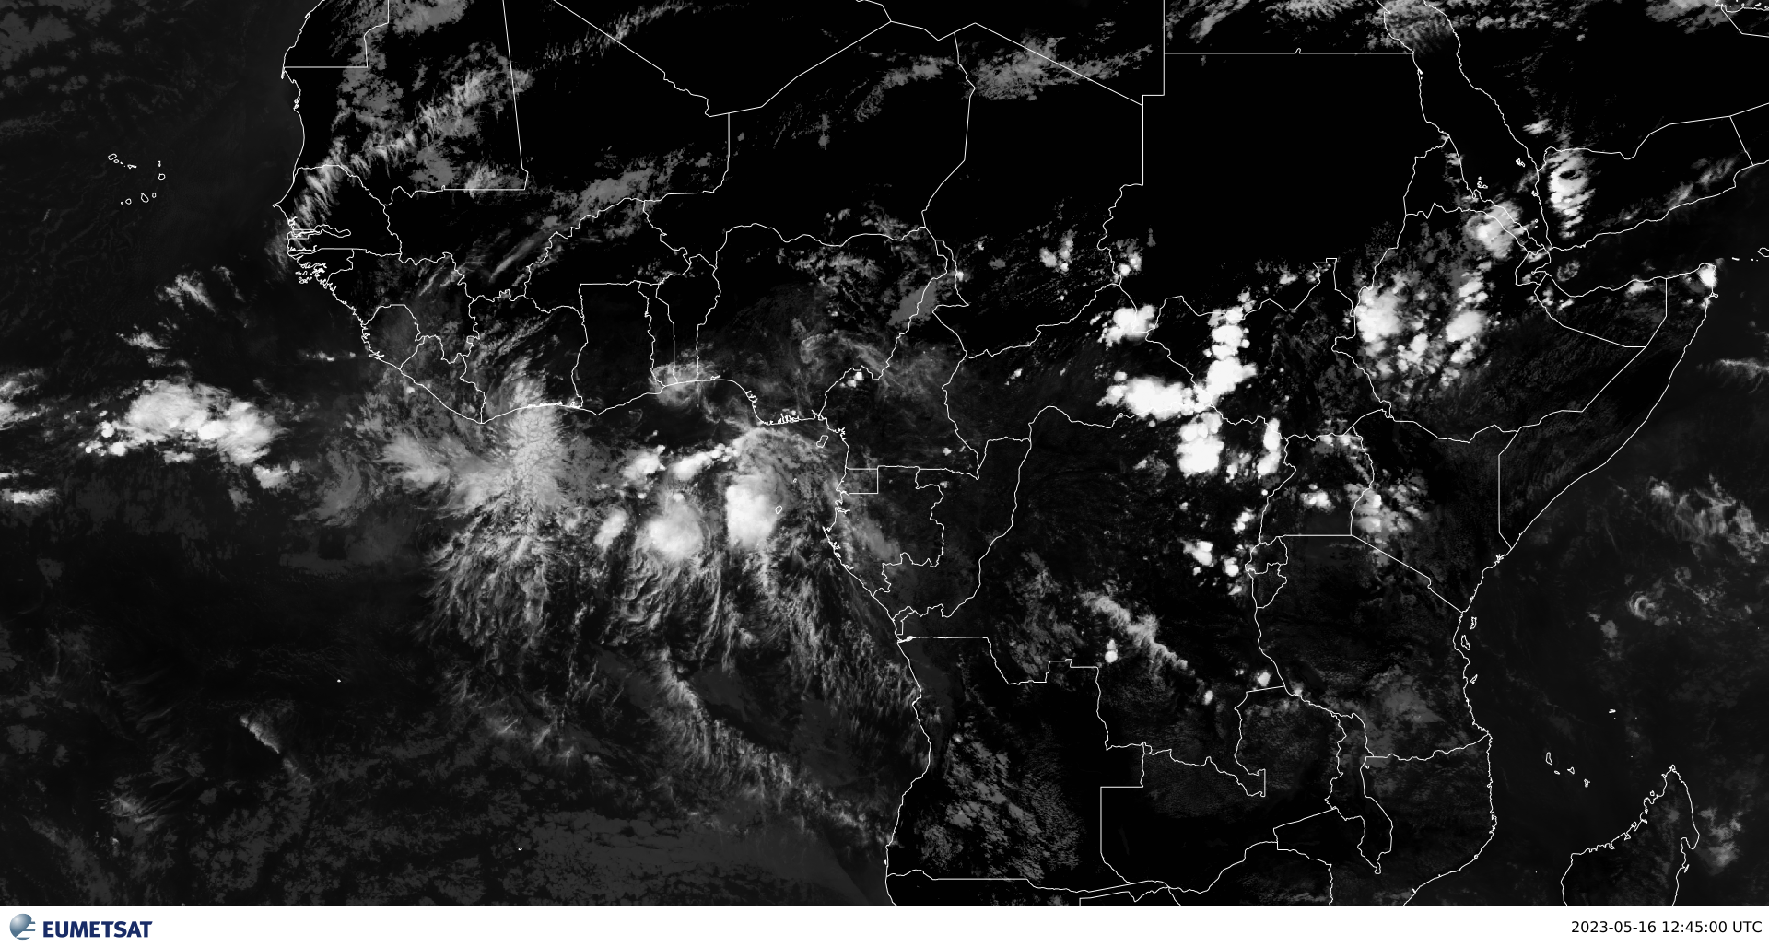
SINGLE CHANNELS (IR 10.8)

Slide 8
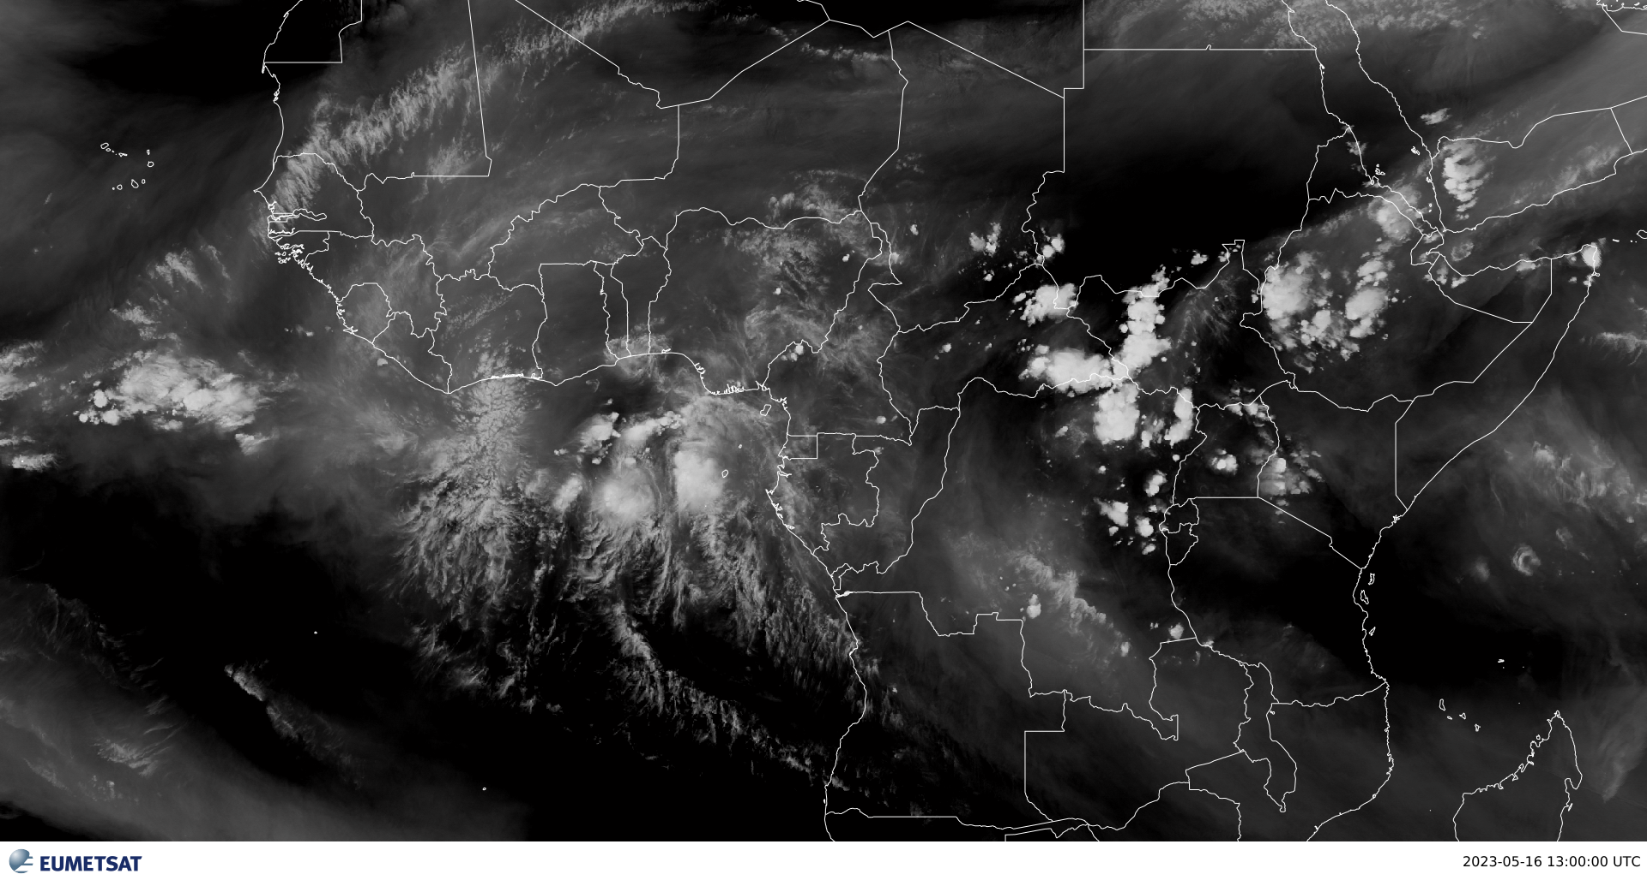
WV 6.2
WV Channel measures radiation from a set amount of water vapor in the upper-levels of the troposphere in grey shades.

Slide 9
SINGLE CHANNELS (WV 6.2)
WV displays the height and distribution of water vapor features
Well suited for illustrating the three dimensionality of the atmosphere and the continuous water vapor layer in the mid and high latitudes.
WV useful in monitoring developing thunderstorms, mesoscale downdrafts and upper level dynamics in the tropics

Slide 10
Poll Exercise

Slide 11
RGB COMPOSITES

Slide 12
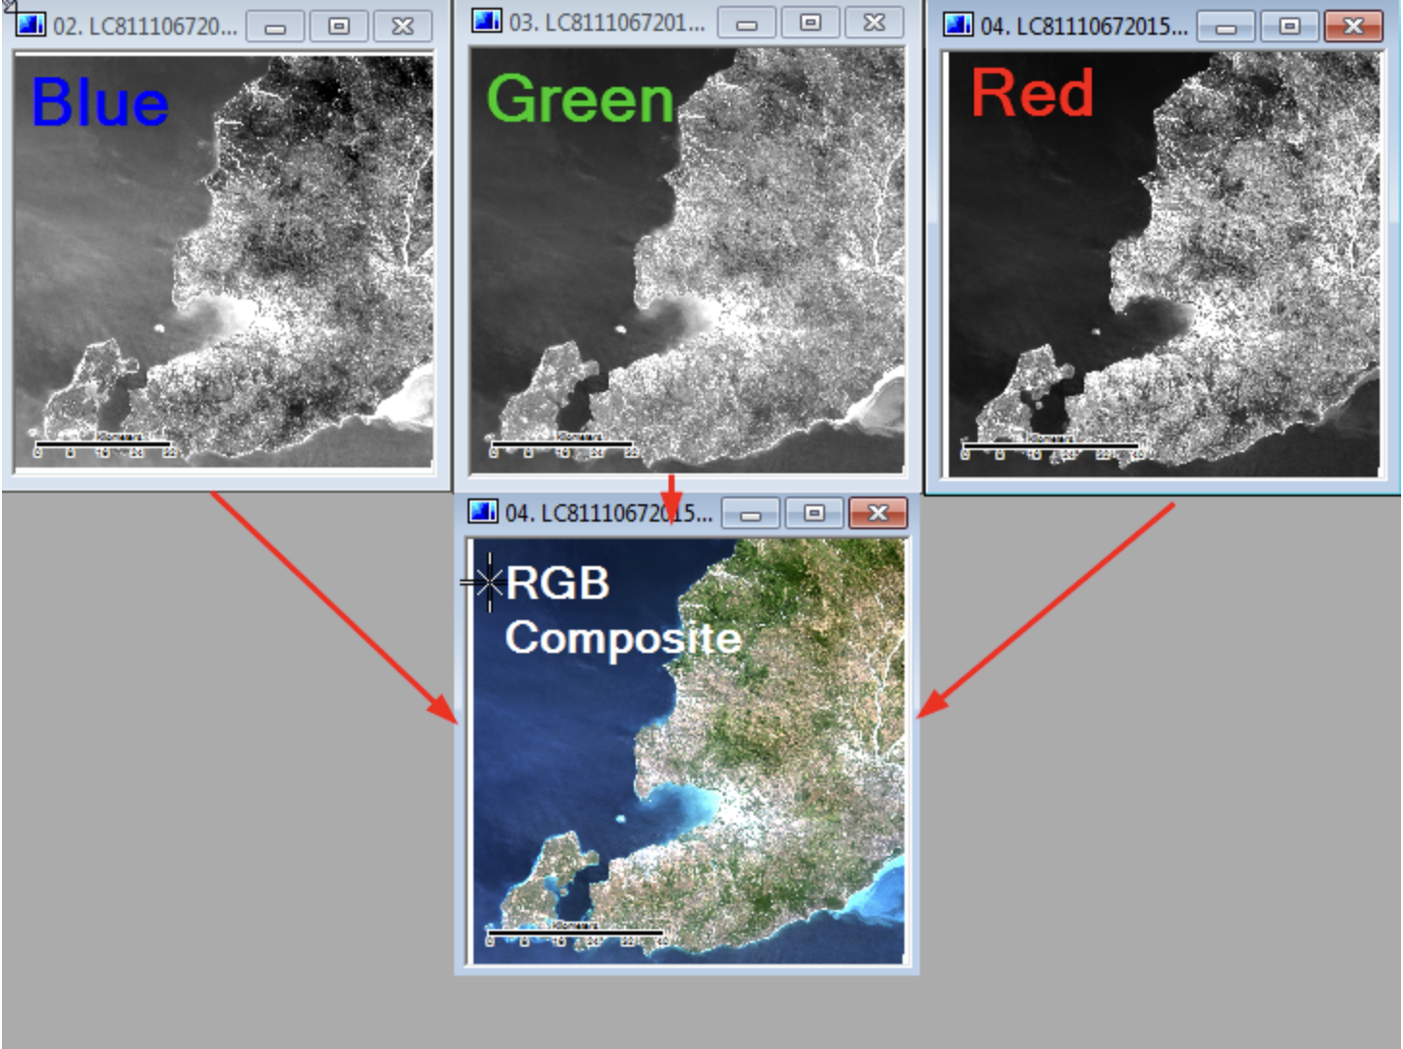
RGBs
RGB stands for red, green, and blue
RGB colors are the basic colors used for displaying images, objects, etc.
Satellite imagery is captured in multiple wavelengths of reflected light otherwise known as image ‘Bands’
Three image bands can be combined into one picture by displaying each band as either Red, Green or Blue.

Slide 13
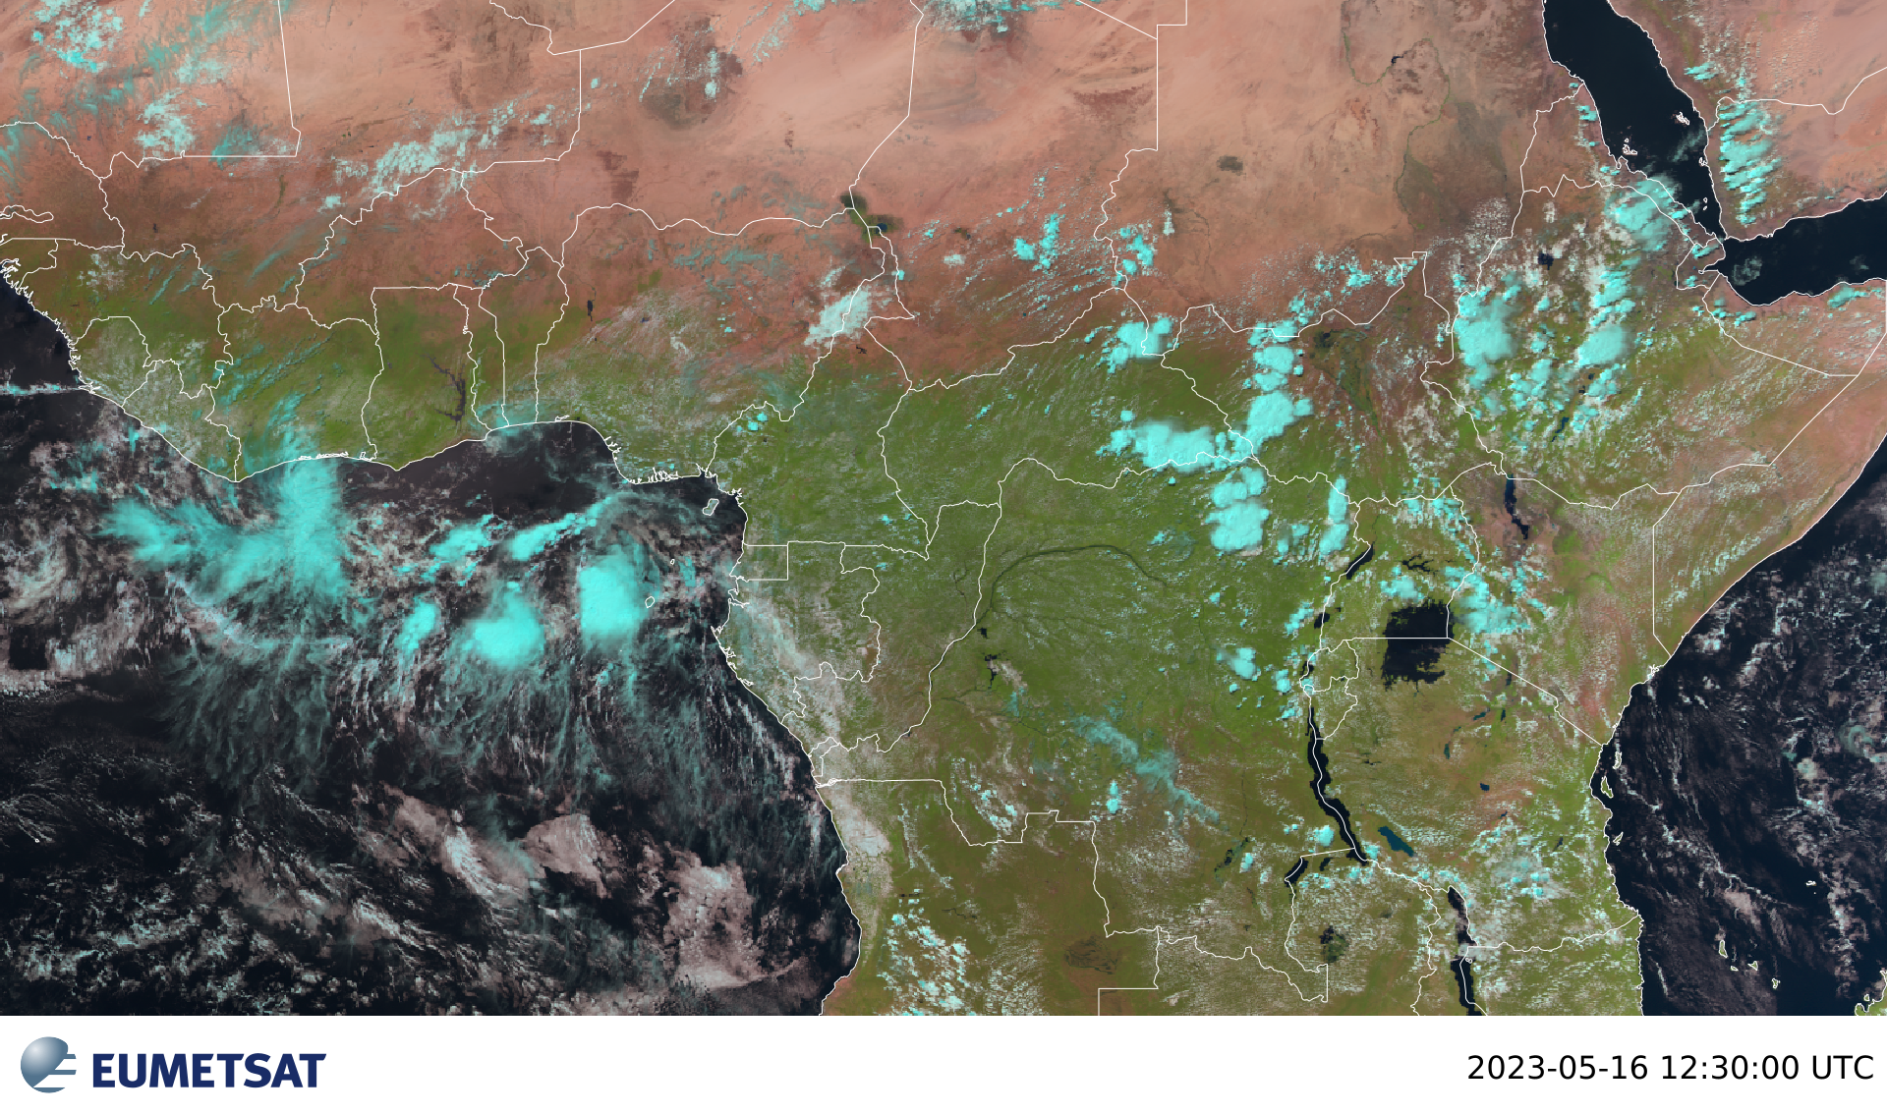
Natural Color RGB
Combines three channels (two visible and one near-infrared) to make a colorized version of the visible imagery
Surface ice/snow and ice clouds all show as differing shades of cyan (light blue)
It is not useful at night

Slide 14
Natural Color RGB
Most surface features look realistic in this product:
grasslands and forests are typically green
water appears black
desert is tan to reddish brown
clouds are white-pink
Example with a mixture of ice and water clouds

Slide 15
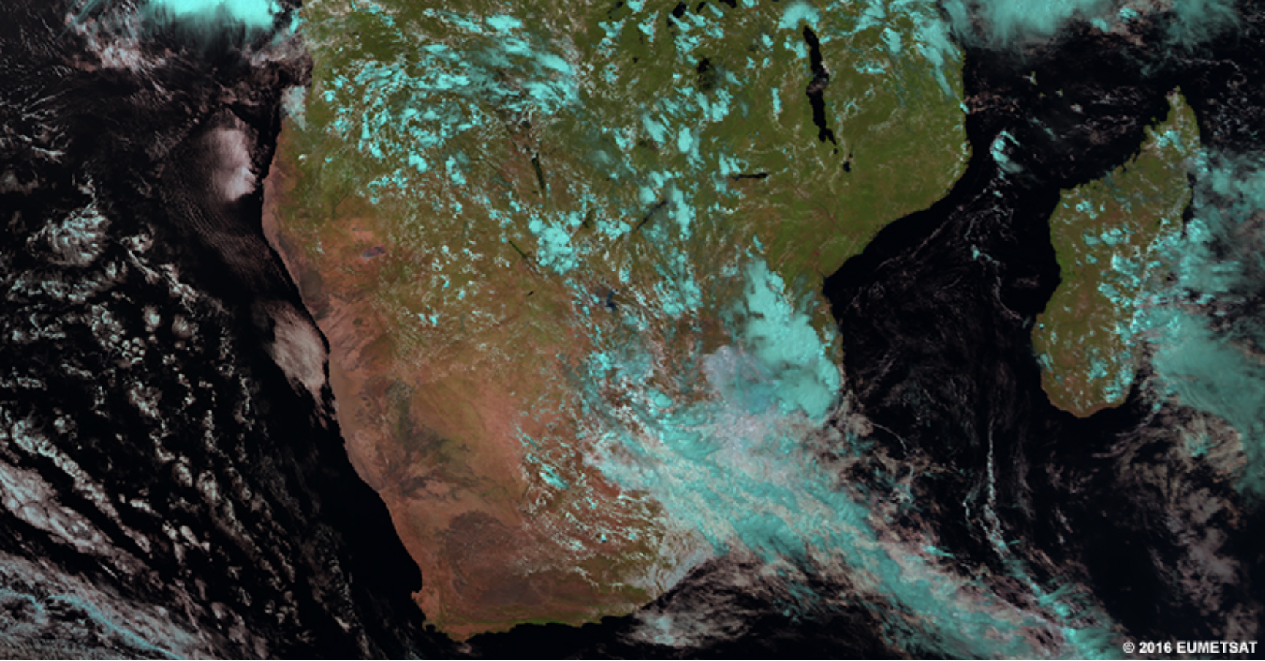
Natural Color RGB

Slide 16
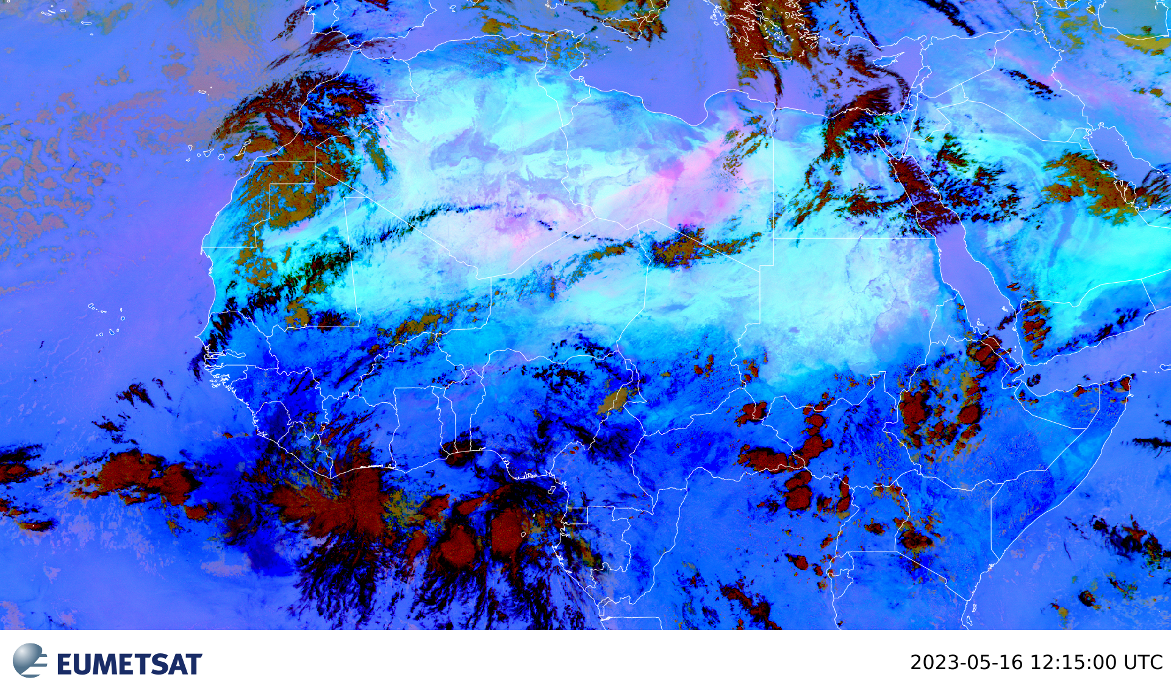
Dust RGB
Combines information from several IR channels and channel differences in order to highlight dust; shades of bright pink in this RGB
Daytime, bright pink areas are always dust and very thick dust can appear dark magenta.

Slide 17
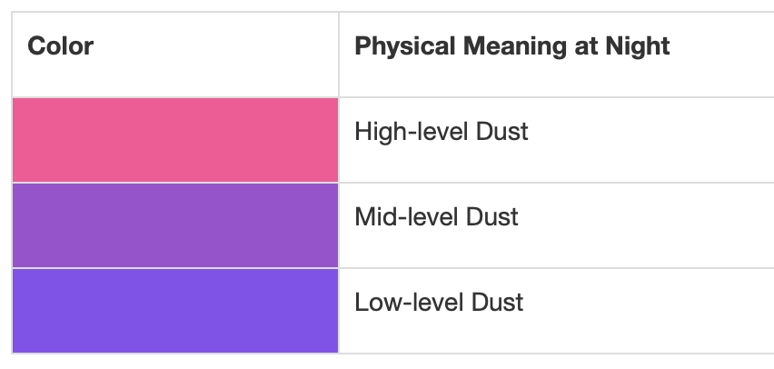
Dust RGB
At night, dust ranges in colour from pink to purple or purple-blue. The pinker the dust area, the higher its cloud-top is. Likewise, the bluer the area, the lower the dust cloud top

Slide 18
Dust RGB

Slide 19
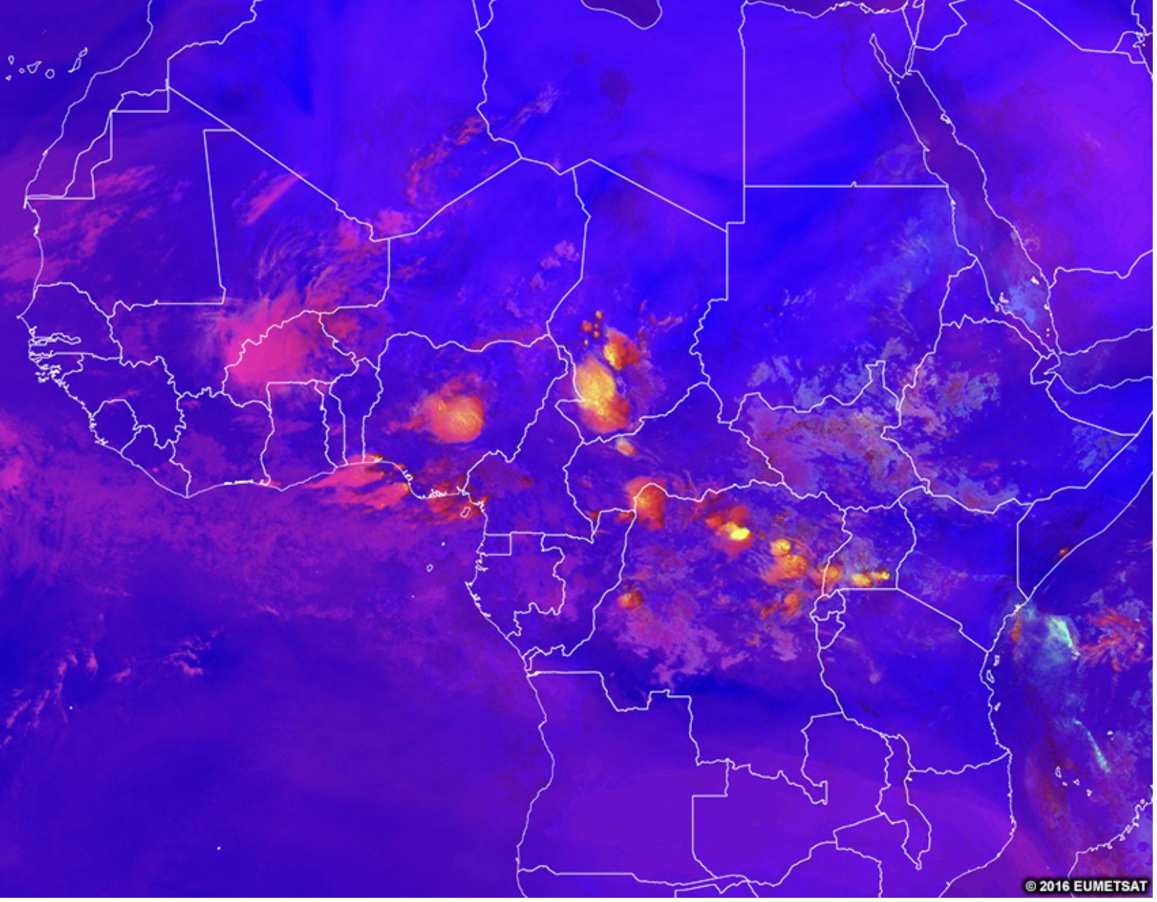
Severe Convection = Convection RGB
Shows areas of active thunderstorms with strong updrafts in colours ranging from red (less intense convection) to yellow (most intense convection)

Slide 20
Severe Convection = Convection RGB
Combination of visible, infrared and water vapour channels and channel differences; can be used only during the day.
Tall, thick clouds initially appear red.
Over time, as the updraft generates and pushes more ice crystals upward, the tops will appear more yellow.
Later on, the yellow areas may grow horizontally as small ice crystals fill out the anvil of the storm.

Slide 21
Severe Convection = Convection RGB
Dissipating yellow colours indicate that the updraft is weakening

Slide 22
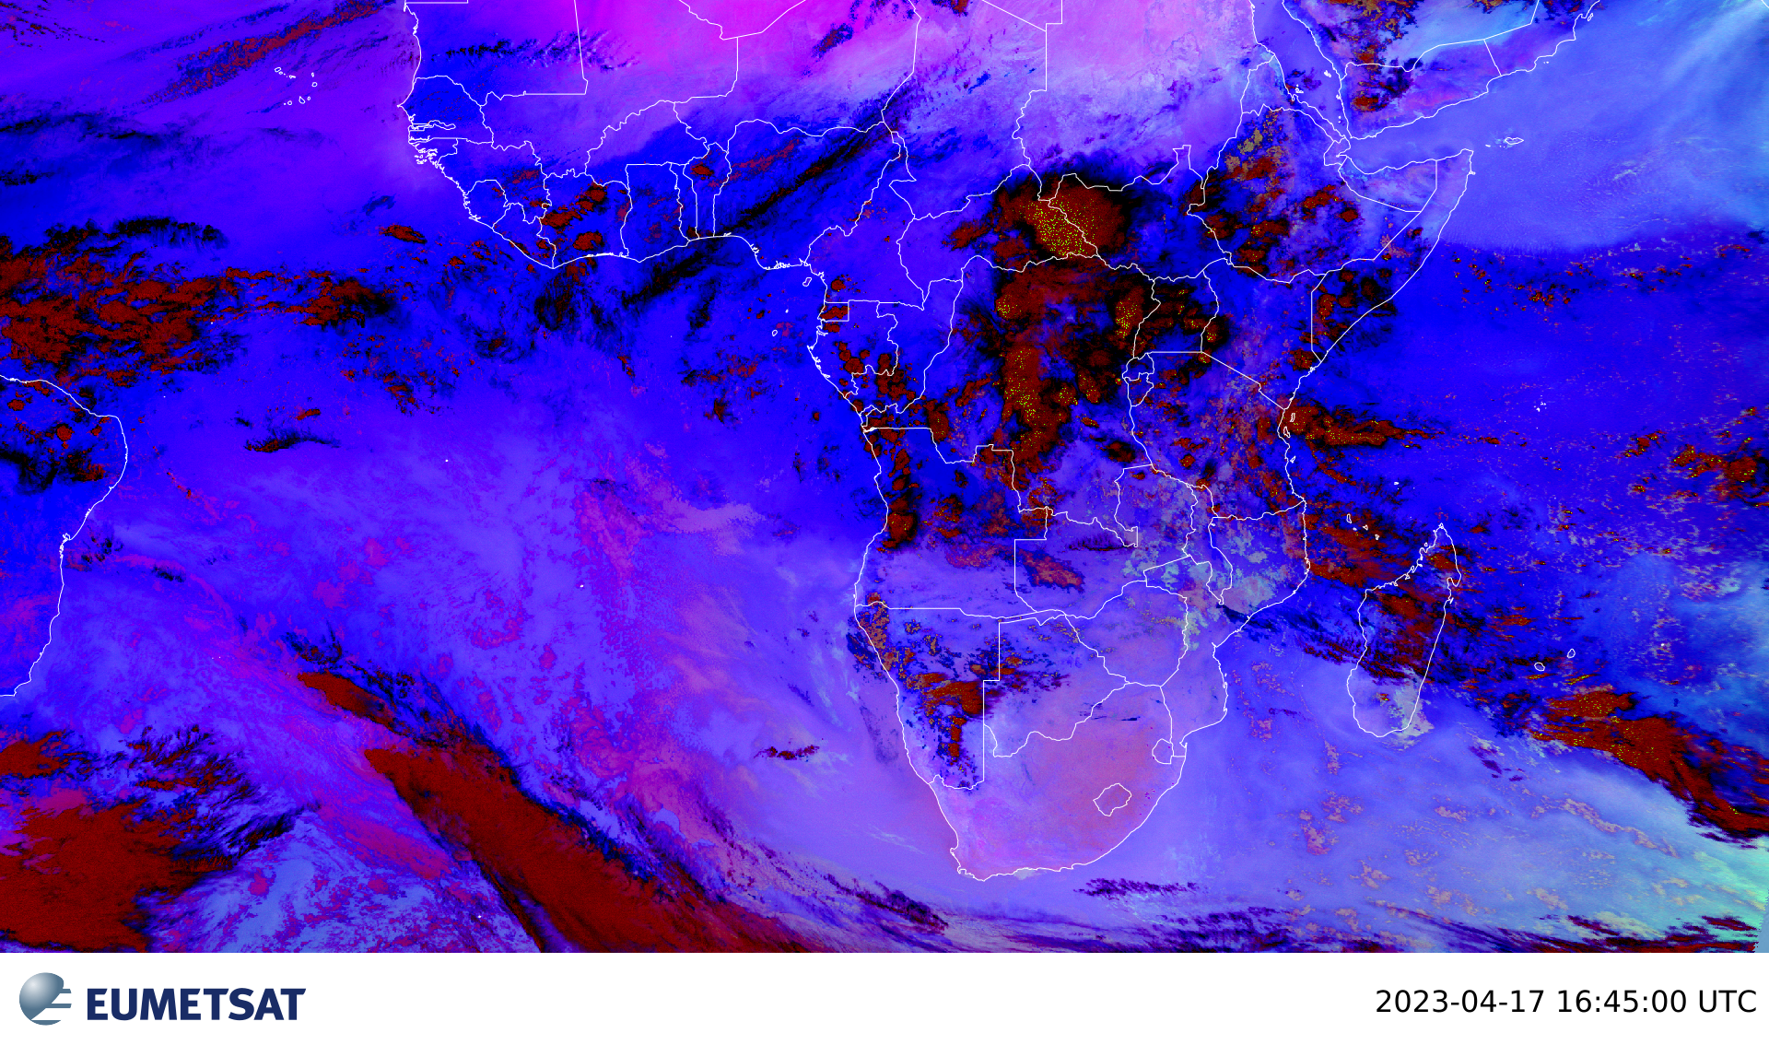
Night Microphysics RGB = Fog/Low Clouds RGB
Combination of three different IR channels and channel differences; can be used any time of day, but night microphysics RGB is tuned for night-time

Slide 23
Night Microphysics RGB = Fog/Low Clouds RGB
Colours are controlled heavily by the cloud-top temperature and cloud-top temperature difference between channels
This also depends on season, viewing angle or overall temperature profile. Generally, low clouds/fog appear:
green in the mid- and high-latitude cold seasons and during cold weather regimes
light blue in the mid- and low-latitude warm season and during warm weather regimes
Helps identify night-time low-level clouds and fog, determine cloud heights.

Slide 24
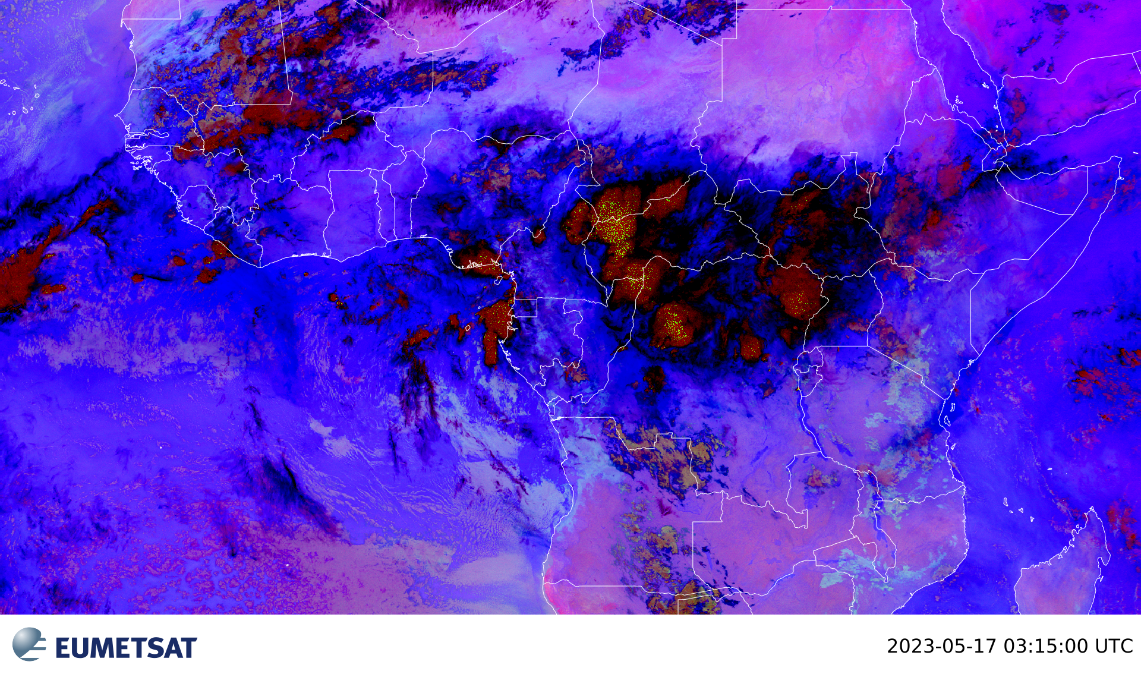
Night Microphysics RGB = Fog/Low Clouds RGB
In the tropics, low-level stratiform clouds are light blue. Mid-level clouds are pinkish to brownish, and high-level cirrus are black to dark blue
Notes:
In the tropics, low-level stratiform clouds are light blue. Mid-level clouds are pinkish to brownish, and high-level cirrus are black to dark blue

Slide 25
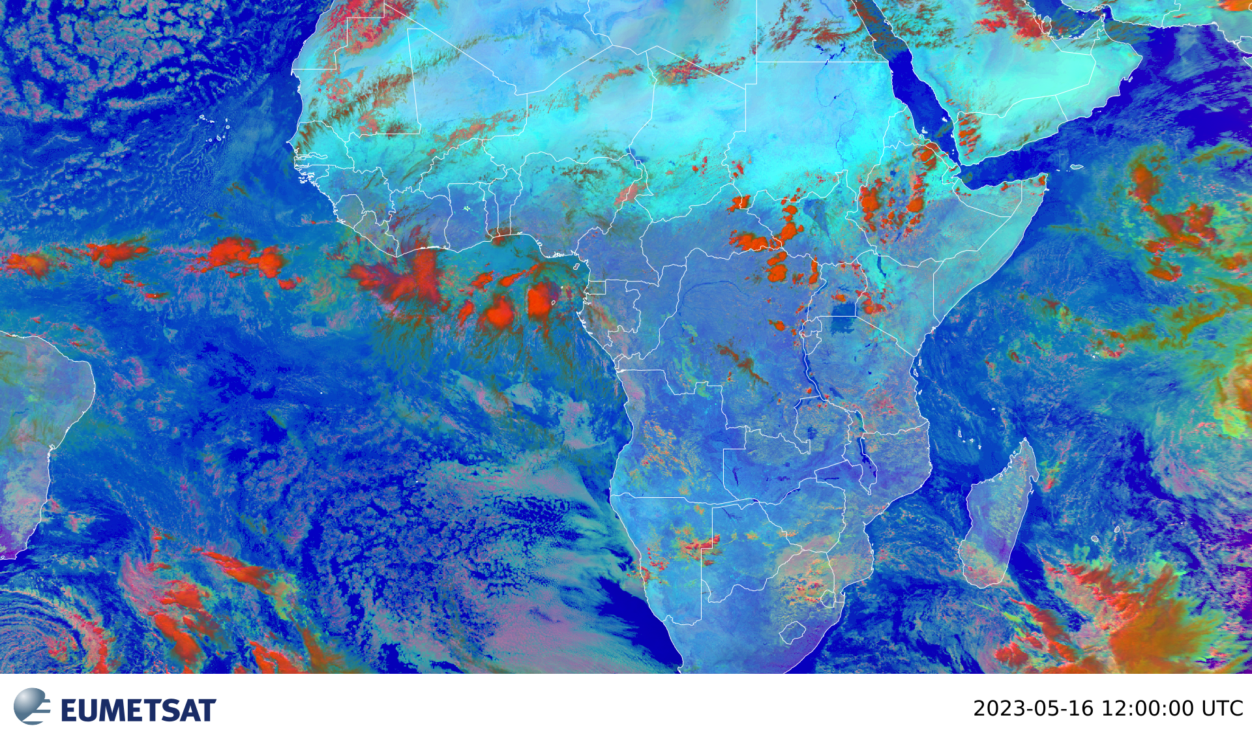
Day Microphysics RGB
Combines information about the cloud brightness, cloud particle phase and size, and cloud top temperature in order to analyze convective clouds as well as other cloud and surface features

Slide 26
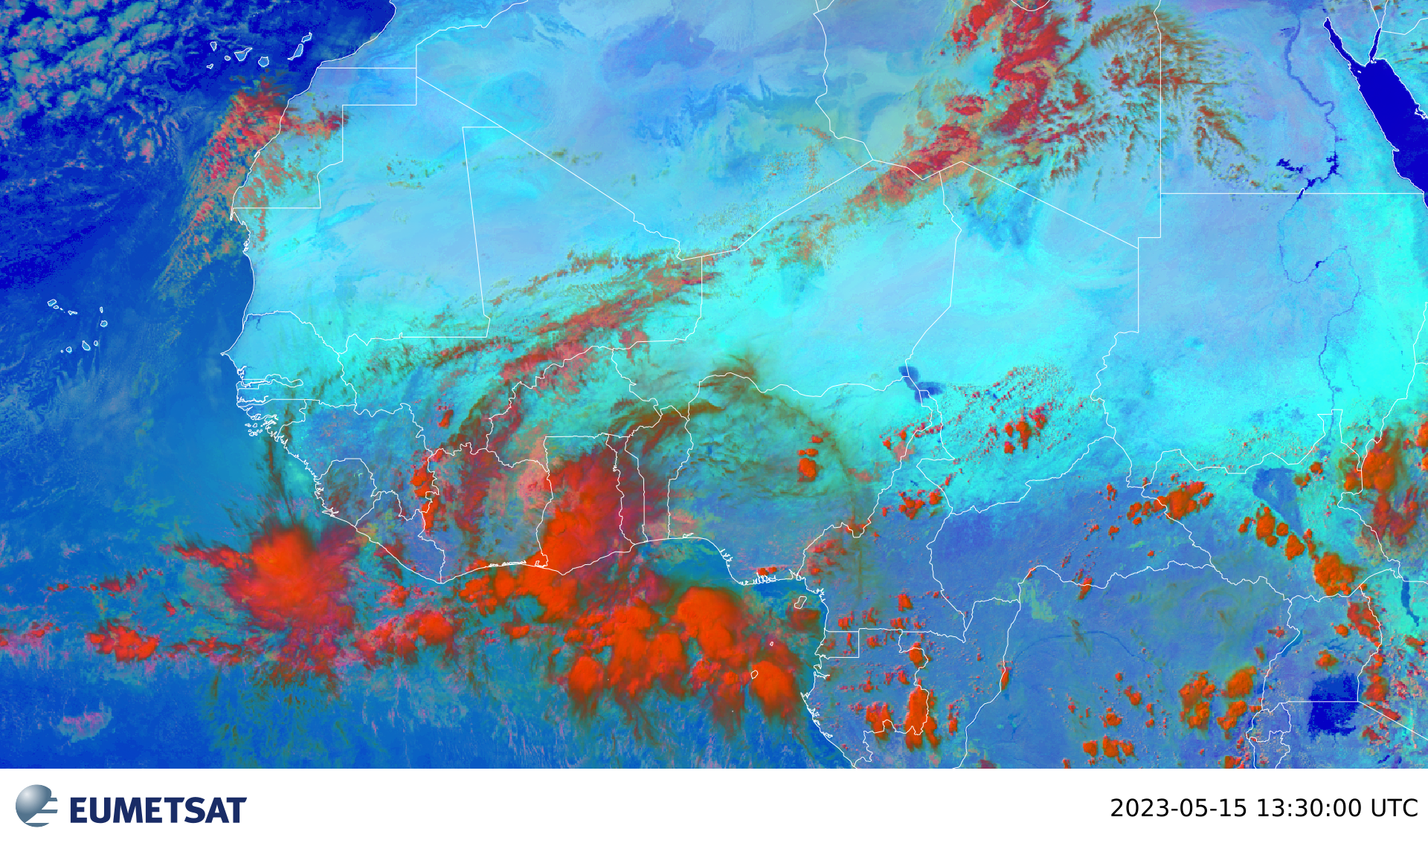
Day Microphysics RGB
The cloud particle phase and size can be qualitatively determined to estimate if strong updrafts are associated with the convection or if warm rain processes are active. Identification of cloud types, including fog and low stratus as well as fires, snow, and contrails
Notes:
Thick, small ice, high cloud , Cb, strong convection, likely precip
Thick, large ice, high cloud Cb, weak convection, likely precip (dark orange, red),Thin, small ice, high cloud, Cirrus (green to dark green), Thick, large drops, mid cloud Supercooled water cloud (tan to light orange)

Slide 27
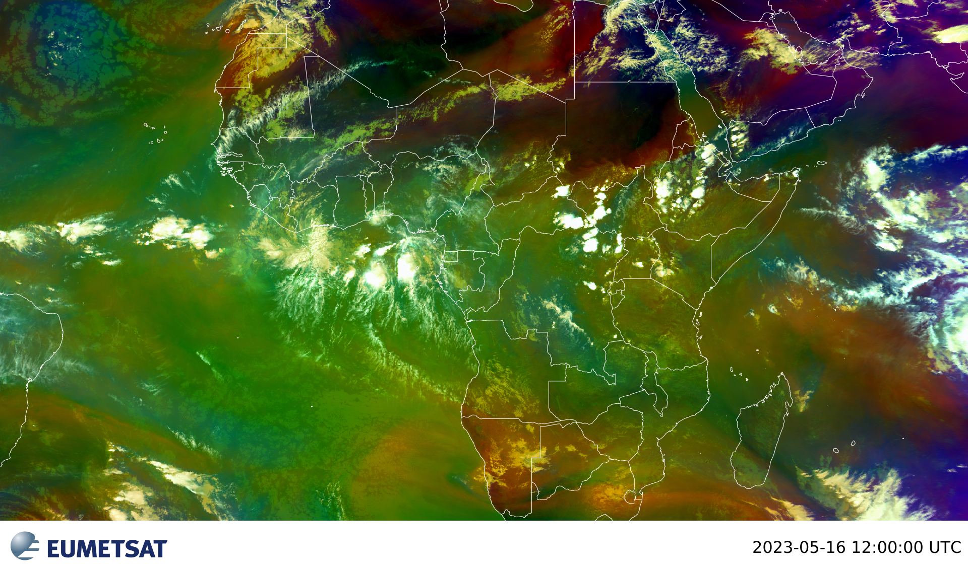
Airmass RGB
Based upon data from IR and WV channels

Slide 28
Airmass RGB
Designed and tuned to monitor
Distribution of different air masses
Evolution of cyclones, in particular rapid cyclogenesis
Jet streaks and
PV (potential vorticity) anomalies

Slide 29
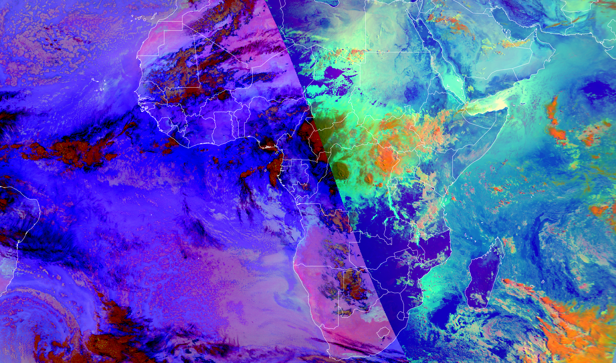
Airmass RGB
A
B

Slide 30
DERIVED PRODUCTS

Slide 31
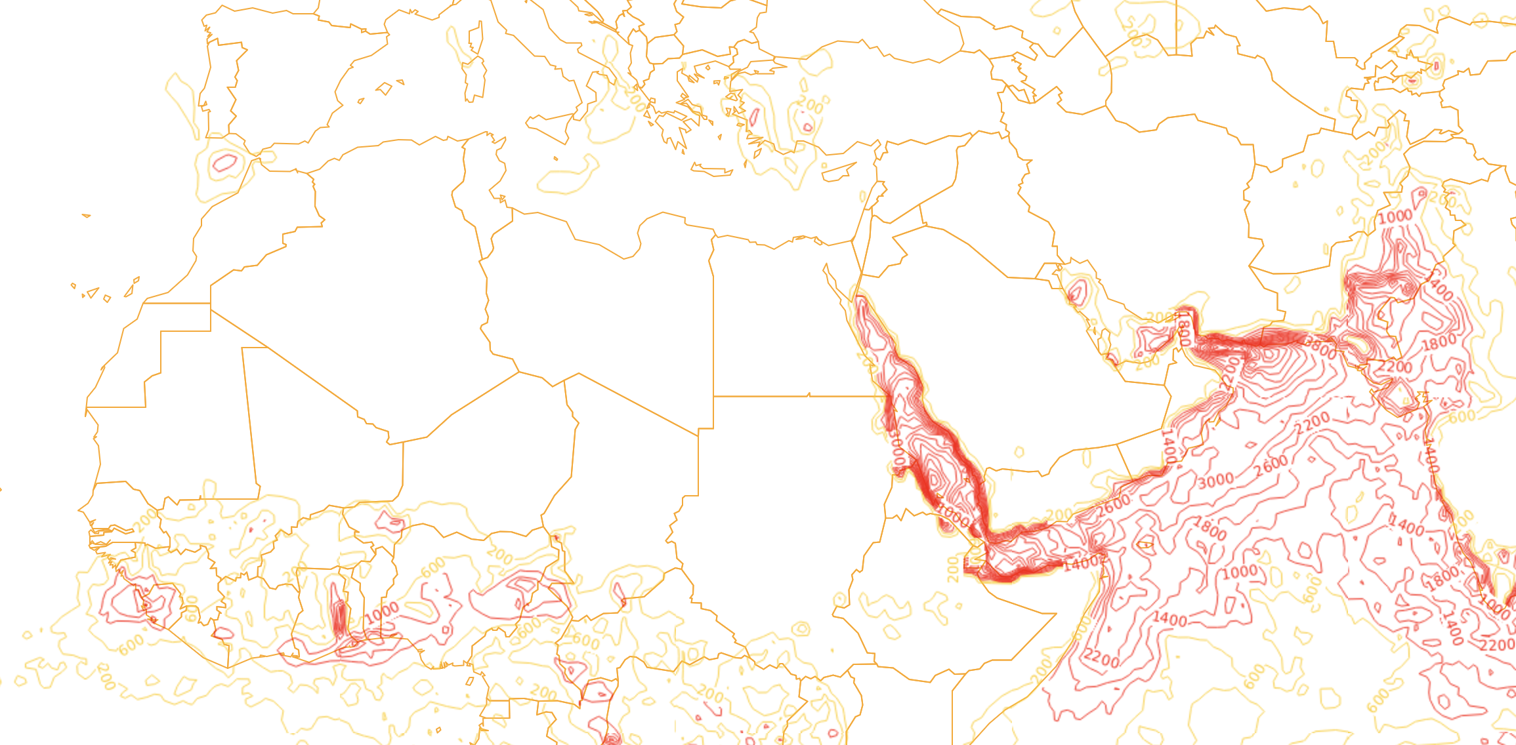
DERIVED PRODUCTS - CAPE

Slide 32
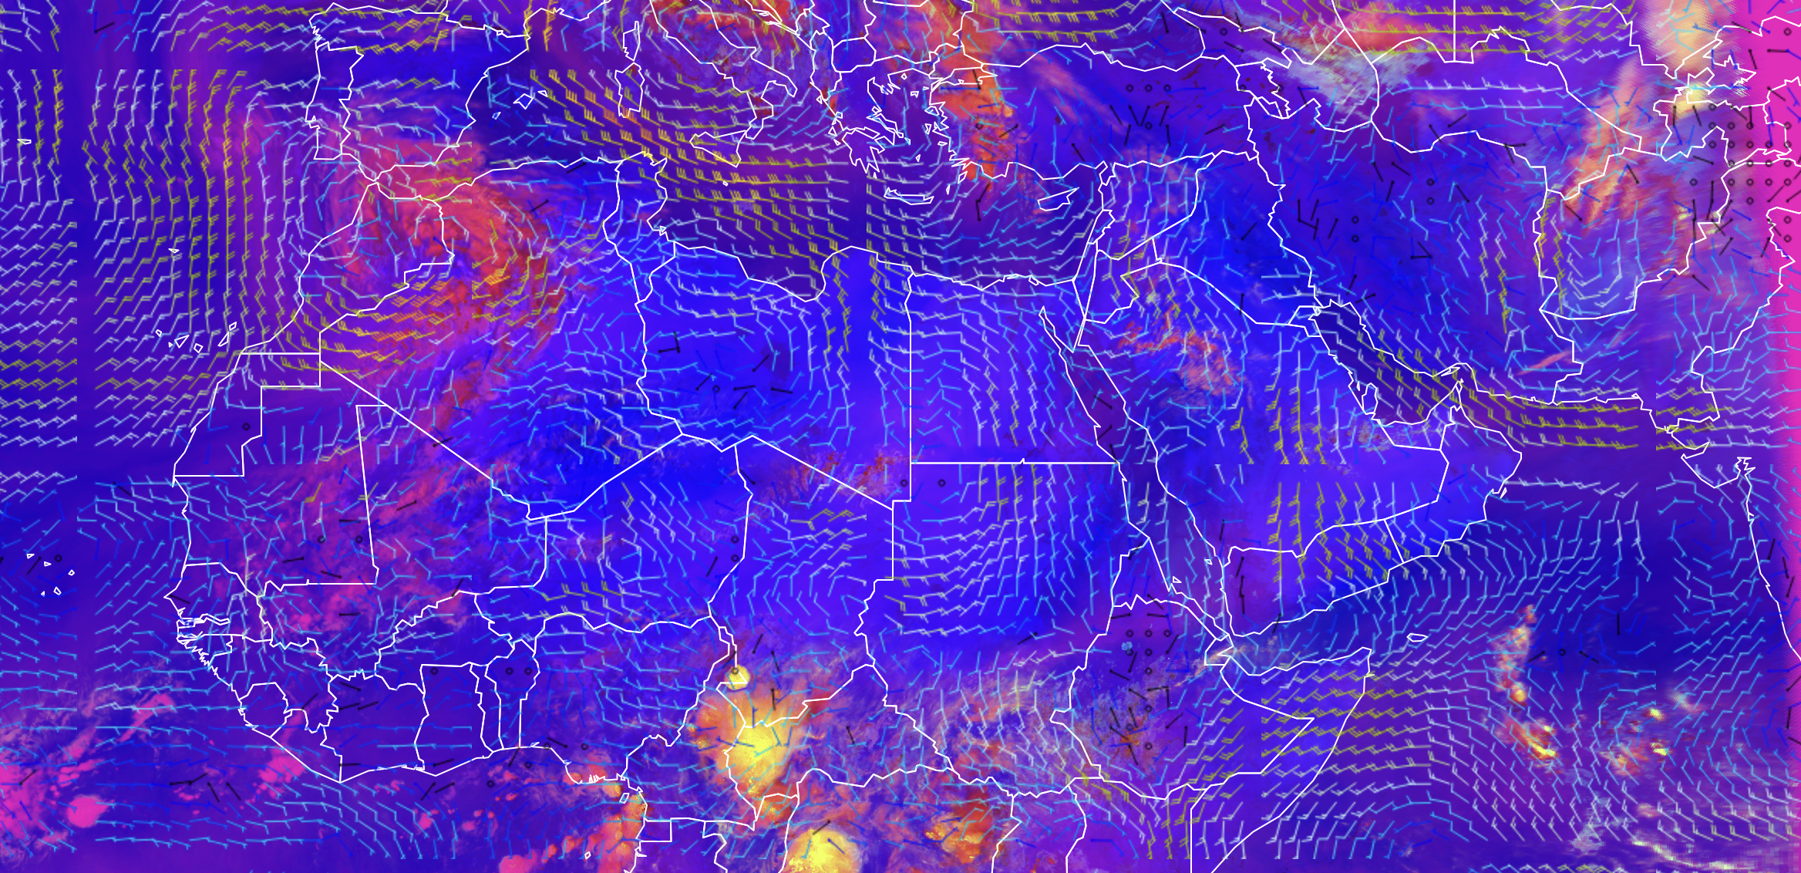
DERIVED PRODUCTS – SEVERE CONVECTION AND 850HPA WIND

Slide 33
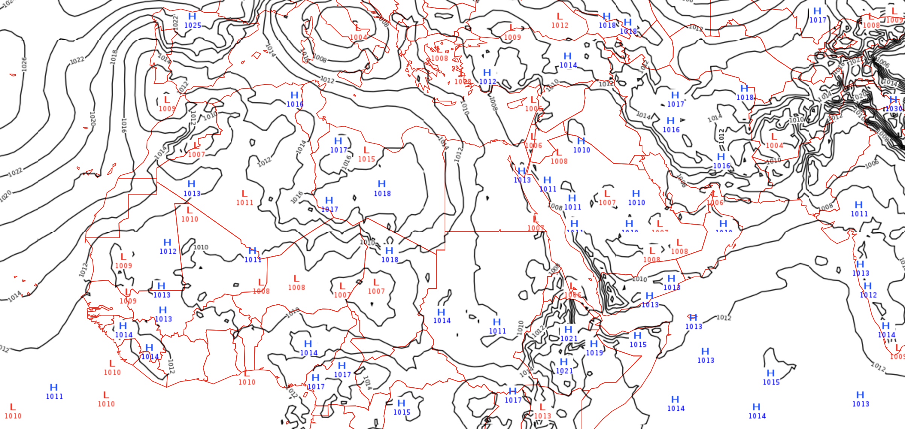
DERIVED PRODUCTS – MSLP

Slide 34
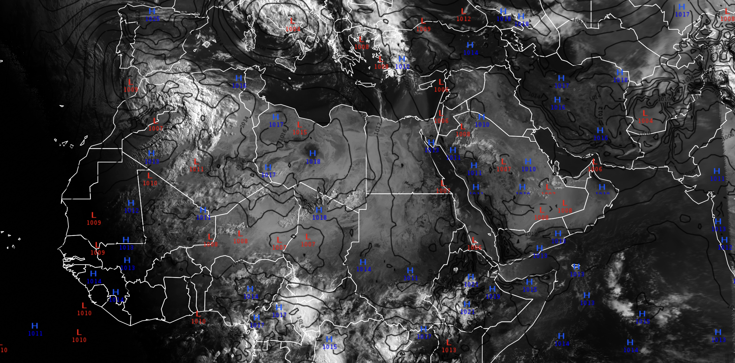
DERIVED PRODUCTS – IR 10.8 AND MSLP

Slide 35
READ MORE HERE
Multispectral Satellite Applications: RGB Products Explained
Basic Satellite Imagery Interpretation
MSG CHANNELS Interpretation Guide

Slide 36
... NEXT... Where do you find all these incredible satellite products?

