Slide 1
FCI view on fires
Ivan Smiljanic
EUMETSAT training team

Slide 2

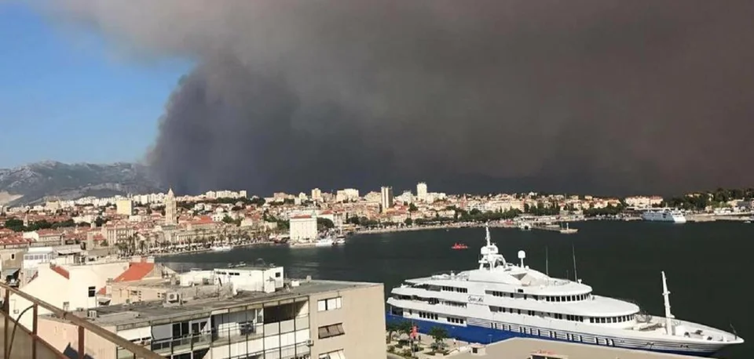
Fire detection
Fire parameters?
What to use to detect fires?

Slide 3
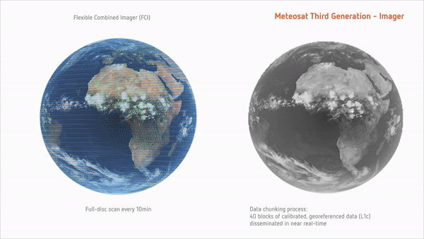

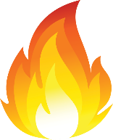
FCI – Overview – A big step forward!
8 channels in the solar VIS-NIR domain (0.4µm - 2.2µm),
1km spatial resolution at nadir (FDHSI).
8 channels in the thermal IR domain (3.8µm - 13.3µm),
2km spatial resolution at nadir (FDHSI).
4 channels are also available at higher spatial resolution (HRFI):
  VIS0.6 and NIR2.2: 0.5km (nadir)
  IR3.8 and IR10.5: 1km (nadir)
2 km
1 km
0.5 km
No. | Central λ / μm | λ width / μm | Resolution / km
1 | 0.44 | 0.06 | 1.0
2 | 0.51 | 0.04 | 1.0
3 | 0.64 | 0.05 | 1.0/0.5
4 | 0.86 | 0.05 | 1.0
5 | 0.91 | 0.02 | 1.0
6 | 1.38 | 0.03 | 1.0
7 | 1.61 | 0.05 | 1.0
8 | 2.25 | 0.05 | 1.0/0.5
No. | Central λ / μm | λ width / μm | Resolution / km
9 | 3.80 | 0.40 | 2.0/1.0
10 | 6.30 | 1.00 | 2.0
11 | 7.35 | 0.50 | 2.0
12 | 8.70 | 0.40 | 2.0
13 | 9.66 | 0.30 | 2.0
14 | 10.50 | 0.70 | 2.0/1.0
15 | 12.30 | 0.50 | 2.0
16 | 13.30 | 0.60 | 2.0
Fires and hotspots can be observed by FCI with unprecedented spatial detail!
All channels have the same reference grid

Slide 4

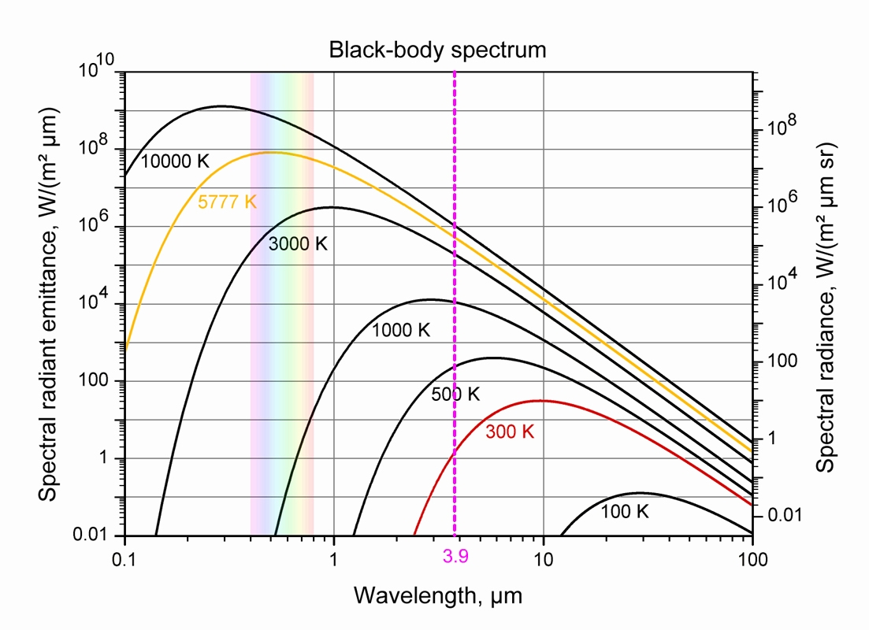

Fire (blackbody) Radiation
Planck/Wien’s law:
the hotter the object ( ), the shorter the wavelength at which it emits the most
Typical temperature: 600K-1300K
→ ~ 3.9µm is the most suitable wavelength range!
  Highest emission
  Highest sensitivity to sub-pixel fires
But hot(ter) fires will appear also in the NIR range
↑ Temperature ↓ Peak Wavelength

Slide 5
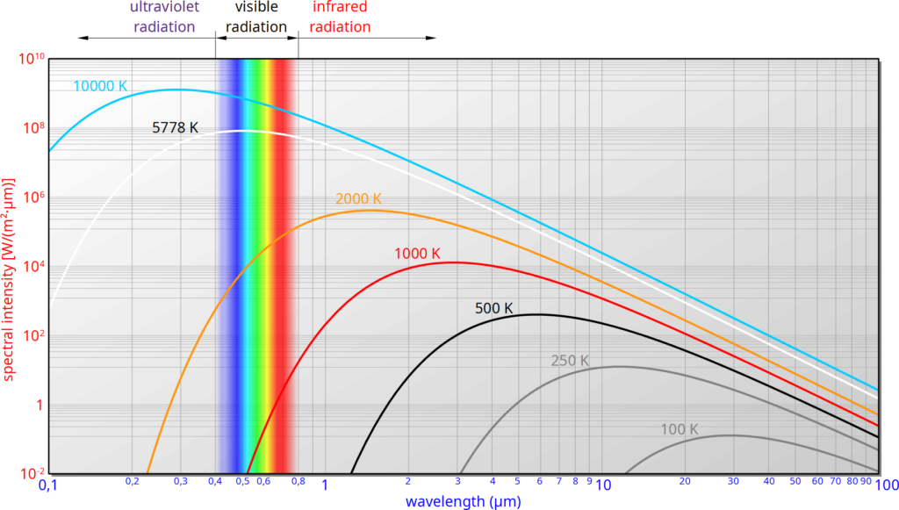
Fire Temperature RGB
Fire Temperature RGB
(IR3.7, NIR2.25, NIR1.6)

Slide 6
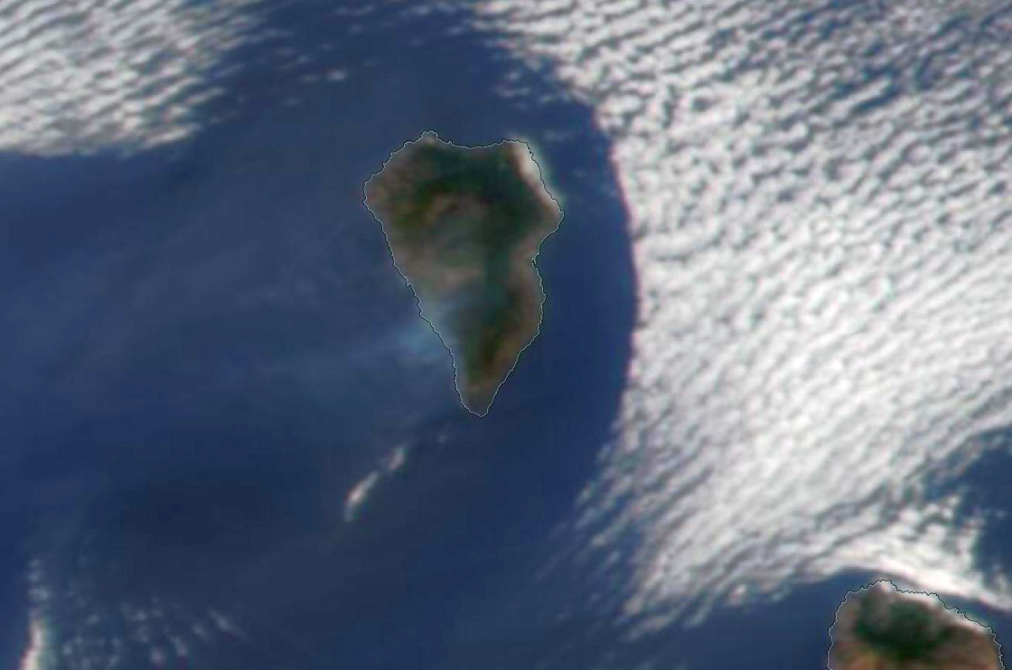
Other RGBs
S-NPP VIIRS, 2 Oct 2021, 13:45Z

Slide 7
Other RGBs
True Colour RGB
(VIS0.6, VIS0.5, VIS0.4)
- Hot spots not detected
S-NPP VIIRS, 2 Oct 2021, 13:45Z

Slide 8
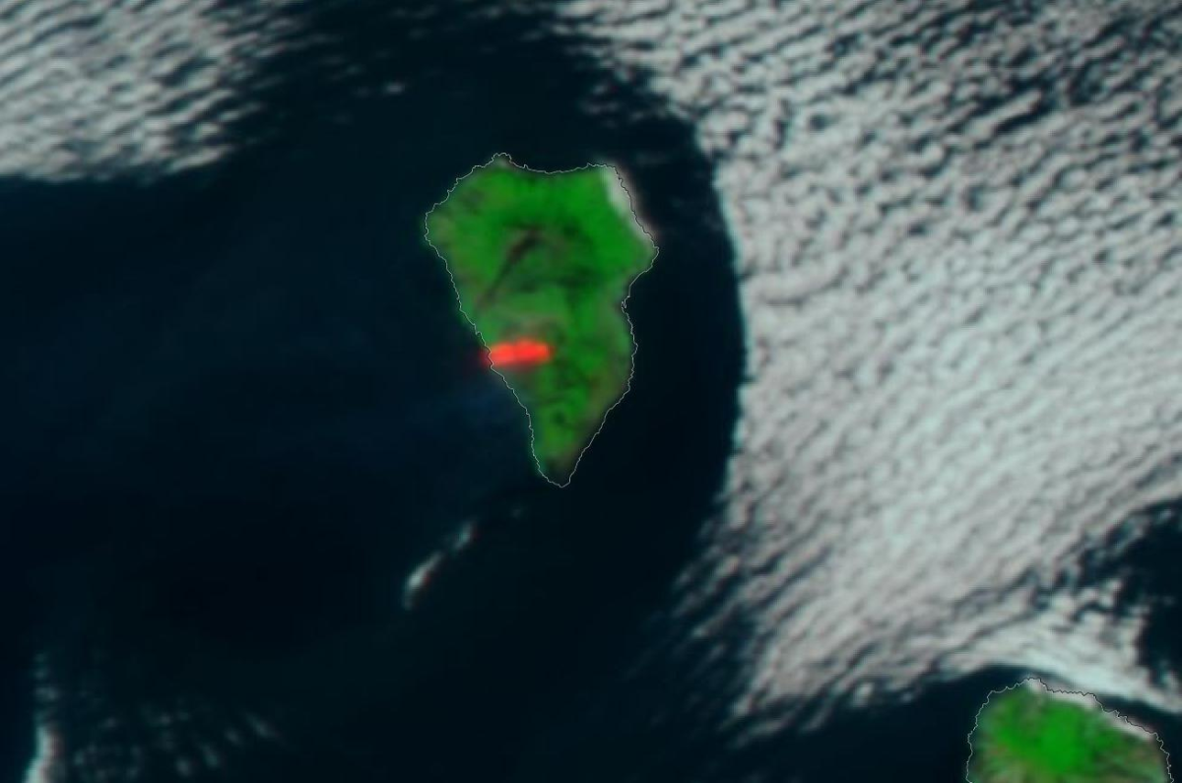
Other RGBs
S-NPP VIIRS, 2 Oct 2021, 13:45Z

Slide 9
Other RGBs
Natural Colour RGB
(NIR1.6, VIS0.8, VIS0.6)
- Hot spot detected
S-NPP VIIRS, 2 Oct 2021, 13:45Z

Slide 10
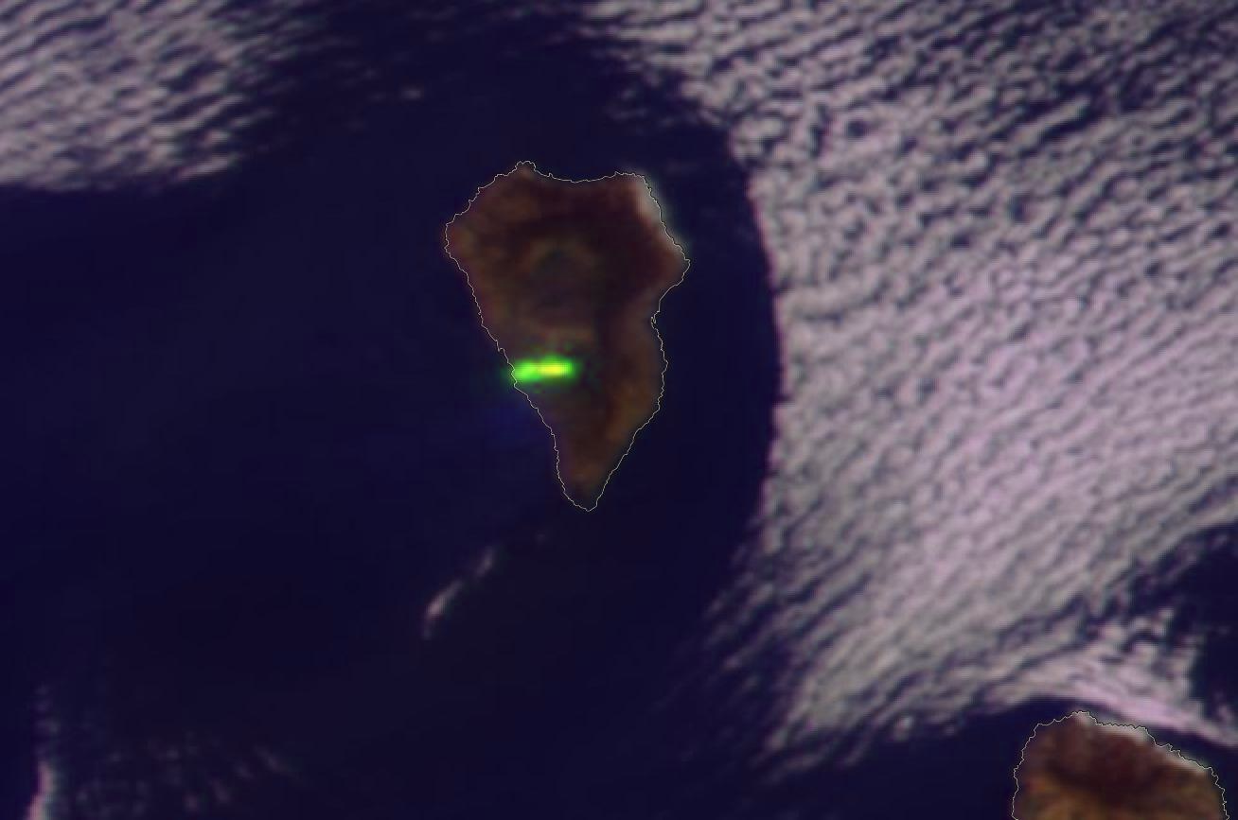
Other RGBs
S-NPP VIIRS, 2 Oct 2021, 13:45Z

Slide 11
Other RGBs
Cloud Phase RGB
(NIR1.6, NIR2.2, VIS0.6)
- Hot spot intensity
S-NPP VIIRS, 2 Oct 2021, 13:45Z

Slide 12

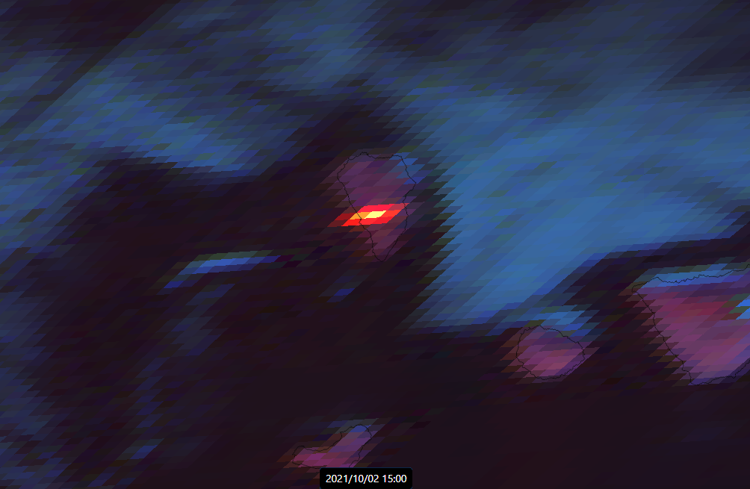
Fire Temperature RGB
Temperature
Level
1 2 3
GOES East ABI, 2 Oct 2021, 15:00Z

Slide 13
Fire Temperature RGB
Fire Temperature RGB
(IR3.8, NIR2.2, NIR1.6)
- Hot spot intensity!
Temperature
Level
1 2 3
GOES East ABI, 2 Oct 2021, 15:00Z

Slide 14
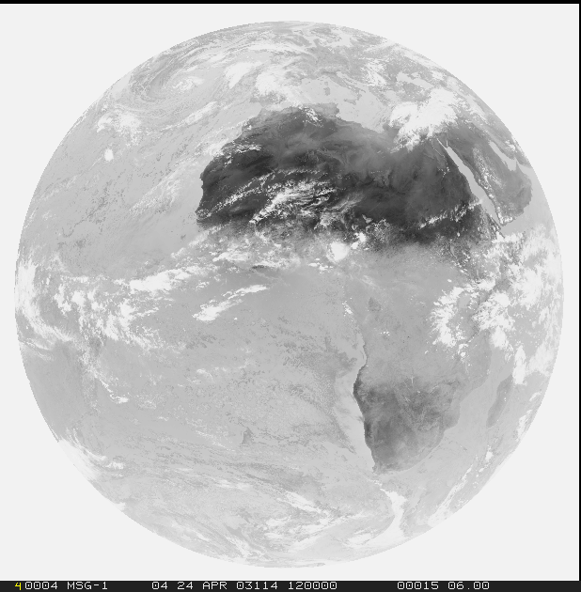
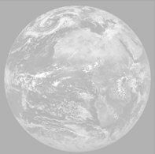
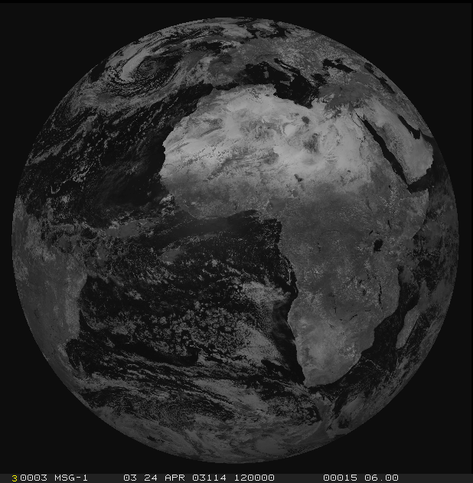
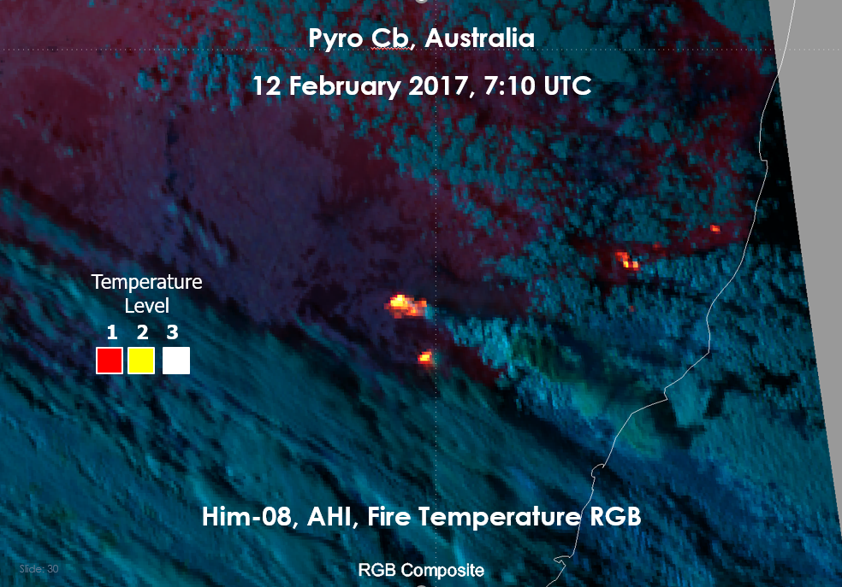
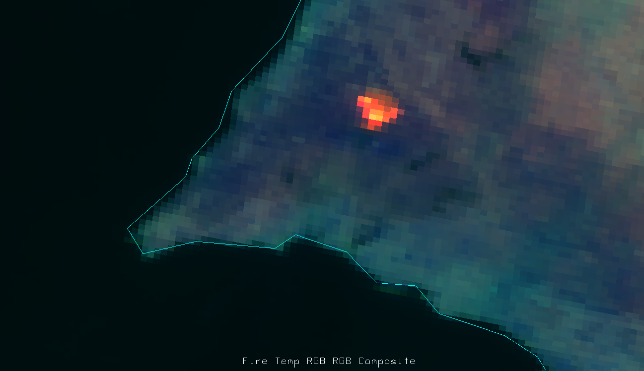
Fire Temperature RGB
9=IR3.8
> FIRE TEMP.
> MICROPHY.
8=NIR2.3
> MICROPHY.
> FIRE TEMP.
Fire intensity
Vegetation/
Burn scars
(Clouds)
7=NIR1.6
R IR3.8
G NIR2.3
B NIR1.6
Range
273 to 350 K
0 to 50 %
0 to 50 %

Slide 15
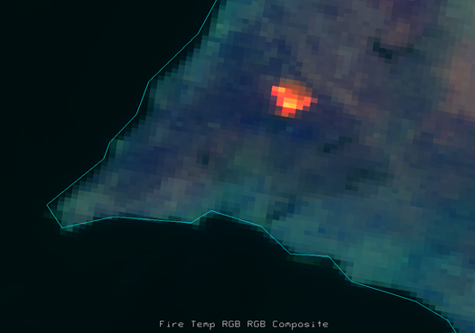
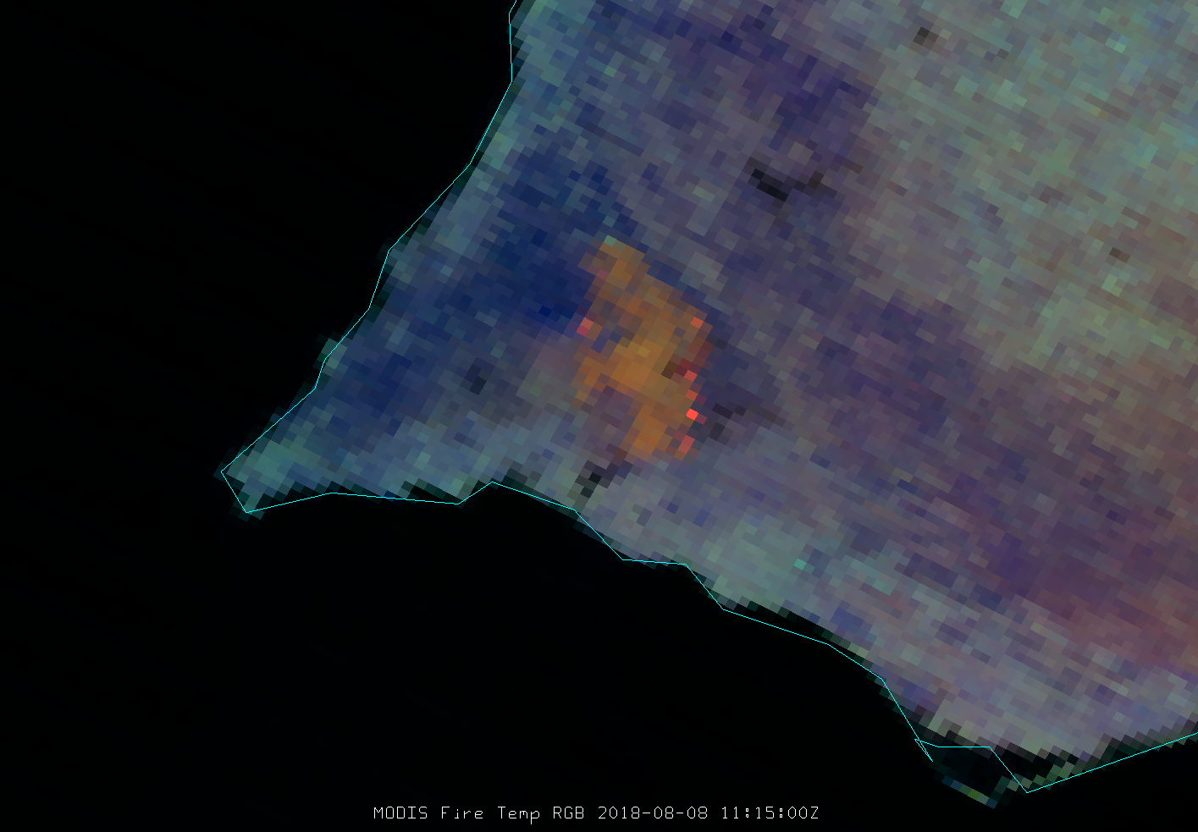
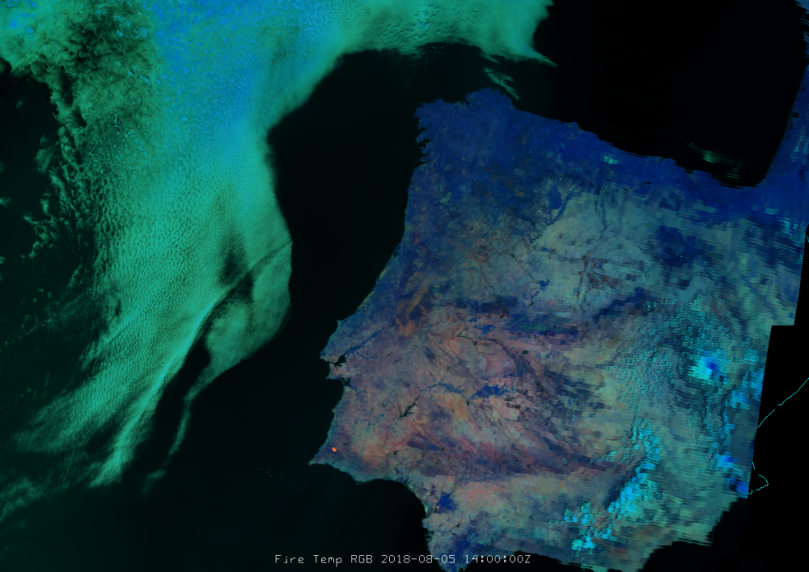
Fire Temperature RGB
9=IR3.8
> FIRE TEMP.
> MICROPHY.
8=NIR2.3
> MICROPHY.
> FIRE TEMP.
Fire intensity
Vegetation/
Burn scars
(Clouds)
7=NIR1.6

Slide 16
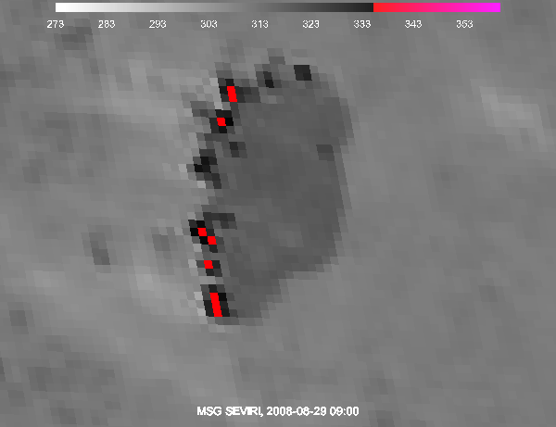
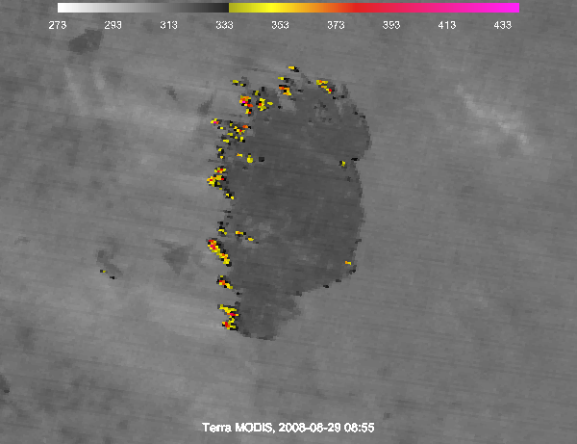
About the resolution (1km IR!)
Current
Future

Slide 17
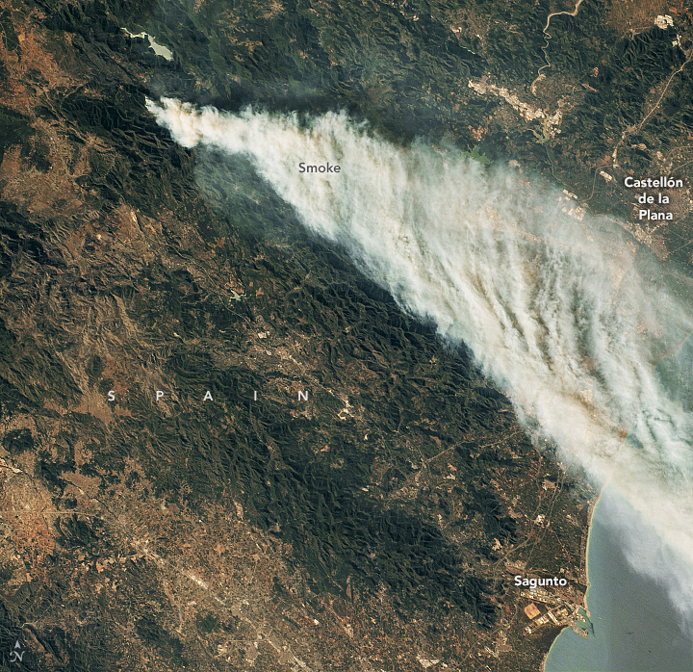
27 March 2023 – ISS photo
Astronaut on the International Space Station took this photograph of the blaze on March 27
- a thick plume of smoke streamed southeast toward the Mediterranean Sea
Credit: https://earthobservatory.nasa.gov/images/151145/a-raging-fire-in-spain

Slide 18
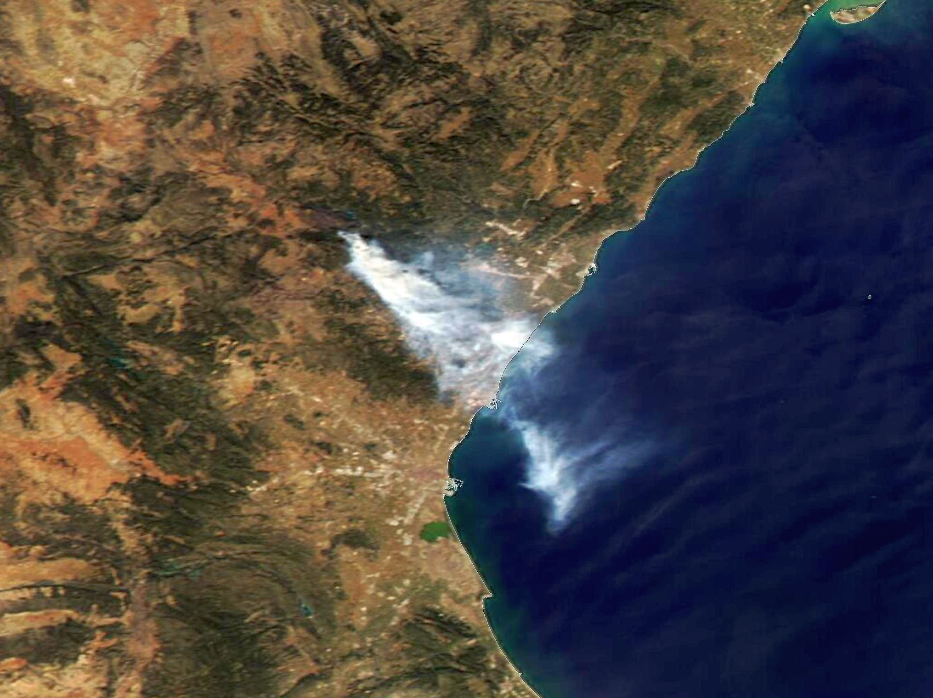
27 March – ISS photo & Aqua MODIS True Colour RGB
Credit: https://earthobservatory.nasa.gov/images/151145/a-raging-fire-in-spain

Slide 19
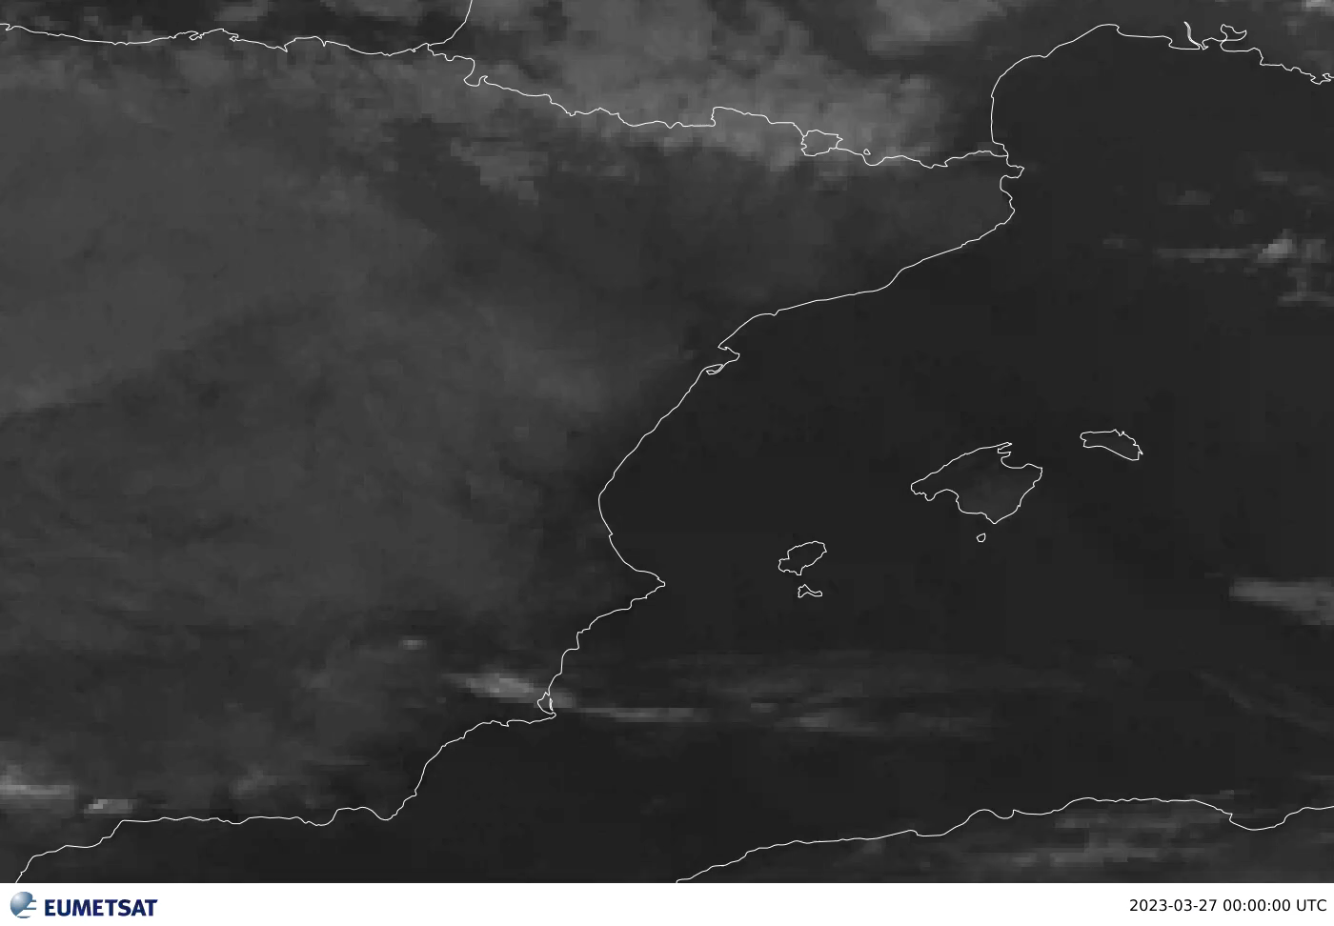
27 March – SEVIRI Natural Colour RGB / IR3.9

Slide 20
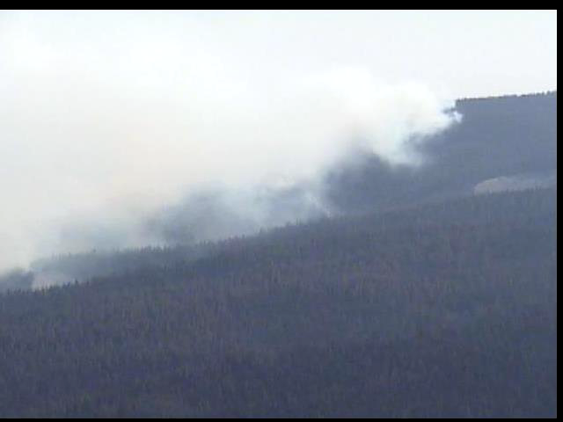
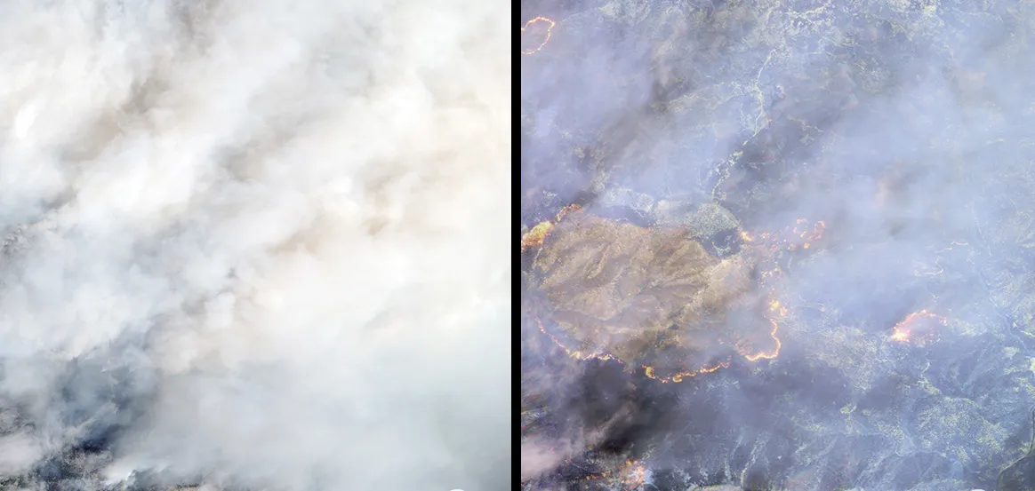
27 March – ISS photo & Aqua MODIS True Colour RGB
A fire burning in Klamath National Forest shown in visible light (left) and in shortwave infrared (right), imaged by Digital Globe's new WorldView-3 satellite.
Credit: https://www.wired.com/2014/09/worldview-3-fire-imagery/

Slide 21
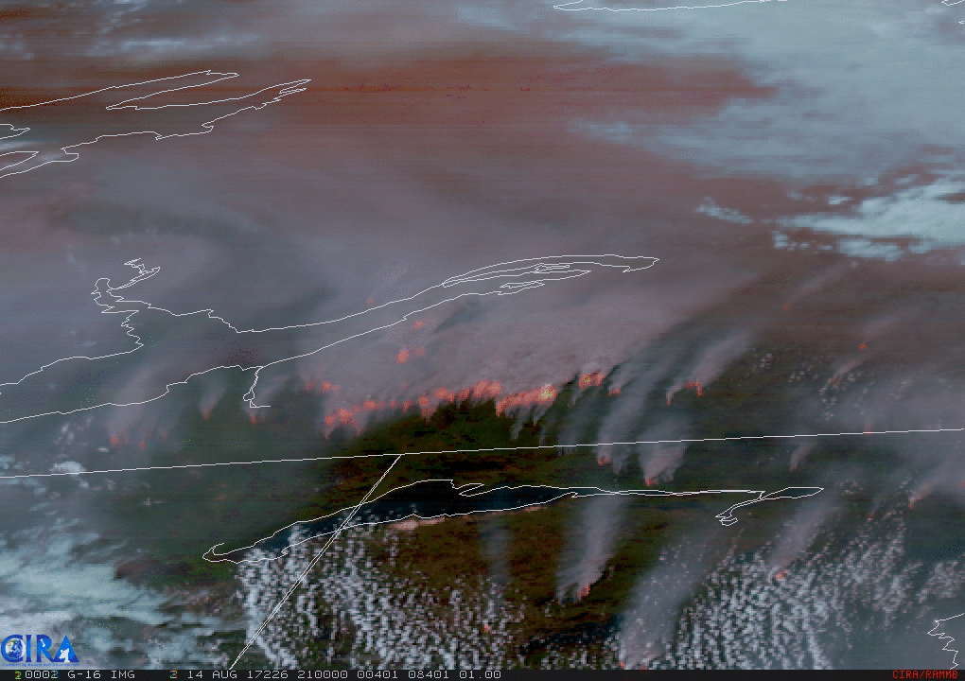
Examples
GOES-16, Fire Temperature RGB (with NIR1.6 and NIR2.25 Bands)
Canada
Northwest Territories
14 Aug. 2017

Slide 22
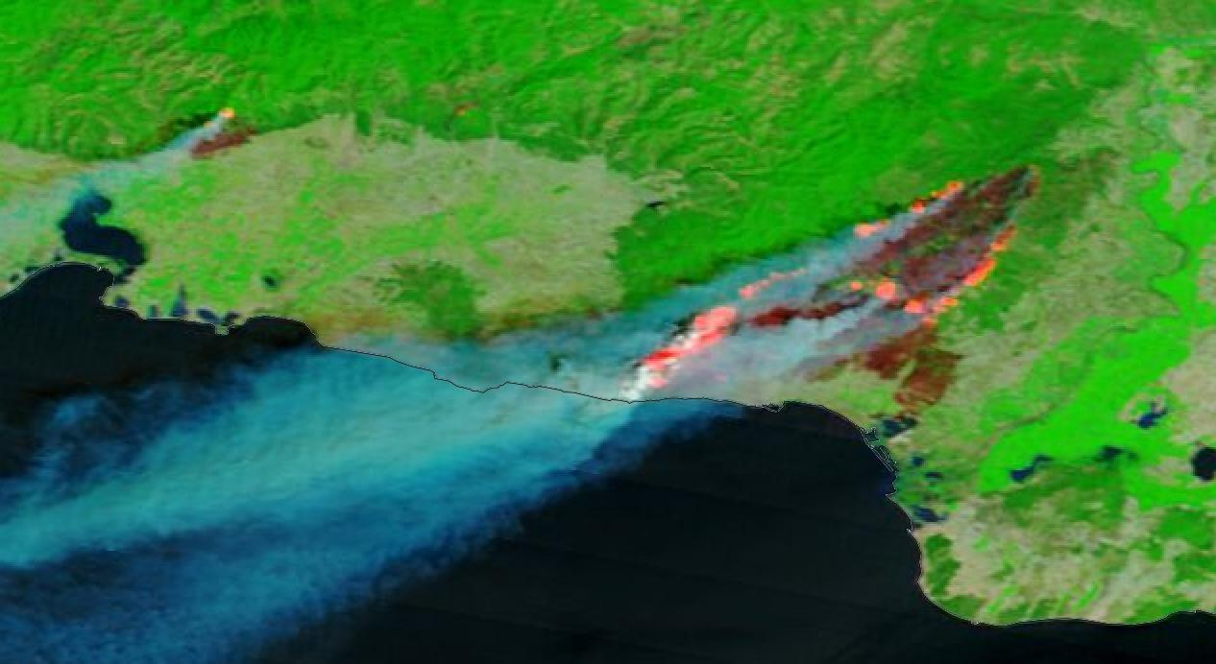
Examples – burn scars
Burn scars seen through (modified) Natural Colour RGB, Terra MODIS, 22 August

Slide 23
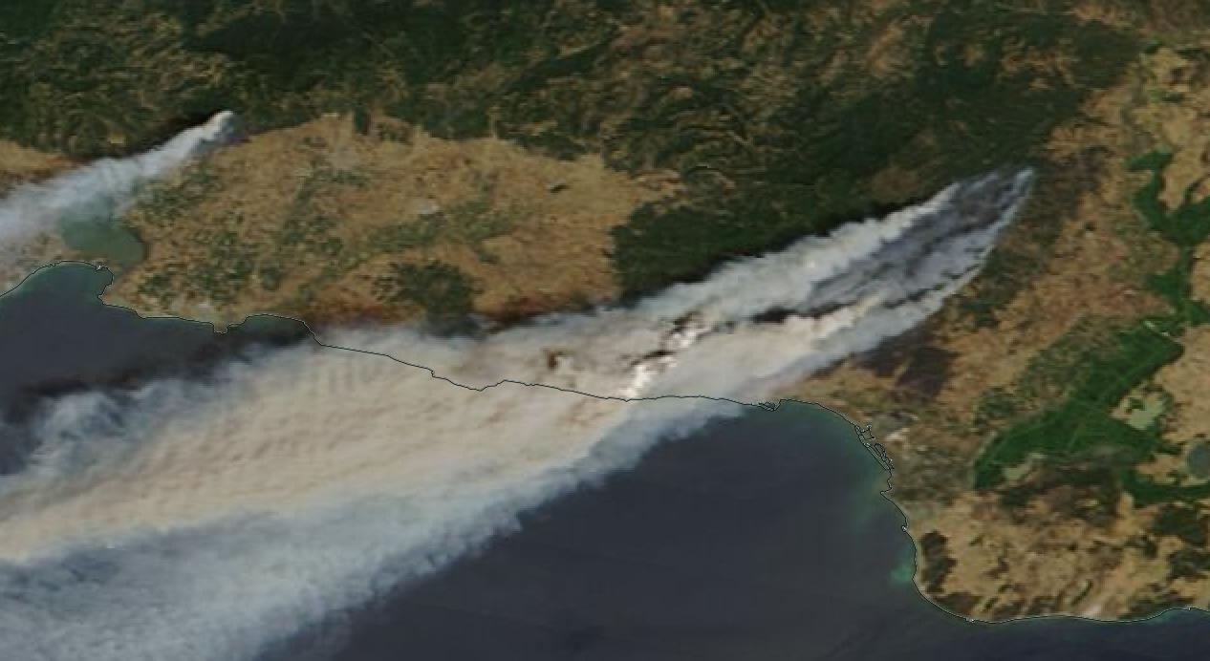
Examples – burn scars
Burn scars seen through (modified) Natural Colour RGB, Terra MODIS, 22 August

Slide 24
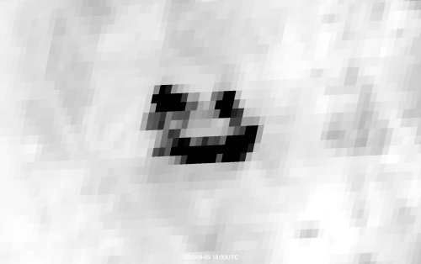
Thank you!
Questions are welcome.

