Slide 1



8th SALGEE-LSASAF User Workshop
15 years SALGEE Project
Julia Stoyanova
National Institute of Meteorology and Hydrology (NIMH), Bulgaria
25 – 26 November 2024, Darmstadt, Germany
Monitoring Drought Impacts on Vegetation & Feedback
SALGEE

Slide 2
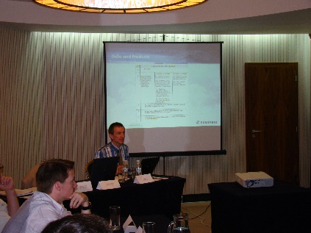
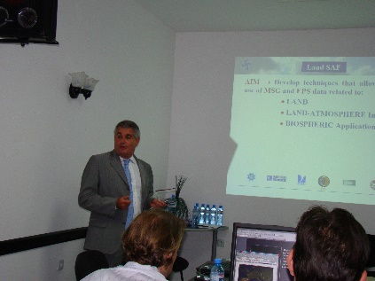
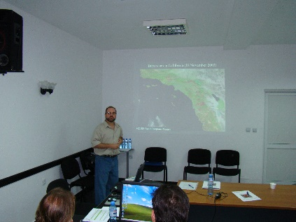
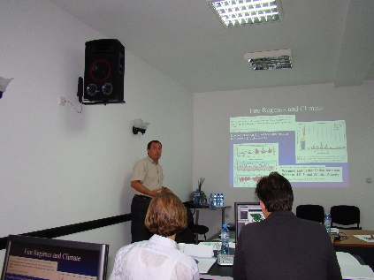
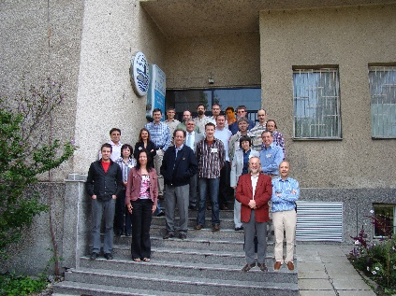
Short SALGEE History
Jose Prieto EUMETSAT
    Satellite Applications in Land surface analyses Group for Eastern Europe (SALGEE) (2009-20210) https://classroom.eumetsat.int/course/view.php?id=69
    First workshop: Sofia, 2009, NIMH Bulgaria initiative
    SALGEE Group establishment, 2010:
      Reported in the CGMS-38 by Dr. Volker Gaertner, EUMETSAT
      Steering Group (2010-2021) for organization purposes
      Elaboration of ToRs
      Establishment of SALGEE Workshop Format: biannual meetings for exchange of knowledge and information between leading scientists and experts with users at target region at an international level on the use of satellite land surface analysis techniques in operational meteorology and climatology
    Purposes according to SALGEE ToRs
      To gather experts in the field of satellite meteorology to complement the activities of the EUMETSAT LSA SAF in order to progress the use of satellite Land Surface Analysis techniques in Eastern Europe and other regions of interest.
      To foster an integrated meteorological and climatological approach for research and operational activates related to the quantification of biogeophysical and biochemical cycles and related land surface processes, in combination with information from in situ data, model output and satellite observations.
Carlos Da Camara
IDL, Portugal
Louis Giglio
SSAI NASA/UM Geography
Ivan Csiszar NOAA/NESDIS SA&R
SALGEE initiation
Sofia, 2009

Slide 3
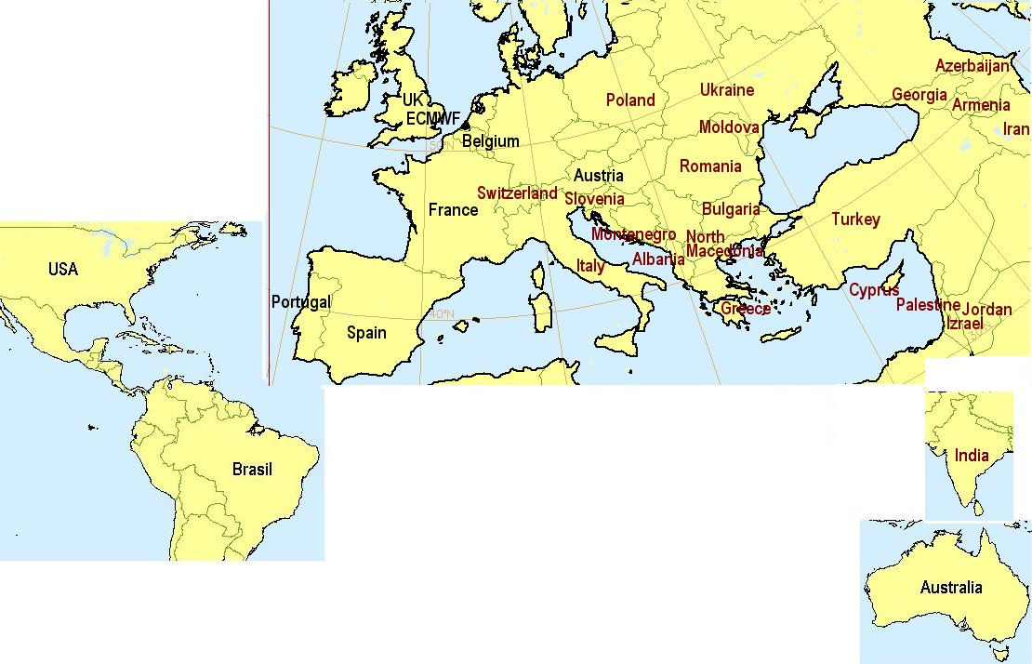
        - Satellite experts and developers (EUM, LSASAF, NASA, NOAA, and other agencies) are invited to present advanced research and operational applications.
        - Studies in support the validation of EUMETSAT and Land SAF products for drought assessment, forest fire detection and the impact of post fire effects on climate.
      - Results: Training & LSASAF products promotion.
SALGEE Activities & Evolution
Thematic Biannual Workshops (2009-2021)
 | Topic | Date | Place
1st Workshop | MSG Land Surface Applications: Drought & Fires | 07-10 Sep 2009 | Sofia, Bulgaria
2nd Workshop | MSG Land Surface Applications: Drought & Fire | 04-07 April 2011 | Antalya, Turkey
3rd Workshop | MSG Land Surface Applications: Drought & Fire emissions | 20-21 March 2013 | Lisabon/Ericeira Portugal
4th Workshop | MSG Land Surface Applications: Drought and Environmental response | 01-03 Sep 2015 | Matera, Italy
5th Workshop | MSG Land Surface Applications: Heat waves, drought hazard and fire monitoring | 18-20 Sep 2017 | Yerevan, Armenia
6th Workshop | MSG Land Surface Applications: Connection of climate and biosphere | 14–17 October 2019 | Darmstadt, EUMETSAT HQ, Germany
7th Workshop | Drought & Vegetation Monitoring: Energy–Water Cycle | 24–26 Nov 2021 | On line
SALGEE
Establish relations & Exchange of knowledge with ECMWF
Exchange of experience with H-SAF and CM SAF.
  Active users and involved in satellite applications in LSA in target region are identified;
  Limitation: Only few countries in SEE have expressed interest to contribute.
- Participants/users from many (22) European countries, Asia, Middle East have been invited with the aim to promote and strengthen the use of LSASAF products in research and operational activities.

Slide 4
SALGEE Prospective
      Combine efforts: First step is the Joint SALGEE & LSASAF User Workshop: “Monitoring Drought Impacts on Vegetation & Feedback”, 25-26 November 2024, Darmstadt, Germany
To combine scientific and/or technical capacity to:
  - Identify research methods on Land Surface Analyses of drought in presence of vegetation and showcase some innovative uses related to drought.
- Transfer from research to operations for early warning.
Applying Integrated tools and in support to analyses drought related processes
  Initiatives for Collaboration, Use of MTG Data.
  A collaborative infrastructure in support of teaming efforts.

