Slide 1
CrIS Obs of Calbuco volcano eruption on 4/23 @ 0509 UTC

Slide 2
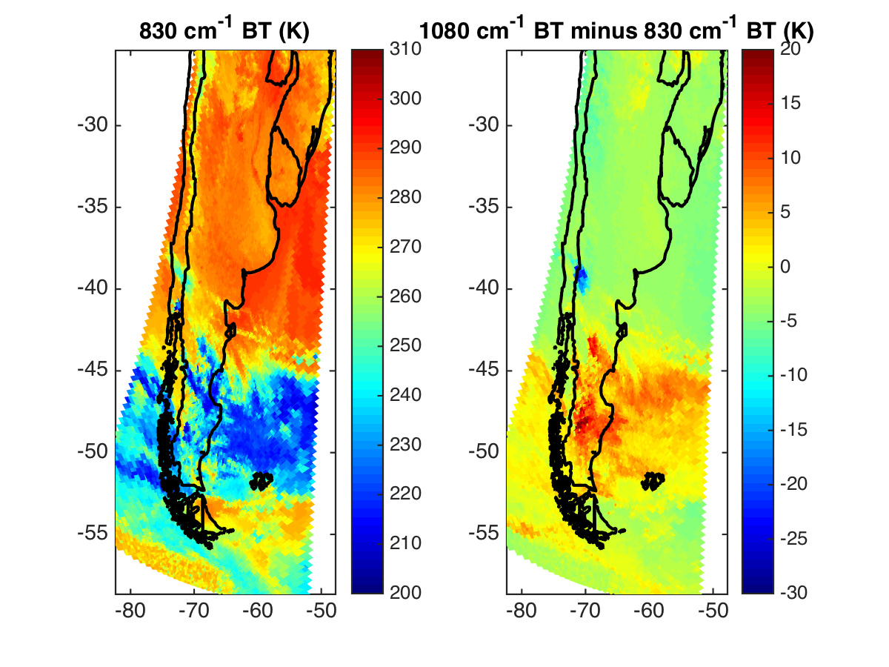

Slide 3
ash plume
volcano

Slide 4
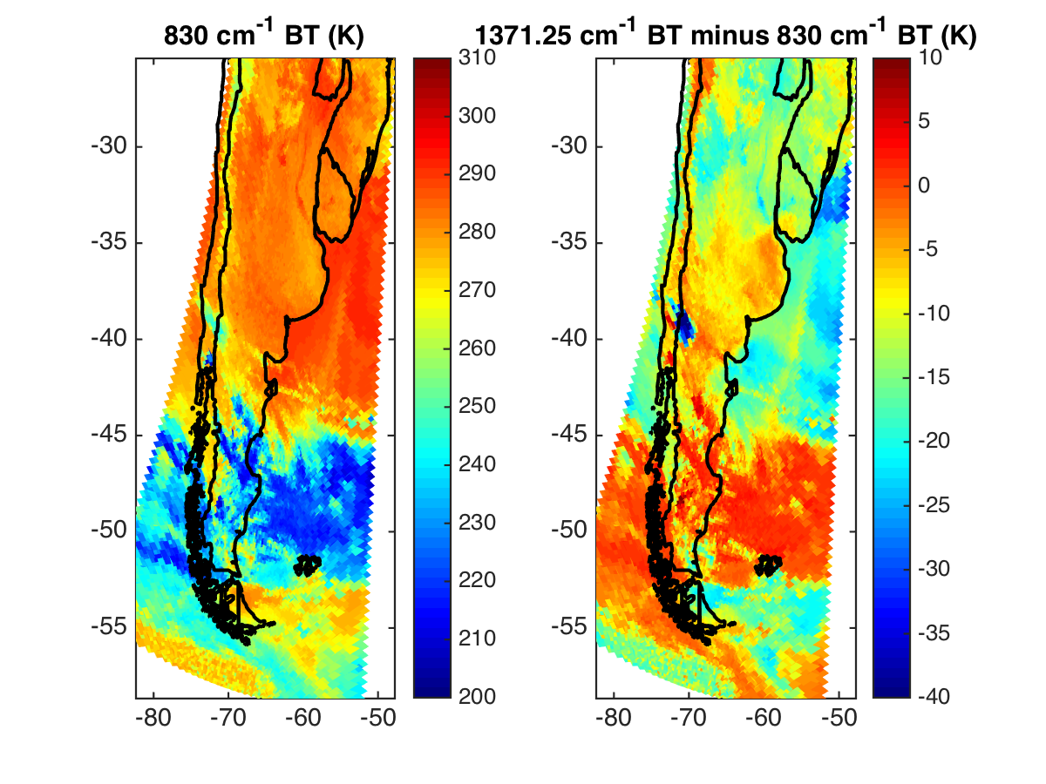
ash plume
volcano

Slide 5
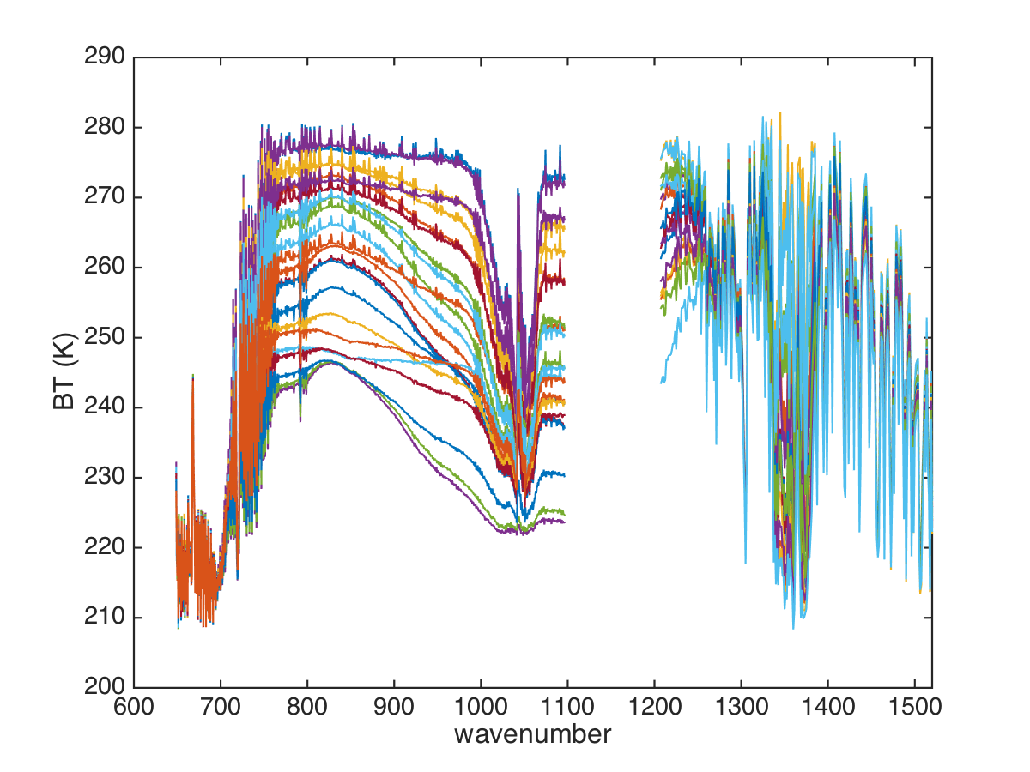
Example spectra of plume north of eruption, ash and SO₂

Slide 6
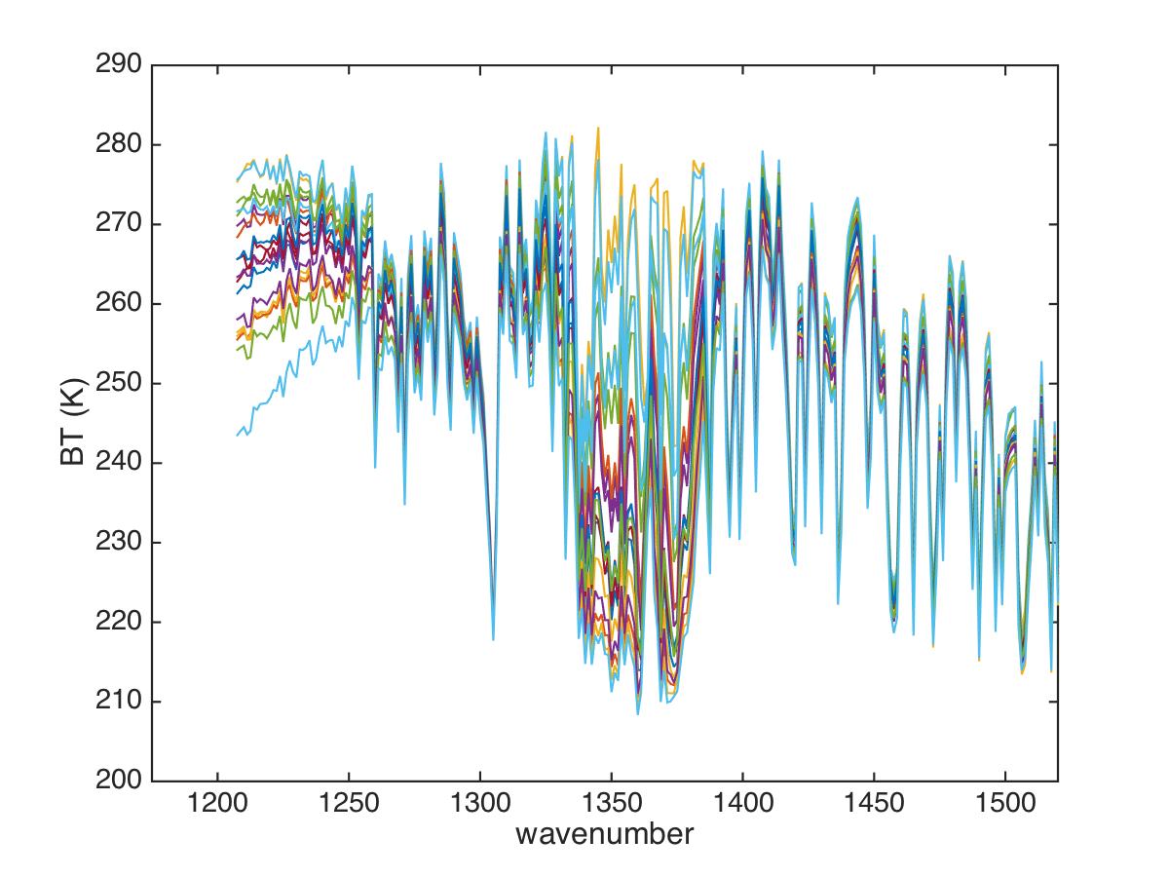
Example spectra of plume north of eruption, ash and SO₂

Slide 7
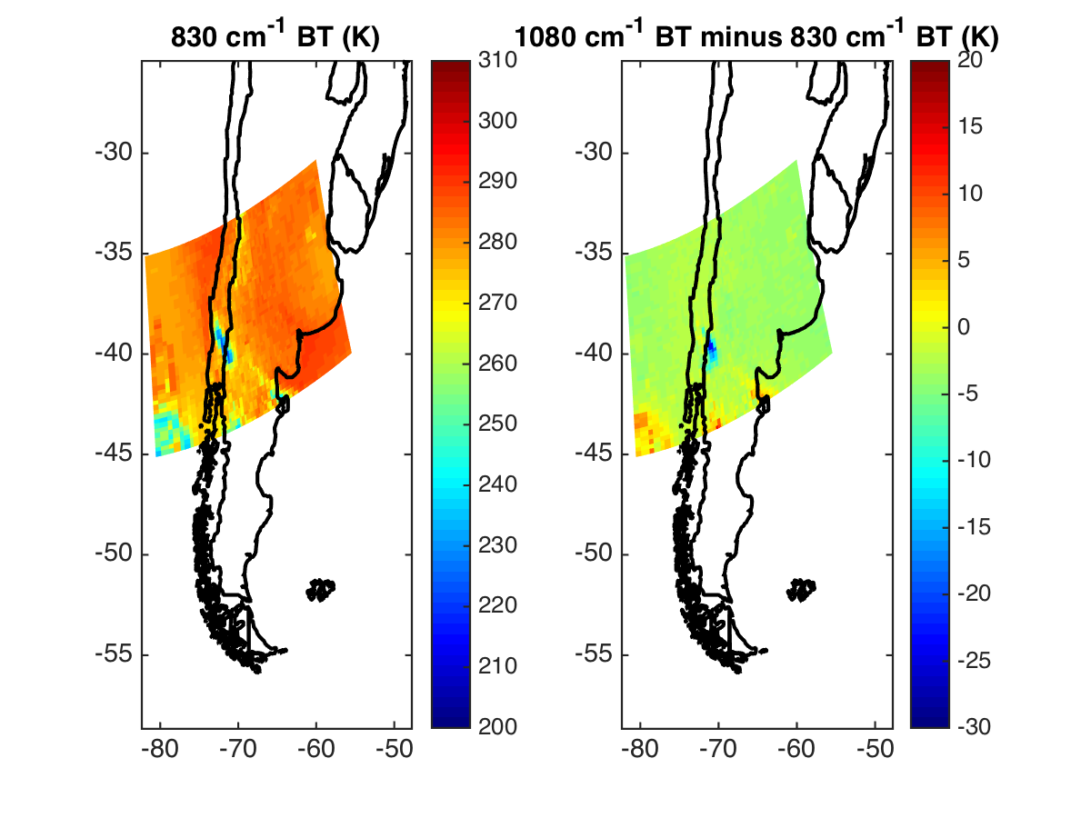
Also, IASI obs at 0235 UTC

Slide 8
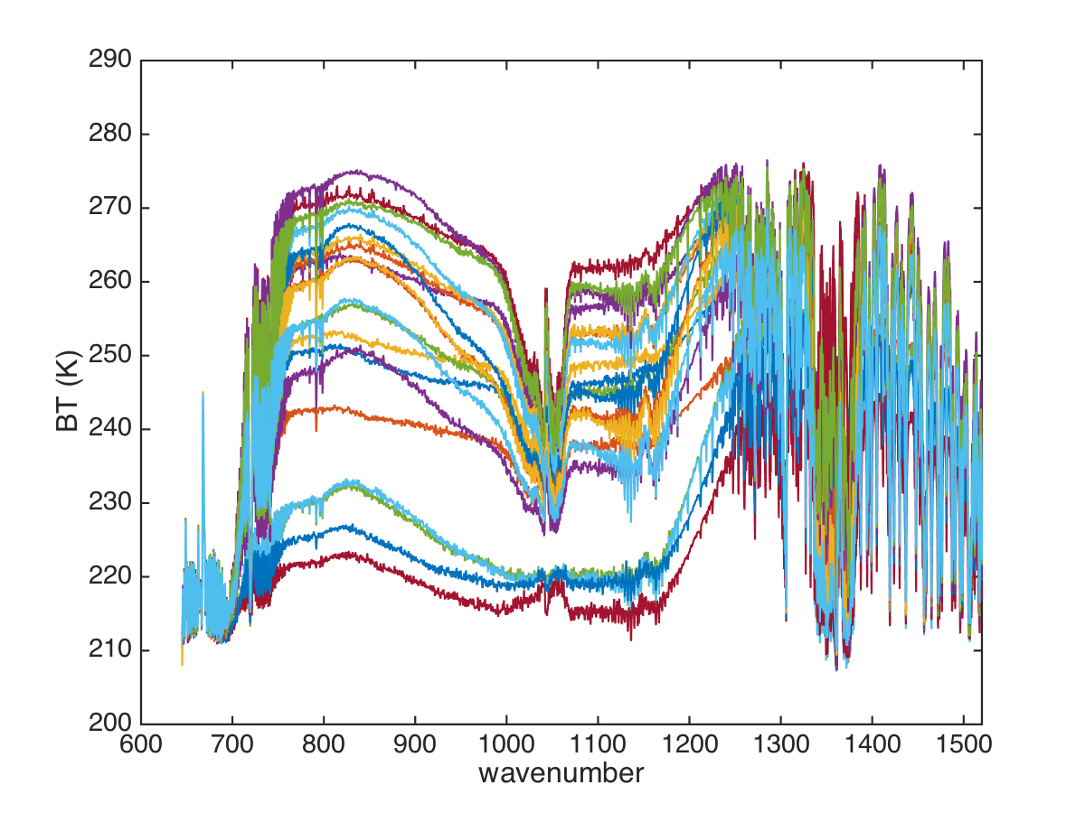
Example spectra of plume north of eruption, ash and SO₂
CrIS
gap

Slide 9
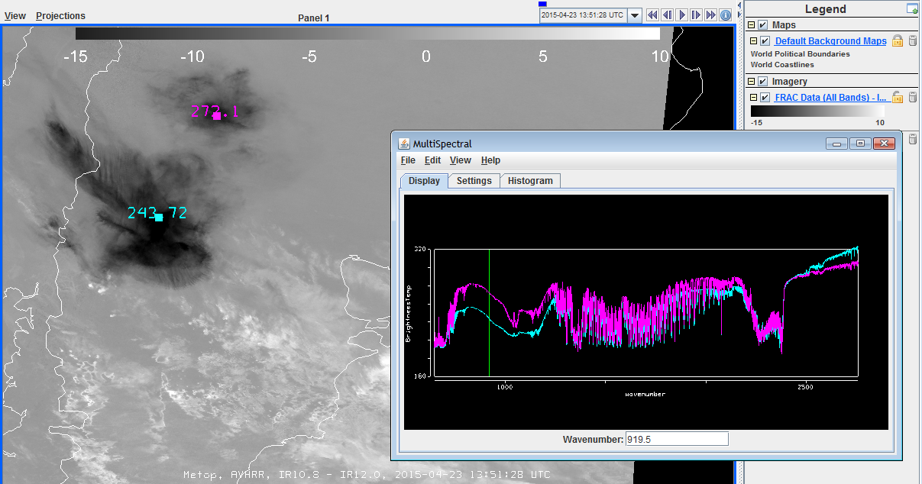
AVHRR IR Difference & IASI
23 April 2015, 13:51 UTC

