Slide 1
Satellites: history, instruments, orbits
Natasa Strelec Mahovic
EUMETSAT
Summer School, Bracciano, 2025

Slide 2
Outline
History of Satellite Remote Sensing
Satellite Orbits
Satellite sensors
Satellite Remote Sensing
•Recap: What is important?

Slide 3
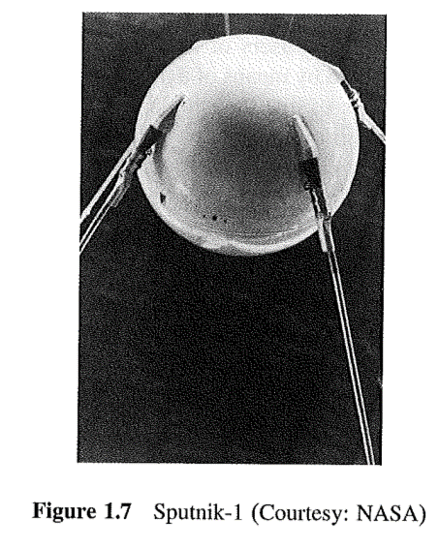
History of Satellite Remote Sensing
Arthur C. Clarke – October 1945 – article proposing feasibility of establishing a communication satellite in a geostationary orbit
1945-1955 period - dominated by launches of experimental sounding rockets carrying a variety of instruments
Sputnik-1, the first artificial satellite, was launched on 4 October 1957 by Soviets from Baikonur Cosmodrome. It orbited Earth once every 96 minutes in an elliptical orbit of 227 km x 941km inclined at 65.1° and was designed to provide information on density and temperature of the upper atmosphere. After 92 successful days in orbit, it burned as it fell from orbit into the atmosphere on 4 January 1958.
From: Maini, Anil Kumar, and Varsha Agrawal. Satellite Technology : Principles and Applications. John Wiley, 2007.
Notes:
It all began with an article by Arthur C. Clarke published in October 1945 issue of Wireless World, which theoretically proposed the feasibility of establishing a communication satellite in a geostationary orbit. In that article, he discussed how a geostationary orbit satellite would look static to an observer on Earth within the satellite's coverage, thus providing an uninterrupted communication service across the globe. This marked the beginning of the satellite era.
The 1945-1955 period was dominated by launches of experimental sounding rockets reaching upper atmosphere. These rockets carried a variety of instruments.
Sputnik-1, the first artificial satellite, was launched on 4 October 1957 by Soviets from Baikonur Cosmodrome. It orbited Earth once every 96 minutes in an elliptical orbit of 227 km x 941km inclined at 65.1° and was designed to provide information on density and temperature of the upper atmosphere. After 92 successful days in orbit, it burned as it fell from orbit into the atmosphere on 4 January 1958.

Slide 4
History of Satellite Remote Sensing
Sputnik-2 launched on 3 November 1957 carried a dog named Laika, the first living creature to orbit Earth. The mission provided information on the biological effect of the orbital flight.
Sputnik-3 was a geophysical satellite that provided information on Earth's ionosphere, magnetic field, cosmic rays and meteoroids.
Explorer-1 launched on 31 January 1958 by Jupiter-C rocket from Cape Canaveral was the first satellite successfully launched by the United States. Explorer's design was pencil-shaped, which allowed it to spin as it orbited the earth. The spinning motion provided stability to the satellite while in orbit. Spin stabilization is still one of the techniques of satellite stabilization.
From: Maini, Anil Kumar, and Varsha Agrawal. Satellite Technology : Principles and Applications. John Wiley, 2007.
Notes:
Sputnik-2 was launched on 3 November 1957 in an elliptical orbit of 212km x 1660km inclined at 65.33°. The satellite carried an animal, a female dog named Laika, in flight. Laika was the first living creature to orbit Earth. The mission provided information on the biological effect of the orbital flight.
Sputnik-3 was a geophysical satellite that provided information on Earth's ionosphere, magnetic field, cosmic rays and meteoroids. The orbital parameters of Sputnik-3 were 217 km (perigee), 1864km (apogee) and 65.18° (orbital inclination).
Explorer-1 launched on 31 January 1958 by Jupiter-C rocket from Cape Canaveral was the first satellite to be successfully launched by the United States. The satellite orbital parameters were 360 km (perigee), 2534 km (apogee) and 33.24° (orbital inclination). Explorer's design was pencil-shaped, which allowed it to spin like a bullet as it orbited the earth. The spinning motion provided stability to the satellite while in orbit. Today, spin stabilization is one of the established techniques of satellite stabilization. During its mission, it discovered that Earth is girdled by a radiation belt trapped by the magnetic field.

Slide 5
History of Satellite Remote Sensing
After the successful launch of Explorer-1, in 1958 launches of Vanguard-1 on 5 February 1958, Explorer-2 on 5 March 1958 and Vanguard-2 (TV-4) on 17 March 1958 followed
Vanguard Satellite at Launch Pad 1958
images courtesy of Prof. F. House , Dept. Physics, Drexel University, Philadelphia

Slide 6
History of Satellite Remote Sensing
Menzel et al., 2009, (BAMS) : The first successful meteorological experiment conducted from a satellite was launched on Explorer VII on 13 October 1959.
Explorer VII carried an early version of a radiometer designed to measure Earth's heat balance from a satellite. The thermal radiation experiment, devised by Verner E. Suomi , along with University of Wisconsin Madison engineering professor Robert J. Parent, established Suomi as the "father of satellite meteorology”.
Preparing Explorer VII for Launch
images courtesy of Prof. F. House , Dept. Physics, Drexel University, Philadelphia

Slide 7
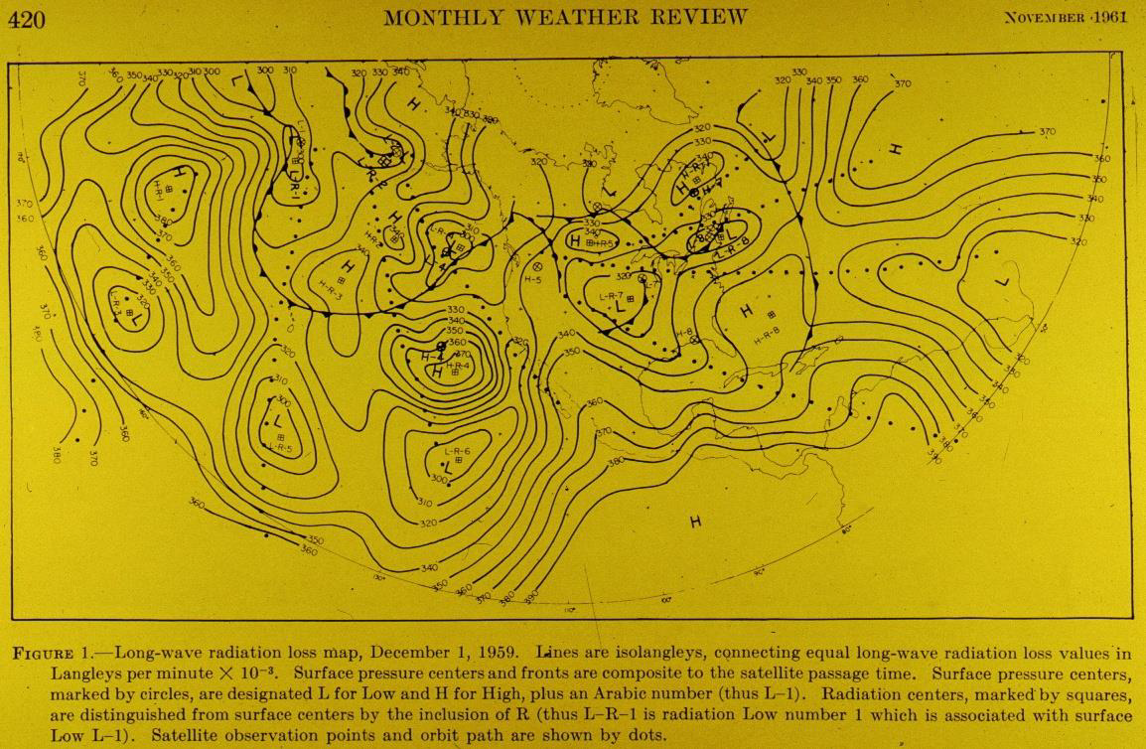
History of Satellite Remote Sensing
Weinstein and Suomi, 1961
images courtesy of Prof. F. House , Dept. Physics, Drexel University, Philadelphia
Notes:
The map shows the results published by Weinstein and Suomi, 1961 on longwave radiation loss for December 1, 1959. based on the satellite measurements

Slide 8
History of Satellite Remote Sensing
TIROS-1 (television and impared observation satellite) was the first weather satellite, successfully launched on 1 April 1960
TIROS Satellite Transition
to ESSA Cart Wheel Orientation
images courtesy of Prof. F. House , Dept. Physics, Drexel University, Philadelphia

Slide 9
History of Satellite Remote Sensing
TIROS Satellite Model with Suomi Radiometers
With two vidicon cameras on board TIROS-1 provided the first pictures of the Earth
images courtesy of Prof. F. House , Dept. Physics, Drexel University, Philadelphia

Slide 10
History of Satellite Remote Sensing
Explorer VII vs ESA’s ENVISAT
Explorer VII vsESA’s ENVISAT
images courtesy of Prof. F. House , Dept. Physics, Drexel University, Philadelphia

Slide 11
History of Satellite Remote Sensing
Think SMALL Think INSIDE the BOX
CubeSatObservation System for Meteorology and Climate Science (COSMCS)
images courtesy of Prof. F. House , Dept. Physics, Drexel University, Philadelphia

Slide 12
Outline
History of Satellite Remote Sensing
Satellite Orbits
Satellite sensors
Satellite Remote Sensing
•Recap: What is important?

Slide 13
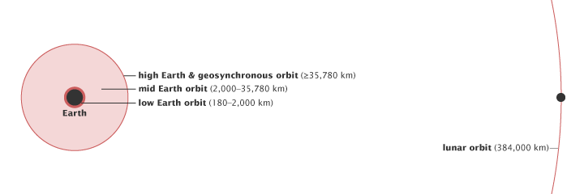
Orbits - height
One way of classifying orbits is by altitude. Low Earth orbit starts just above the top of the atmosphere, while high Earth orbit begins about one tenth of the way to the moon. (NASA illustration by Robert Simmon)
https://earthobservatory.nasa.gov/features/OrbitsCatalog
Notes:
There are essentially three types of Earth orbits: high Earth orbit, medium or mid Earth orbit, and low Earth orbit.

Slide 14
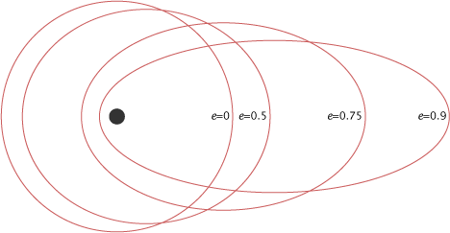
Orbits - Eccentricity
The eccentricity (e) of an orbit indicates the deviation of the orbit from a perfect circle. A circular orbit has an eccentricity of 0, while a highly eccentric orbit is closer to (but always less than) 1. A satellite in an eccentric orbit moves around one of the ellipse’s focal points, not the center.
(NASA illustration by Robert Simmon.)
https://earthobservatory.nasa.gov/features/OrbitsCatalog
Notes:
We should mention several terms related to the orbits. First is eccentricity which indicates the deviation of the orbit from the perfect circle. Circular orbit has eccentricity 0 and highly eccentric orbit has eccentricity close to 1, but never reaches 1

Slide 15
Orbits - Inclination
Inclination 0 degrees : On equator
Inclination 90 degrees: Directly over pole
Inclination < 90 degrees: prograde orbit
Inclination > 90 degrees: retrograde orbit
Notes:
Orbital inclination is the angle between the plane of an orbit and the equator. An orbital inclination of 0° is directly above the equator, 90° crosses right above the pole, and 180° orbits above the equator in the opposite direction of Earth’s spin.
Together, the satellite’s height, eccentricity, and inclination determine the satellite’s path and what view it will have of Earth.

Slide 16
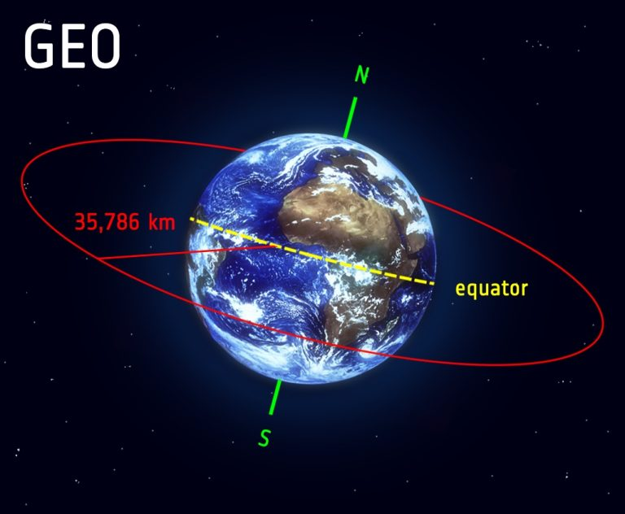
Geostationary orbit (High Earth Orbit)
Inclination 0 degrees : On equator
Speed: 1 rotation/24 hrs
Distance to surface: ~ 36000 km
Notes:
Many weather and some communications satellites tend to have a high Earth orbit, farthest away from the surface. Satellites that orbit in a medium (mid) Earth orbit include navigation and specialty satellites, designed to monitor a particular region. Most scientific satellites, including NASA’s Earth Observing System fleet, have a low Earth orbit.
A satellite in a circular geosynchronous orbit directly over the equator (eccentricity and inclination at zero) will have a geostationary orbit that does not move at all relative to the ground. It is always directly over the same place on the Earth’s surface.

Slide 17
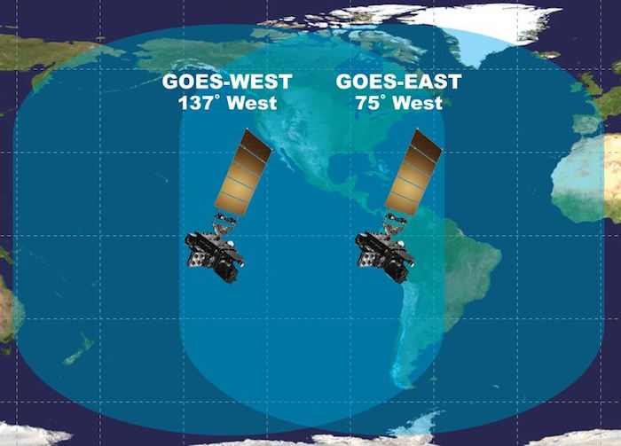
Geostationary orbit (High Earth Orbit)
Notes:
Satellites in geostationary orbit fly at an altitude of app. 36-38000 km with a speed that keeps them always in the same position relative to the Earth. This video shows how Meteosat second generation satellites scan – both in operational mode, every 15 minutes and in the rapid scanning mode, every 5 minutes. In case o GOES satellites rapid scan images can be performed every 1 minute

Slide 18
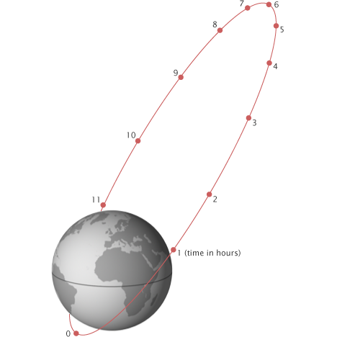
Medium Earth Orbit
Molniya orbit works well for observing high latitudes
The Molniya orbit combines high inclination (63.4°) with high eccentricity (0.722) to maximize viewing time over high latitudes. Each orbit lasts 12 hours, so the slow, high-altitude portion of the orbit repeats over the same location every day and night. Russian communications satellites and the Sirius radio satellites currently use this type of orbit. (Adapted from Fundamentals of Space Systems by Vincent L. Pisacane, 2005.)
https://earthobservatory.nasa.gov/features/OrbitsCatalog
Notes:
Closer to the Earth, satellites in a medium Earth orbit move more quickly. Two medium Earth orbits are notable: the semi-synchronous orbit and the Molniya orbit.
The Molniya orbit is highly eccentric: the satellite moves in an extreme ellipse with the Earth close to one edge. Because it is accelerated by our planet’s gravity, the satellite moves very quickly when it is close to the Earth. As it moves away, its speed slows, so it spends more time at the top of its orbit farthest from the Earth. A satellite in a Molniya orbit takes 12 hours to complete its orbit, but it spends about two-thirds of that time over one hemisphere. Like a semi-synchronous orbit, a satellite in the Molniya orbit passes over the same path every 24 hours. This type of orbit is useful for communications in the far north or south.

Slide 19
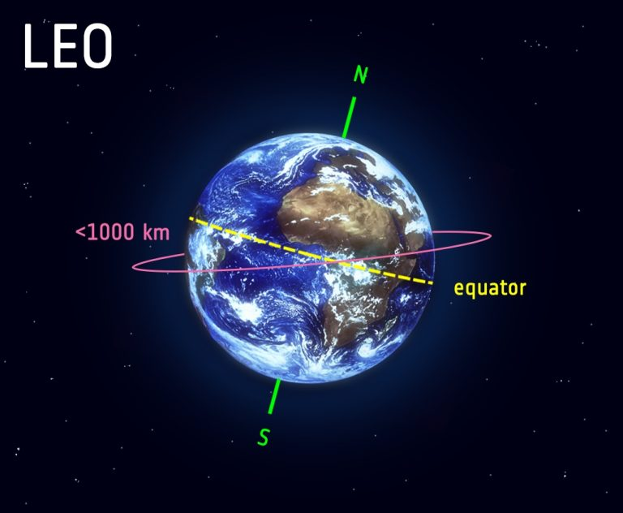
Low Earth Orbit
Inclination: slightly retrograde
Speed: One rotation per 90 - 100 mins
Distance to surface: ~ 600 - 800 km
Notes:
Most scientific satellites and many weather satellites are in a nearly circular, low Earth orbit.

Slide 20
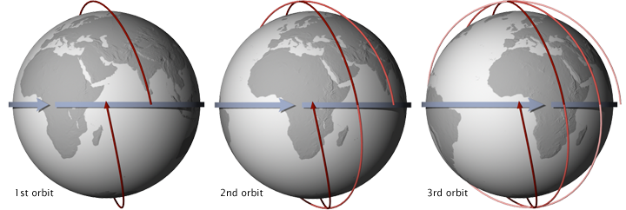
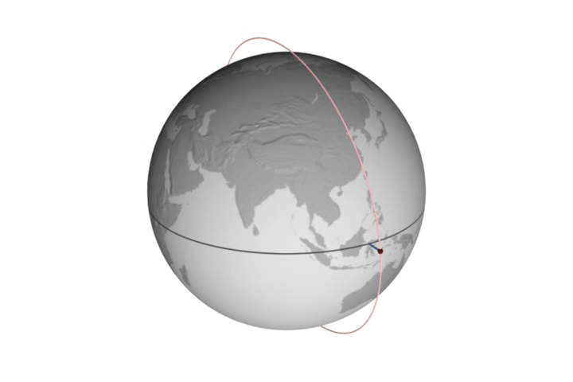
Low Earth Orbit
3 consecutive orbits of a sun-synchronous satellite with an equatorial crossing time of 1:30 pm.
A Sun-synchronous orbit crosses over the equator at approximately the same local time each day (and night). This orbit allows consistent scientific observations with the angle between the Sun and the Earth’s surface remaining relatively constant. (NASA illustration by Robert Simmon.)
https://earthobservatory.nasa.gov/features/OrbitsCatalog
Notes:
Just as the geosynchronous satellites have a sweet spot over the equator that lets them stay over one spot on Earth, the polar-orbiting satellites have a sweet spot that allows them to stay in one time. This orbit is a Sun-synchronous orbit, which means that whenever and wherever the satellite crosses the equator, the local solar time on the ground is always the same.

Slide 21
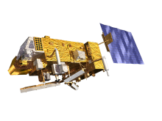
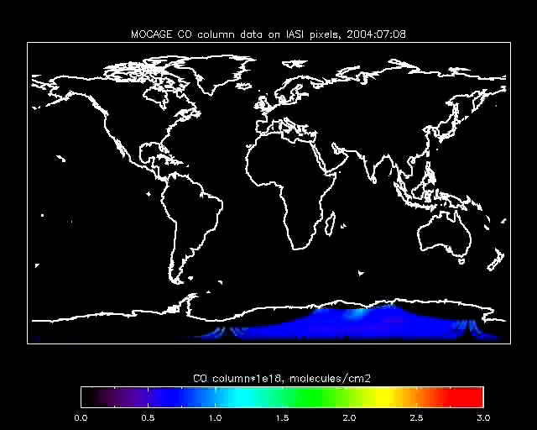
Low Earth Orbit
Notes:
polar orbiters fly much lower, cca 700-850 km above Earth . They fly around the poles allowing the Earth to spin below them therefore covering different slice of the globe with each overpass, as can be seen in this animation.

Slide 22
Outline
History of Satellite Remote Sensing
Satellite Orbits
Satellite sensors
Satellite Remote Sensing
•Recap: What is important?

Slide 23
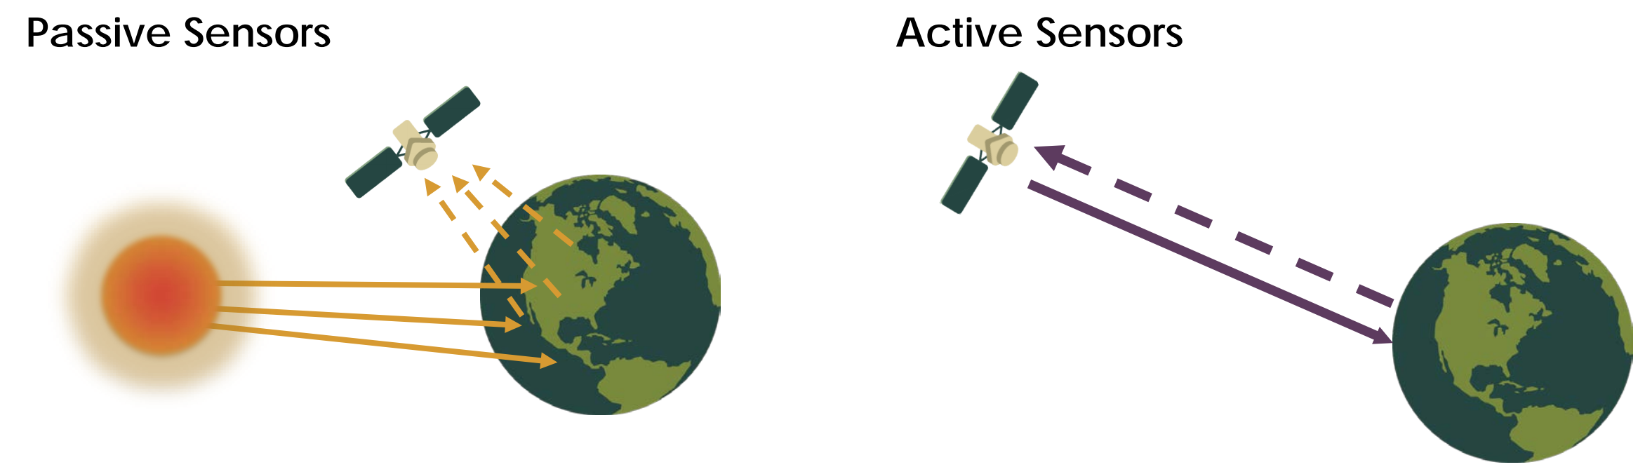
Satellite Sensors
Notes:
Remote sensing instruments are of two primary types:
Active sensors, provide their own source of energy to illuminate the objects they observe. An active sensor emits radiation in the direction of the target to be investigated. The sensor then detects and measures the radiation that is reflected or backscattered from the target.
Passive sensors, on the other hand, detect natural energy (radiation) that is emitted or reflected by the object or scene being observed. Reflected sunlight is the most common source of radiation measured by passive sensors.

Slide 24
Satellite Sensors
Lidar
Radar (CLOUDSAT)
Scatterometer (ASCAT)
Sounder
Laser altimeter
https://earthdata.nasa.gov/learn/remote-sensors/active-sensors
Notes:
The majority of active sensors operate in the microwave region of the electromagnetic spectrum, which enables them to penetrate the atmosphere under most conditions. An active technique views the target from either end of a baseline of known length.
LIDAR uses a laser to transmit a light pulse and a receiver with sensitive detectors to measure the backscattered or reflected light. Distance to the object is determined by recording the time between transmitted and backscattered pulses and by using the speed of light to calculate the distance traveled.
An active RADAR sensor, emits microwave radiation in a series of pulses from an antenna. When the energy reaches the target, some of the energy is reflected back toward the sensor. This backscattered microwave radiation is detected, measured, and timed. By recording the range and magnitude of the energy reflected from all targets as the system passes by, a two-dimensional image of the surface can be produced.
Scatterometer is a high-frequency microwave radar designed specifically to measure backscattered radiation. Over ocean surfaces, measurements of backscattered radiation can be used to derive maps of surface wind speed and direction.
Sounder measures vertical distribution of precipitation and other atmospheric characteristics such as temperature, humidity, and cloud composition.
Laser altimeter uses lidar to measure the height of the platform (spacecraft or aircraft) above the surface. The height of the platform with respect to the mean Earth’s surface is used to determine the topography of the underlying surface.

Slide 25
Satellite Sensors
Radiometer
Imaging radiometer (SEVIRI, VIIRS, ABI)
Hyperspectral radiometer
Sounder (IASI)
Accelerometer
Spectrometer
Spectroradiometer (MODIS)
https://earthdata.nasa.gov/learn/remote-sensors/passive-sensors
Notes:
Passive sensors include different types of radiometers and spectrometers. Most passive systems used in remote sensing applications operate in the visible, infrared, thermal infrared, and microwave portions of the electromagnetic spectrum. Passive remote sensors include
Radiometer—An instrument that measures the intensity of electromagnetic radiation in some bands within the spectrum. Usually, a radiometer is further identified by the portion of the spectrum it covers; for example it can be visible, infrared, or microwave radiometer.
Imaging radiometer has a scanning capability to provide a two-dimensional array of pixels from which an image may be produced.
Hyperspectral radiometer is an advanced multispectral sensor with very high spectral resolution that detects hundreds of very narrow spectral bands throughout the visible, near-infrared, and mid-infrared portions of the electromagnetic spectrum. By this it can discriminate between different targets based on their spectral response in each of the very narrow spectral bands.
Sounder measures vertical distributions of atmospheric parameters such as temperature, pressure, and composition from multispectral information.
Accelerometer is an instrument that measures acceleration. There are two general types of accelerometers. One measures translational accelerations (changes in linear motions in one or more dimensions), and the other measures angular accelerations (changes in rotation rate per unit time).
Spectrometer is designed to detect, measure, and analyze the spectral content of incident electromagnetic radiation. Conventional imaging spectrometers use gratings or prisms to disperse the radiation for spectral discrimination.
Spectroradiometer—A radiometer that measures the intensity of radiation in multiple wavelength bands (i.e., multispectral). Many times the bands are of high-spectral resolution, designed for remotely sensing specific geophysical parameters

Slide 26
Questions?

