Slide 1


Slide 2
The Electromagnetic Spectrum
Prof. Ralf Bennartz
EES, Vanderbilt University

Slide 3
Outline
Electromagnetic radiation
The Planck function
Measuring EM radiation – quantities and units
The solar versus terrestrial spectral range

Slide 4
Electromagnetic Radiation
Transports Energy
Quantized, wave-particle dualism
Carrier of energy is the photon
Energy of photon increases with frequency
Wave representation: Energy proportional to (amplitude)²
Can be polarized
In vacuum, propagates at speed of light: 3x10⁸ m/s

Slide 5
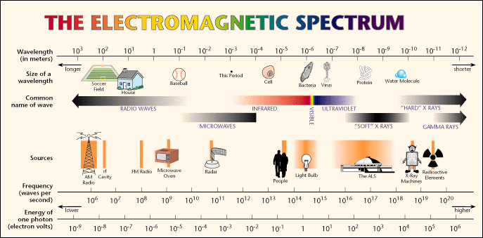
The Electromagnetic Spectrum

Slide 6
Frequency, Wavenumber, Wavelength

Slide 7
The Electromagnetic Spectrum

Slide 8
The Planck Function
Kirchhoff’s question (1859): How is the EM emission of a blackbody distributed spectrally?
Could be easily measured…. No theoretical explanation ….
Various attempts by Wien, Rayleigh, Jeans, Planck fail……
October, 19th, 1900: Max Planck proposes solution….
…. which only works by introducing the quantum of action (birthday of quantum theory, Nobel Prize 1918)

Slide 9
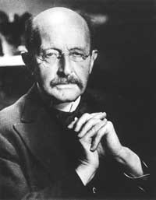
The Planck Function
From Max Planck’s Nobel laureate: ‘Either the quantum of action was a fictional quantity, then the whole deduction of the radiation law was […] illusory and represented nothing more than an empty non-significant play on formulae, or the derivation of the radiation law was based on a sound physical conception. […] Experiment has decided for the second alternative.’

Slide 10
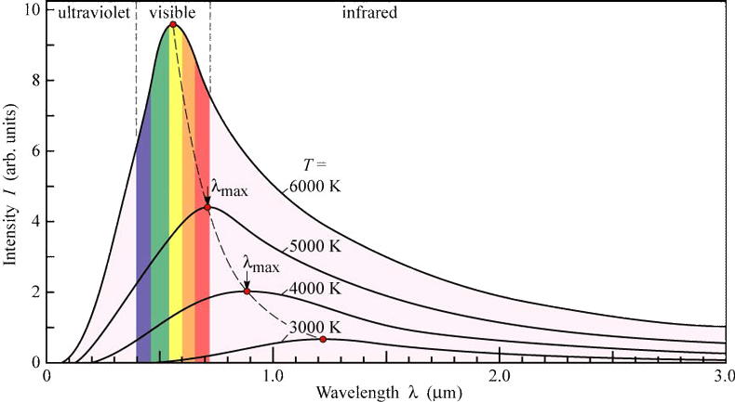
The Planck Function
For a given wavelength it increases monotonically with temperature
Peak moves to longer wavelengths as temperature decreases (Wien’s displacement law)
How much energy in total does a blackbody emit?

Slide 11
The Planck Function
Total power emitted is proportional to T⁴
Stefan-Boltzmann Law

Slide 12
Measuring EM Radiation:
Quantities and Units

Slide 13
Measuring EM Radiation:
Quantities and Units

Slide 14
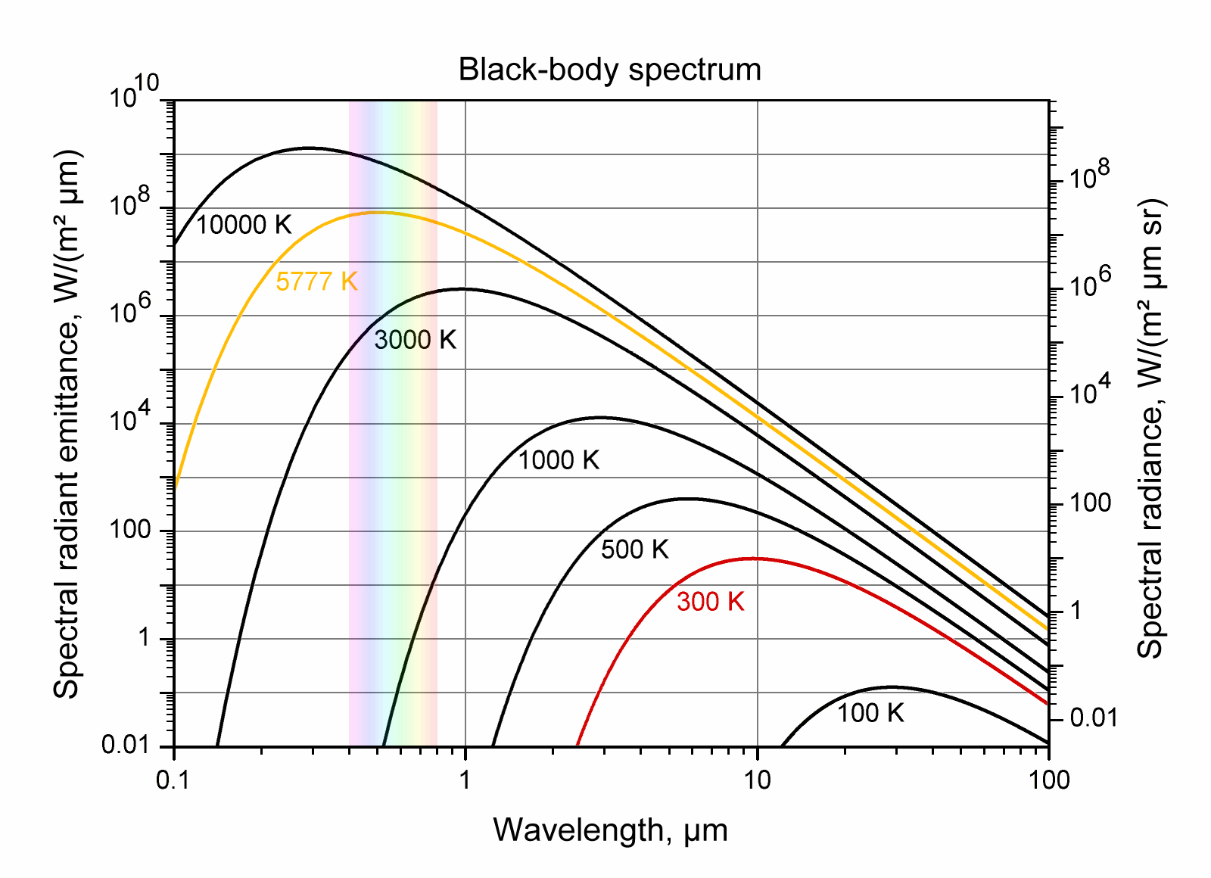
Planck function

Slide 15
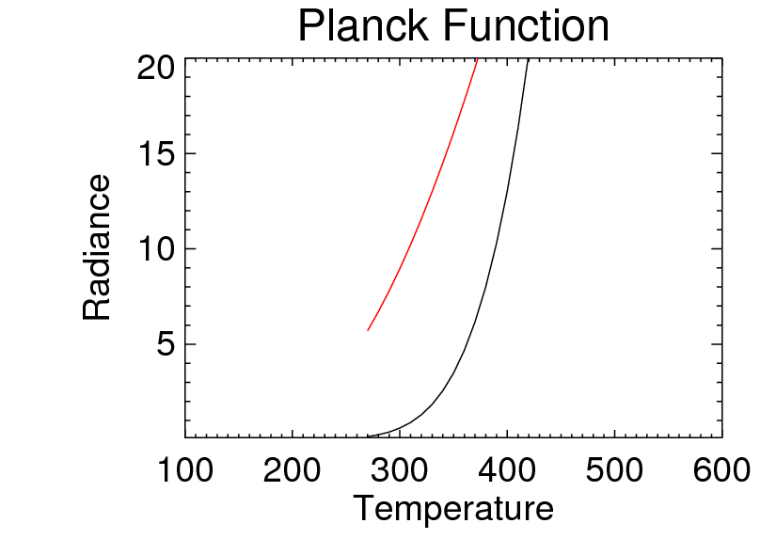
Planck function

Slide 16
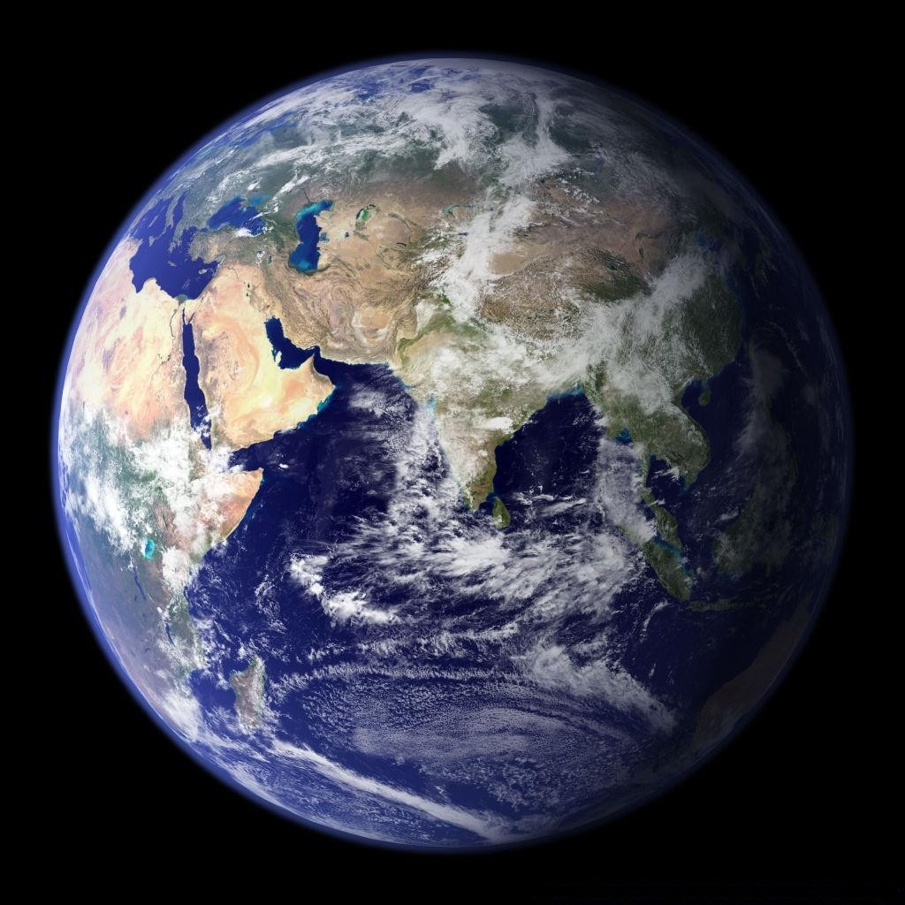
A Simple Example

Slide 18
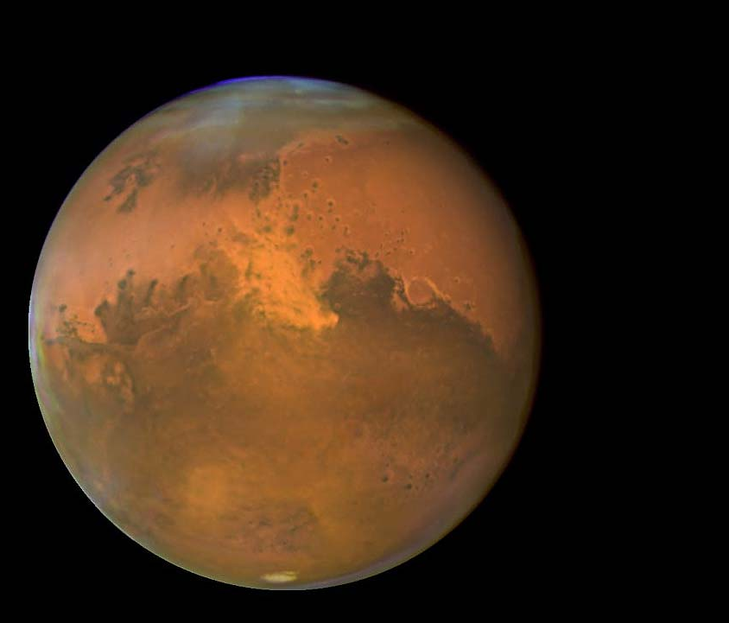
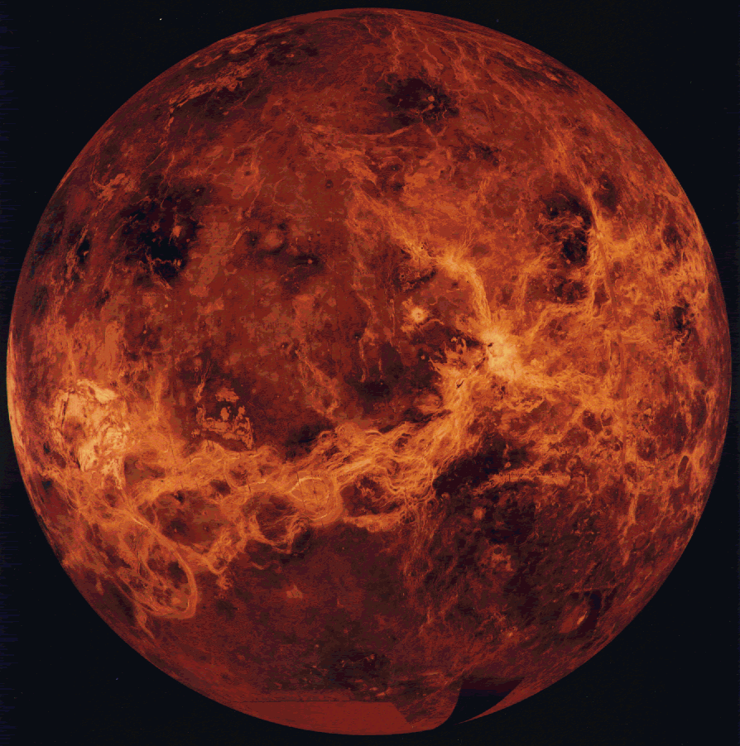
Notes:
AE T(Celsius) Durchmesser P CO2
Venus 0.7 460 0.95 9300 95.5%
Erde 1.0 14 (-50 - +50) 1.01 1 0.038%
Mars 1.6 -45 (-87 - -5) 0.7 0.7 96%

Slide 19
A Simple Example
Distance to sun, solar flux, and intensity of sunlight:
  Earth: 1.0 AE 1370 W/m² 2.28×10⁷ W/m²/sr
  Venus: 0.7 AE ??? ???
  Mars: 1.6 AE ??? ???
Does the solar flux change with distance from the sun?
Does the intensity change with distance from the sun?
What is the functional dependency on distance?
Why?
Notes:
1 Starting from SB/law, the blackbody intensity is flux/pi b/c BBs are isotropic emitters (cosine law)
2 The solid angle of the sun seen from Earth is about 6E-5 sr
3 Hence, the intensity is 1370/6E-5 = 2.28E7
4 Also, the intensity is 1/pi*5.67E-8*6000^4 (b/c of point 1 above)
* Intensity does not change, since solid angle of sun changes
Flux does change proportional to distance^2
VENUS 1370/0.7^2 = 2795 W/m^2
MARS 1370/1.6^2 = 535 W/m^2

Slide 20
Notes:
Ausfallende Waermestrahlung =einfallende Sonnenstrahlung
„Die Bilanz muss stimmen“
1370 W/m2
Circa 10 qm eine Stunde lang = taeglicher Energiebedarf eines Menschen
6 Milliarden Menschen benoetigen circa 30-50% der nutzbaren Agrarflaeche fuer Naherungsmittel
Aber
Am Equator mehr Energie als an den Polen

Slide 21
Energy Balance
To a very high accuracy (inner) planets are in energy balance
I.e.: Incoming –reflected solar flux equals outgoing emitted flux
One can ask the question: What is the equivalent blackbody temperature of a planet in order to be in equilibrium given its solar constant and albedo?
Notes:
1 Starting from SB/law, the blackbody intensity is flux/pi b/c BBs are isotropic emitters (cosine law)
2 The solid angle of the sun seen from Earth is about 6E-5 sr
3 Hence, the intensity is 1370/6E-5 = 2.28E7
4 Also, the intensity is 1/pi*5.67E-8*6000^4 (b/c of point 1 above)
* Intensity does not change, since solid angle of sun changes
Flux does change proportional to distance^2
VENUS 1370/0.7^2 = 2795 W/m^2
MARS 1370/1.6^2 = 535 W/m^2

