Slide 1
Low level humidity
Ivan Smiljanic
Training and Satellite Application Expert EUMETSAT Training Team
18 June 2024, Summer School, Bracciano

Slide 2
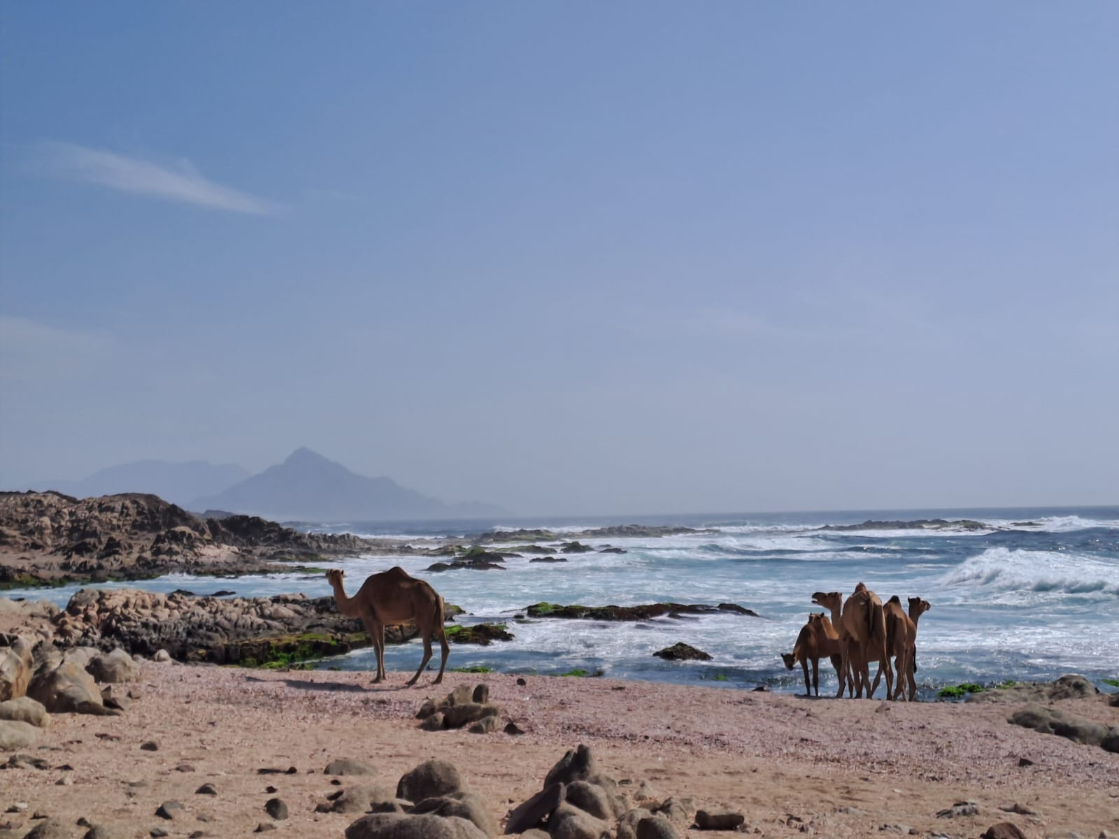
MOISTURE in the atmosphere – can we see it?
c. Ivan Smiljanic

Slide 3
Agenda
Low level moisture
Importance of moisture information
(FCI) moisture channels
Ways to detect moisture
View on low-level moisture
Examples of FCI proxy imagery

Slide 4
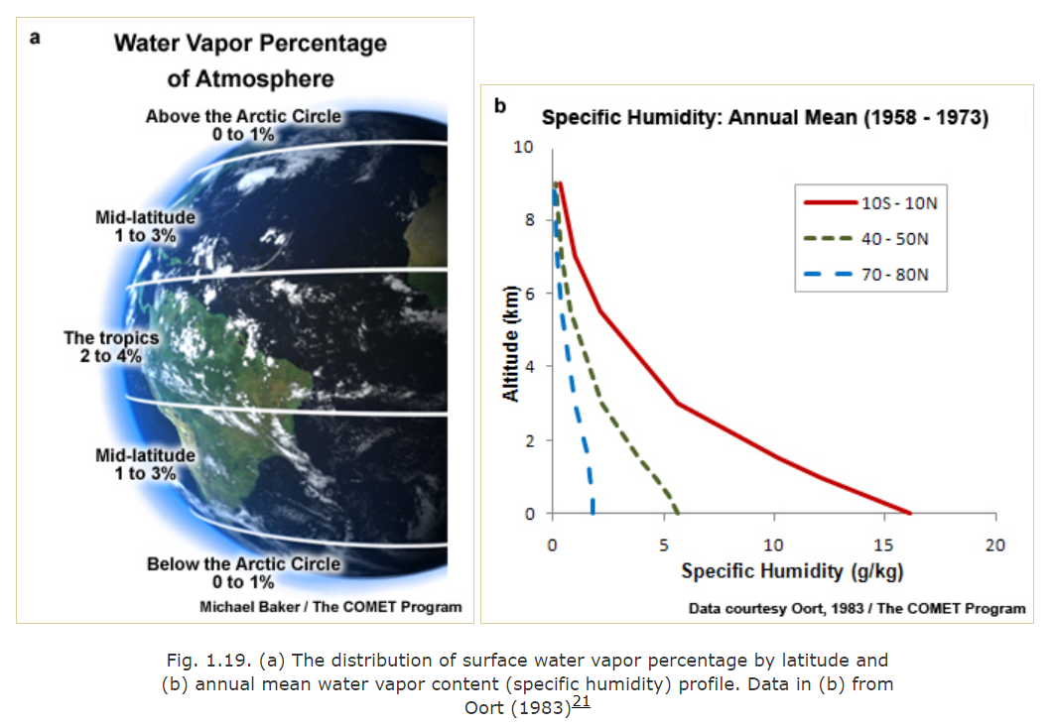
MOISTURE in the atmosphere – where is it?
Credit: COMET Program

Slide 5
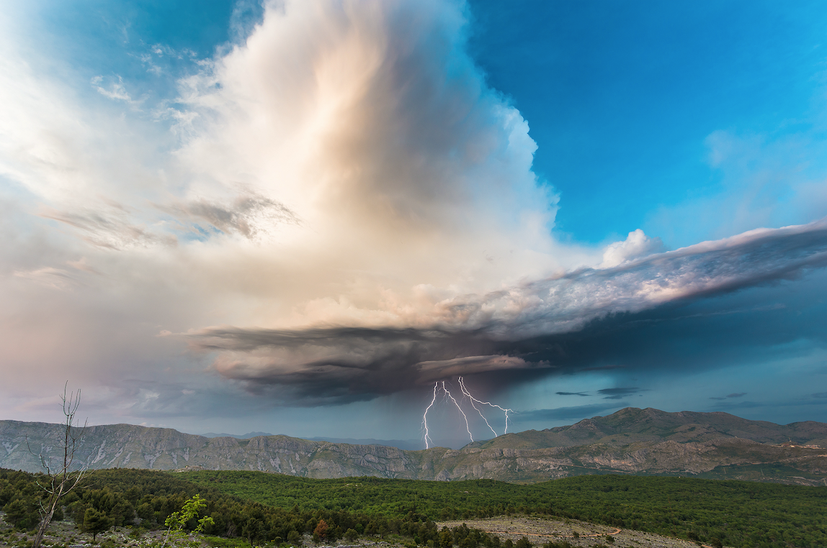

Why do we want to know about low-level MOISTURE?
Unstable atmosphere supports upward motion – rising moist air can lead to severe weather
Stable atmosphere resists rising motion
– usually low clouds or fog are produced

Slide 6
Agenda
Low level moisture
Importance of moisture information
(FCI) moisture channels
Ways to detect moisture
View on low-level moisture
Examples of FCI proxy imagery

Slide 7
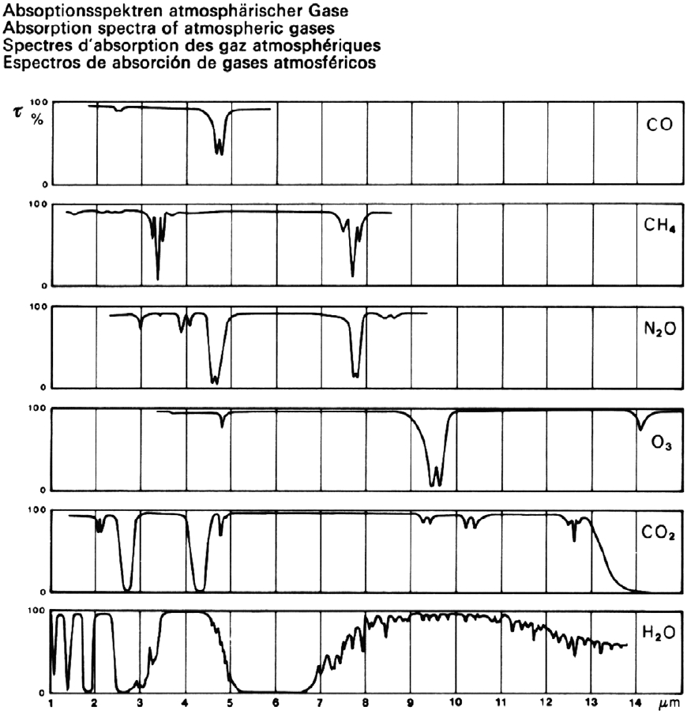
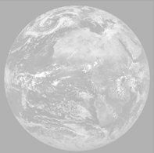
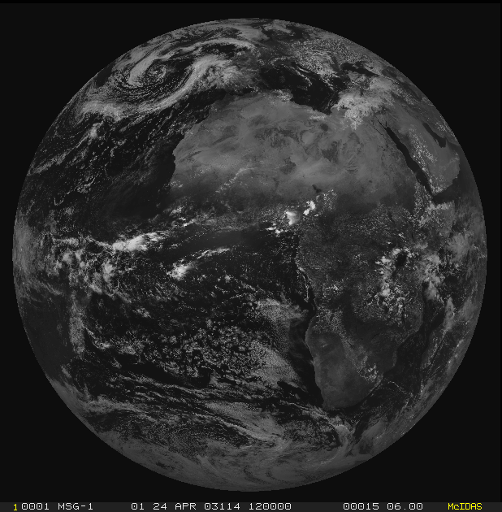
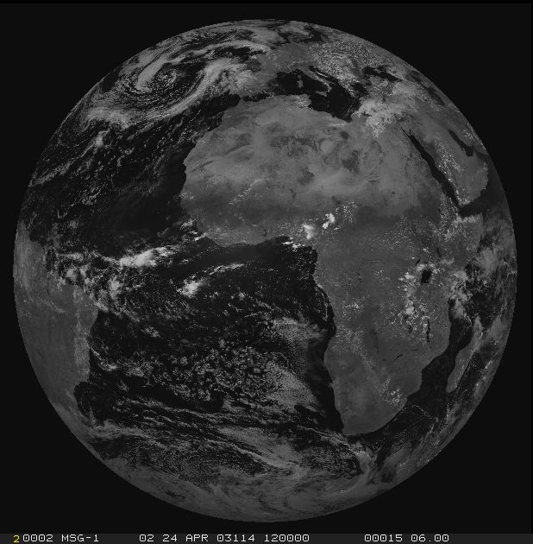
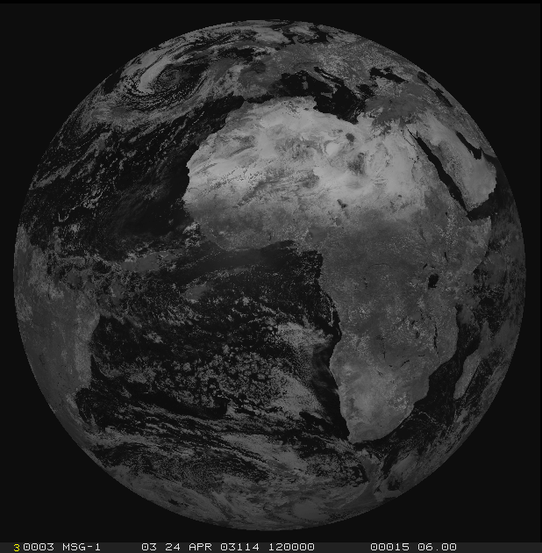
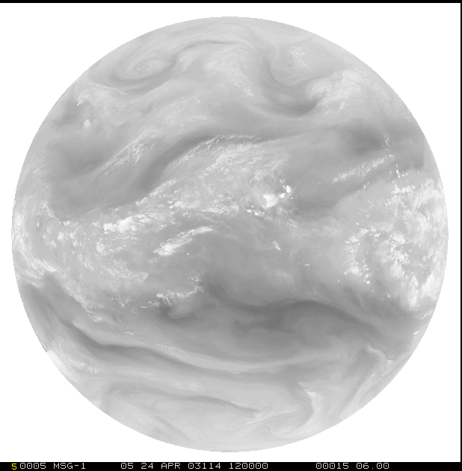
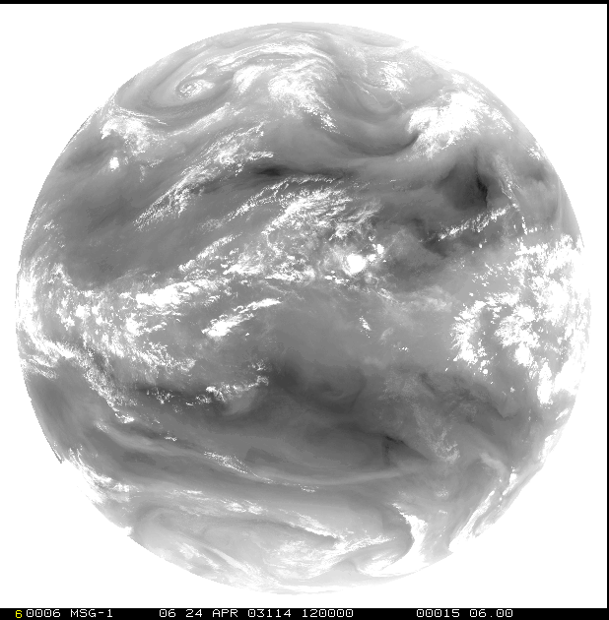
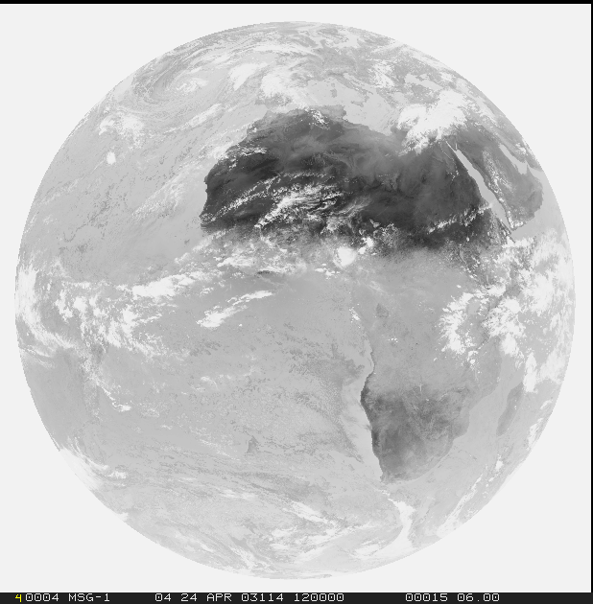
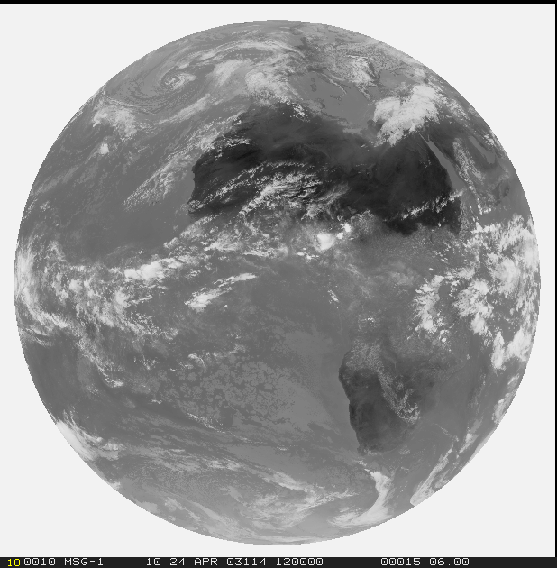
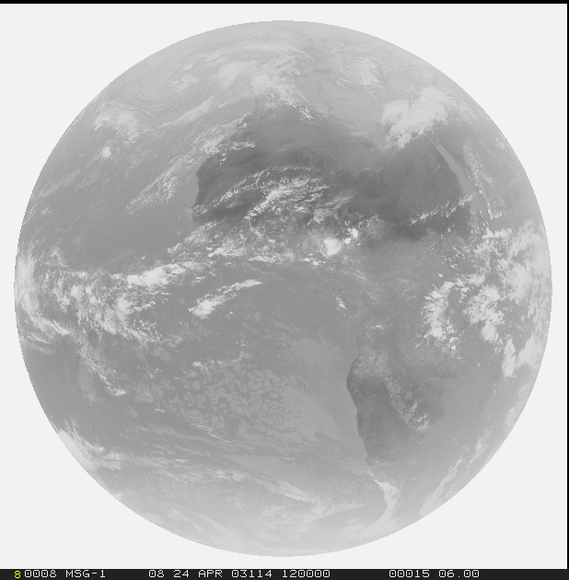
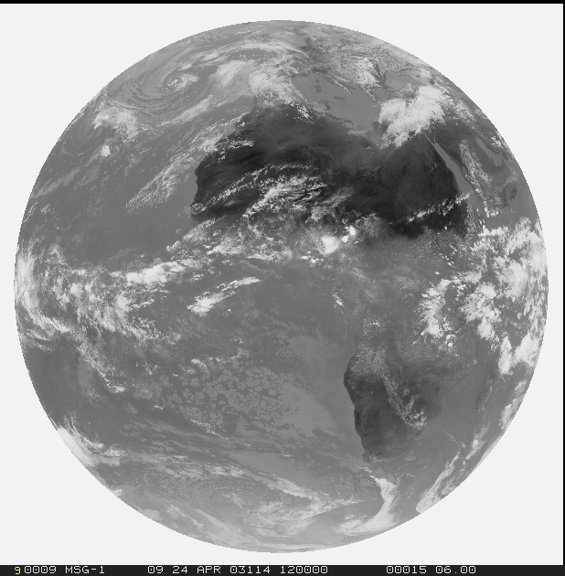
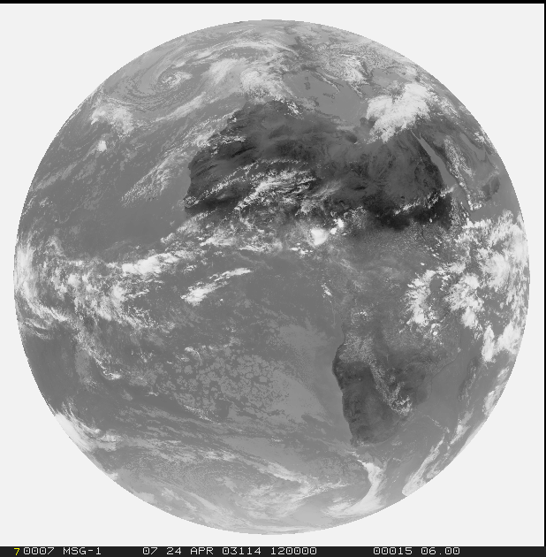
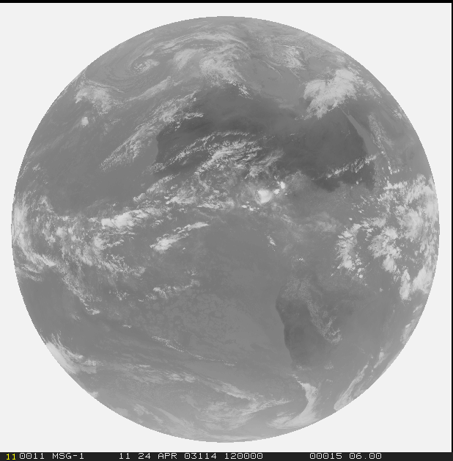
FCI vs SEVIRI
1=VIS0.4
2=VIS0.5
3=VIS0.6
4=VIS0.8
5=NIR0.9
6=NIR1.3
Solar
1.0 km (0.5 km)
Thermal
2.0 km (1.0 km)
7=NIR1.6
8=NIR2.25
10=WV6.2
12=IR8.7
10=WV6.2
11=WV7.3
9=IR3.8
11=WV7.3
13=IR9.7
14=IR10.5
15=IR12.3
16=IR13.3

Slide 8
WV Absorption Bands in the IR ‘window’ region
IR3.9 IR10.8 IR12.0

Slide 9
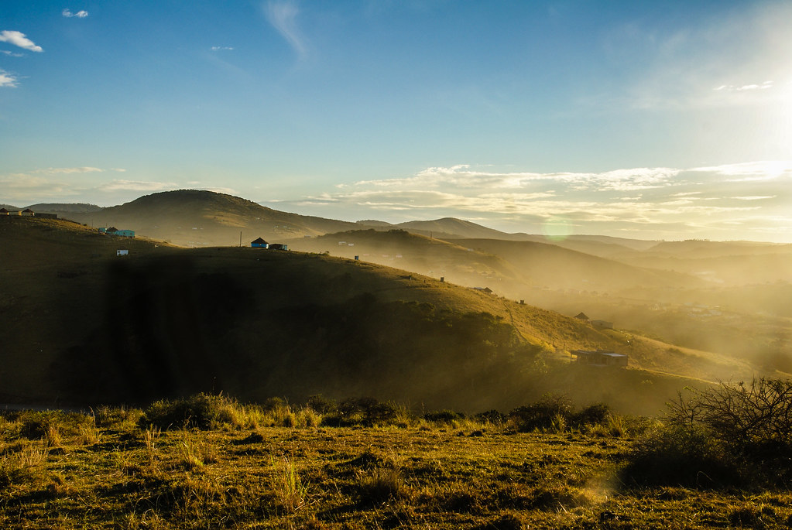
How does this affect the IR Channels ?
λ = 3.9
λ = 10.8
λ = 12.0
T(BL) = 290 K
T(surf) = 300 K

Slide 10
How does the BTD12.0-10.8 becomes bigger?
λ = 3.9
λ = 10.8
λ = 12.0
T(BL) = 290 K
T(surf) = 300 K

Slide 11
How does the BTD12.0-10.8 becomes bigger? >> more H20
λ = 3.9
λ = 10.8
λ = 12.0
T(BL) = 290 K
T(surf) = 300 K

Slide 12
How does the BTD12.0-10.8 becomes bigger?
λ = 3.9
λ = 10.8
λ = 12.0
T(BL) = 290 K
T(surf) = 300 K

Slide 13
How does the BTD12.0-10.8 becomes bigger?? >> T change
λ = 3.9
λ = 10.8
λ = 12.0
T(BL) = 290 K
T(surf) = 320 K

Slide 14
How does the BTD12.0-10.8 becomes bigger?
λ = 3.9
λ = 10.8
λ = 12.0
T(BL) = 290 K
T(surf) = 300 K

Slide 15
How does the BTD12.0-10.8 becomes bigger?? >> slant view
λ = 3.9
λ = 12.0
λ = 10.8
T(BL) = 270 K
T(surf) = 300 K

Slide 16
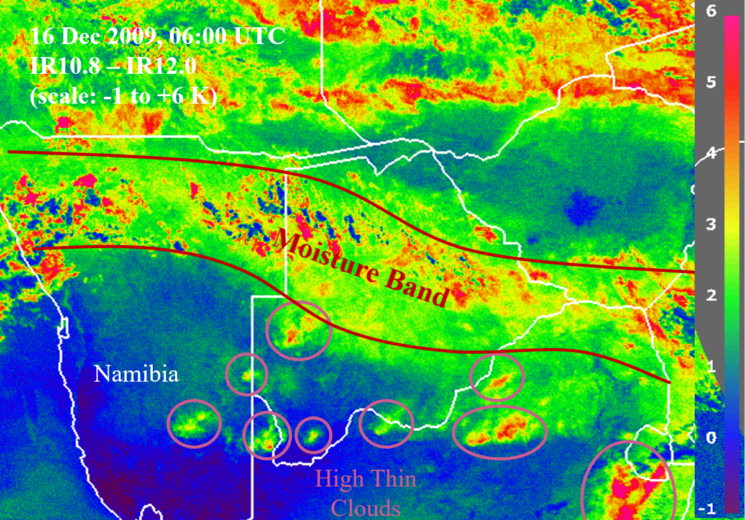
BTD IR10.8 – IR12.0

Slide 17
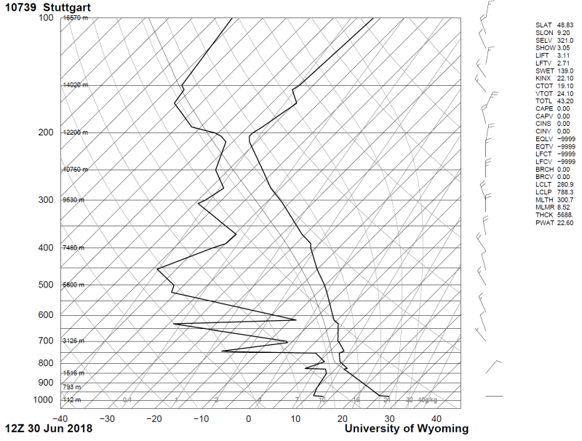
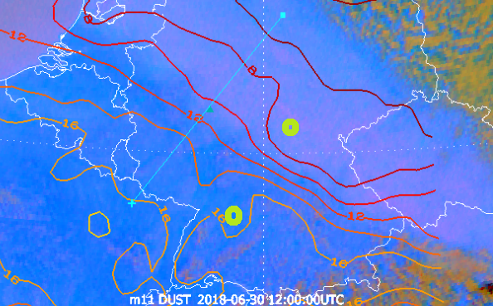
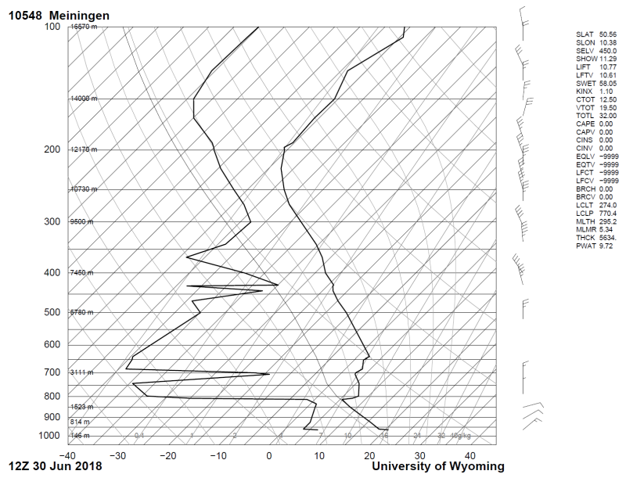
Radiosoundings
30 June 2018
12:00 UTC

Slide 18
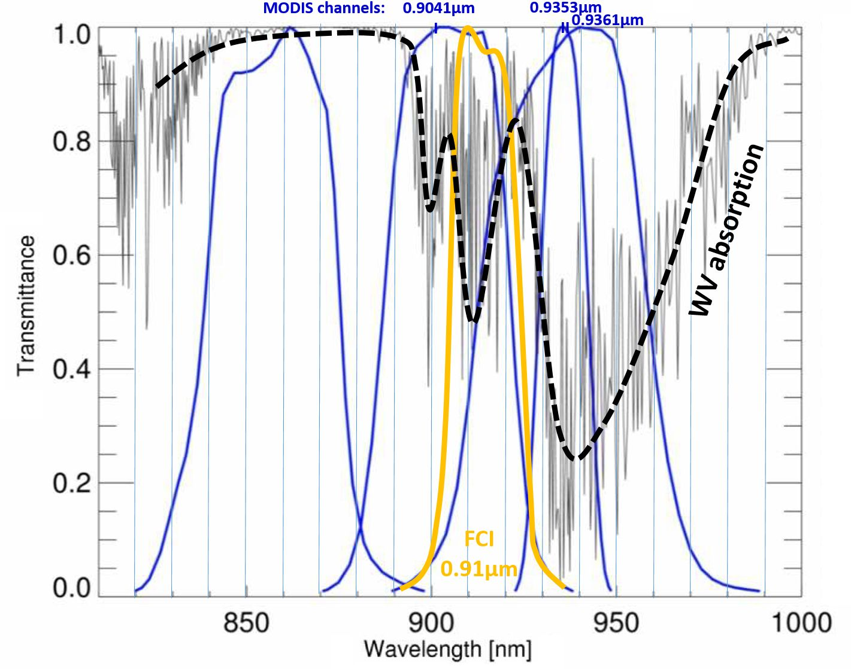
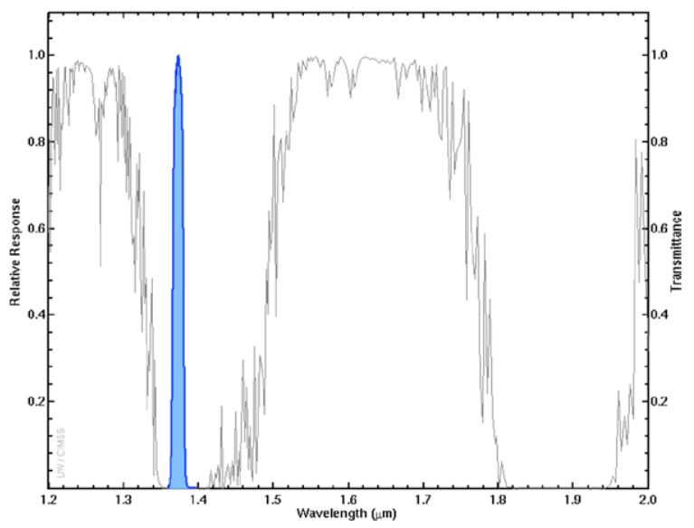
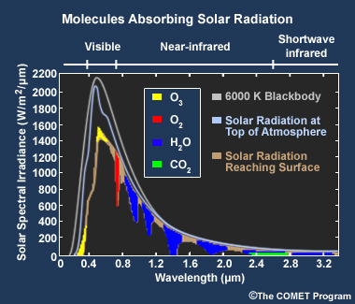
WV absorption (solar region)
910 nm
1375 nm

Slide 19
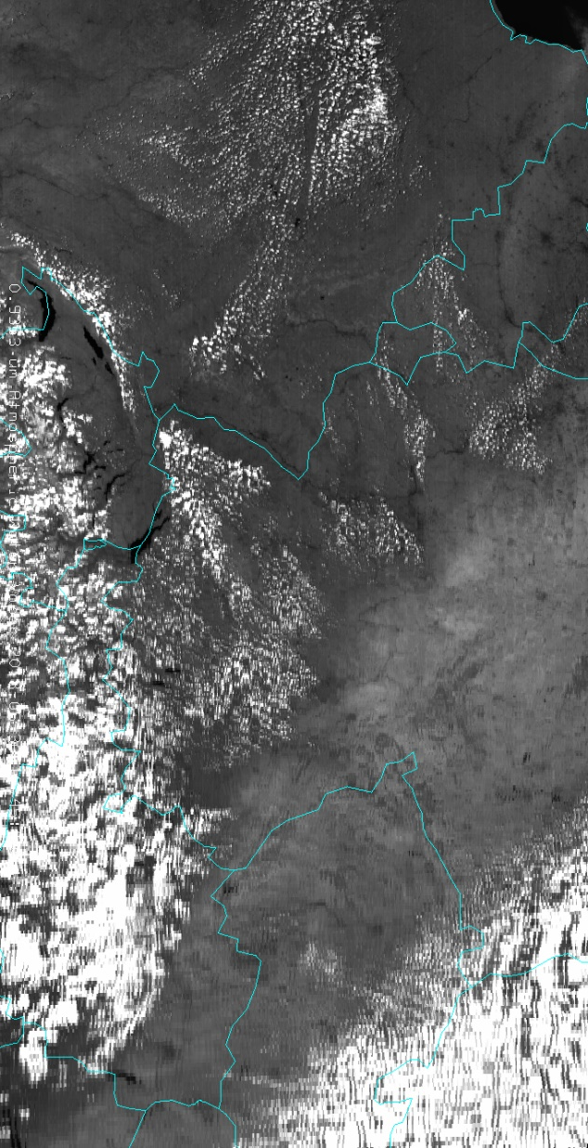
WV Absorption: what does it mean in NIR0.9 region?
Aqua MODIS 0.935 µm single channel
100
100
100
38
32
16
DRY Atmosphere
WET Atmosphere
WET Atmosphere
98
40
96
36
96
18
94
92
92
44
40
20
88
80
80
Reflectivity = 50%
Reflectivity = 50%
Reflectivity = 25%

Slide 20
Agenda
Low level moisture
Importance of moisture information
(FCI) moisture channels
Ways to detect moisture
View on low-level moisture
Examples of FCI proxy imagery

Slide 21
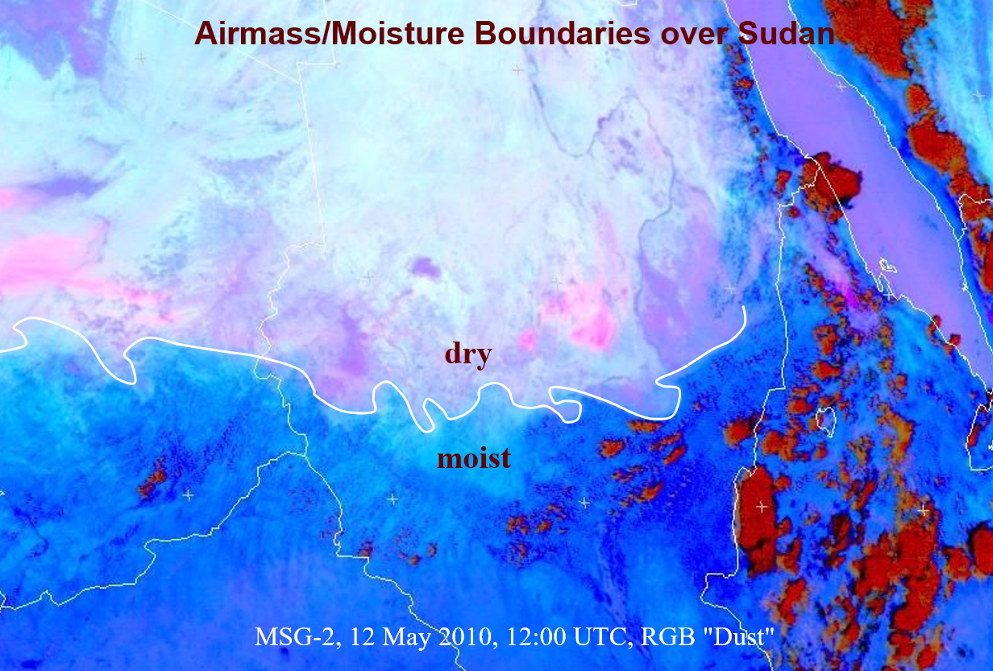
How to ignite
Notes:
- Sometimes the boundaries are very sharp

Slide 22
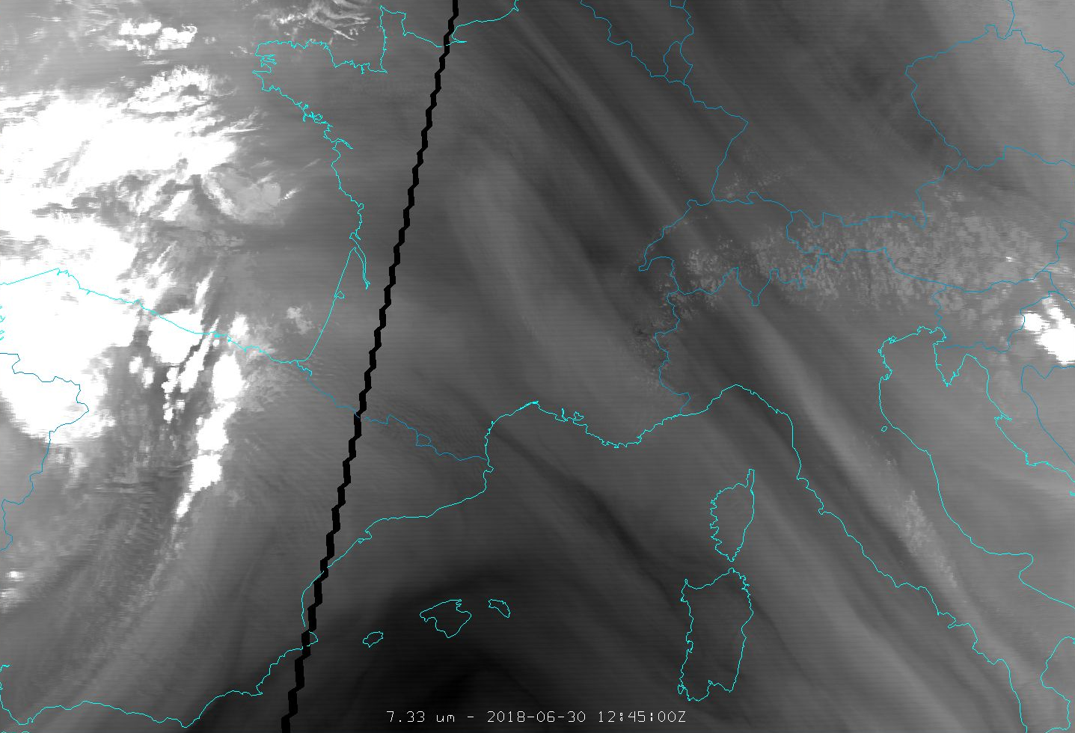
Higher level moisture
Mid-level moisture
MODIS
WV7.3 channel
Locate moisture boundaries!

Slide 23
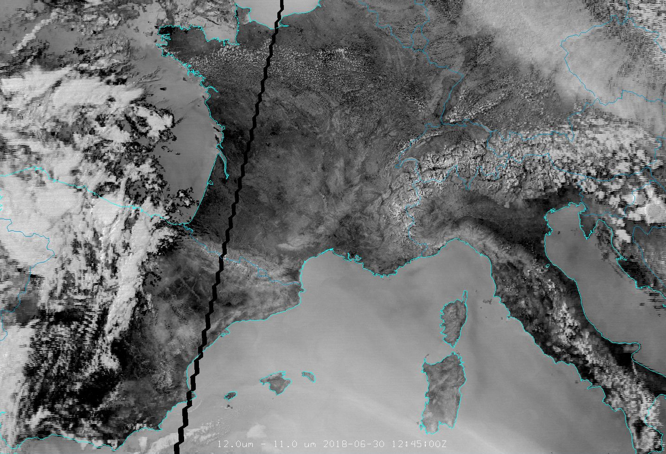
Higher level moisture vs low level moisture
Low-level moisture
MODIS
BTD12-11 channel

Slide 24
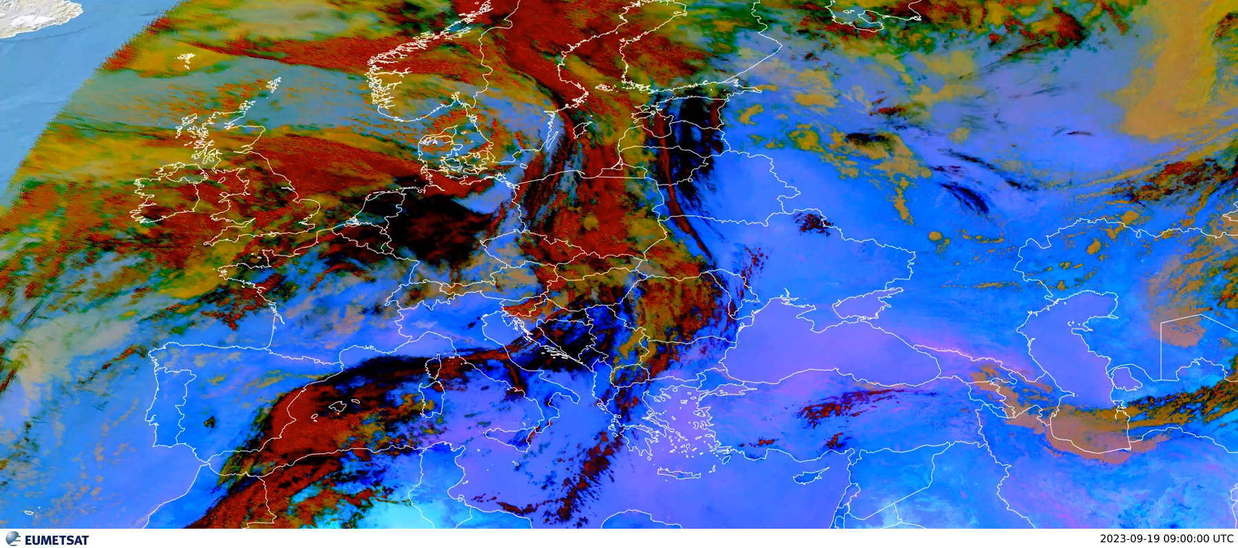
Examples of LL moisture
Limitations:
cloud-free areas only
relatively weak signal
diurnal circles
https://www.eumetsat.int/diurnal-development-sea-breeze-front

Slide 25
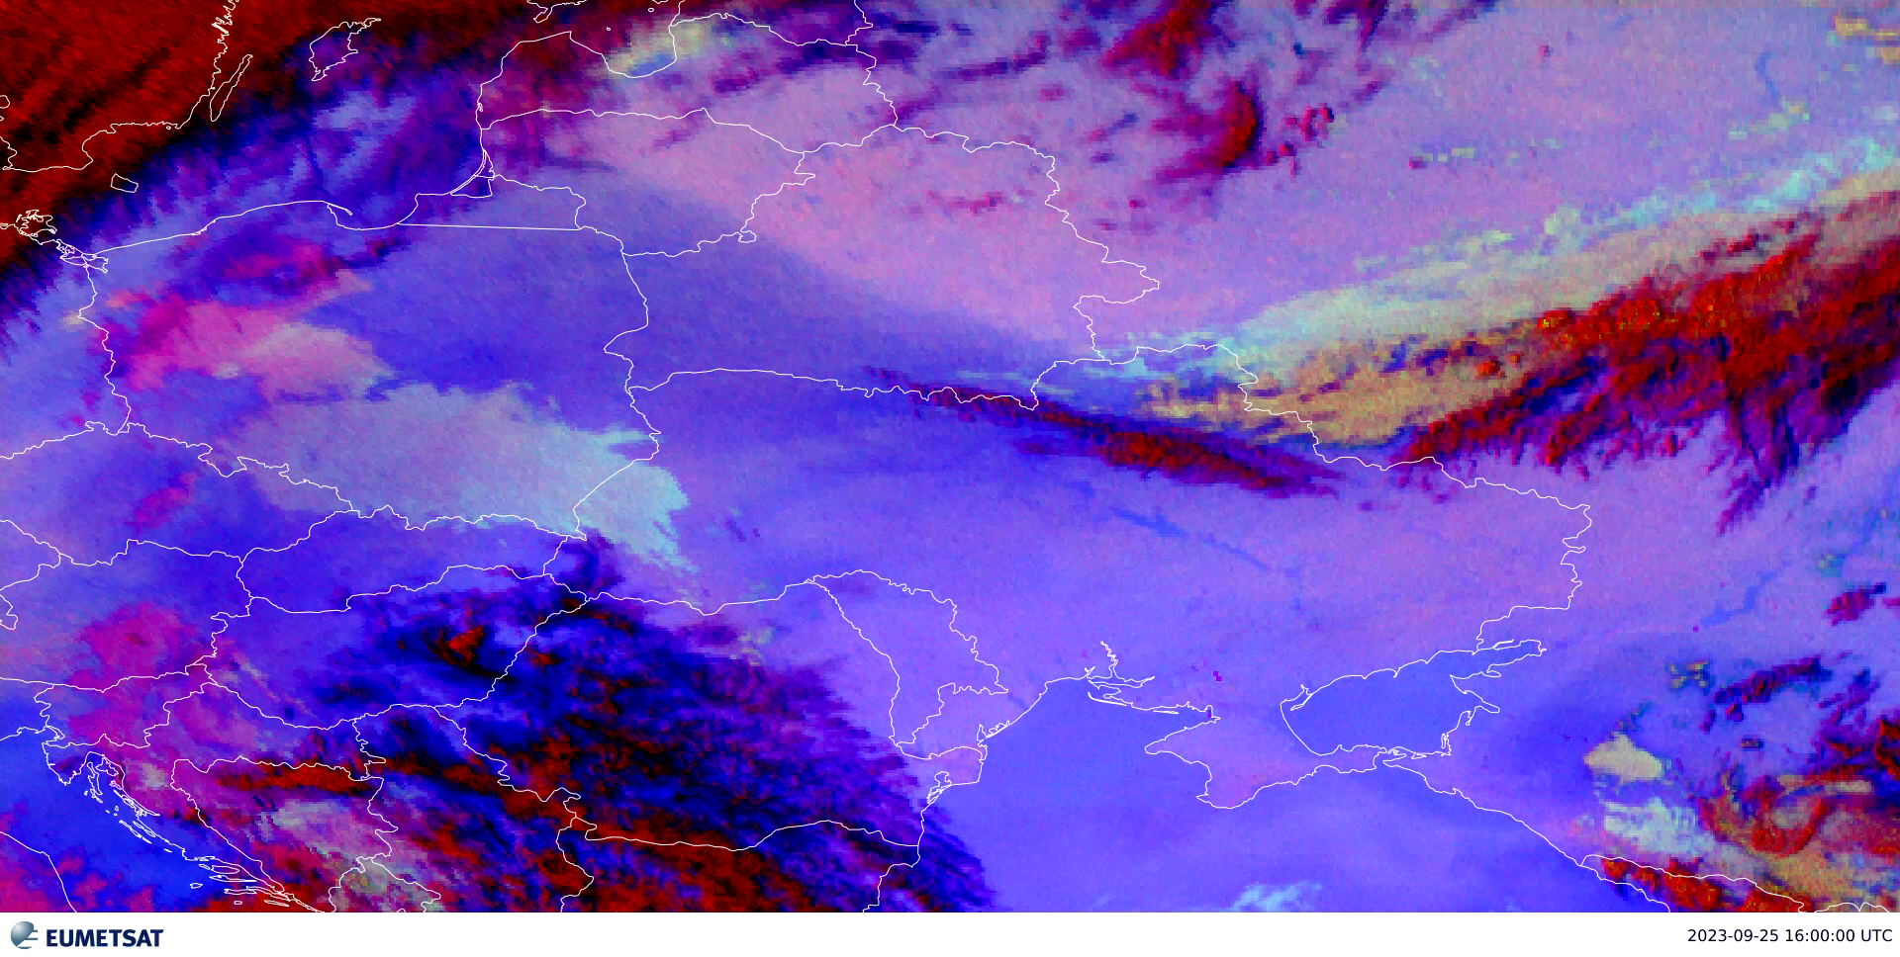
Examples of LL moisture
Where did the moisture go?
c. Jochen Kerkmann
https://www.eumetsat.int/diurnal-development-sea-breeze-front

Slide 26
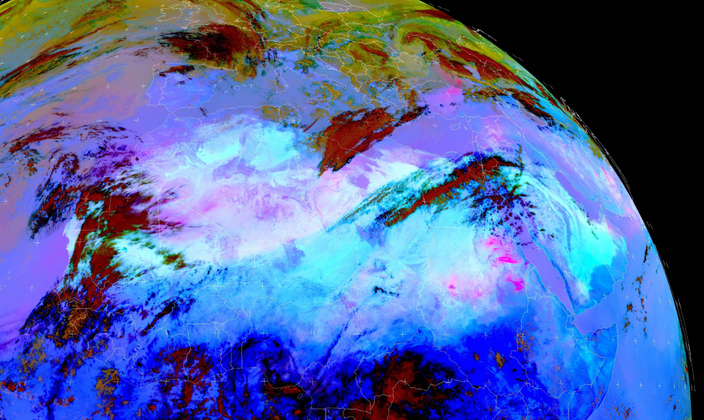
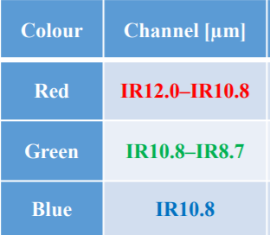
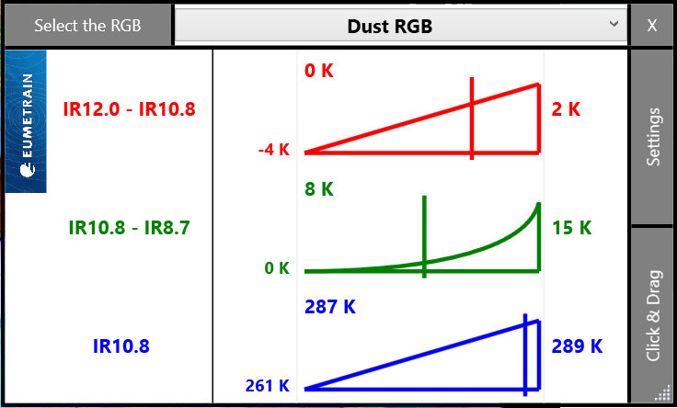
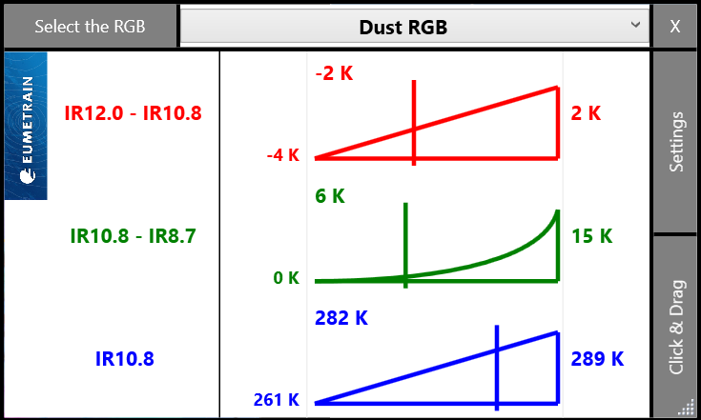
Examples of LL moisture/ cloud detection
Dust RGB
27 March 2018

Slide 27
Examples of LL moisture/ cloud detection
Take a look - where do the clouds reside?
Dust RGB
27 March 2018

Slide 28
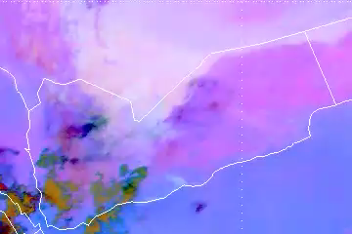
Examples of LL moisture/ cloud detection
Diurnal development of the sea breeze front all along the coast(s)
Strong moisture advection – area of local convection development (if other conditions met!)
https://www.eumetsat.int/diurnal-development-sea-breeze-front

Slide 29
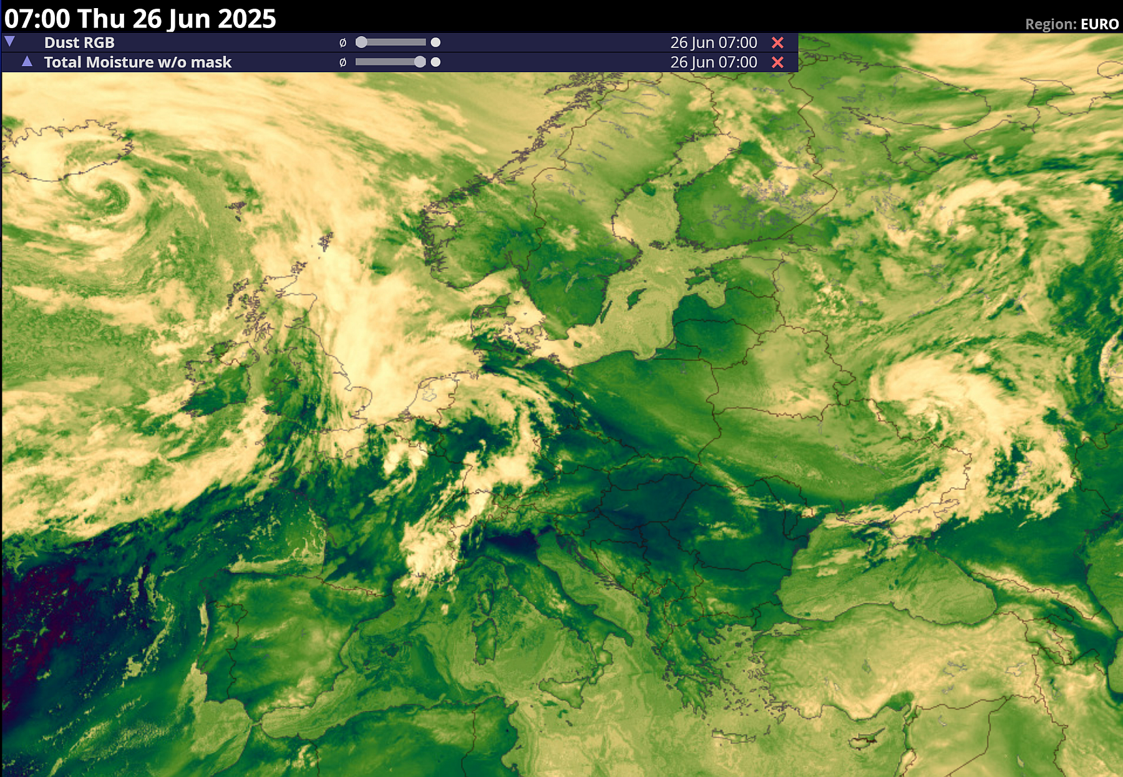
NIR0.9 (SMT) example
To ESSL viewer for loop

Slide 30
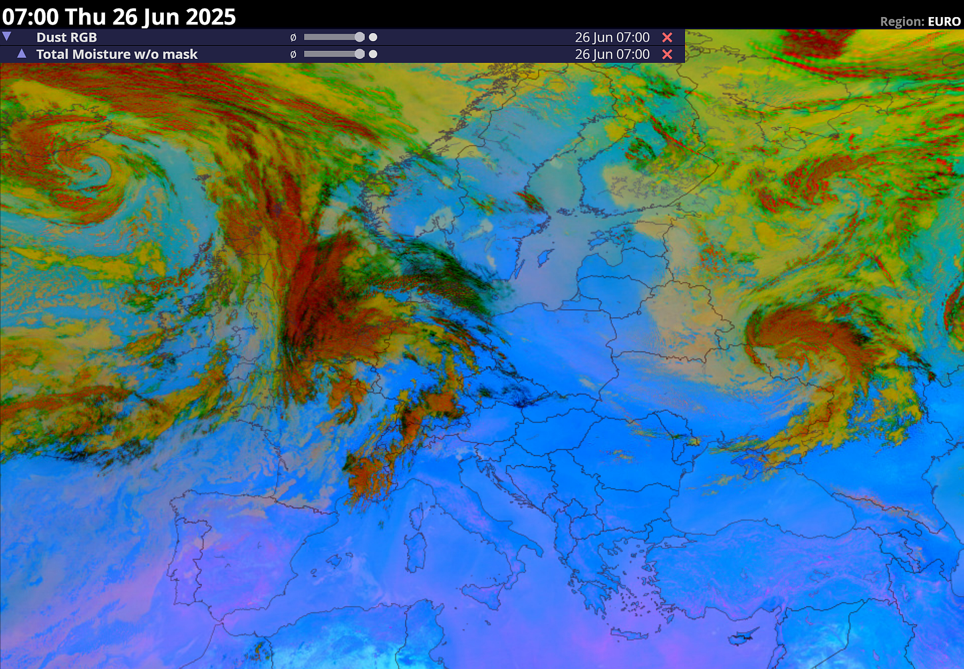
NIR0.9 (SMT) vs Dust RGB (BTD12.3-10.5)

Slide 31
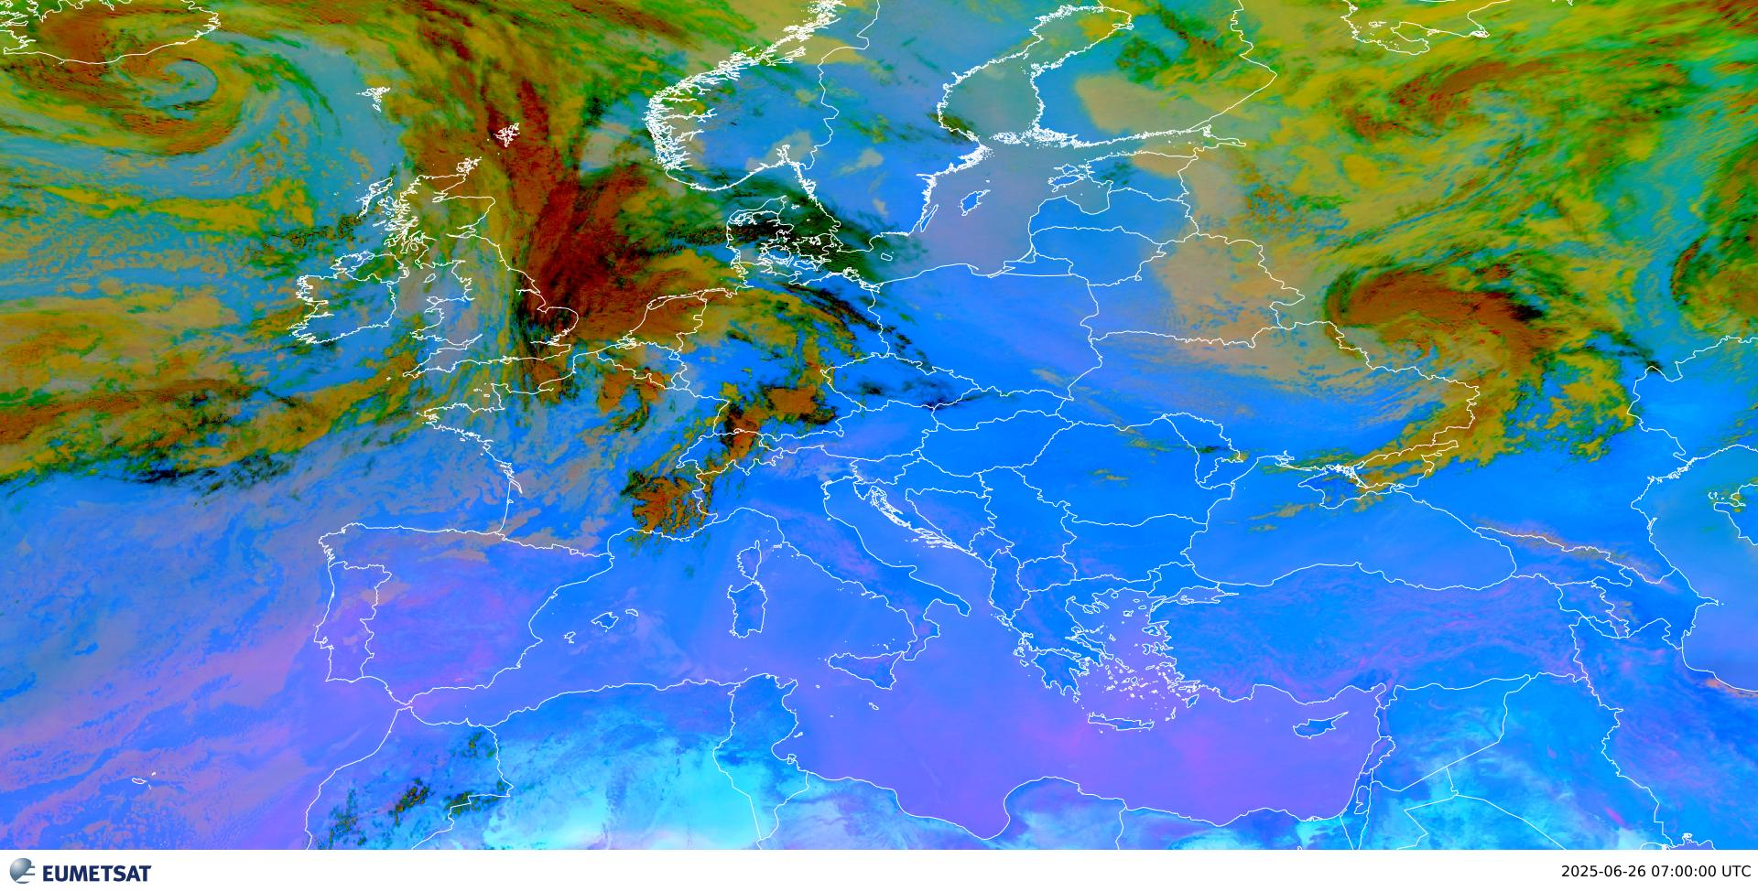
FCI vs SEVIRI Dust RGB
FCI

Slide 32
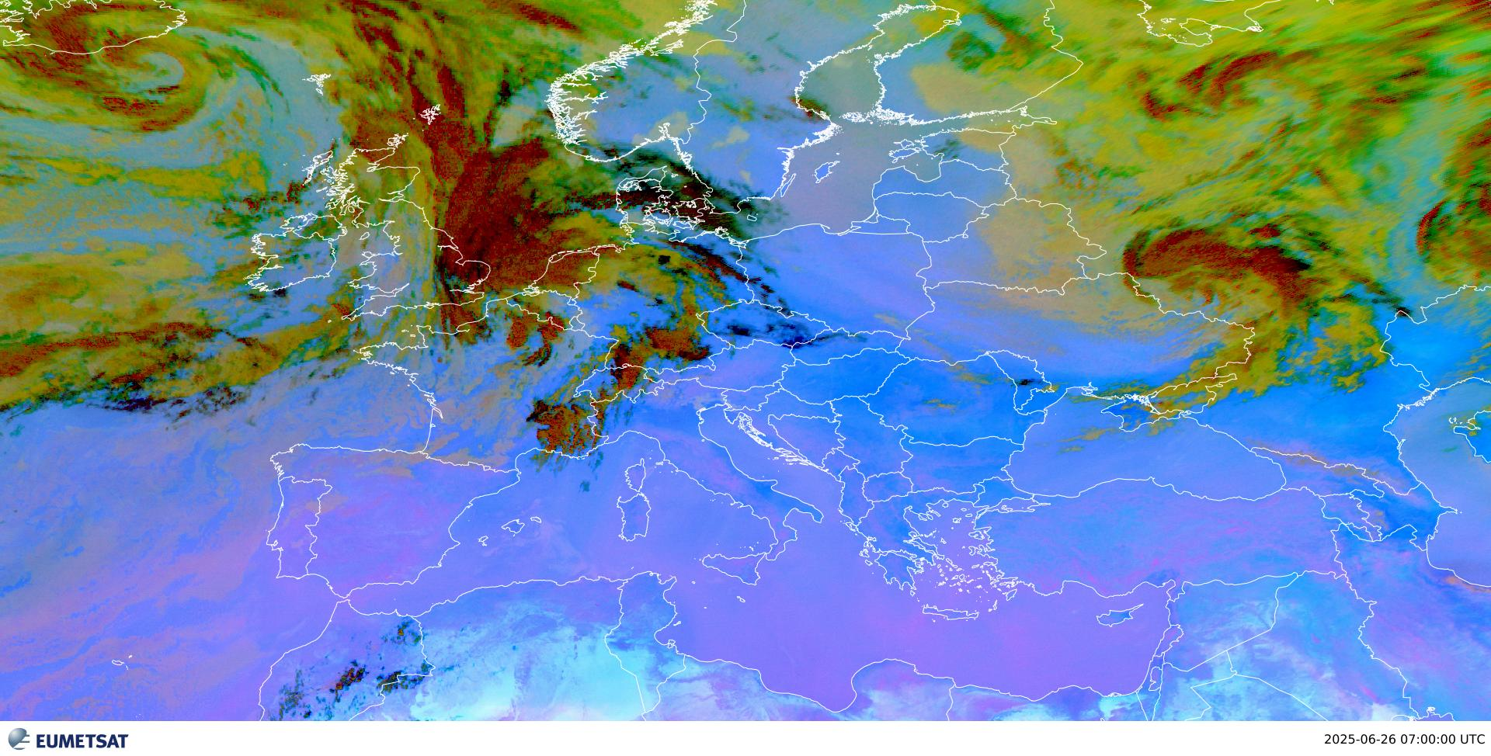
FCI vs SEVIRI Dust RGB
SEVIRI

Slide 33
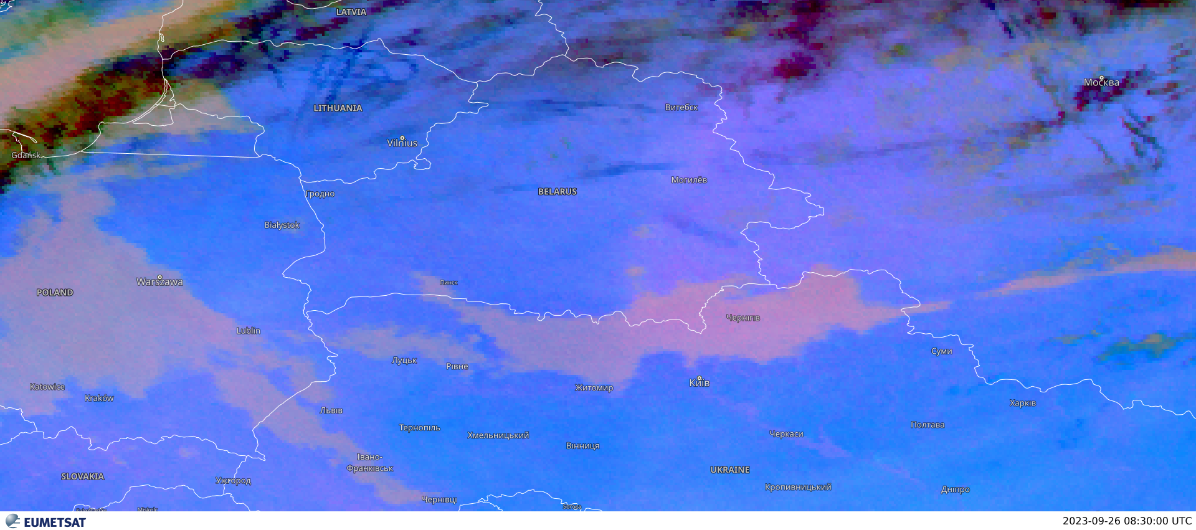
IR temperature dependence
https://www.eumetsat.int/diurnal-development-sea-breeze-front

Slide 34
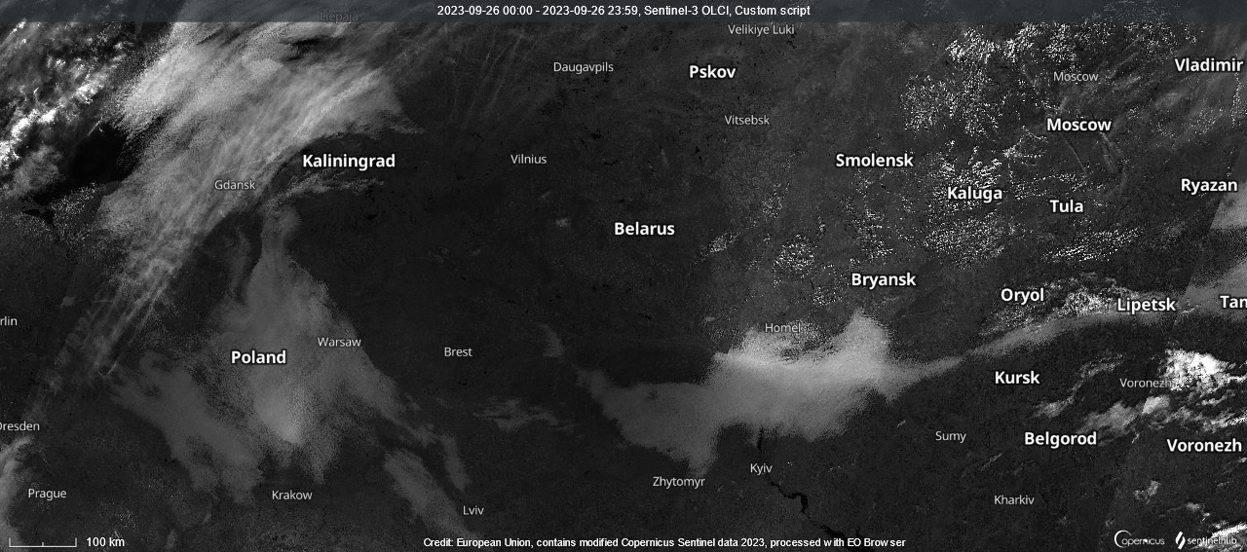
IR temperature dependence
https://www.eumetsat.int/diurnal-development-sea-breeze-front

Slide 35
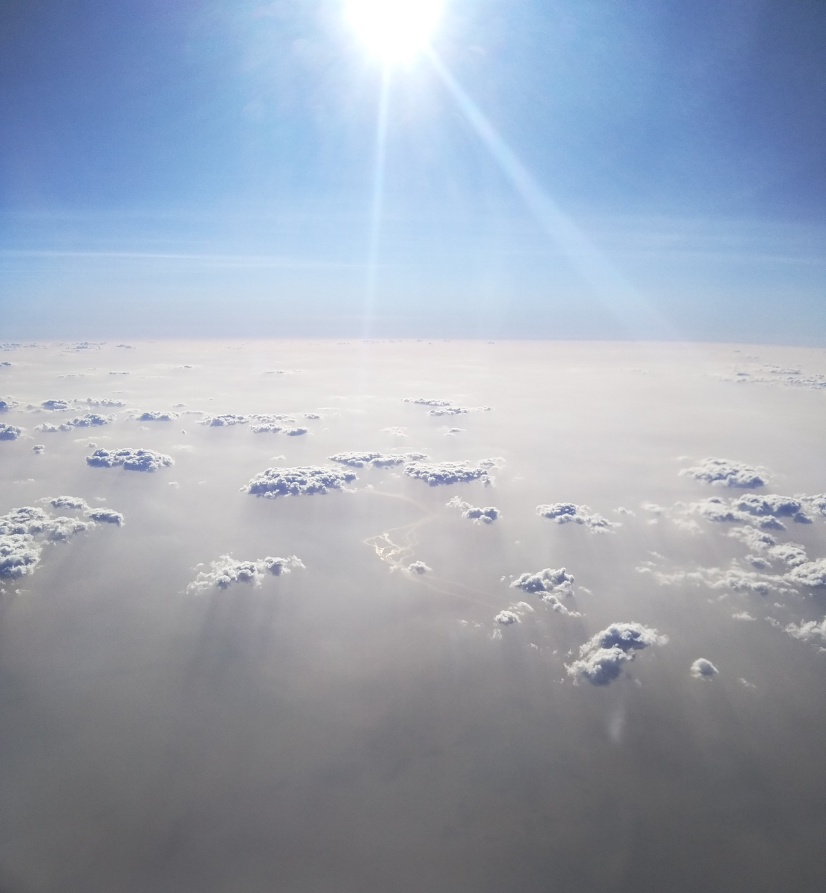
Thank you.
Khartoum, Sudan,20191010 14:18 UTC
Ivan Smiljanic

