Slide 1
Example: Infrared Atmospheric Sounding Interferometer
On Metop
Temperature and water vapor profiles available globally about once every 12hours
Michelson Interferometer

Slide 2
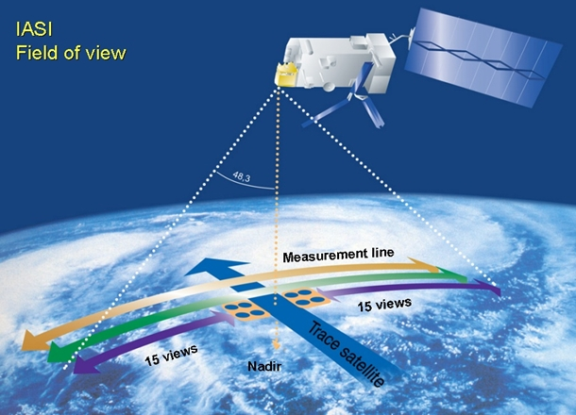
Example: IASI

Slide 4
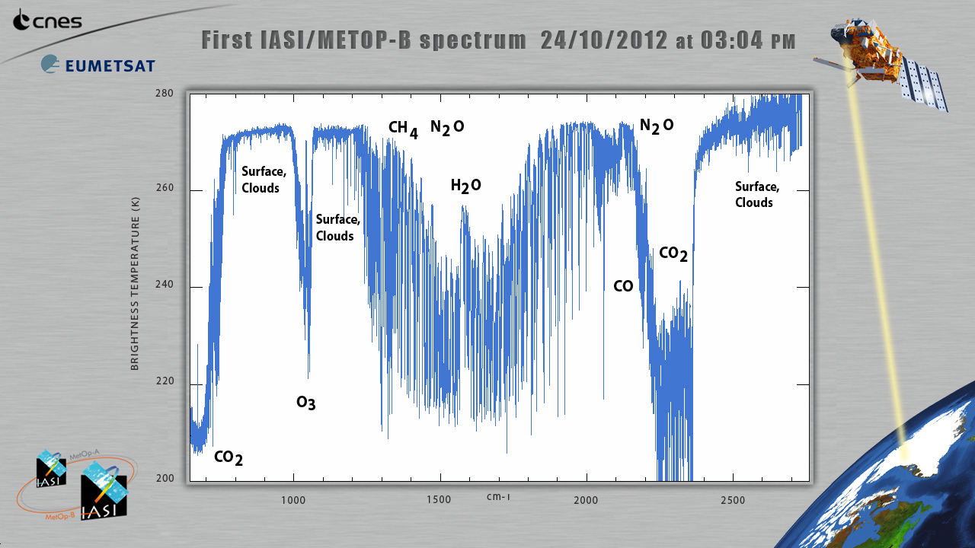
Example: IASI

Slide 5
Example: Atmospheric InfraRed Sounder (AIRS)
Provides data since mid 2002
Temperature and water vapor profiles available globally about once every 12hours
Spatial resolution about 15 km horizontally
Accuracy T : ±1K @ dz=1km
Accuracy RH : ±10% @ dz=1km
Other, similar instruments out there. Data continuity high priority for NOAA and EUMETSAT

Slide 6
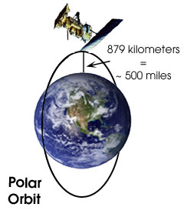
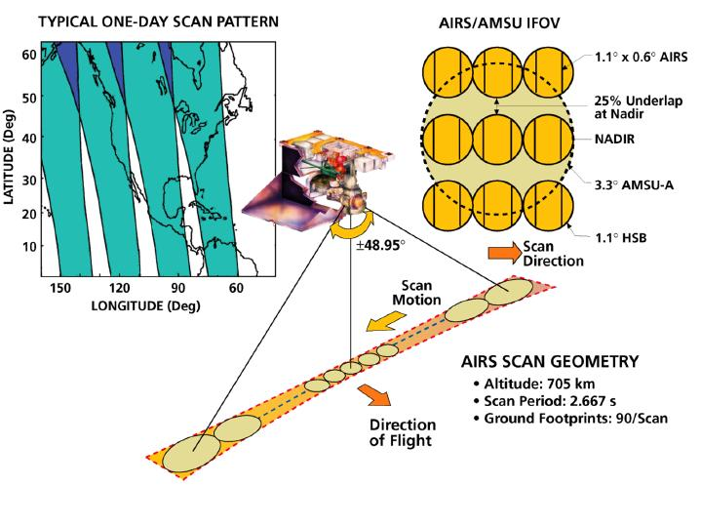
Example: Atmospheric InfraRed Sounder (AIRS)
2378 channels
3.7-15.4 micron
dL/L=1200

Slide 7
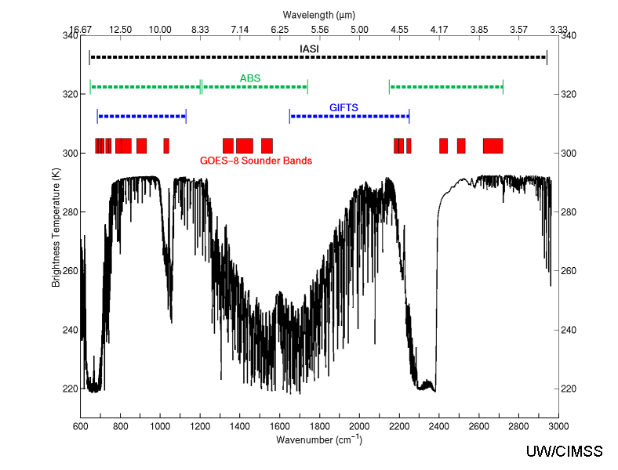
Example: Atmospheric InfraRed Sounder (AIRS)

Slide 8
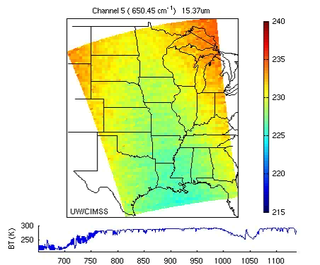
Example: Atmospheric InfraRed Sounder (AIRS)

