Slide 1
MTG-S
Meteosat Third Generation - Sounding 1

Slide 2
Mission
2nd flight unit of MTG, 1st of the “S” type.
Mission: operational meteorology.
Instrument: IRS
Substantial contribution to atmospheric chemistry.
Instrument: Sentinel-4
Contribution to space weather monitoring.
Instrument: RMU

Slide 3
MTG Orbit
Geostationary over 0/0

Slide 4
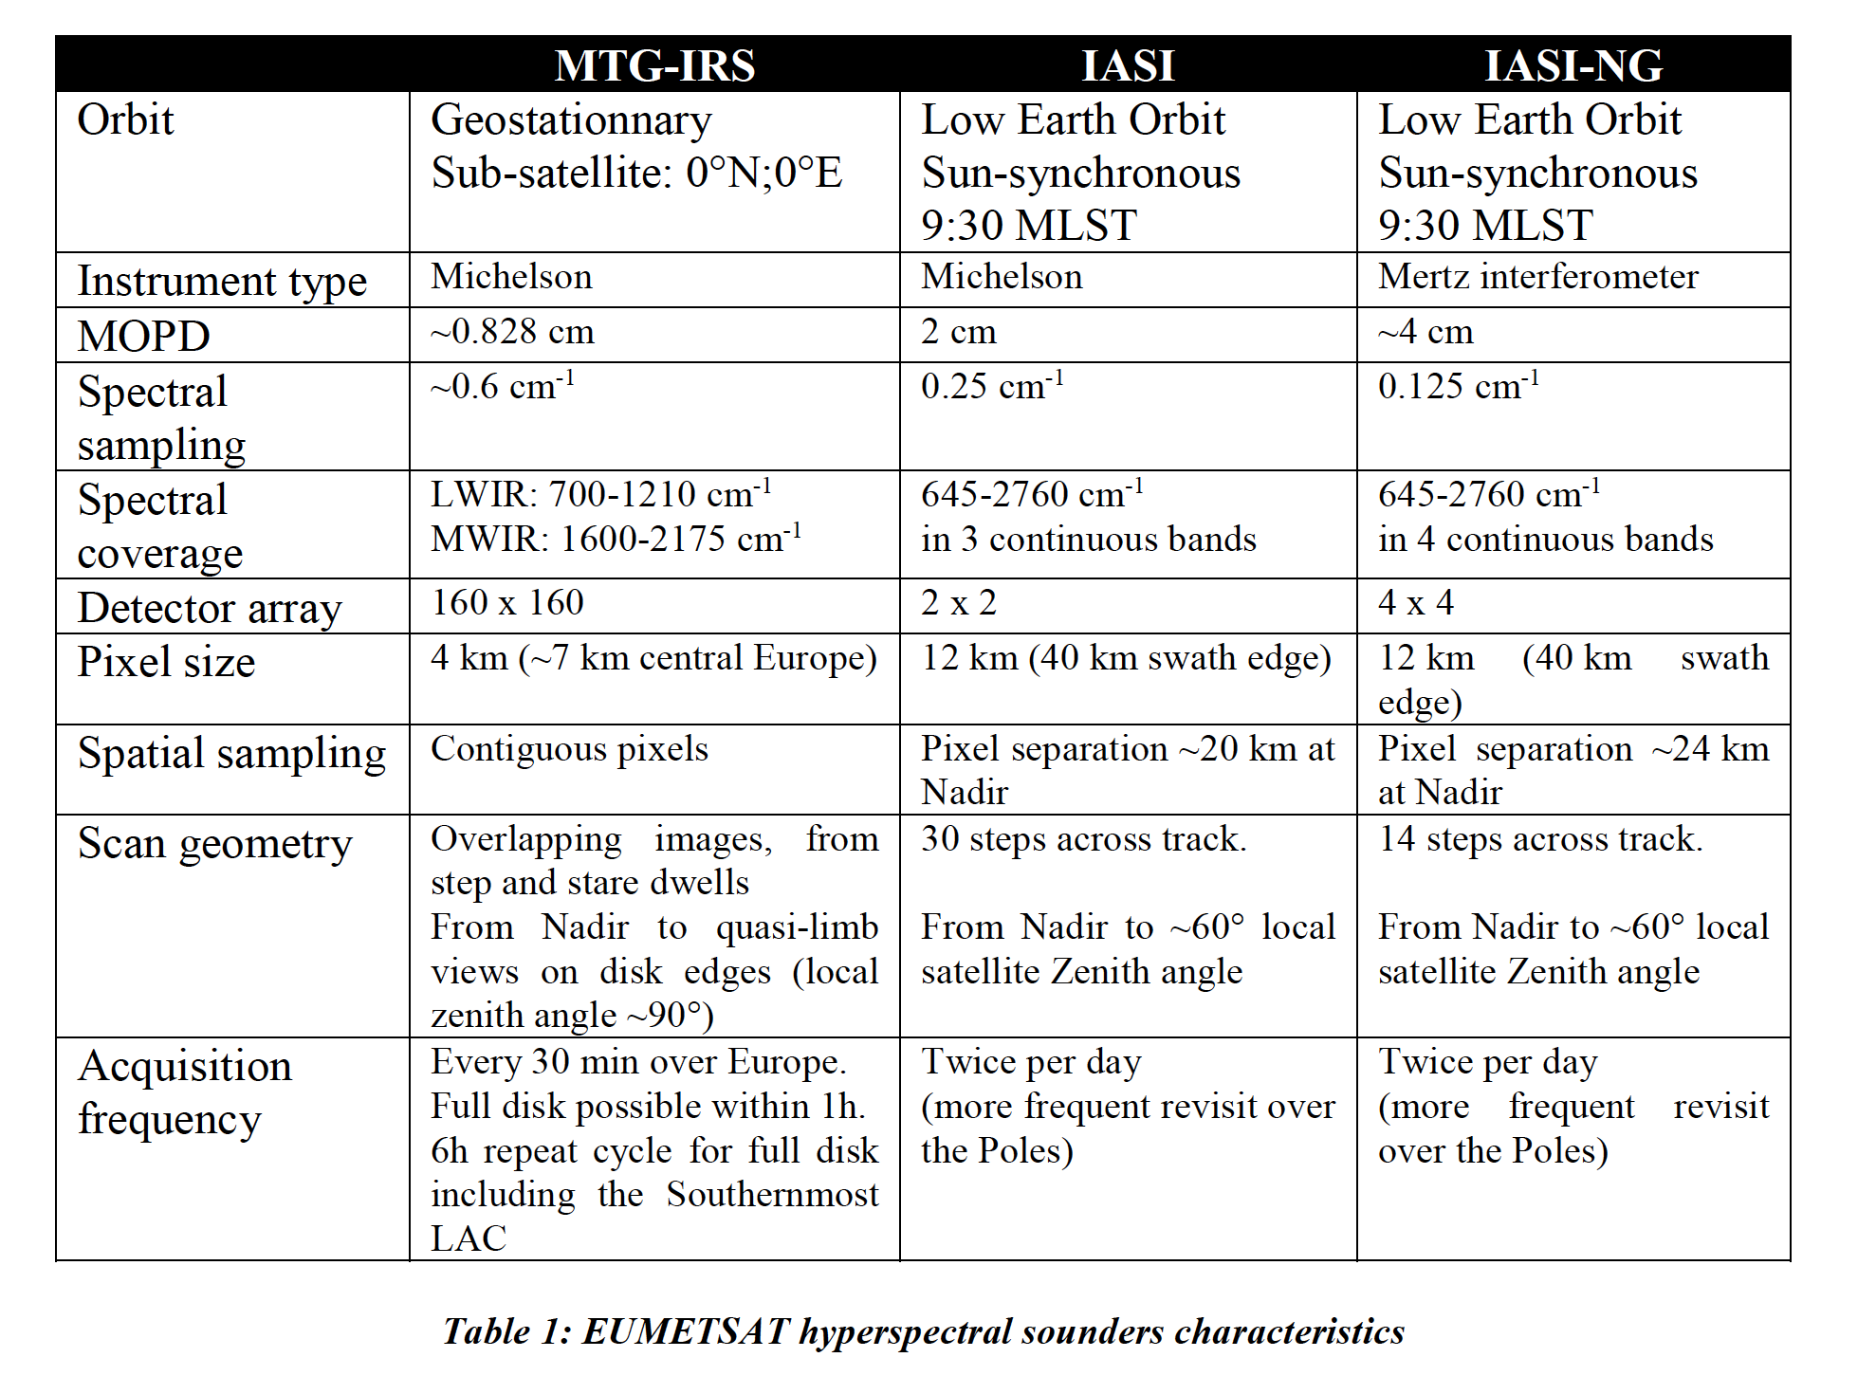

Slide 5
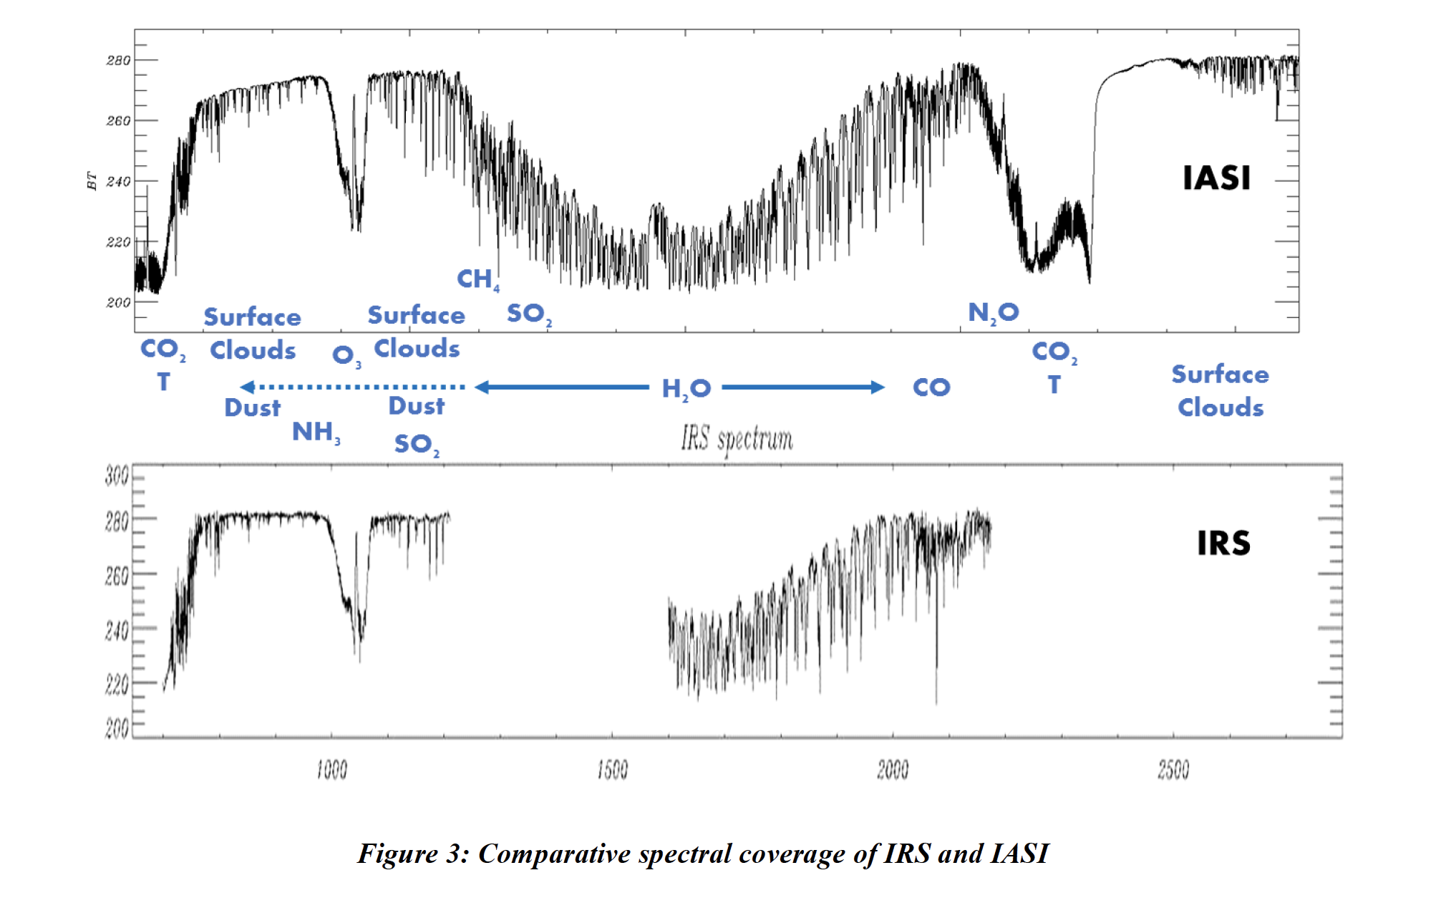

Slide 6
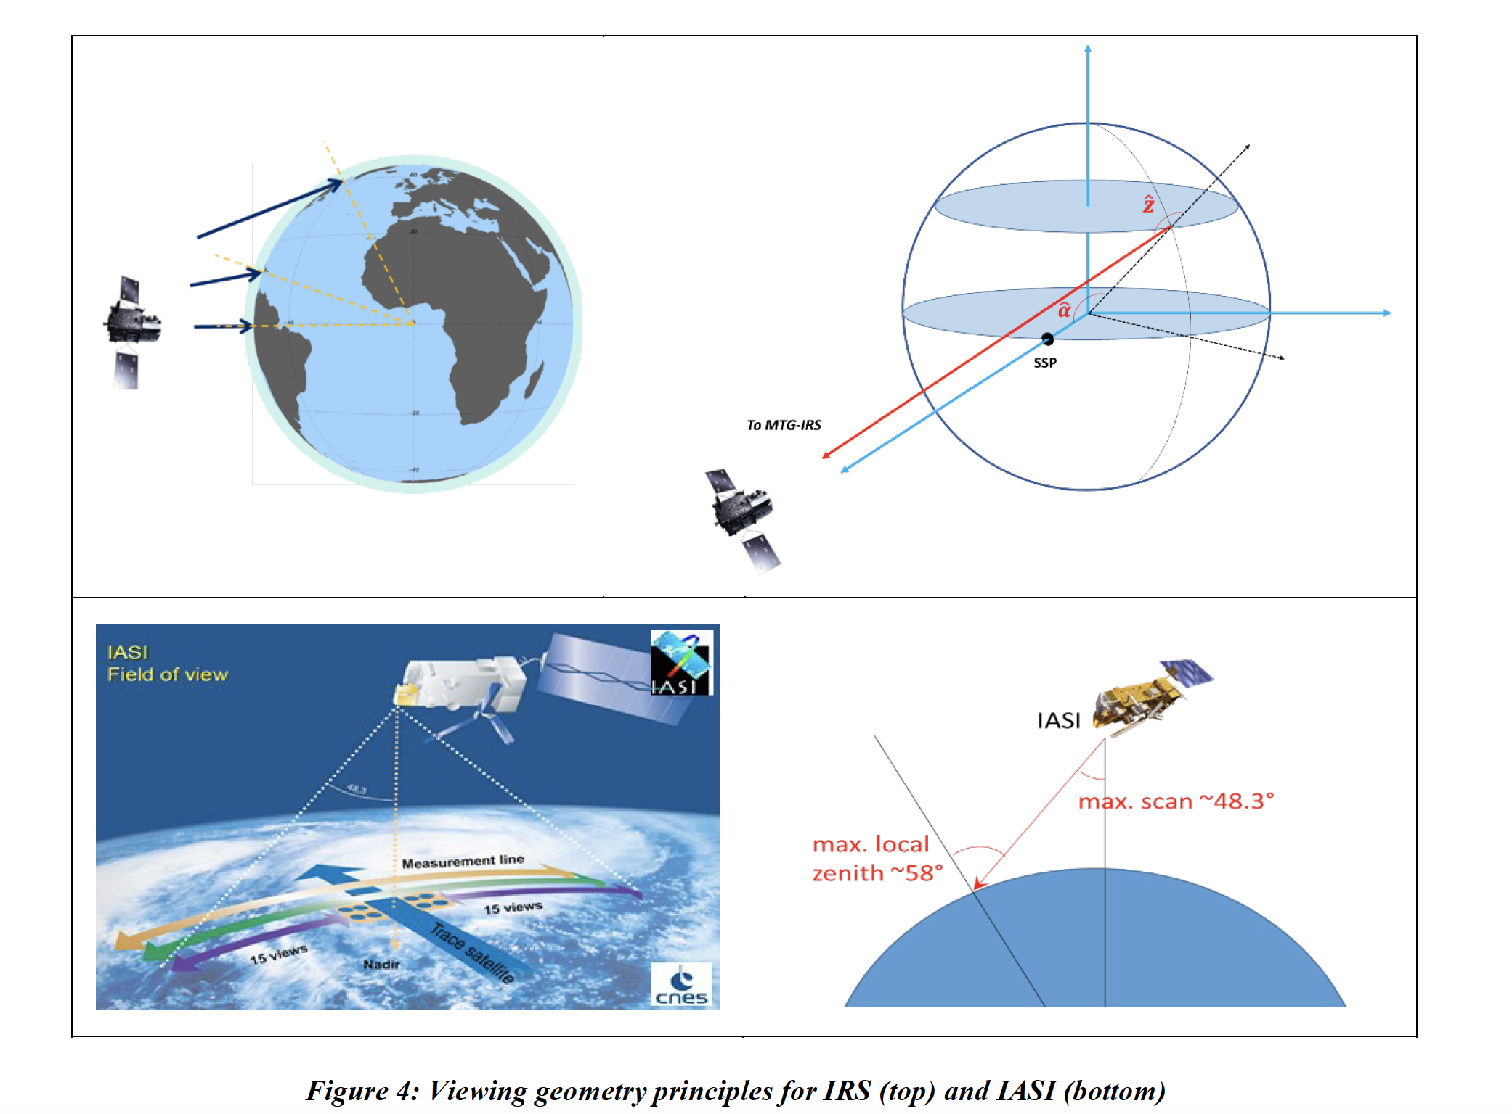

Slide 7
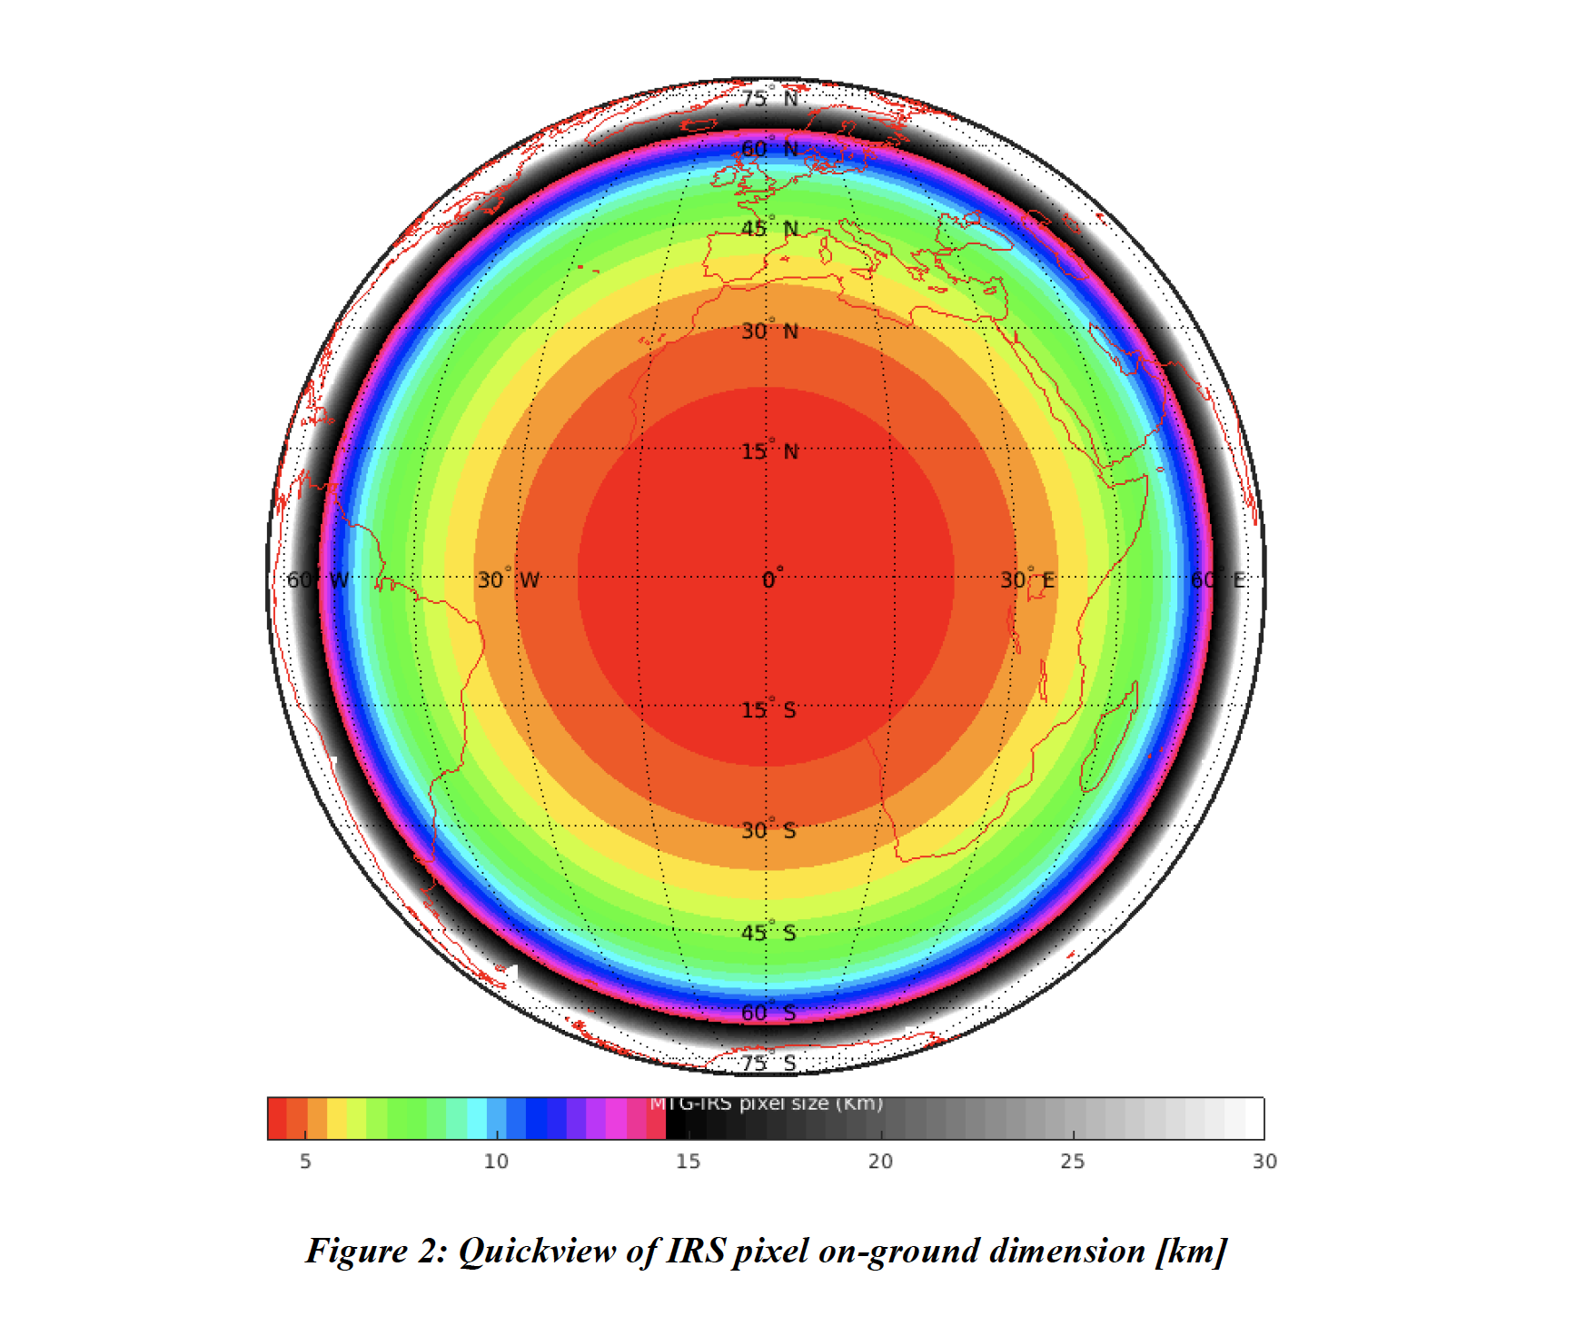

Slide 8
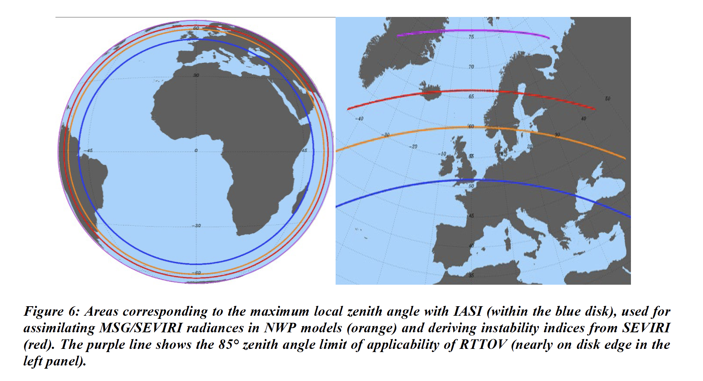

Slide 9
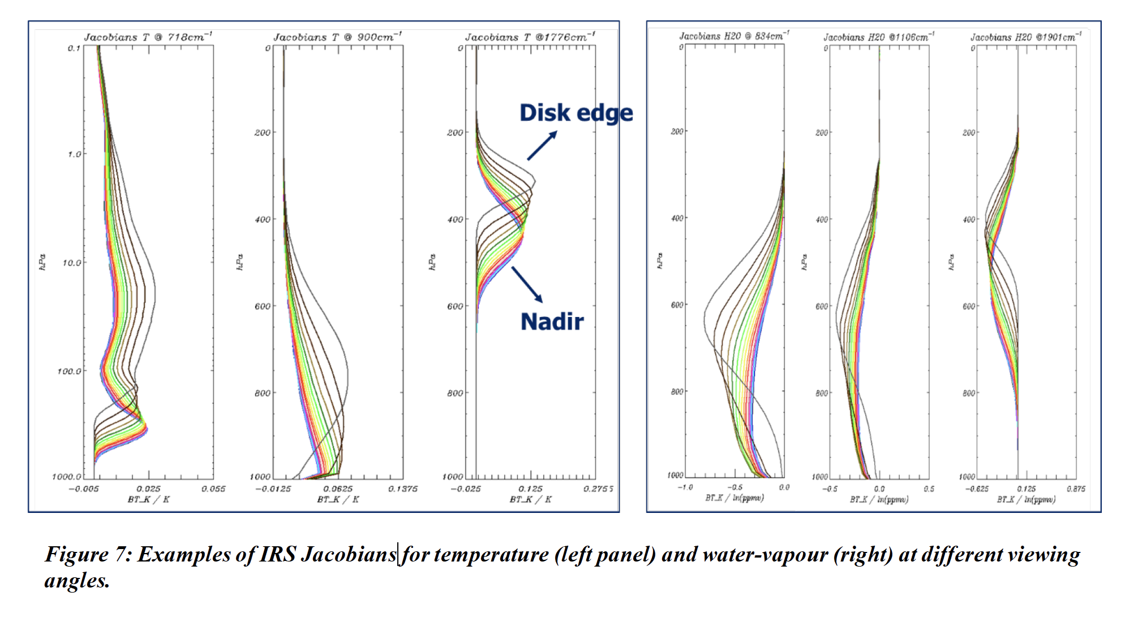

Slide 10
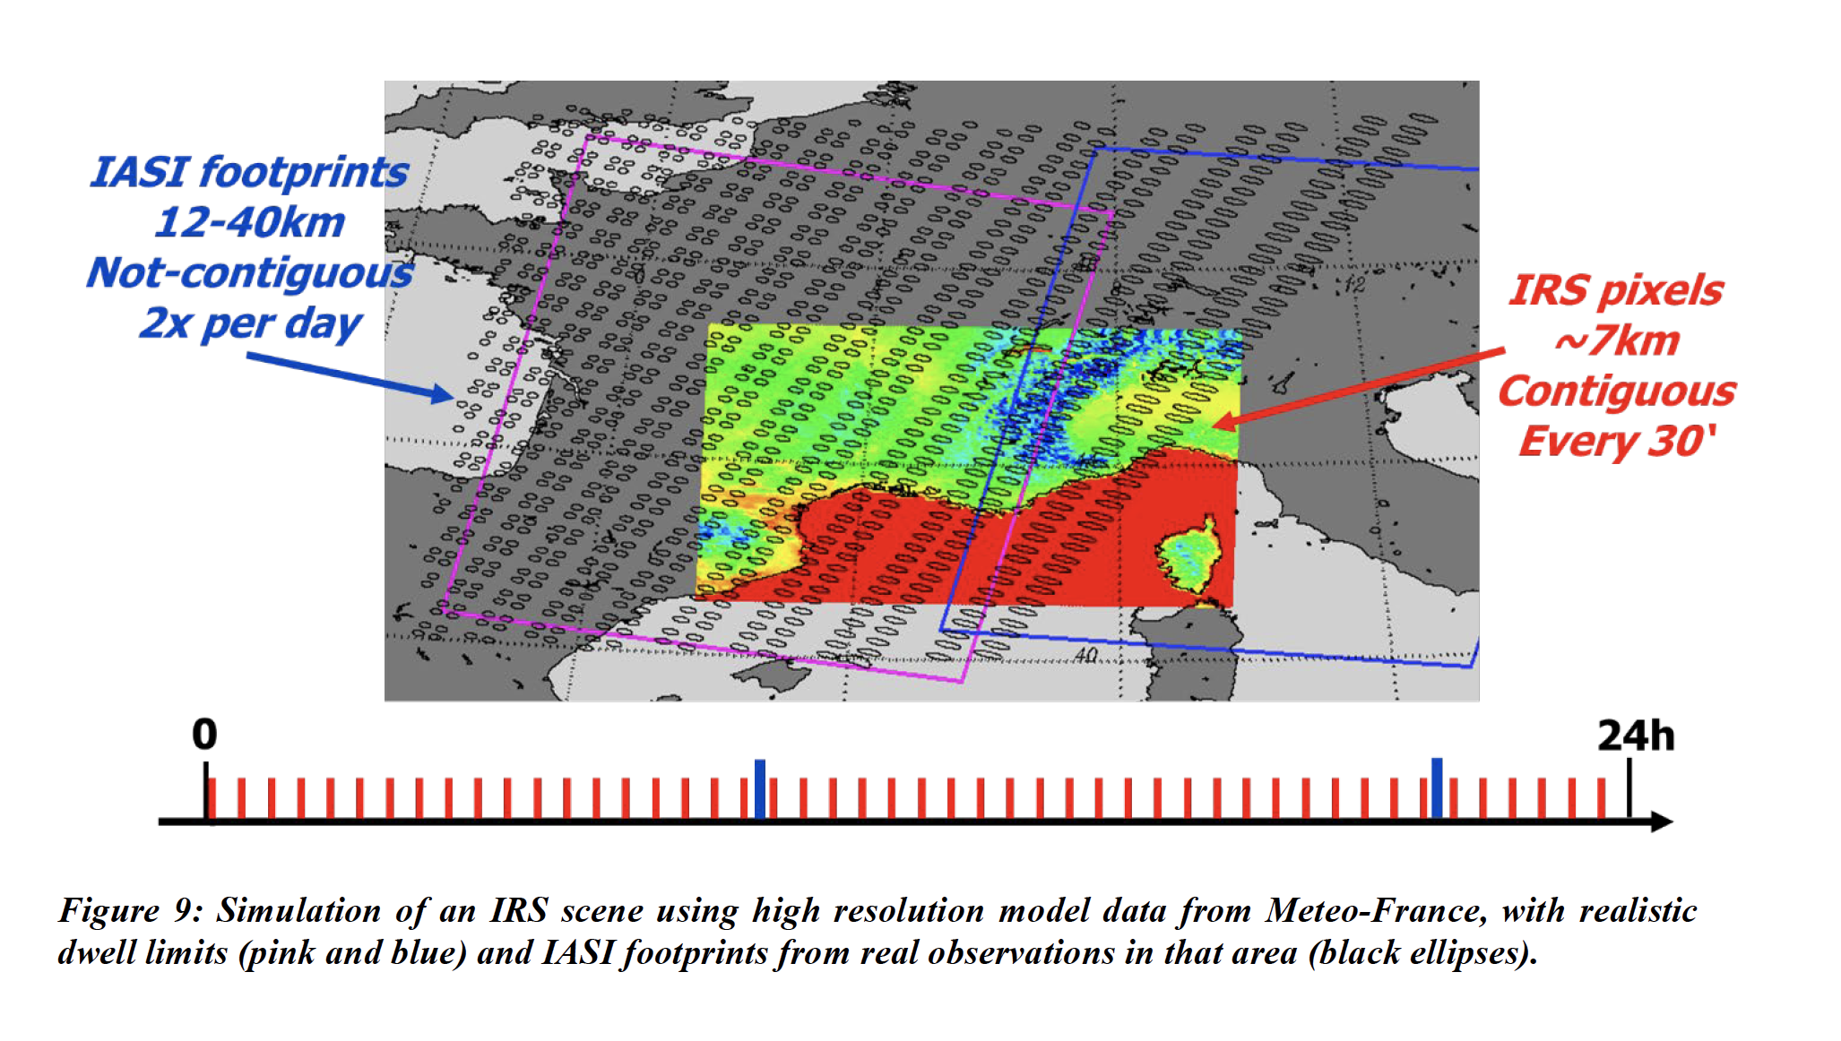

Slide 11
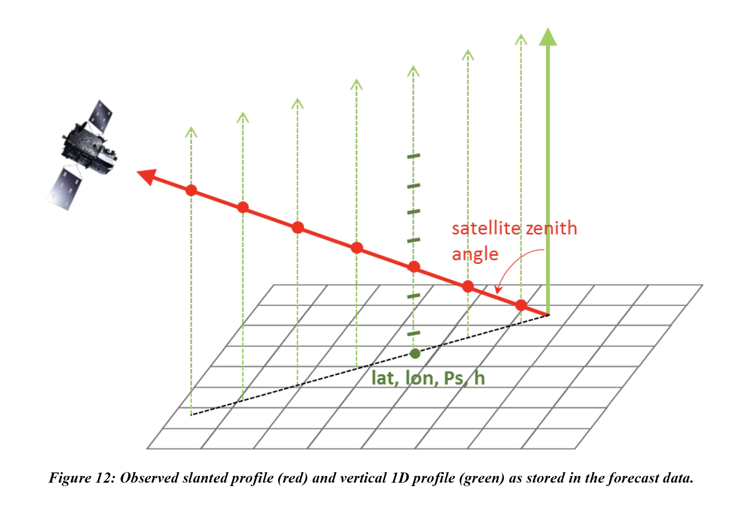

Slide 12
https://sounding.trainhub.eumetsat.int

