Slide 1
Novel FCI solar WV absorption
channels NIR1.3
(and NIR0.9)
Ivan Smiljanic
Training and Satellite Application Expert EUMETSAT Training Team

Slide 2
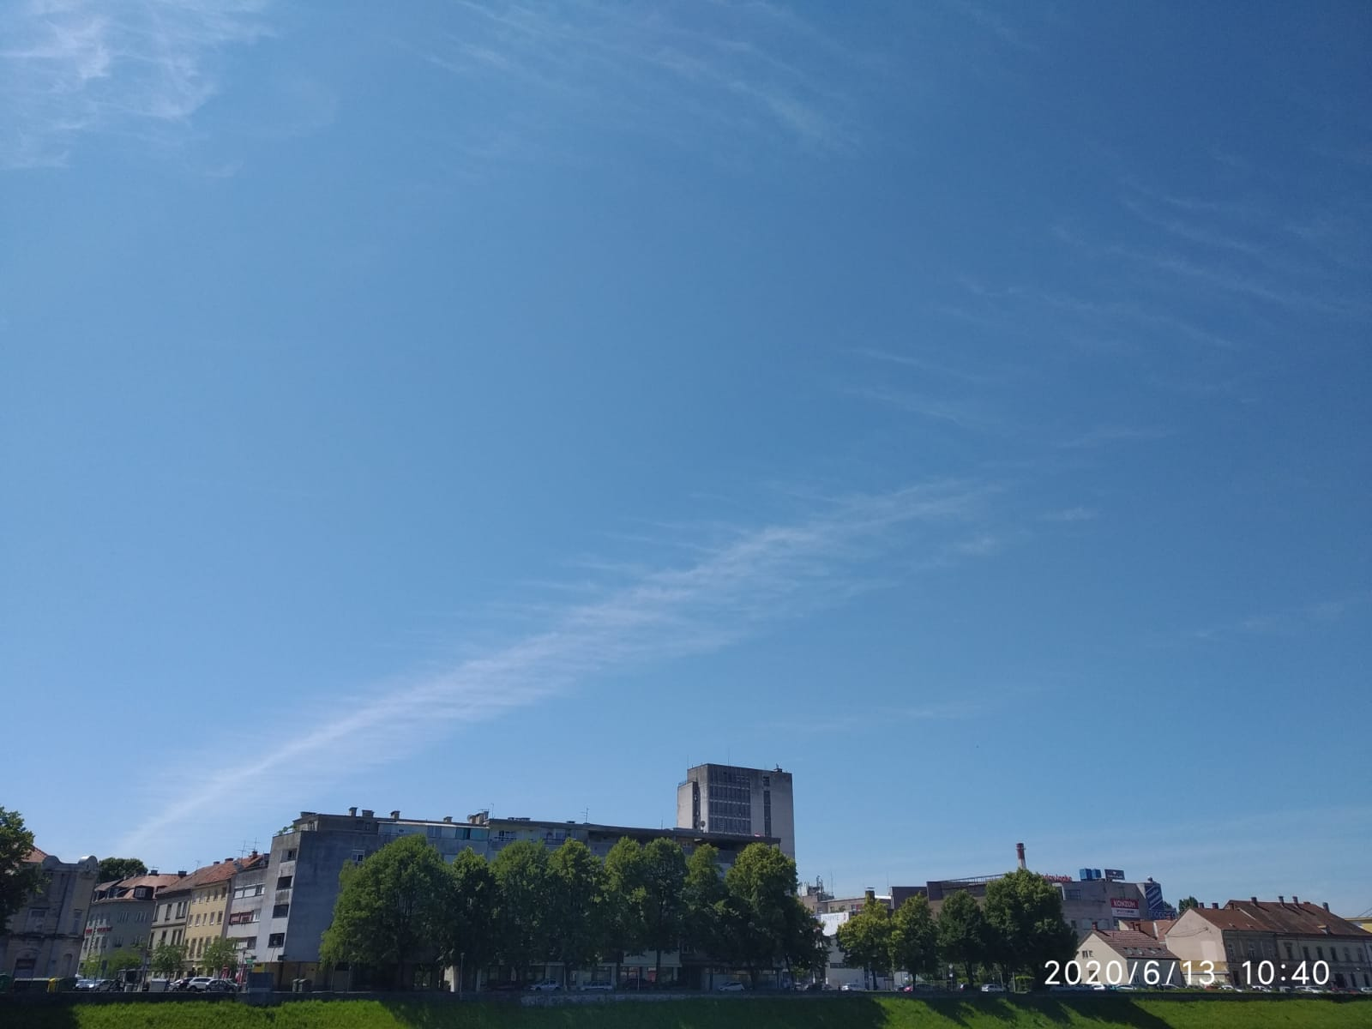
CLOUDS in the atmosphere

Slide 3
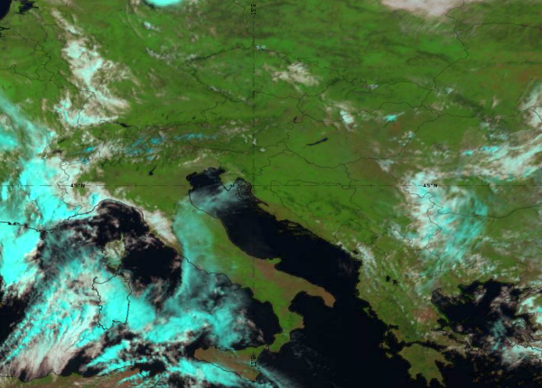
CLOUDS in the atmosphere

Slide 4
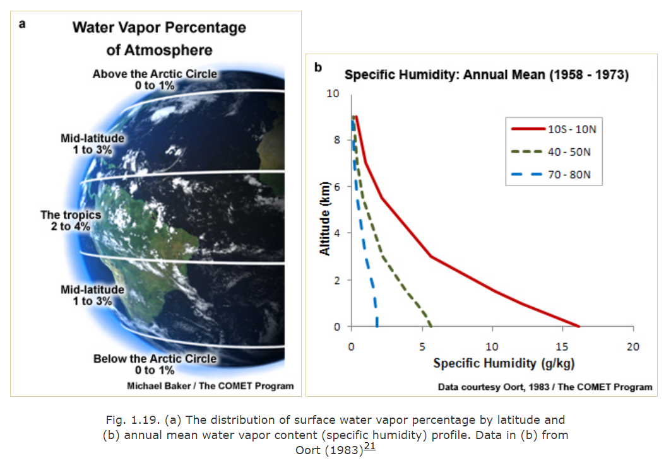
MOISTURE in the atmosphere
Credit: COMET Program

Slide 5
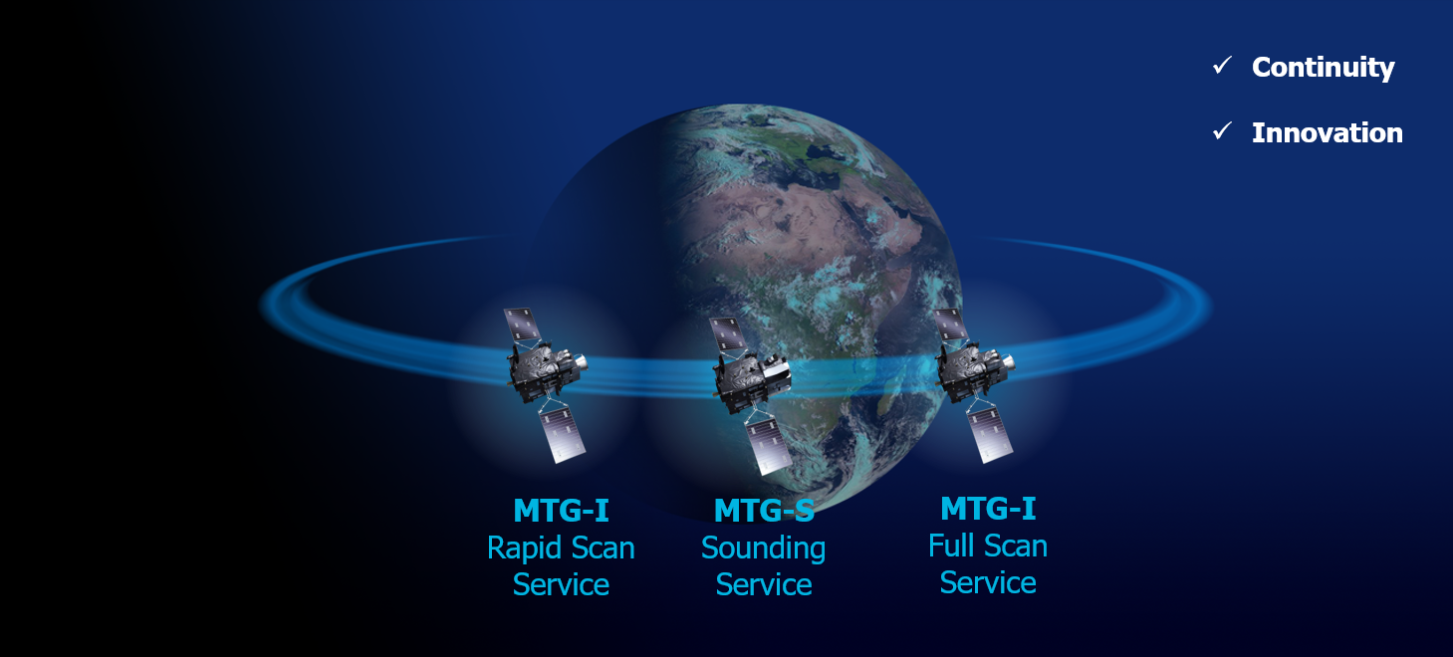
MTG vs MSG (FCI vs SEVIRI)
MTG mission
Continuity
Innovation

Slide 6
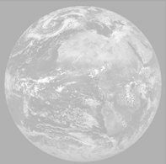
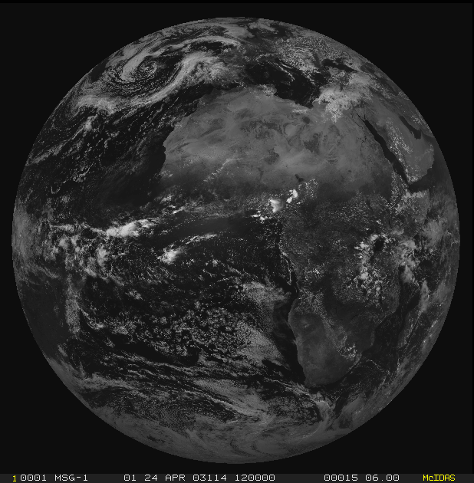
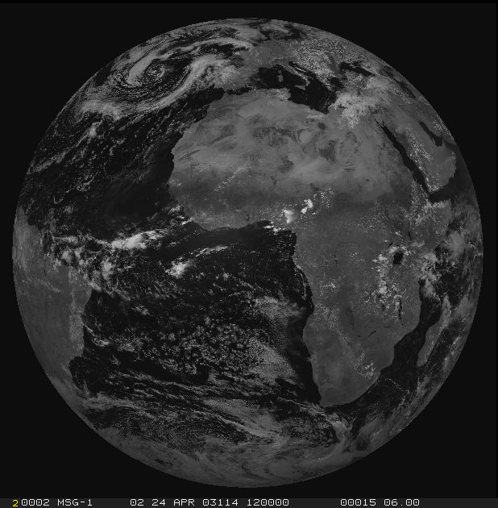
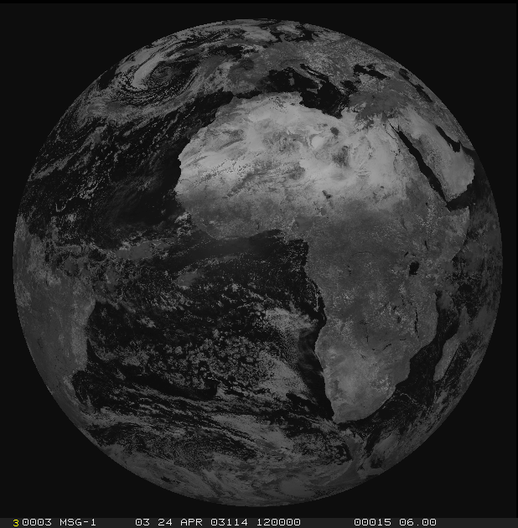
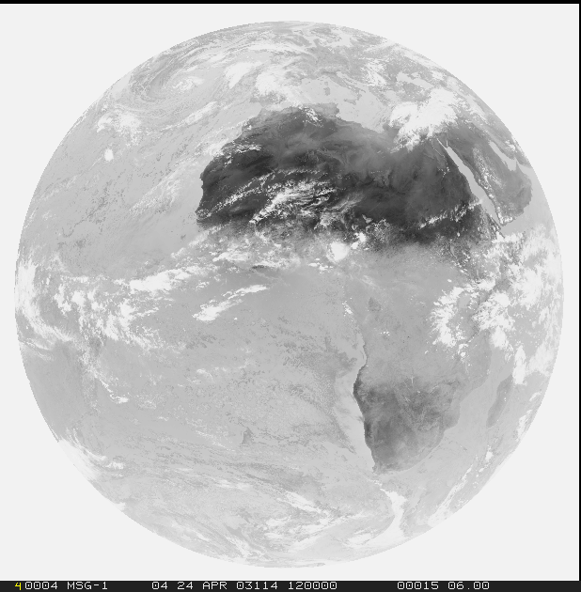
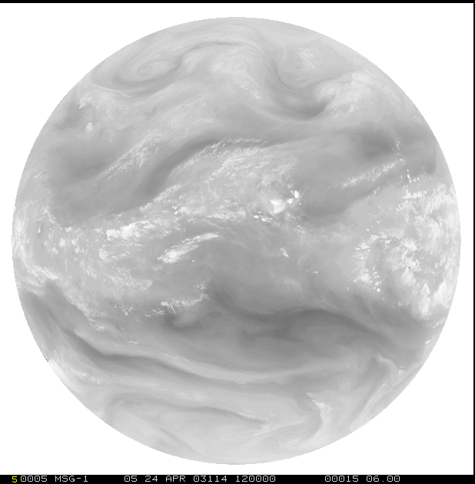
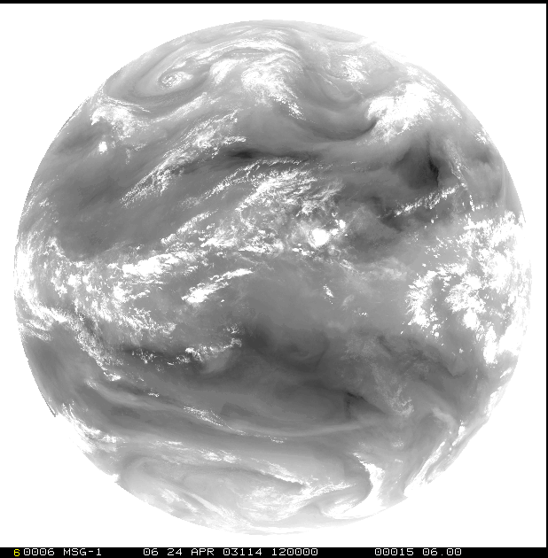
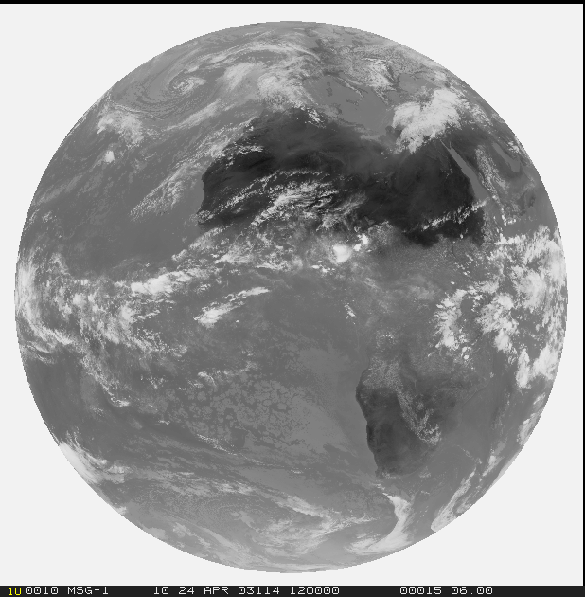
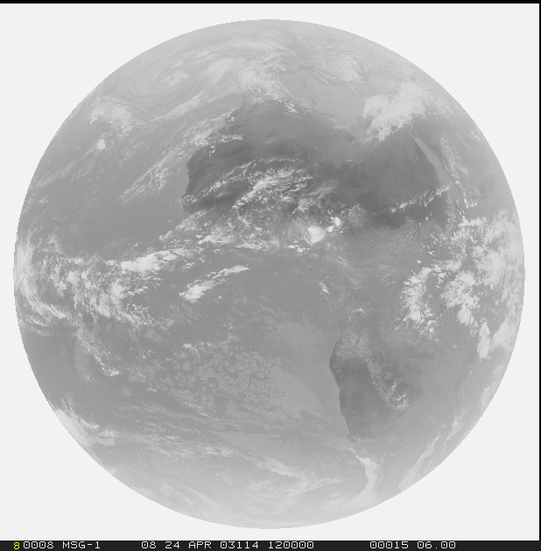
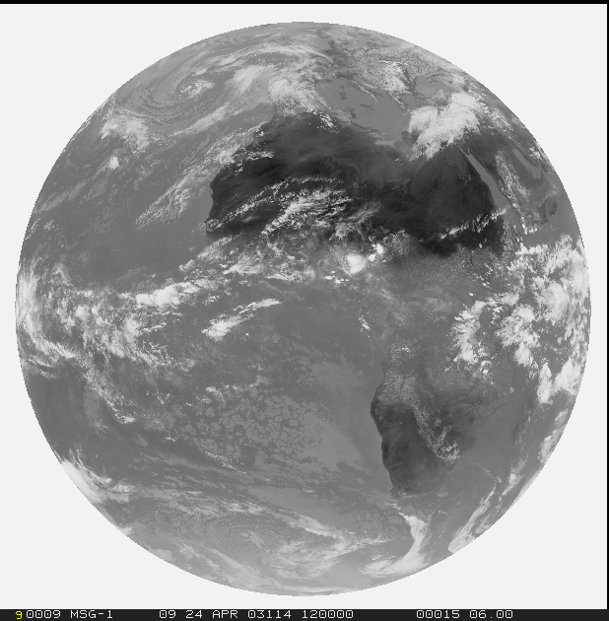
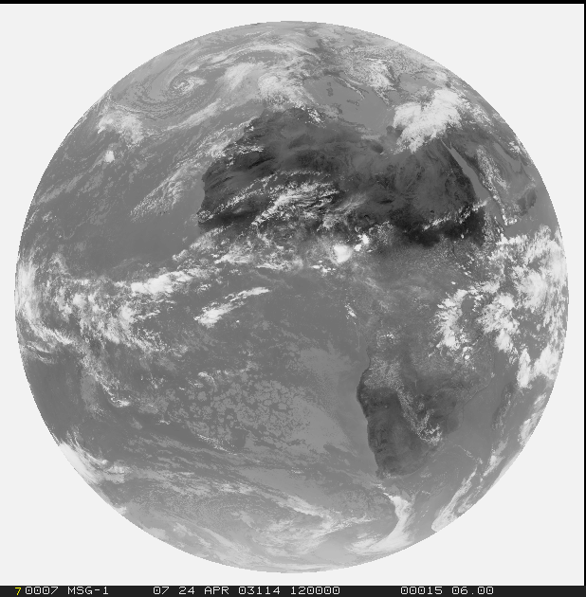
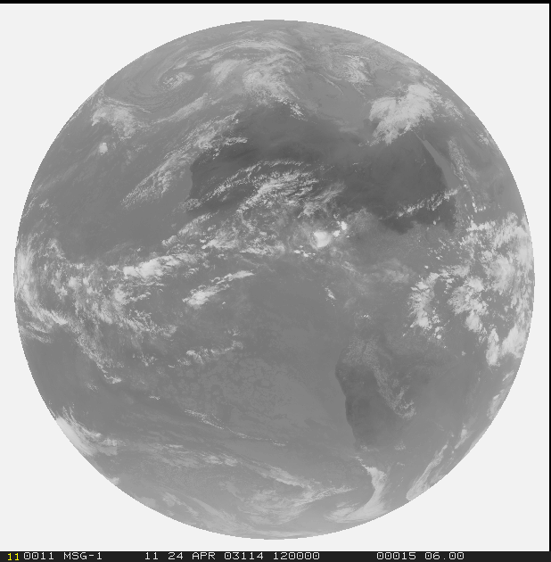
FCI vs SEVIRI
1=VIS0.4
2=VIS0.5
3=VIS0.6
4=VIS0.8
5=NIR0.9
6=NIR1.3
Solar
1.0 km (0.5 km)
Thermal
2.0 km (1.0 km)
7=NIR1.6
8=NIR2.25
9=IR3.8
10=WV6.2
11=WV7.3
12=IR8.7
13=IR9.7
14=IR10.5
15=IR12.3
16=IR13.3

Slide 7
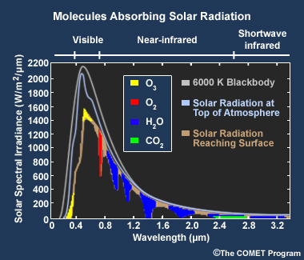
WV absorption (solar region)
910 nm
1375 nm

Slide 8
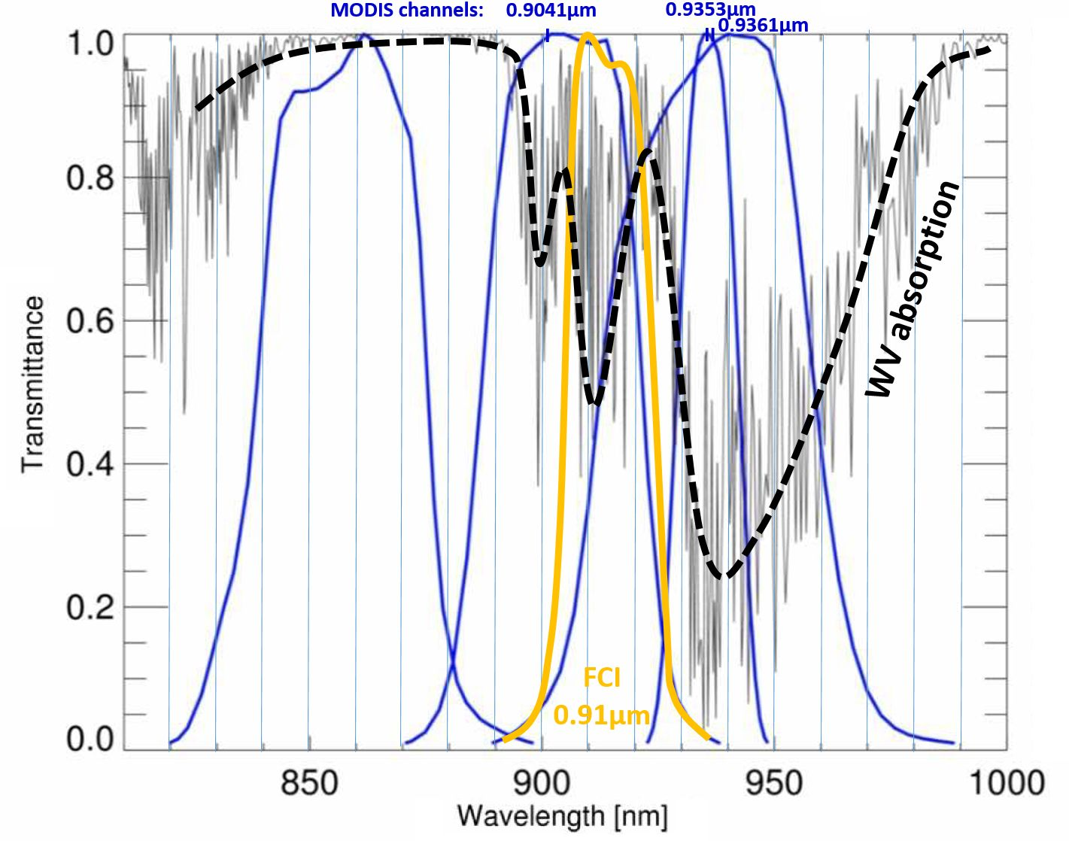
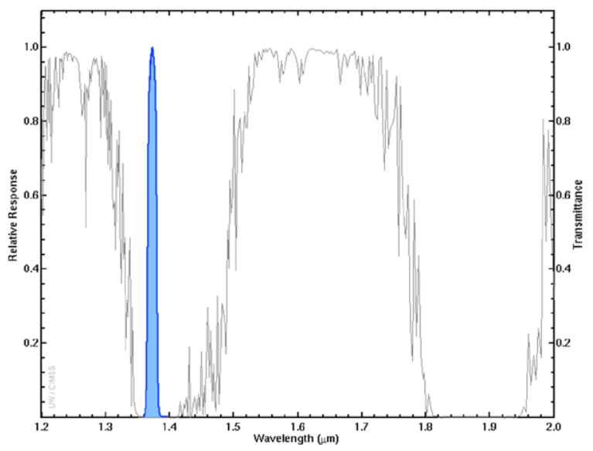
WV absorption (solar region)
910 nm
1375 nm

Slide 9
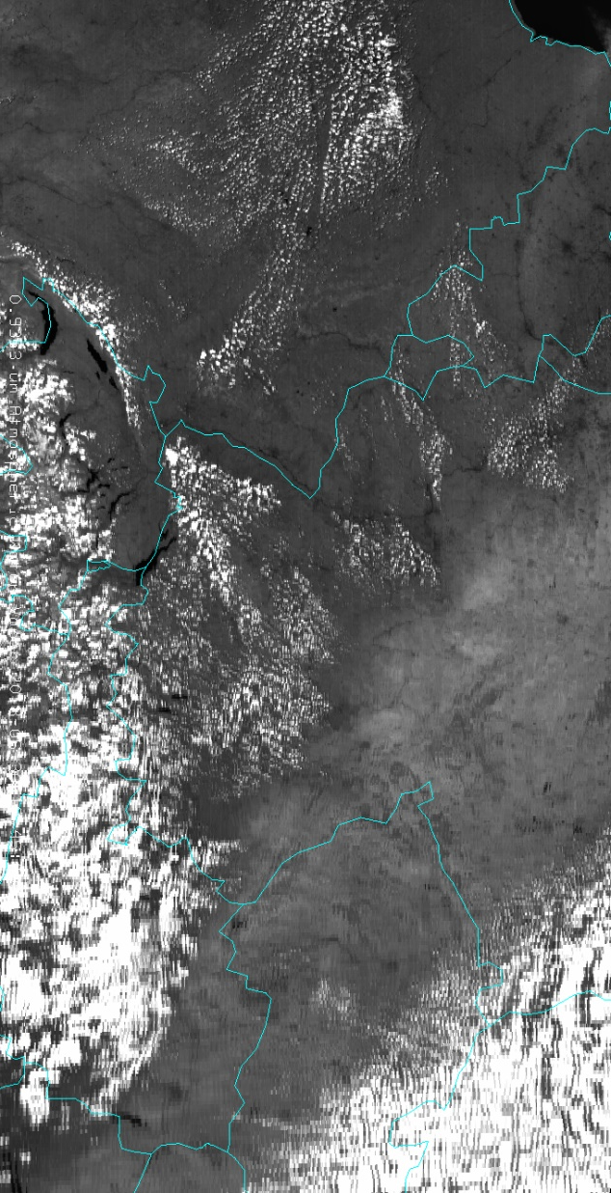
WV Absorption: what does it mean in NIR0.9 region?
Aqua MODIS 0.935 µm single channel
100
100
100
38
32
16
DRY Atmosphere
WET Atmosphere
WET Atmosphere
98
40
96
36
96
18
94
92
92
44
40
20
88
80
80
Reflectivity = 50%
Reflectivity = 50%
Reflectivity = 25%

Slide 10
WV Absorption: what does it mean in NIR1.3 region?
Cloud-free
1-path T=0
NO SIGNAL
Low Cloud
2-path T=0
NO SIGNAL
High Cloud
2-path T>0
SIGNAL!
100
100
100
8
80
00
80
10
High cloud, R=25%
30
30
10
Low cloud, R=33%
00
Sfc Reflectivity = 50%
Sfc Reflectivity = 50%
Sfc Reflectivity = 50%
1
Transmission
0
1
Transmission
0
1
Transmission
0

Slide 11
1.38 μm: If we see a cloud, what can we say about it?
… maybe not so much(?), except that it must be high
Brighter
Darker
Darker
Brighter
Darker
Brighter
0 hPa
Same cloud; same height
Different atmosphere
Same cloud; same height
same atmosphere; different view angle
Same cloud;
Different heights
Moist atmosphere
Limb View
Dry atmosphere
Nadir View
1000 hPa
1
Transmission
0
1
Transmission
0
1
Transmission
0

Slide 12
1.38 μm compared to 0.9 μm
Darker
Brighter
0 hPa
1.38 μm photons
do not get to here and
back because they are
absorbed by H₂O
molecules
Some 0.9 μm photons
get to here and
back because they are
scattered by cloud
particles
1000 hPa
Transmission
1
Transmission
0
1
0

Slide 13
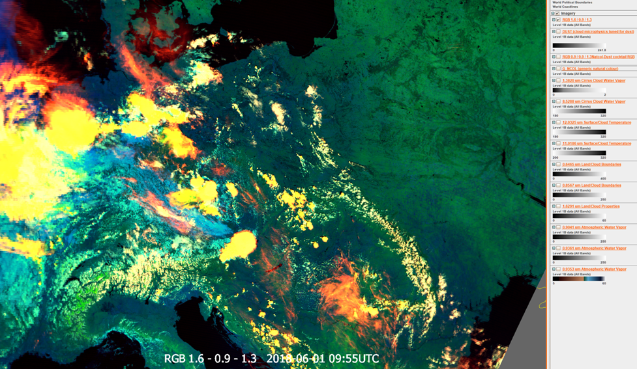
NIR0.9 imagery examples
RGB: NIR1.38 (0-3%) - NIR0.9353 (lower end) - NIR1.64
‘LL moisture’ RGB
  Similarity with Cloud Type RGB
thin cirrus
ice clouds
water clouds
thin cirrus
VIIRS Cloud Phase 20170622, Germany

Slide 14
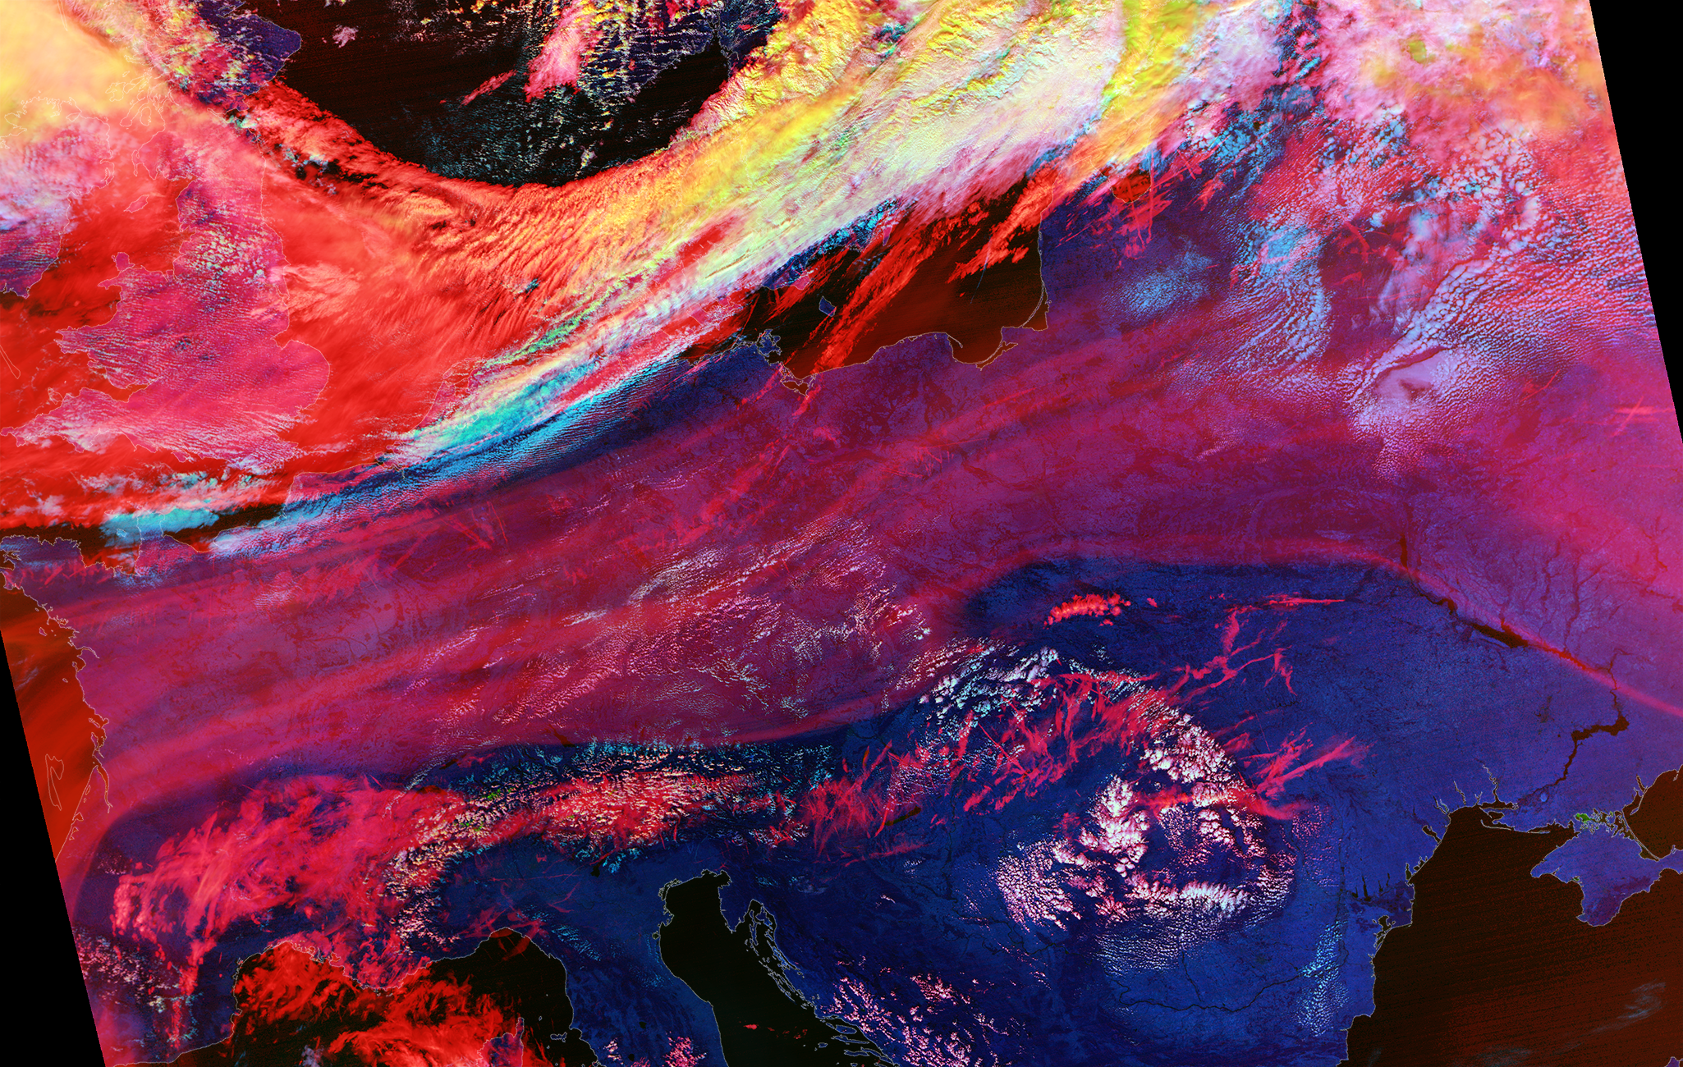
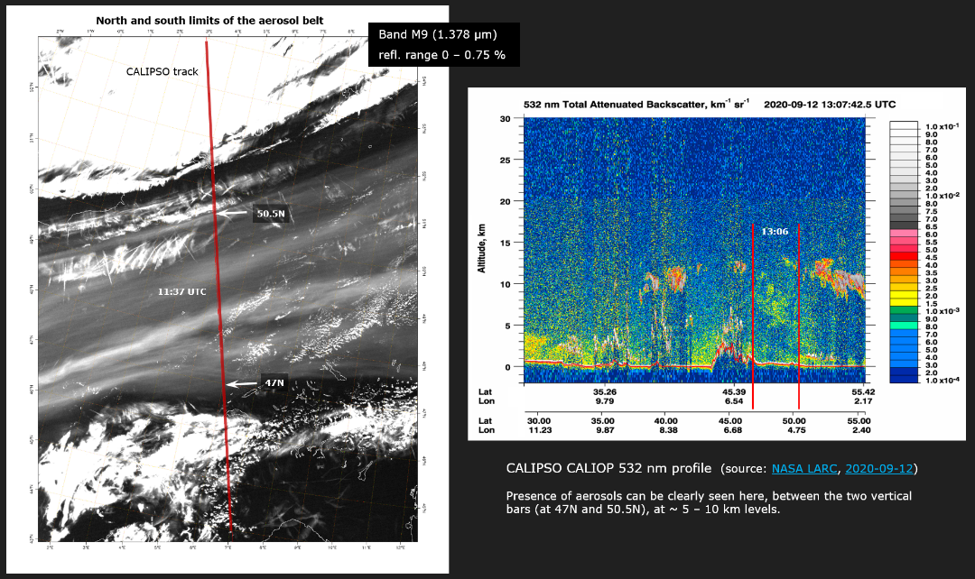
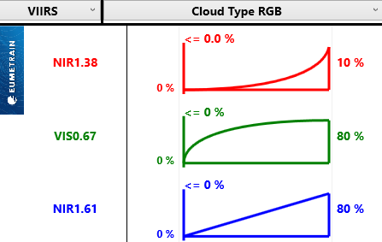
NIR1.3 imagery examples
Aerosols
  High thin smoke
VIIRS Cloud Phase 20170622, Germany
https://www.eumetsat.int/smoke-california-fires-above-europe-noaa20

Slide 15
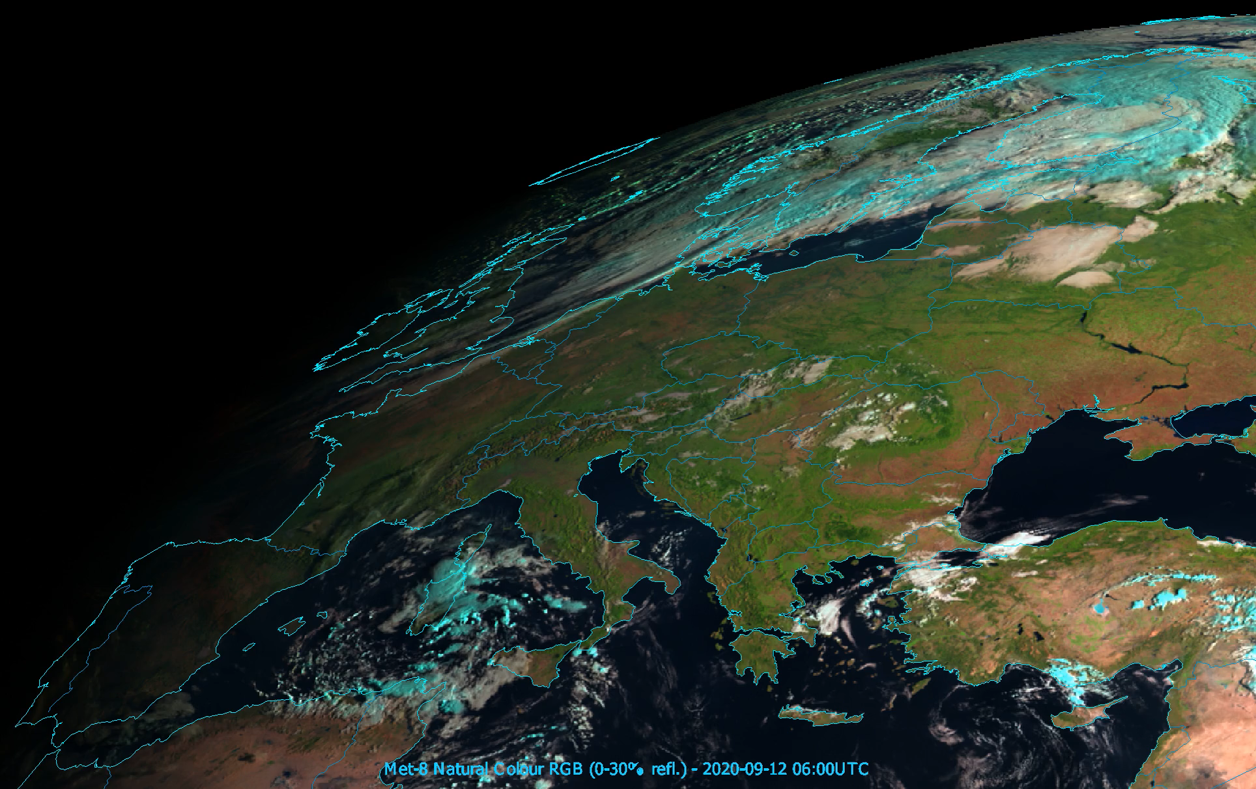
NIR1.3 imagery examples
Aerosols
  High thin smoke
  Hard to detect with SEVIRI
VIIRS Cloud Phase 20170622, Germany
https://www.eumetsat.int/smoke-california-fires-above-europe-noaa20

Slide 16
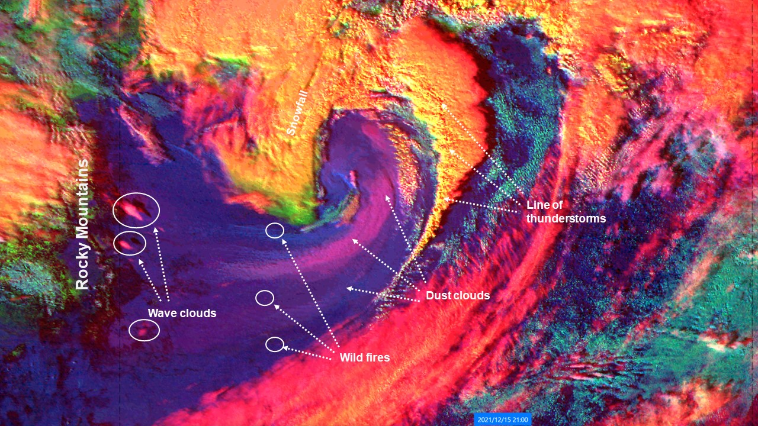
Cloud Type RGB / MTG expected ‘novel’ RGBs
Aerosols
  Dust
    Height
    Thickness
GOES-16 ABI Cloud Type RGB, 15 December 2021
https://www.eumetsat.int/variety-severe-weather-events-hit-parts-us

Slide 17
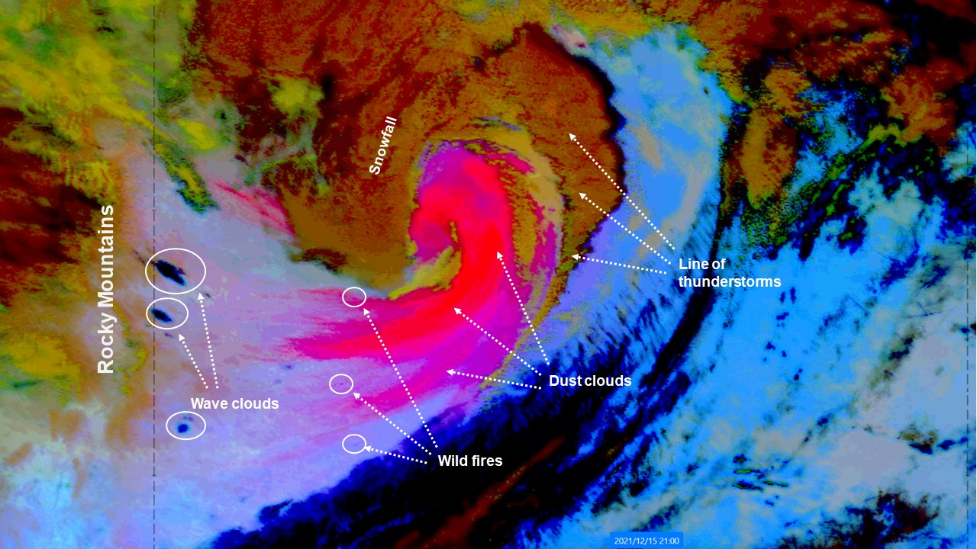
Cloud Type RGB / MTG expected ‘novel’ RGBs
Aerosols
  Dust
    Height
    Thickness
GOES-16 ABI Dust RGB, 15 December 2021
https://www.eumetsat.int/variety-severe-weather-events-hit-parts-us

Slide 18
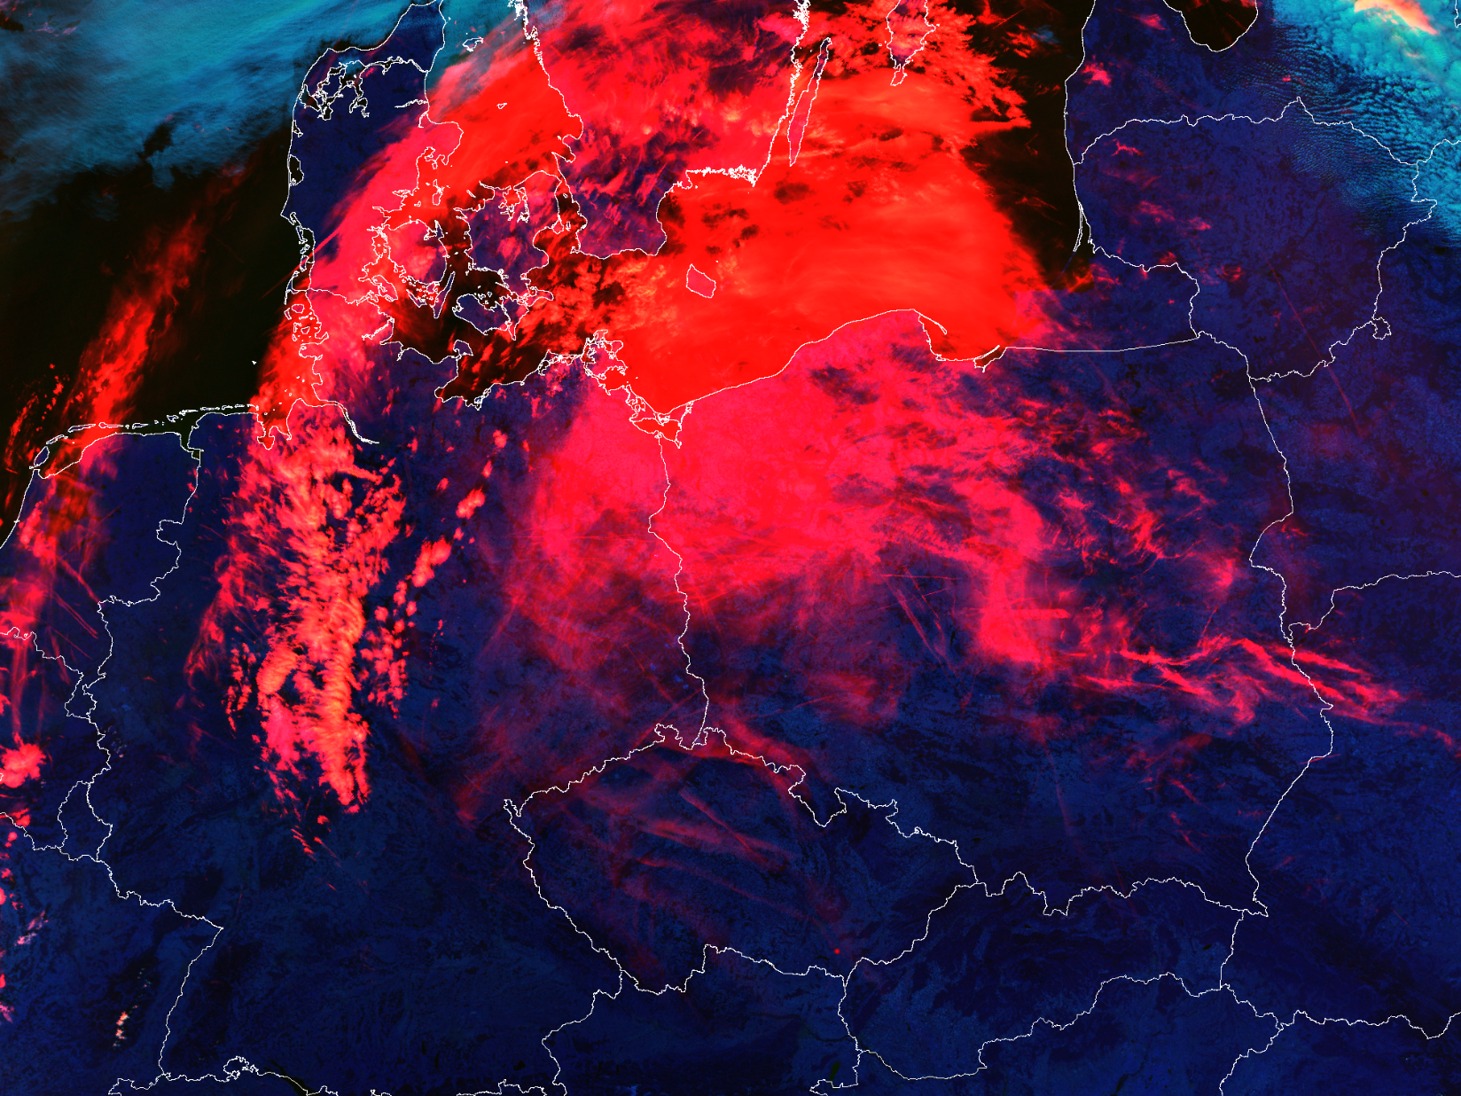
Cloud Type RGB / MTG expected ‘novel’ RGBs
Clouds
  Thin cirrus
SNPP VIIRS, Cloud Type RGB, 15 September 2020, 11:32 UTC
VIIRS Cloud Phase 20170622, Germany
https://portal.eumetnet.eu/display/CWG/Martin+Setvak%3A+1.38+micron+bands+-+aerosols%2C+ash+and+dust

Slide 19
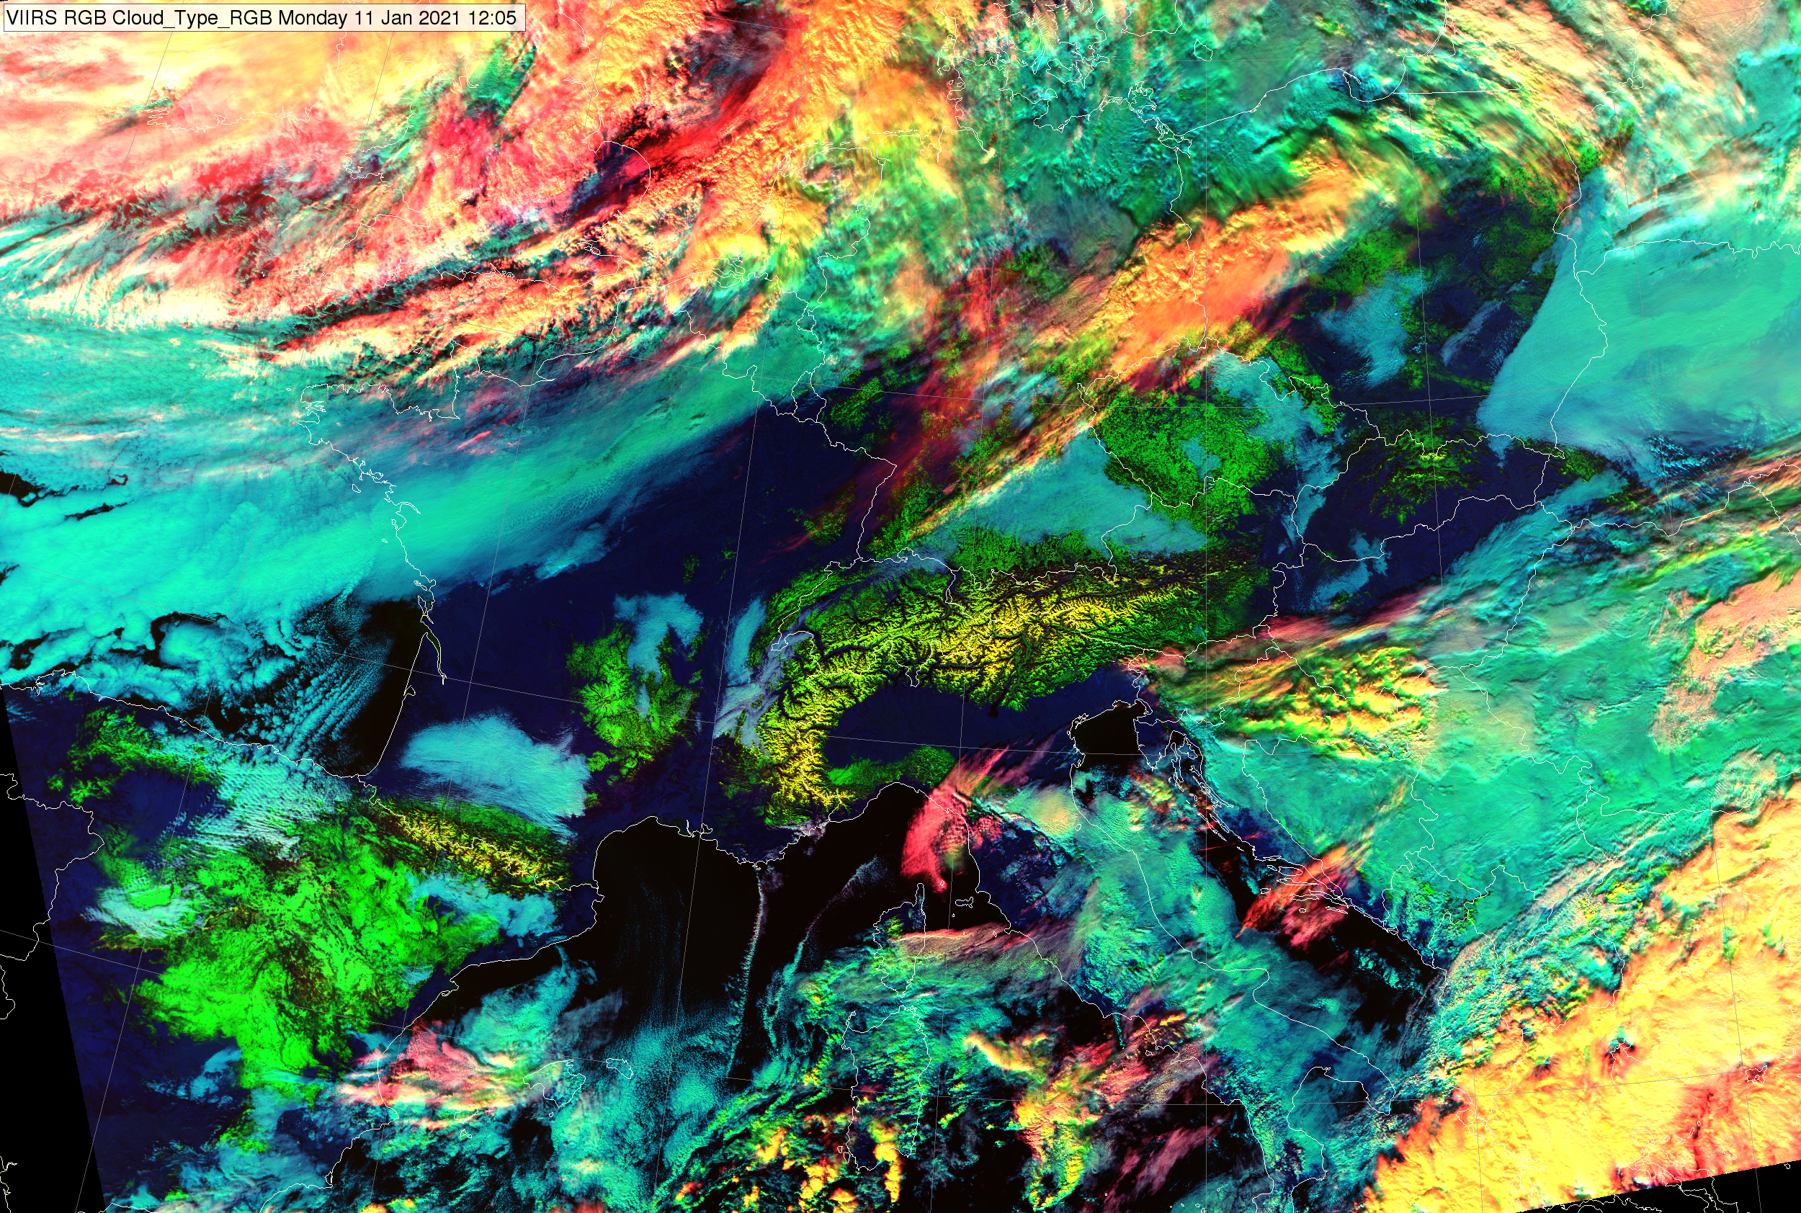
Cloud Type RGB / MTG expected ‘novel’ RGBs
Clouds
  Phase
  Height
  Thickness
Snow/Ice
VIIRS Cloud Phase 20170622, Germany
https://www.eumetsat.int/heavy-snow-in-spain

Slide 20
Summary
Near Infra-Red (1.37 µm) ‘Cirrus’ channel
Detection of very thin cirrus clouds during the day
Strong water vapor absorption spectral region (see the image on the right)
Does not routinely sense the lower troposphere, where there is substantial water vapor
Provides excellent daytime sensitivity to high, very thin cirrus under most circumstances, especially in warm, moist atmospheres
Correction for the presence of contrail and thin cirrus
It can be used to distinguish between low and high clouds or other bright objects and high clouds
Useful in detecting other upper-level features
Under certain conditions can also detect smoke and ash plumes

Slide 21
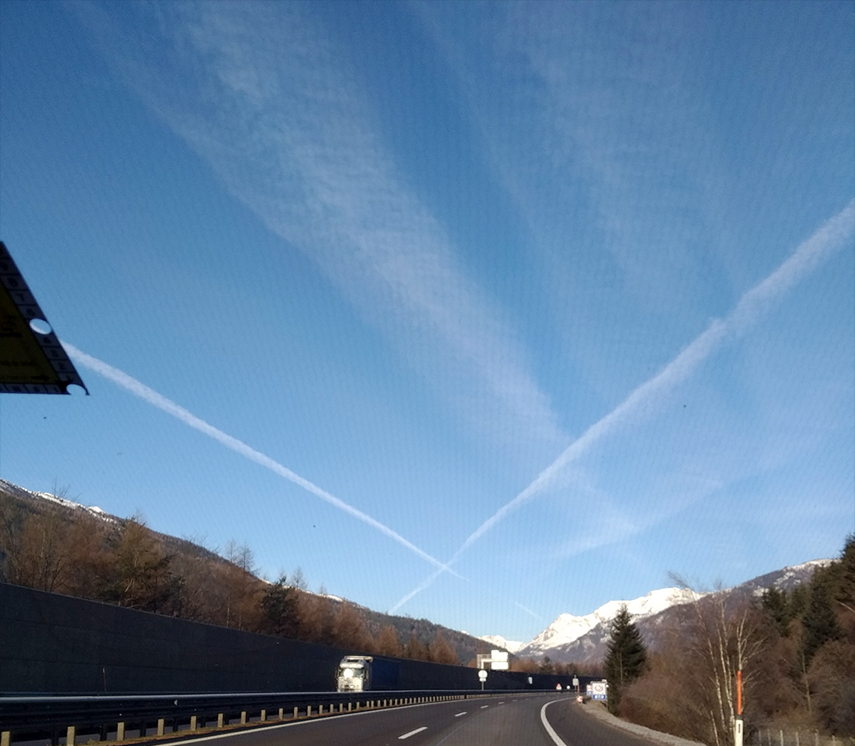
Shukran!

