Slide 1


Slide 2
From data to information
Prof. Ralf Bennartz
SSEC, University of Wisconsin – Madison
EES, Vanderbilt University

Slide 3
Outline
What we want to know and why we need it?
What does a satellite really observe?
How do we reconcile observations with what we already know?
Recap: What is important?

Slide 4
What do we want to know?
Weather forecasting? What data is needed for NWP model initialization (assimilation)?
Source: Kelly and Thepaut, 2007 ECMWF Newsletter 113

Slide 5
Why are satellite data important for forecasts?
Forecast skill strongly dependent on satellite data
E.g. Southern hemisphere: Day 3-4 forecasts now as good as Day 1 forecasts without satellite data.
Source: Kelly and Thepaut, 2007 ECMWF Newsletter 113

Slide 6
What does a satellite observe?
Detects number of photons per exposure time at a given wavelength (or wvl range)traveling from viewing direction into detector
No. of photons, direction, per time → RADIANCE

Slide 7
Imagine you are climatologist and,
together with an ocean biologist, a physicist, and a statistician
you are drifting on a boat somewhere on the ocean.

Slide 8
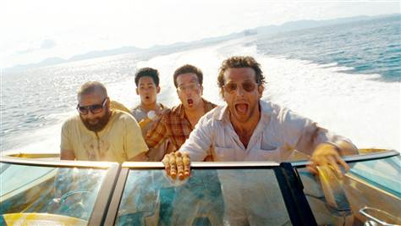
The scene looks like that…..
And, you have no idea where you are

Slide 9
Luckily you have your sea surface temperature climatology with you

Slide 10
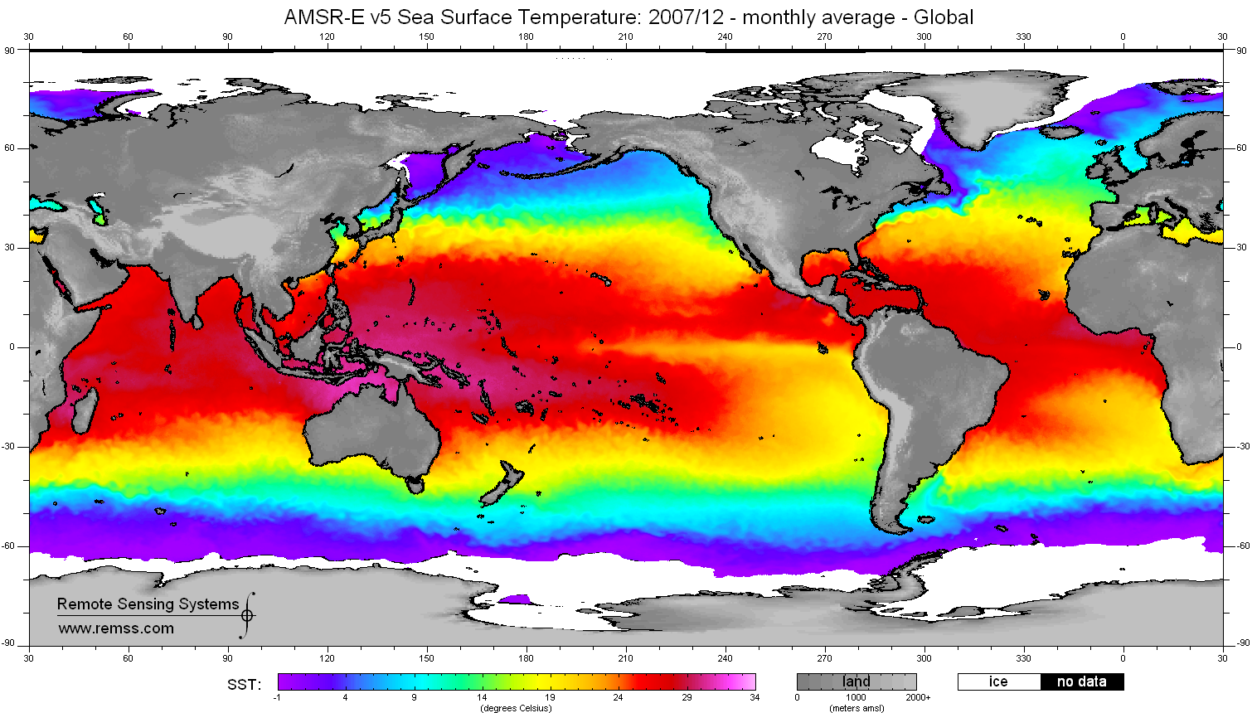

Slide 11
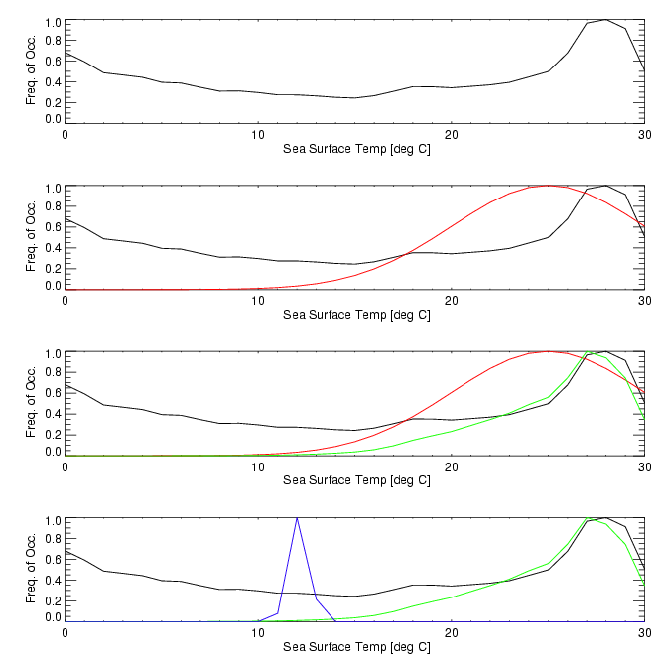

Slide 12
What would be your best estimate of the temperature of the water given this information and the climatological information above?
Get help from your statistician friend

Slide 13
Maximum Likelihood Estimate
Minimum Variance Estimate

Slide 14
Now, your ocean biologist friend observes a certain very sensible fish species.
He knows this fish species only lives in water with a temperature of 25±1 deg C.
What would be your best estimate of the temperature of the water given this information and the climatological information above?

Slide 15
This is your a-priori knowledge

Slide 16
This is your a-priori knowledge
The red curve is your observation (what you know from seeing the fish)

Slide 17
This is your a-priori knowledge
The red curve is your observation (what you know from seeing the fish)
The green curve is your a-posteriori knowledge

Slide 18
It turns out your physicist friend has a thermometer with him….
… but of course he forgot to tell anyone.
The thermometer now tells you that the SST is only 12 ±0.5 deg C
How does your estimate of the ocean temperature change?

Slide 19
This is your a-priori knowledge
The red curve is your observation (what you know from seeing the fish)
Fish and climatology only
The blue curve gives you the a-posteriori from climatology, fish and, thermometer

Slide 20
Now let’s hand it over to the statistician friend
What we applied here is called Bayes’ rule after 18th century British mathematician Thomas Bayes (modified by Pierre-Simon Laplace).
It provides a powerful mathematical framework to evaluate hypotheses given different (and potentially conflicting) pieces of information.

Slide 21
Meteorological Data Assimilation
Uses the same principle, that is you need:
A forecast model (that constitutes your background knowledge)
Observations + uncertainties
DA will now integrate model + observations to generate a best guess of the atmospheric state.
This is called analysis and is used to re-initialze the forecast

Slide 22
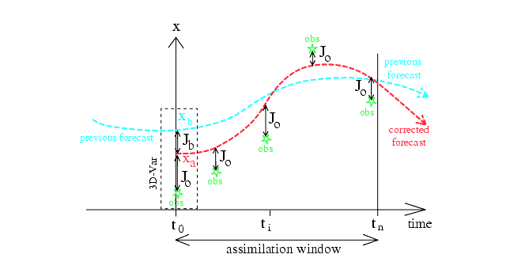
Meteorological Data Assimilation
From ECMWF

Slide 23
Meteorological Data Assimilation
DA systems are very complex because of the sheer amount of observational data

Slide 24
What do we want to know?
Weather forecasting? What data is needed for NWP model initialization (assimilation)?
Source: Kelly and Thepaut, 2007 ECMWF Newsletter 113

Slide 25
Recap
Bayes’ theorem provides a method to formally include different pieces of information and weight them according to their uncertainty
Meteorological data assimilation is based on this methodology.

