Slide 1
Cloud microphysics
- phase and particle size
Natasa Strelec Mahovic
EUMETSAT
Summer School, Bracciano, 2025
Notes:
Title slide template 1 of 2 with presentation title/information on the left. Please choose between slide 1 or 2 for the title slide and delete the other.

Slide 2
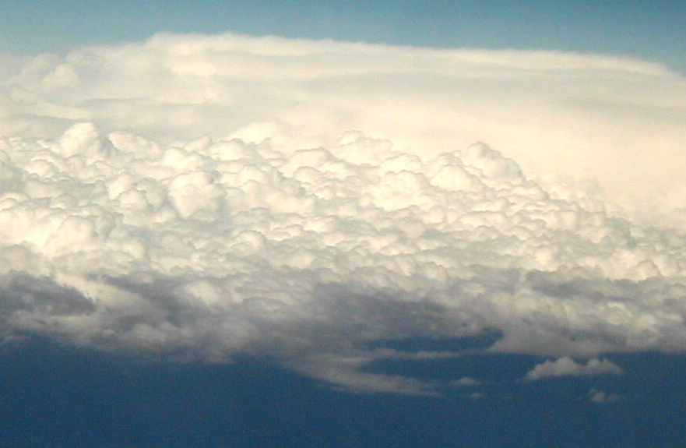
Ice
Mixed phase
Water
Photo: Daniel Rosenfeld

Slide 3
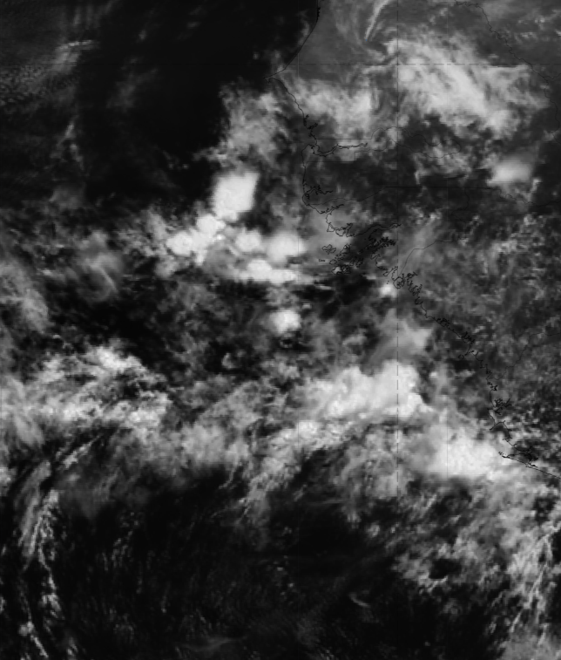
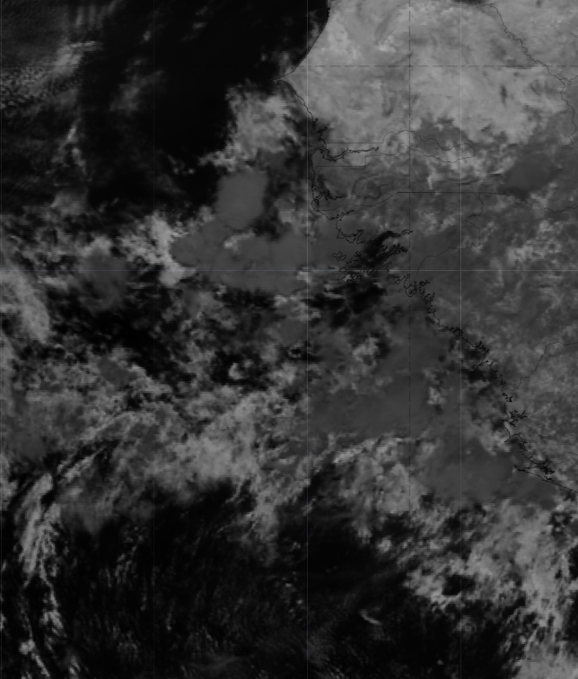
What difference do you see?

Slide 4
What difference do you see?
ICE CLOUD
ICE CLOUD
WATER CLOUD
WATER CLOUD

Slide 5
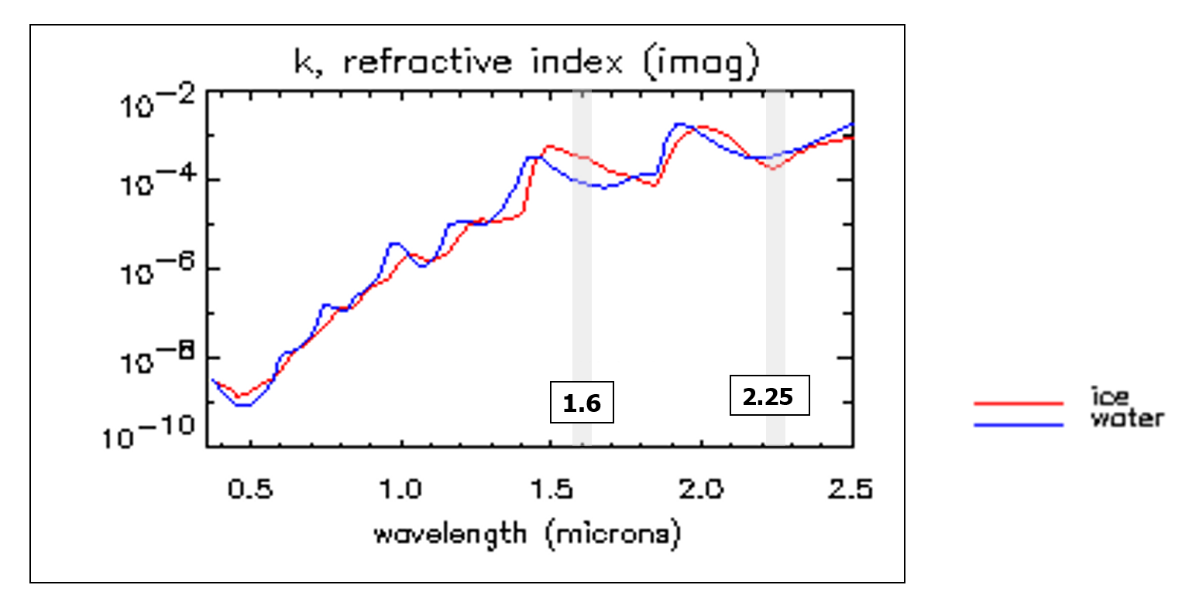
1.6 and 2.25 micron channels
Different reflectivity of ice and water!
Ice absorbs more in 1.6 micron – ice clouds are dark!
1.6 micron channel used in MSG RGBs to differentiate cloud phase.
Notes:
The most important property of 1.6 micron channel is different reflectivity from ice and water. As you can see here in the graph ice absorbs to the order of magnitude more radiation than water in 1.6 micron channel therefore ice clouds and snow are dark, they reflect much less, whereas water clouds are bright, although not as bright as in 0.6. So, 1.6 enables distinction of cloud phase. Therefore 1.6 micron channel is used in RGB combinations that aim to distinguish cloud types or cloud microphysics based on the information of cloud phase. In 2.25 absorption of ice ice weaker than at 1.6, wheras the absorption of water is stronger at 2.25 than at 1.6

Slide 6
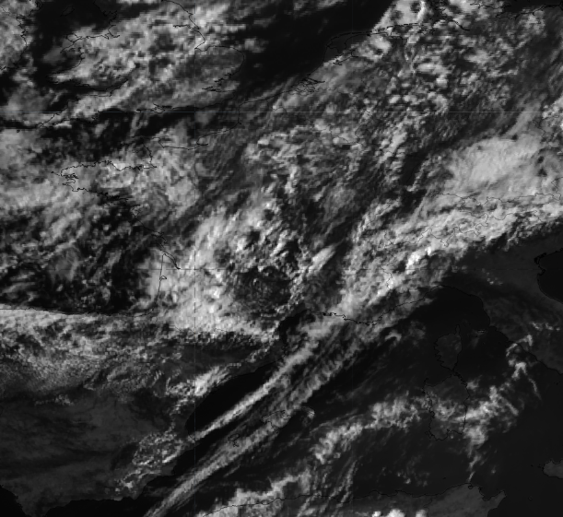
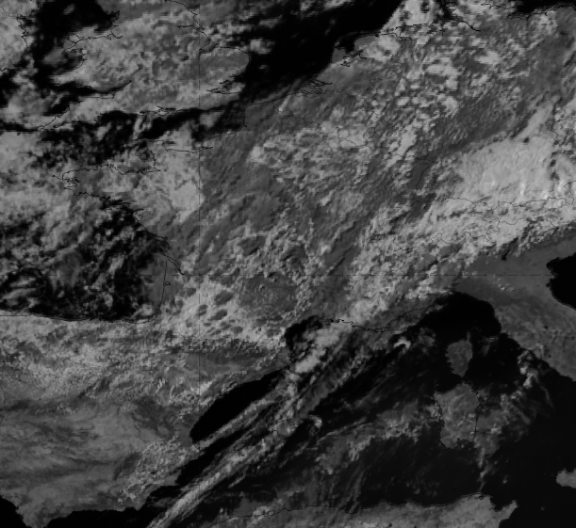
0.6 vs 1.6 micron
Notes:
you can see that left is 0.6 and right 1.6 – it can be seen by the dark shades of the convective cloud tops in the circle. Since ice absorbs much more in the 1.6 than water, ice clouds are dark in 1.6 !!

Slide 7
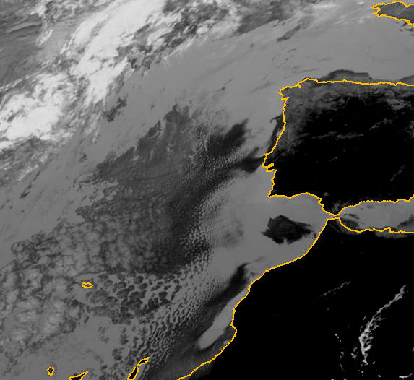
3.9 micron
Due to the high reflection from water droplets at IR3.9, low-level water clouds are much darker than high-level ice clouds (during day-time)
MSG-1, 7 July 2003, 11:00 UTC, Channel IR3.9

Slide 8
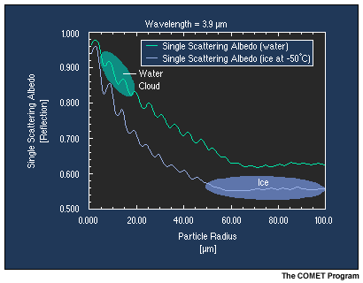
3.9 micron channel
Reflectivity in IR3.9 – depends on cloud phase but even more on particle size of cloud droplets (ice crystals)
water droplets reflect more than ice crystals!
smaller particles reflect more than bigger ones!

Slide 9
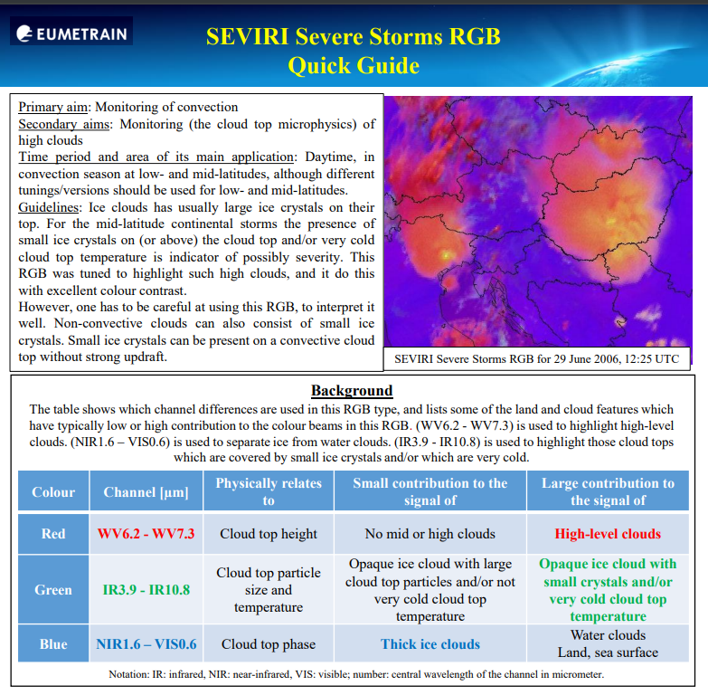
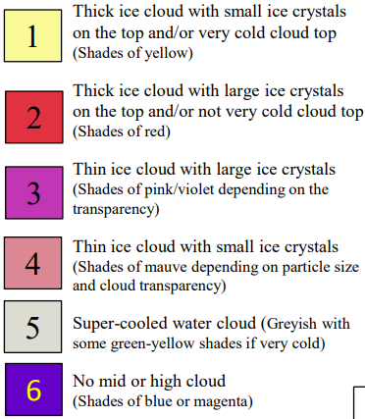
Severe Storms RGB - MSG RGB that uses both 3.9 and 1.6 micron channels information
Notes:
Both 1.6 and 3.9 micron channel are used in convection RGB to help distinguish ice on top of clouds and ice clouds with small ice particles – a signal of strong updraft or a very cold storm top

Slide 10
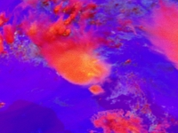
Severe Storms RGB
29 June 2006, 12:00 UTC

Slide 11
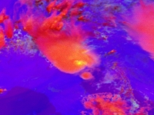
Small ice (high IR3.9r of 6-7%)
Long-living storm system
Convective outflow boundary
Overshooting tops
Gravity waves
Radial Ci
Severe Storms RGB
29 June 2006, 12:15 UTC
12:15 UTC
(animation 2/7)

Slide 12
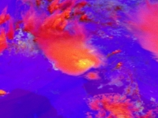
Severe Storms RGB
29 June 2006, 12:30 UTC

Slide 13
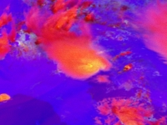
Severe Storms RGB
29 June 2006, 12:45 UTC

Slide 14
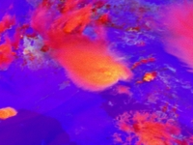
Severe Storms RGB
29 June 2006, 13:00 UTC

Slide 15
2.25 micron channels
The difference between ice and water absorption is less at NIR2.25 than at NIR1.6.
The absorption of water is stronger at NIR2.25 than at NIR1.6.
The absorption of ice is weaker at NIR2.25 than at NIR1.6
Notes:
The most important property of 1.6 micron channel is different reflectivity from ice and water. As you can see here in the graph ice absorbs to the order of magnitude more radiation than water in 1.6 micron channel therefore ice clouds and snow are dark, they reflect much less, whereas water clouds are bright, although not as bright as in 0.6. So, 1.6 enables distinction of cloud phase. Therefore 1.6 micron channel is used in RGB combinations that aim to distinguish cloud types or cloud microphysics based on the information of cloud phase. In 2.25 absorption of ice ice weaker than at 1.6, wheras the absorption of water is stronger at 2.25 than at 1.6

Slide 16
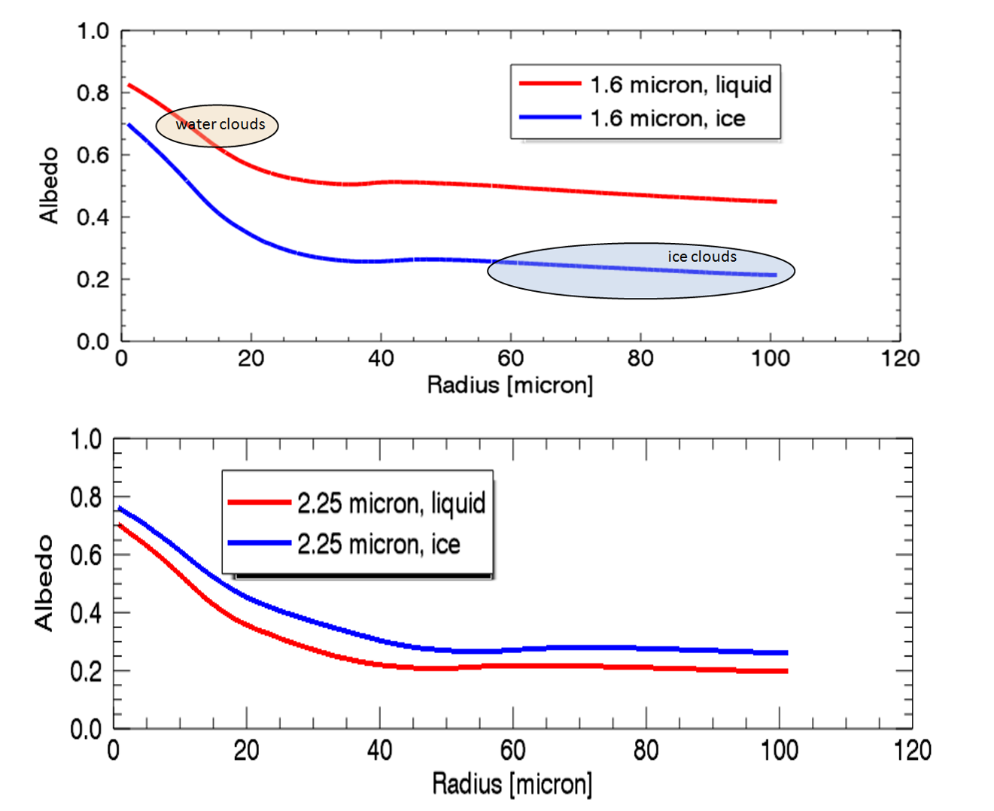
Albedo of ice and water clouds
NIR1.6 - good for separating opaque ice and water clouds due to the large difference between the water and ice cloud albedo curves and the typical particle size ranges.
ice clouds covered by small ice crystals and water clouds covered by large droplets can have similar albedo values.
NIR2.25 alone is NOT good for separating phase - it is good for separating opaque clouds with small and large particles.
The NIR2.25 albedo changes in a broader interval of cloud top particle sizes than the NIR1.6 albedo.
Notes:
Simulated albedo of opaque water and ice clouds as a function of the cloud top effective radius for 1.6 μm (top) and 2.25 μm (bottom). Typical range of cloud top particle size for water and ice clouds are indicated.
(Source: Ralf Bennartz, University of Wisconsin–Madison)

Slide 17
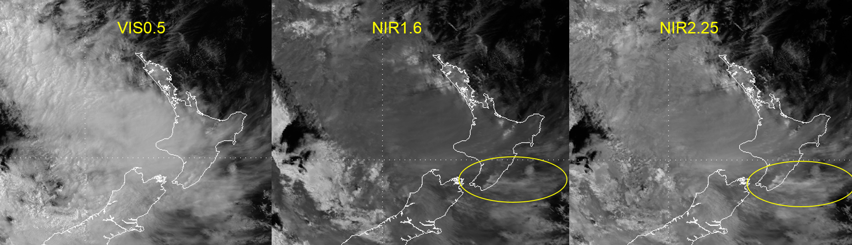
Himawari/AHI VIS0.5, NIR1.6 and NIR2.25 images over New Zealand. The encircled clouds are high-level lee clouds.
Notes:
an example over New Zealand. In the VIS0.5 channel all opaque clouds are bright. In the NIR1.6 image there are bright and medium grey clouds with rather good contrast between them. Ice clouds are darker than water clouds. However, the encircled clouds are ice clouds in spite the fact that they are rather bright. These are high-level lee clouds (cirrus clouds), which typically consist of very small ice crystals. In the NIR2.25 image there are less brightness contrasts within the cloudy area. The high-level lee clouds are bright.

Slide 18
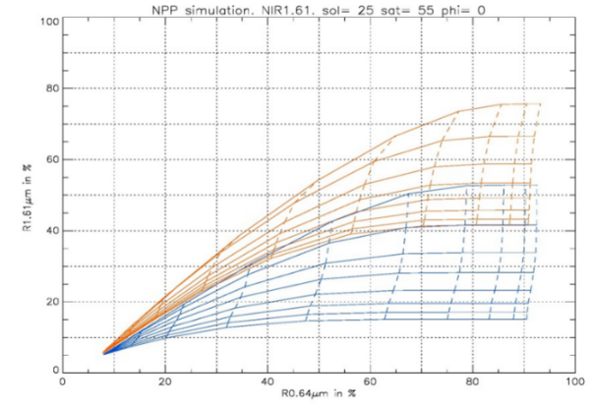
Simulated NIR1.6 and VIS0.64 reflectance pairs for water and ice clouds over sea.
water - orange
ice - blue, respectively.
(Source: G.Kerdraon et al., Meteo-France, NWCSAF)
Notes:
The image shows that NIR1.6 is usually good for separation opaque ice and water clouds (with some exceptions). Simulated VIIRS reflectance pairs (NIR1.6 and VIS0.64) for water and ice clouds over ocean are shown. The blue curves correspond to ice clouds, while the orange curve to water clouds. The simulated reflectance values depend on the optical depth (constant along the “vertical” curves), effective particle size (constant along the “horizontal” curves), angles, as well as on the characteristics of the background (in case of thin clouds). Such simulations are used at optical depth and particle size retrieval in case of SEVIRI data. As there is some overlap between the orange and blue curves one cannot always unequivocally retrieve cloud top phase (and hence particle size) using this channel pair.

Slide 19
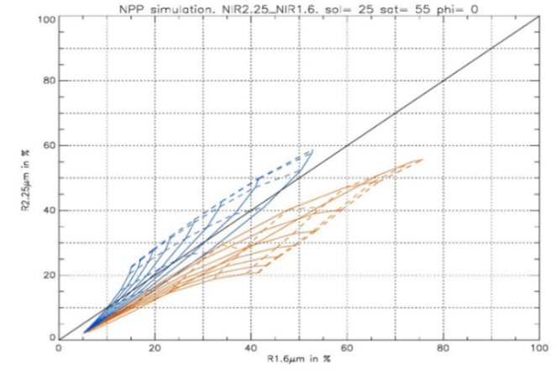
Simulated VIIRS NIR1.6 and NIR2.25 reflectance pairs for water and ice clouds over sea. (Source: G.Kerdraon et al., Meteo-France, NWCSAF)
Notes:
if we use the two microphysical channels (NIR1.6 and NIR2.25) together then we will have a more reliable, more perfect separation. That is why both microphysics channels are used in the Cloud Phase RGB.

Slide 20
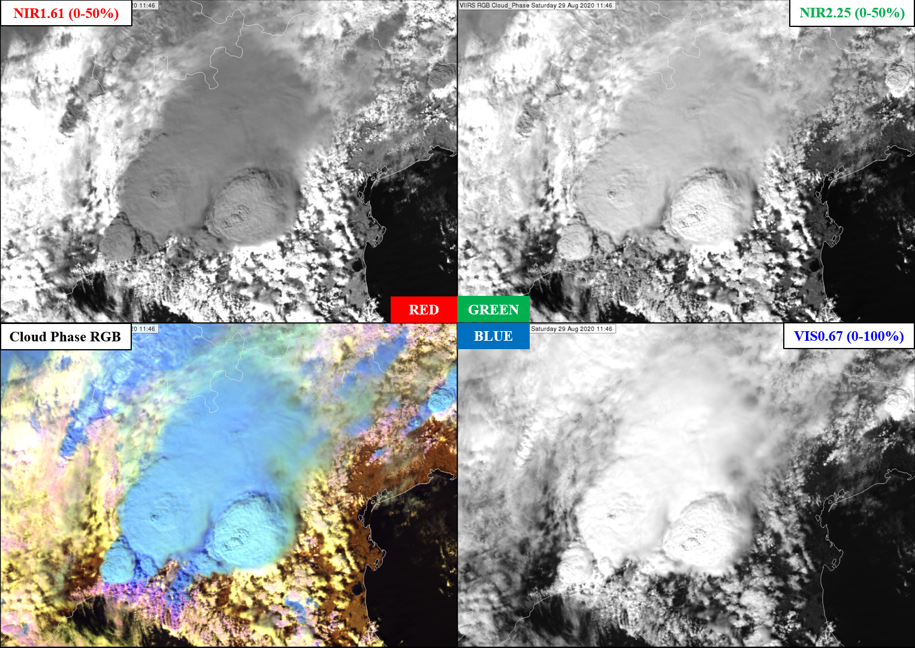

Slide 21
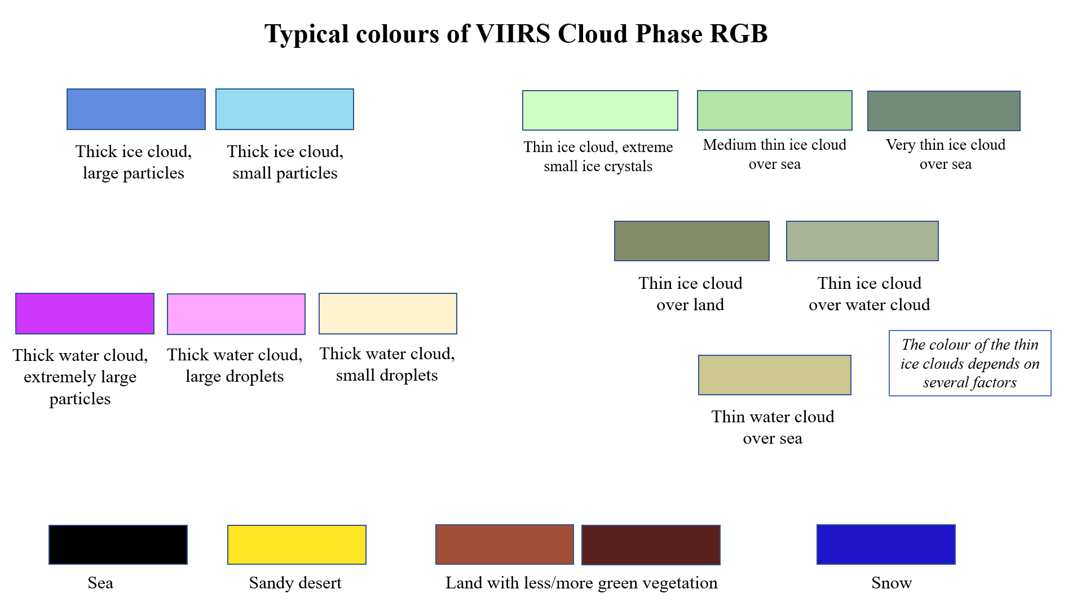

Slide 22
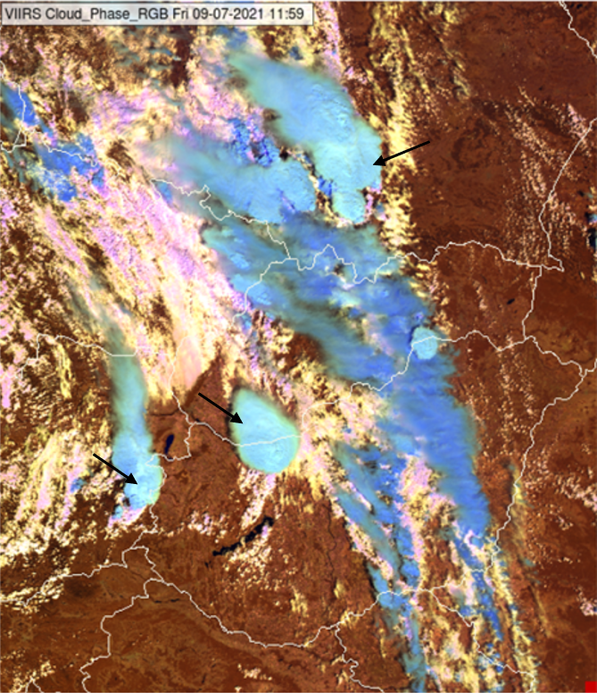
Ice clouds
Thick ice clouds covered by large ice crystals (medium blue) and small ice crystals (light blue or cyan)
VIIRS Cloud Phase RGB from 09 July 2021, 11:59 UTC.

Slide 23
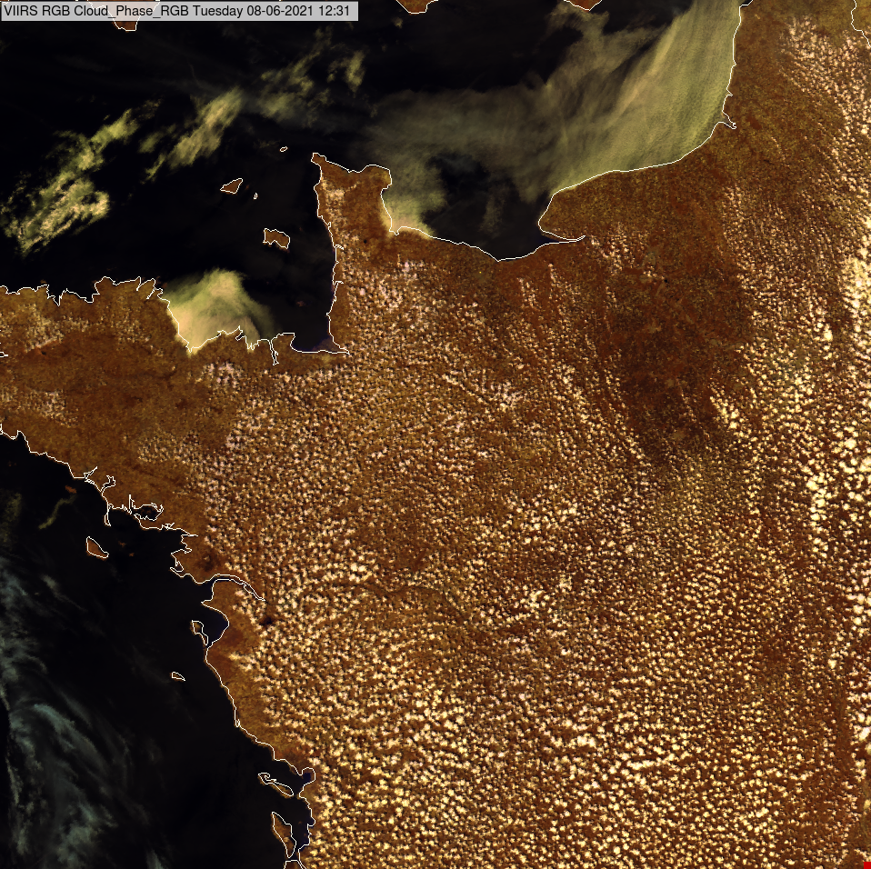
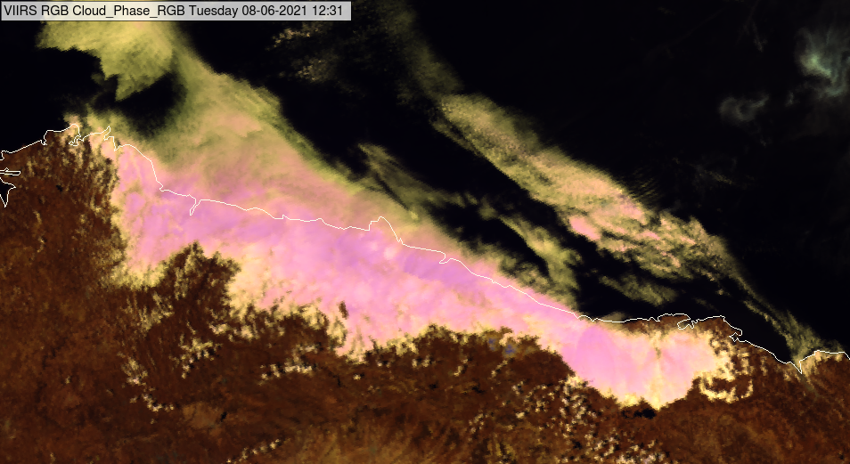
Water clouds
small isolated cumulus clouds over land in France consisting of small droplets. They appear pale yellow in Cloud Phase RGB.
fog along the northern coast of Spain. Over land it is mainly thick appearing in pale yellow and pink colours indicating smaller and larger droplets, respectively.

Slide 24
Snow
1.6
2.25
Notes:
NIR2.25 channel is more sensitive to the snow grain size than the 1.6. As a consequence, Cloud Phase RGB will be more sensitive to the snow grain size than other RGBs using only the NIR1.6 channel.

Slide 25
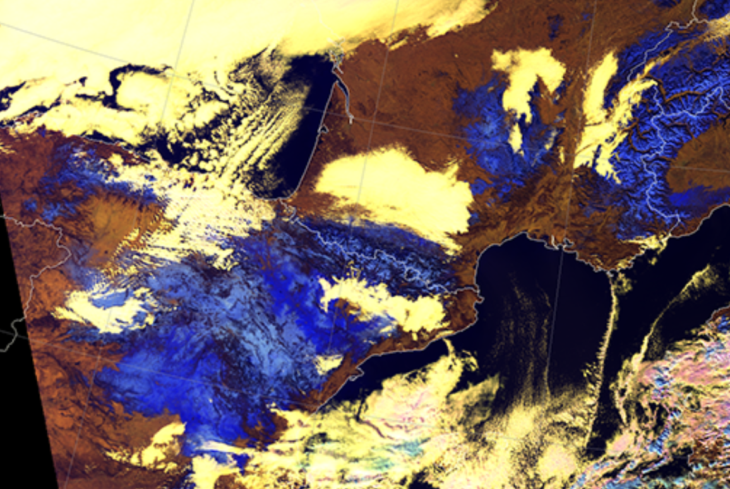
Snow
Coarse snow
Large particles)
Fine snow
(small particles)

Slide 26
Thank you!
Questions are welcome.

