Slide 1


Slide 2
Weighting Functions and Atmospheric Soundings: Part I
Prof. Ralf Bennartz
SSEC, University of Wisconsin – Madison
EES, Vanderbilt University

Slide 3
What does a satellite observe?
Detects number of photons per exposure time at a given wavelength (or wvl range)traveling from viewing direction into detector
No. of photons, direction, per time → RADIANCE
We need to physically and quantitatively understand the relation between observed radiance and state of the atmosphere
Radiative Transfer Equation

Slide 4
What can happen to photons?
1. Photons can be ABSORBED
2. Photons can be EMITTED
3. Photons can be SCATTERED
Let’s now build a budget equation for a beam of photons I(θ, ϕ) traveling in a certain direction (θ, ϕ):
Done…..
Theoretical physics is so great…

Slide 5
Unfortunately, we need a bit more detail…
Sink I: Absorption
Proportional to how many photons are traveling in the first place (I)
Proportional to how effectively the medium absorbs radiation, let’s call this proportionality constant the volume absorption coefficient (β_{A})
Beer’s Law (exponential decay)

Slide 6
Unfortunately, we need a bit more detail…
Source I: Emission
Proportional to Planck function of medium (gas) at temperature T
Proportional to how effectively the medium emits radiation
If the medium is in local thermodynamic equilibrium this is also described by to the volume absorption coefficient (β_{A})
This cannot be integrated so easily as we do not know T along the way….
….and, if the medium emits (β_{A}>0), it also absorbs….
… so, we have to put absorption and emission together

Slide 7
Schwarzschild’s Equation
Alright…
This is the differential form of Schwarzschild’s Equation
Applies to radiative transfer, IF scattering can be neglected
Good news: For many applications in the infrared and microwave scattering actually can be neglected
Bad news: If we want to understand atmospheric soundings and weighting functions, we will have to integrate Schwarzschild’s Equation….

Slide 8
Non-scattering
θ_{S}
Temperature

Slide 9
Integrating Schwarzschild’s Equation

Slide 10
Integrating Schwarzschild’s Equation

Slide 11
Integrating Schwarzschild’s Equation

Slide 12
Integrating Schwarzschild’s Equation

Slide 13
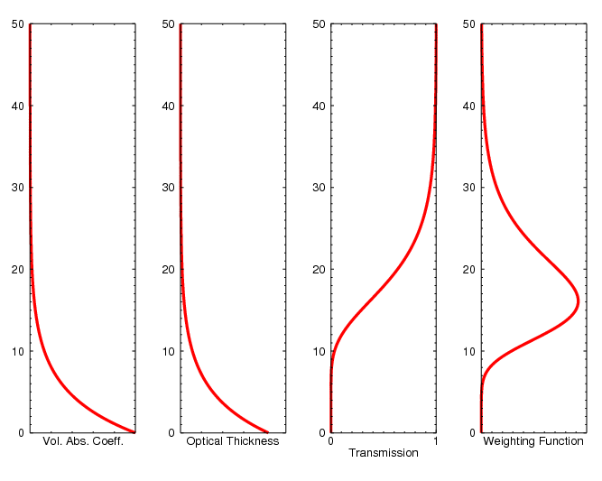
Weighting Functions

Slide 14
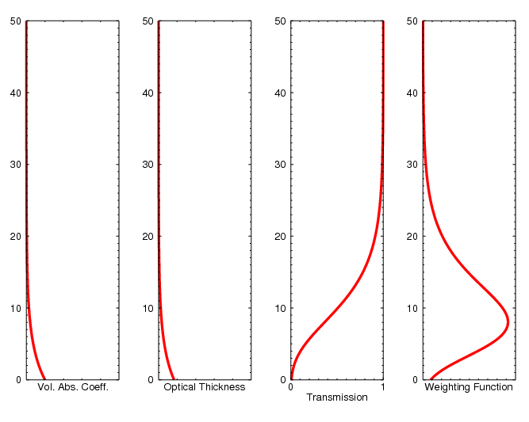
Weighting Functions

Slide 15
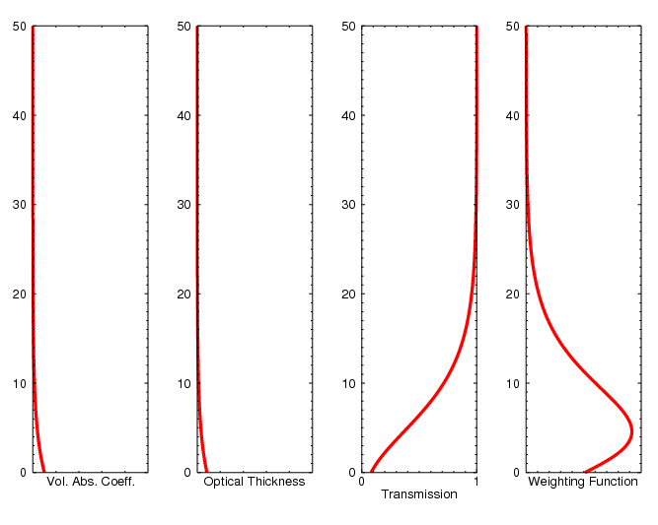
Weighting Functions

Slide 16
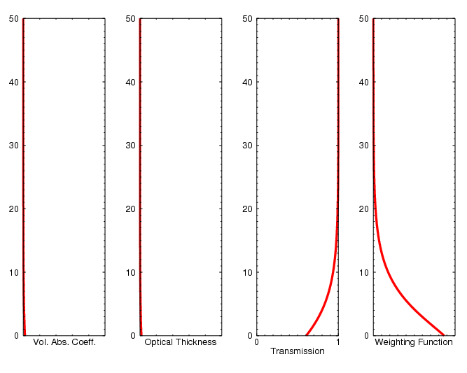
Weighting Functions

Slide 17
Recap
Non-scattering radiative transfer can be described using Schwarzschild’s Equation
Very useful in the infrared and microwave
Absorption coefficient tells us how strongly a gas absorbs/emits.
Transmission (between two points A and B) tells us what fraction of radiation will ‘survive’ (i.e. not be absorbed
Weighting function tells us where the radiation observed originated in the atmosphere. Allows us to relate observed radiance to layers/levels in the atmosphere
Next: What gases absorb where and how strongly?

