Slide 1
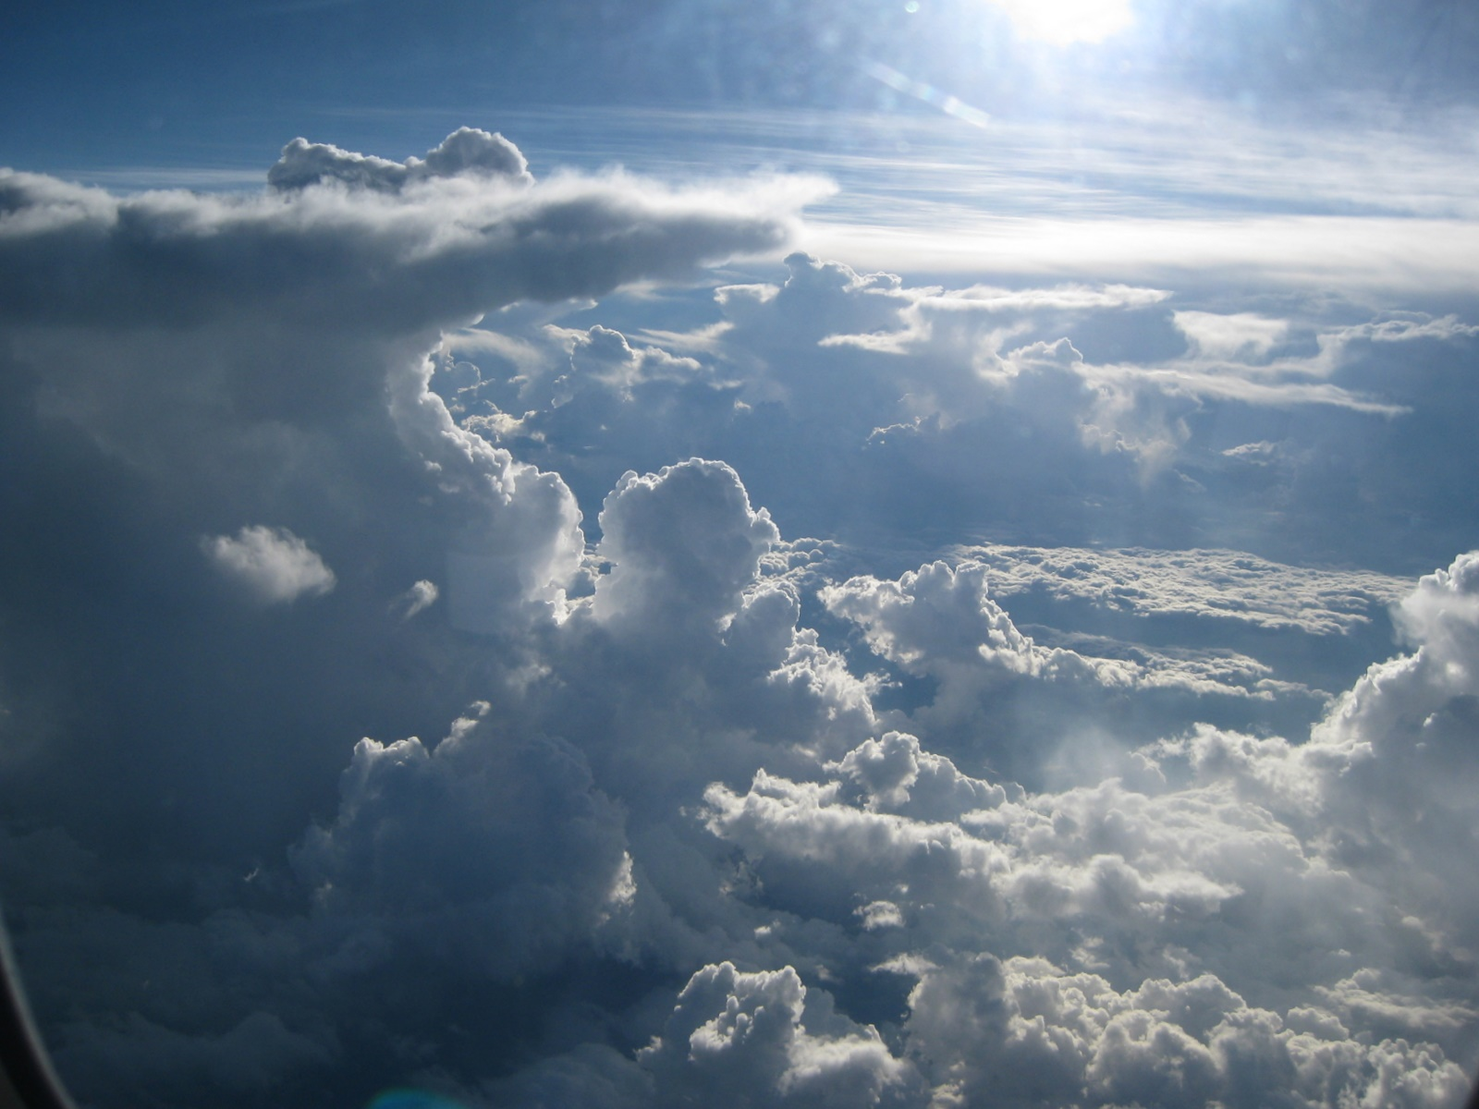
Scattering Radiative Transfer
Ralf Bennartz
Cooperative Institute for Meteorological Satellite Studies
University of Wisconsin – Madison

Slide 2
Outline
What we want to know and why do we need it?
The radiative transfer equation revisited.
Different scattering regimes
Molecules, aerosols, cloud droplets, rain, birds, planes, the moon.
Recap: What is important?

Slide 3
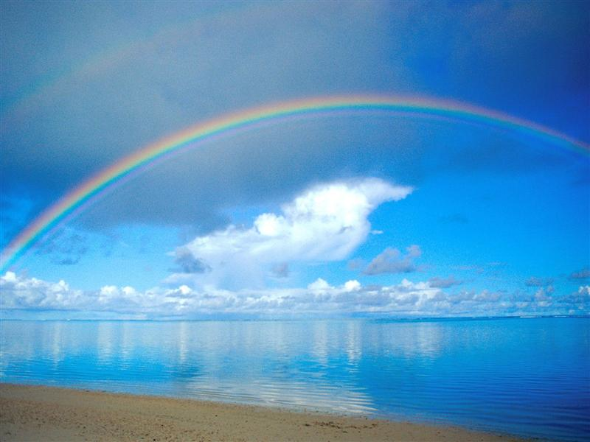
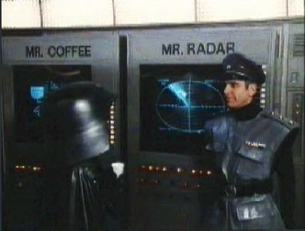
Why is scattering important?
We see scattered radiation.
Clouds scatter radiation back to space (energy loss)
Meteorological applications
E.g. radar

Slide 4
What does a satellite observe?
Detects number of photons per exposure time at a given wavelength (or wvl range)traveling from viewing direction into detector
No. of photons, direction, per time → RADIANCE
We need to physically and quantitatively understand the relation between observed radiance and state of the atmosphere
Radiative Transfer Equation

Slide 5
What can happen to photons?
1. Photons can be ABSORBED
2. Photons can be EMITTED
3. Photons can be SCATTERED
Let’s now build a budget equation for a beam of photons I(θ, ϕ) traveling in a certain direction (θ, ϕ):
Done…..
Theoretical physics is so great…

Slide 6
What can happen to photons?
1. Photons can be ABSORBED
2. Photons can be EMITTED
3. Photons can be SCATTERED
Let’s now build a budget equation for a beam of photons I(θ, ϕ) traveling in a certain direction (θ, ϕ):
Done…..
Theoretical physics is so great…

Slide 7
Scattering into line of sight: SOURCE
Scattering
Scattering out of line of sight: SINK
θ_{S}

Slide 8
Radiative Transfer Equation including scattering
Alright…
This is the radiative transfer equation including scattering
All the SINKS are in the First term (-I)
Scattering Source is the last term
Bad news: Can only be integrated numerically b/c of ugly integral in last term…

Slide 9
Quantities we already know….

Slide 10
Couple of new quantities
Scattering Phase Function determines where radiation gets scattered…..
Single Scatter Albedo gives importance of scattering.

Slide 11
Scattering Regimes
Size parameter x=2πr/λ determines scattering regime
Rayleigh scattering: Object much smaller than wavelength
Geometrical Optics: Object much larger than wavelength
Mie Scattering: In between
Figure from Petty (2006)

Slide 12
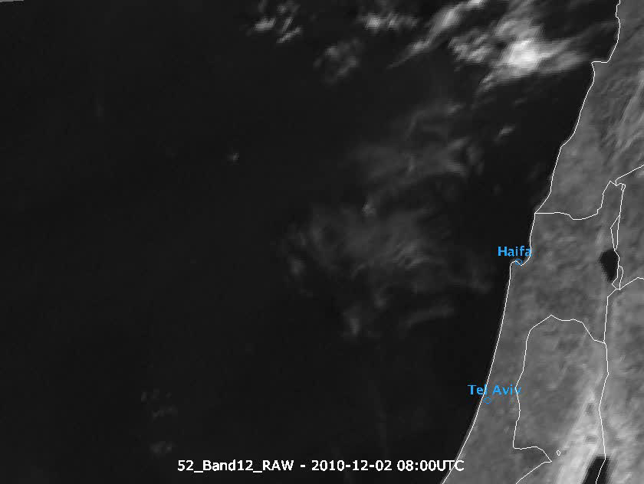
Cloud or Smoke?
From HP Roesli

Slide 13
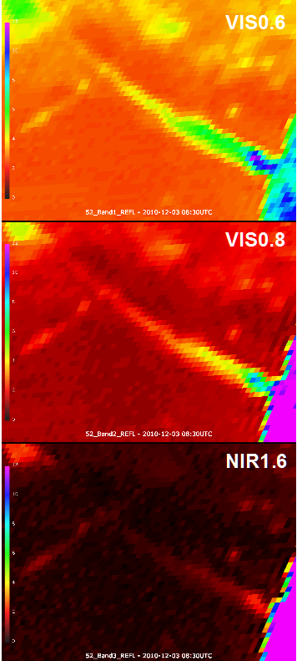
Cloud or Smoke?
To the right are the reflectances at 0.6, 0.8, and 1.6 microns in identical units.
How does the feature appear in the different bands?
What is the difference?
What does this tell you about the particles?
So, is it cloud or smoke?
From HP Roesli

Slide 14
What scattering regimes?
Blue sky/red sunset?
This is Rayleigh regime… Scattering efficiency depends x⁴
Rainbow?
Geometrical Optics. Can be understood using Ray tracing
Rain with radar?
Rayleigh
Clouds and sunlight?
Mie scattering

Slide 15
Recap
Scattering important for solar spectral range but also for various other application (e.g. radar)
Scattering redistributes energy. Phase function tells us how.
Scattering can be source or sink in radiative transfer equation.
Single scattering albedo tells us how important scattering is in a given situation.
Next: How can we measure cloud properties from backscattered solar radiation?

